Slide 1


MQXFA19 Structure and Status
Dan Cheng, for the AUP team
20-Nov-2024
LBNL

Slide 2
MQXFA19 Structure Assembly
Coil Pack Assembly Plans
Applying Lessons Learned
Status and Summary

Slide 3
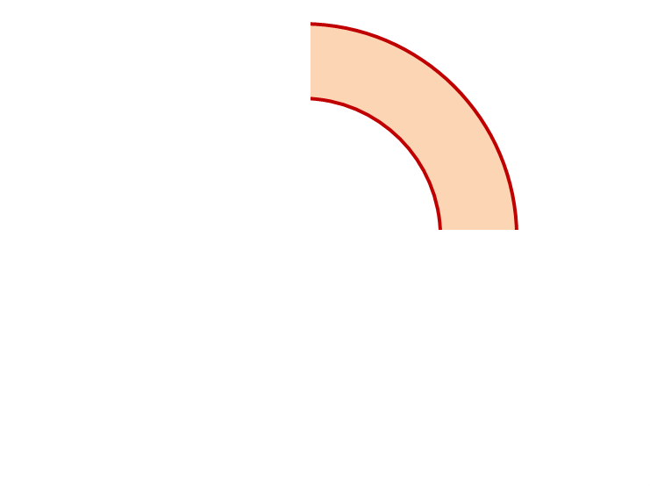
MQXFA19 Proposed Coil Arrangement
8 x δ_{midplane} = 2 π x δR_{OR}
~0.005” Undersized R
neglected
~.0035” Undersized per Midpl.
Add 0.003” shim per side
~0.0015” Undersized R
Neglected
~0.0045” Undersized per Midpl.
Add 0.005” shim per side
161
248
Q2
Q1
Q3
Q4
251
156
~0.001” Undersized R
Neglected
~0.003” Undersized per Midpl.
Add 0.003” shim per side
~.001” Undersized R
Neglected
~0.0035” Undersized per midpl.
Add 0.003” shim per side
Coil Electrical Order: A :248 – 156 – 161 – 251: B
Conforms to a favorable order based on RRR data

Slide 4
MQXFA19 Coil Pack Build 1 (Fuji)
Nominal Collar R: 114 mm
Nominal Coil R: 113.376 mm
Nominal Radial shim = 0.025” (0.624 mm)
  But we still target ~0.020”
Fuji radial stack up is ~0.021” (~0.54 mm)
  0.0045” Coil GPI + 0.007” Fuji + 0.005” Kapton & 0.005” G11
Add Kapton to various midplanes
 | 248 | 161 | 251 | 156
Kapton Ground plane insulation | 0.0045” (0.114 mm)
Coil Specific Radial Shim | 0 | 0 | 0 | 0
Coil-specific midplane shim | 0.005” 0.125 mm | 0.003” 0.075 mm | 0.003” 0.075 mm | 0.003” 0.075 mm
Fuji paper | 0.007” (0.175 mm)
Radial Shim | 0.005” Polyimide + 0.005” G11 (~0.25 mm)

Slide 5
MQXFA19 Coil Pack Build (Final)
Nominal Collar R: 114 mm
Nominal Coil R: 113.376 mm
Nominal Radial shim = 0.025” (0.624 mm)
  But we still target ~0.020”
Actual radial stack up is ~0.020” (~0.51 mm)
  0.0045” Coil GPI + 0.005” Kapton + 0.005” Kapton & 0.005” G11
Add Kapton to various midplanes
 | 248 | 161 | 251 | 156
Kapton Ground plane insulation | 0.0045” (0.114 mm)
Coil Specific Radial Shim | 0 | 0 | 0 | 0
Coil-specific midplane shim | 0.005” 0.125 mm | 0.003” 0.075 mm | 0.003” 0.075 mm | 0.003” 0.075 mm
Fuji paper | 0.000” (0.0 mm)
Radial Shim | 0.005” Polyimide + 0.005” Polyimide + 0.005” G11 (~0.38 mm)

Slide 6
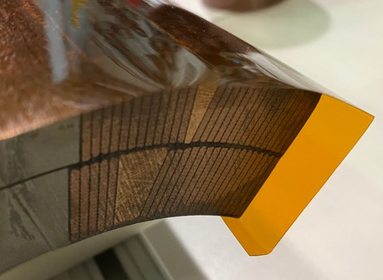
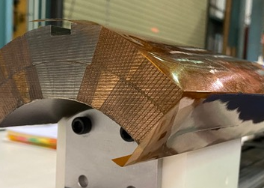
Fuji Assembly Notes (1)
GPI Layers will have ID fold
  Process was developed and incorporated into MQXFA07 and later coils
Preventing a repeat of the MQXFA09 NCR:
  Fuji build will have Kapton tape holding fold down on the ID
  Final build will use Araldite spots of glue with tape removed
  Inspection step after the upper coil pair is placed on top of bottom coil pair will verify no foldback condition is present

Slide 7
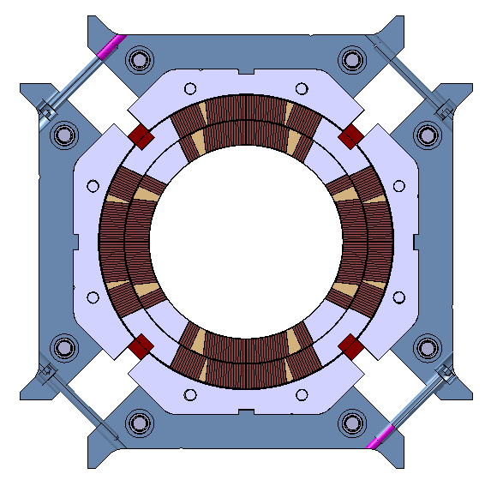
Fuji Assembly Notes (2)
Based on MQXFA12 size and gap size with respect to the 75 in-lbs. torque vs. 125 in-lbs. torque:
  Mechanical measurements show ~0.006” on coil pack size difference
  Equates to ~ 0.001” pole key gap difference, per side
Large gaps
Large gaps
Q2
Q1
Q3
Q4
Small gaps
Small gaps
Depiction not to scale

Slide 8
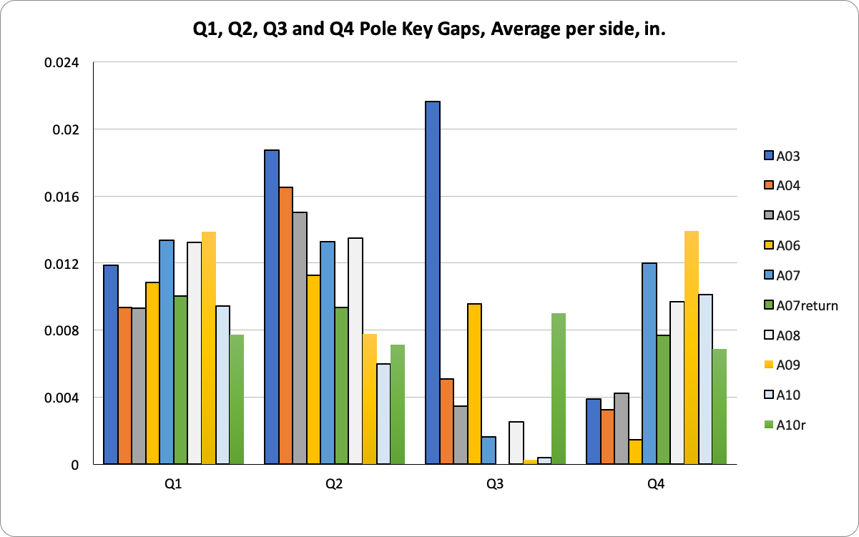
Final Coil Pack Assembly Notes
Lessons learned from MQXFA07 disassembly and MQXFA10 rebuild
  A revised process for squaring and torqueing the Coil Pack was developed
  Greater emphasis on squareness and gap uniformity throughout the entire torqueing process
  Torque target is 75 +/- 25 in-lbs., depending on gaps
  Iterative measurements throughout build will ensure and verify that the gaps and coil pack squareness specifications are met
Uniform gaps
Q2
Q1
Q3
Q4
Improved squareness
See next slide

Slide 9
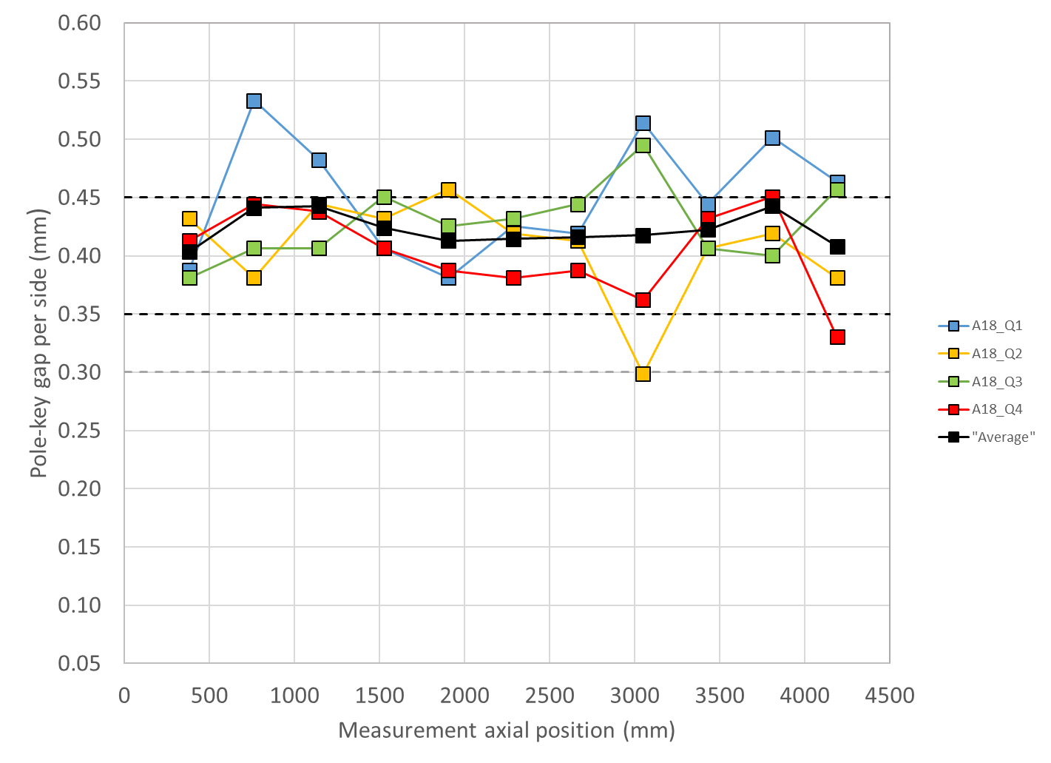
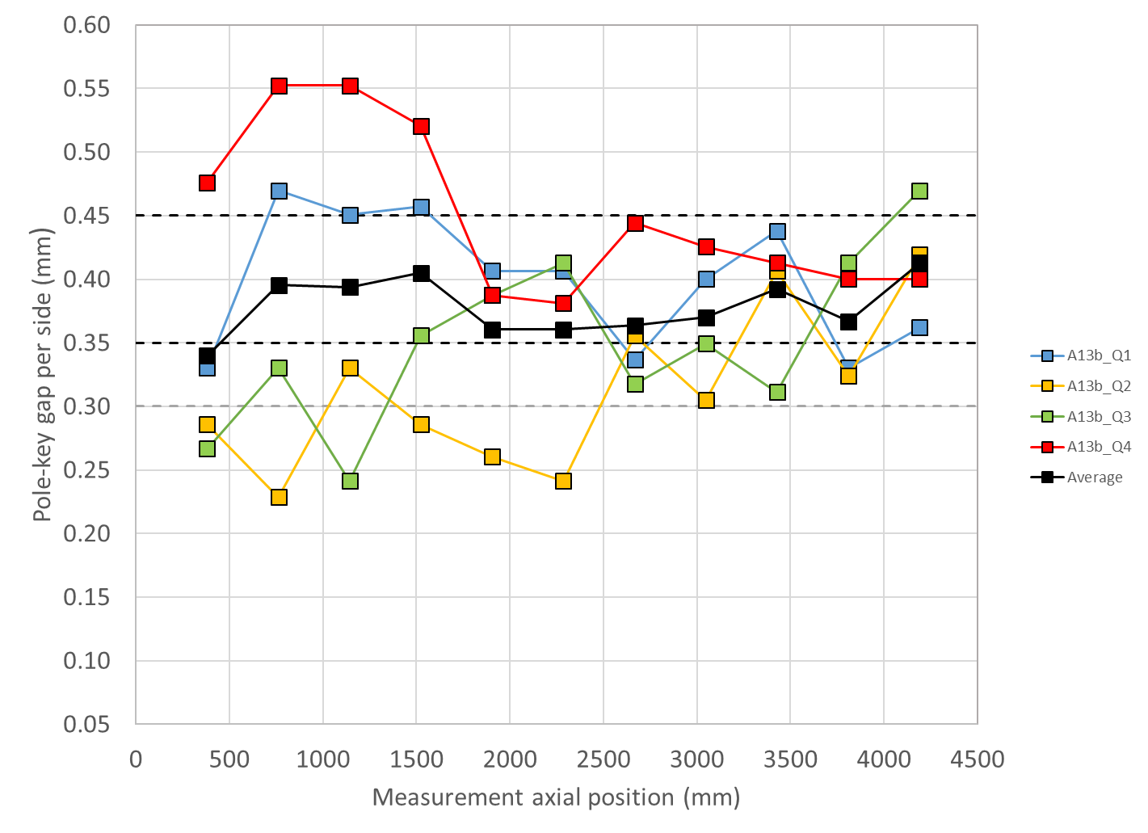
MQXFA18 and A13b Gap Measurements
Updated Specification wording in Doc DB 4009
For the pole key gap:
  The average pole key gap (per side) among the four coils on each longitudinal location shall be +0.400 ±0.050 mm.
  The minimum pole key gap (per side) in any quadrant and in any longitudinal location shall be > +0.300 mm.
MQXFA18
With previously tested coils
MQXFA13b

Slide 10
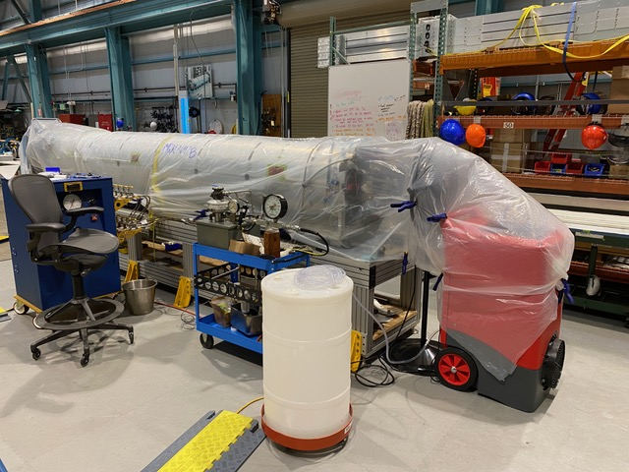
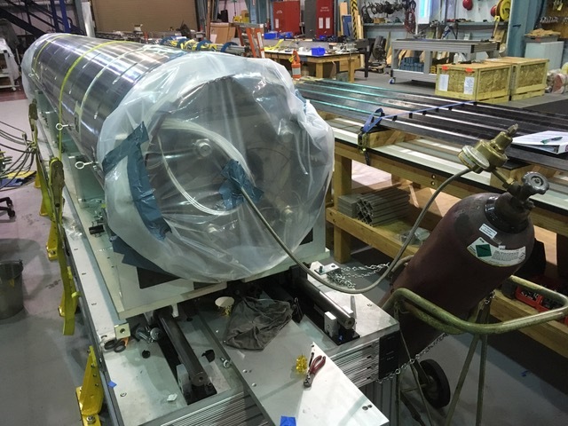
Avoiding Water-Electrical Issues
Bladder reliability is key
However, if a bladder fails
  Dehumidifiers are on hand during bladder operations to bag and flow immediately after operations are complete
Since MQXFA05 load key step sizes are at least 0.005” increments, in order to reduce the number of bladder cycles
Magnet “bagged” with dehumidifier units blowing through

Slide 11
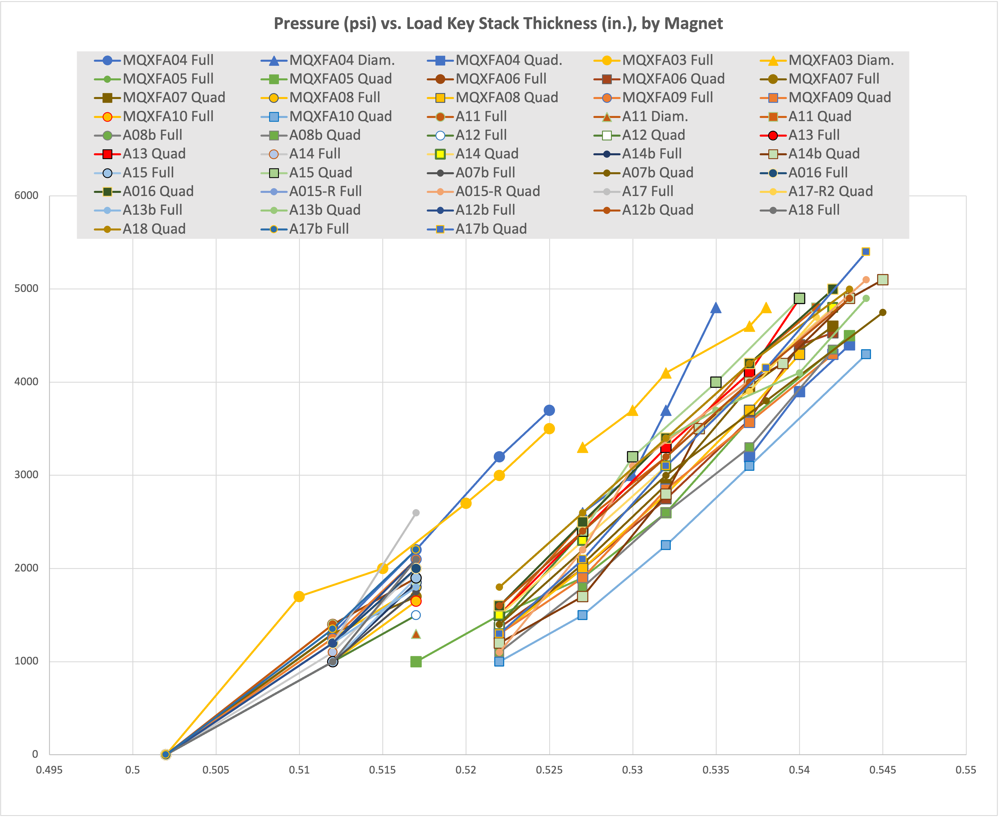
Reducing Bladder Cycles
Based on the bladder failure/load key incident experienced in MQXFA04 we successfully introduced procedural changes starting with MQXFA05
Magnet preload operations will continue to implement the following:
  A pressure check at the beginning of operations
  A “stable hold” at target pressures
  Fewer pressure cycles by using 0.005” thick shim steps (about 8 steps expected)
  Spare keys on hand to replace as needed, and/or second set of keys ready to replace
50% Azimuthal load
Starting with MQXFA06 an additional 0.005” step was added using all bladders before transitioning to quadrant loading.

Slide 12
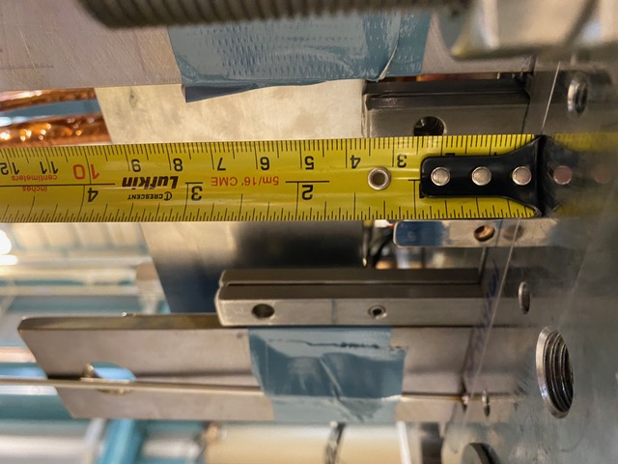
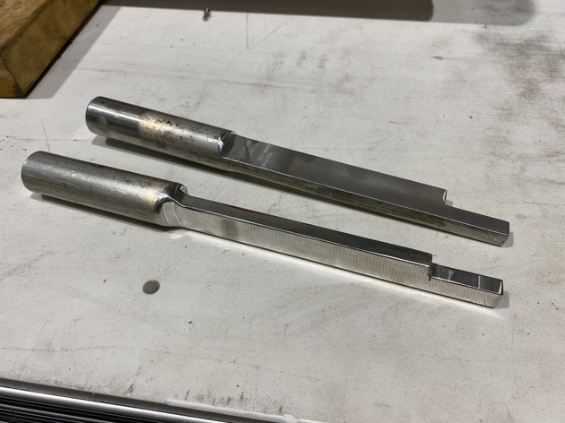
Lessons Learned (MQXFA08b Load Key NCR)
NCR #381 in MQXFA08b
  One load key was sticking out of bottom by ~1.75”
  The tooling used to push the key in (to proper length) hit something, and the key was not visually verified prior to releasing pressure
Lessons Learned to be applied:
  Modified tooling
  New visual checks, especially on bottom where it takes more effort to see
  WI will be updated with these instructions
This section was narrowed for better clearance between preload tooling and components

Slide 13
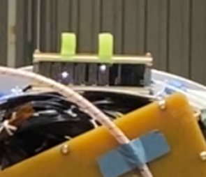
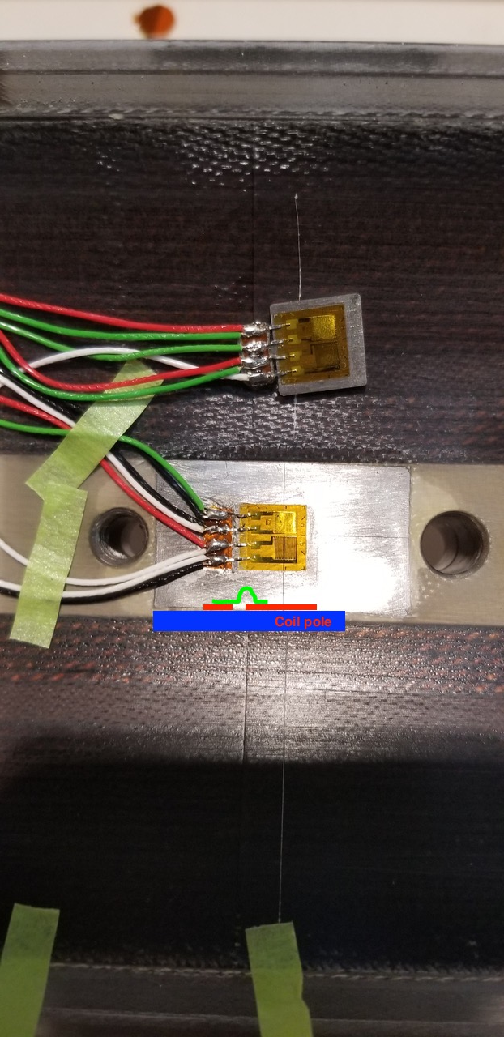
Lessons Learned: Strain Gauges and Hipot
MQXFA12 revealed potential weakness of SG to coil pole, if pins are incorrectly placed
  If the Coil pole charges up, high voltage between SG wiring and ground can occur
MQXFA13 & MQXFA14
  SGs were disconnected after preload prior to EQC
  All SG connector signals will be verified prior to post-preload EQC is performed
MQXFA Strain gauge electrical tests:
  Sample pieces were tested to verify bonding and protection; voltage standoffs were inconsistent, often installation dependent
SGs have been disconnected after preload and not used for testing
  Final magnet with Coil SGs will be MQXFA17b (re-tested magnet)
Shells and Rods can still be present
  Would need to study this data from prior magnets to understand ability to interpret mechanical behavior, if possible

Slide 14
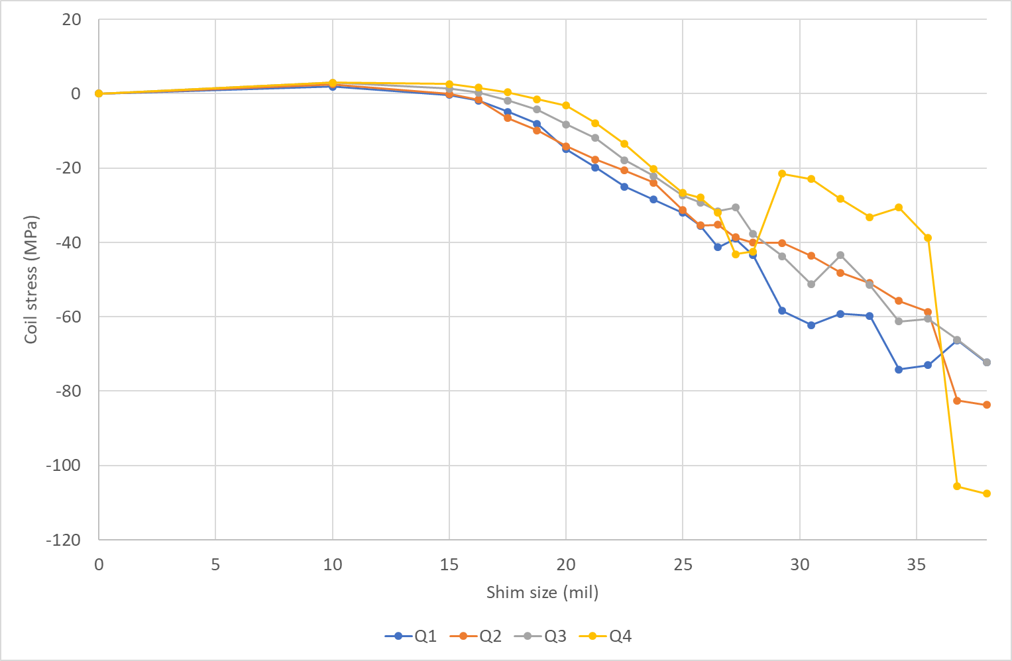
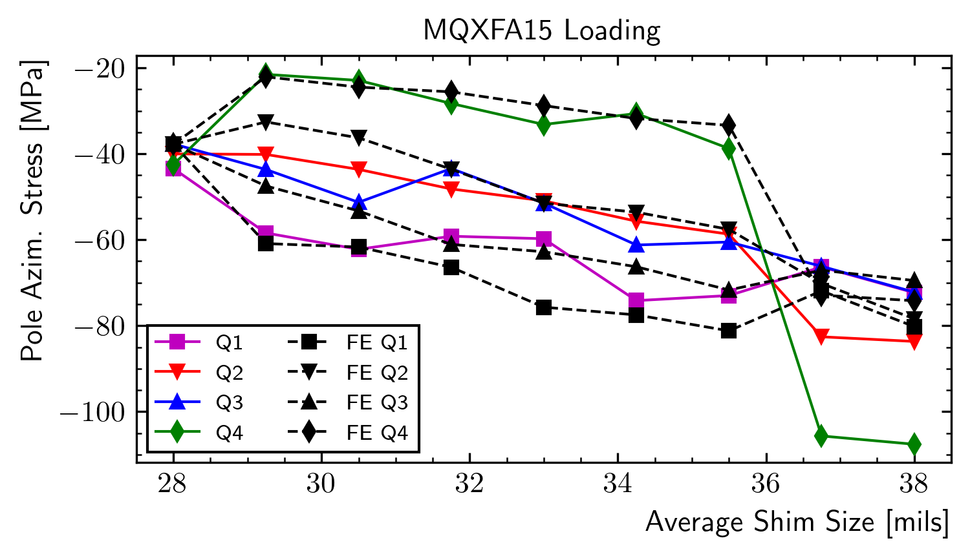
Lessons from “theoretical” MQXFA15 asymmetric shimming
MQXFA15 Preload experienced uniform loading until the 0.033” shim step
  Q4 coil experienced significant loss of compression; Q1 experienced significant increase of compression
  Final state ended with Q4 highly compressed
  Subsequent FEA modeled asymmetric shimming (slides at https://indico.fnal.gov/event/59997/ ) exhibited similar behavior, but did not fully replicate observations
Preload operations with key shim stacks will be verified prior to insertion and swap

Slide 15
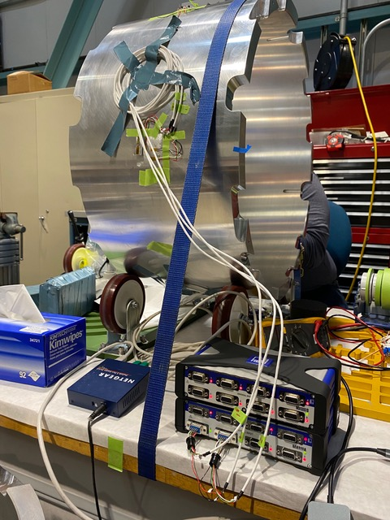
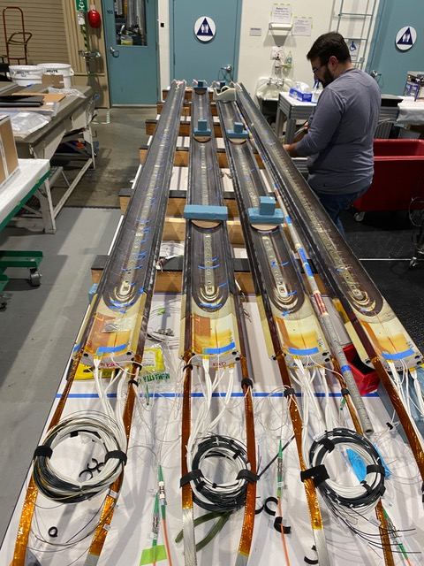
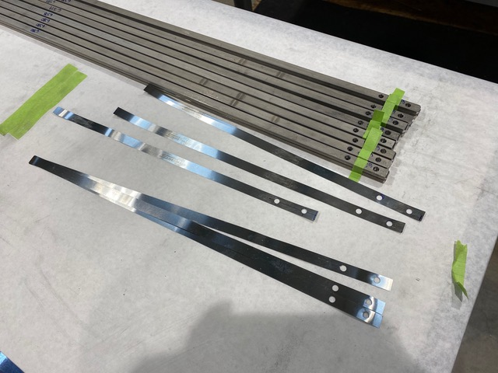
Using Tapered Load Shims
MQXFA12b demonstrated the use of tapered load shim
  Shell 1 strain gauges were installed
  Strain gauges were mounted to LE pole locations
  Final configuration was 0.002” (50 µm) TLS on LE
  Magnet is cooling down for vertical test this week
MQXFA18 was successfully tested with 2x 0.002” (100 µm) TLS on LE

Slide 16
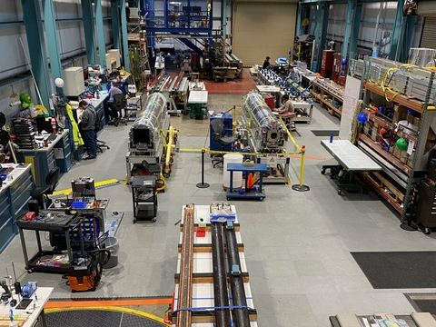
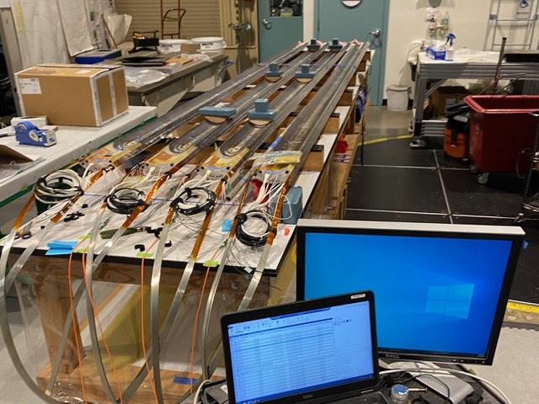
MQXFA19 Structure Status
MQXFA17b
  Magnet has been preloaded (with 50 µm TLS); finishing ops now
  Expecting to ship 12/14
MQXFA19
  Shell-yoke, pad-collar assemblies complete, ready for Fuji build
  Coil dressing operations in process
  Tapered load shims will be installed
  Expected completion ~late January

Slide 17
Summary
MQXFA19 structural parts are ready for assembly
  Fuji coil pack assembly can be built once dressed coils are ready
Lessons learned from recent magnets are being applied to build this magnet
  What was learned from MQXFA07 and MQXFA10 re-squaring (and rebuild of A10, A11, and A08b and subsequent magnet builds) of the coil pack will also be applied
  MQXFA08b key insertion has been addressed
  MQXFA12 SG hipot issue has been addressed; removing connector blocks from skirts prior to final EQC
  Possible MQXFA15 asymmetric shimming has been addressed
  Tapered load shims will continue to be installed, now that MQXFA18 has tested successfully
Pion locations were identified that require modification in all coils
MQXFA19 is expected to ship ~early Feb 2025

Slide 18
Additional Slides

