Slide 1
MQXFA19 Preload Targets
D. Cheng, P. Ferracin, L. Garcia-Fajardo, H. Pan
For the LBNL AUP Team
20-Nov-2024
LBNL

Slide 2
Outline
Preload targets
Overview of MQXFA03-13b pre-loads achieved
Proposed preload process

Slide 3
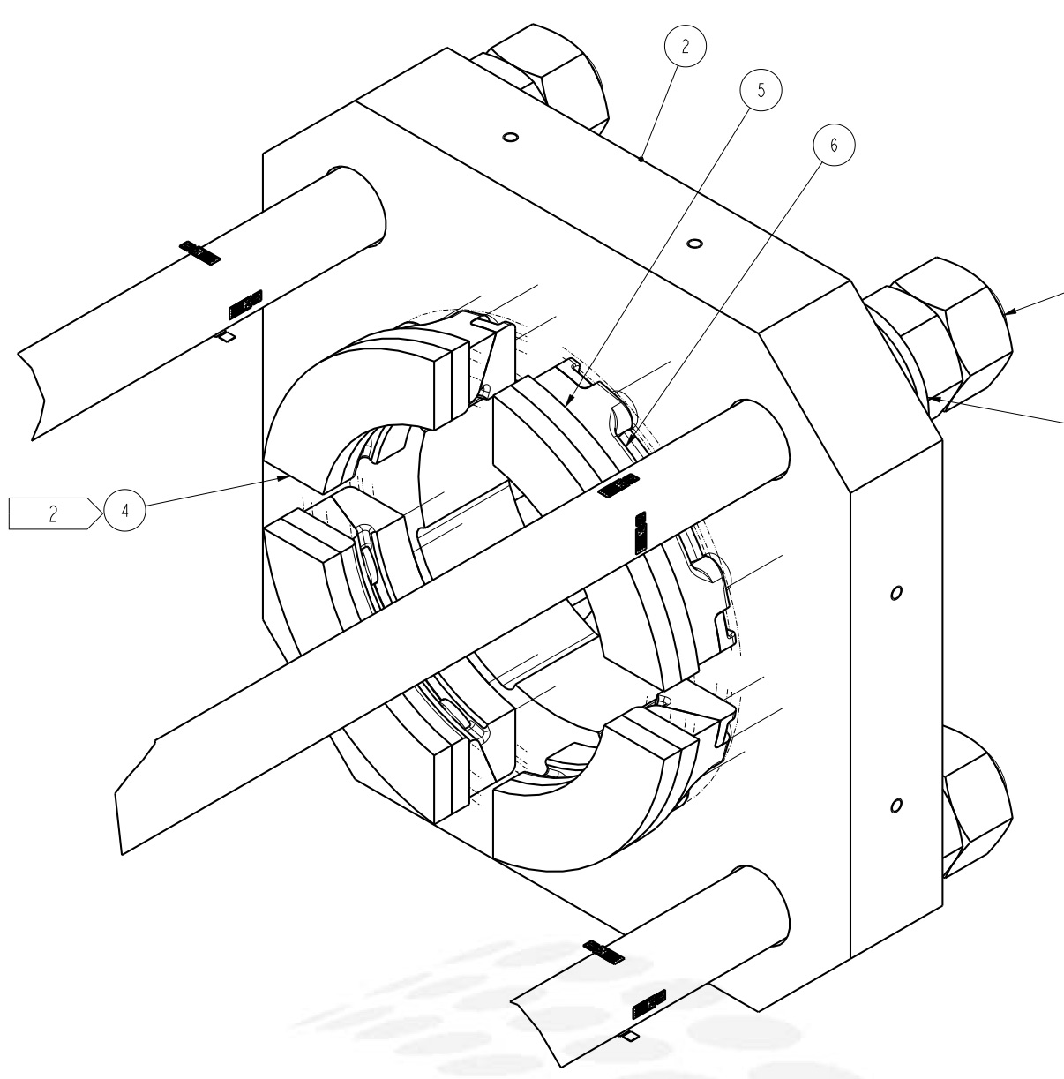
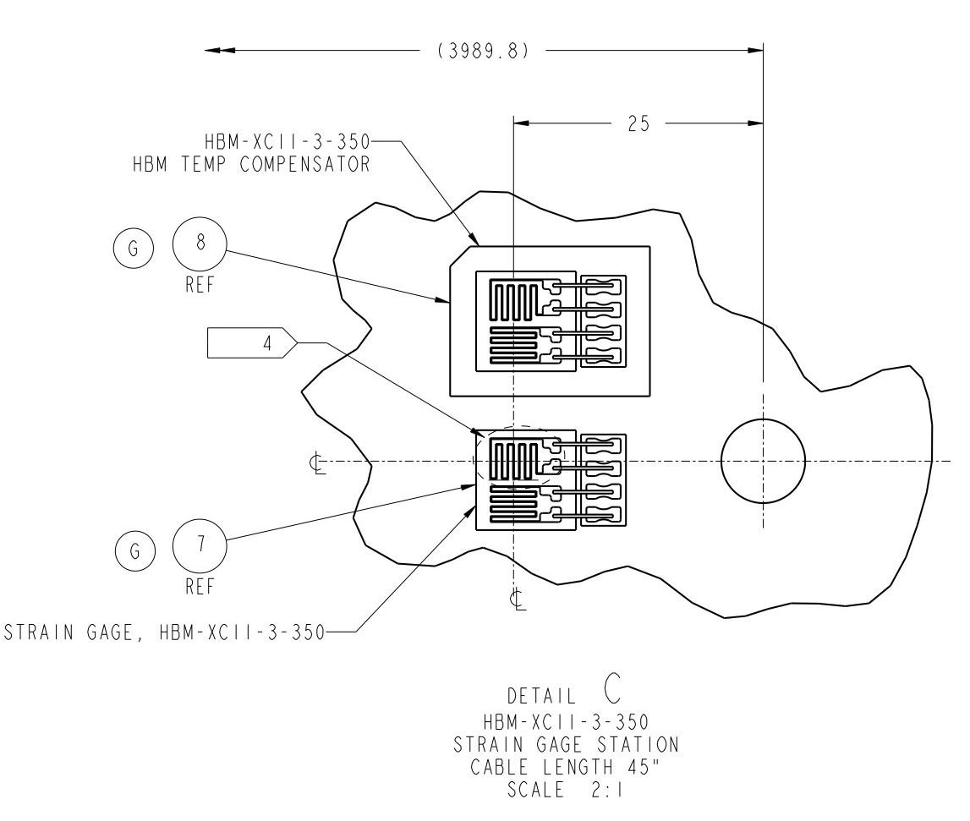
MQXFA SG Layout
LE
MID
RE
Shell 1
Shell 2
Shell 4
Shell 7
Coil Stations
Rod Stations
HBM gauges and FBG (next slide) are installed
Shell gauges --- three axial locations:
Shell gauges (T & Z): on shell 1, 4, & 7
Shell 1 gauges are for tapered load shims
Shell 2 gauges will no longer be employed
Coil gauges (T & Z): on the axial location of 3989 mm (RE) from LE
Adding gauges to LE coil pole for tapered load shims
Rod stations are located on the RE (see inset)
Each station is full bridge with four individual gauges.
RE axial plate assembly

Slide 4
MQXFA SG Layout (FBG)
FBG Coil gauges (T & Z): on three axial locations:
715 mm, 1915 mm, and 3725 mm from LE.
Based on experience since MQXFA09
Only on Upper coils
Except for MQXFA16, MQXFA17, which have all four coils with FBG

Slide 5
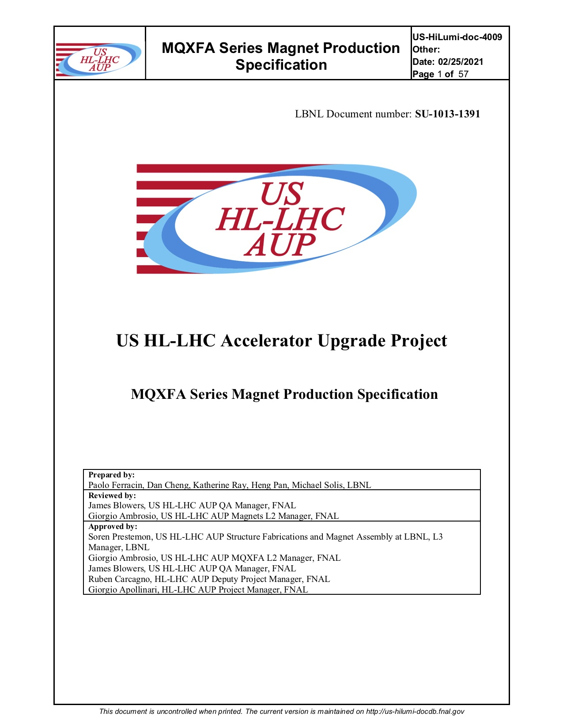
MQXFA Preload Specifications
Pole key gap: 0.016” (~400µm) average per side
New specification wording has been in place since MQXFA11
Azimuthal pre-load
Target coil pre-stress at cold of 100 MPa requires:
~80 ± 8 MPa at R.T. after 24 hours
Assumes 5-10 MPa decrease in 24 hours
We set as maximum coil stress to 120 MPa during loading
Axial pre-load
The total force at cold is: 1.0 MN
~950 με at R.T
Equates to total rod force ~0.58 MN at R.T.
Revised “target” after MQXFA17 results
These stress targets have remained unchanged for both Pre-Series (MQXFA03-A07) and Series magnets, and are captured in the Series Magnet Specifications Document (US-Hilumi-Doc-4009).

Slide 6
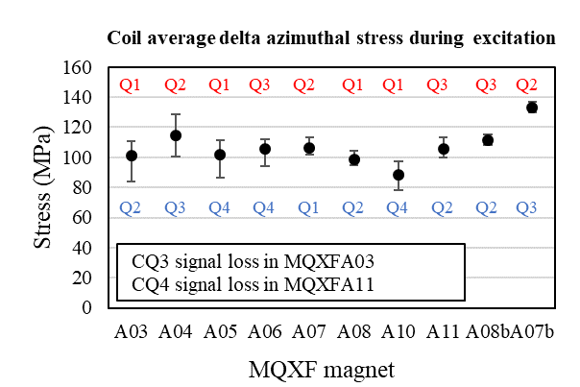
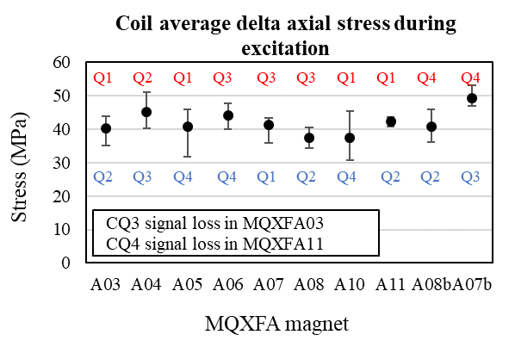
Preloads Measured for MQXFA Magnets
 |  | Target (MPa) | A03 | A04 | A05 | A06 | A08b | A10 | A11 | A13 | A14b | A07b | A15 | A16 | A17 | A13b | A12b | A18
R.T. | Coil | -80 ± 8 | -79 | -76 | -73 | -80 | -76 | -66 | -70 | -71/ -77 | -67 | -80 | -83 | -86 | -86 | -72 | -82 | -83
 | Shell 7 | 58 ± 6 | 54 | 64 | 62 | 60 | 50 | 56 | 66* | 61 | 58 | 56 | 62 | 65 | 66 | 58 | 67 | 56
Cold | Coil | -103 | Determined from unloading deltas during powering (see pictures on next slide
 | Shell 7 | 110 | 112 | 142 | 144 | 137 | 123 | 142 | 132 | 128 | 136 | 157 | 146 |  | 118 | 127 |  | 134
*Apparent high shell stress is due to residual offsets observed after the unloading of the MQXFA09 shell-yokes, which were reused in MQXFA11
Maximum stress values of each coil were selected for these plots
In red: Coil quadrants with the highest stress increase
In blue: Coil quadrants with the lowest stress increase

Slide 7
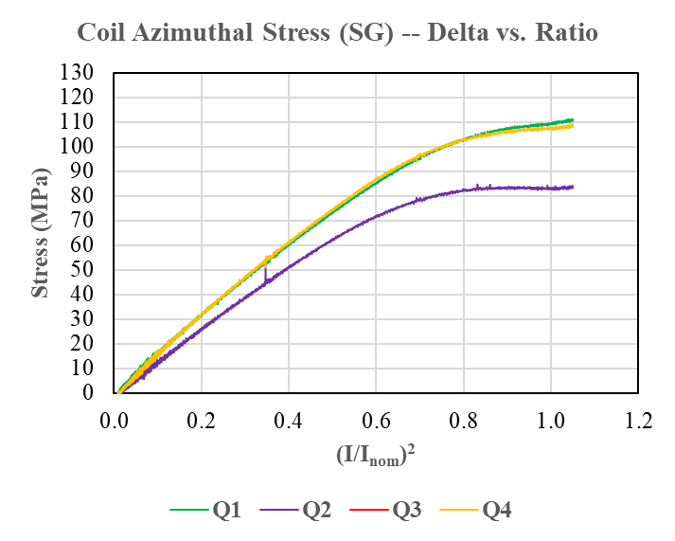
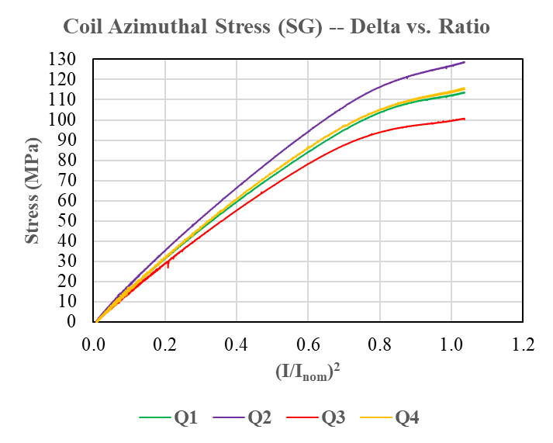
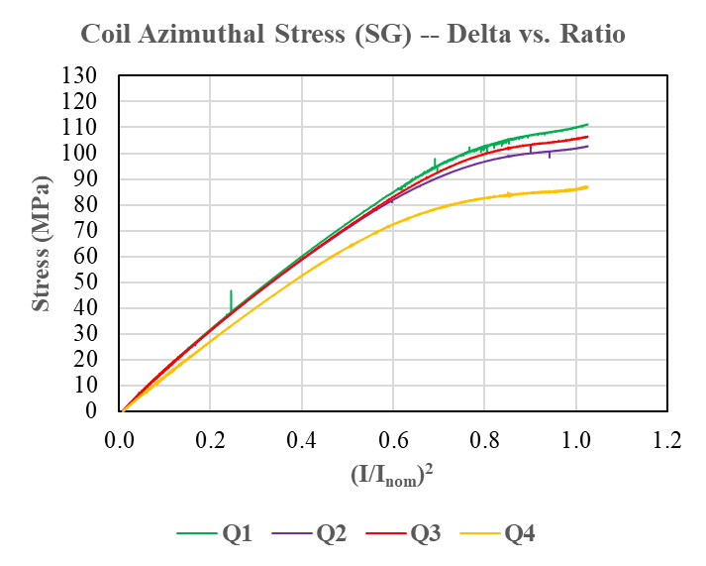
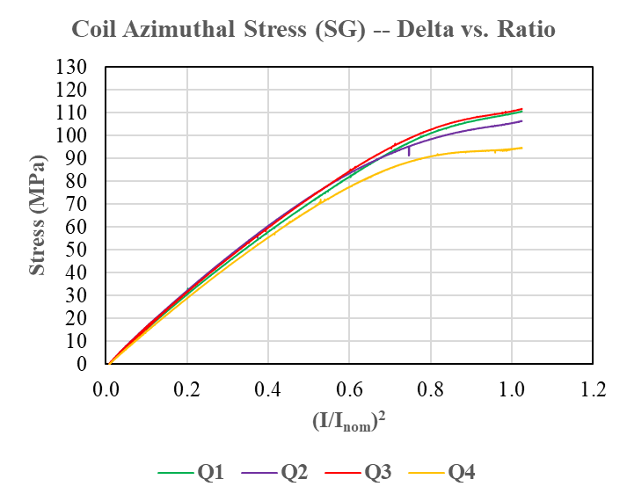
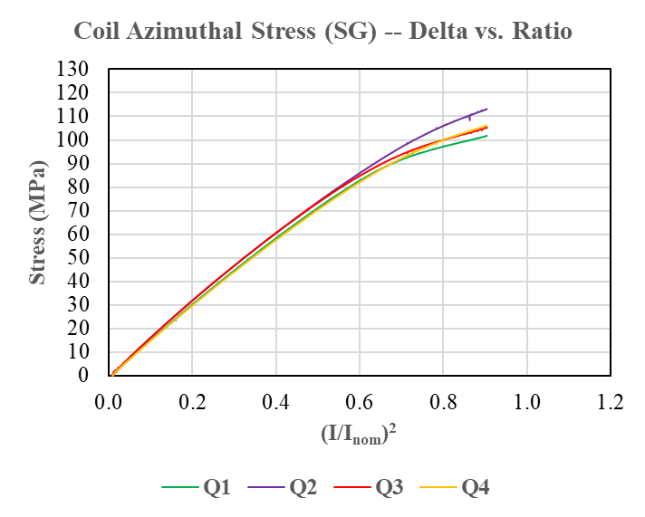
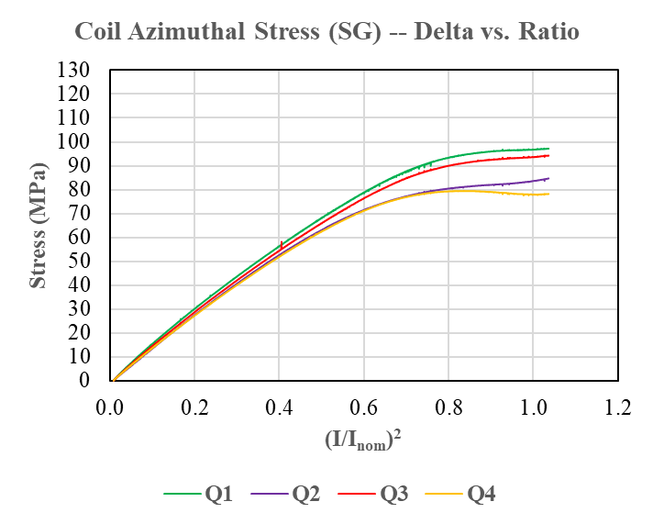
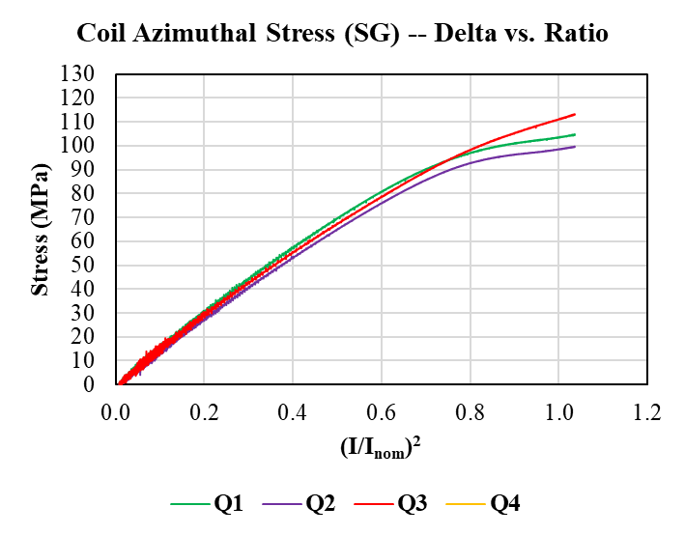
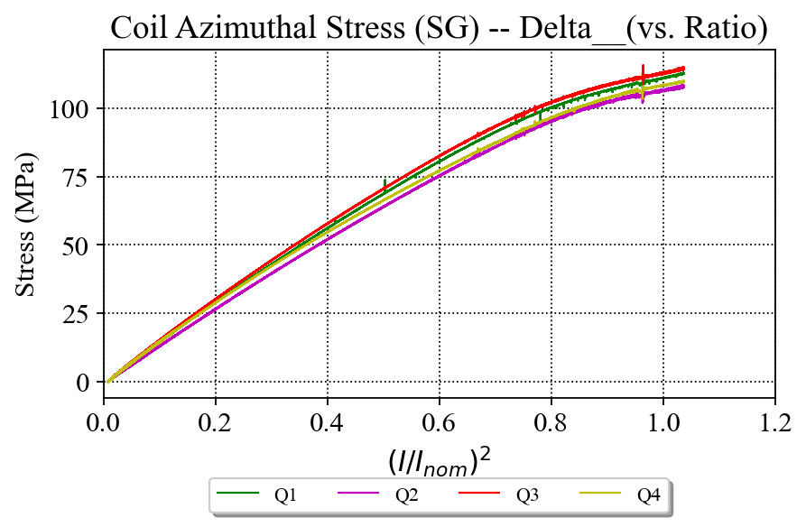
Preloads Measured for MQXFA Magnets
MQXFA03
Ramp to 16.65 kA
MQXFA04
Ramp to 16.55 kA
MQXFA05
Ramp to 16.46 kA
MQXFA06
Ramp to 16.45 kA
Av. delta stress: 101 MPa
Av. delta stress: 115 MPa
Av. delta stress: 102 MPa
Av. delta stress: 106 MPa
MQXFA07
Ramp to 15.45 kA
MQXFA08b
Ramp to 16.50 kA
MQXFA10
Ramp to 16.54 kA
MQXFA11
Ramp to 16.54 kA
Av. delta stress: 107 MPa
Av. delta stress: 111 MPa
Av. delta stress: 89 MPa
Av. delta stress: 106 MPa

Slide 8
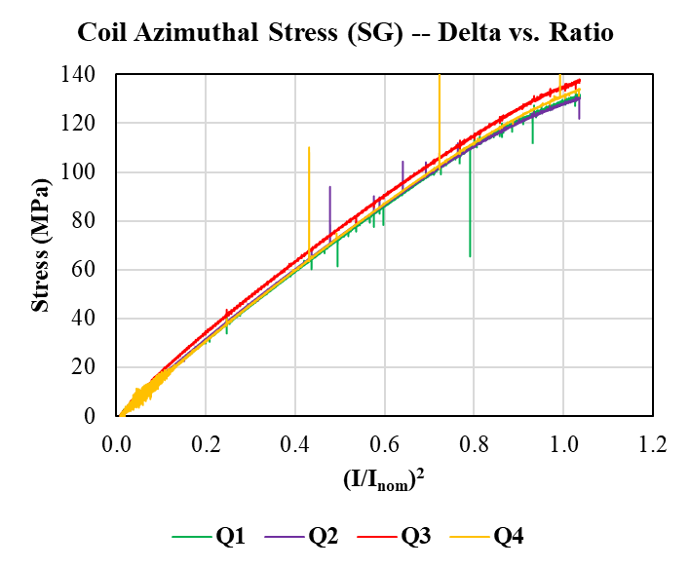
MQXFA07b
Ramp to 16.54 kA
Av. delta stress: 133 MPa

Slide 9
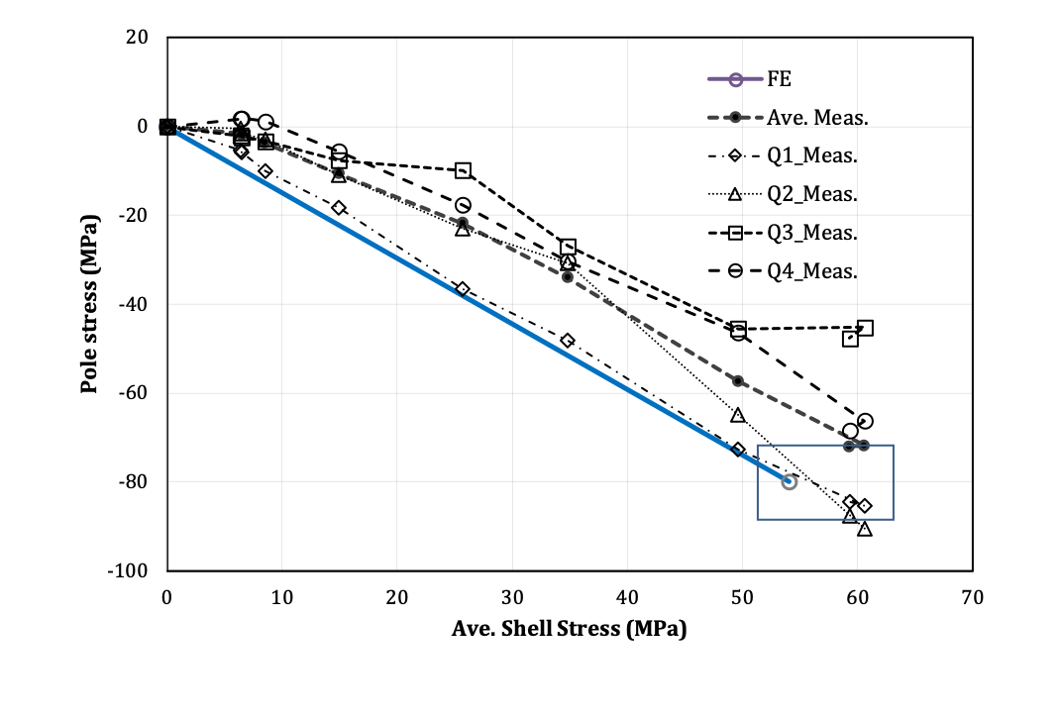
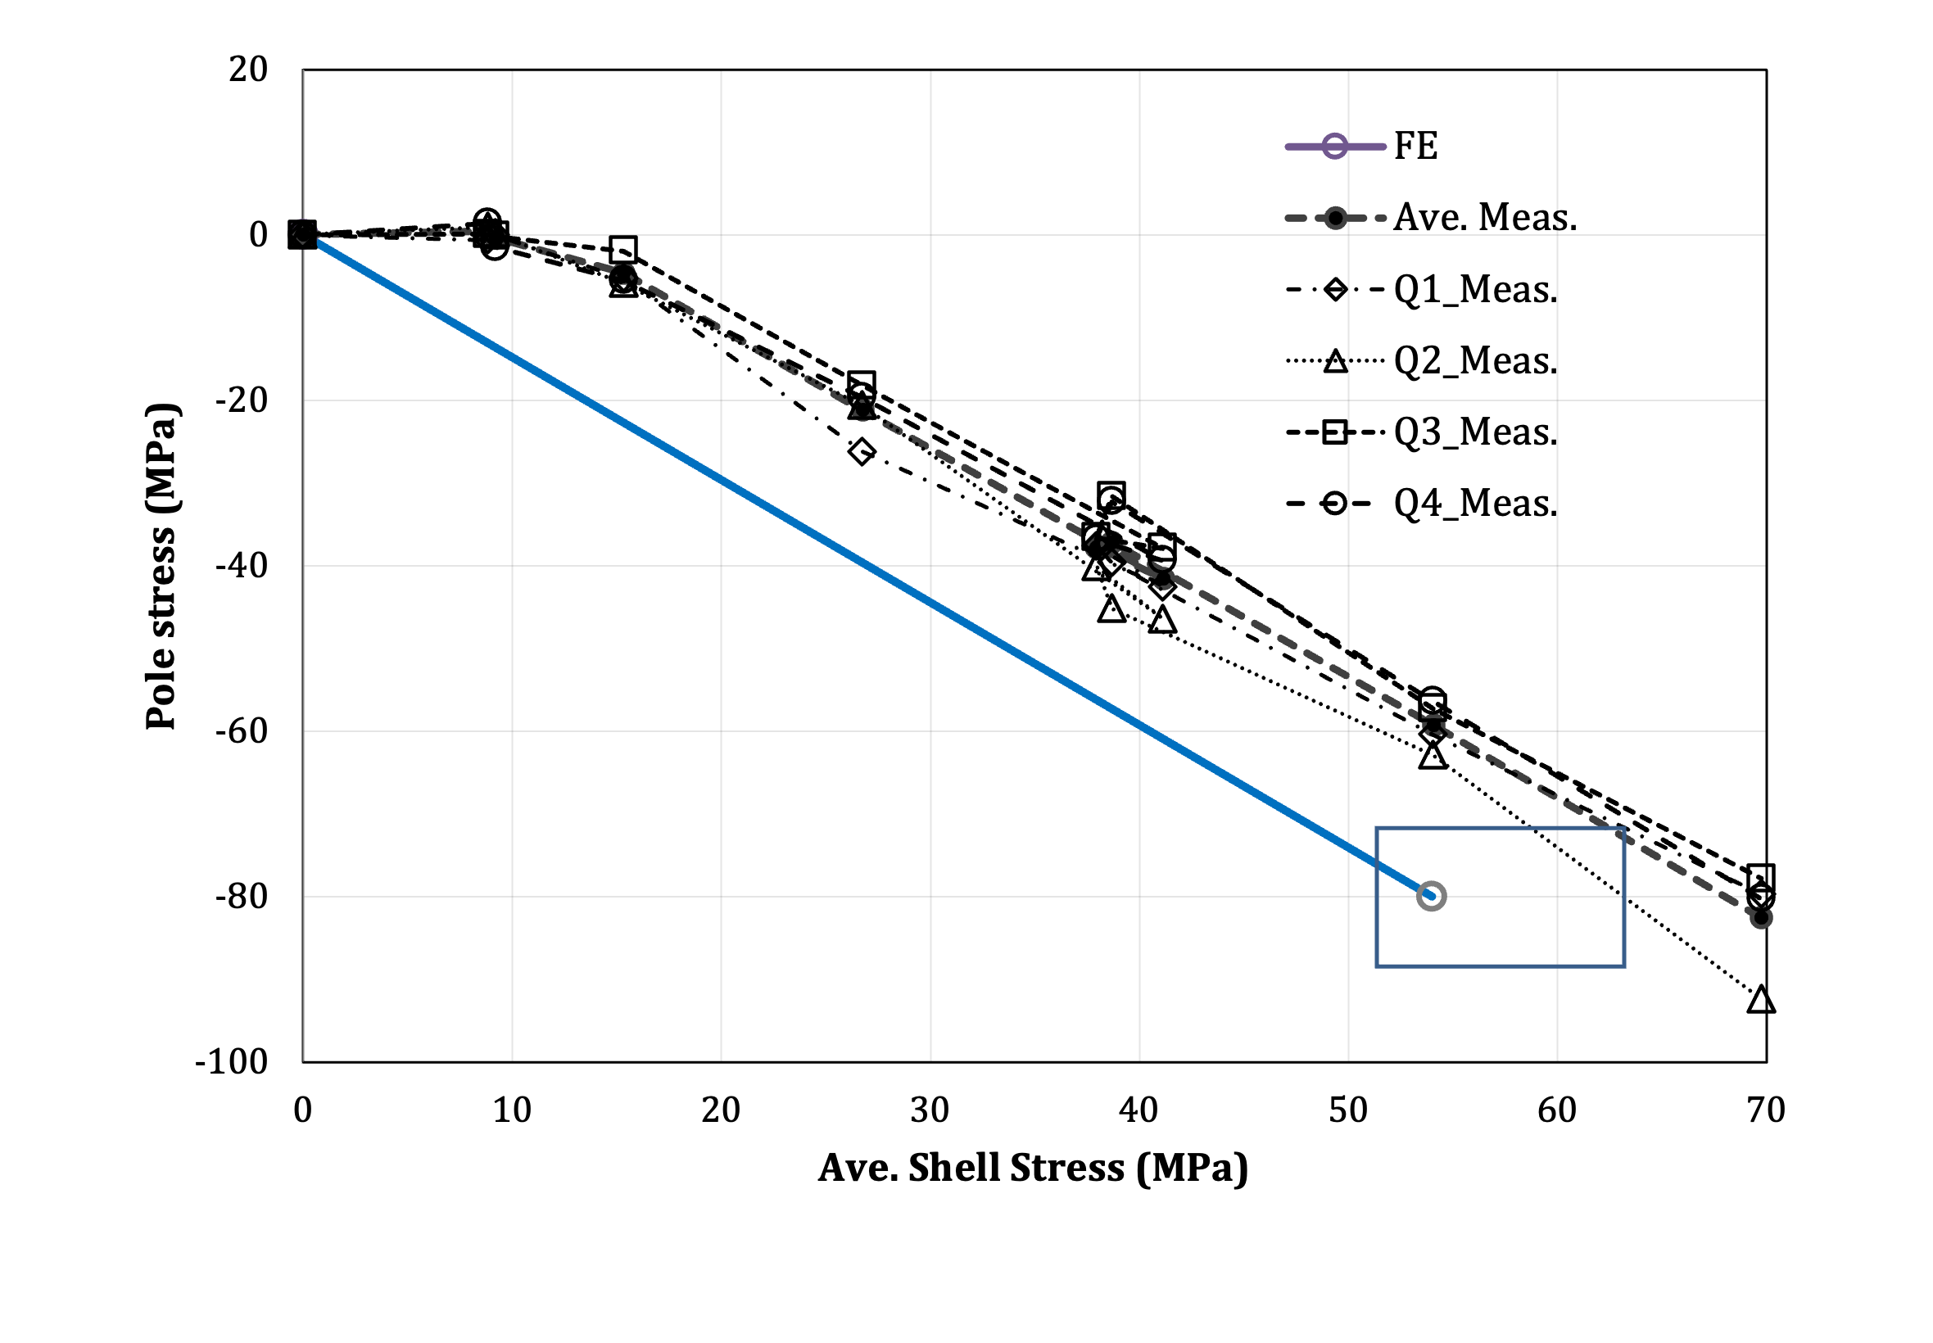
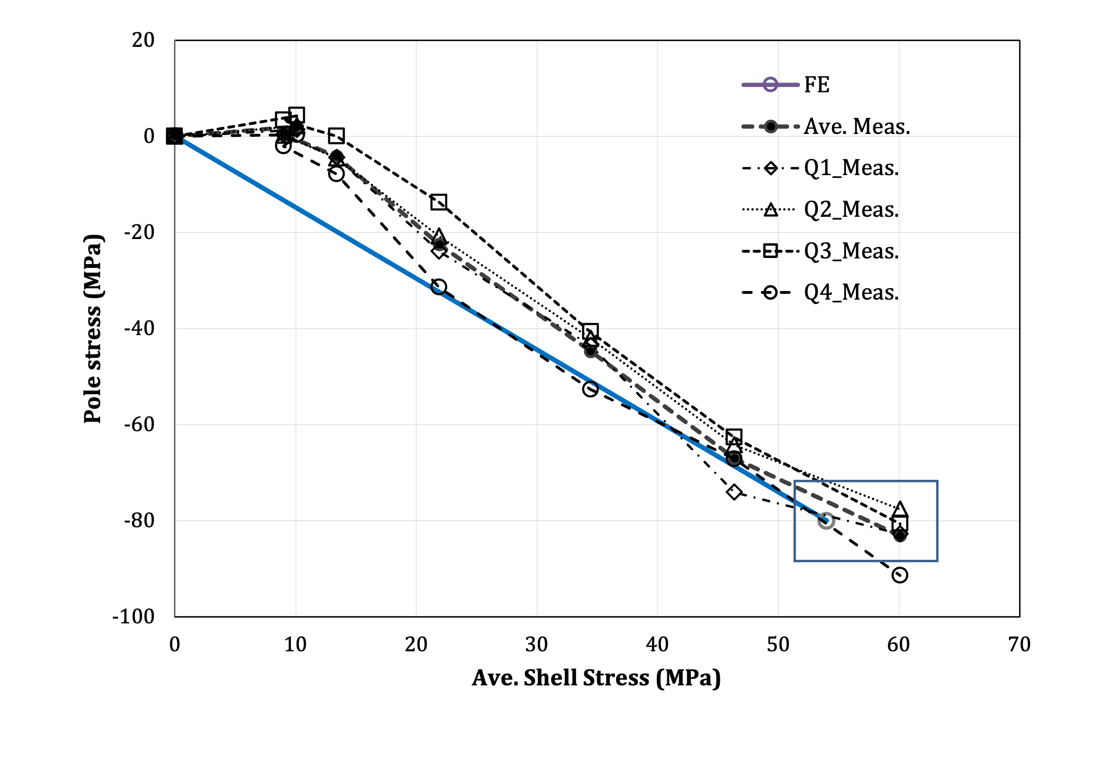
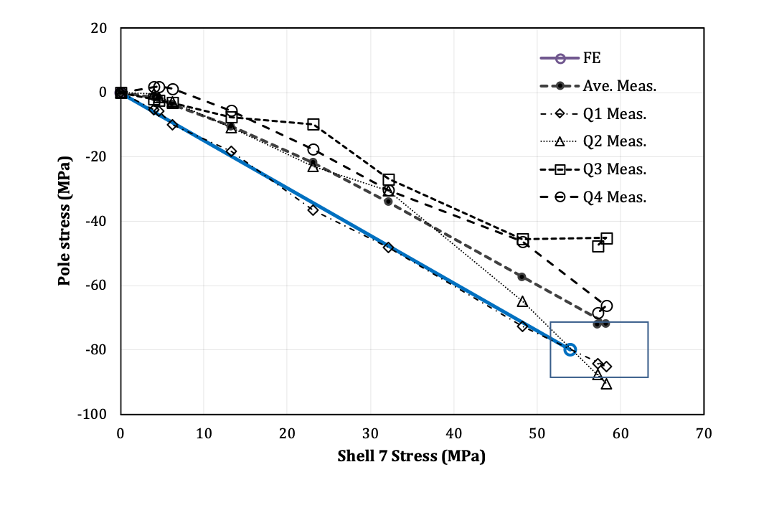
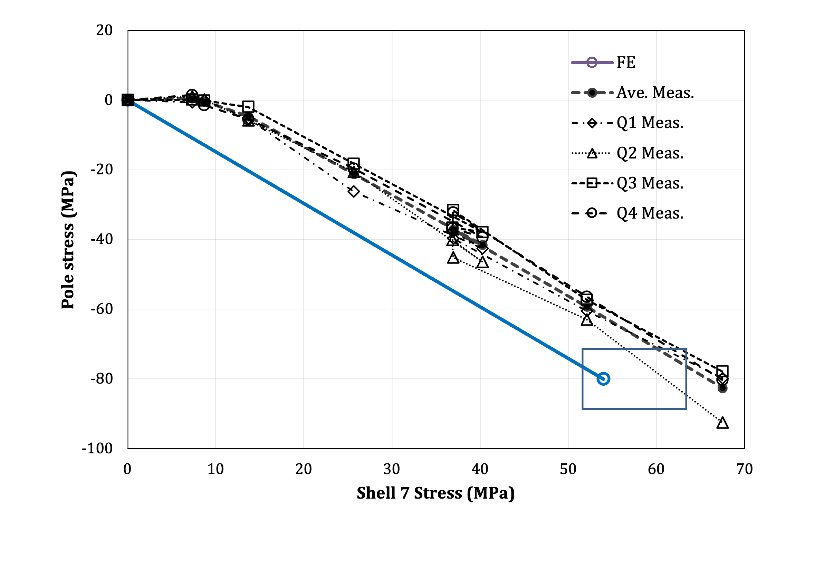
MQXFA13b, MQXFA12b, and MQXFA18 Transfer Function Plots
MQXFA13b (rebuild after test) had a large spread, avg 72 MPa preload
MQXFA12b (rebuild after preload) had a small spread, avg 82 MPa preload
MQXFA18 had a small spread; followed FEA line; avg 83 MPa preload
MQXFA13b
MQXFA12b
MQXFA18
MQXFA13b
MQXFA12b
MQXFA18

Slide 10
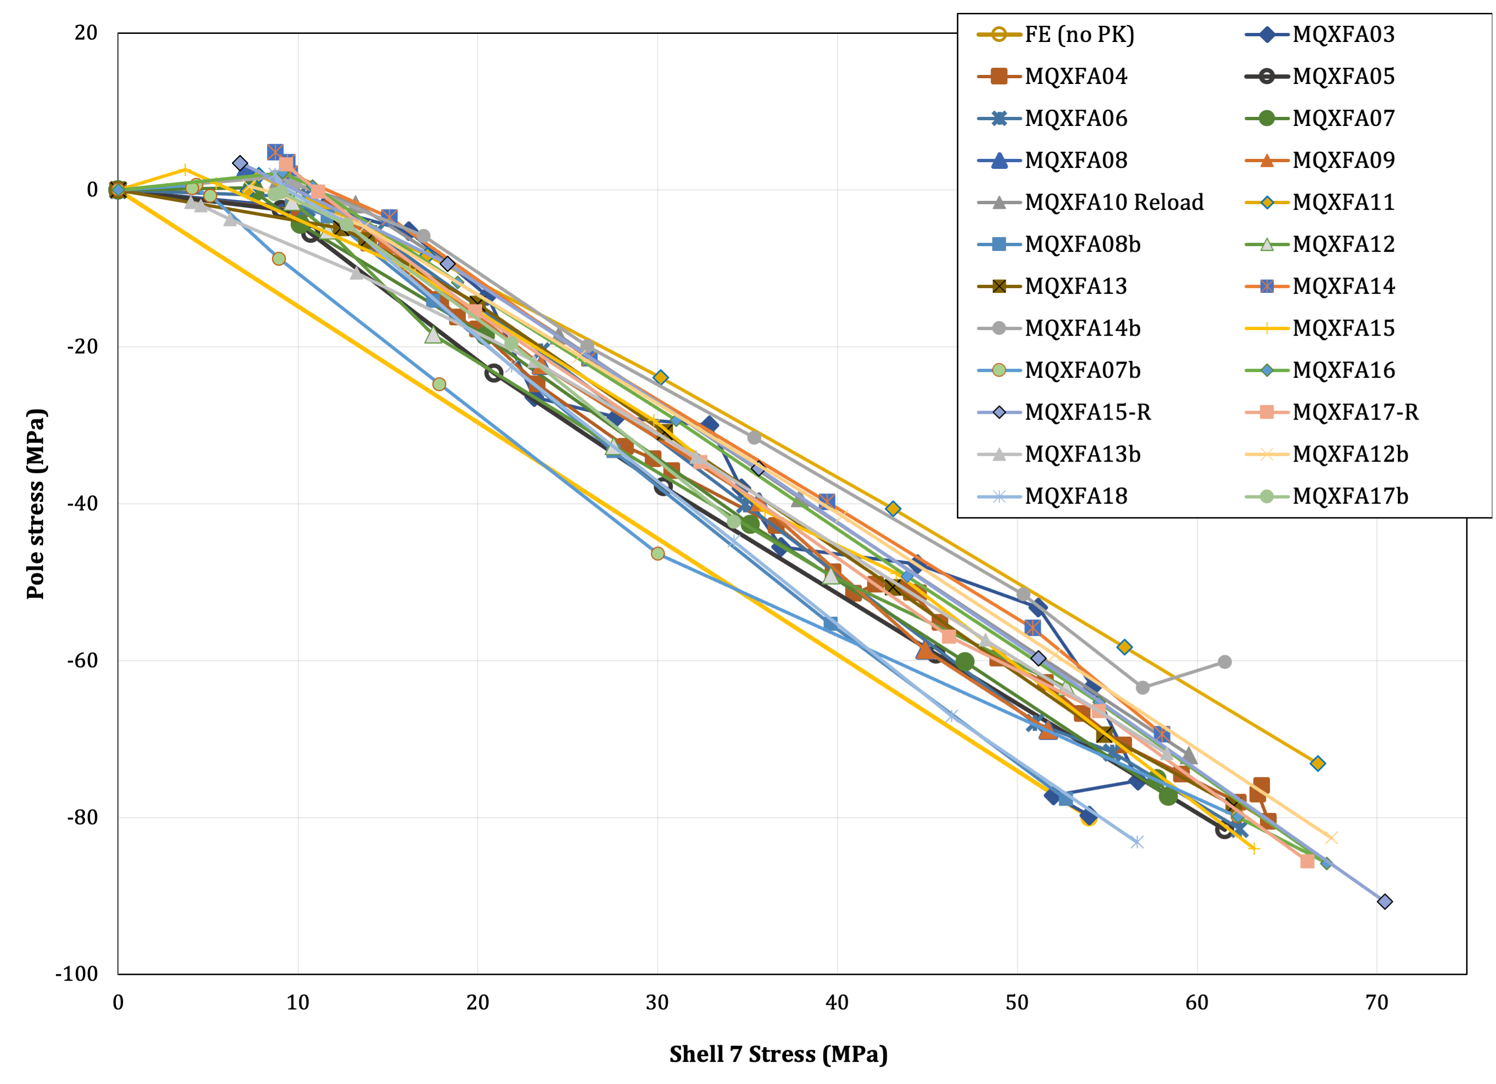
Transfer Function at RT for MQXFA Magnets
* NOTE: MQXFA09 shell-yoke assembly was unloaded and SG offsets were forced to original pre-A09 preload values before preloading MQXFA11. E.g. shell SG values are likely over-reporting calculated stresses by 2-5 MPa in Shell 7. See appendix.

Slide 11
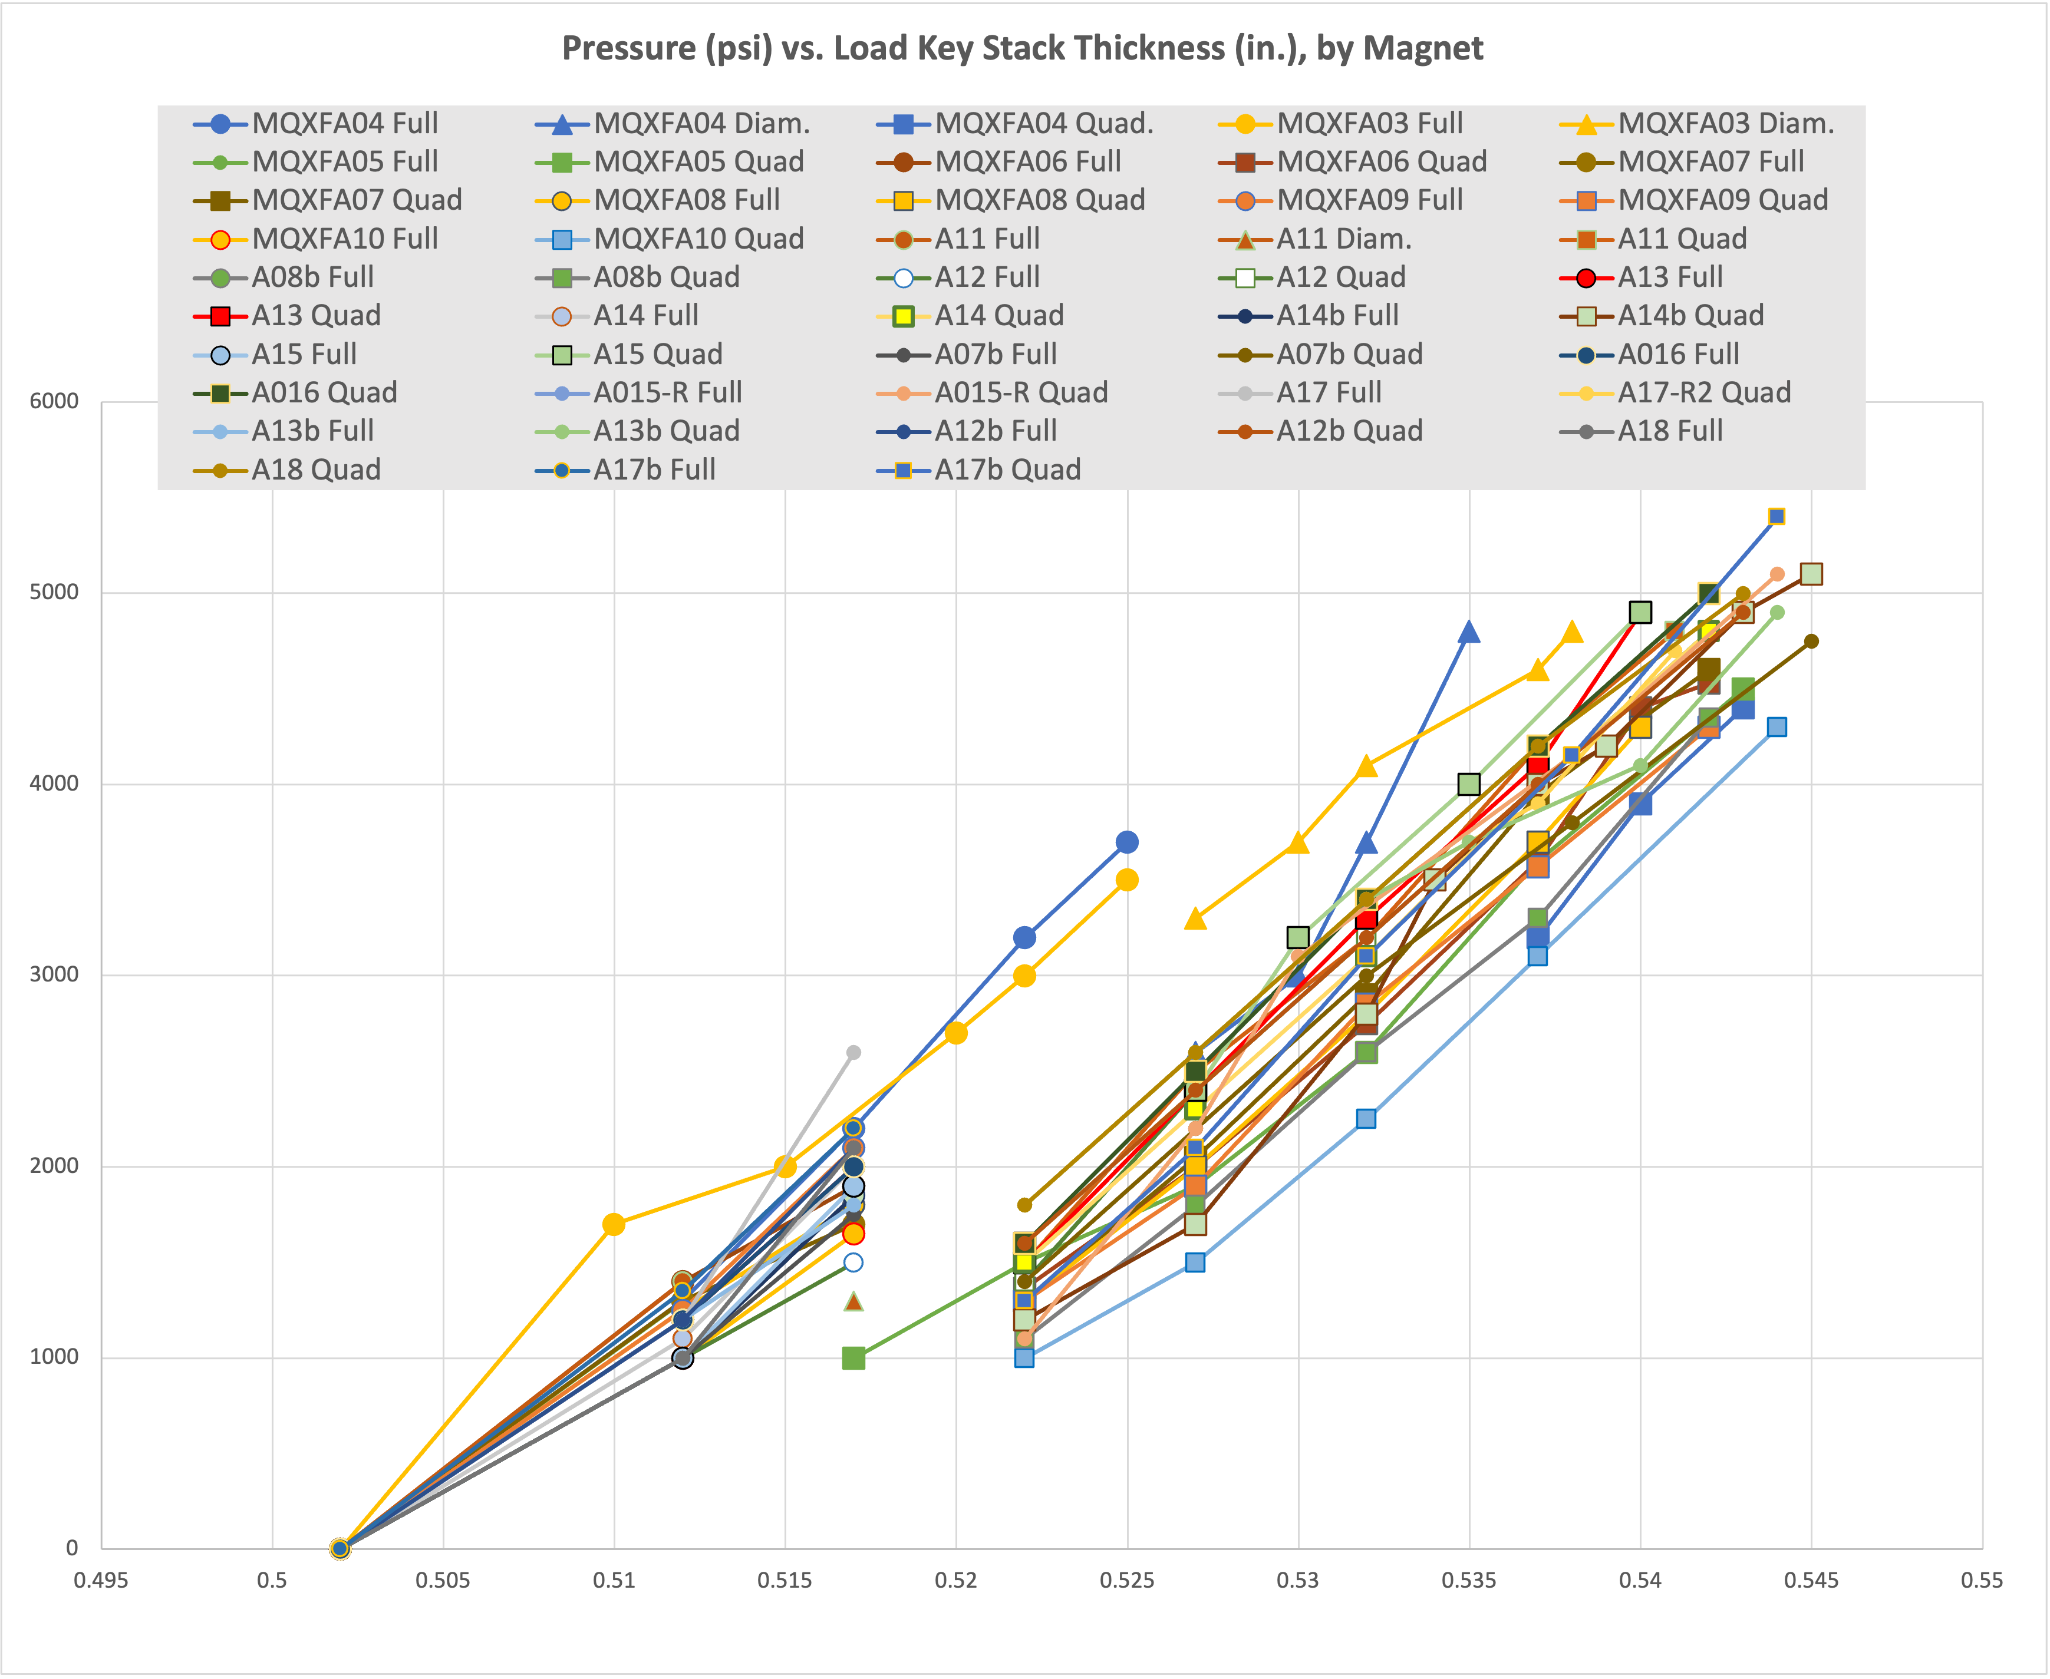
MQXFA Bladder Pressures
MQXFA10 shimmed coils were smaller, so overall coil pack size was smaller than in other magnets
Required an additional .025 mm of load key shim to achieve target coil preload (13.82 mm total)
MQXFA11 utilized more midplane shim than A07-A10) due to adjusted measurement reporting
Larger coil pack required higher pressures at same key shim size
But required smaller total key size to reach target (13.74 mm total)
Plot of bladder pressures vs target shows correlation between required bladder pressure to achieve preload targets
50% Azimuthal load

Slide 12
Preload Process With Tapered Keys
See Talk about shim package targets
The pre-load sequence:
Pre-loaded axial rods with average ~50 µε;
50% azimuthal pre-load (~0.030” shims, or total 13.52 mm)
50% axial pre-load (~470 µε)
100% azimuthal pre-load (~.040” shims, or total ~13.8 mm)
Final Operation with Tapered Load shims on LE
100% axial pre-load (~950 µε)
The pre-load process:
We preloaded MQXFA05 quadrant by quadrant from the initial 0.010” shims (total 13.01mm) in 0.005” steps, reaching a peak bladder pressure of 4500 psi.
All subsequent magnets used quadrant by quadrant loading after the 0.015” shims step (total ~13.14 mm)
MQXFA05 Coil 115 slope may have been caused by “locking in” a position too early in the preload process

Slide 13
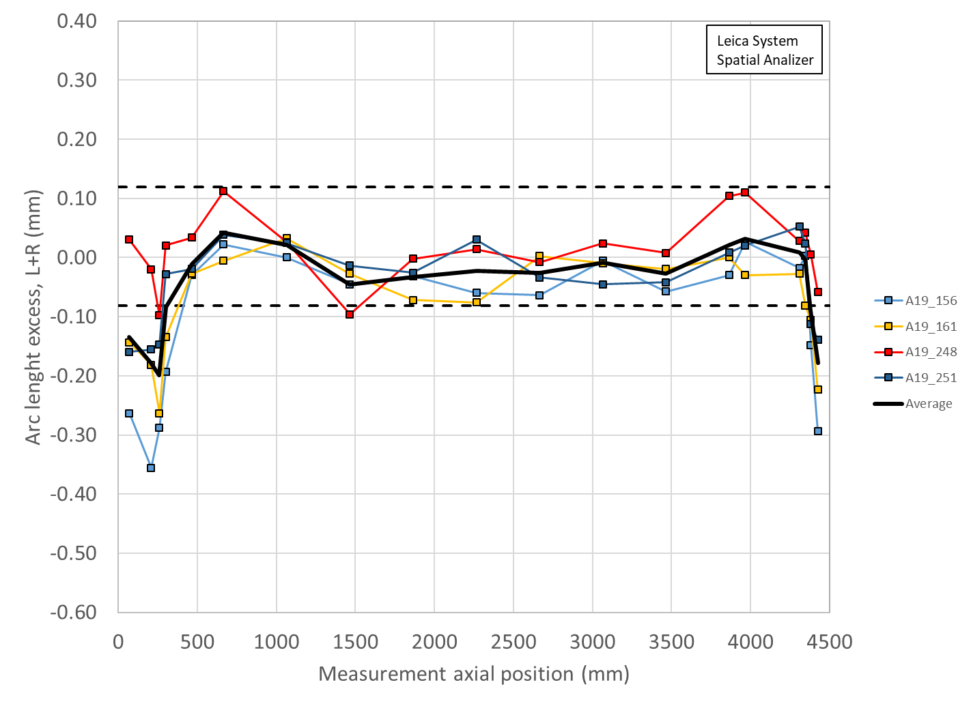
Variation of MQXFA19 Pre-Stress due to Coil Variations
Coil sizes based on CMM and shimmed sizes on midplane
The amount of increased average stress above what is measured at the SG is still below the +10 MPa “hard limit” when staying below the 120 MPa limit during all pressure operations
Shimmed
0.003” on 156
0.003” on 161
0.005” on 248
0.003” on 251
Two locations appear slightly larger on average than at the SG location, per measurements
Starting with MQXFA08 coils there is now a CMM measurement at the SG location

Slide 14
Axial Preload for MQXFA
The axial preload targets the same level of MQXFA04 - 11:
MQXFA Target | R.T. | 1.9 K | Nom. Current
Preload | 950 µε ± 95 µε | 1700 µe | 1750 µe
Axial Force (MN) | 0.6 | 1.07 | 1.12
Ratio to the E.M. force at nom. current | 50% | 90% | 93%
Total axial e.m. force is 1.2 MN at nominal current

Slide 15
Summary
The R.T. preload targets for MQXFA19 remain unchanged and follow the Magnet Specifications:
Shell Stress: 58 ± 6 MPa
Coil Stress: -80 ± 8 MPa
Rod strain: 950 ± 95 µε
(New) Shell 1 average stress <80 Mpa
Cold powering deltas are used to determine the preload on the coils (MQXFA7b Coil SG data is the latest set available)
Max Coil stress excursion to 120 Mpa
Average coil size (arc length) after shimming is within ~±100 µm with respect to average coil size measured at the strain gauge location within the straight section
The preload process will start quadrant by quadrant loading after the ~13.14 mm load key step
Intended to prevent “locking in” a position too early
See other talk for a discussion on the shim package targets
Tapered load shims will be installed in this magnet

Slide 16
Additional Slides

Slide 17
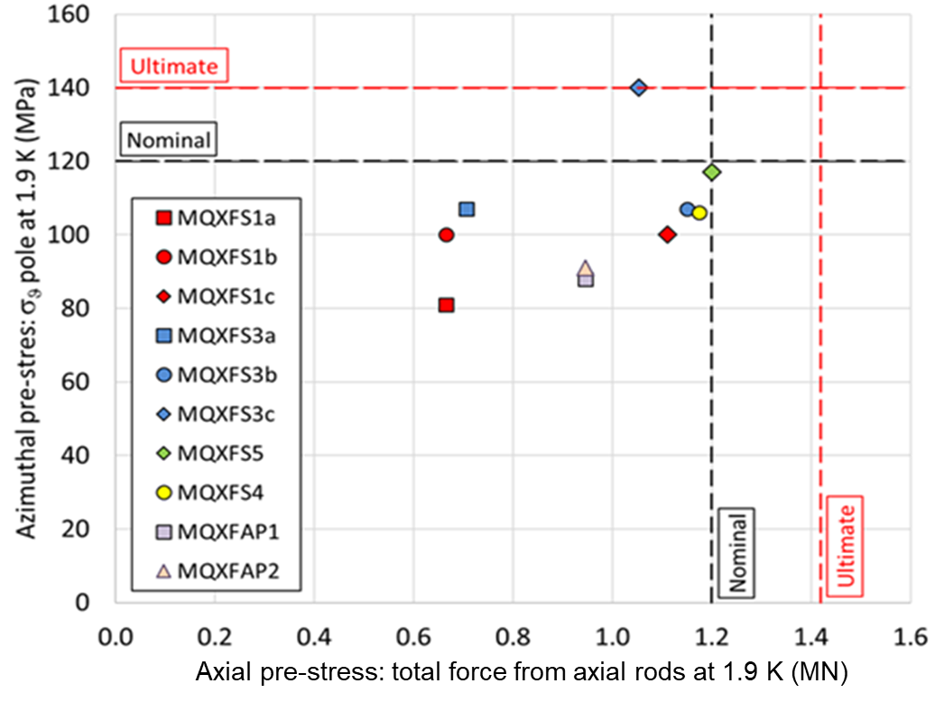
The Load Condition after CD (based on powering)
MXQFA04
MXQFA03
MXQFA07
MXQFA05
MXQFA06
NOTE: axial load values due to cool down SG data is still being examined

Slide 18
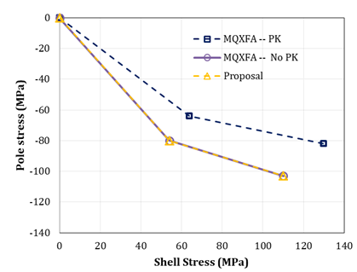
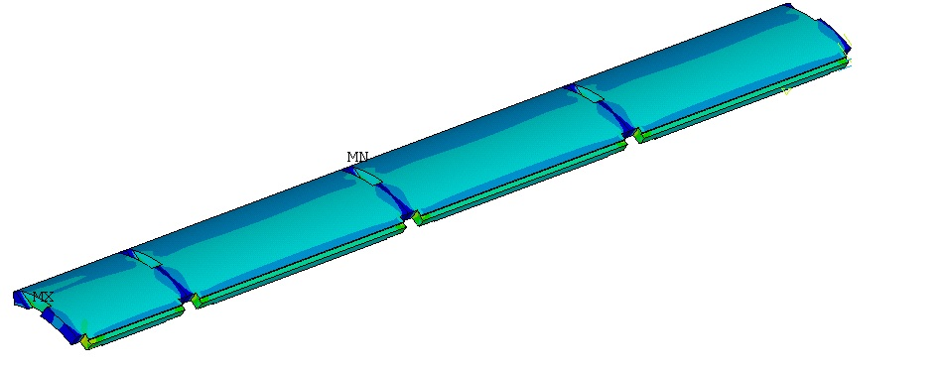
Preload Targets for MQXFA
We have kept the same pole-gap since MQXFA03:
About ≥ 5.5 mil/side: will not fully close at cold
 | Value
Interference (µm) | 470
Polekey gap (µm/side) | 145
Polekey interception F_{pole}/F_{shell} (1.9K) | 0
 | 1.9 K | 16.47 kA | 17.89 kA | 19 kA
Shell Average Von Mises Stress (MPa) | 116 | 121 | 125 | 129
Shell Peak Stress (MPa) | 488 | 481 | 481 | 480

Slide 19
MQXFA05 &6 Load Key Shimming Summary
From MQXFA05, we reduced number of operations from ~10 steps to 7 steps using a constant 0.005” shim increment
Magnets MQXFA03 to -05 were plotted together
Shows full-quadrant loading, diametrical loading, and quadrant loading
Load key shims stacks are shown vs. pump pressure required to achieve insertion
Pressures shown are the highest pressure required (in the case of diametrical and/or quadrant) to complete a full round of shimming

Slide 20
Analysis of low stress in MQXFA05 coil 115

Slide 21
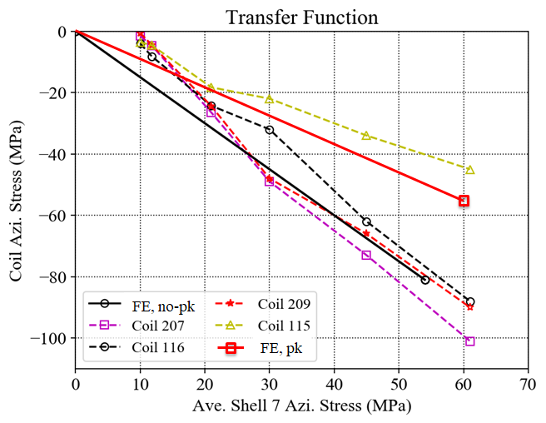
MQXFA05 Coils TF
Detailed data points in next slide

Slide 22
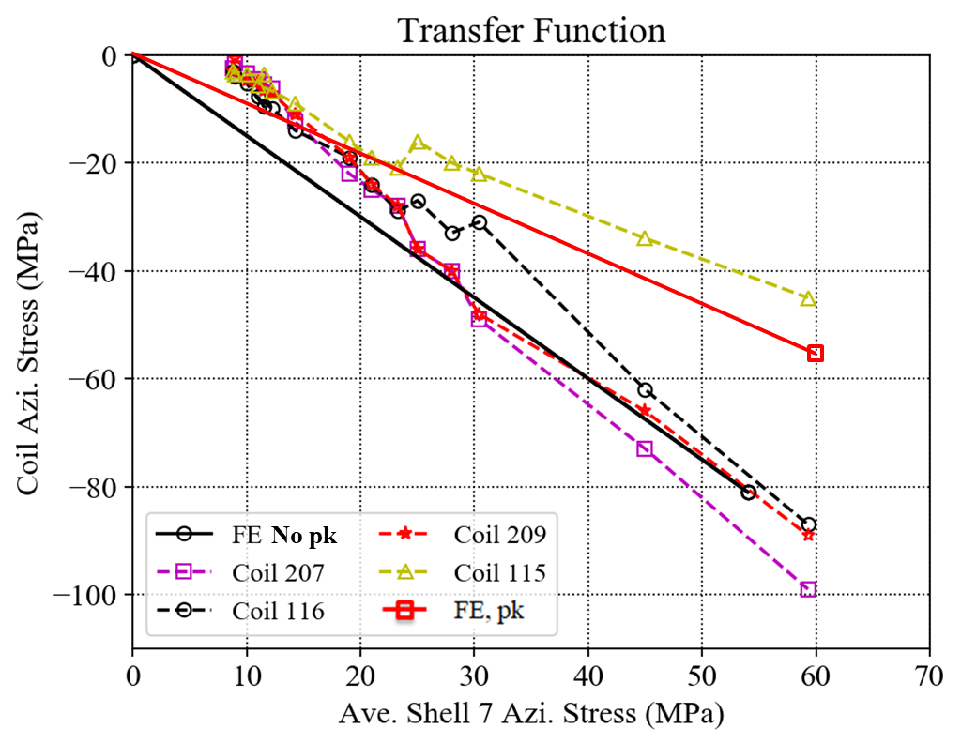
MQXFA05 Coils TF (detailed)
Detailed data points from 20 mil to 30 mil shims

Slide 23
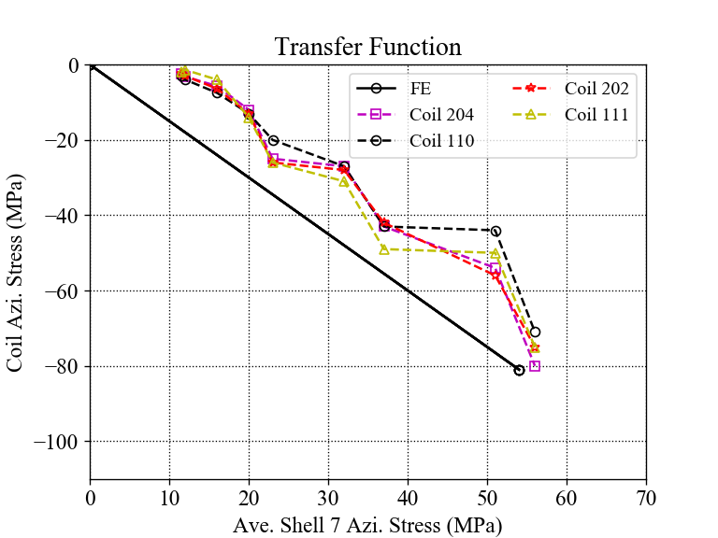
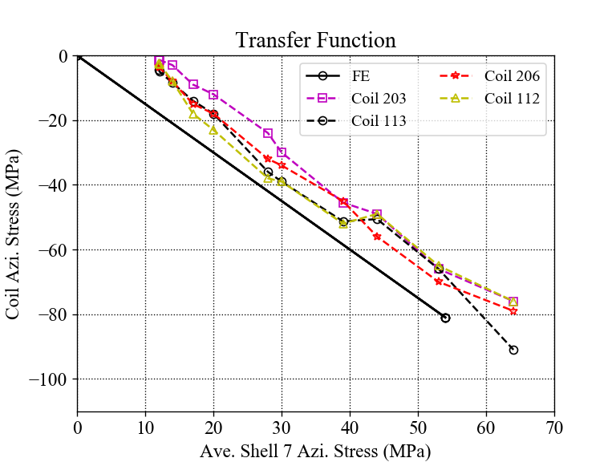
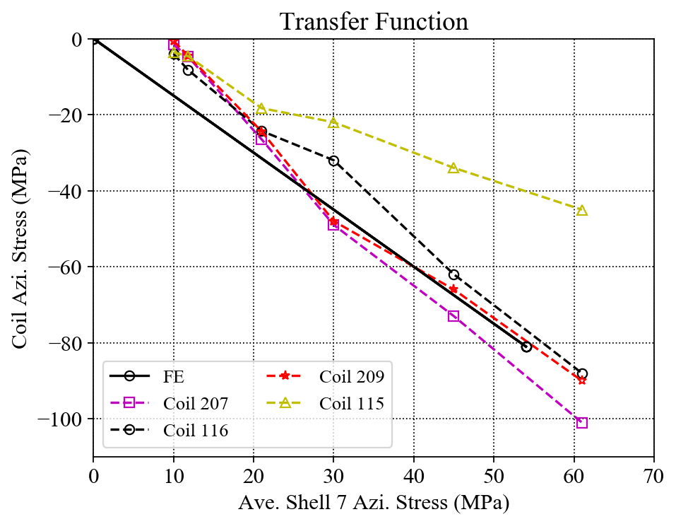
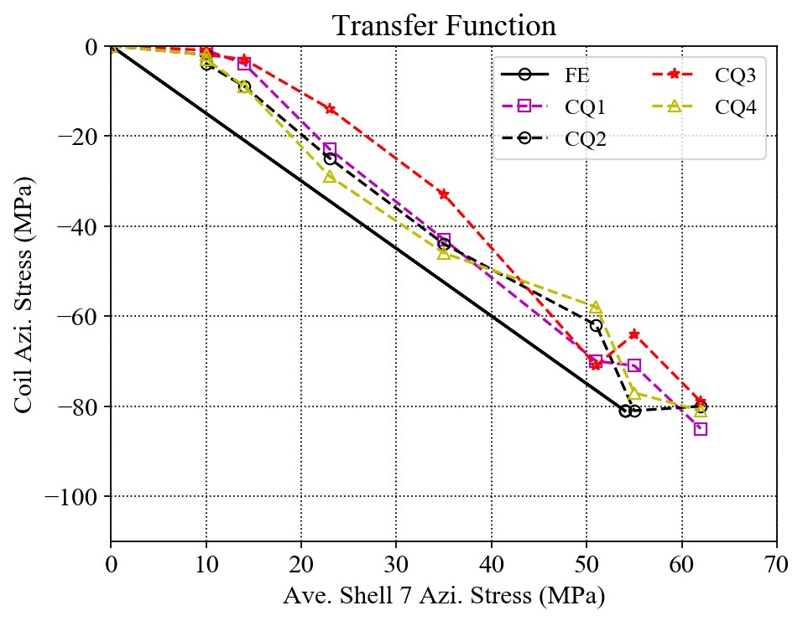
Individual Coil TF Comparisons
MQXFA03
MQXFA04
MQXFA05
MQXFA06
In general, coil stress spreads in MQXFA03 and A06 are much smaller.

Slide 24
Previous cases

Slide 25
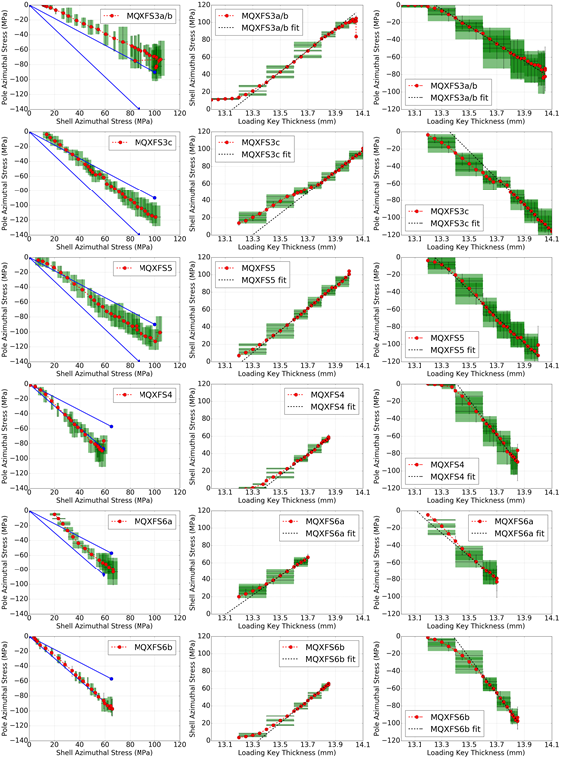

Slide 26
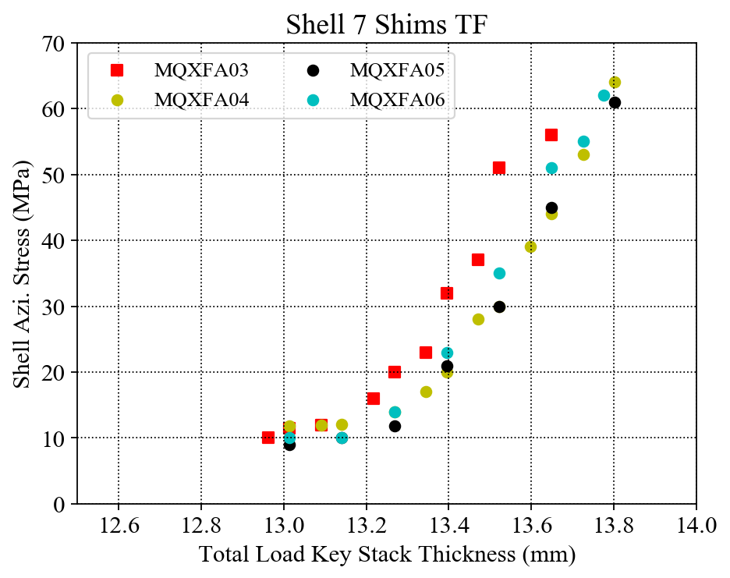
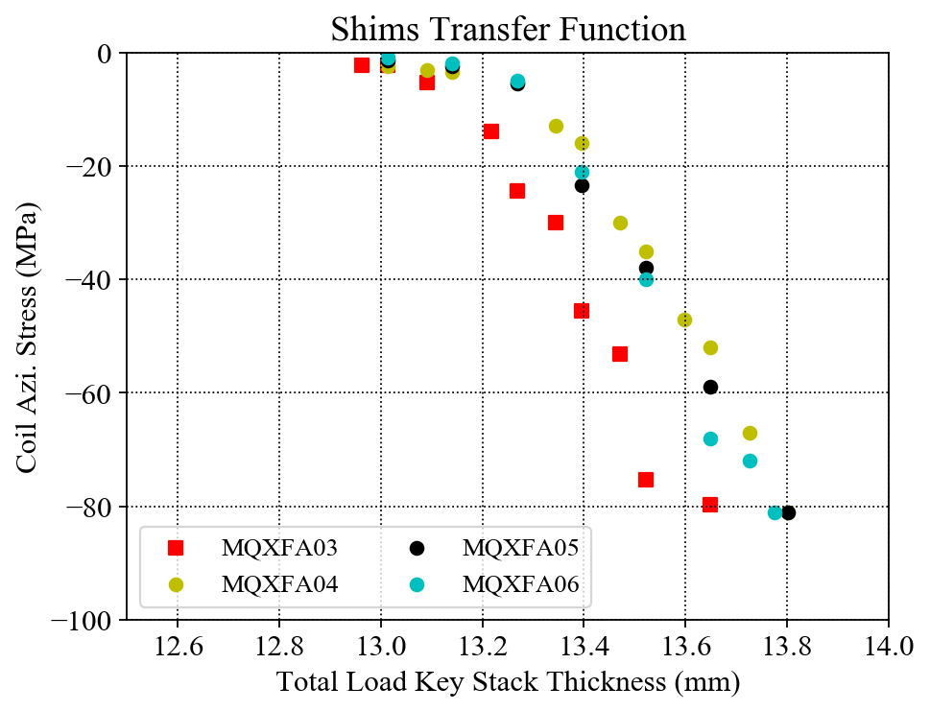
MQXFA03 - 06 Shims TF Plots
The correlations of the total load key thickness and the average coil / shell azimuthal stresses are investigated;
The slopes of the linear part of the three magnets are very close.

Slide 27
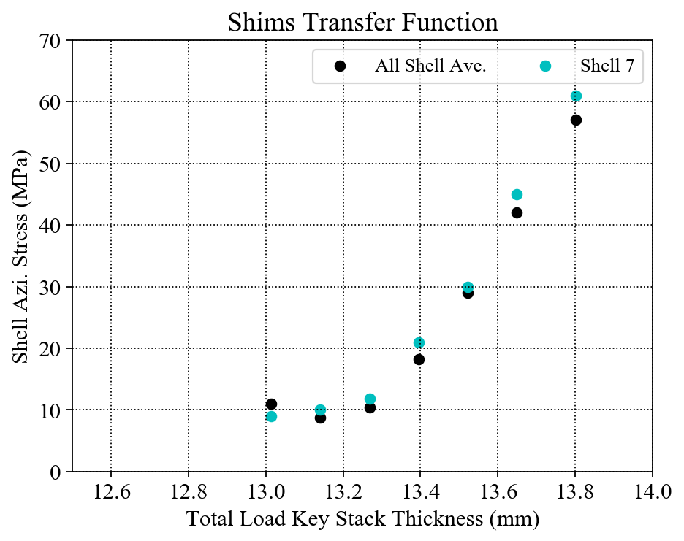
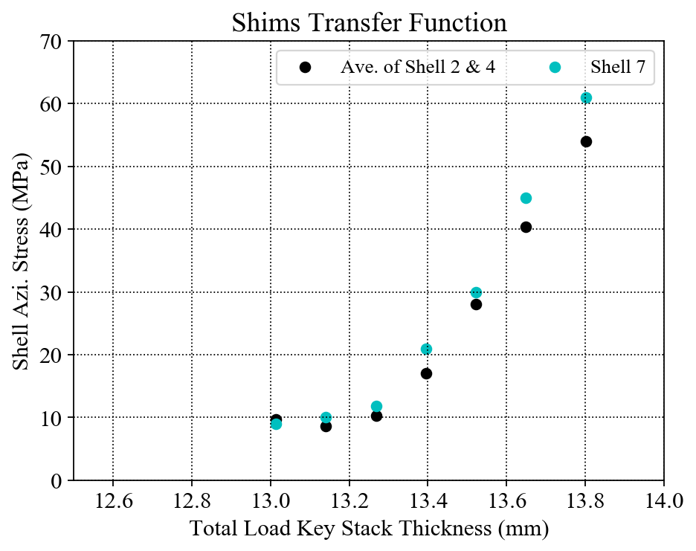
Shim TF only for MQXFA05
Only MQXFA05
The average stress of all the shells (shell 2, shell 4 and shell 7) seems linear (red line) ;
The average stress of the shells 2 & 4 seems linear (Dark blue line) ;
The average stress of shell 7 seems to have slope change (green line).

Slide 28
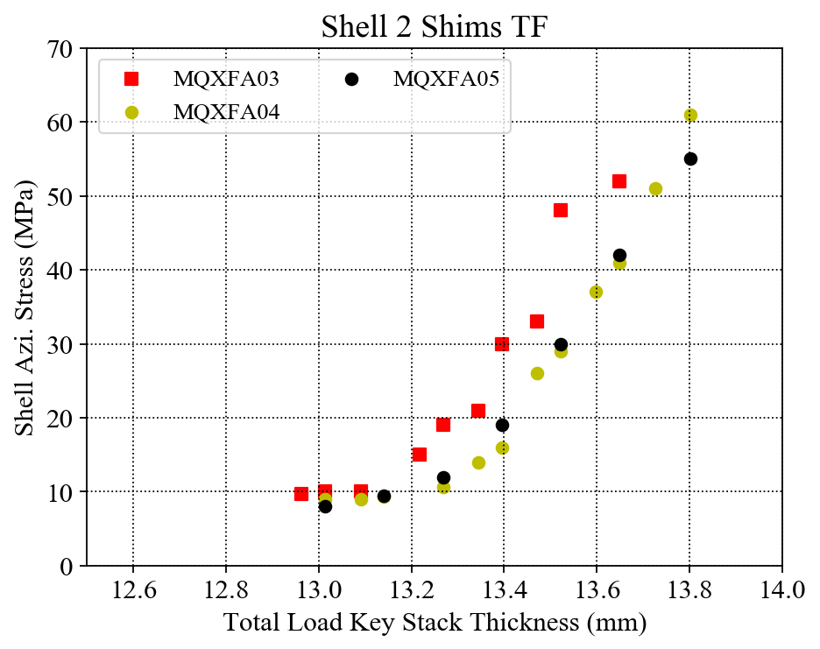
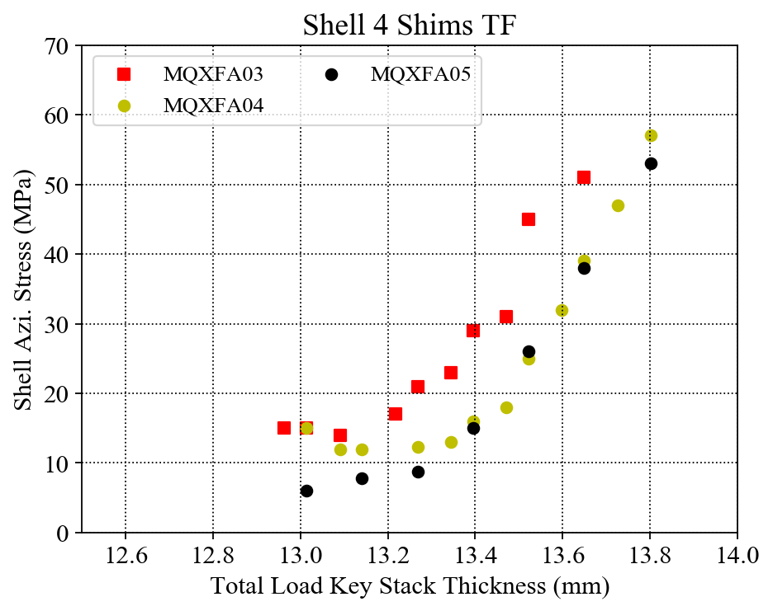
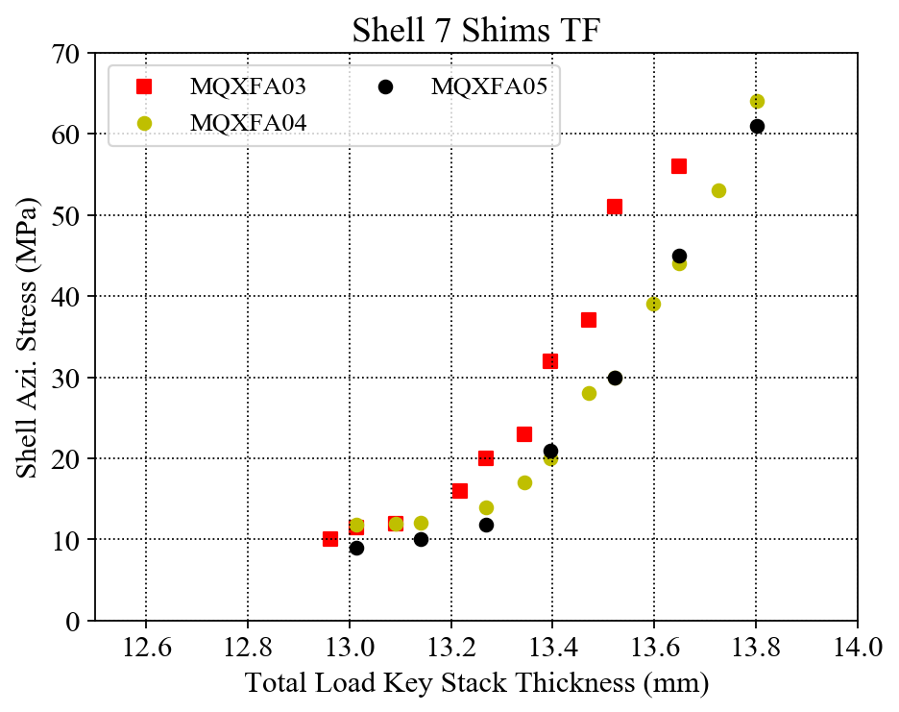
Individual Shell Shim TF Comparison
Individual shell stress with error bar at each final data point.

Slide 29
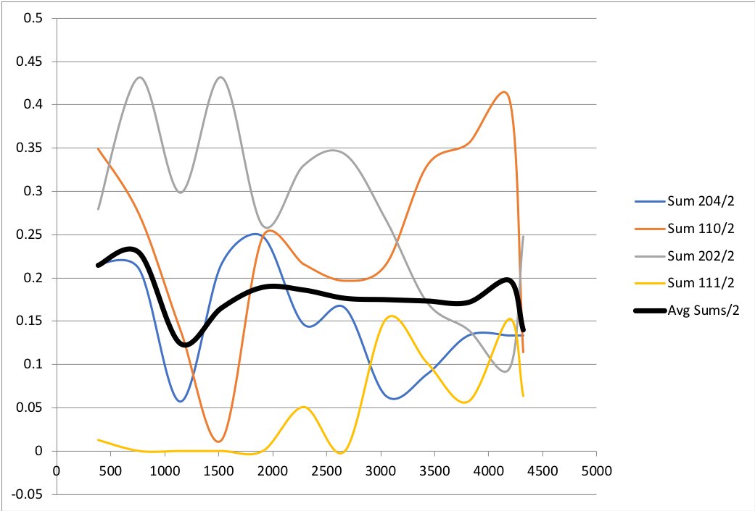
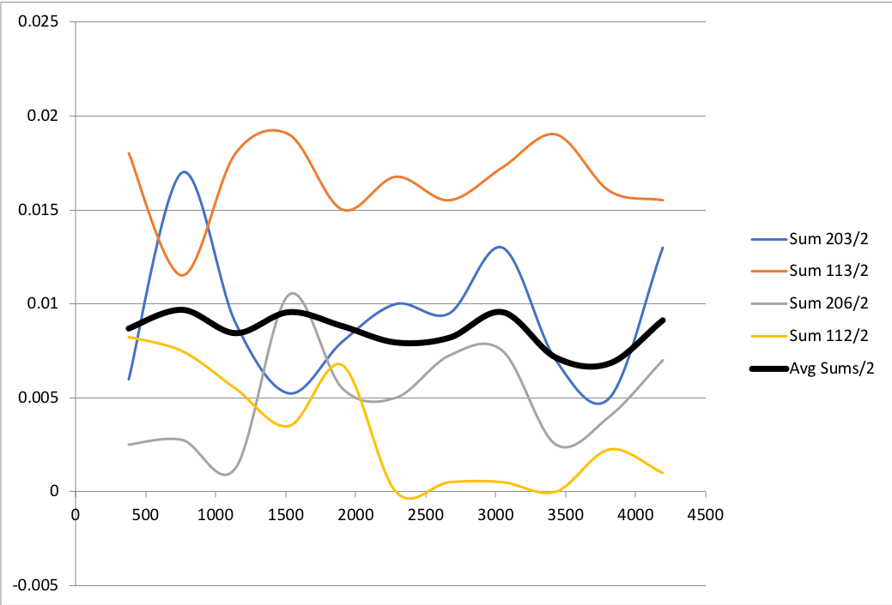
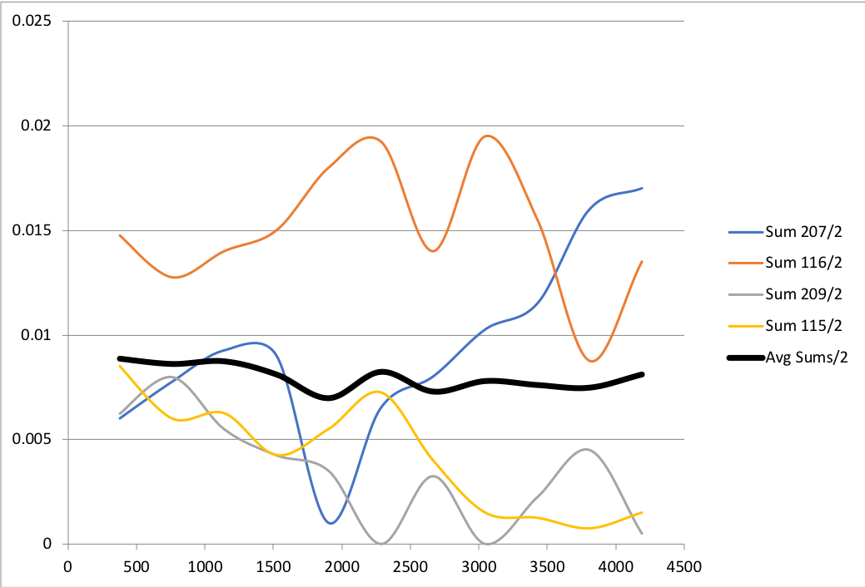
Coil Pack Pole-key Gaps
mm
inch
inch
MQXFA03
MQXFA04
MQXFA05

Slide 30
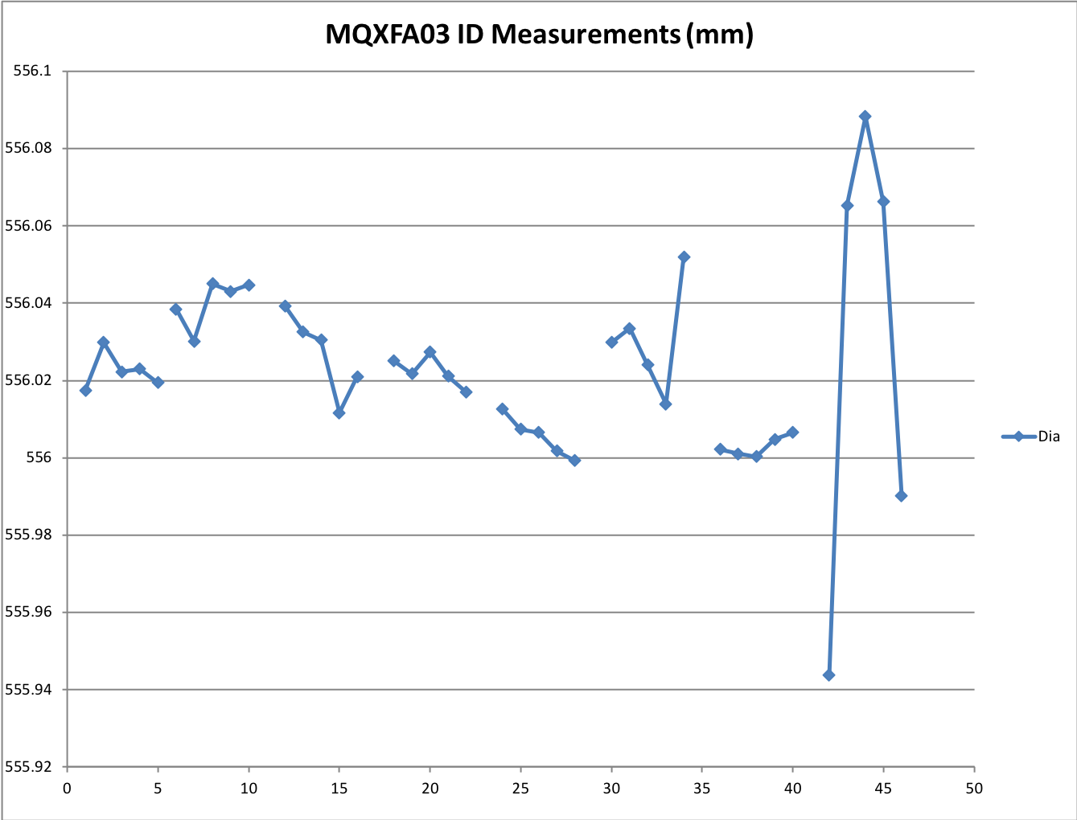
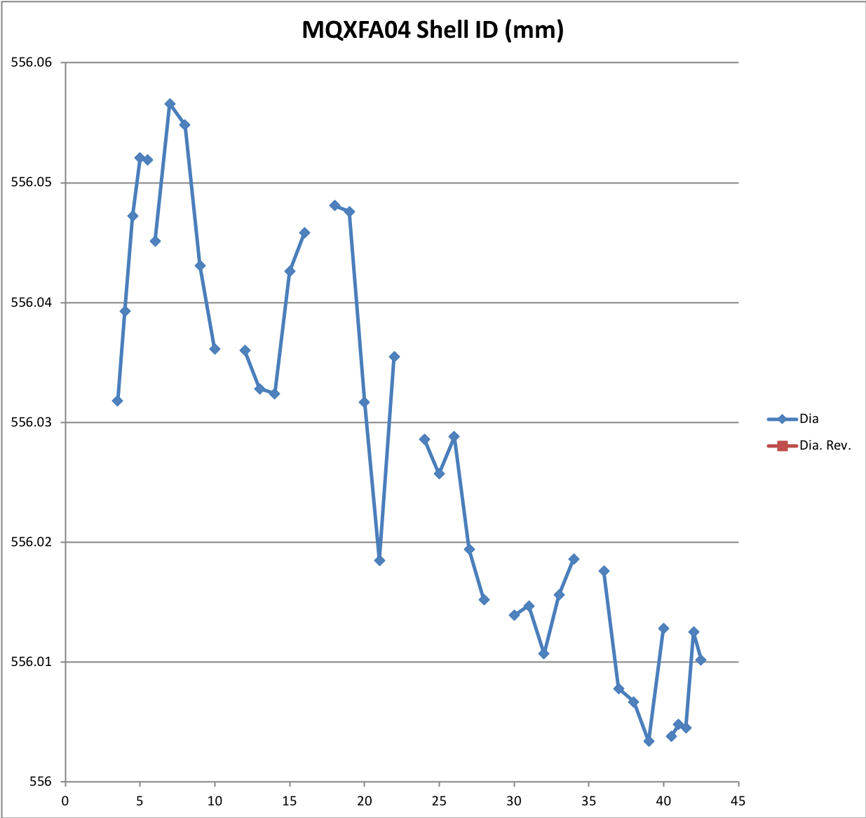
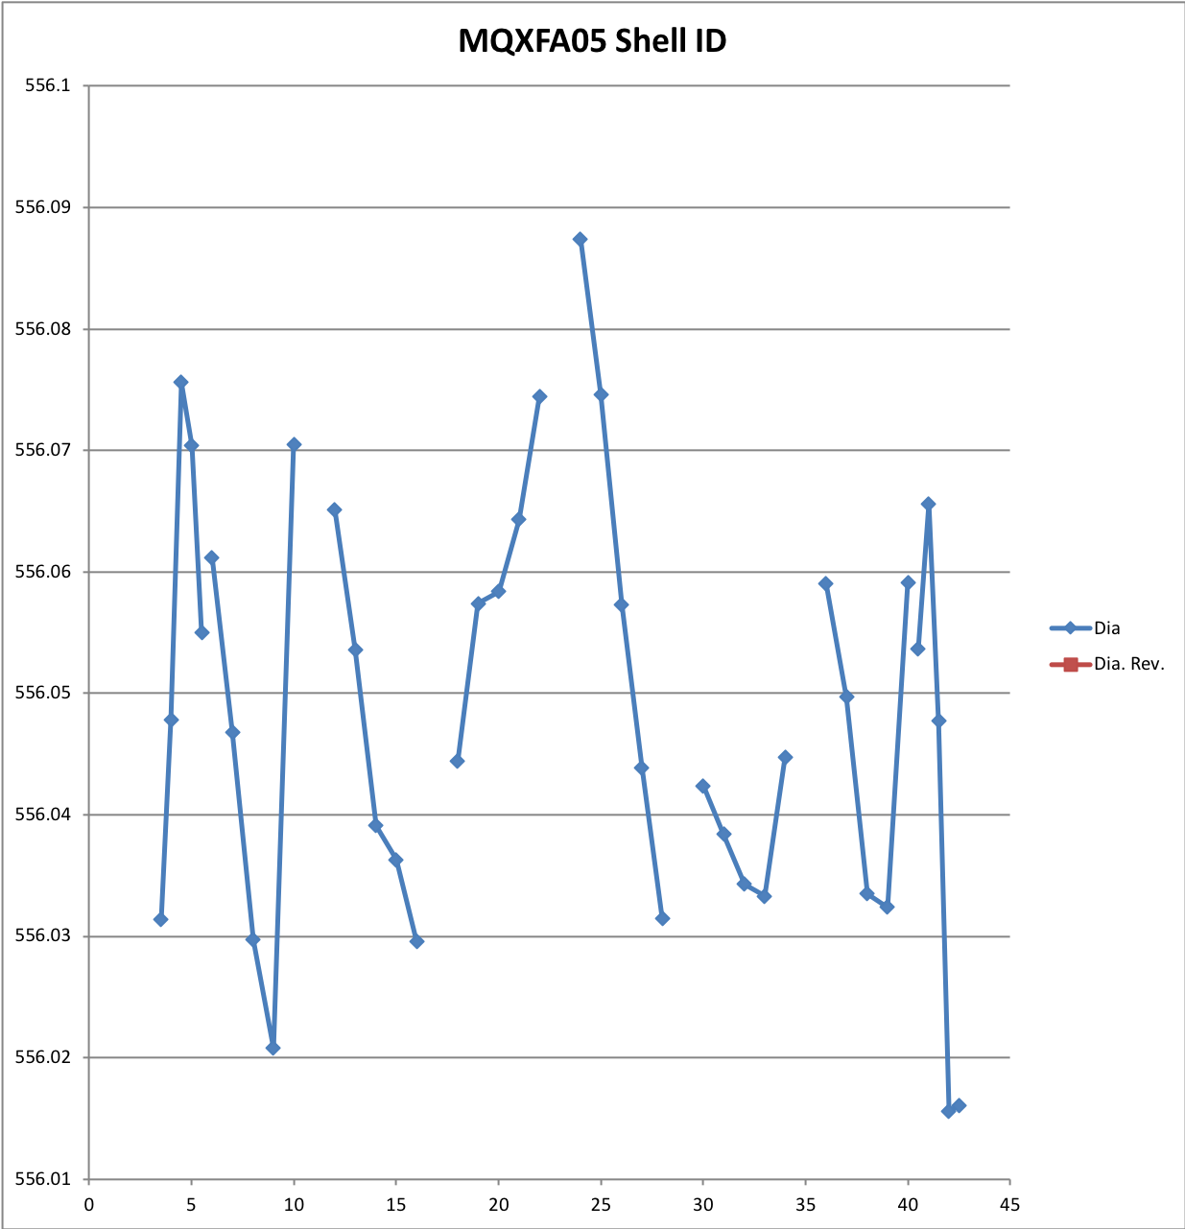
Shell ID Measurements
Unit: mm

Slide 31
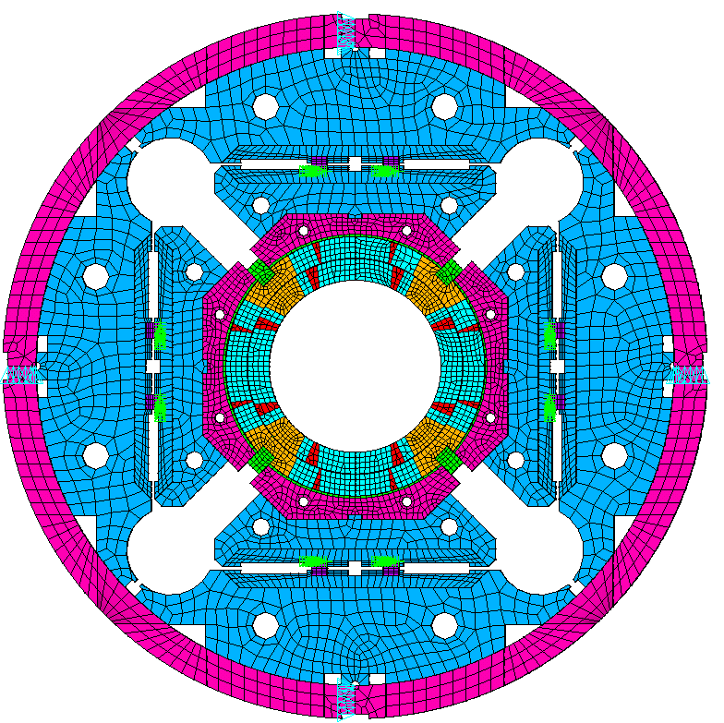
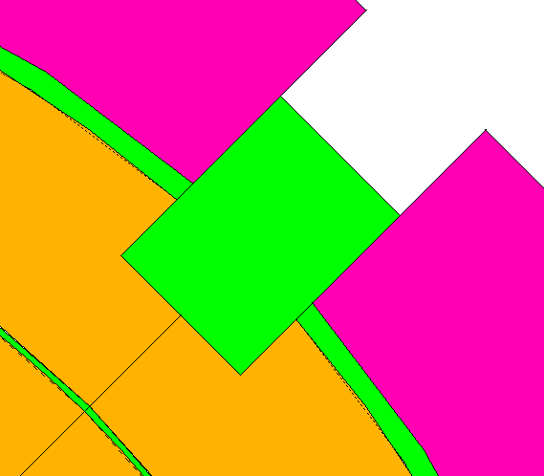
Appendix: Possible Polekey Interception in Q4
2D model Basic Settings:
X-lock
Full size 2D model.
The pad is assumed as only iron.
Initial pole key gap is 140 μm / side in quadrant 1 to 3.
No pole key gap in quadrant 4.
No axial loading in the 2D model.
All components are in contact using contact elements
Contact172
Target169
Baseline Friction coefficient is 0.2
Y-lock
Q2
Q1
Q3
Q4
Boundary conditions:
Apply uy=0 and ux=0 on Y-lock and X-lock, respectively
Apply interference at the loadkey and p-master interface
No Gap
No Gap

Slide 32
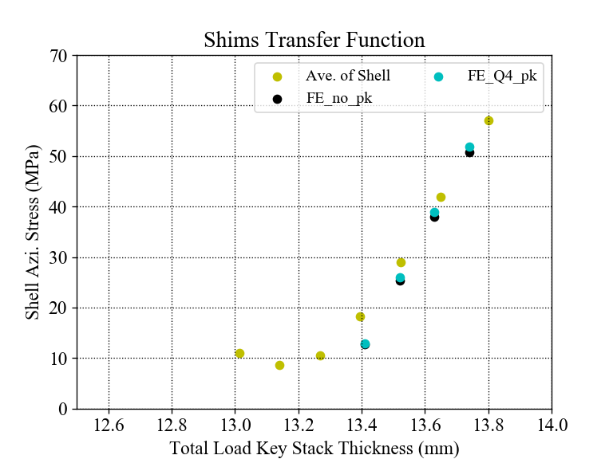
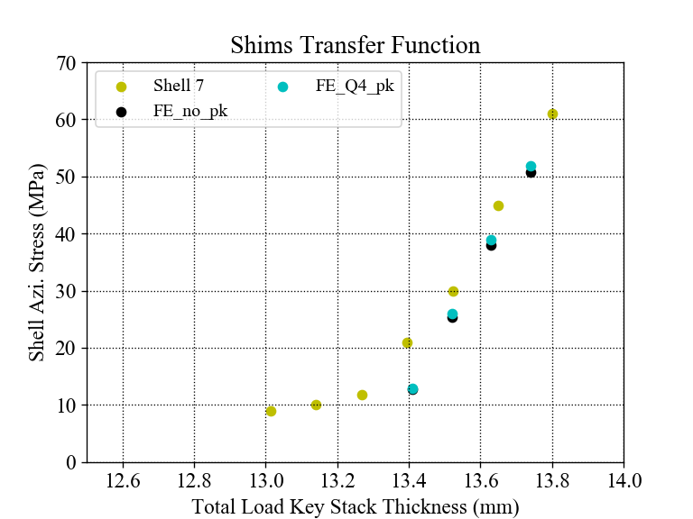
Shim TF (with FE simulations)
With simulations
The slope of average stress of FE is slightly higher than the measurements;
However, the slopes of the simulation results are not different obviously to make a clear comparison with the measurements.

Slide 33
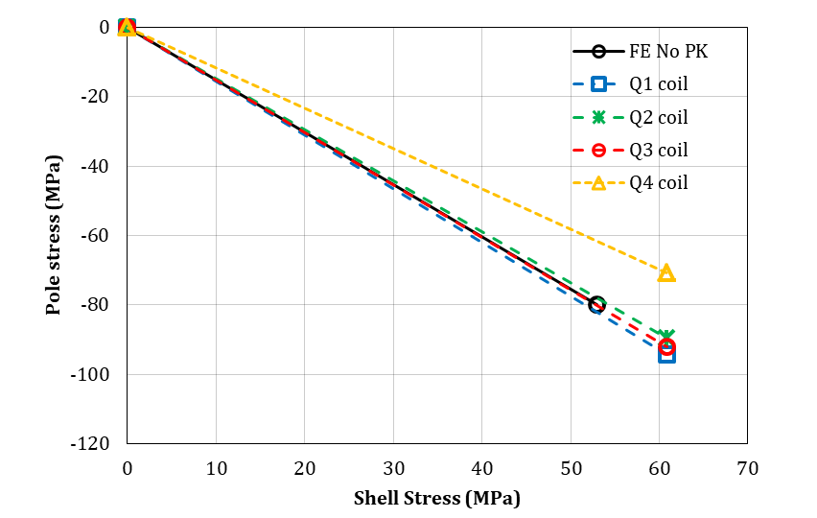
Measurements vs. Simulation
Measurements
No polekey gap in Q4

Slide 34
TF of the Simulation
No polekey gap in Q4

Slide 35
Coil stress distribution
Coil Von Mises Stress after preloads:
All quadrants with polekey gap (8 mil /side)
No polekey gap in Q4, 8 mil /side gap in the rest quadrants
Pa
Pa

Slide 36
Coil stress distribution
90°
Coil Von Mises Stress on the path (red dash line):
0°
180°
All quadrants with polekey gap (8 mil /side)
No polekey gap in Q4, 8 mil /side gap in the rest quadrants
270°
Cooldown
Cooldown
Stress (MPa)
Stress (MPa)
R.T.
R.T.

