Slide 1


MQXFA19
Coil Pack and Shimming Proposal
Dan Cheng, Paolo Ferracin, Mike Solis
11/20/24
LBNL

Slide 2
Outline
Coil Selection Review Recap
Coil CMM Summary
Coil Matrix
Proposed Coil Pack and shimming
Summary

Slide 3
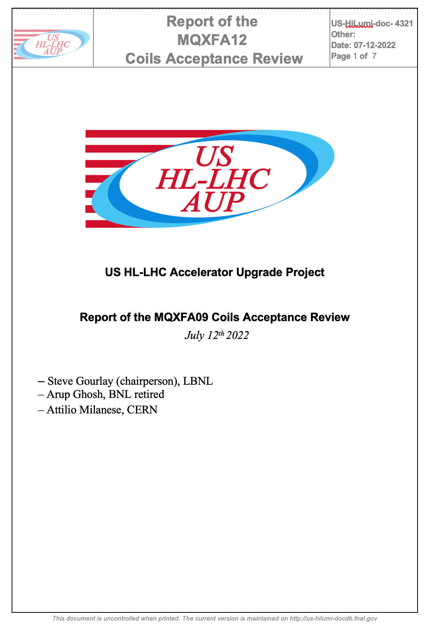
Coil Selection Review Report Summary
MQXFA19 Coil Selection Review was held 25-Sep-2024
  See https://indico.fnal.gov/event/66169/
    Coils 156, 161, 248, 251 picked
    Coils 244, 163 as spares
  All coils have b6 correction
  All electrical QC passed
  Fabrication reports and CMM reported
    Outer radial sizes appear similar
    Midplanes (“arc length excess”) appear to be similar

Slide 4
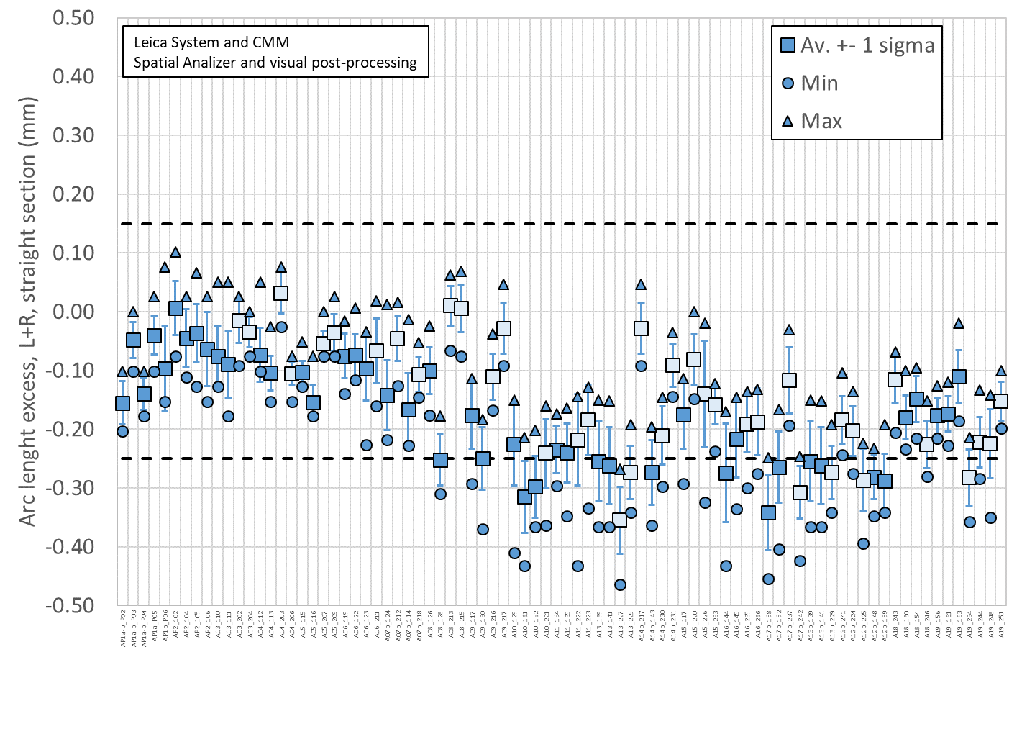
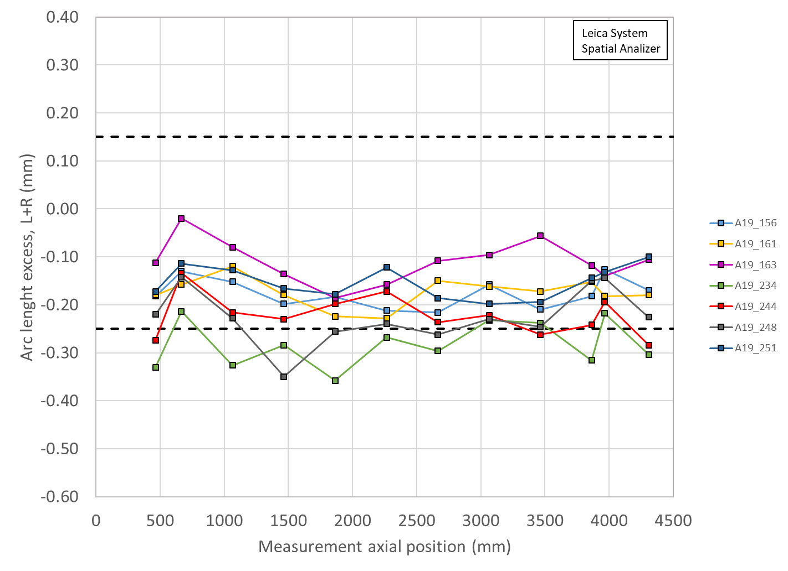
Total Arc Length Excess (Leica)
3965 mm is location of SG:
156 -126 µm (-177 µm avg)
161 -182 µm (-174 µm avg)
163 -140 µm (-110 µm avg)
244 -194 µm (-222 µm avg)
248 -144 µm (-225 µm avg)
251 -132 µm (-153 µm avg)

Slide 5
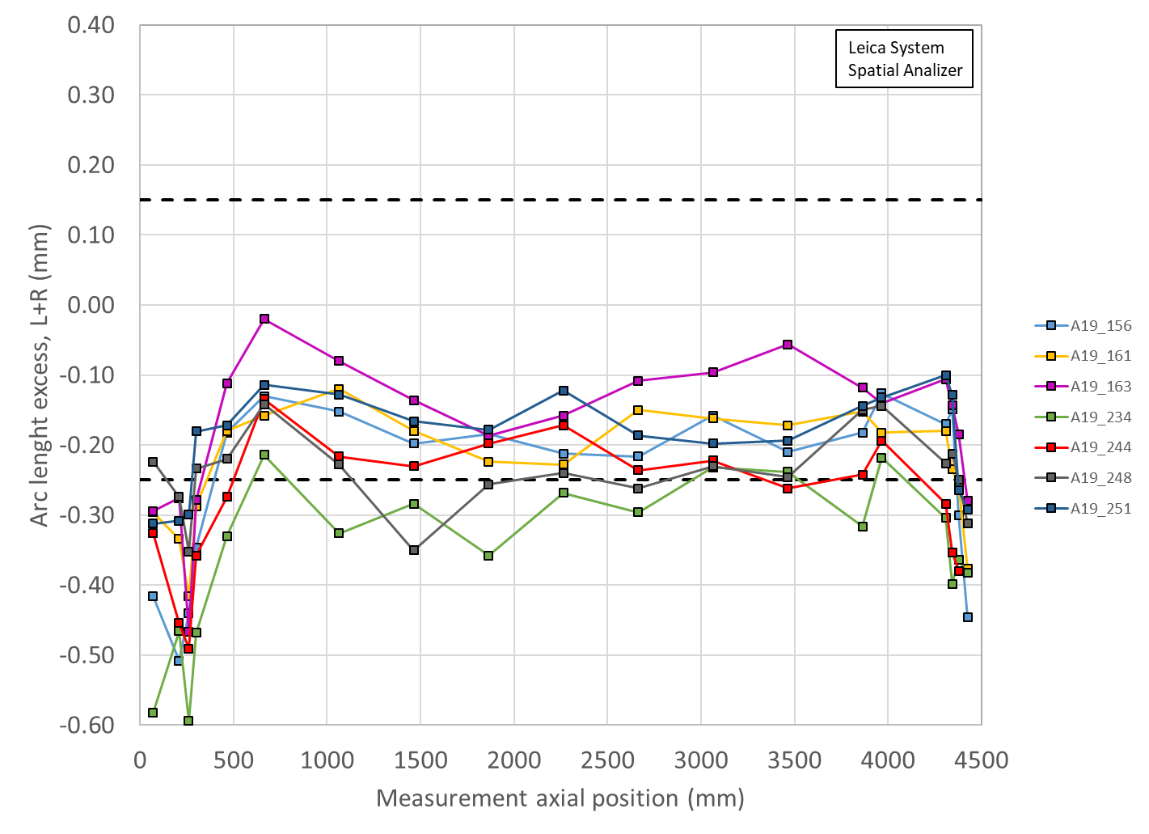
Arc length excess full length

Slide 6
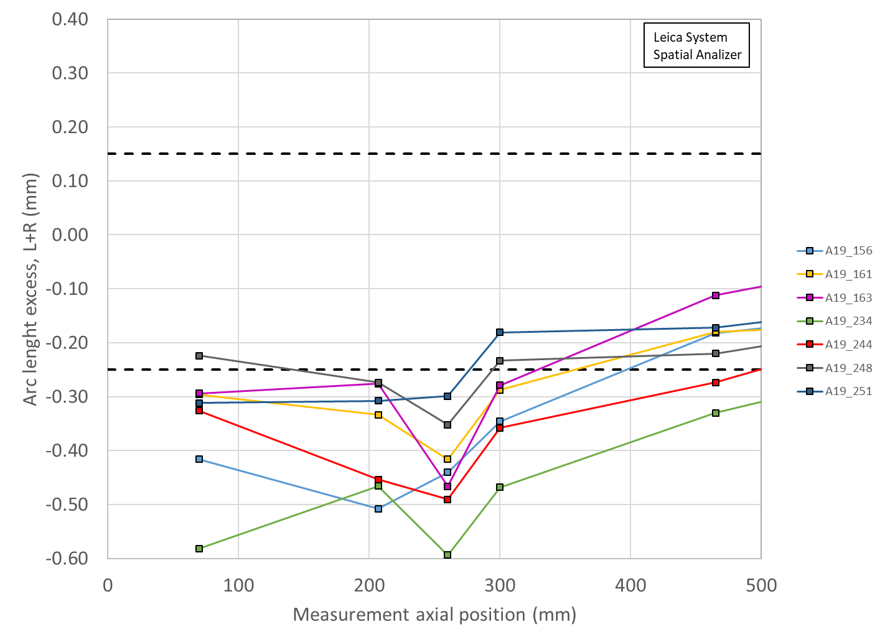
Arc length excess LE

Slide 7
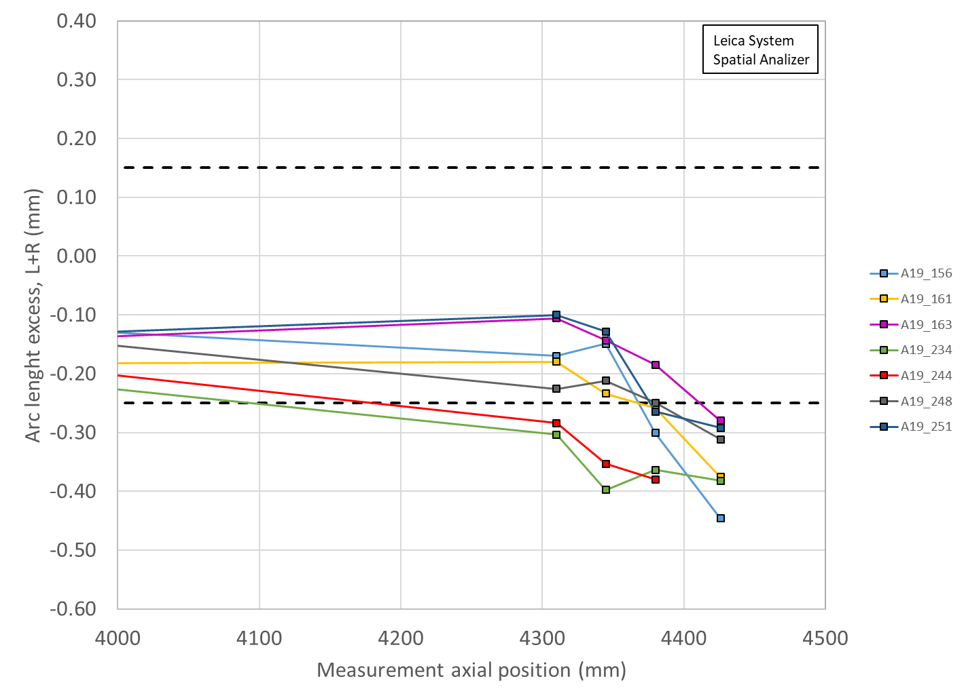
Arc length excess RE

Slide 8
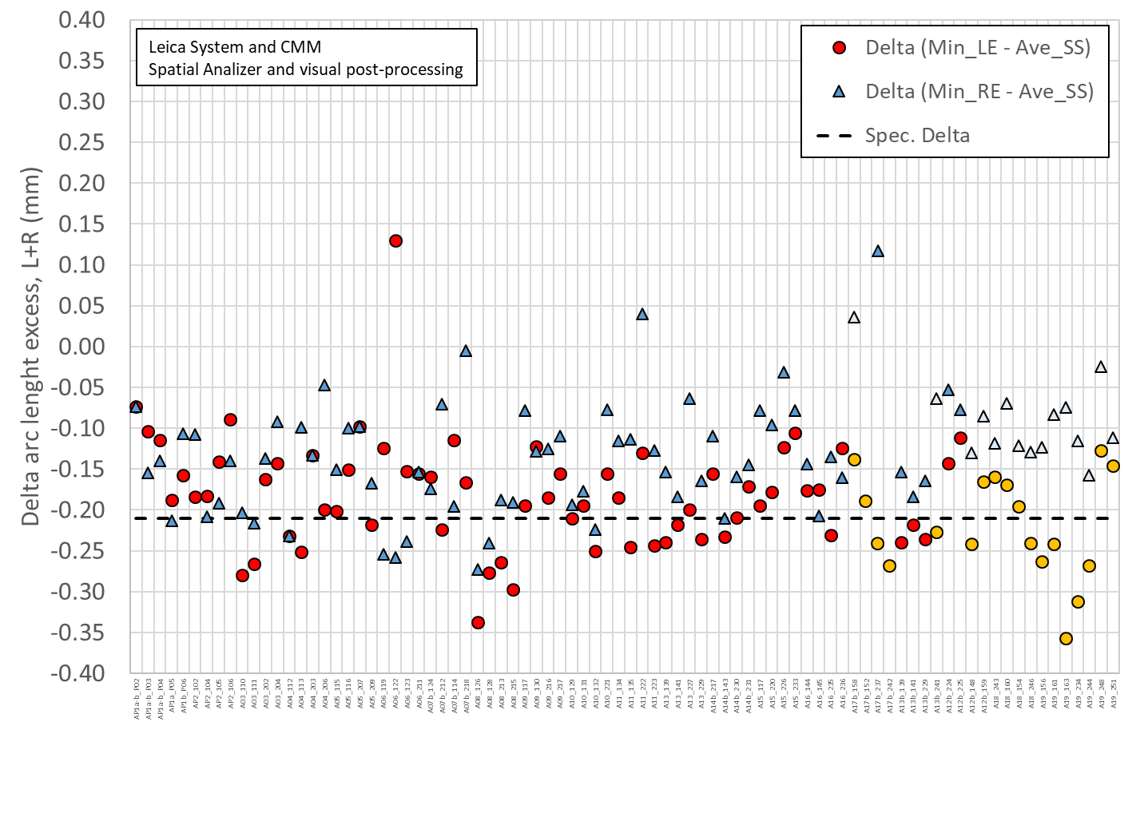
Delta arc length

Slide 9
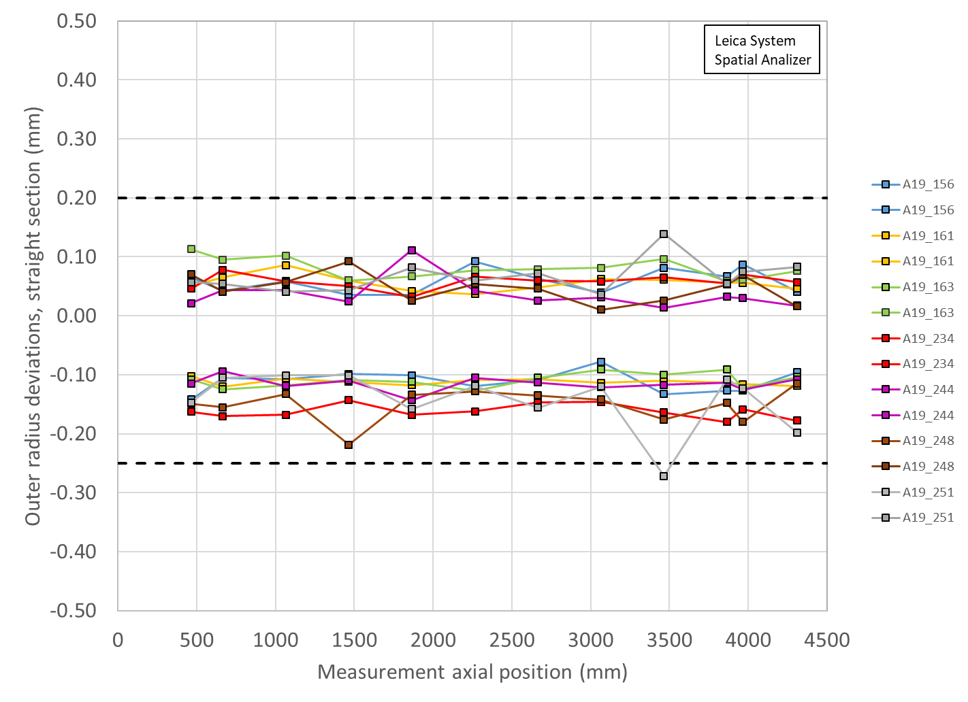
Outer Radius Profile Deviations (Leica)
All Coils within spec
Outer Radius deviation ranges are all similar among the coils

Slide 10
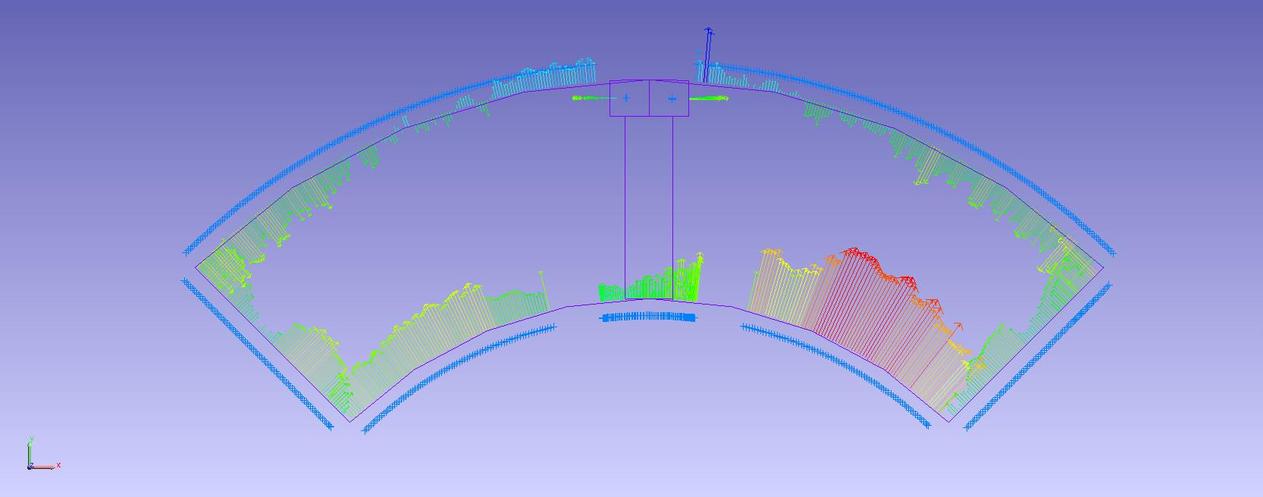
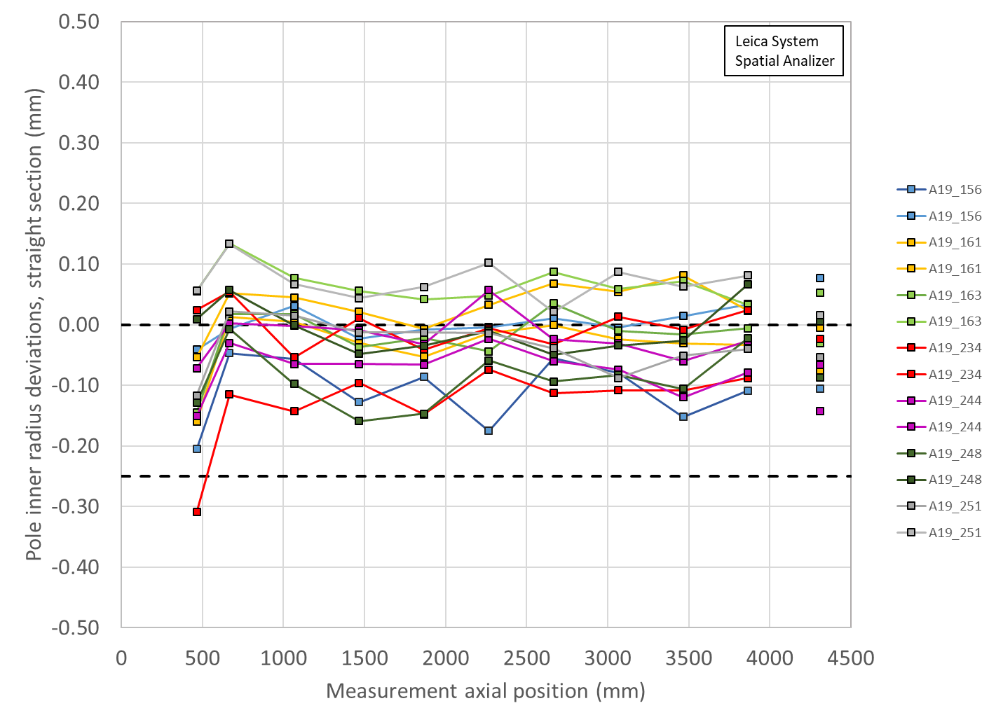
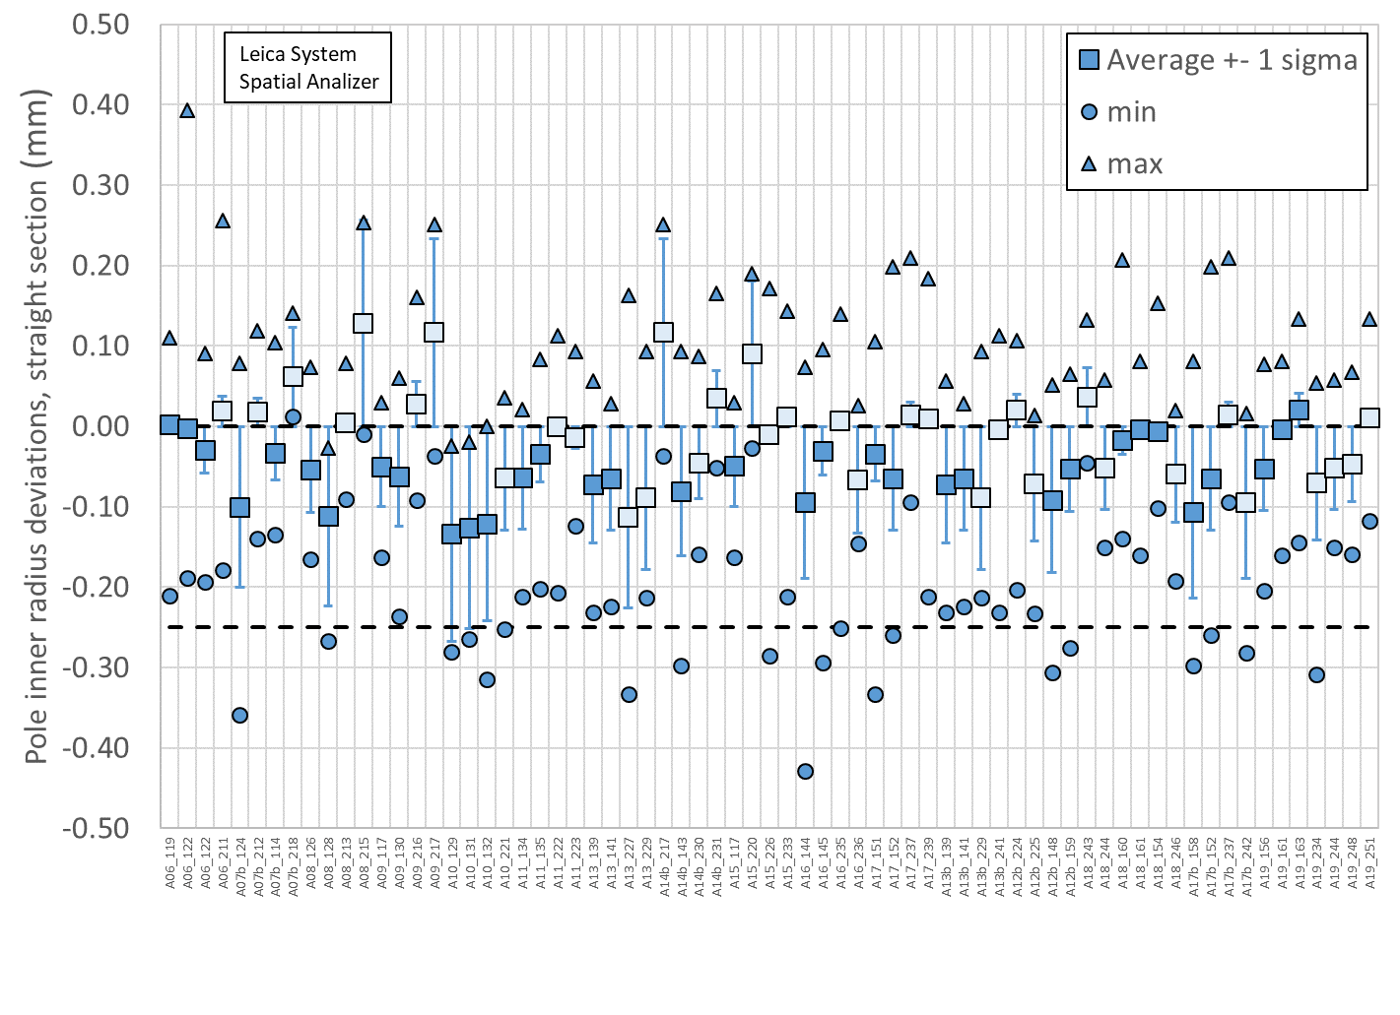
Pole Inner Radius Deviations (Pion Locations)
Inner Radius of the pole key is small (deviation into the bore)

Slide 11
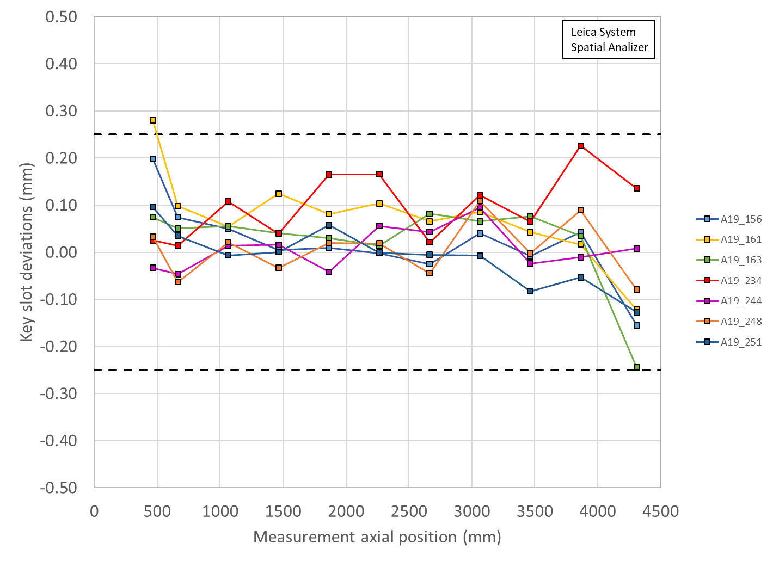
Key Slot Deviations
Single point out of spec

Slide 12
MQXFA19 Coils Matrix
Coil | b6 Corr. | Keyway shift | Avg. Pole Inner R Dev | Avg R Dev. | Avg. Midpl Dev. | Ends Delta Arc Length
156 | Yes | Ok | -54 µm | -32 µm | -88 µm | -264 µm
161 | Yes | Ok | -1 µm | -32 µm | -87 µm | -242 µm
163 | Yes | Ok | 22 µm over | -22 µm | -55 µm | - 357 µm
244 | Yes | Ok | -46 µm | -41 µm | -111 µm | -269 µm
248 | Yes | Ok | -85 µm | -42 µm | -113 µm | -128 µm
251 | Yes | Ok | 14 µm over | -30 µm | -76 µm | -147 µm
OD: all coils are slightly undersized
Midplane: all coils are undersized, will require extra midplane shim
Midplane LE deviations out of spec for most coils
Several coils’ pole inner radii show deviations into the bore; pions will need to be machined in these locations
LBNL measurements are using Leica system data

Slide 13
Acceptable coil ordering (244 spare)
Coils are reported in mechanical order
There are 62 (with coils 248/244) acceptable coil orderings with voltage < 353 V that are common for both rolled and minor edge RRR values (values reported for rolled RRR)
P1 | P2 | P3 | P4 | Volt
244 | 161 | 156 | 251 | 333
244 | 161 | 251 | 156 | 333
248 | 161 | 156 | 251 | 333
248 | 161 | 244 | 251 | 333
248 | 161 | 251 | 156 | 333
248 | 161 | 251 | 244 | 333
156 | 161 | 244 | 251 | 334
156 | 161 | 251 | 244 | 334
156 | 161 | 251 | 248 | 334
244 | 161 | 251 | 248 | 334
244 | 161 | 248 | 251 | 334
248 | 161 | 156 | 244 | 334
248 | 161 | 244 | 156 | 334
156 | 161 | 244 | 248 | 335
156 | 161 | 248 | 244 | 335
156 | 161 | 248 | 251 | 335
244 | 156 | 248 | 161 | 335
244 | 161 | 156 | 248 | 335
244 | 161 | 248 | 156 | 335
244 | 248 | 156 | 161 | 335
156 | 244 | 248 | 161 | 336
P1 | P2 | P3 | P4 | Volt
156 | 248 | 244 | 161 | 336
156 | 248 | 251 | 244 | 336
248 | 156 | 244 | 161 | 337
248 | 244 | 156 | 161 | 337
244 | 248 | 251 | 156 | 338
156 | 244 | 251 | 248 | 339
156 | 251 | 244 | 248 | 340
244 | 248 | 156 | 251 | 341
248 | 244 | 156 | 251 | 341
156 | 248 | 244 | 251 | 342
244 | 156 | 251 | 248 | 342
248 | 156 | 244 | 251 | 342
248 | 244 | 251 | 156 | 342
248 | 251 | 244 | 156 | 342
244 | 251 | 156 | 248 | 343
251 | 156 | 244 | 248 | 343
251 | 244 | 156 | 248 | 343
251 | 248 | 156 | 244 | 343
248 | 156 | 251 | 244 | 343
156 | 251 | 248 | 244 | 344
244 | 251 | 248 | 156 | 344
P1 | P2 | P3 | P4 | Volt
161 | 244 | 248 | 251 | 344
161 | 248 | 244 | 251 | 344
251 | 248 | 244 | 156 | 344
248 | 251 | 156 | 244 | 344
244 | 156 | 248 | 251 | 345
161 | 156 | 248 | 251 | 345
161 | 248 | 156 | 251 | 345
156 | 244 | 248 | 251 | 346
251 | 156 | 248 | 244 | 346
251 | 244 | 248 | 156 | 346
161 | 156 | 244 | 251 | 347
161 | 244 | 156 | 251 | 347
251 | 156 | 244 | 161 | 351
251 | 244 | 156 | 161 | 351
156 | 248 | 251 | 161 | 352
251 | 156 | 248 | 161 | 352
251 | 244 | 248 | 161 | 352
251 | 248 | 156 | 161 | 352
251 | 248 | 244 | 161 | 352
156 | 251 | 248 | 161 | 353
Coils reported in mechanical ordering from CSR
Used opposing quadrants to minimize potential CLIQ effects on Q2/Q4 BNL coils
Delta LE midplane values preferred Coil 244 instead of Coil 248

Slide 14
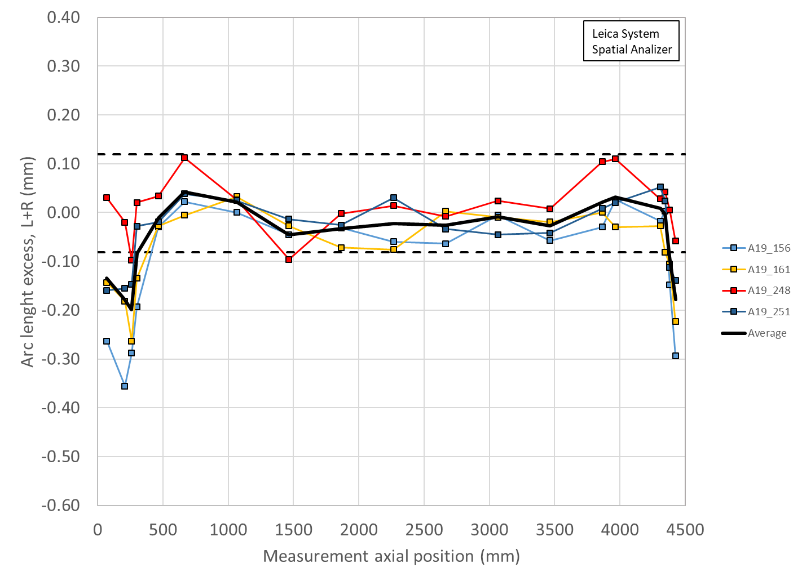
Coil Size estimates with midplane shims
Coil measurement plots created to show the effect of adding shims to both midplanes of Coils 156, 161, 248, 251
Limited by thicknesses of Kapton midplane shim availalble
Shimmed
0.003” on 156
0.003” on 161
0.005” on 248
0.003” on 251
Unshimmed

Slide 15
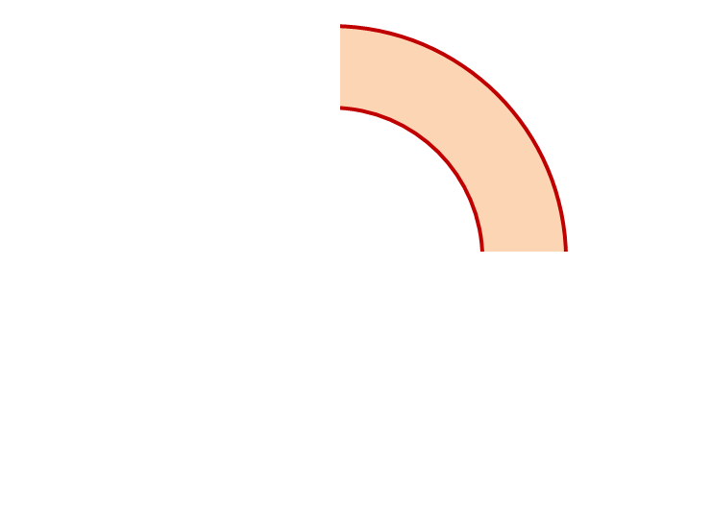
MQXFA19 Proposed Coil Arrangement
8 x δ_{midplane} = 2 π x δR_{OR}
~0.005” Undersized R
neglected
~.0035” Undersized per Midpl.
Add 0.003” shim per side
~0.0015” Undersized R
Neglected
~0.0045” Undersized per Midpl.
Add 0.005” shim per side
161
248
Q2
Q1
Q3
Q4
251
156
~0.001” Undersized R
Neglected
~0.003” Undersized per Midpl.
Add 0.003” shim per side
~.001” Undersized R
Neglected
~0.0035” Undersized per midpl.
Add 0.003” shim per side
Coil Electrical Order: A :248 – 156 – 161 – 251: B
Conforms to a favorable order based on RRR data

Slide 16
MQXFA19 Coil Pack Build 1 (Fuji)
Nominal Collar R: 114 mm
Nominal Coil R: 113.376 mm
Nominal Radial shim = 0.025” (0.624 mm)
  But we still target ~0.020”
Fuji radial stack up is ~0.021” (~0.54 mm)
  0.0045” Coil GPI + 0.007” Fuji + 0.005” Kapton & 0.005” G11
Add Kapton to various midplanes
 | 248 | 161 | 251 | 156
Kapton Ground plane insulation | 0.0045” (0.114 mm)
Coil Specific Radial Shim | 0 | 0 | 0 | 0
Coil-specific midplane shim | 0.005” 0.125 mm | 0.003” 0.075 mm | 0.003” 0.075 mm | 0.003” 0.075 mm
Fuji paper | 0.007” (0.175 mm)
Radial Shim | 0.005” Polyimide + 0.005” G11 (~0.25 mm)

Slide 17
MQXFA19 Coil Pack Build (Final)
Nominal Collar R: 114 mm
Nominal Coil R: 113.376 mm
Nominal Radial shim = 0.025” (0.624 mm)
  But we still target ~0.020”
Actual radial stack up is ~0.020” (~0.51 mm)
  0.0045” Coil GPI + 0.005” Kapton + 0.005” Kapton & 0.005” G11
Add Kapton to various midplanes
 | 248 | 161 | 251 | 156
Kapton Ground plane insulation | 0.0045” (0.114 mm)
Coil Specific Radial Shim | 0 | 0 | 0 | 0
Coil-specific midplane shim | 0.005” 0.125 mm | 0.003” 0.075 mm | 0.003” 0.075 mm | 0.003” 0.075 mm
Fuji paper | 0.000” (0.0 mm)
Radial Shim | 0.005” Polyimide + 0.005” Polyimide + 0.005” G11 (~0.38 mm)

Slide 18
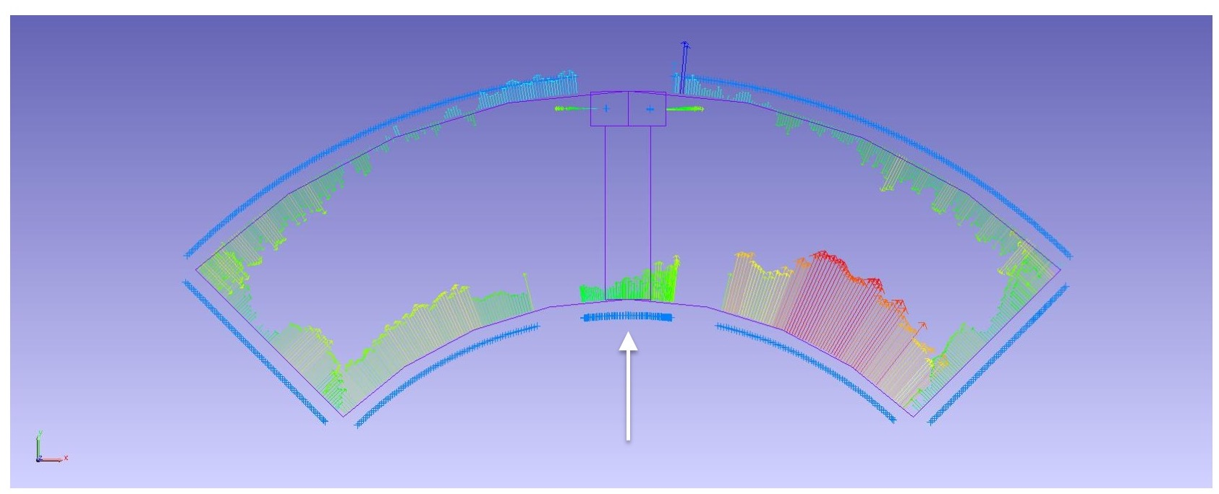
Pion Machining, Details
Used “average” values as starting point
  Measurements based on best-fit of combined Outer Radius and Midplane deviations
Positive deviations = extra material in bore
  This is what needs to be removed from a nominal 1.2 mm thick pion
Negative deviations will not require “addition” of material
  Nothing will be done to these pions
For MQXFA19 many pions need to be modified

Slide 19
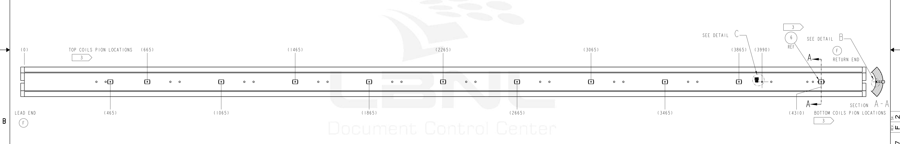
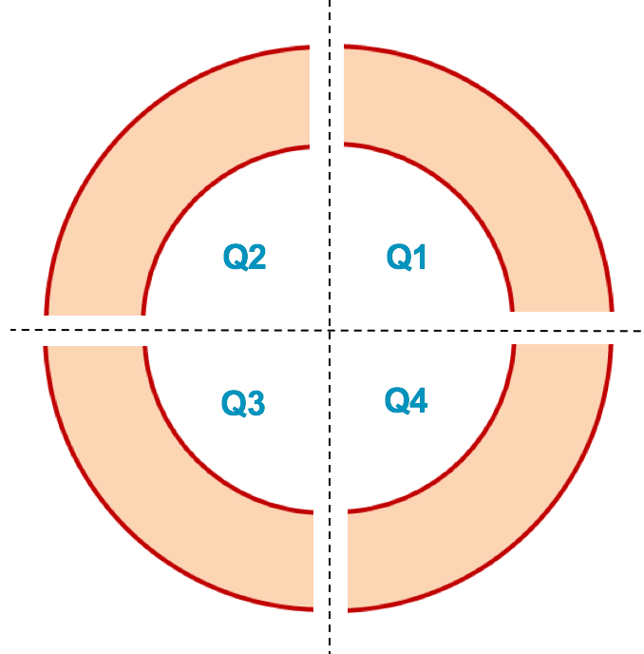
MQXFA19 Pion Machining Positions
Upper Coils, Pion thickness (mm)
Loc. | 665 | 1465 | 2265 | 3065 | 3865
248 | 1.14 | 1.2 | 1.2 | 1.2 | 1.11
161 | 1.15 | 1.17 | 1.16 | 1.13 | 1.17
1.00
1.05
Lower Coils, Pion thickness (mm)
1.10
1.15
Loc. | 465 | 1065 | 1865 | 2665 | 3465 | 4310
251 | 1.15 | 1.12 | 1.12 | 1.18 | 1.12 | 1.18
156 | 1.2 | 1.16 | 1.2 | 1.19 | 1.18 | 1.12
Upper Coils
Upper Coils
161 248
Lower Coils
Lower Coils
251 156

Slide 20
Summary
Coils 156, 161, 248, 251 chosen for the MQXFA19 magnet
  Midplane shimming determined to be added:
    Coil 248 will have 0.005” per side added
    Coil 161 will have 0.003” per side added
    Coil 251 will have 0.003” per side added
    Coil 156 will have 0.003” per side added
  Coil 248, 161 will be upper coils
    Most coils will require a number of Pions to be machined, even for the lower coils
Coil circuit order is 248-156-161-251
  Conforms to a favorable order based on RRR data

Slide 21
Additional Slides

