Slide 1
MQXFA19 Structure & Shim Review Introduction & Charge
Giorgio Ambrosio
Magnets L2
U.S. HL-LHC Accelerator Upgrade Project
MQXFA19 Structure & Shim Review
November 20, 2024

Slide 2
Committee
Peter Wanderer, chairperson (BNL)
Rodger Bossert (FNAL)
Helene Felice (CEA-Saclay)
Susana Izquierdo Bermudez (CERN)
Date and Time
November 20, 2024. Start time is 7/9/10/16 (LBNL/FNAL/BNL/CERN,CEA)
Location/Connection
Video-link by Zoom, info by email.
Link to agenda with talks and other documents
MQXFA19 Structure & Shims Review (November 20, 2024) · INDICO-FNAL (Indico)

Slide 3
Review Goals
The HL-LHC AUP project is starting the assembly of MQXFA19 quadrupole magnet. If MQXFA19 meets MQXFA requirements [1] it will be used in a Q1/Q3 cryo-assembly to be installed in the HL-LHC.
MQXFA19 coils were presented and approved at the MQXFA19 Coil Acceptance Review [2].
Discrepancy or Non-Conformity Reports are generated whenever a component does not meet specifications [3-4].
The goal of this review is to evaluate MQXFA19 structure and the proposed shim plan including tapered load shims.

Slide 4
CHARGE Questions
The committee is requested to answer the following questions:
Have all recommendations from previous reviews [5] been adequately addressed?
Have discrepancies and non-conformities been adequately documented and processed?
If there are major/critical non-conformities, have they been adequately documented and processed?
Are the proposed shims adequate for allowing MQXFA19 to meet MQXFA requirements [1]?
Do you have any other comment or recommendation to assure MQXFA19 is going to meet requirements?

Slide 5
Major/Critical DR/NCR:
Critical nonconformance: a nonconformance which meets at least one of the following:
affects form, fit, or function in the as-found condition
involves damage, or suspected damage, to the coil conductor
is likely to trigger yellow or red schedule or cost variance reporting thresholds
meets the requirements of “Moderate” or higher per the CERN Impact Matrix (for collaborations) in EDMS 1863763
Handling of Discrepancies and Nonconformances
US-HiLumi-doc-2484

Slide 6
References
MQXFA Functional Requirements Specification, US-HiLumi-doc-36.
MQXFA19 Coils Acceptance Review, US-HiLumi-doc-5354.
MQXFA Series Magnet Production Specification, US-HiLumi-doc-4009.
Handling of Discrepancies and Nonconformances, US-HiLumi-doc-2484.
MQXFA17b Structure and Shims Review, US-HiLumi-doc-5349.

Slide 7
Traveler Upload Status
Update by Jamie.

Slide 8
MQXFA17b Review Recommendations
Proceed with the assembly of MQXFA17b.
MQXFA17b assembly is in progress and preloading will be done soon.

Slide 9
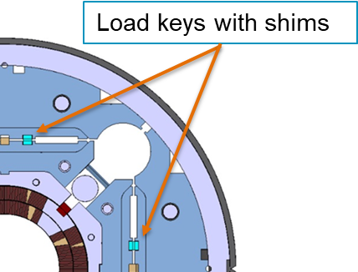
MQXFA17b Review Comment
Consider starting with 0.050 mm shims instead of 0.100 mm shims.
We try to minimize the number of loading steps at high pressure, to minimize risk of bladder failures at bladder high pressure.
0.050 mm shims were installed in MQXFA12b and MQXFA16
+ 100 μm + 0 μm
Tapered load shims in Lead End

Slide 10
Schedule
Today:
Talks
Q&A
Following days:
Closed session(s)
Possibly Q&A by email
Report by email or Zoom mtg in ~2 weeks

