Slide 1
Project Activities for MSD
Mayling Wong-Squires
AD Operations Friday 9am Meeting
1 November 2024

Slide 2
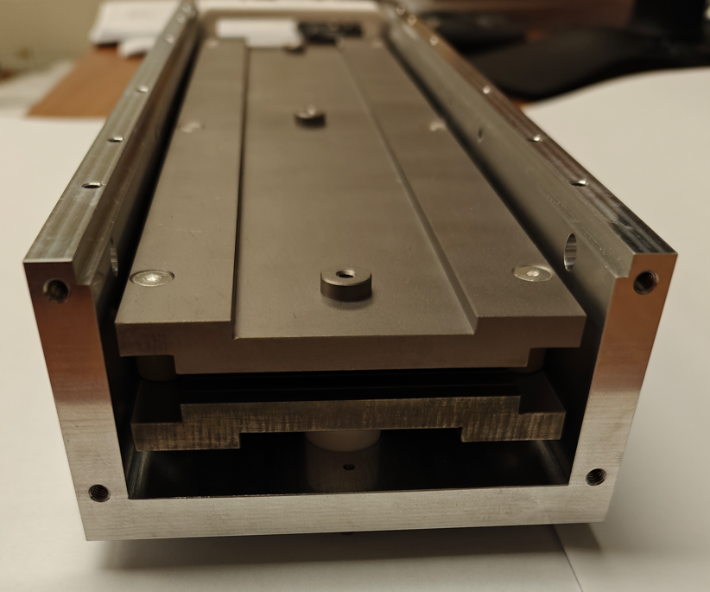
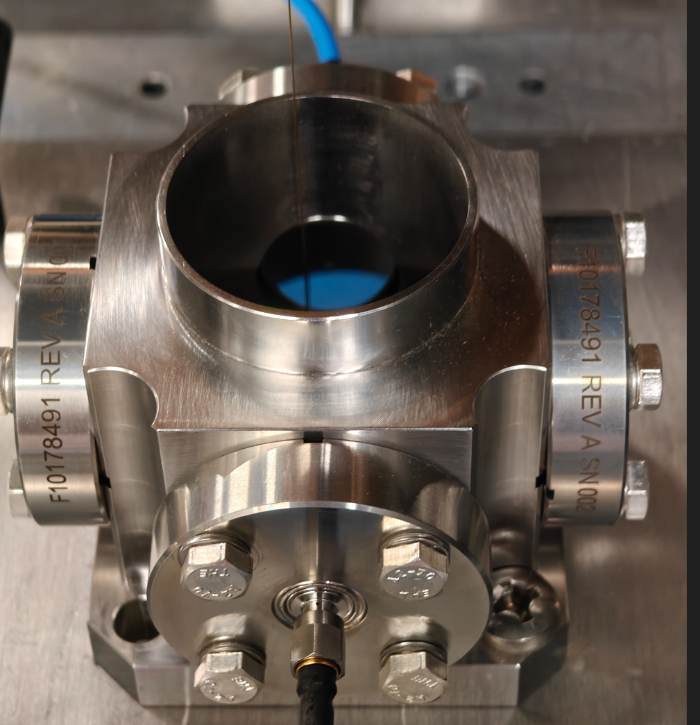
PIP-II Instrumentation Update Dakota Krokosz, Amadon Faul (Instrumentation)
Wirescanners
MEBT Wirescanner assembly - awaiting delivery of actuators from vendor.
Will proceed with lower quality MEBT frames until a replacement vendor is found.
SOW for BTL and diagnostic cart linear actuators submitted to procurement for bidding.
Emittance Scanners
Fabricated / Machined parts are past due from vendors.
LEBT construction delayed due to lack of parts.
Actuators have arrived. Currently installing connectors for motion controls.
Dry assembly of the MEBT AES has begun.
Diagnostic Cart
Procurement in progress.
BPM’s
Mechanical development for the split plane design is delayed.
Received re-work of the prototype buttons from SST. Will need to test and inspect.
Testing of the warm BPM prototype has begun on test stand.
Laserwire
Started quoting of magnet design.
SOW for vacuum chamber submitted for bidding.
Drawings for first unit stand have been completed. Procurement to begin.
HV Sawtooth Plates
Macor Standoffs
MEBT Emittance Scanner
Thin Wire
Pickup
2” BPM Assembly on Test Stand

Slide 3
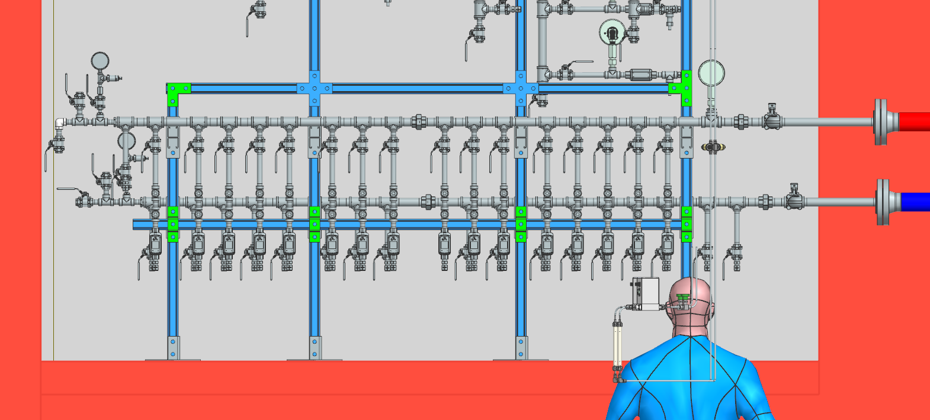
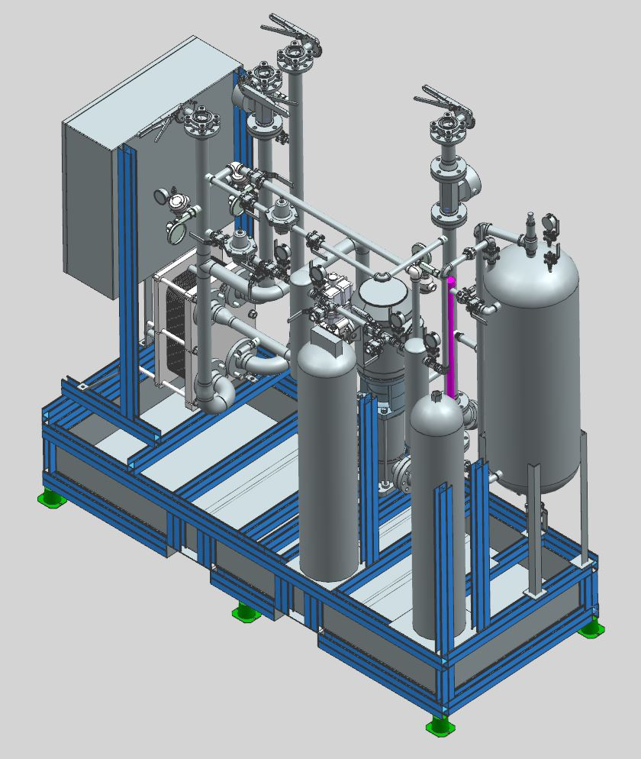
PIP-II Fluid Systems Update Maurice Ball, Michael Geelhoed, Michael Hanson, Jason Grischkat, Monika Sadowski, Frank Rios, Amos Horton
Process Clean Water (PCW) Pump Room Piping System Installation
Installation contract underway
Change order submitted
Updating pipes to bridge connection
Heat exchanger modification
Expansion Tank interference
Procurement for Warm Front End
Ion Source & LEBT LCW Manifolds out for bid
RFQ LCW intermediate skid out for bid soon
Creating to Statement of Work Documents for Linac Installation
UPB Design change
Ion Source and LEBT LCW Manifolds
RFQ LCW Intermediate Skid

Slide 4
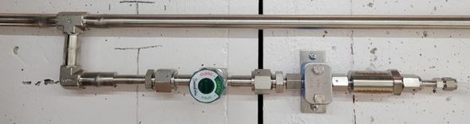
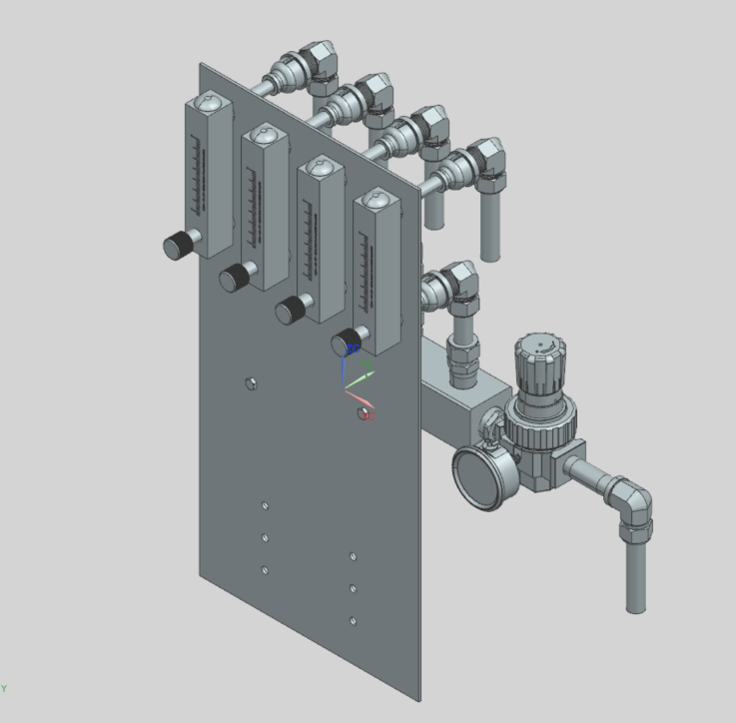
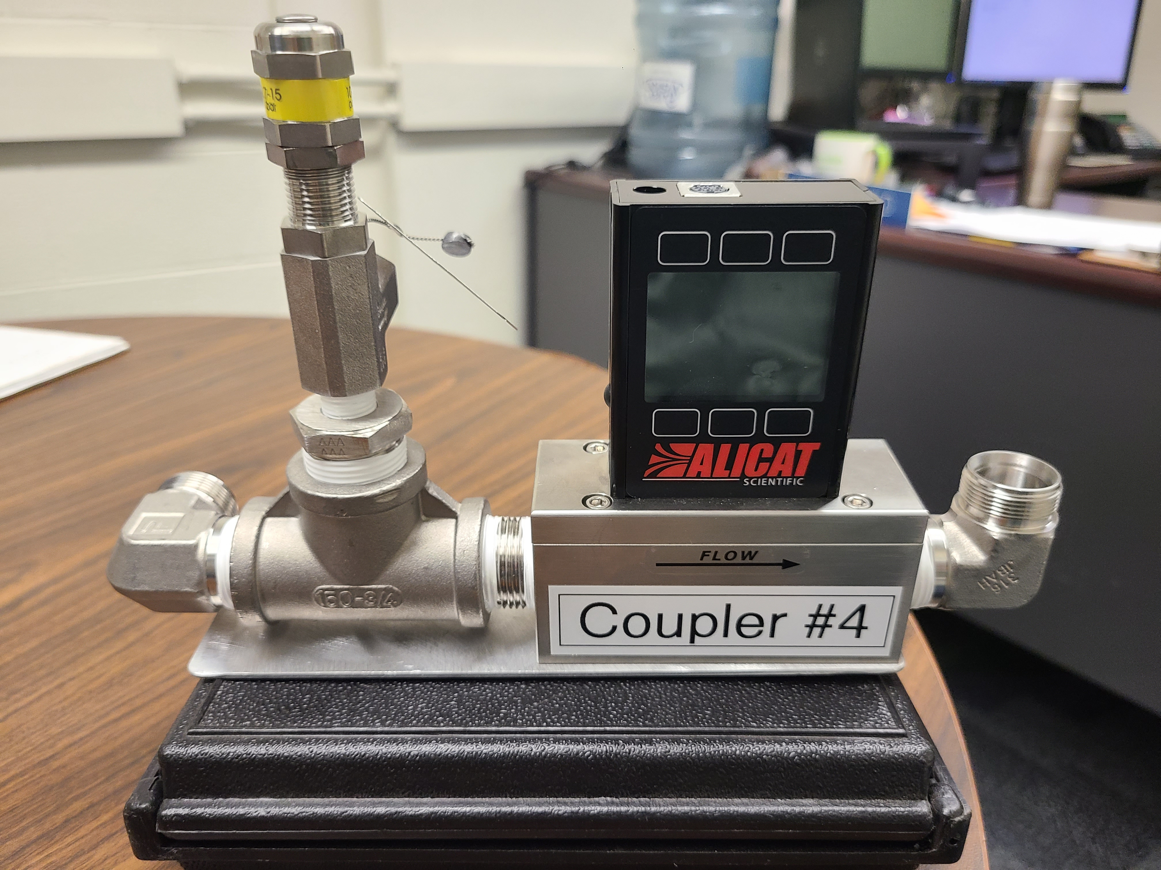
PIP-II Fluids Update (cont’d)
Compressed air cryomodule manifold
Components delivered
Assembly underway using AD/MSD techs
Utility Nitrogen Gas System pipe route design underway
Compressed air distribution manifolds for SRF cryomodule couplers
Components delivered
Assembly underway using AD/MSD techs
Utility Nitrogen Gas System with Ultrahigh-purity pipe fitting specification and installation
Compressed air distribution manifold for SRF cryomodule couplers
Instrumentation for Compressed air distribution to individual SRF cryomodule couplers

