Slide 1
Magnetic Forces
And Fringe field Updates
Marco Oriunno, Nov, 8 2024

Slide 3
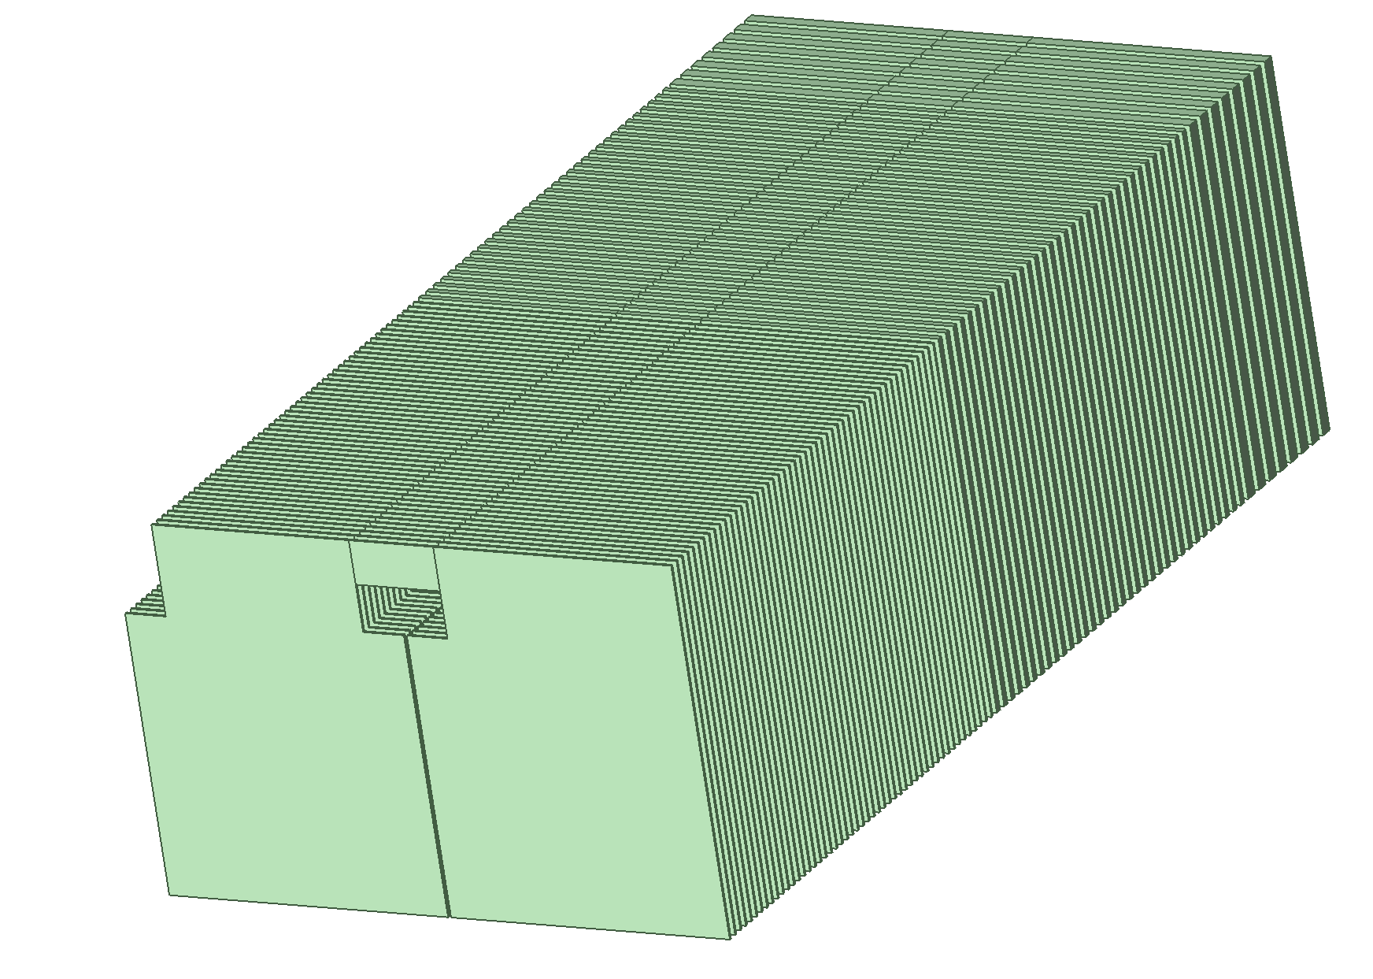
Y_axis
200 gauss

Slide 4
X_axis
200 gauss

Slide 5
Z_axis
200 gauss

Slide 6
Isolines – 500 gauss max
500 gauss

Slide 7
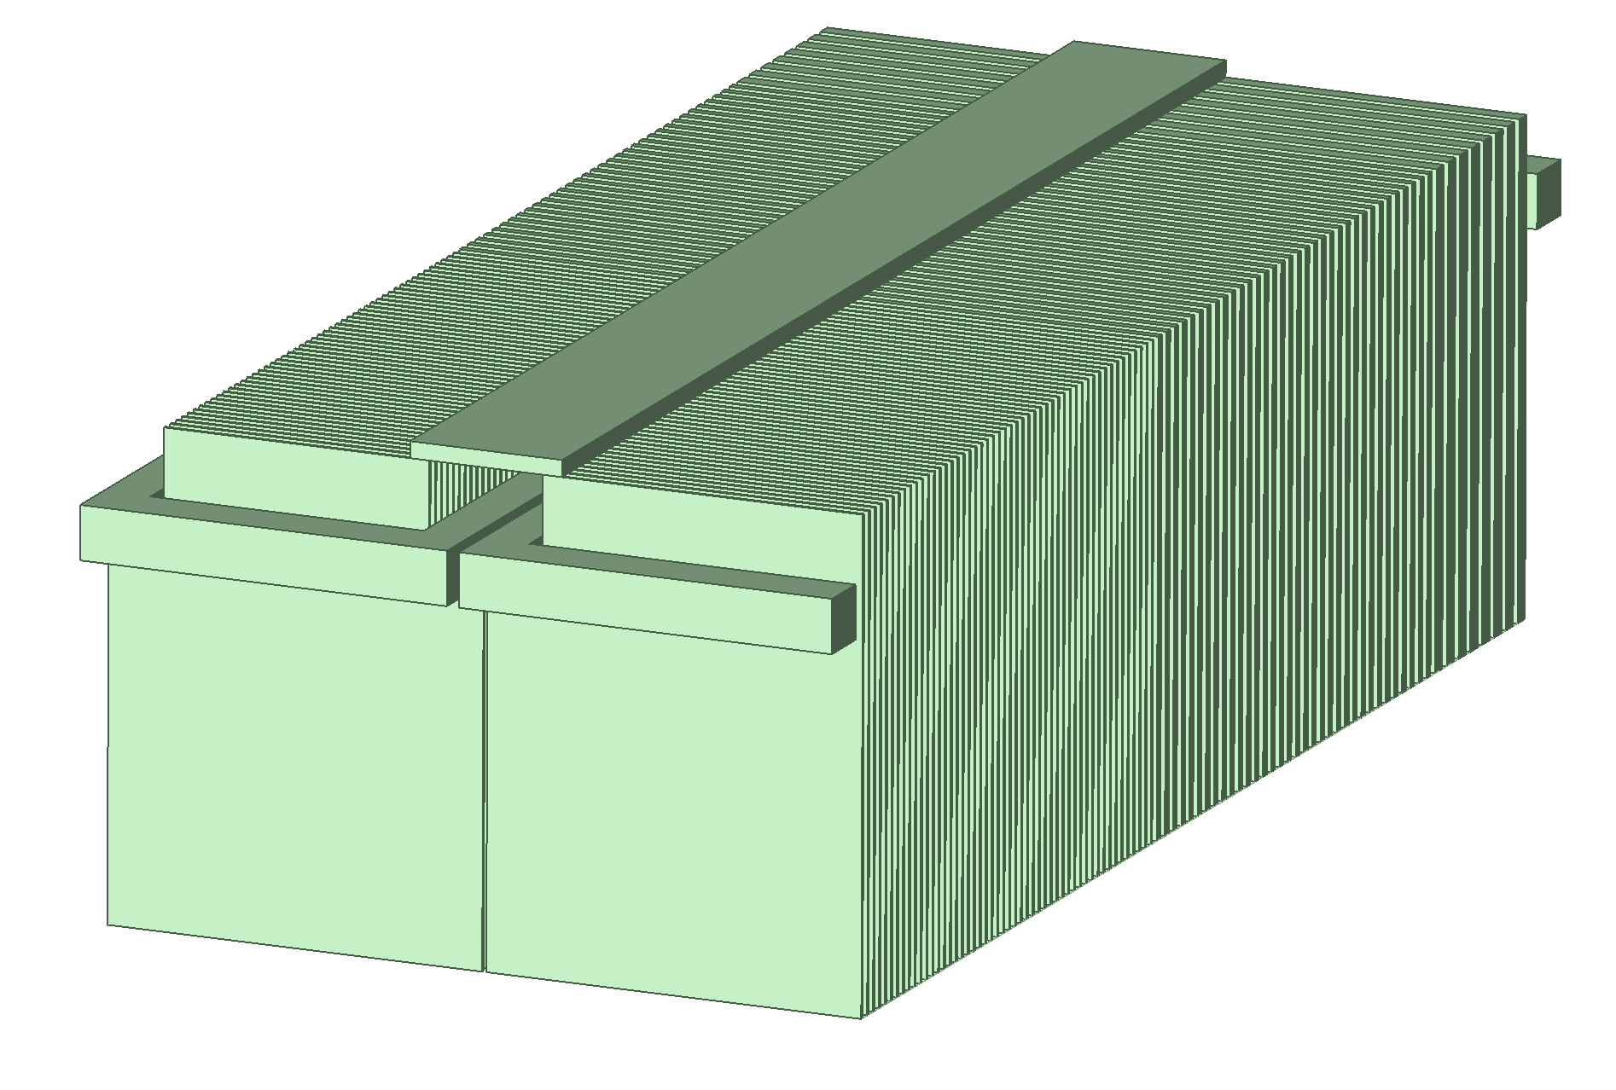
Isolines – 500 gauss max
500 gauss

Slide 8
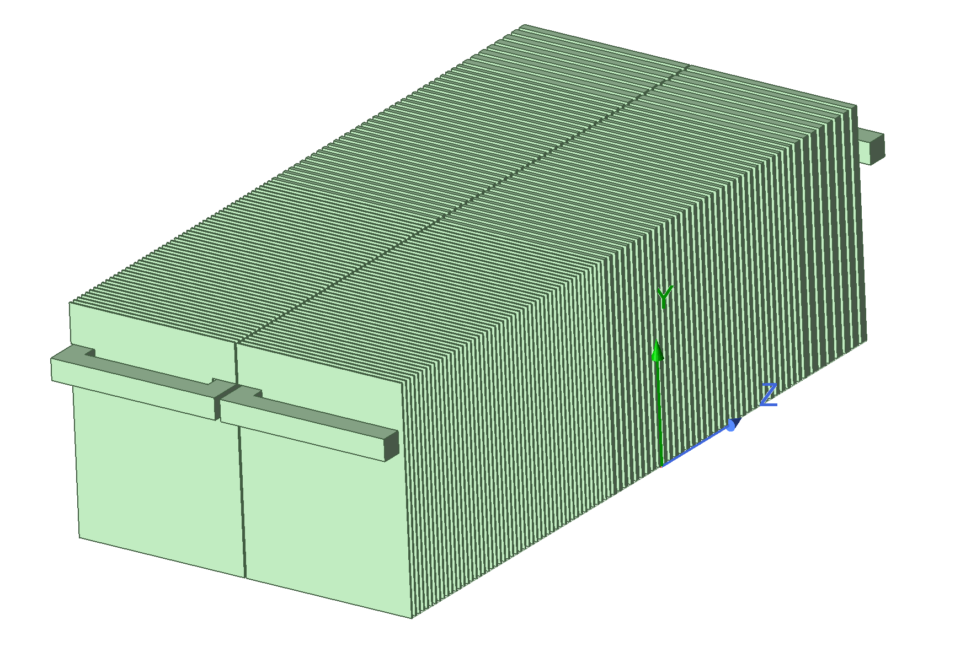
Isolines – 1000 gauss max
1000 gauss

Slide 9
Magnetic Forces

Slide 10
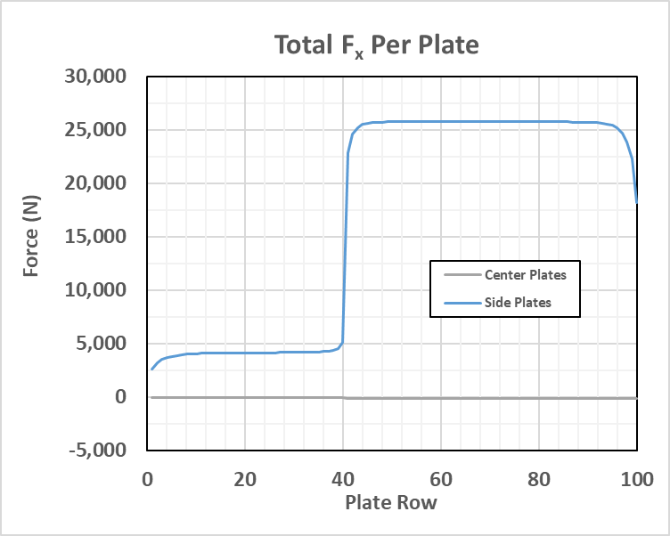
CDR – Horizontal Forces
Marco’s model - Maxwell
Argonne - Maxwell

Slide 11
PDR 50/34/8

Slide 12
PDR 50/34/8

Slide 13
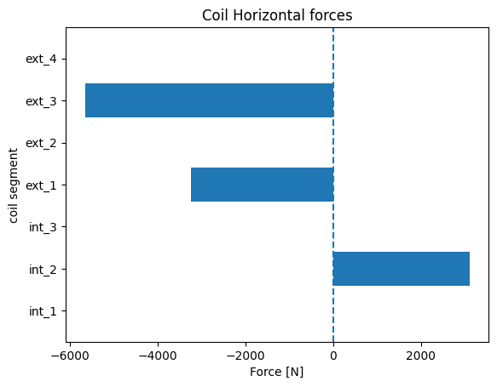
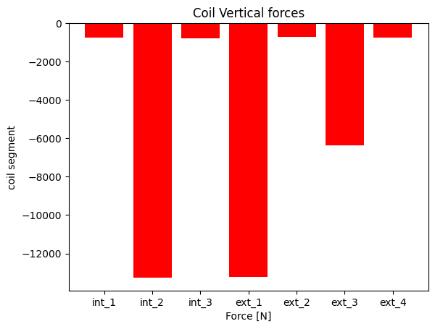
Coils
4
3
3
1
2
2
1

