Slide 1
302.4.01 Magnets Vertical Test at BNL Weekly Status
Febin Kurian
4-Nov-2024

Slide 2
MQXFA18-Training Summary
Spontaneous quench test program at 1.9K; Ramp to 16530 A
(Q1= Coil 160, Q2=Coil 246, Q3=Coil 243, Q4= Coil 154)

Slide 3
MQXFA13b-Quench Location Summary

Slide 4
MQXFA18 – Remaining
Magnet is warmed up
Expected to be taken out of dewar and disconnected by tomorrow
Outgoing warm outgoing measurements

Slide 5
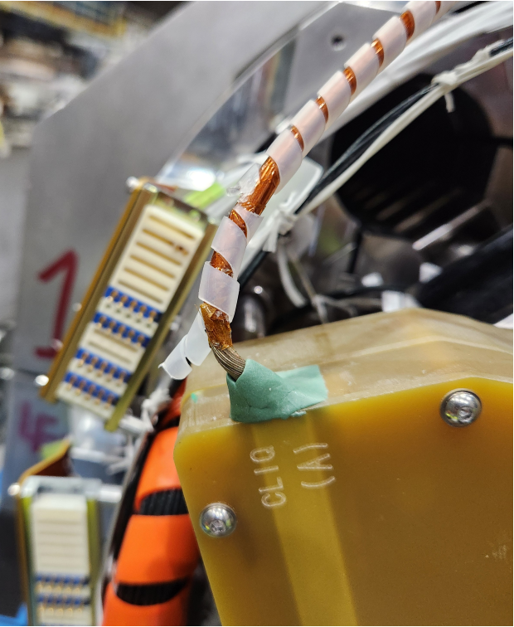
Next Magnet - MQXFA12b
Magnet is under incoming-inspections
Expected to finish all horizontal tests today
Expected to be moved to dewar on Tuesday (11/12/24)
HiPot Failure:
Coil to magnet shell (shell grounded) : Passed (3.680 kV)
Quench Heaters (All) to shell(shell grounded): Arc fail (at 1.59 kV)
Quench heaters(1-4) to shell (shell grounded): passed (3.680kV)
Quench heaters(1-4) to Coil (shell grounded): Arc fail (at 0.94kV)
After repairing the insulation CLIQ lead, hipot again
Quench heaters(1-4) to Coil (shell grounded): Arc fail (at 0.78kV)

Slide 6
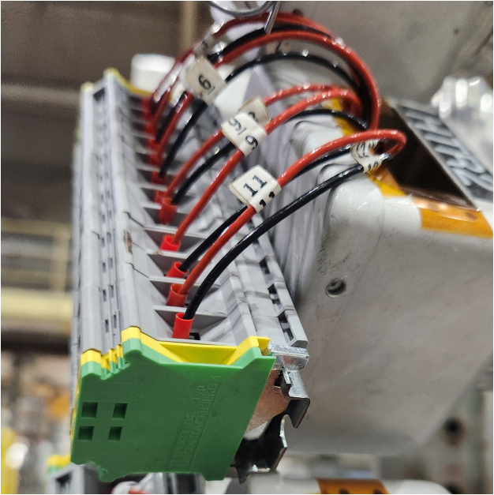
Second Top Hat Repair
Heaters: All Passed Hi Pot
V-taps: Undergoing pin-by-pin hipot
Did not pass hipot in the past: VT3, VT4,VT5
Passed Hipot: VT1, VT2, VT6

Slide 7
CRYOGENIC STATUS
CTI 4000 system status
Running
Linde 1610 system status
Running

