Slide 1
Repair of QXFA 127 Heater to Coil Short
F. Nobrega, S. Krave
AUP Coil WG
13 January 2021
27 January 2021 UPDATE

Slide 2
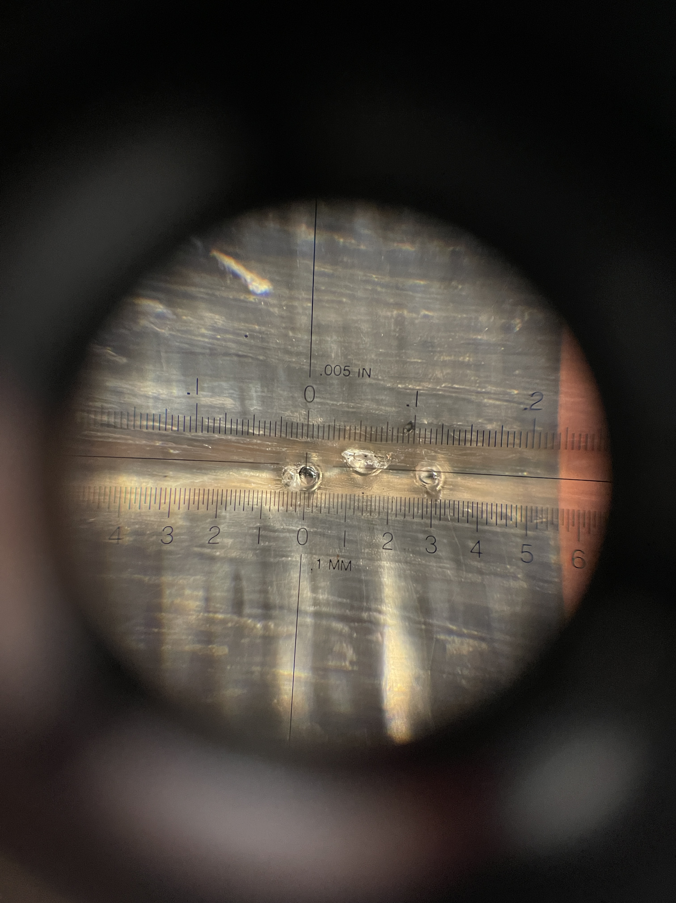
Background:
After impregnation, A short between the heater and coil was detected. (0.4Ω)
Initial investigations found small glass beads present on the coil OD
Beads formed by laser cutting of fiberglass
Likely knocked off glass during handling/rolling of tooling before final tightening.
Sine localization was performed by canned air method, but erratic capacitance (or other effects) led to many false indicators

Slide 3
Short Localization: Resistance Methods
An electrical model of the system was created.
The short resistance exists between two other resistor pairs, representing both halves of the coil and heater.
Since the short resistance is low, any resistance value can be determined with high precision in this configuration

Slide 4
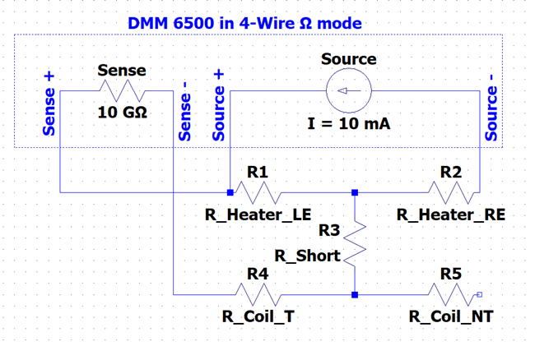
Heater resistance as a function of distance
Since the heater consists of a series of Copper plated and bare stainless elements, the resistance per unit length is not constant.
Resistance as a function of length can be determined by material properties. Theoretical values yield slightly different results, so the copper plating thickness was varied to match the measured heater resistance
The voltage drop at the location of the short can be measured and correlated to the distance from heater LE with reasonably high precision, depending on if the short was in the copper or heating station
1.4 mΩ/m for the copper clad vs 121 mΩ/m for the stainless heater station
Resistance to short was 0.504Ω, corresponding to 1308mm from LE

Slide 5
Glass Beads at 1304-1306 mm from LE
Above measurement indicated are to the right of beads but this area responded somewhat to touch and has obvious damage from the beads

Slide 6
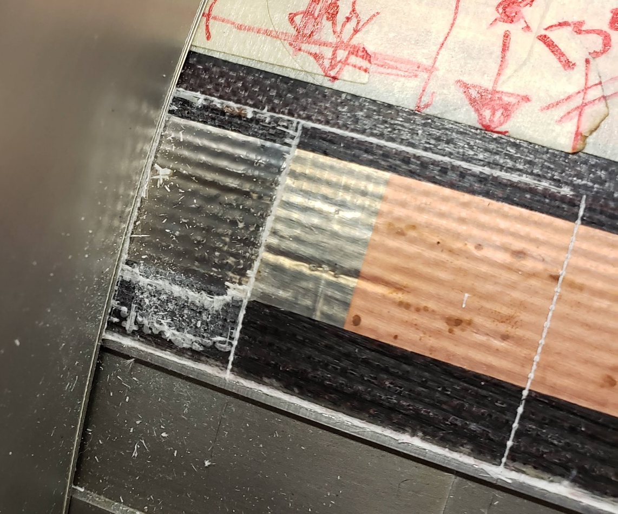
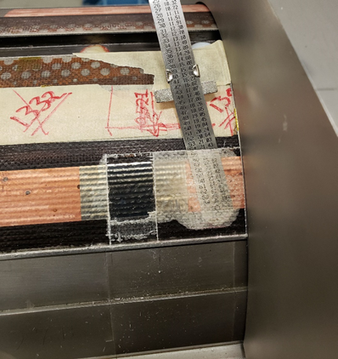
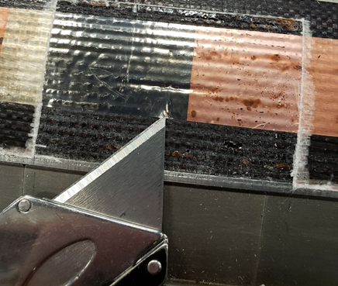
Plan for Removal
From experience working on other coil autopsies, confidence has been gained in safe separation of heaters from coil. A decision was made to excavate the area and add additional Kapton underneath the heater. The steps are as follows
Mark out area of repair. Cut over wedge where possible to minimize risk to coil
Cut and remove fiberglass from coil OD
Gently lift heater in area of interest and install Kapton
Build back area in suitable fashion and return coil to production

Slide 7
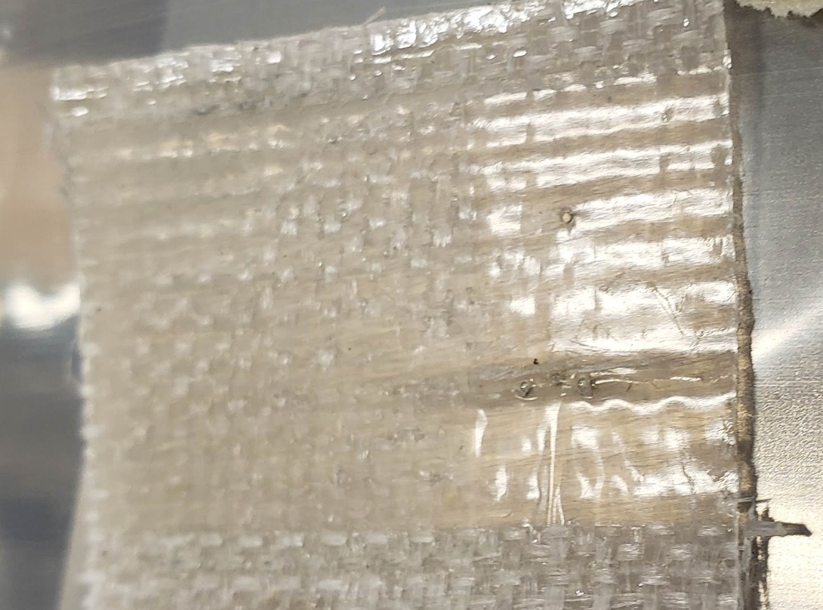
Lifted Heater
25mm of heater was separated from the coil the glass beads left some holes in the initially identified location
The Multimeter was on during the operation and no major change in resistance was noted
=[

Slide 8
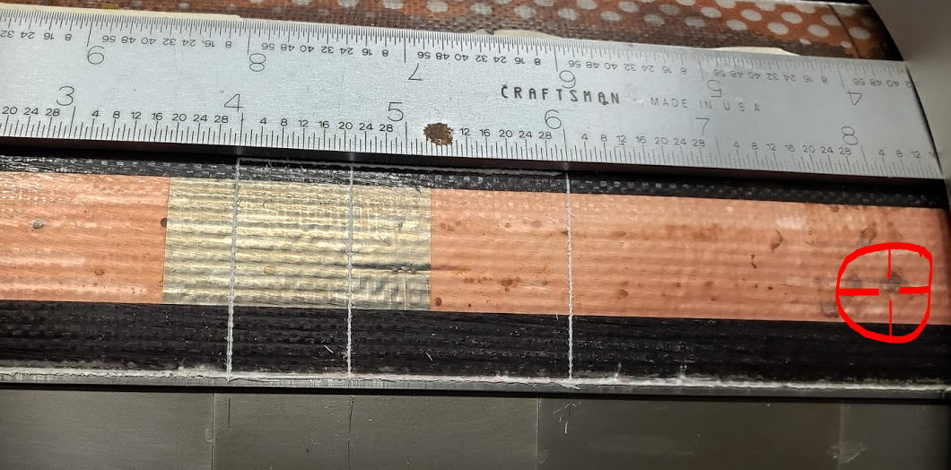
New Area
A new area was identified, it exhibited the following indications that a short was present:
Very close to the electrical measurement determination, similar error in positioning from low copper resistance value
Responded to touch
Glass bead present
Responded to canned air (Freeze Spray)
Note other location only exhibited the 1st three symptoms

Slide 9
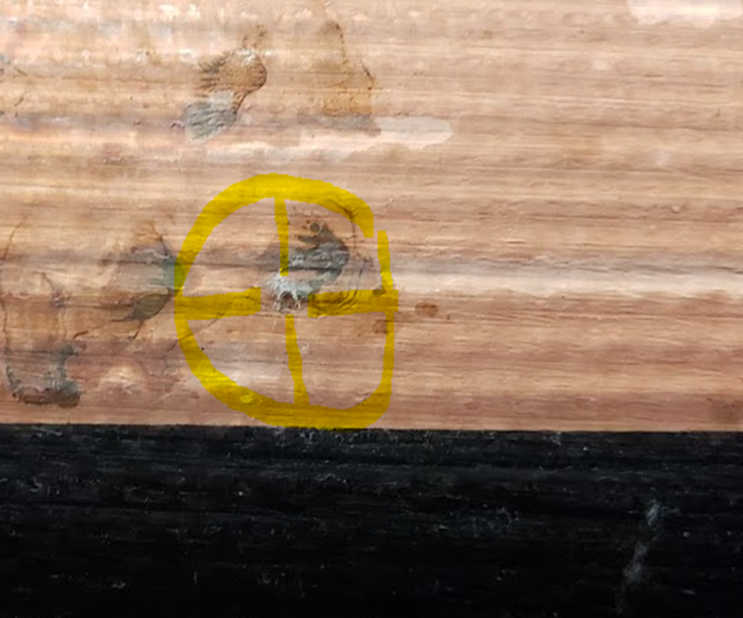
Short resistance behavior during cooling by canned air/freeze spray. Note sharp decrease in resistance when air is applied followed by exponential response as the location warmed back to equilibrium. The decrease in resistance indicates metallic components dominate the short behavior in this location, as they exhibit a positive temperature coefficient of resistance.
Closeup of short

Slide 10
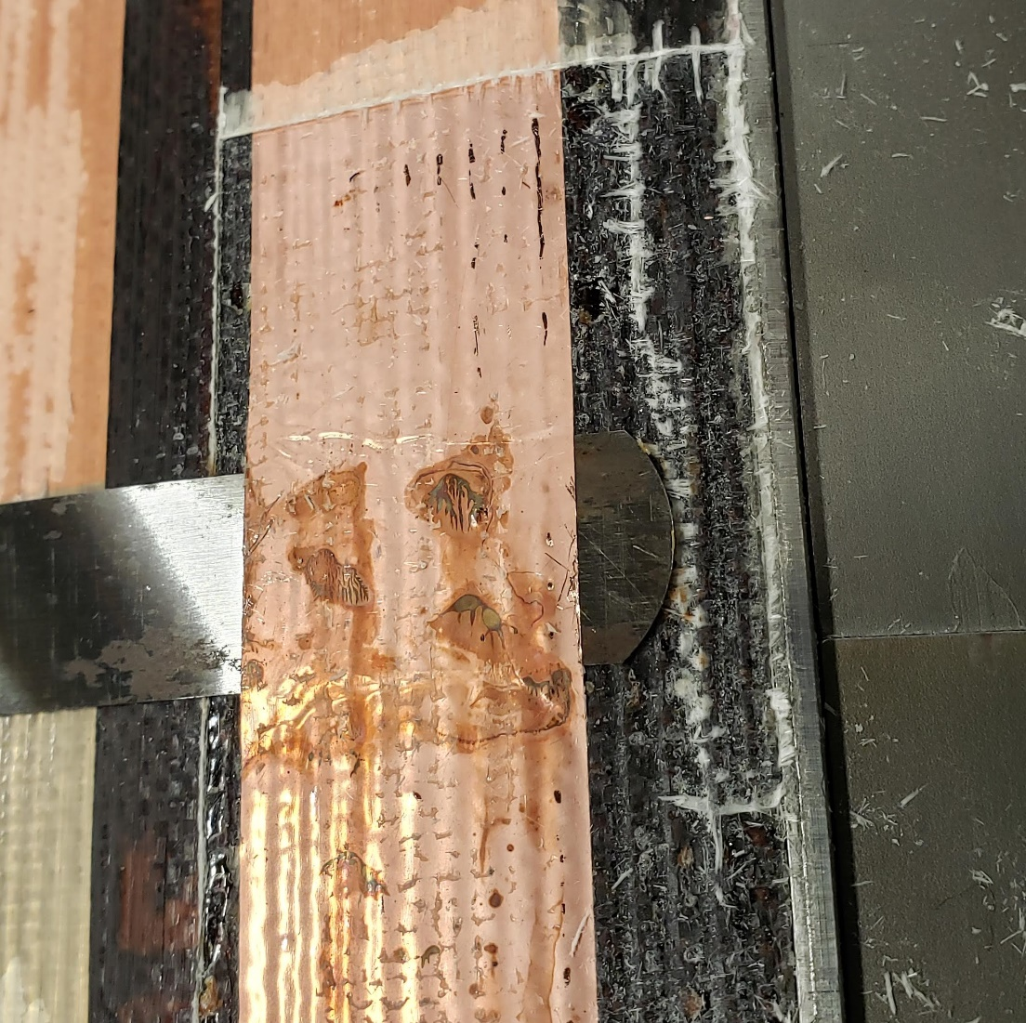
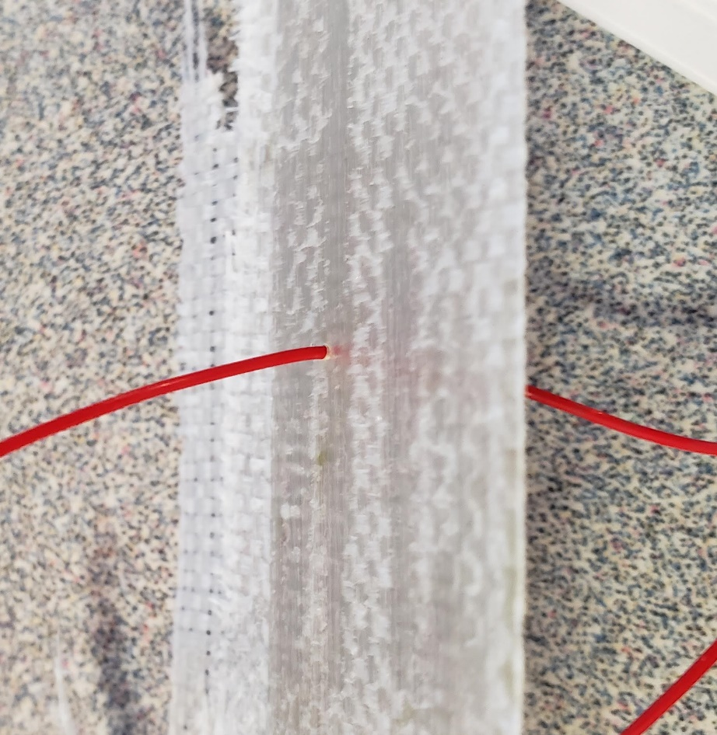
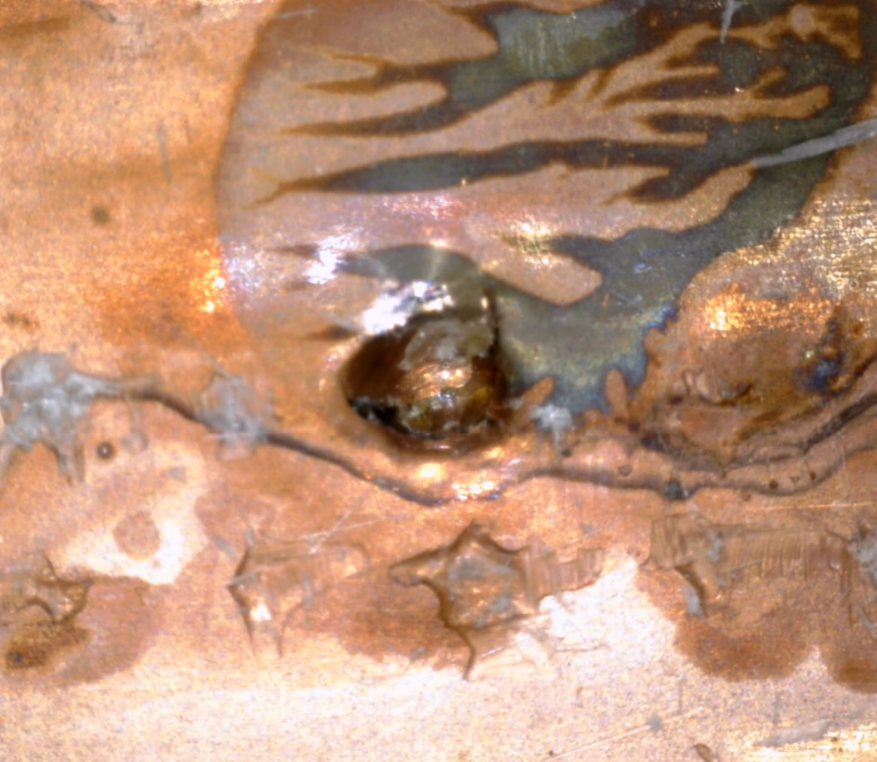
Excavation and insertion of Kapton
Since this area was close to the 1st suspect location, the window was enlarged.
The same procedure was followed, a thinner feeler gage was used to reduce wrinkles on heater.
Lifting Heater with 5 mil Feeler gage
Glass Bead Location before separation
Extracted Fiberglass showing location of bead through glass

Slide 11
Success!
As heater was peeled at this location, the short resistance crept up as the dent was approached until it was separated

Slide 12
Installation of Additional Kapton
Additional 50µm polyimide has been installed
2 fresh layers of 4522 follow
No noticeable oversize condition when checked by straightedge
Hand Cut (no beads)
Impregnation to follow

Slide 13
Next Steps
Coil is to be re-impregnated
Concerns about the risk of trapping helium around and under heater led to a second impregnation as the preferred path forward
A off-normal procedure has been written to close the mold
Regular traveler steps will be followed once end plates are back on
Coil Status as of 9:45 AM, 13 Jan.

Slide 14
2nd Coil Impregnation
Off normal steps
Did not use mandrel filler on the repaired sided of coil to increase epoxy volume to repair site.
Fill time was about 30 min
Coil degas: Jan 15, 2021
Epoxy impregnation: Jan 19, 2021
Cure cycle: Jan 19-21, 2021
QXFA127 before potting
QXFA127 after potting

