Slide 1
QXFA140 Heater to Coil Shorts
Fred Nobrega
Coil Working Group Meeting
November 14, 2024

Slide 2
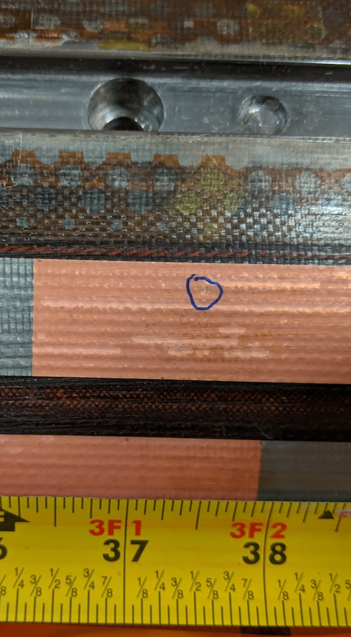
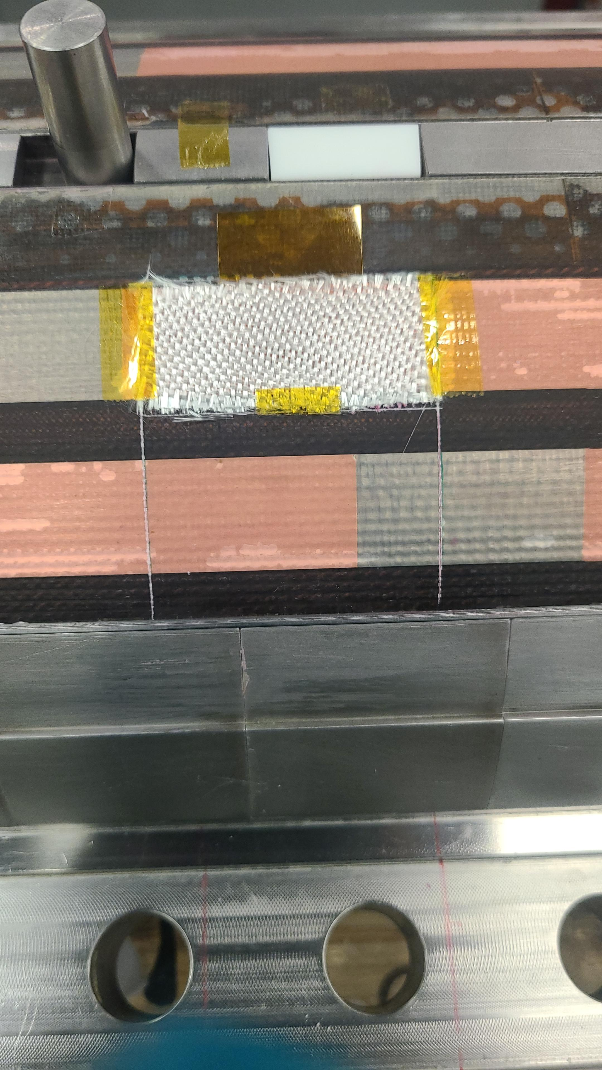
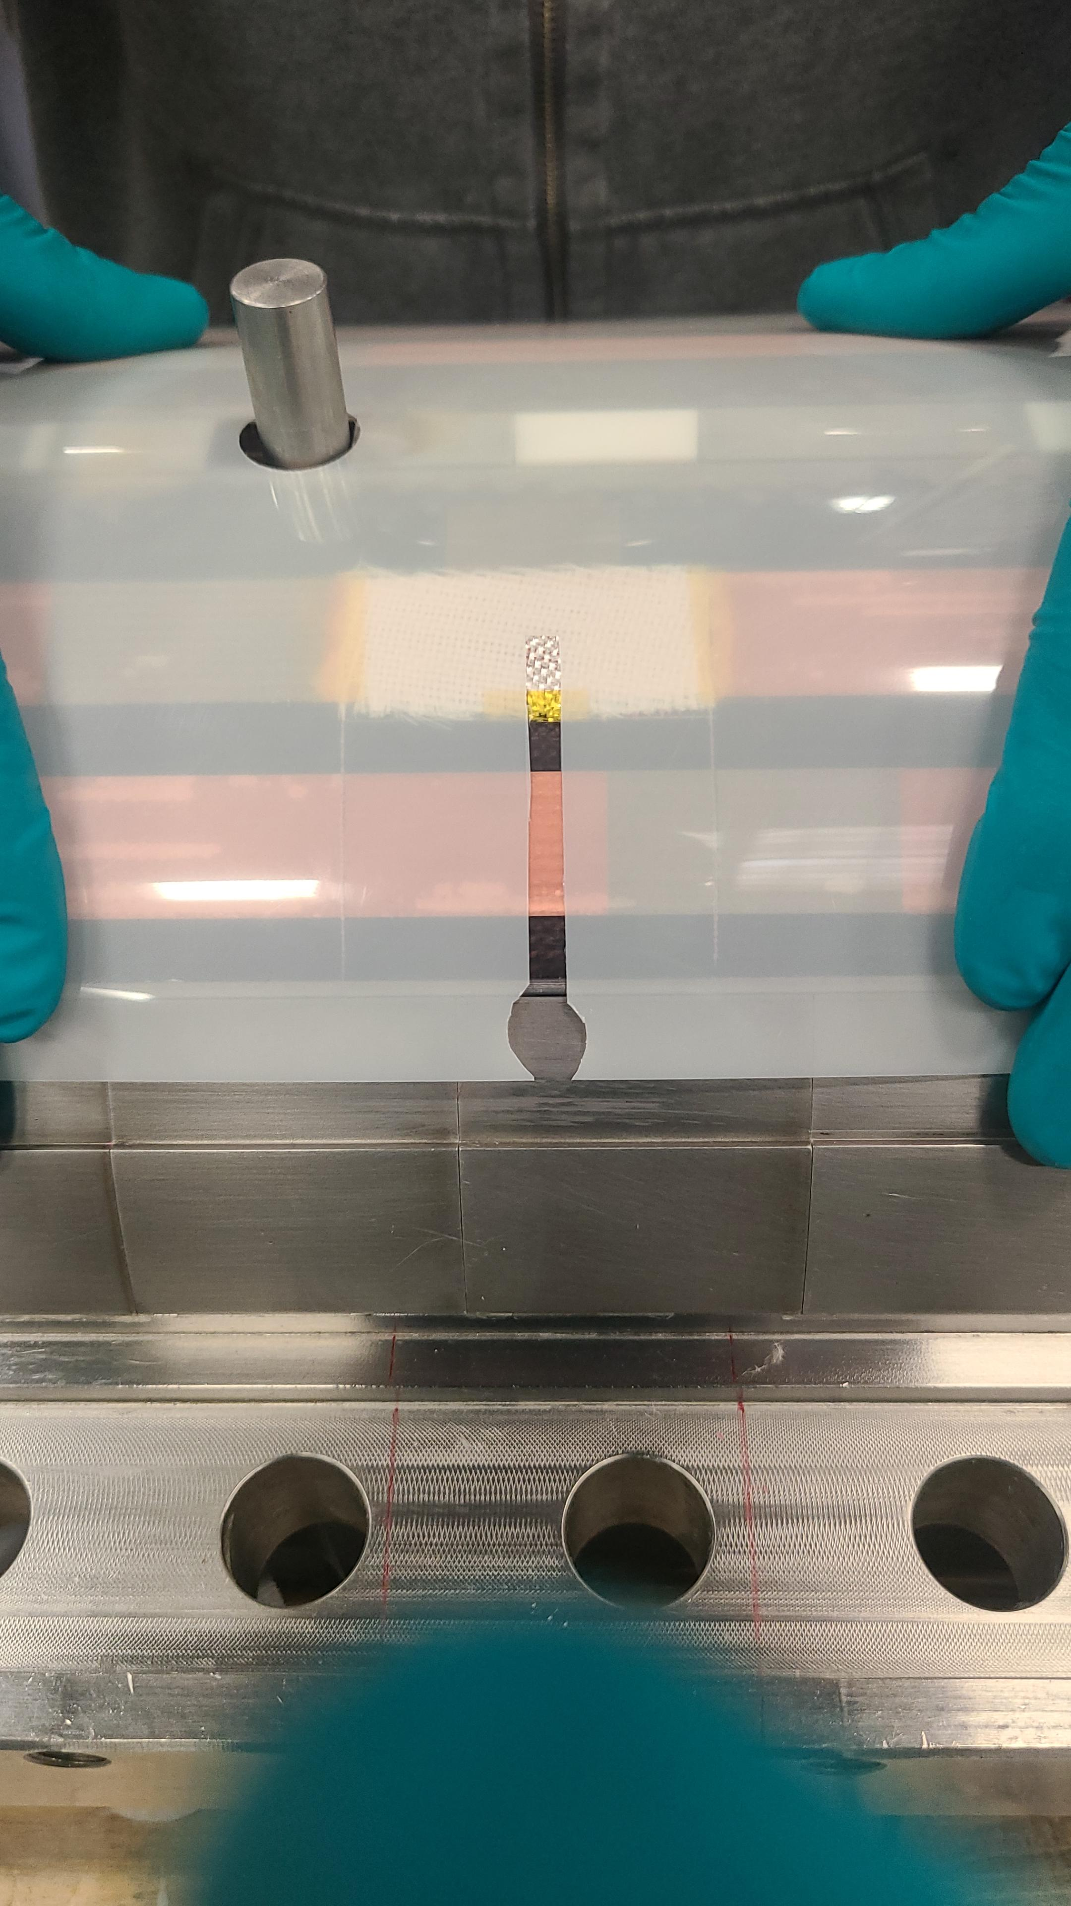
QXFA140 – 1st Repair & Impregnation
Coil QXFA140 had a dead short between the midplane quench heater and the coil caused by a fiber glass beads. The short was repaired by cutting away the outer glass layers and separating the heater from the coil. The glass bead was removed and Kapton inserted between the heater and coil.

Slide 3
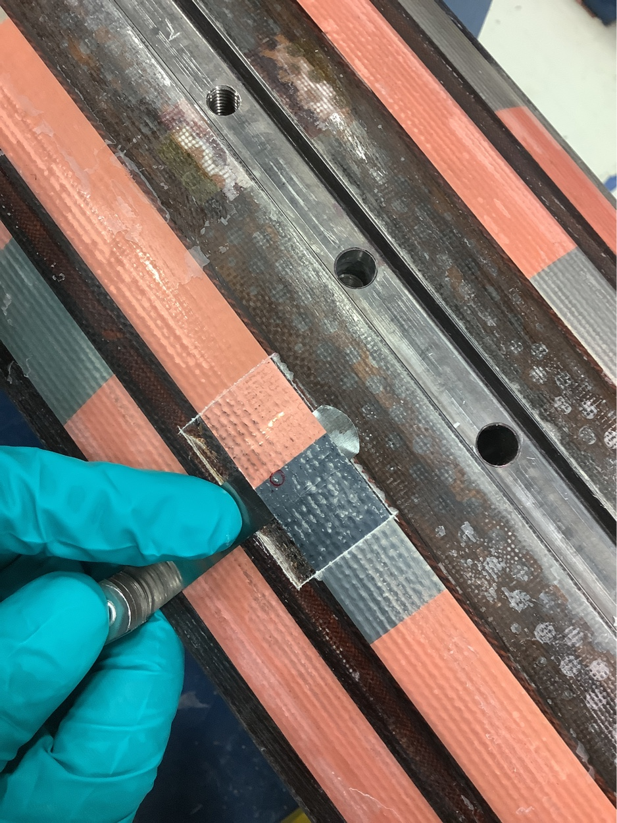
QXFA140 – 2nd Repair & Impregnation
Glass beads form during laser cutting of the Hexcel S2 glass used on the outer layer of the coil. A very tiny S2 bead was discovered over the QH causing a short to coil when light to moderate finger pressure was applied. The glass bead was removed and Kapton inserted between the heater and coil.

