Slide 1
QXFA142 Quench Heater-Coil Short Investigation/Repair and Glass Bead Mitigation
Fred Nobrega, CAM/L3
Coil Working Group
May 2, 2023

Slide 2
Introduction
QXFA142 developed heater #3 to coil hipot failure at magnet assembly. The coil was returned to FNAL for analysis and possible repair.
The repair process hopes to find evidence of the cause of failure, S2 glass bead or other foreign object.
There are 2 failure modes with glass beads that create electrical creep paths.
Glass bead between the coil and QH that damages the Kapton under load.
Glass bead above the QH. Load applied to the area drives the bead through the heater and Kapton.

Slide 3
QXFA142
Pit ~ 7mm wide, burn area is larger.
No clear evidence at this time the object was above or below the QH trace.

Slide 4
Repair Plan
The coil is in the shipping crate and will be moved to the roll over station.
Remove damaged section of glass above the trace about 2 inches wide. Inspect glass and trace. Bag and save the glass.
Follow repair procedure used on coils 127 and 137 with the following exception.
Beginning about an inch away from the hole on both sides to separate the trace from the coil and slowly move towards the damaged area from both directions.
The objective is to retrieve any possible debris to characterize the size, and to inspect the damaged area below the trace.
Add Kapton below the trace and cover the repair area with fiberglass.
Assemble into the impregnation tooling and VPI.
Perform complete electrical measurements & tests
CMM the repair area.

Slide 5
S2 Glass Beads
QXFA155
QXFA142
Glass beads below trace.
Glass beads above trace

Slide 6
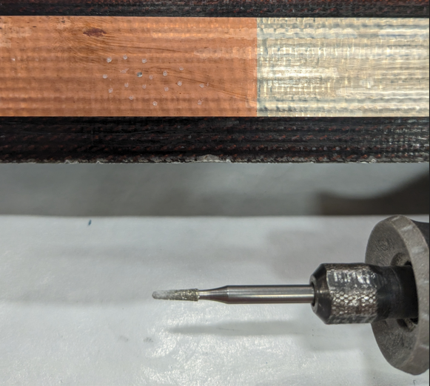
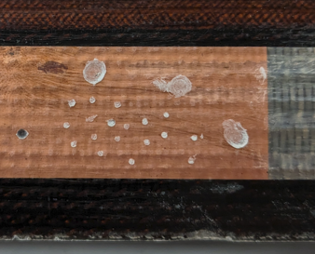
Glass Bead Mitigation
Glass beads above trace.
Use Dremel Tool to grind the bead and create a recess, small or large. Low RPM, easy to control.
Very small.
Large.
Small.

Slide 7
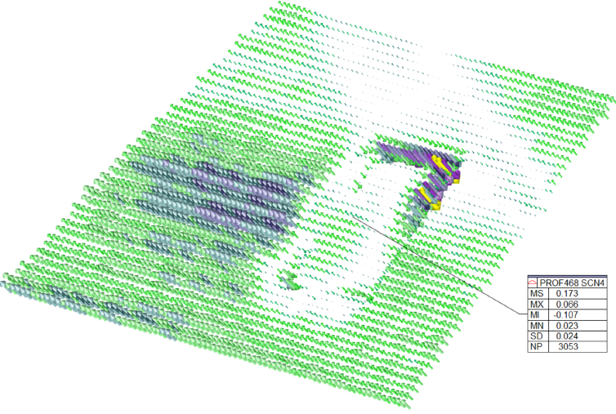
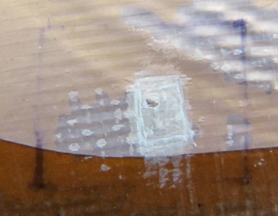
Glass Bead Mitigation
Glass beads below trace.
2 options depending on size and location.
Small bead → file/sand/machine S2 glass/epoxy area above bead.
Large bead → peel trace from coil to retrieve glass bead and perform 2nd VPI.
QXFA137 after rework.

