Slide 1


QXFA146 Midplane Delamination
Fred Nobrega
CERN – AUP Coil WG Mtg. August 24, 2023

Slide 2
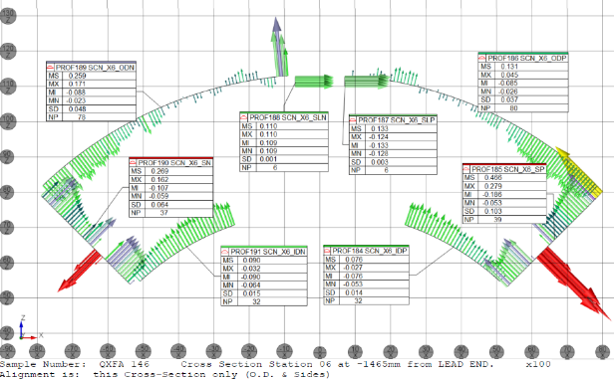
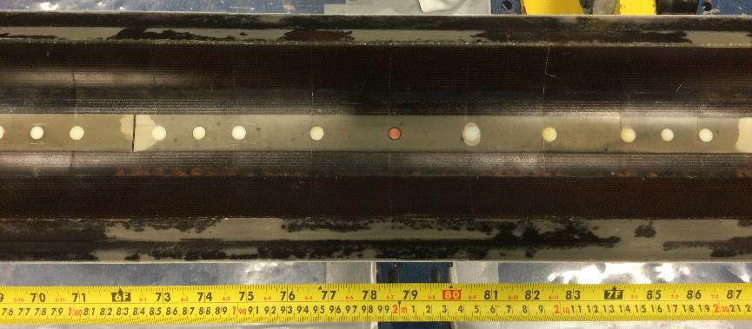
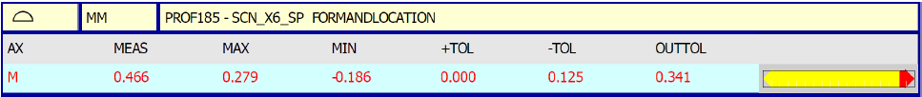
QXFA146 Midplane Delamination
DR12956: Coil CMM measurement of the midplane is out of tolerance at multiple locations.
Cause: G11 shims were checked for size using newly mold released SS midplane shims. Some mold release transferred to the G11.
Corrective action: Use dedicated SS midplane shims for checking G11 and for trimming if necessary.

Slide 3
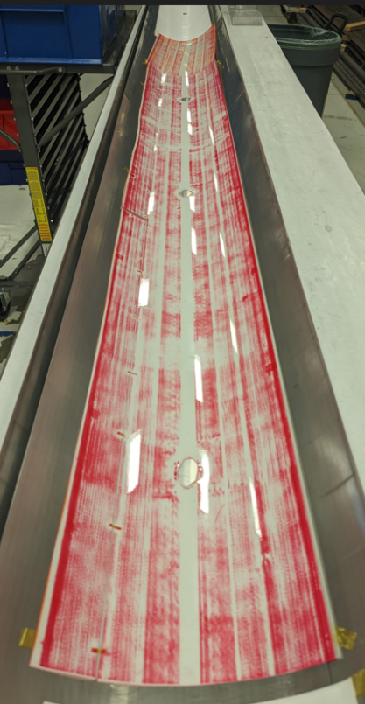
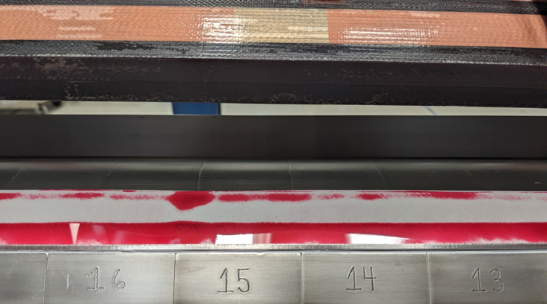
Fuji Film Tests
Fuji film tests performed to determine midplane integrity between conductor and G11.
Low pressure, 10 MPa film used with impregnation tooling.
Photos show uniform radial pressure (right) and typical imprint without midplane delamination (below).

Slide 4
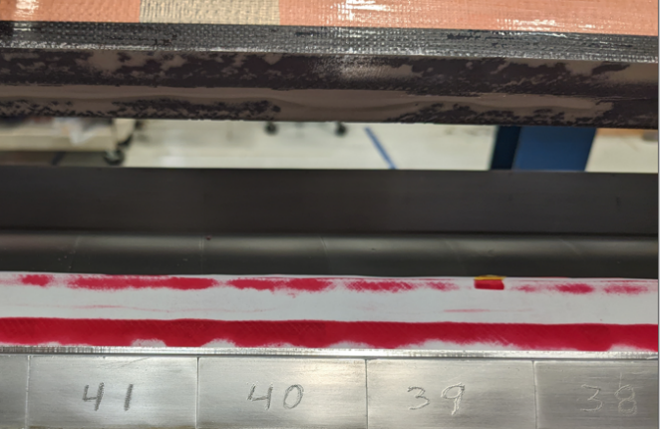

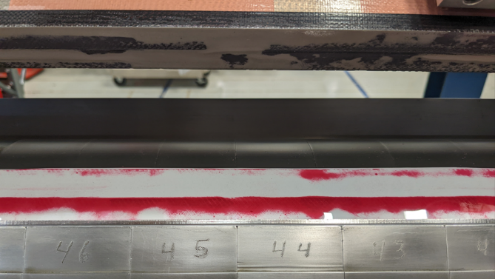
Fuji Film Test Results
Coil sections
with delamination
Coil section w/o delamination

Slide 5
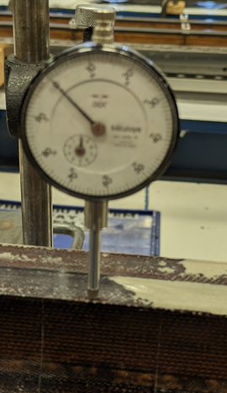
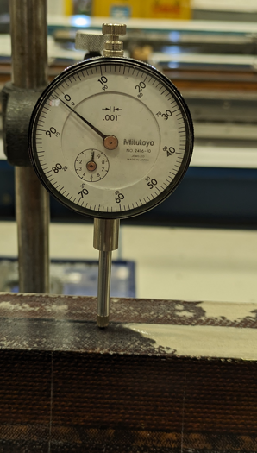
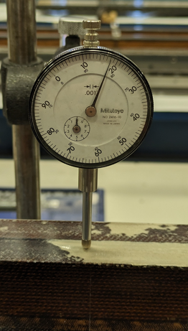
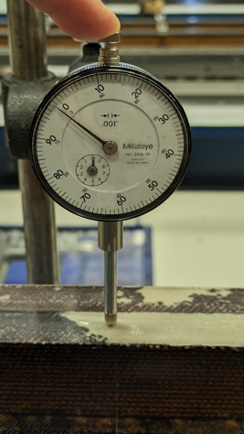
Dial Indicator Tests
Rotate coil with midplane horizontal. Zero dial indicator on midplane adjacent to delamination.
Slide dial indicator to delamination and push the probe until it bottoms out.

Slide 6
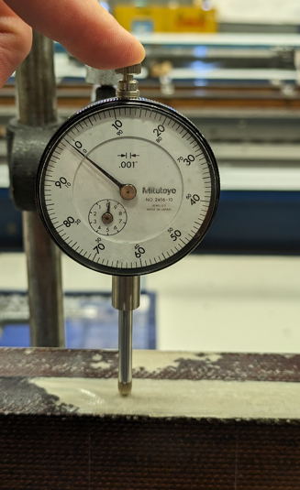
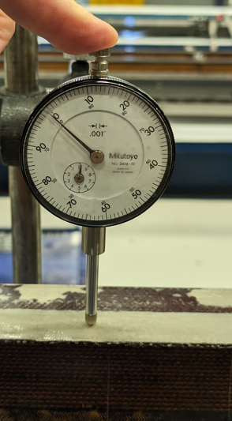
Dial Indicator Tests
Moved dial indicator two more times with little variation.
The coil was inspected with this method with variations of ± 30 microns.

Slide 7
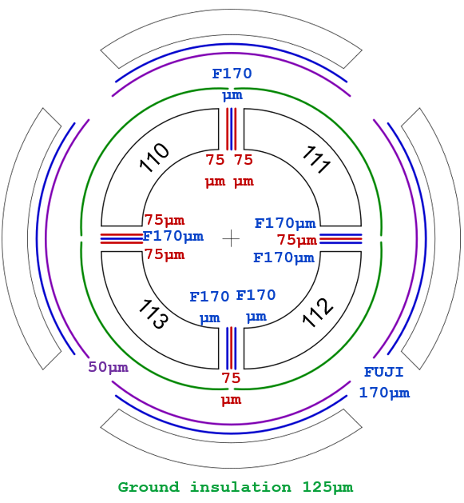
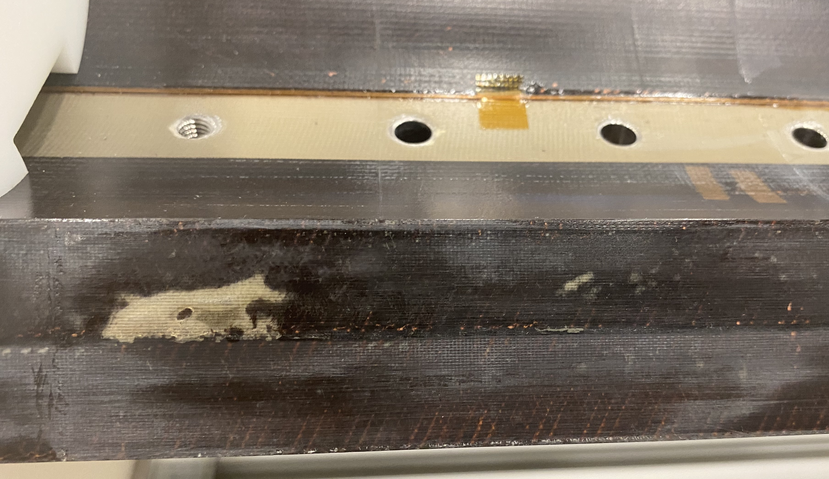
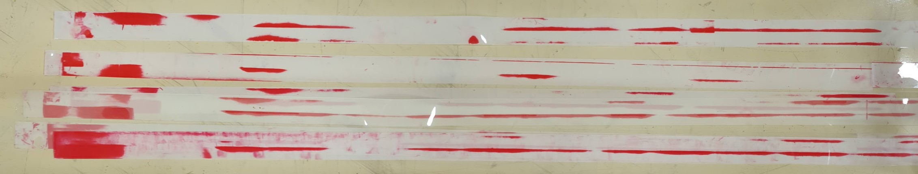
Coil CR110 – Mid-plane
Delamination in the inner layer mid-plane → FUJI paper was installed in the mid-planes during the coil pack assembly (Super Low Pressure, 0.5-2.5 MPa) → no trace of the deffect in the mid-plane, meaning that it is just a delamination wihtout an over-thickness, considered no critical.
Ref: Susana Izquierdo Bermudez, email 8/24/2023

Slide 8
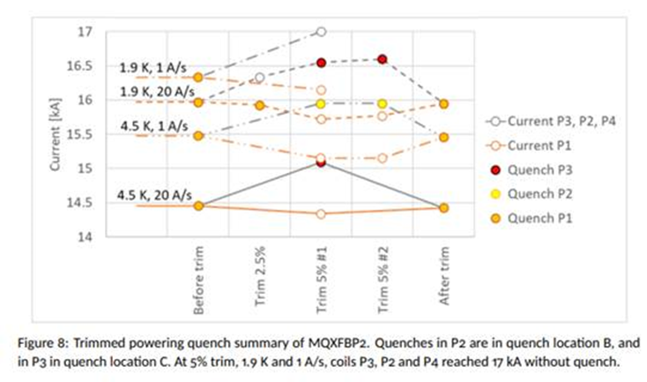
Magnet Test with Coil CR110
(HCMQXFBC08-CR000110)
“Here the issue we had in coil 110 (the mid-plane shims were sticking). It is much more localized, but it didn’t show up as a limitation up to 16 kA. Actually it was the coil that never quench in BP2, neither with the trim current test (P4 in that plot)”
Ref: Susana Izquierdo Bermudez, email 8/24/2023

