Slide 1
MQXF taskforce Bending tests on reacted Rutherford cable Metallographic inspection
Mickaël Crouvizier
EN/MME/MM EDMS 2788659

Slide 2
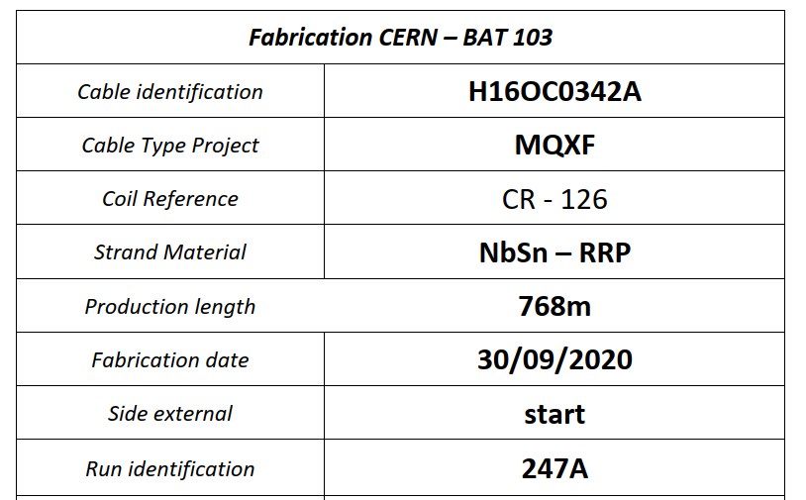
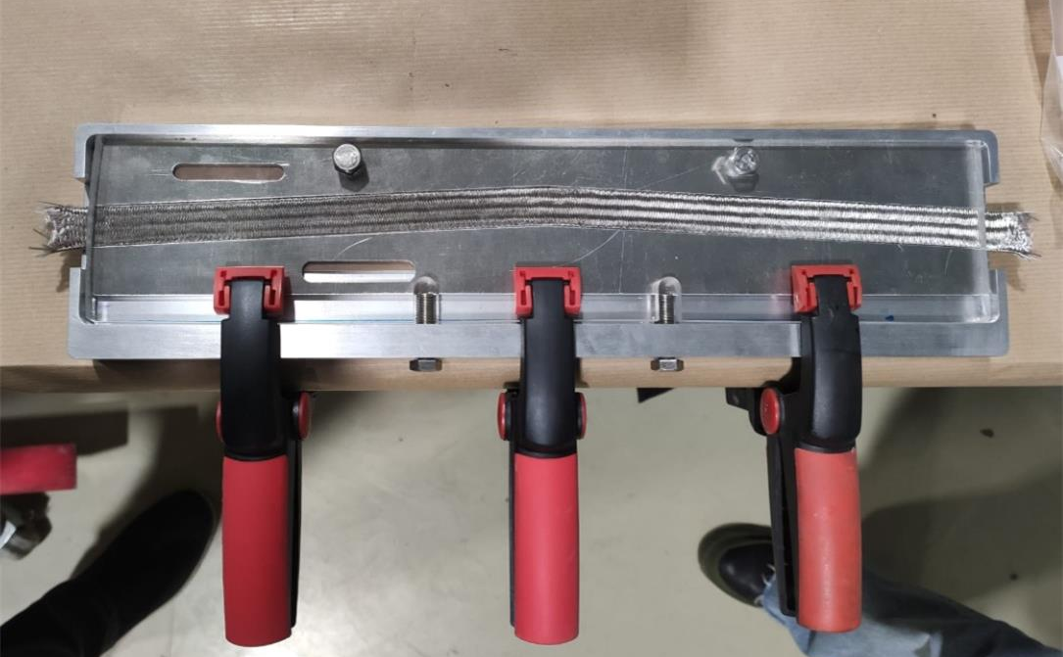
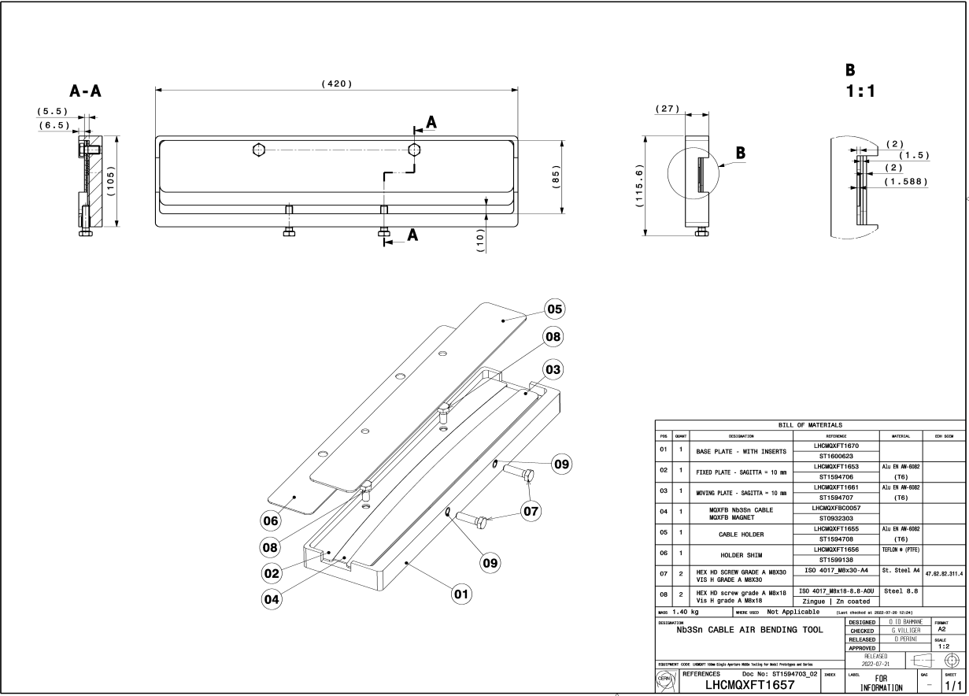
Introduction
Experience gained from previous metallographic inspection on CERN quadrupoles coils CR108, CR120 and CR126 (EDMS 2731361 and EDMS 2769488) showed:
Collapsed superconductive (SC) filaments on the straight part of the coil occur generally at pole turn inner layer with cracked filaments appearing at the crest of the cable. A V-shape is noticed: bending issue is envisaged.
Plane bending tests with a sharp angle on as-reacted Rutherford cable has been carried out with the testing fixture illustrated below. The idea is to reproduce observed failures on CERN coils. But also from a general point of view, bending behaviour of reacted Nb3Sn is not well known: data on bending strength and max. bending angle are needed.
After bending, cables are embedded in PMMA resin at b.527 for handling and sampling purposes.

Slide 3
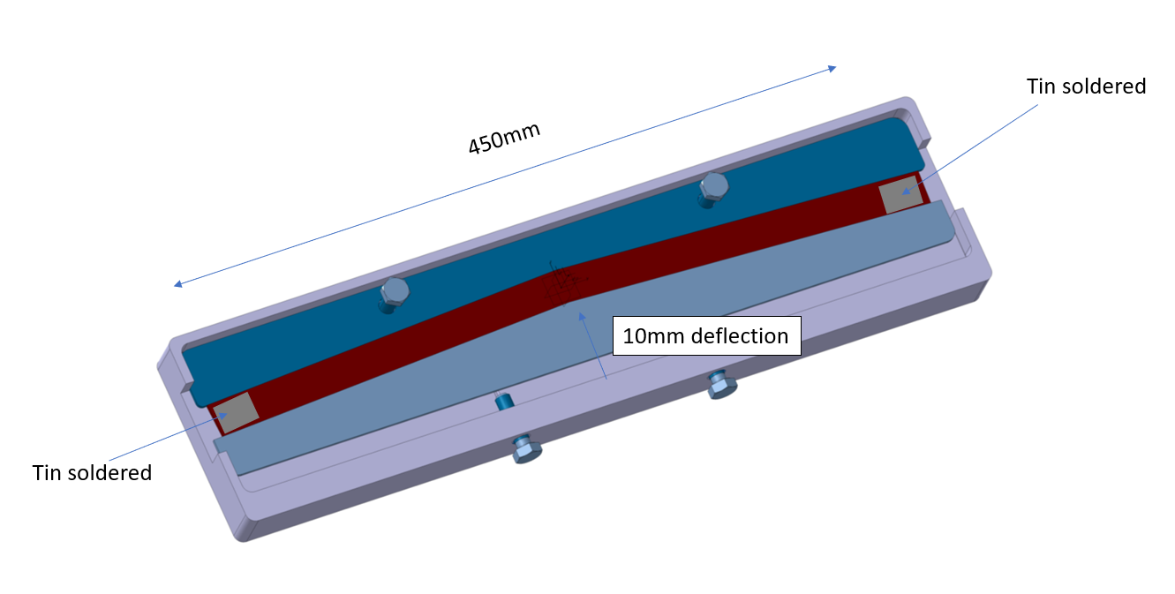
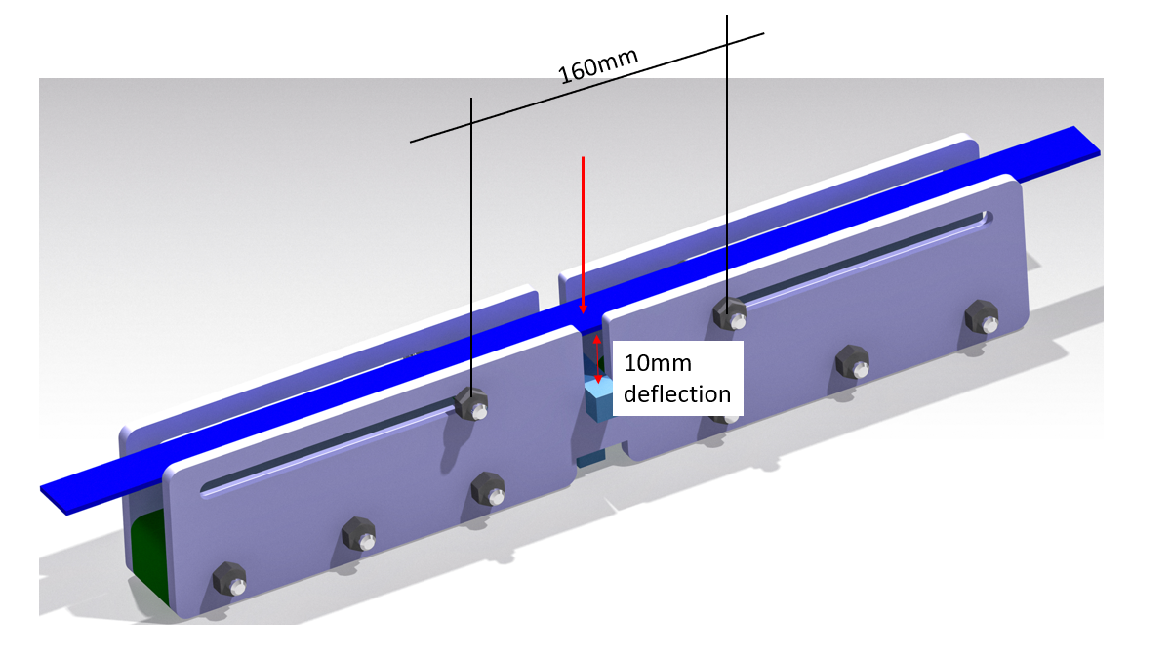
Samples and test set-up
As-reacted Rutherford cable (with cured ceramic binder and glass fibres envelope) has been subjected to two different bending tests.
“soft bending”
Courtesy of Marco Masci
“hard bending”

Slide 4
Sampling and method
A cable as-reacted and not bended is used as reference.
Embedded cable is provided to EN/MME/MM for metallographic inspection following the detailed steps:
Sampling of portions by diamond wire saw (DWS),
Preparation of mountings in PMMA resin: bended specimen + reference per mounting. This for longitudinal and transverse cross section,
Plane grinding and polishing,
Examination by optical microscopy,
Deep copper etching on transverse cross sections.
For longitudinal cross section For transverse cross section
indicates plane prepared and observed

Slide 5
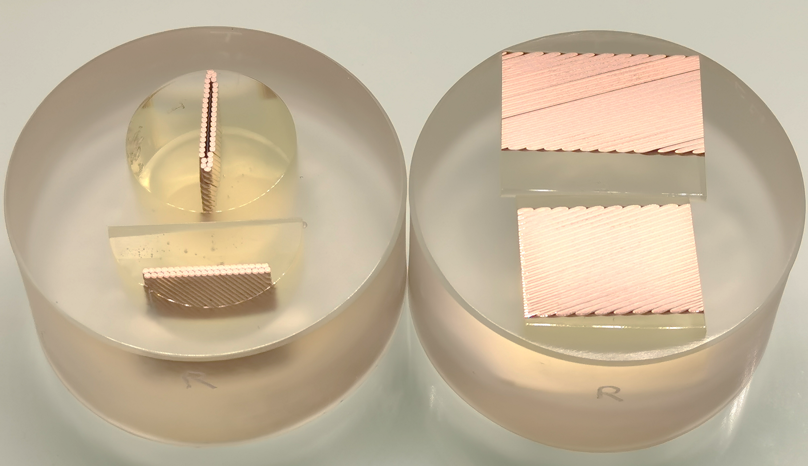
Preparation and metallographic inspection
Metallographic inspection is carried out with a Carl Zeiss AXIO Imager optical microscope.
On transverse cross sections, subsequent deep copper etching with HNO3 is performed.
bended
bended
reference
reference
Metallographic samples as-prepared (representative pictures): transverse cross sections (left) and longitudinal cross sections (right)
Illustration of transverse cross section after deep copper etching (0,5-1 mm of copper is removed.
Only SC filaments (grey phase) remain close to surface.

Slide 6
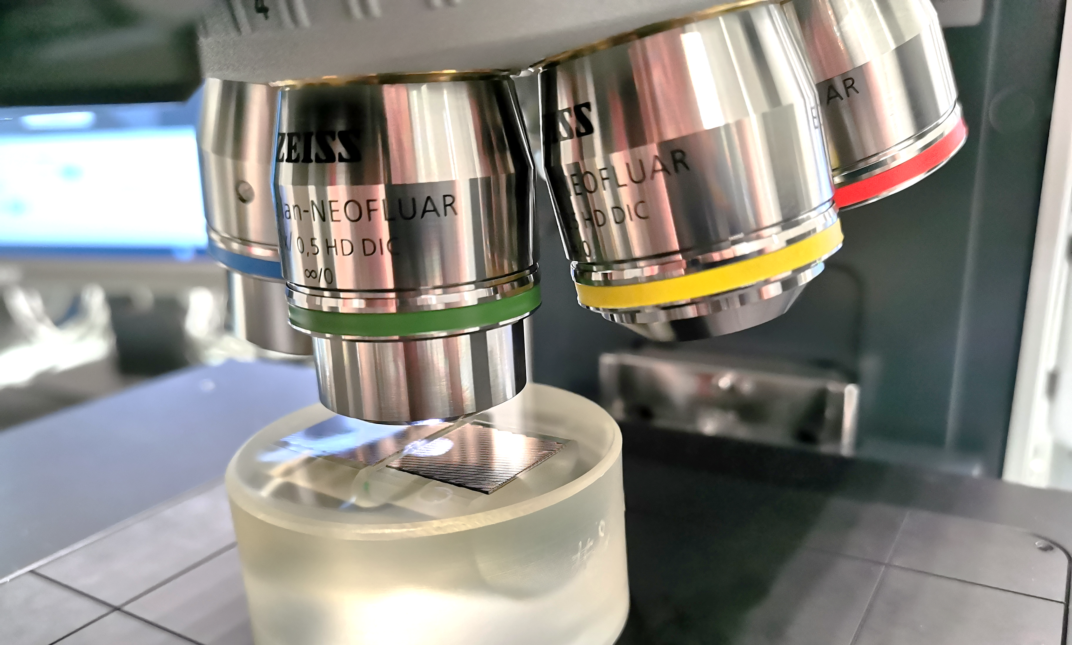
Results
In the following slides, representative pictures are illustrating the status of the cable and SC filaments.
All original high-definition pictures are set out in annexes
The thorough examination all transverse and longitudinal cross sections (bended cable and reference) did not reveal any cracks at SC filaments.
Subsequent deep copper etching on transverse cross sections did not reveal any collapsed SC filaments.

Slide 7
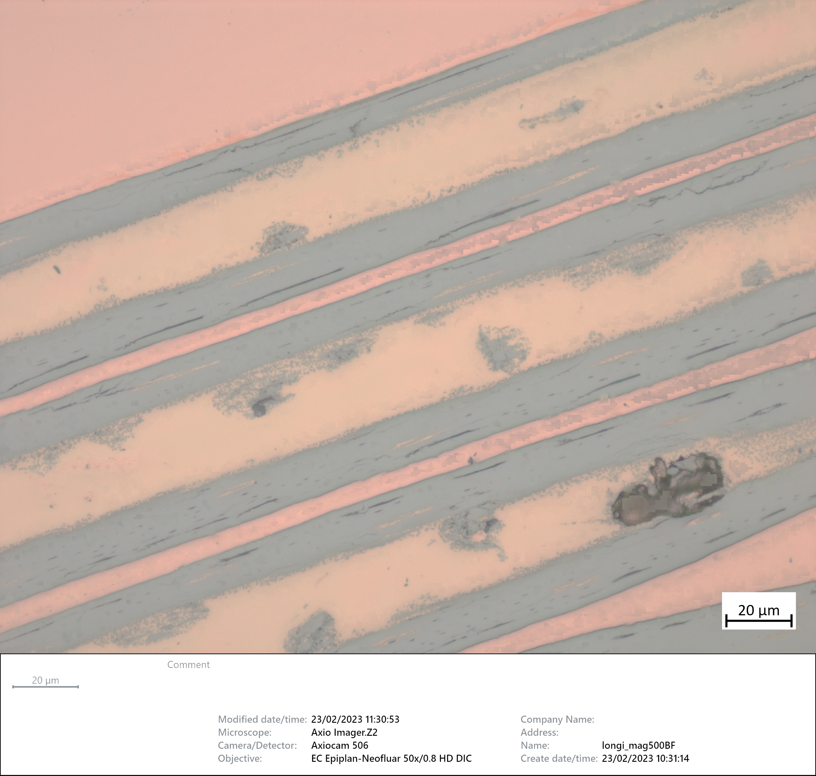
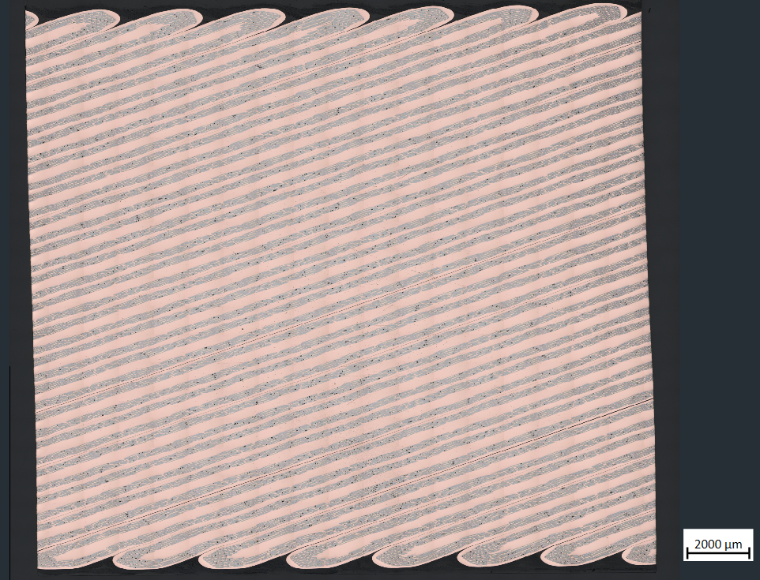
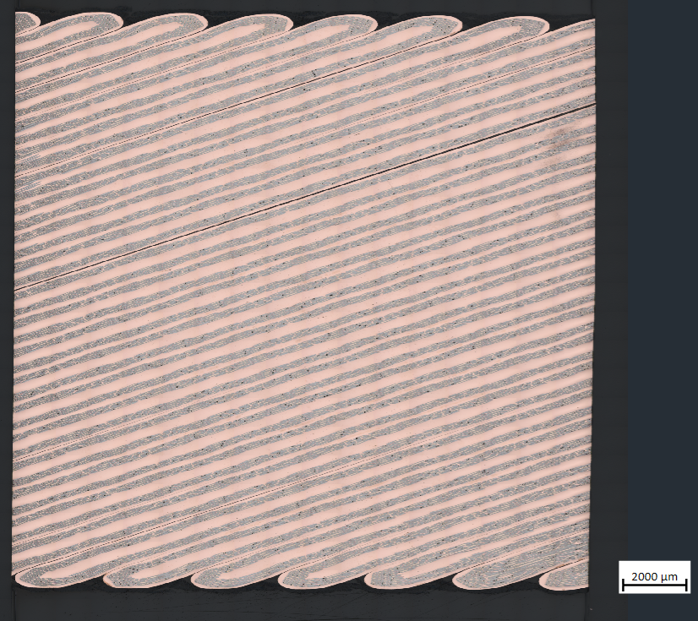
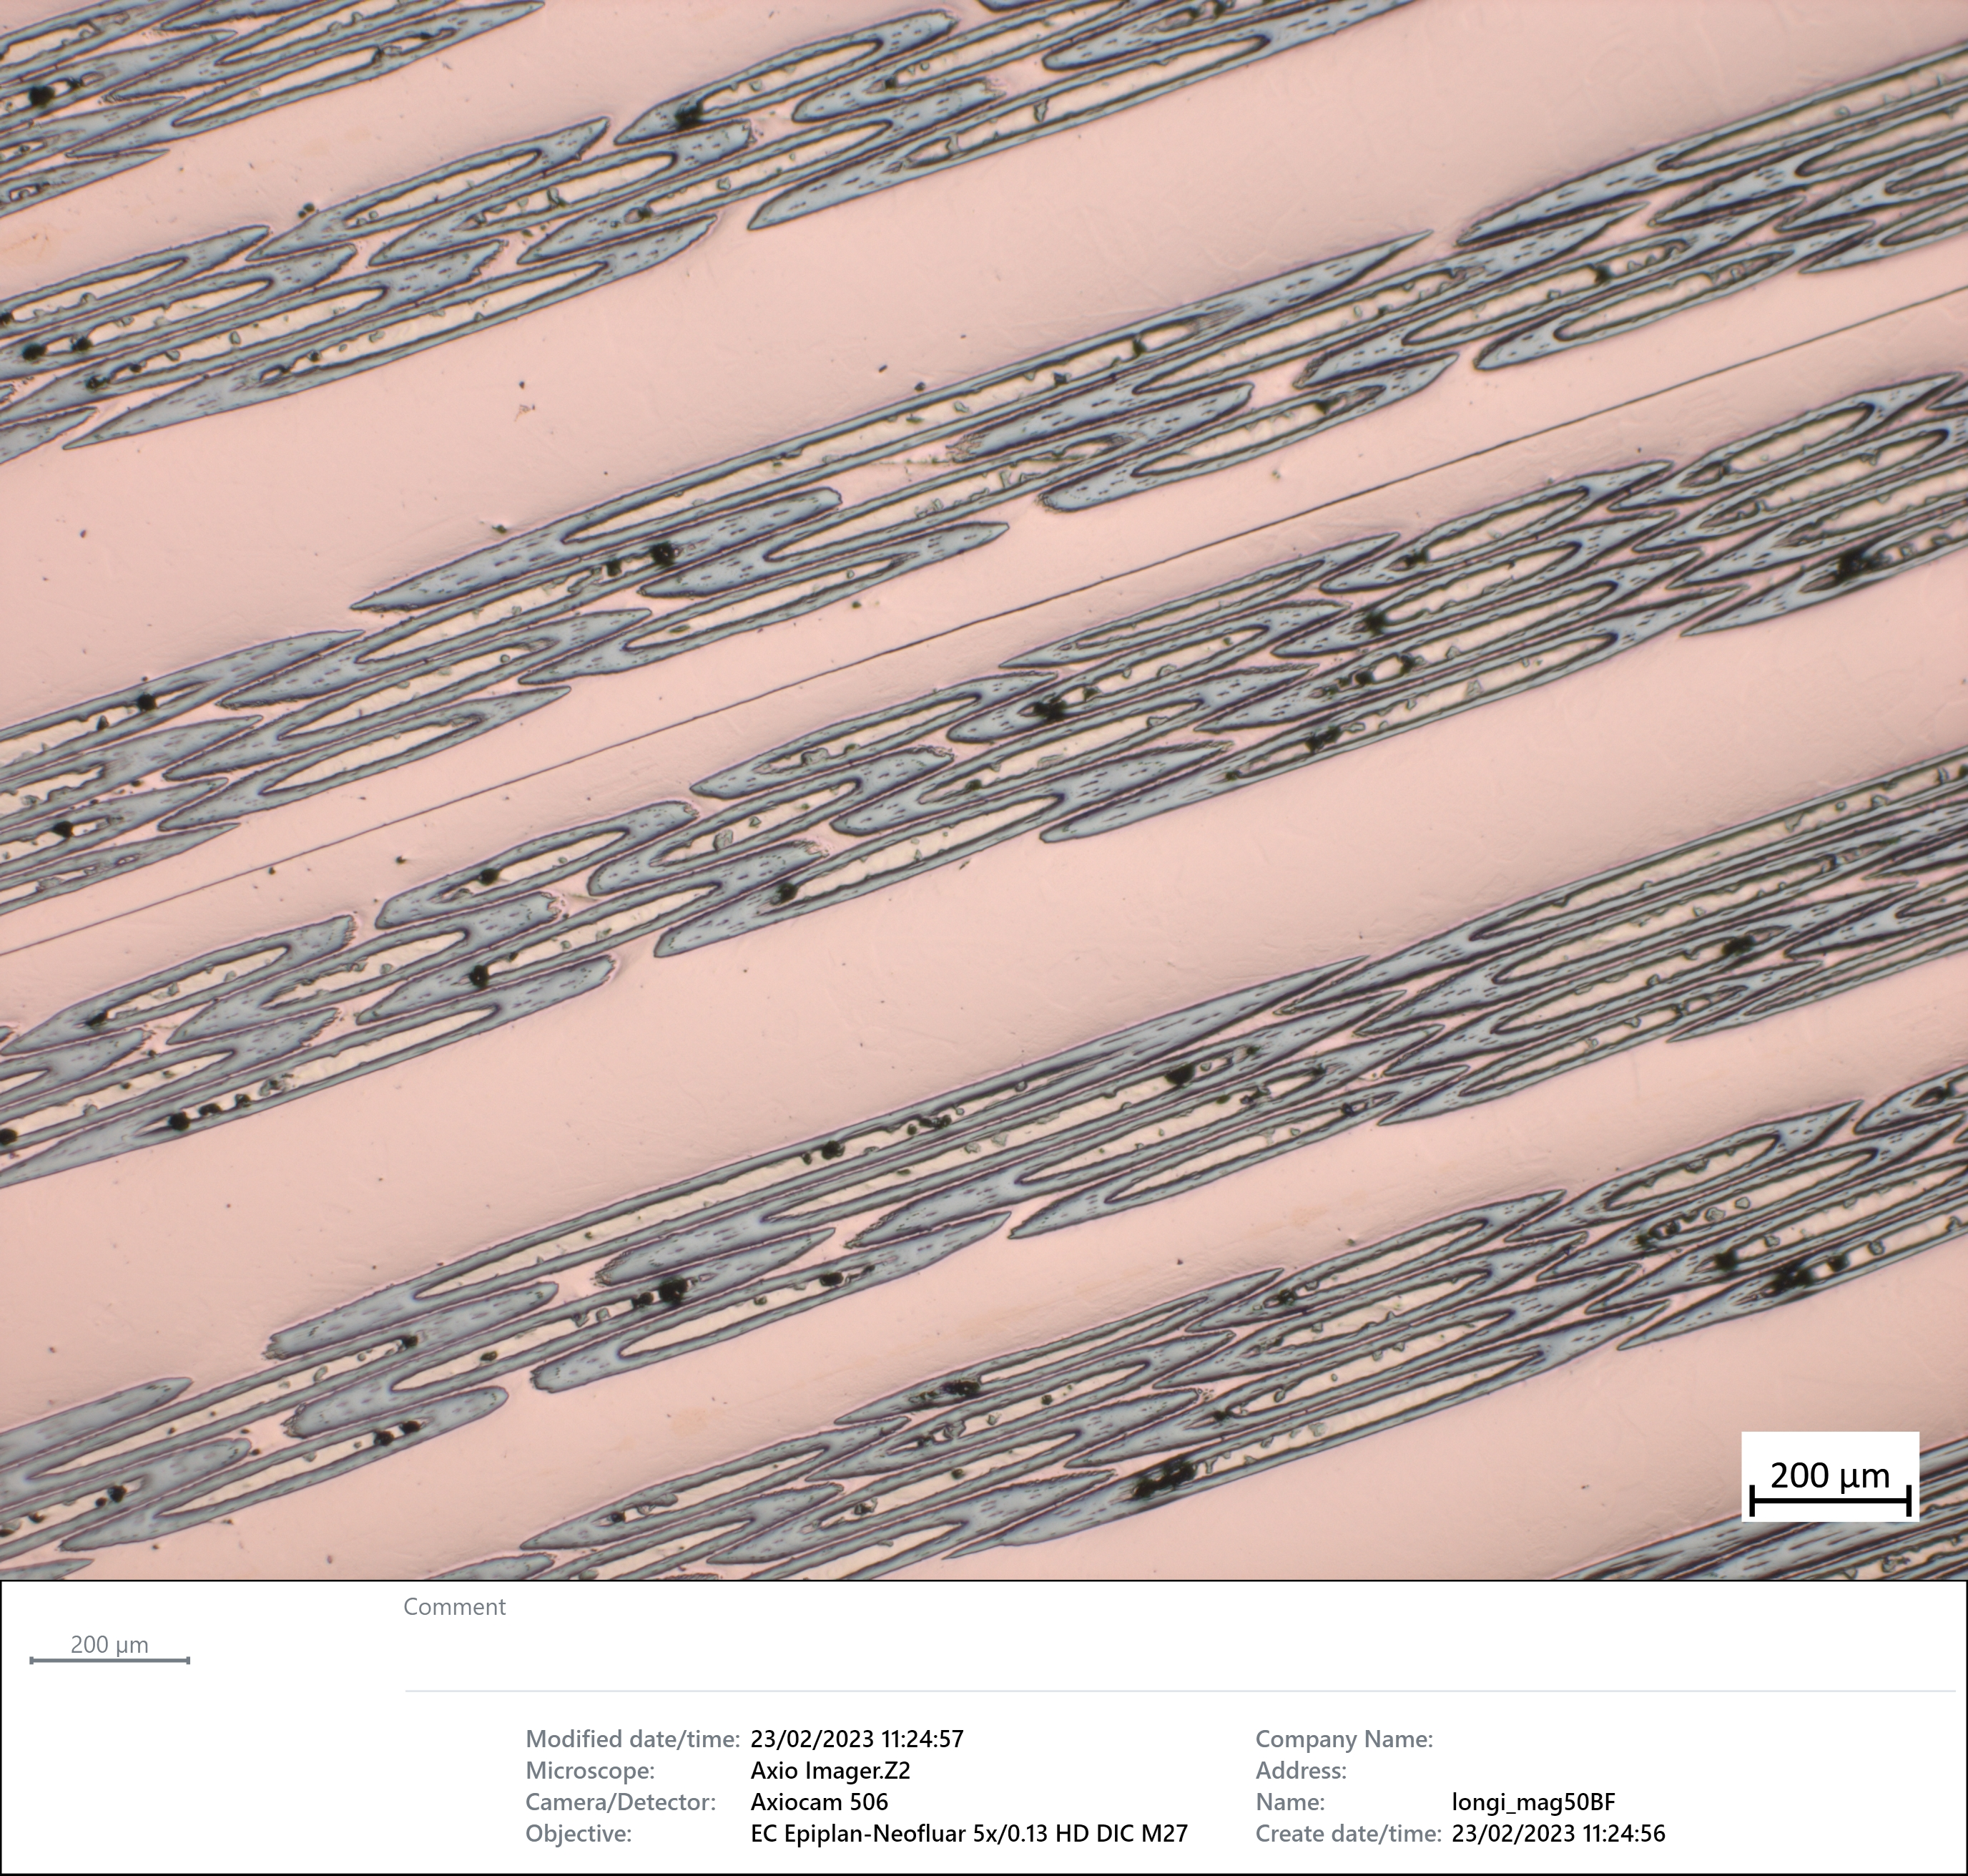
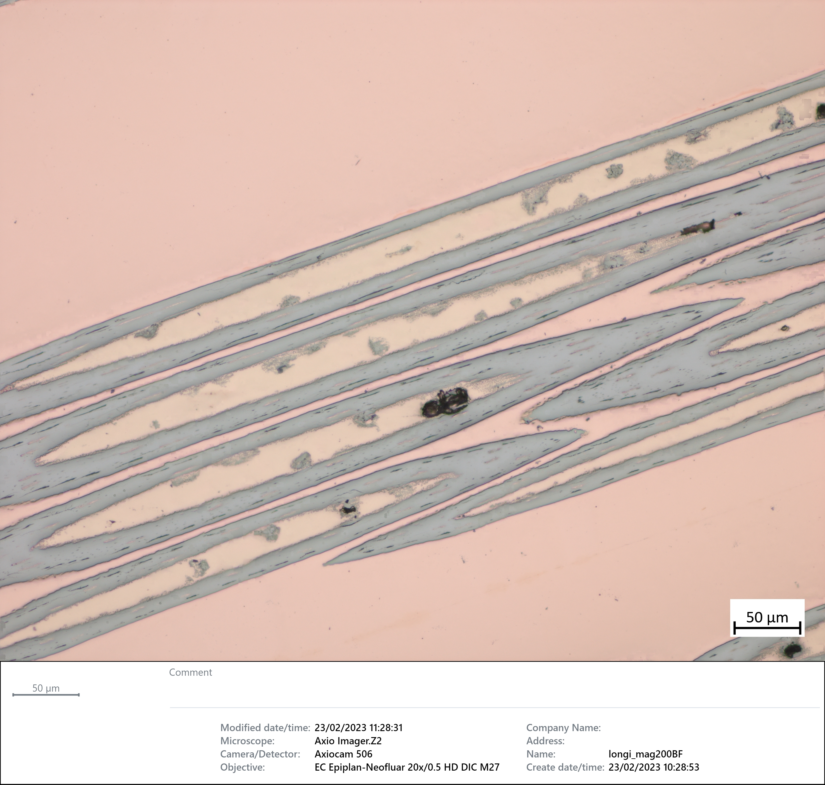
Results longitudinal cross sections
Hard bending soft bending

Slide 8
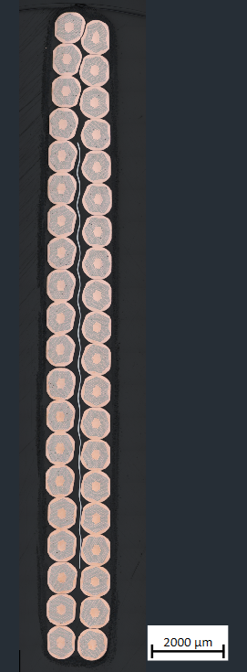
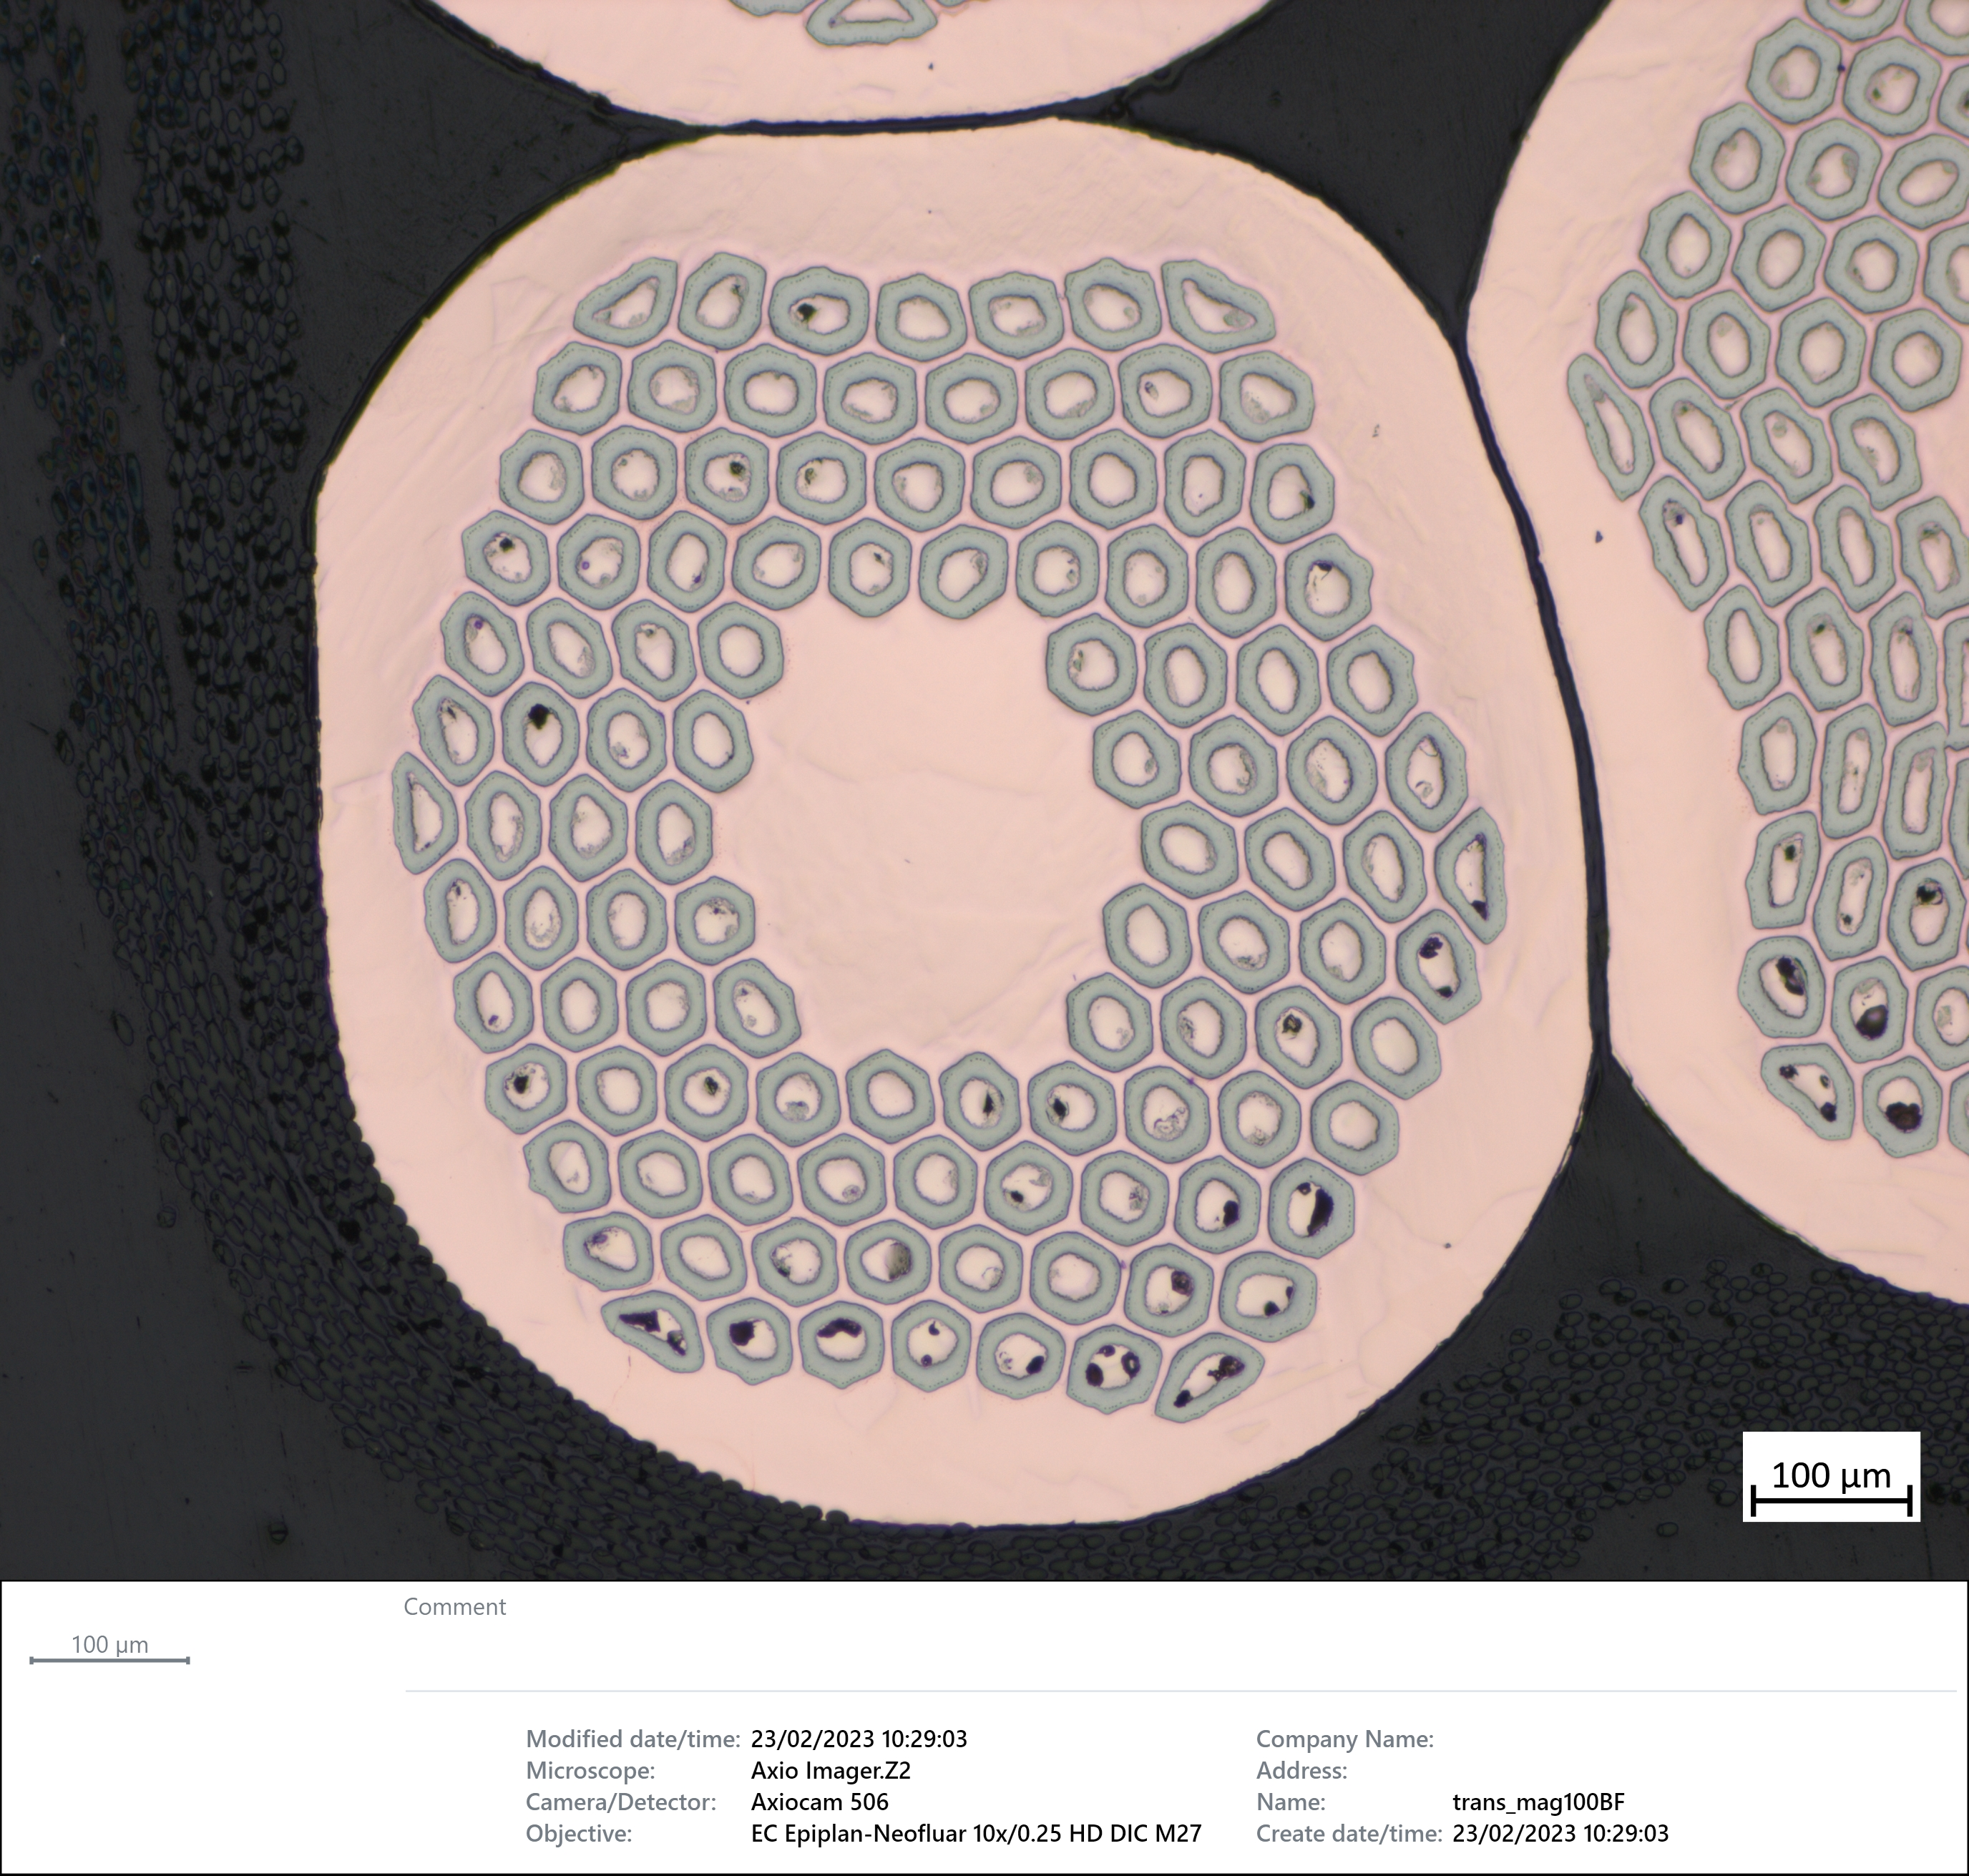
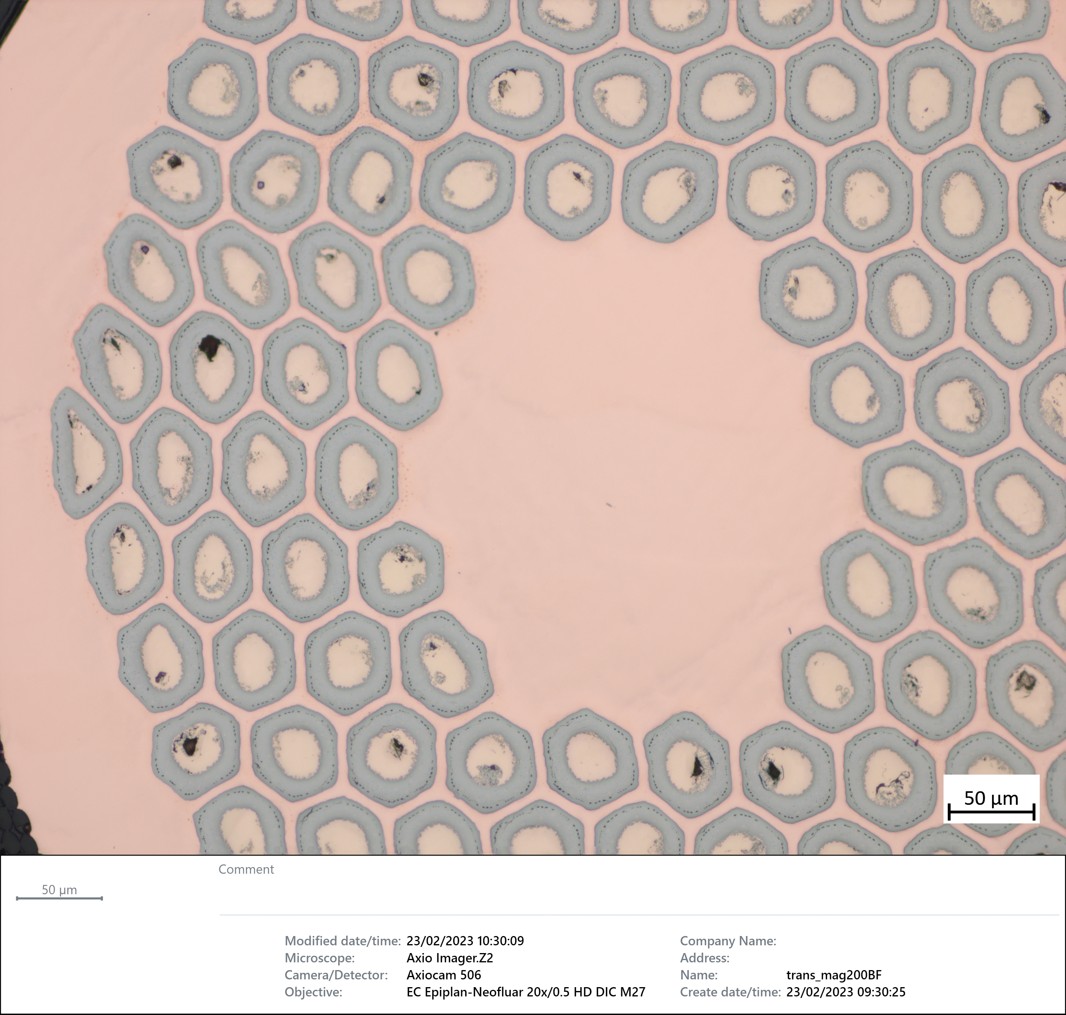
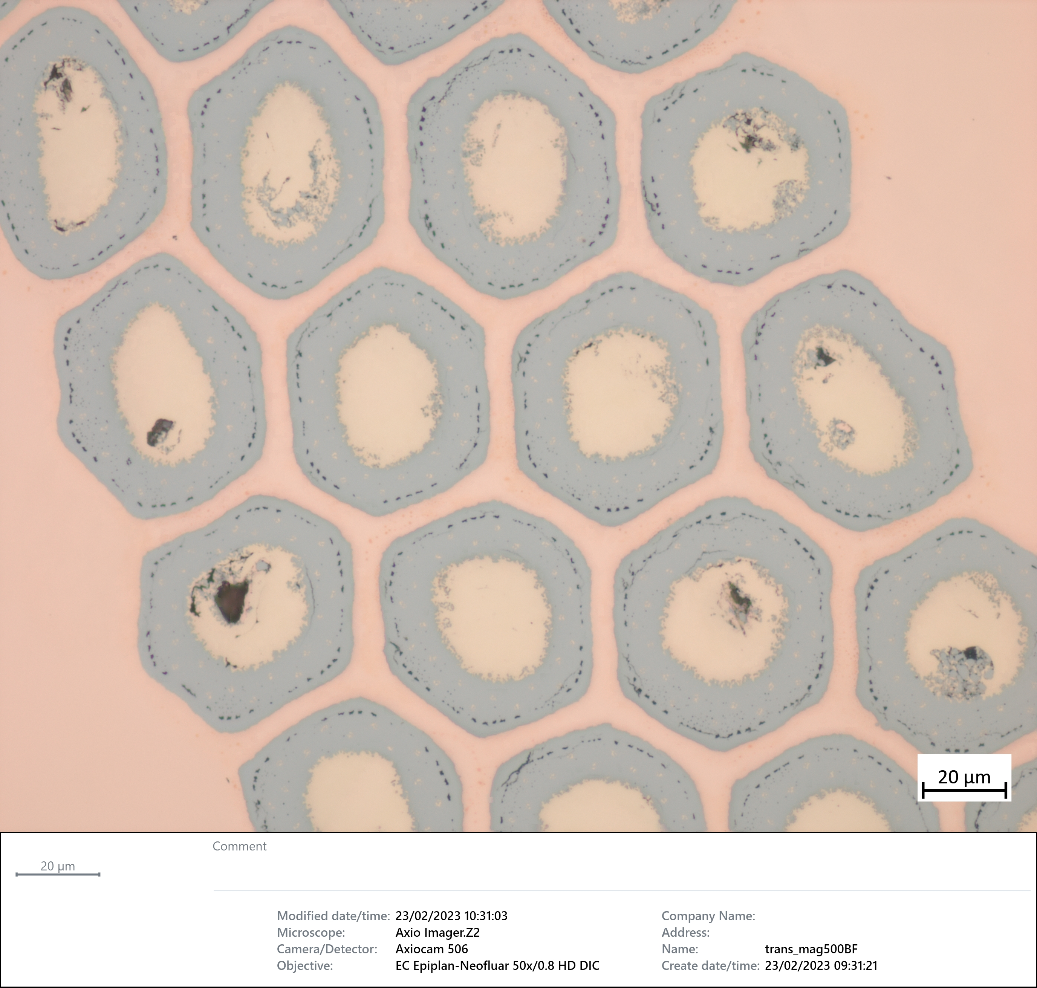
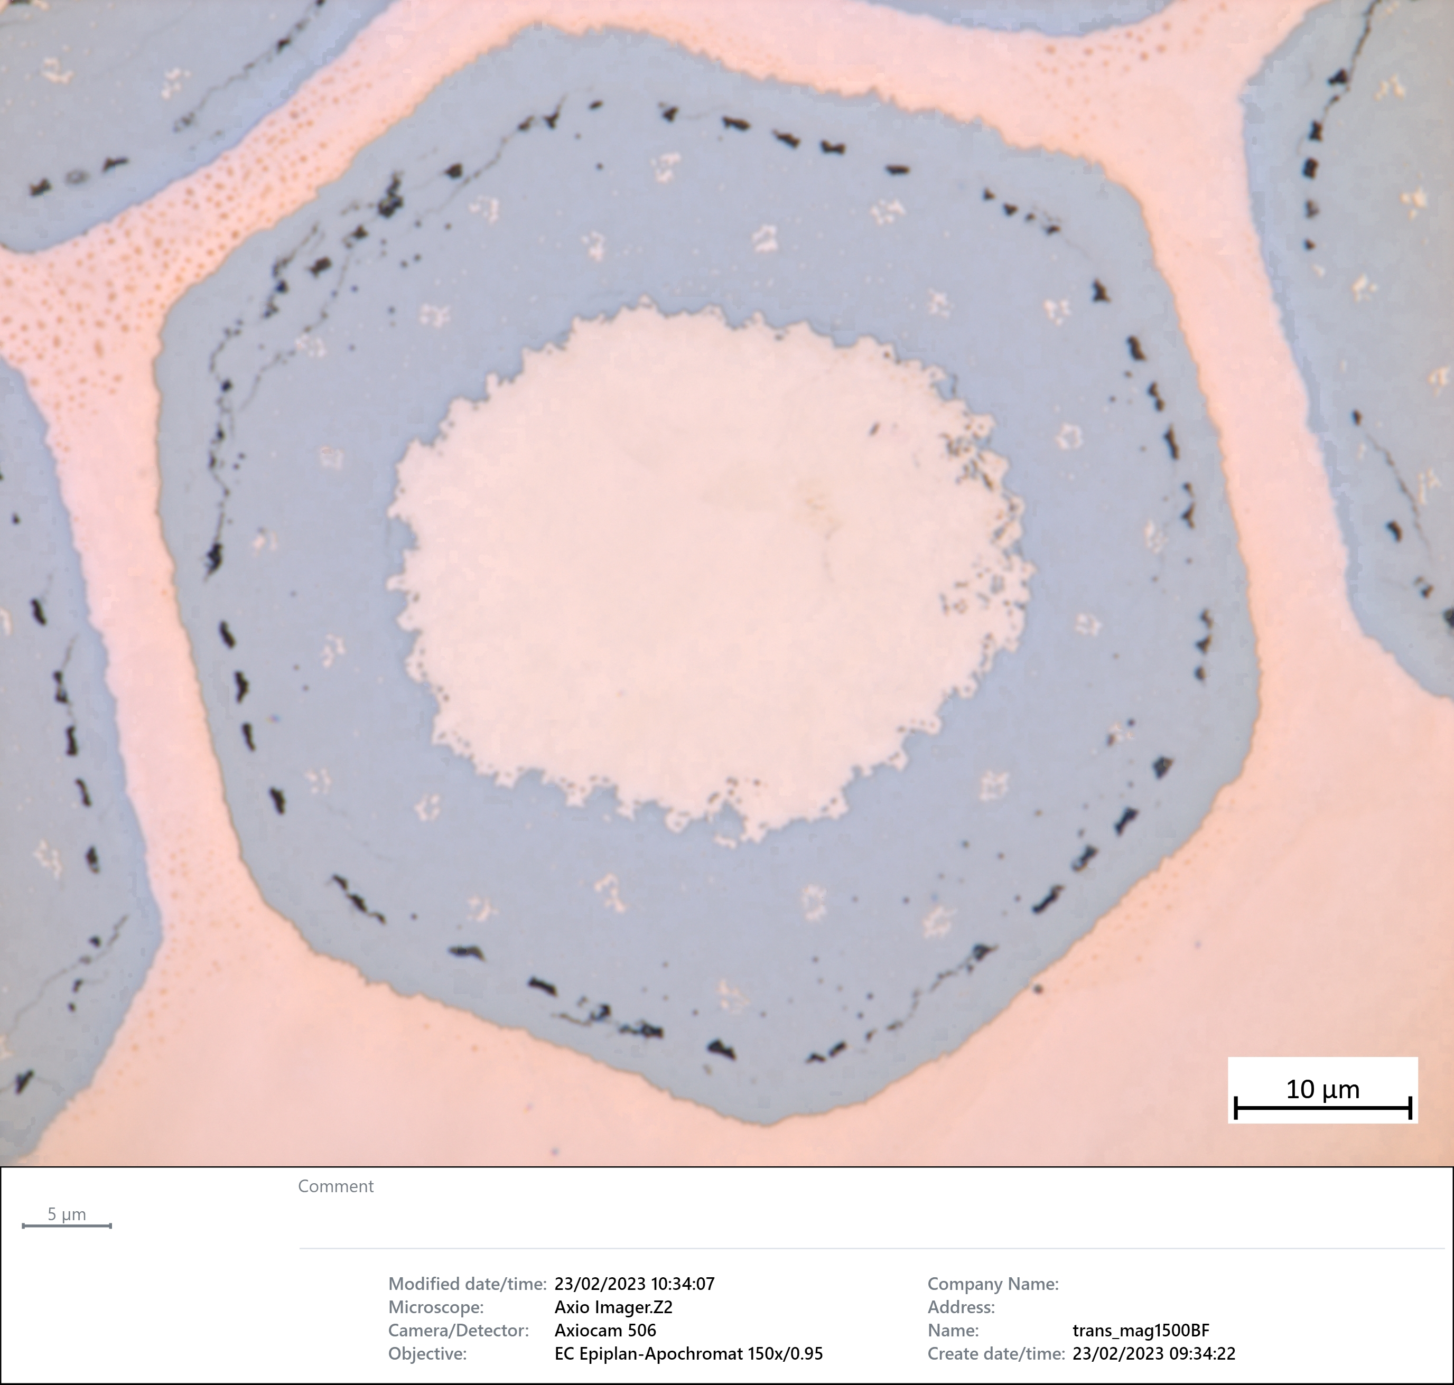
Results transverse cross sections
“opening” of the cable is visible, especially for “hard bending” sample.
This indicates an geometrical adaptation of the cable under bending stress.
No cracks and or indications of deformations have been noticed during optical inspection.
Hard bending
Soft bending

Slide 9
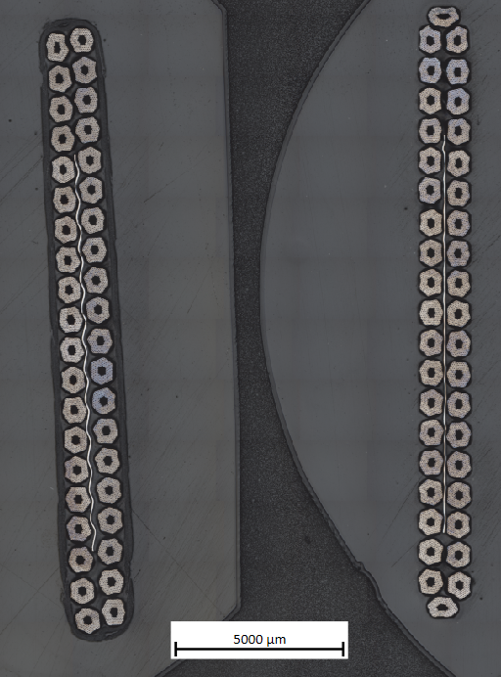
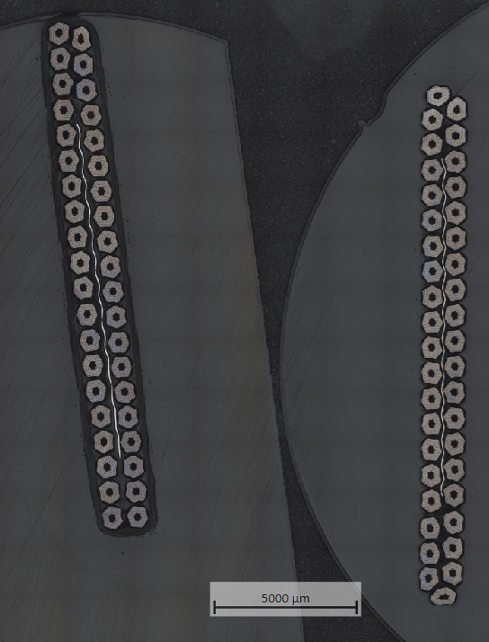
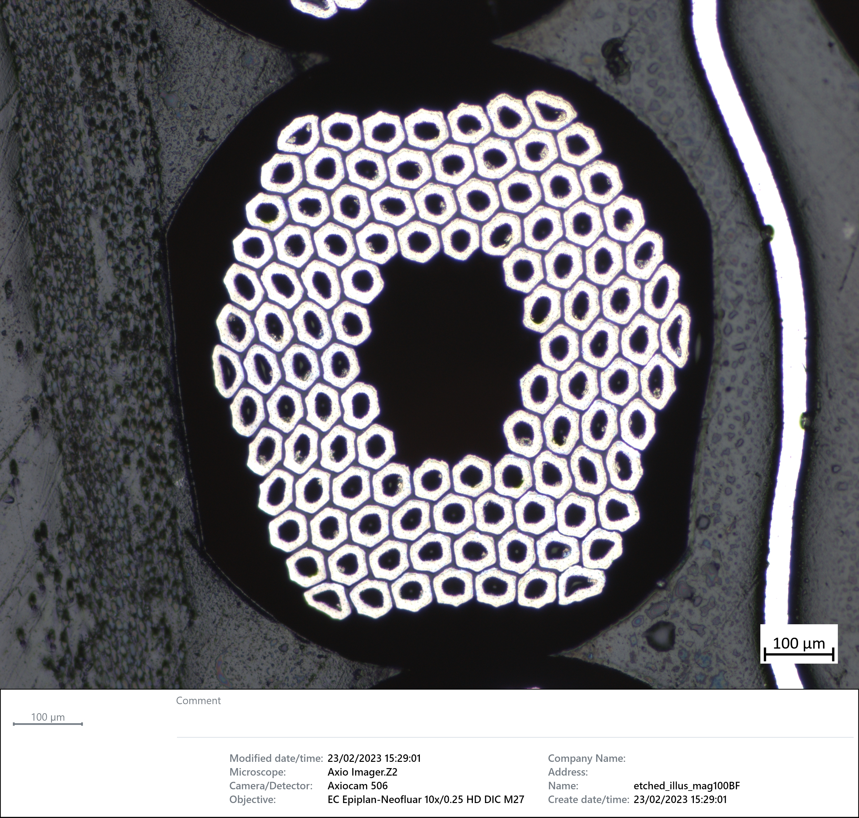
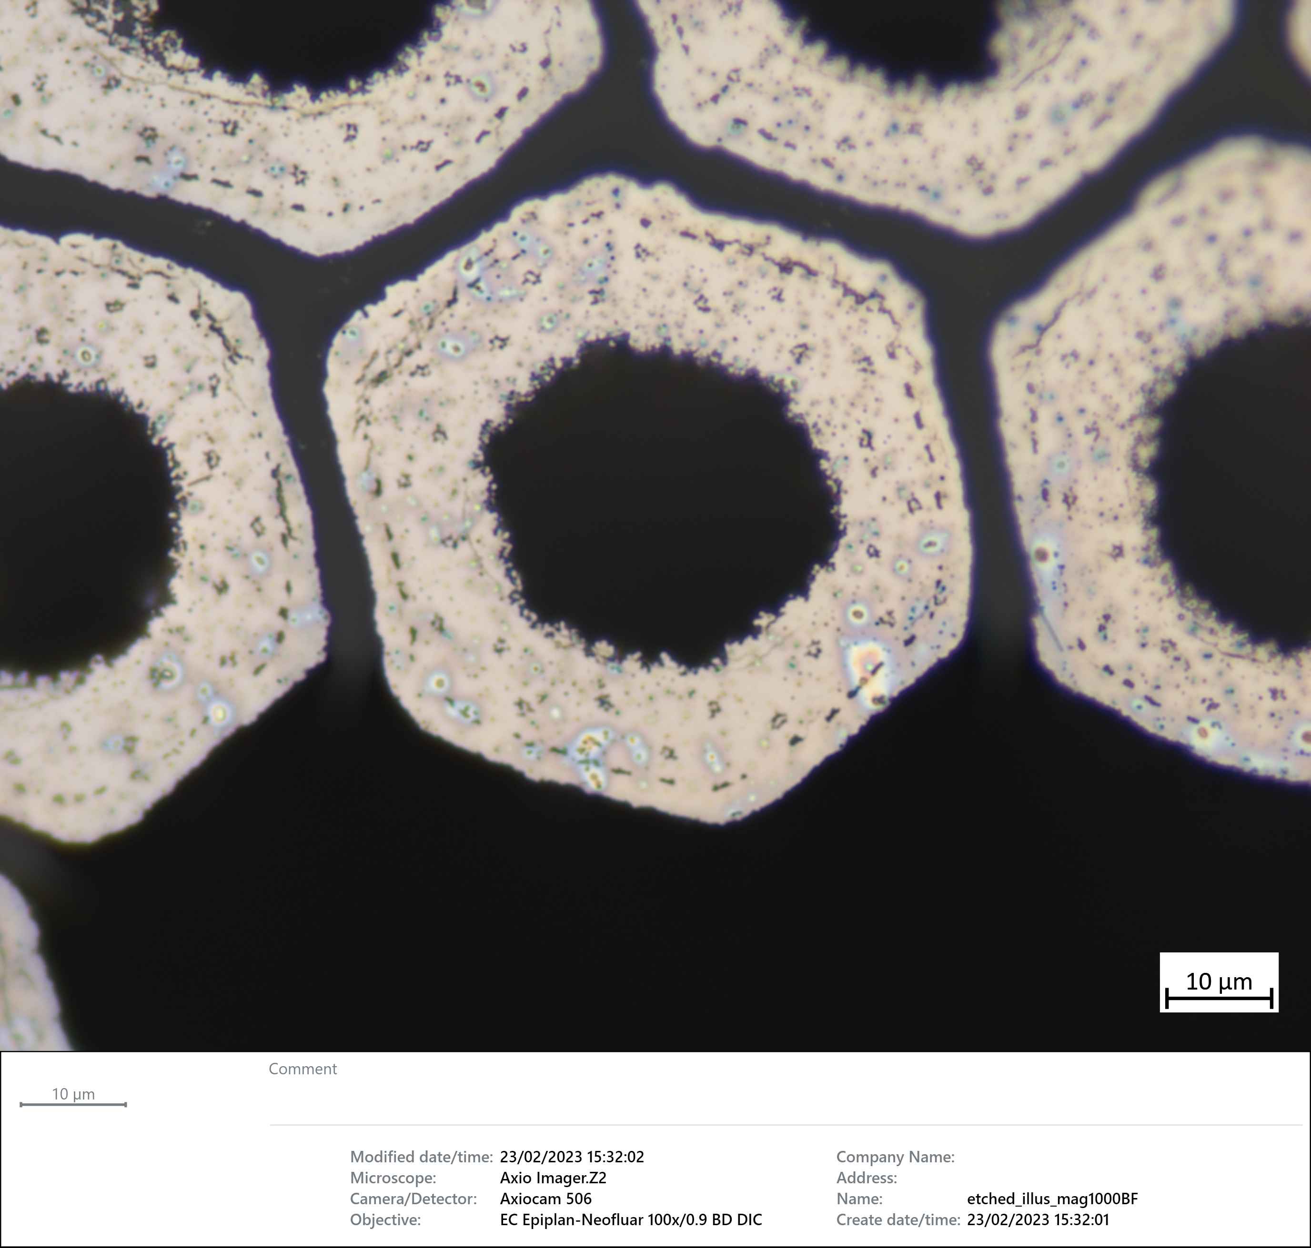
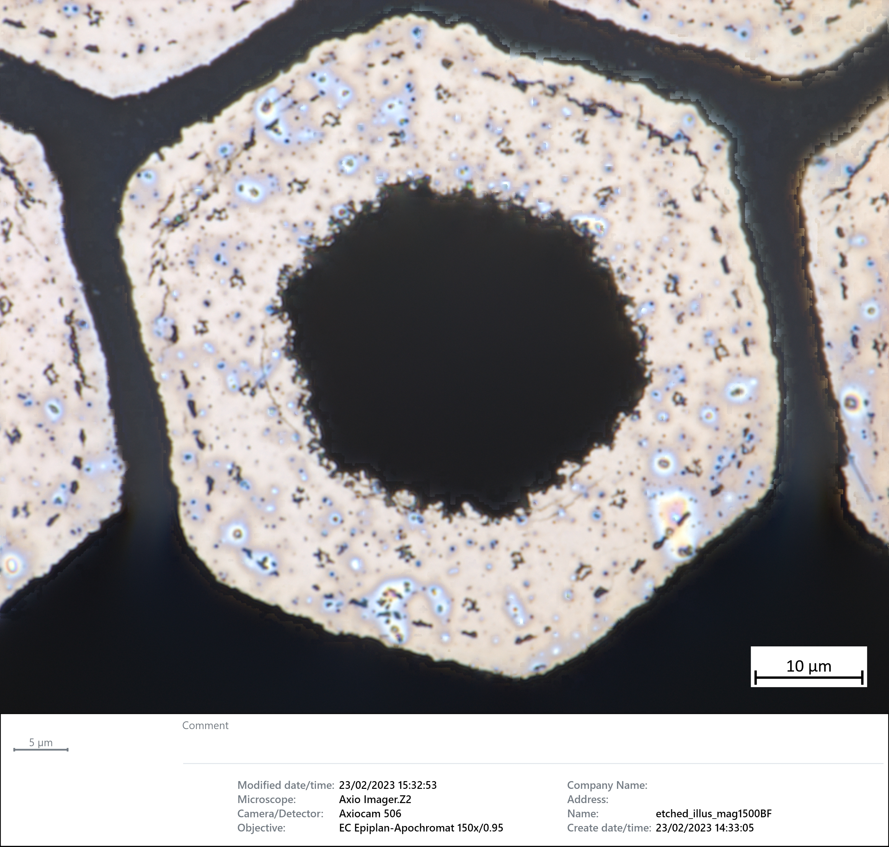
Results Etched / transverse cross sections
No collapsed filament have been observed after deep copper etching.
Pictures are illustrating bended cable and reference cable that appear both intact.
Hard bending
Soft bending

Slide 10
Conclusion and discussion
To the extent of present inspection, it appears that:
All transverse and longitudinal cross sections did not reveal any cracks at SC filaments.
Subsequent deep copper etching on transverse cross sections did not reveal any collapsed SC filaments.
Bended cable exhibit slight opening. This, especially for “hard bending” sample where extremities have been soldered.
It seems that the bending tests did not lead to breakage of SC filaments. Two conclusions can be drawn from these attempts:
There’s too much freedom for the cable that adapts its overall shape to compensate the applied load ,
The as-reacted Rutherford cable is not so brittle as it is generally expected (see EDMS 2824575)
A different approach to create cracks in Nb3Sn has to be discussed and envisaged.

