Slide 1
QXFA121 Reacted Coil Lead Displacement
Fred Nobrega
Giorgio Ambrosio
Coil Working Group Meeting
February 12, 2020

Slide 2
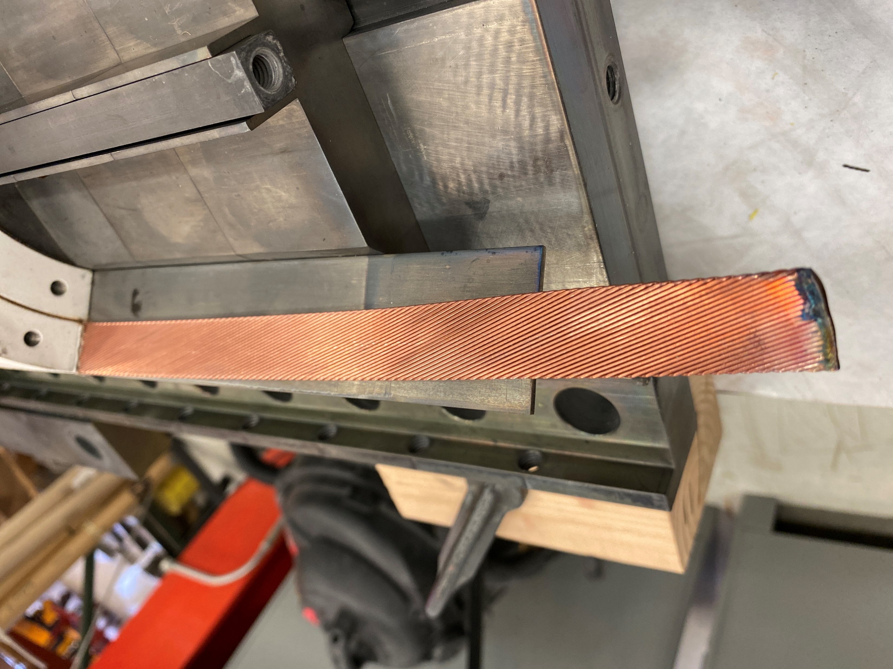
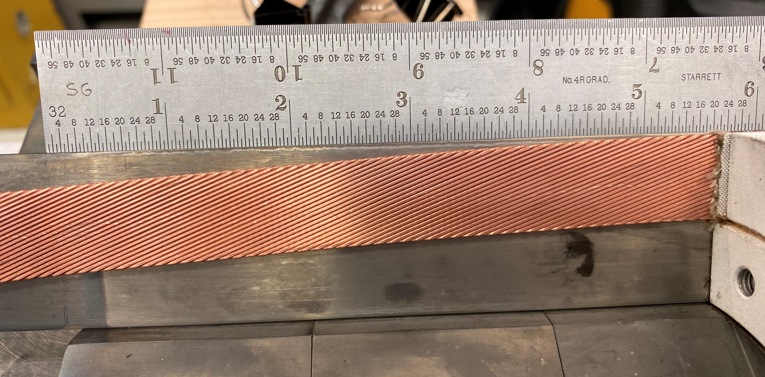
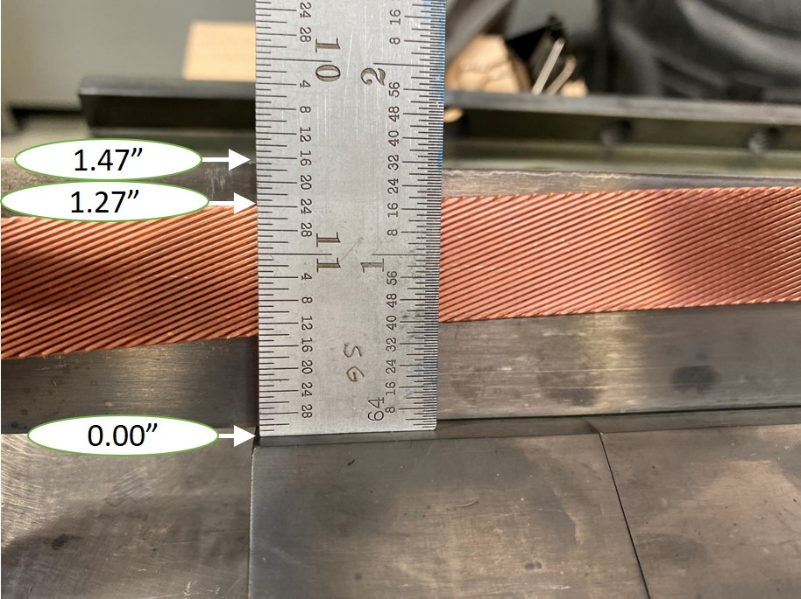
QXFA121 Prep for Impregnation
The mandrel block stuck to the base plate. During the removal process the technician bumped the tip of the L2 lead. The lead was displaced in the plane of the mid-plane shim.
DR11968 was written.

Slide 3
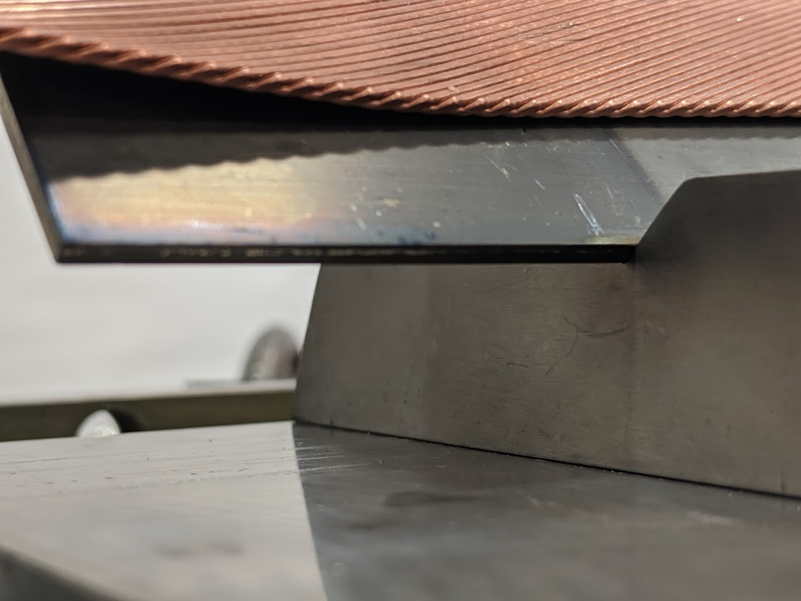
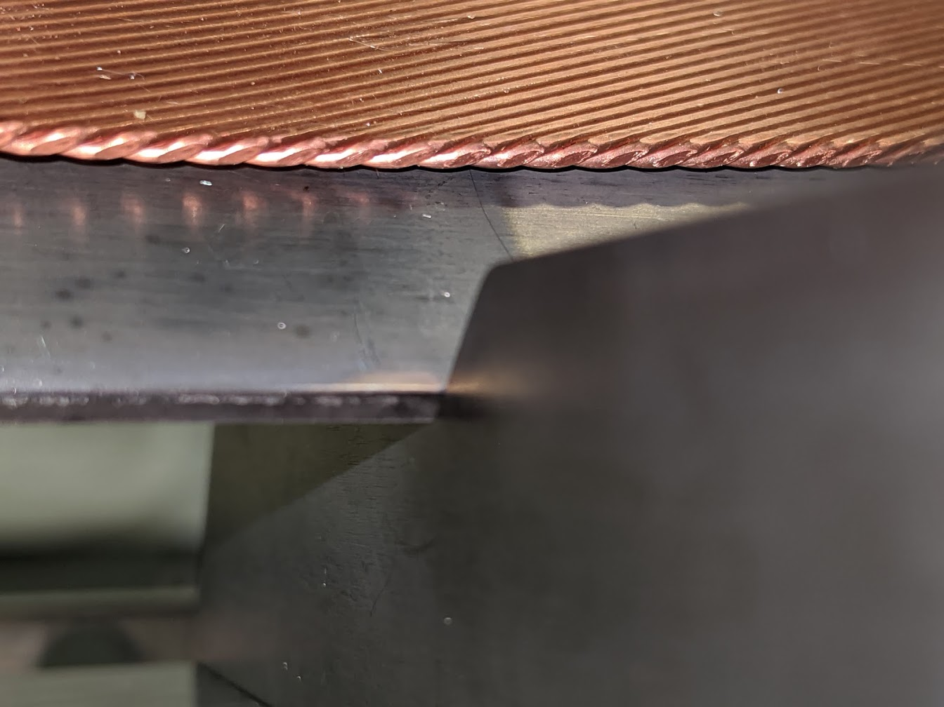
Layer 2 Lead
No visible strand damage.

Slide 4
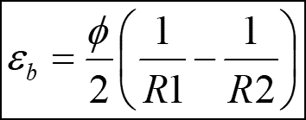
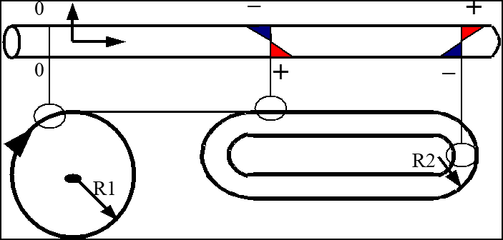
Bending Strain
Strain due to bending
 | mm | inches | inches | inches
Radius before bending | infinite
Radius after bending | 548.132 | 66.25 | 33.31 | 21.58
Cable width | 18.15 | 0.715 | 0.715 | 0.715
Drop from horizontal | 19.8 mm | 1/4" | 1/2" | ~3/4"
Max strain | 0.0166 | 0.0054 | 0.0107 | 0.0166
criteria | 0.0005
damage threshold | 0.0020
Single wire bending strain | mm | inches | inches | inches
Radius after bending | 548.132 | 66.25 | 33.31 | 21.58
Strand Dia | 0.85 | 0.715 | 0.715 | 0.715
Stain | 0.00078 | 0.00025 | 0.0005 | 0.00078

Slide 5
Mitigation
Tap threaded holes to mandrel blocks to extract mandrel
Modify size of tab on the bottom of mandrel blocks that need to be removed.
Clamp lead to SS midplane shim after removal of 1st mandrel block.

