Slide 1
MQXF125 Midplane Repair Options
Fred Nobrega – FNAL
Coil Working Group Meeting – Wednesday Jan 27, 2021

Slide 2
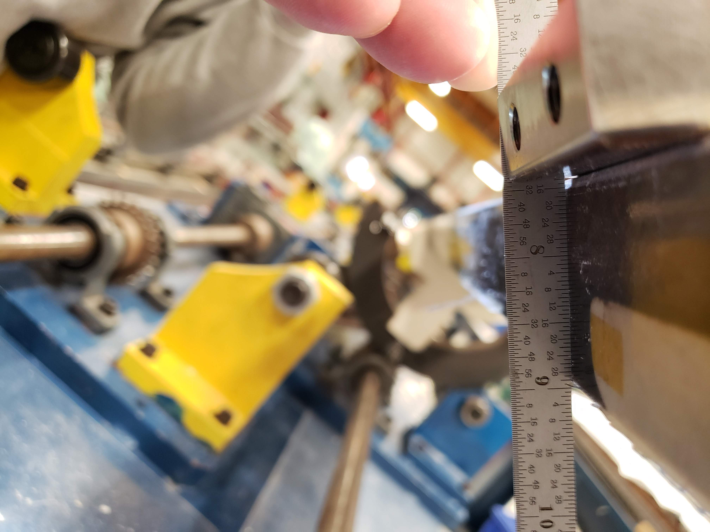
Discrepancy 12166
Description
After coil QXF125 impregnation and during epoxy flash removal, too much epoxy and fiberglass was filed exposing the corner of the cable.
Cause
Improper use of file angle and pressure
Repair options
Build up with Stycast then sand to shape
Remove L2 midplane G11 insulation & replace with S2 glass, 2nd impregnation.
Details in following slides.

Slide 3
QXFA125 Damaged Area
Chamfer length = 90 mm
Exposed Cable
Lead End
50 mm
Lead End

Slide 4
Lead End
4/64 = 0.0625” (1.588 mm)
Lead End
1/64 = 0.016” (0.397 mm)
\\tdserver1\project\HFM\LARP\QXF Coils\QXFA Coils\QXFA 125\DR Post Impregnation Filed Lead\QXFA125\Picture \A007 - 20201013_095629

Slide 5
QXFA125 CMM Scan
Coil OD
COIL OD
0.145 mm cable insulation
0.100 mm trace
0.310 mm S2 glass
0.555 mm nominal thickness
Midplane
0.145 mm cable insulation
0.125 mm G11
0.270 mm nominal thickness
Midplane

Slide 6
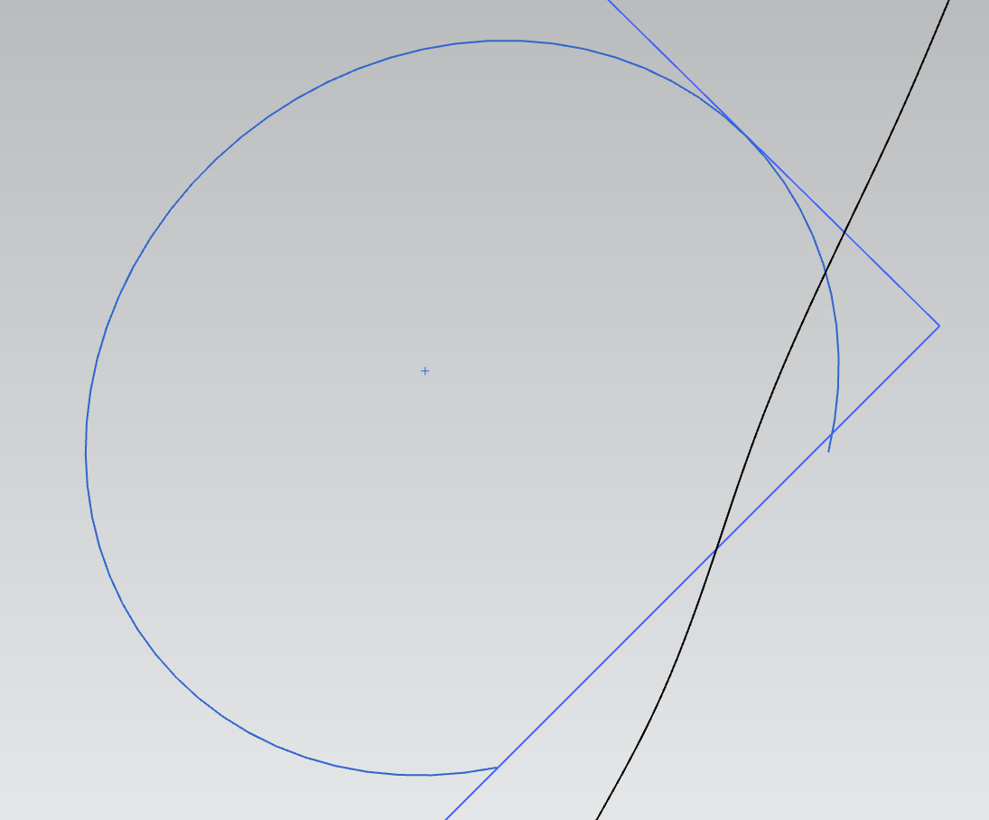
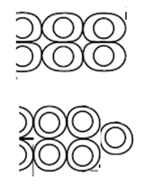
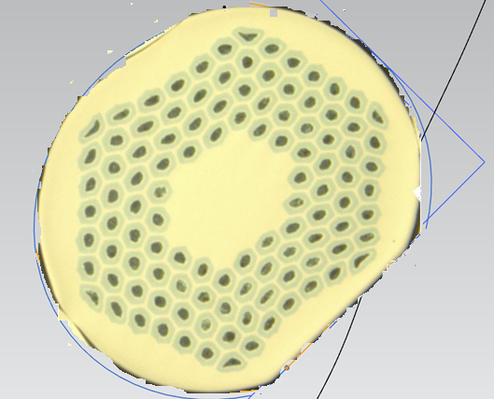
Deformed Cable Strand
R2= 0.45 mm
R1= 0.4 mm
Quadruplet cable edge
(worst configuration for A125 damage)
Triplet cable edge

Slide 7
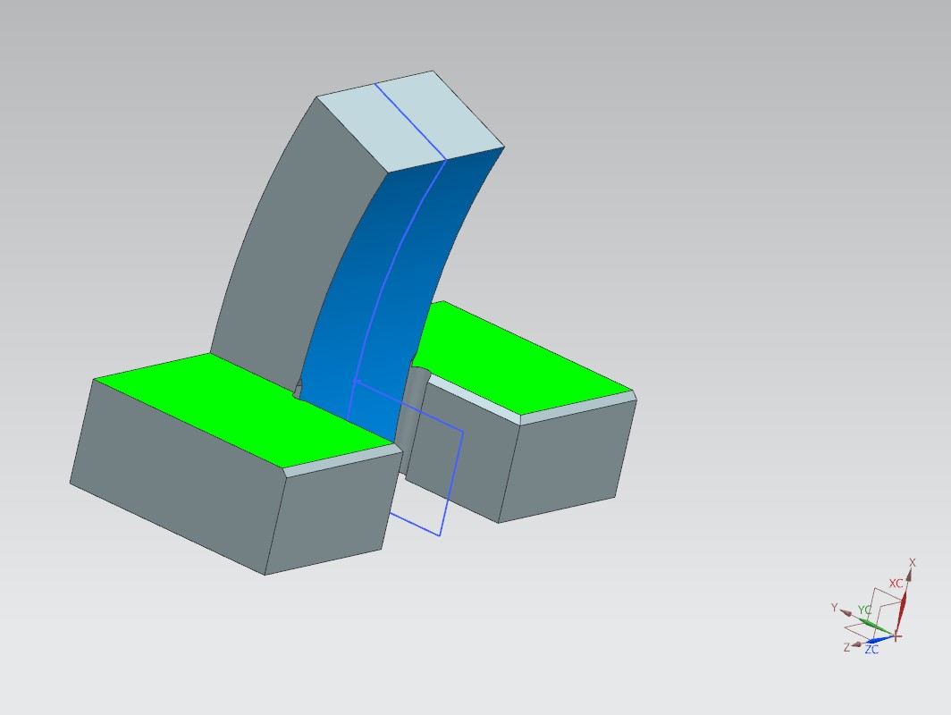
Midplane Repair, Stycast
Build up with Stycast
Sand to shape with new tool.
Coil OD
Midplane

Slide 8
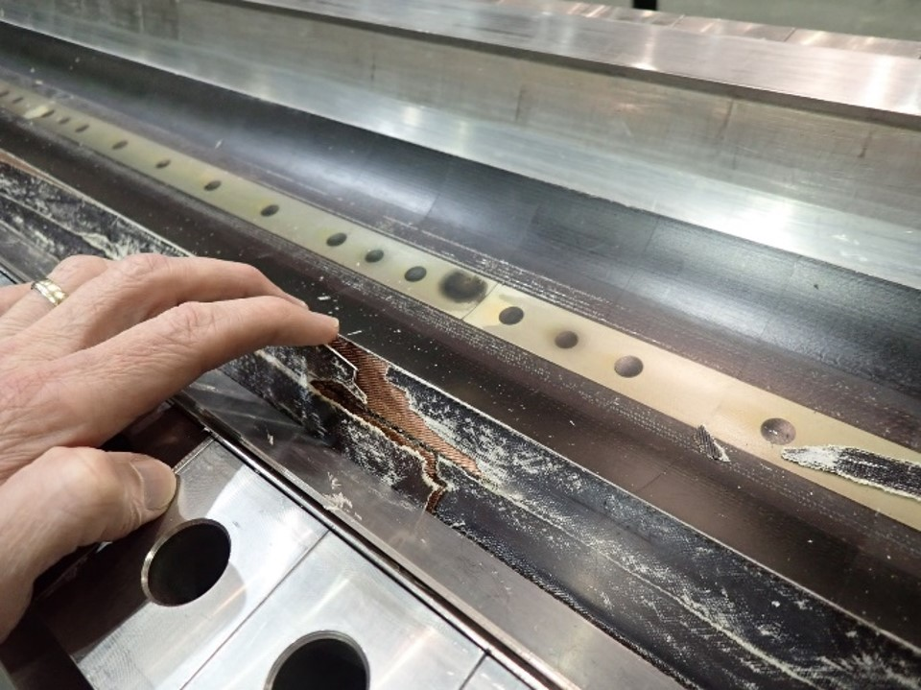
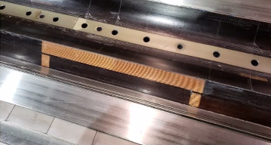
Midplane Repair, 2nd Impregnation
Remove 90 mm of L2 G11 midplane.
Add 2 layers S2 glass
Perform 2nd full impregnation
QXFA213 before
QXFA127 before
Coil Outer Diameter
Coil Midplane
QXFA127 after
QXFA127 after

