Slide 1
Coils on Hold
Jesse Schmalzle
November 14, 2024

Slide 2
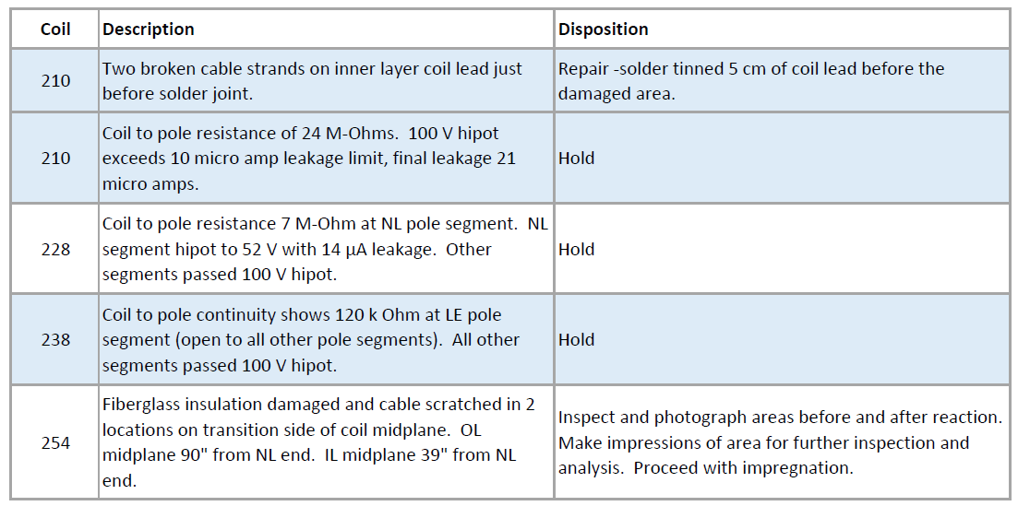
DRs
DRs
216 also in storage – removed from magnet 09 after Kapton pinched at midplane

Slide 3
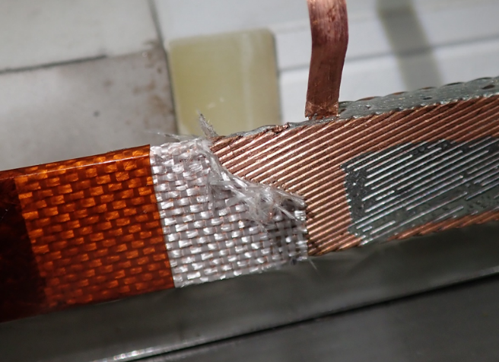
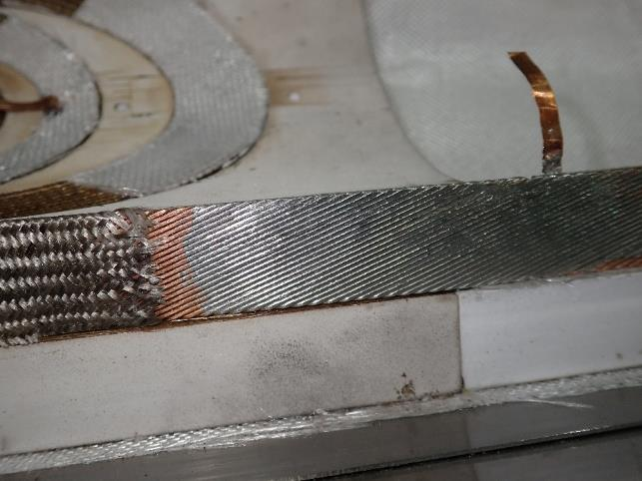
QXFA210
Coil 210 – 2 cable strands broken during prep for impregnation.
Location 1 cm beyond coil end saddle, at start of Nb₃Sn to NbTi splice.
Damage is at inner edge of inner layer coil lead.
Cable solder filled starting 5 cm before damaged area to aid in current sharing.

Slide 4
QXFA228 / QXFA238
Coil 228 – coil to pole resistance below spec.
Standard coil to pole hipot at 100 volts – passes with all pole segments connected EXCEPT NL segment.
NL pole segment reaches 52 volts with leakage current of 14.1 µA.
Coil 238 – coil to pole connection.
Standard coil to pole hipot at 100 volts – passes with all pole segments connected EXCEPT LE segment.
LE pole segment shows 120 kOhm coil to LE pole segment.

Slide 5
QXFA254
Fiberglass cable insulation damage and cable scratches noted during prep for reaction.
Damage caused by razor blade when trimming fiberglass interlayer insulation after coil curing.
2 locations, each area ~ 2.5” long:
Inner layer coil midplane, transition side, 39” from NL end.
Outer layer coil midplane, transition side, 90” from NL end.
Inspection and photos before and after reaction.
Inner layer – scratches in copper.
Outer layer – scratches in copper, 4 small black spots observed under magnification after reaction.
Silicone mold putty impression made for detailed inspections.

Slide 6
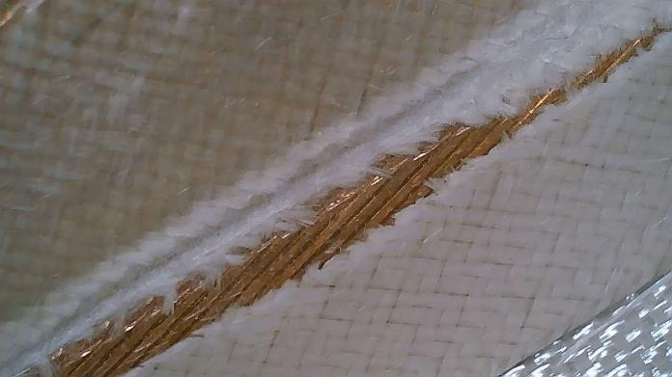
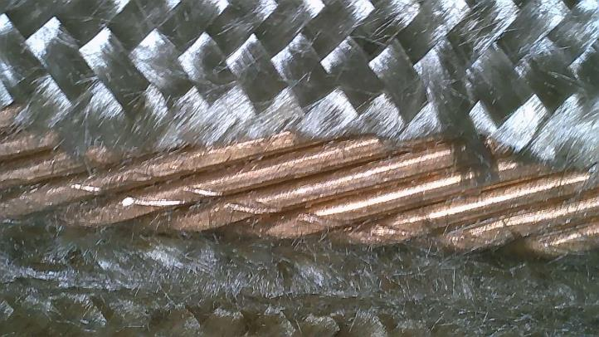
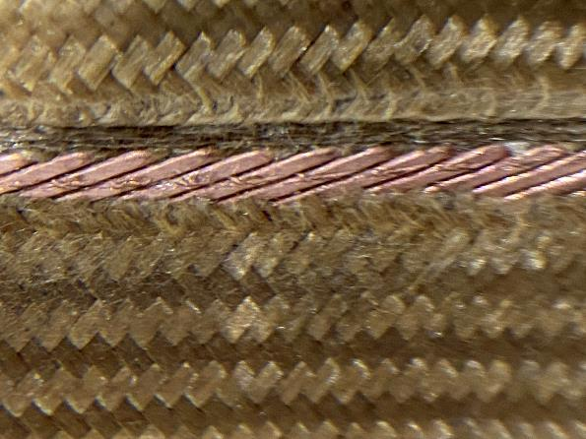
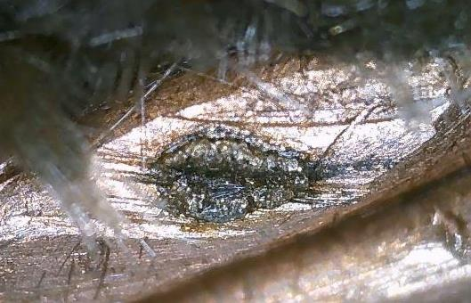
QXFA254

