Slide 1
Muon Campus Shutdown Report
Jim Morgan
Friday 09:00 Ops Meeting
November 8, 2024

Slide 2
Muon Campus status
Rigging work through D40 Hatch completed on Wednesday
Operational ESS2 transported from NWA to tunnel
Prototype ESS2 removed from tunnel and transported to A0 Clean Room
Original Q205 quadrupole transported to Technical Division for rad hardening
Forklift returned to MI-8 Line for Collimator work
D30 downstream mechanical work in progress
ESS2 installed in Delivery Ring, vacuum connections next
Preparing for installation of Rad Hard Q205 installation
Domestic water line repair north of AP-0 and over MI-8 Line
Small sinkhole observed last Friday in area to be excavated
Transport Enclosure secured for Booster CDC testing
Muon LCW resistivity continues to be poor
AP-0 A/C work paused, reasons unclear
Study – M1-M3 Optics
Study – Alternative M5 optics

Slide 3
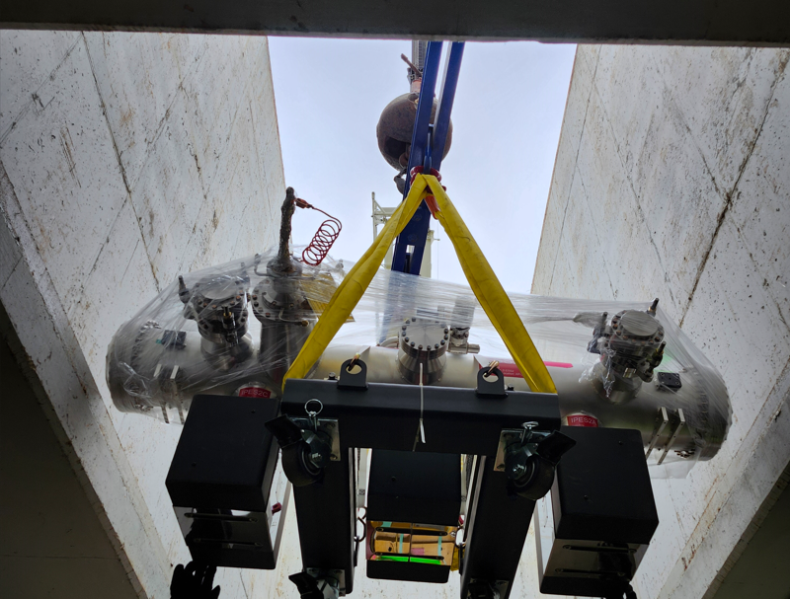
Operational ESS2 being lowered into tunnel

Slide 4
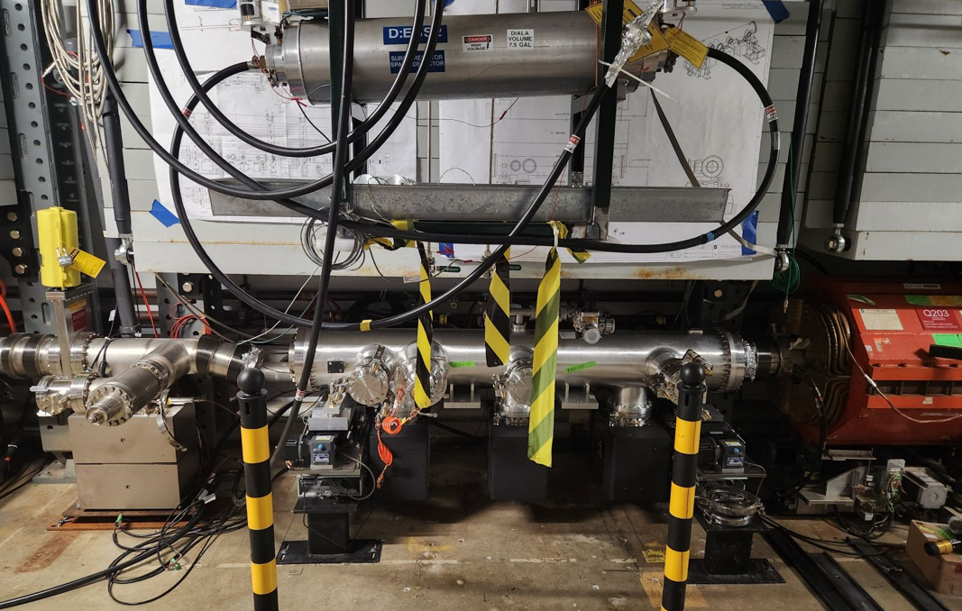
Operational ESS2 set in Delivery Ring

Slide 5
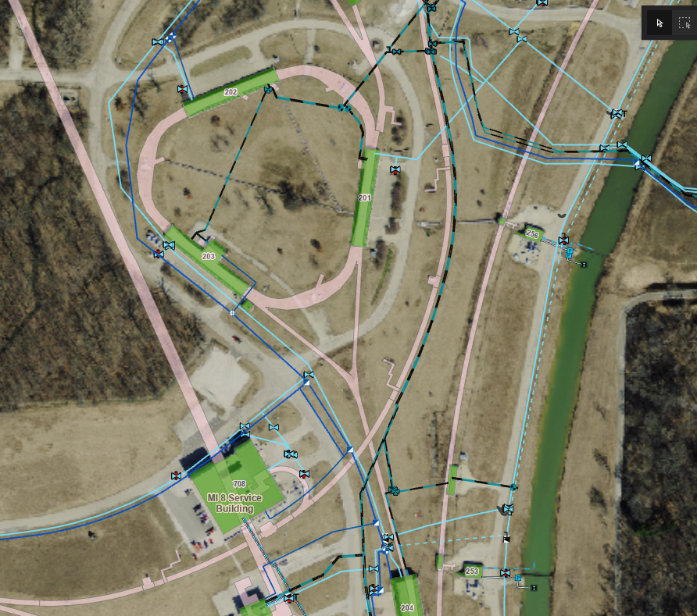
Domestic water line replacement
Domestic water
leak/repair zone

Slide 6
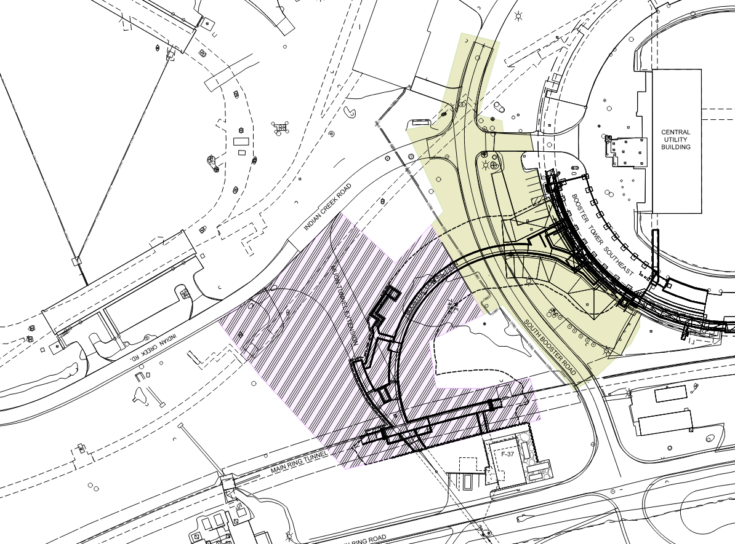
PIP-II Beam Transport Line Civil Construction
Booster Phase 2
Begins January 2028
Booster Phase 1
Begins January 2027
Muon Campus
cryo header
F-Sector Reconfiguration Task Force
Dean Still - Chairman
Mark Austin, Maurice Ball, Steve Dixon, Cons Gattuso, Michael Geelhoed, Stan Johnson, Jim Morgan, Denton Morris, Michael Olander, Dan Vrbos

Slide 7
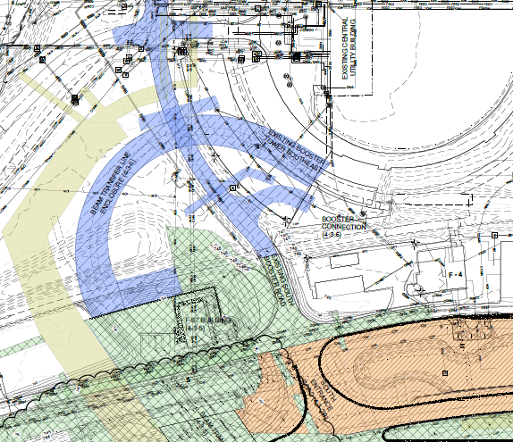
PIP-II Beam Transport Line Civil Construction
Booster Phase (2027-2028)
Linac Phase (in progress)
Main Ring Road excavation begins January 2025
Main Ring Road

Slide 8
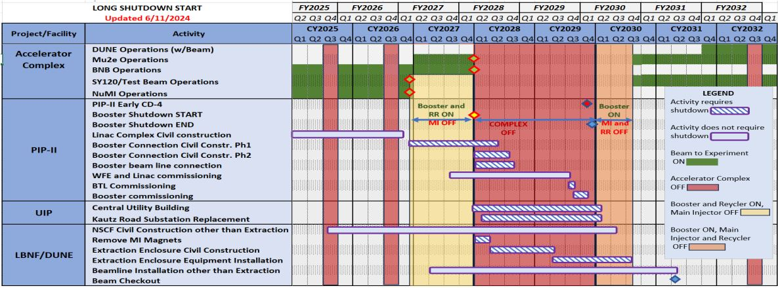
Lab Schedule

Slide 9
Upcoming work
D30 installation work continues
Getting operational ESS2 under vacuum highest priority, alignment on Monday
Rad Hard Q205 and special vacuum pipe
Vacuum Tee for Profilometer
Plan to leave 24 mr roll on ELAM in as it improves extraction trajectory
More Muon Campus Feeder 24 outages planned over the next two months
Domestic water line repairs south of AP-0 may have compromised shielding
Close to Transport berm, need to survey to understand if berm was disturbed
Excavation for new water line crossed over MI-8 tunnel
Other upcoming work
Install additional steel shielding above ECMAG
Several survey & alignment tasks including Q205, ESS1, ESS2 and M4 WCM
Repair Kirk Key hardware on disconnects, requires more modifications to disconnect
Replace several power supply circuit breakers and some primary wiring
Prepare to install Mu2e Extinction Monitor Collimator in Absorber area
M4 Final Focus vacuum installation, A/C dipole installation
Hope to begin preparing for beam operation later this month

