Slide 1
0900 AD Shutdown Scheduling Meeting
Marty Murphy
8 Nov. 2024

Slide 2
Current Status
KRS Power outage was successful on Tuesday AM. Subsequent outages were postponed due to weather.
MI-8 Collimators
Gradient magnets and spool pieces were installed and aligned this week.
Rough vacuum was established overnight Thursday-Friday.
Leak check Friday; if that goes well ion pumps will start Friday afternoon.
MI LCW
Gasket replacement complete for the Ring LCW system was completed on Tuesday afternoon.
MI magnet LCW system was successfully filled & re-started on Wednesday morning.
Currently running two pumps at each house to minimize heat load added by pumps.
Run in this mode for one week to reach temperature steady state and verify our plan.
MI Power
AD continues to work with ISD to determine the best configuration for powering beam lines and to adjust LOTO procedures as needed.

Slide 3
Plan:
MI-8 Collimators
Assuming leak check is successful on Friday, remaining collimator steel will be moved into the MI-8 Magnet drop lower level to prevent it from being impacted. This will take two days.
MI LCW
Determine an appropriate LCW temperature set point to handle heat load from BNB operation with only one functioning heat exchanger (at MI-30).
MI beam sign-offs
We wish to speak to ES&H regarding how to handle the Run Conditions for the MI-10 enclosure during BNB operation.
Complete Power Outages that were postponed due to weather earlier this week. TBD
Houses remaining are MI 20, 30, 40, 52 & 62.

Slide 4
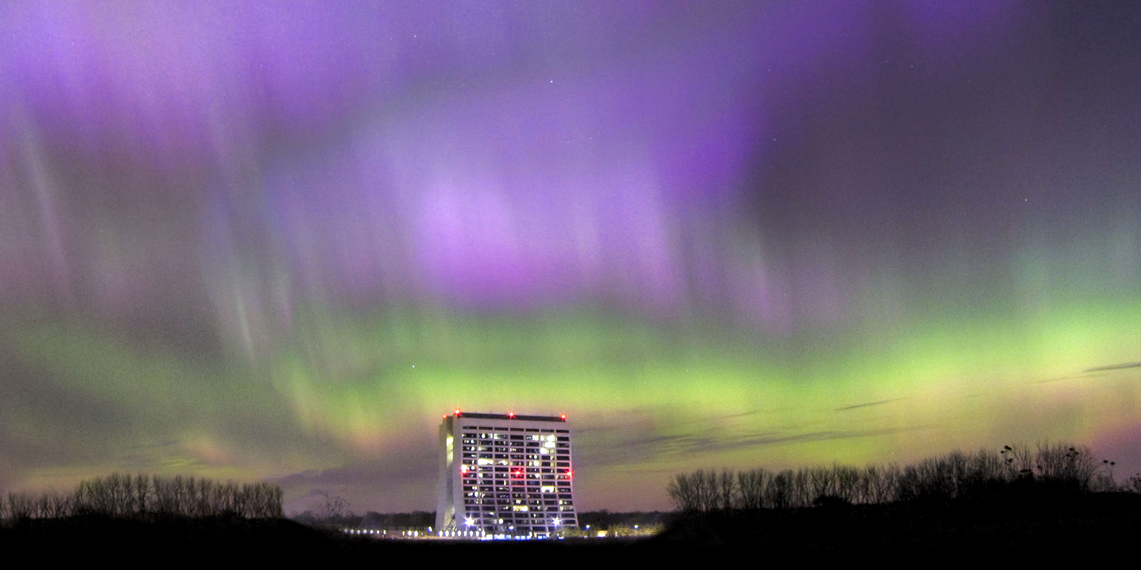
This picture is 20 years old today. At the time this was among the 10 most powerful solar storms on record.

