Slide 1
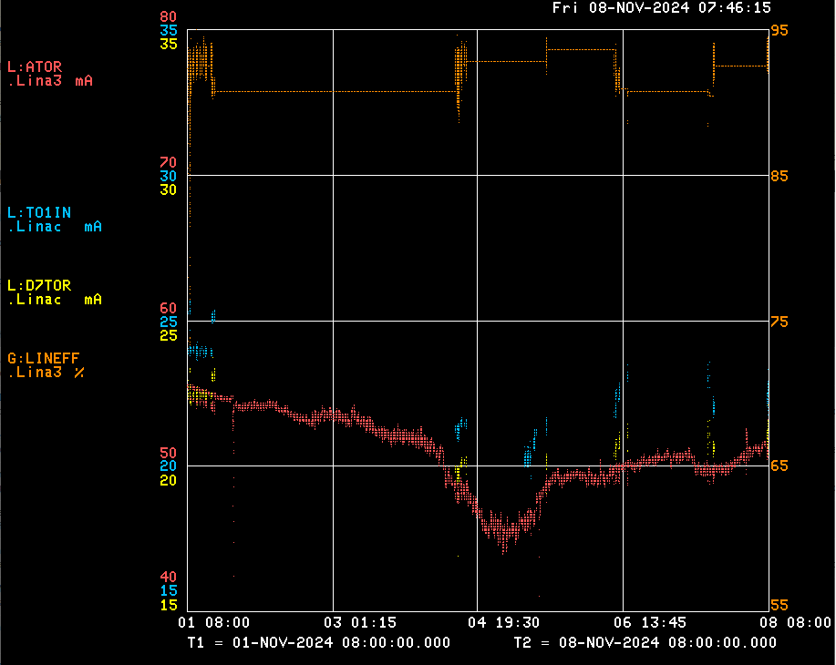
Linac/Preacc Operation (Nov 1 – Nov 7, 2024)
Notable Events:
Beam to MTA, Linac Studies. D7TOR ~20 mA, 93% efficiency.
LRF3 cell swap for ZOV trips.
KRF water skid adjustments for Collector Water Flow trips at KRF2 – now on Skid 1 & 3.
Debuncher is on.
Source A current drooping this week; tuning it back up.
Future Concerns:
We will run LRF2 & LRF5 driver until they die; will need ½ day downtime to swap.

