Slide 1
Mu2e report
Greg Rakness (FNAL)
Friday 9am AD meeting
08-Nov-2024
https://indico.fnal.gov/event/66979/

Slide 2
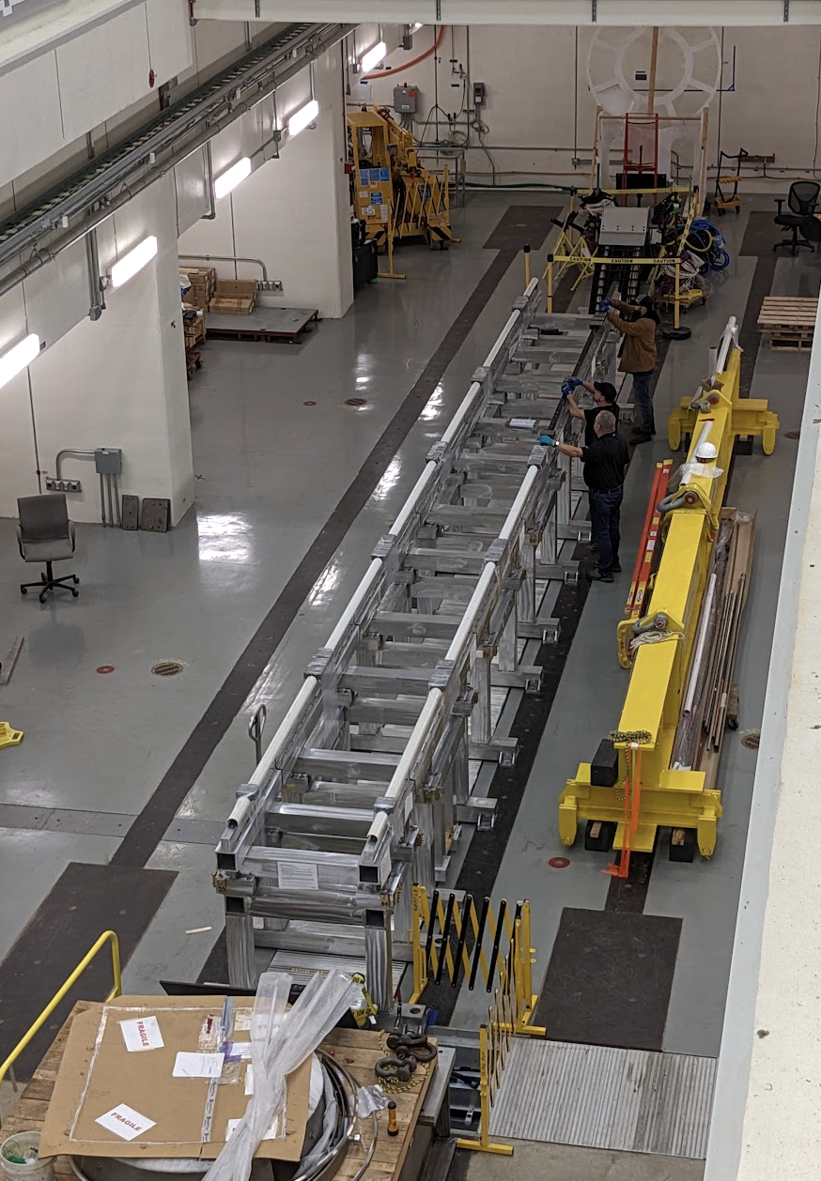
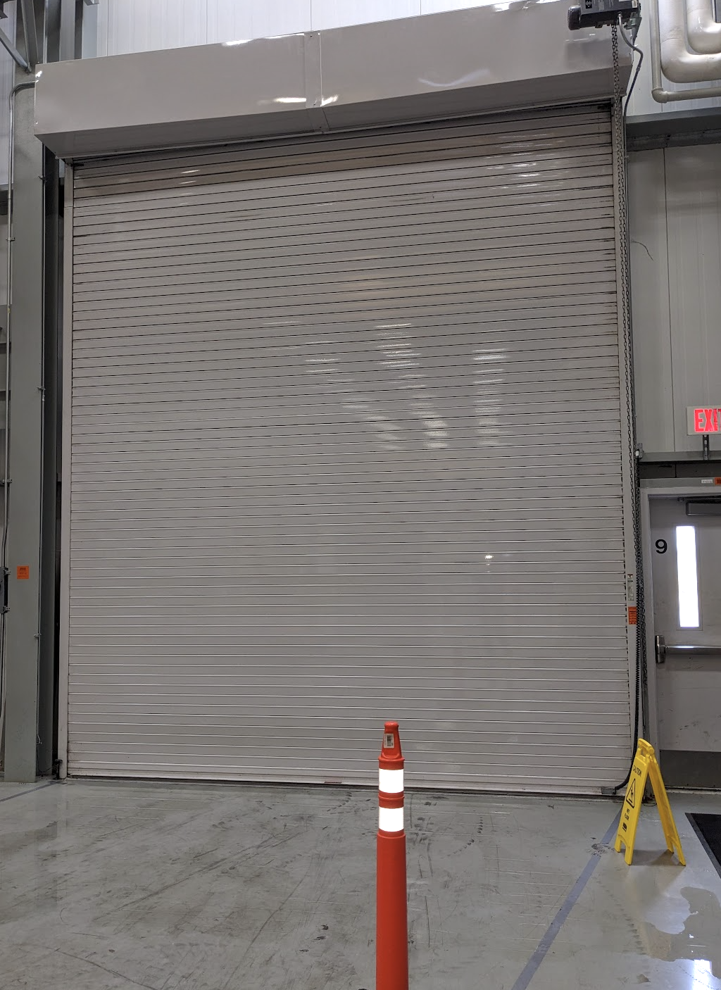
Preparations ongoing to receive detectors at Mu2e
External rails (support tracker and calo for servicing) aligned to near-final position
  Final position when Detector Solenoid is here
Working to understand environment for detectors in the building
  Want tighter humidity control…
Roll-up door
  Rain water creeps in underneath
  Also gets transferred within housing from outside to inside when door is rolled up

Slide 3
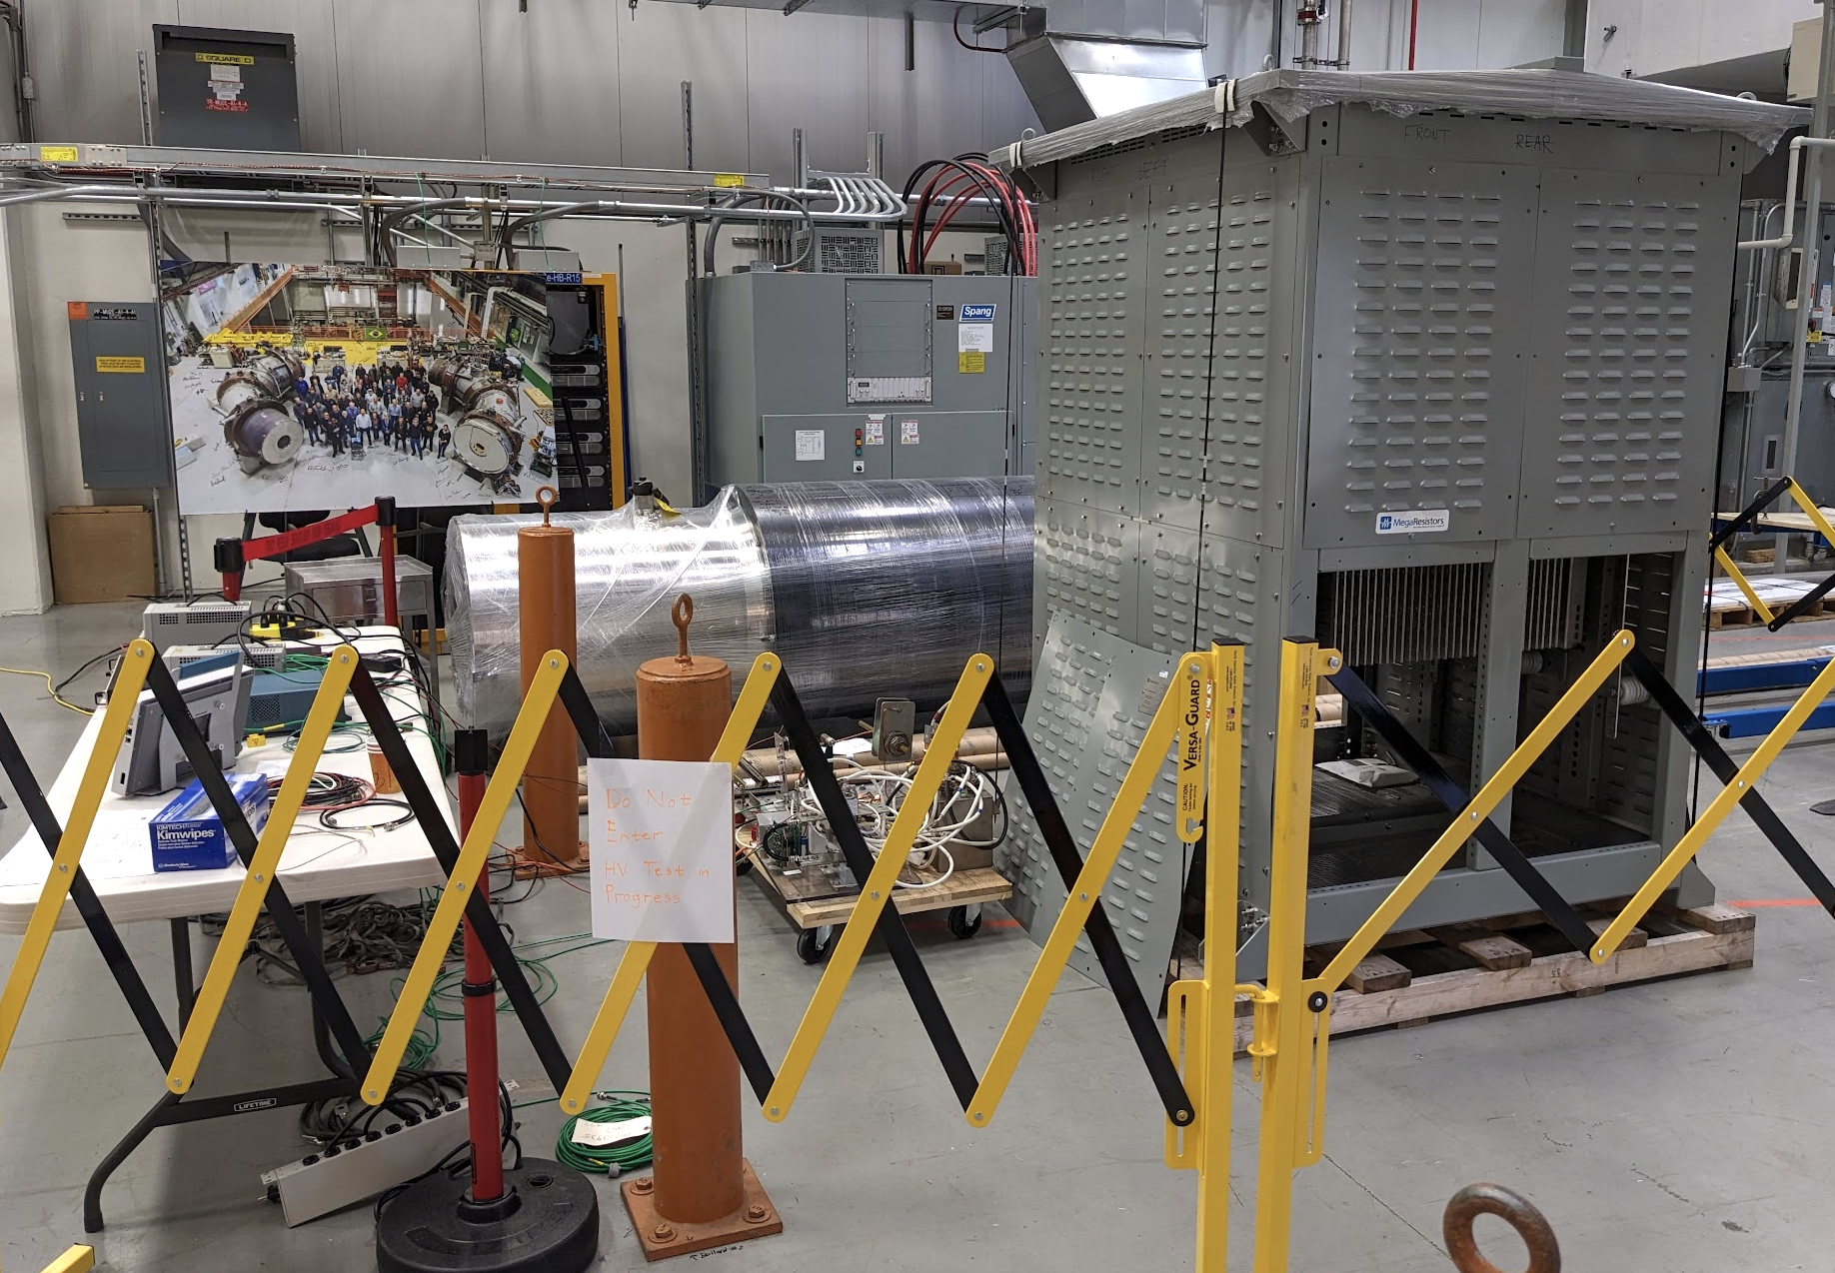
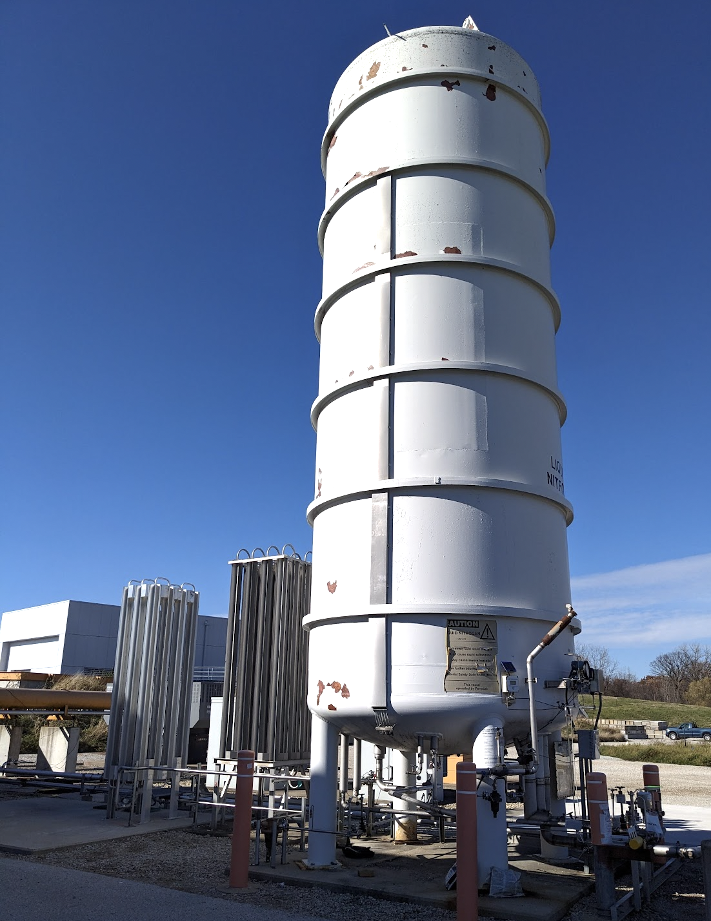
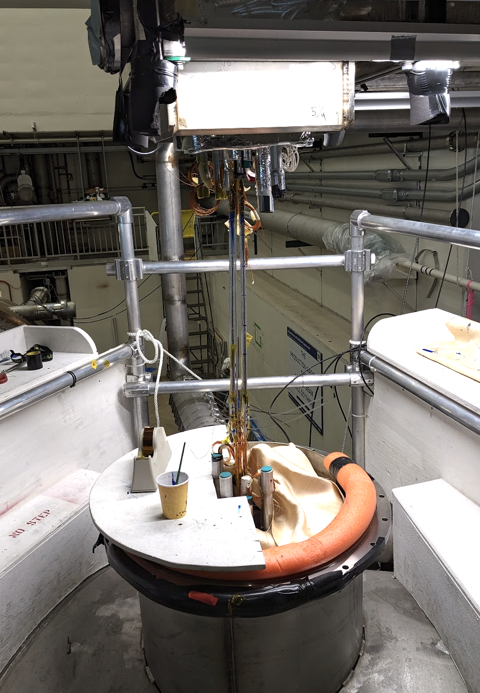
Preparations ongoing to receive solenoids at Mu2e
Electricians ~finished cables from cabinets to power supplies
Dump resistors testing has started
Both TSu and TSd superconducting splices completed
Cryo
  Liquid nitrogen tank refurb done
  Full Flow purifier expected before Thanksgiving

