Slide 1
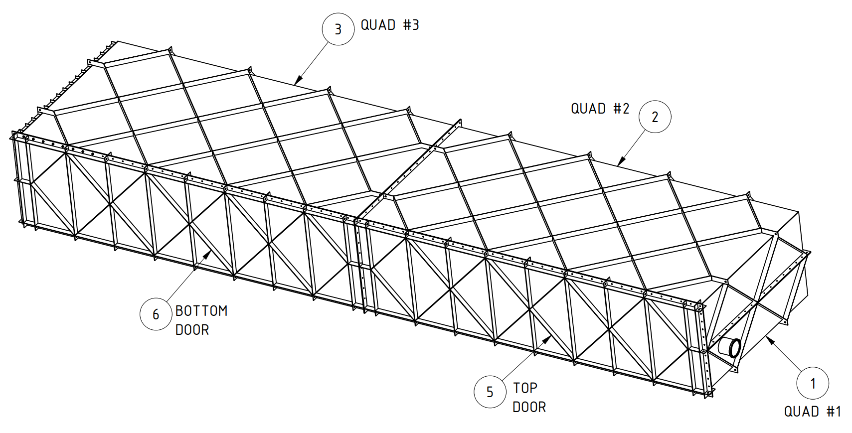
HD Coldbox
https://edms.cern.ch/project/CERN-0000252193
Status
Documents released
PRR held Oct. 28, 2024
QC requirements checklist received, in review
Working on critical lift plan
Install Activity:
Assemble the cold boxes for the HD detector
8-Jun-26
Tech Spec. | 252224 | Released | 10/17/2024
3D Model | 252254 | Released
Eng. Analysis | 252285 | Released
CO Report | 252317 | Released
2D Drawings | 252347 | Released
Schedule Contact | 252407 | Empty
Install Procedure | 252437 | Released
Store/Move 120d - 4mo
Fabrication
180d – 6mo
Procurement plan
LPTA
Fabrication drawings send to vendor
Final subassemblies delivered to SDWF
Procurement
180d – 6mo
Latest “Submit to Procurement”
15-Dec-24
Fabrication/delivery
PRR Target: October 2024

Slide 2
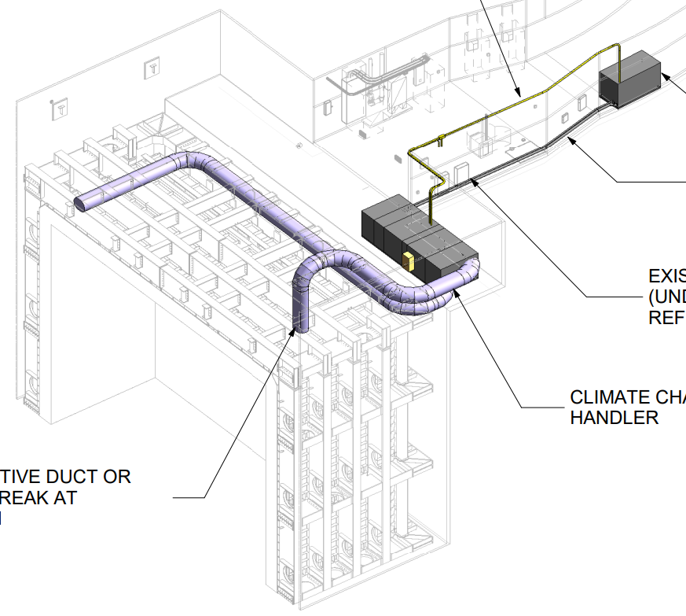
VD Temporary AHU
https://edms.cern.ch/project/CERN-0000252187
Status
Procurement specification, 2D drawings created
Awaiting additional information from ventilation engineering
Install Activity:
Install the air units and filters on the manholes of the cryostat in the South Cavern 24-Jan-26
Tech Spec. | 252218 | Eng. Check | 10/17/24
3D Model |  | n/a
Eng. Analysis | 252278 | Released | 04/13/23
CO Report |  | n/a
2D Drawings | 252341 | In work | 10/17/24
Schedule Contact |  | Empty
Install Procedure |  | n/a
Store/Move 120d - 4mo
Fabrication
90d – 3mo
Procurement plan
Best Bid Value
Installed by vendor
Procurement
120d – 4mo
Latest “Submit to Procurement”
30-Mar-25
Fabrication/installation
PRR Target: ISD/ESH document review Oct 2024 (fulfills PRR)

Slide 3
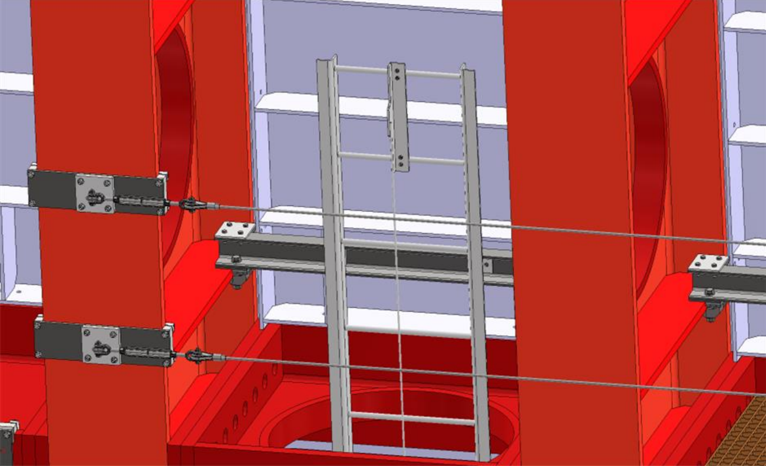
VD Cryostat Fall Protection (Ladders/Guardrails)
https://edms.cern.ch/project/CERN-0000252186
Status
Procurement specification drafted, reviewing by ES&H
2D drawings created, with interfaces
Installation to be self-performed
Install Activity:
Install the ladders and the access system for the side walls of the cryostat in the South Cavern
24-Jul-26
Tech Spec. | 252217 | In work | 10/17/24
3D Model |  | Empty
Eng. Analysis |  | Empty
CO Report |  | Empty
2D Drawings | 252340 | In work | 11/11/24
Schedule Contact |  | Empty
Install Procedure |  | Empty
Store/Move 120d - 4mo
Fabrication
180d – 6mo
Procurement plan
LPTA
Fabrication drawings send to vendor
Final subassemblies delivered to SDWF
Procurement
180d – 6mo
Latest “Submit to Procurement”
30-Apr-25
Fabrication/delivery
PRR Target: November 2024

Slide 4
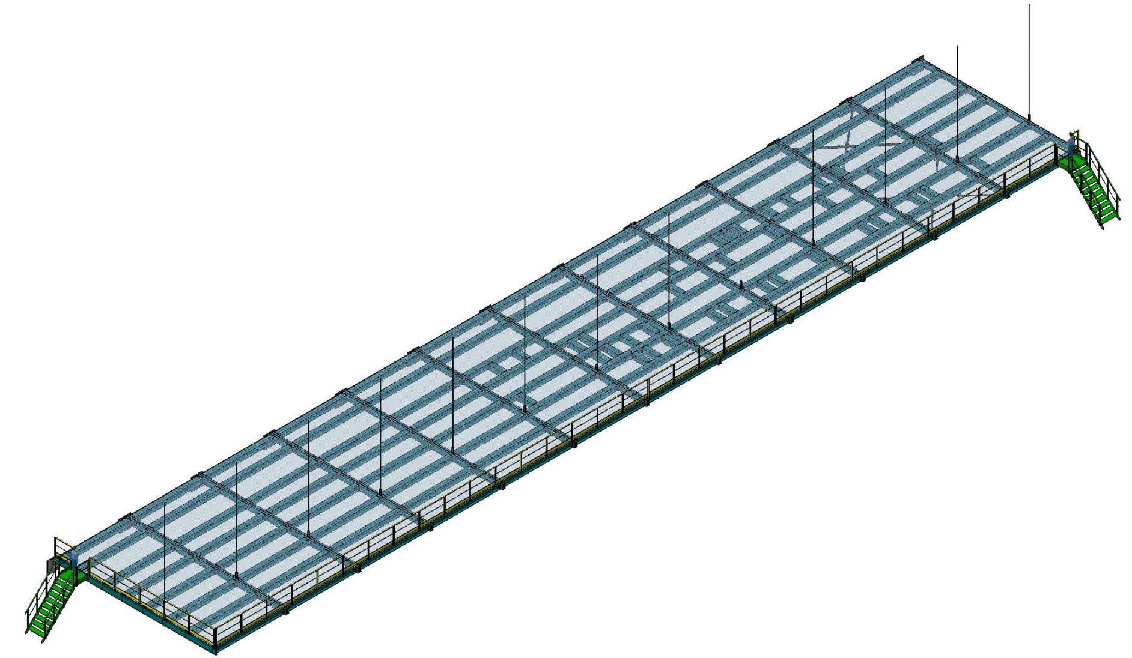
HD/VD Cryogenic Mezzanines
https://edms.cern.ch/project/CERN-0000252179
Status
Revising model and engineering note for accommodating updated assembly plan and beam profiles
Install Activity:
Install cryogenic Mezzanine level 1 for cryostat #1 - FNAL personnel 28-Jul-26
Tech Spec. | 252213 | Empty
3D Model | 252243 | In work
Eng. Analysis | 252273 | In work
CO Report | 252306 | Draft
2D Drawings | 252336 | Empty
Schedule Contact | 252396 | Empty
Install Procedure | 252426 | Empty
Store/Move 90d - 3mo
Fabrication
150d – 5mo
Procurement plan
LPTA
Fabrication drawings send to vendor
Structural components delivered to SDWF
Installed by contractor
Procurement
180d – 6mo
Latest “Submit to Procurement”
3-Jun-25
Fabrication/installation
PRR Target: December 2024

Slide 5
HD/VD engineering update – 11/12/2024
HD Coldbox
Received majority of comments from PRR, will receive final report in next couple days
Will be working with rigging specialist to develop the critical lift plan in coming weeks
Air handling equipment for cryostat installation
Fermi ventilation engineer preparing unit specification
Cryostat external ladder/guardrail cable (fall protection system)
Procurement specification created
Detailed connections and drawings/interface documents created
Cryo. mezzanine
Still in work, plan to have documents to C.O. mid-Nov.
Looking at wall T- bracket boundary conditions
BSI-BIM coordination progressing
Minor outstanding items being resolved.
Small improvements outlined by installation managers have been implemented

