Slide 1
FD1/FD2 Installation Engineering Update
Nicholas Joniak
11/12/2024

Slide 2
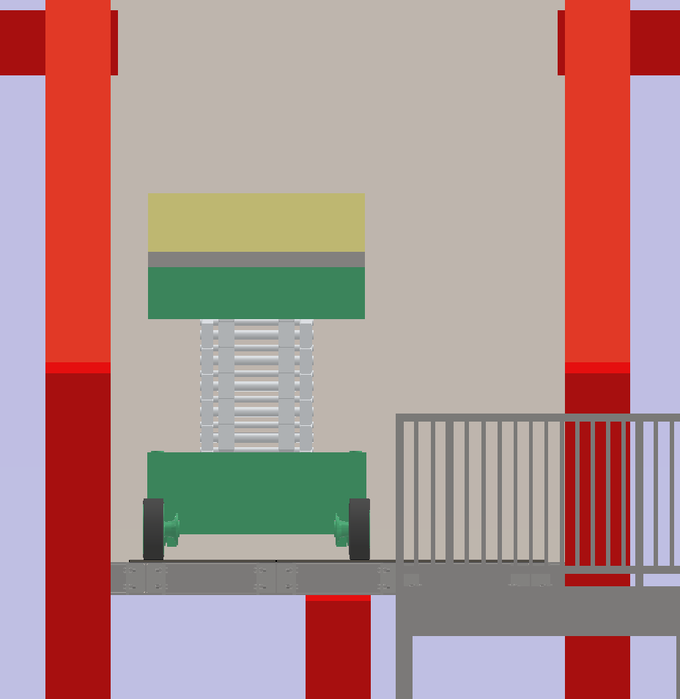
Engineering Updates
Lift Table
Procurement Status:
  No changes since last week.
FD2 TCO:
  Platform redesigned - analysis plan being drafted now.
    Working with safety railing company on how to integrate their COTS products into this design.
185 Test:
  Training completed for:
    Mobile elevated work platforms.
    Work at heights.
      Need clarification on medical clearance requirement for CERN.
  Need to schedule pallet jack training for next visit.
Stairs

Slide 3
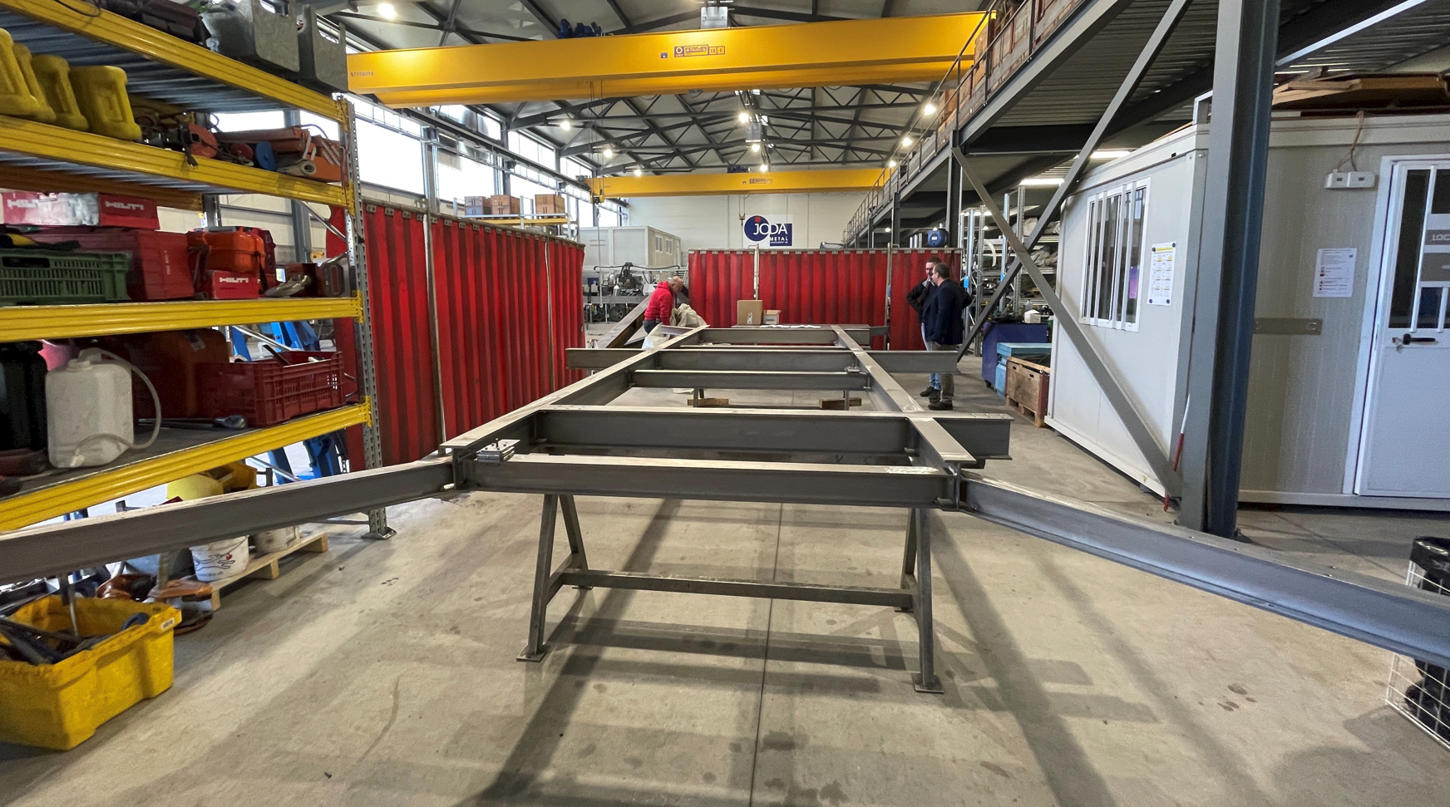
Engineering Updates (Cont.)
CRP-SST Prototype – Company Visit

