Slide 1
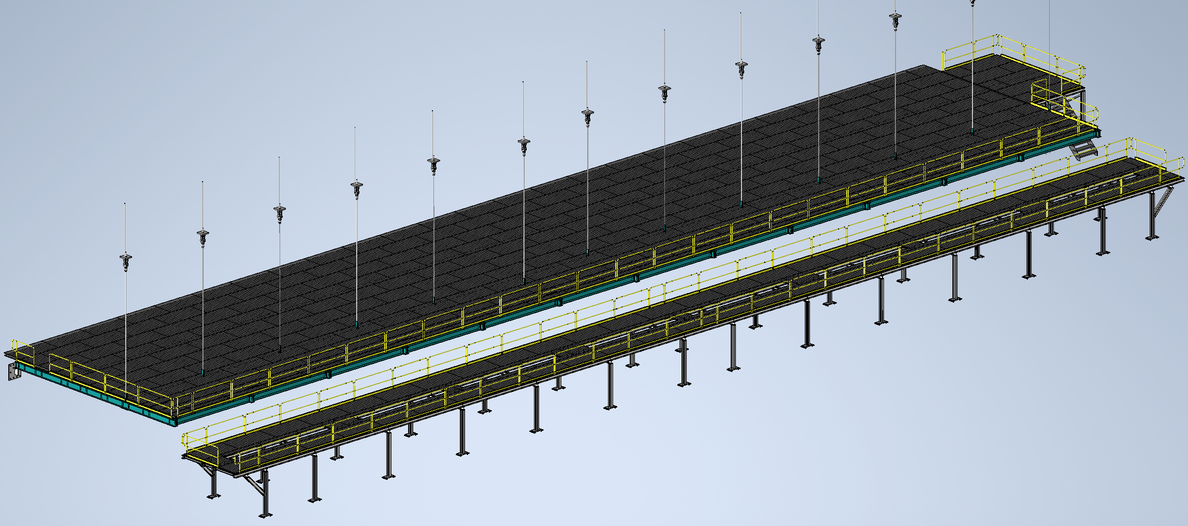
Mezzanine Flooring and Railing
Status
  Layout work complete on VD detector mezzanine
  CAI offers workarounds for toeboards
  Design note first draft complete
Walking surface and railings for mezzanines
Install Activity:
Install flooring and railing onto detector, cryo, and ledge mezzanines
16-Sept-26
Tech Spec. | N/A | Starting this week
3D Model | N/A | Complete | 11/1/24
Eng. Analysis | N/A | First Draft Complete | 11/8/24
CO Report | N/A | Empty
2D Drawings | N/A | Empty
Schedule Contact | N/A | Empty
Install Procedure | N/A | In Work
Store/Move 120d - 4mo
Fabrication
30d – 1mo
Procurement plan
  Decking and railings are COTS
  Two types of custom railing mounts will be required
  Self install
Procurement
90d – 3mo
Latest “Submit to Procurement”
16-Jan-26
Fabrication/delivery
PRR Target: Dec. 2024

Slide 2
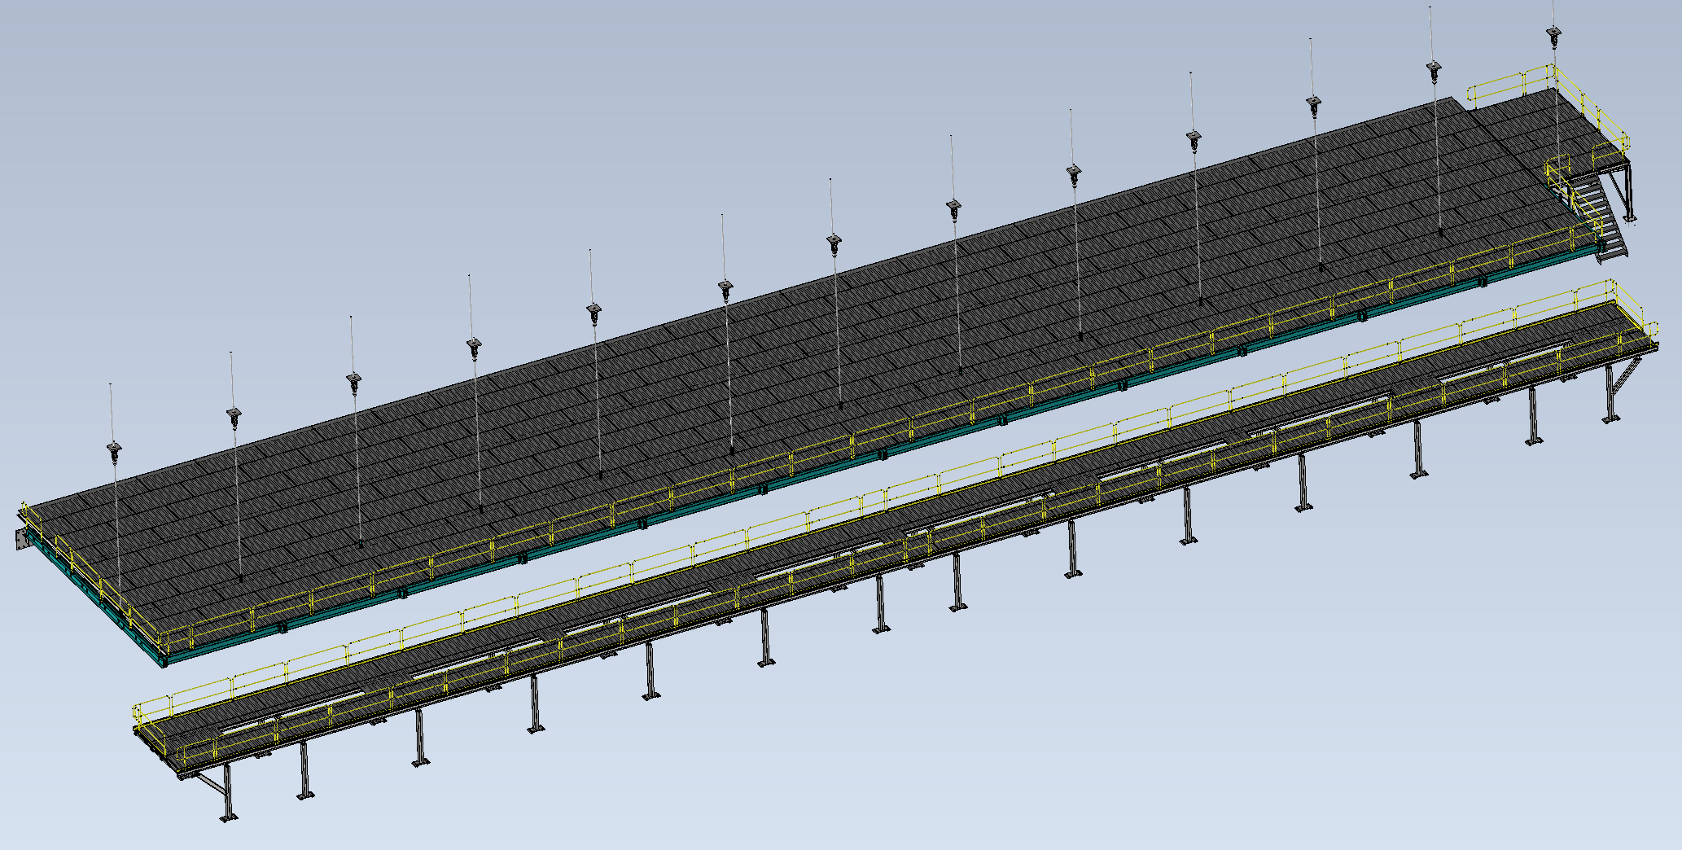
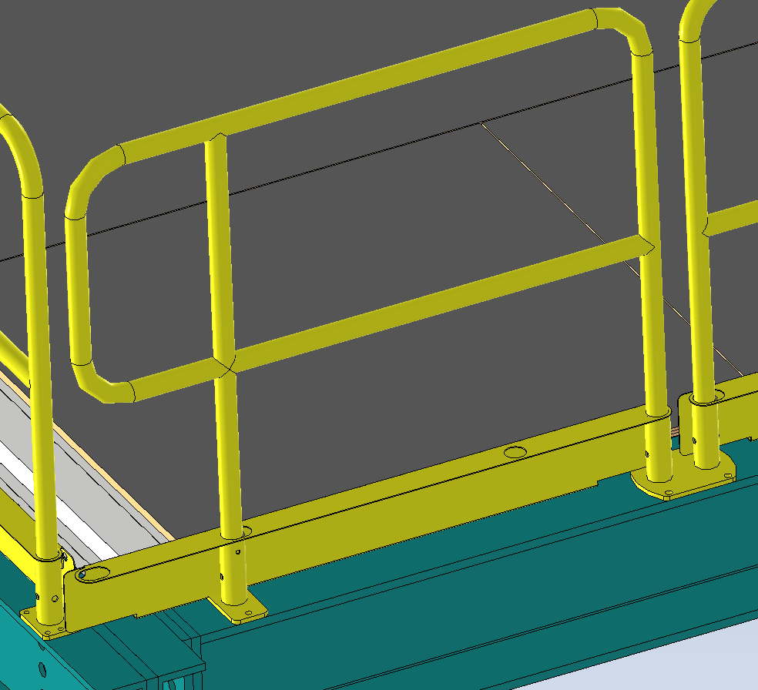
Last Week
Mezzanine Flooring and Railing
  Layout work complete on all three mezzanines
  CAI offers workarounds for making their toe boards compatible with end and adjustable rails
    Drill extra hole for end rails
    Cut and weld for adjustable rails
  Design note first draft complete
  Working on analysis of custom rail bases
Condensation Prevention Piping
  Working on drawing packet for procurement/installation

