Slide 1
Update on geometry board assembly at W&M
Nelson, Dar
11-11-2024

Slide 2
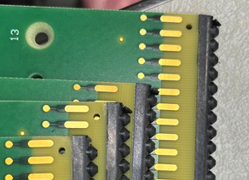
Updates on W&M production
Full production reauthorized on 9-September-2024
Shipped APA layer 1U arrived 1-October
I missed loose strips on 4 boards and 1 board had a scratch unacceptable to UC
Shipped some replacements later that week
Shipped APA layer 1G and replacement boards for 4X and 4V
Some shipping damage to box and 4 G boards (end half teeth broken)
Found out UK had had issues with this too early one
They added cardboard between bags and hard layers on top and bottom of boxes
Proc’s being revised to make this packaging plan clearer
These boards will be returned to W&M for repair
Received some of the needed boards from UK on 28-October-2024
Shipped APA layers 4U and 4G on 1-November-2024
We will be shipping APA layers 5X and 5V this week

Slide 3
Step checking
In early October, the UK team had produced enough boards with their revised fixtures that they were allowed move away from measuring each board
At W&M we have made ~170 boards with the revised fixtures, but much of the data seems to have been lost in cloud uploads
All boards have passed QC, but only 41 boards' data ended up in the google spreadsheet
We plan continue to measure steps until we have a convincing dataset

Slide 4
Scratches
After talking to Terry about the issue of scratches on the surface of boards
Her statement is that the only worry is that if there might be a continuity issue
The Solder mask is making sure that one doesn’t get solder in the wrong location and not about insulation
All boards are designed to code, so arcing isn’t a worry
Brian Zubair revisited all the boards we had set aside with surface scratches
A good fraction of the set aside boards at W&M are now deemed viable
Brian asked Zubair to take photos of representative boards and post them for you to look at to agree or otherwise that those boards can be used

Slide 5
We will need additional tooth strip
We have replaced strips on a number of boards
We will complete an estimate before the end of the month to ask for replacements from Anthony

