Slide 1


FBK IV analysis* @ Ferrara (part 2)
*tested by FBK
M. Andreotti, R. Calabrese, D. Casazza, A. Cotta Ramusino, S. Chiozzi, R. D’amico, M. Fiorini, T. Giammaria, M. Guarise, E. Luppi, I. Neri, L. Pierini, L. Tomassetti
DUNE photo-sensor meeting
12/11/2024

Slide 2

Last meeting
Analysis of data from FBK HD pre-production
Differences with CACTUS typical data
Results
https://indico.fnal.gov/event/66659/contributions/302064/attachments/182669/250861/DUNE_meeting_Tommaso_Giammaria_22_10_2024.pdf

Slide 3
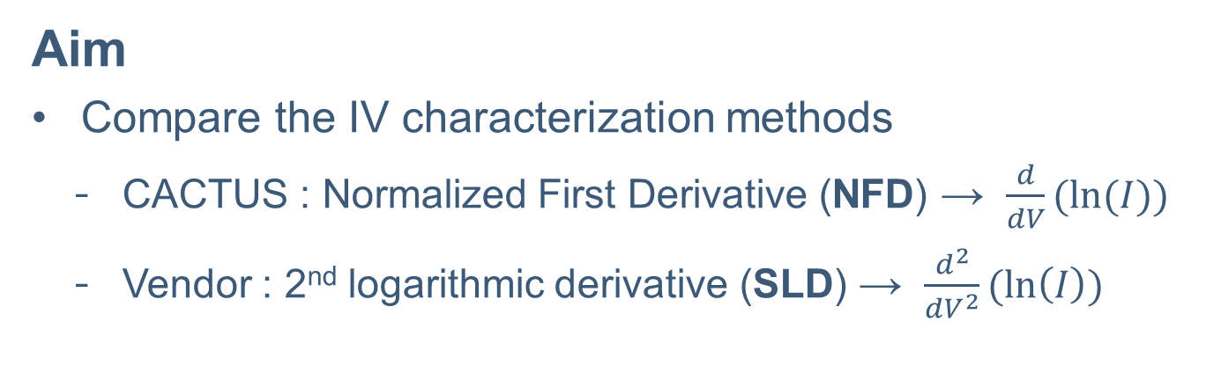
General info
Samples
100 SiPM strips
FBK model (HD pre-production)
Aim
Compare the IV characterization methods
  CACTUS : Normalized First Derivative (NFD) → $\frac{d}{dV}(ln⁡(I))$
  Vendor : 2nd logarithmic derivative (SLD) → $\frac{d^{2}}{{dV}^{2}}(\ln\left(I\right))$

Slide 4
General info
News
Received results from FBK (both NFD and SLD methods)
Discussed with FBK about different V_{BD} estimators
IV curve types (room T)
Packaging IV:
  Strip (or single SiPM ?) level
  Large V_{step}: 50 mV (CACTUS: 20 mV)
Parametric IV, also called Wafer Level (WL) IV:
  WL → same temperature for all the SiPMs → more stable
  Larger V_{step}: 100 mV (!!)

Slide 5
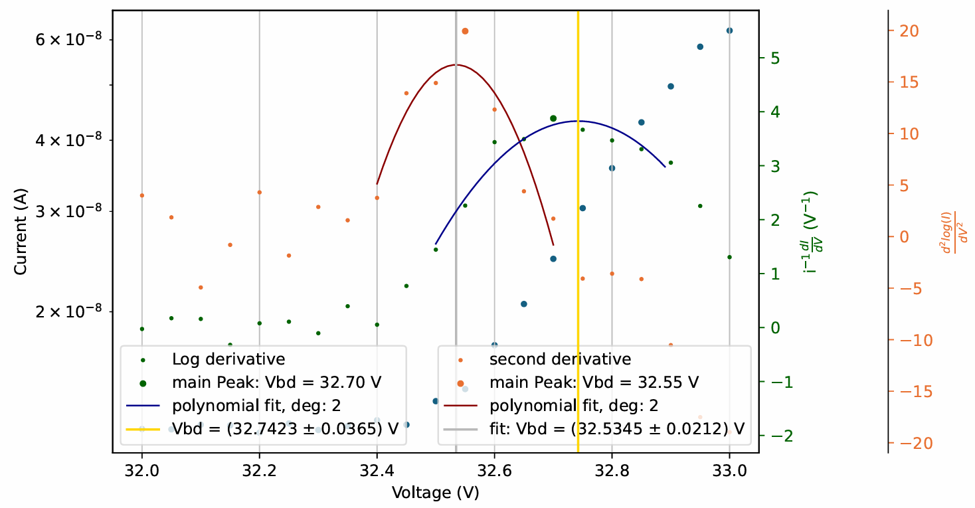
Single IV curve – packaging
SLD
NFD

Slide 6
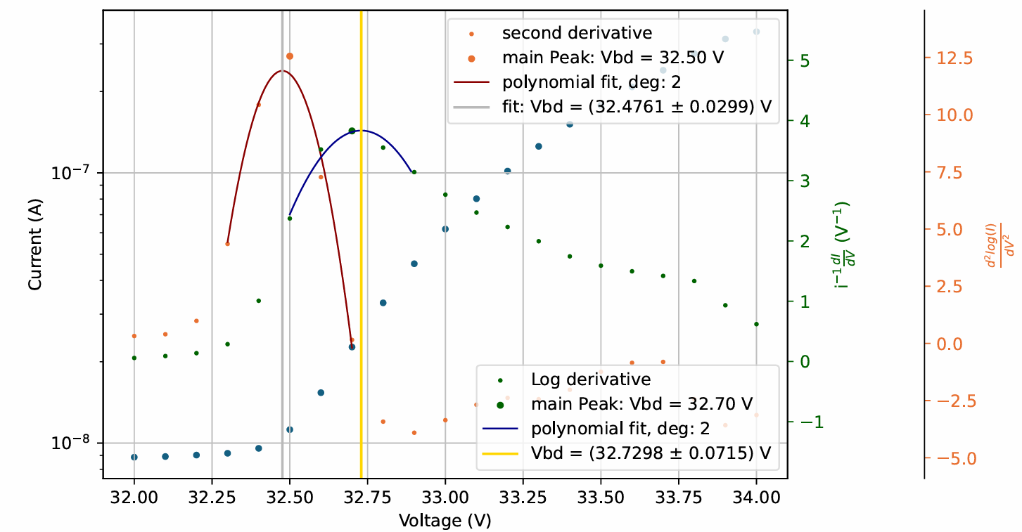
Single IV curve – parametric (or WL)
SLD
NFD

Slide 7
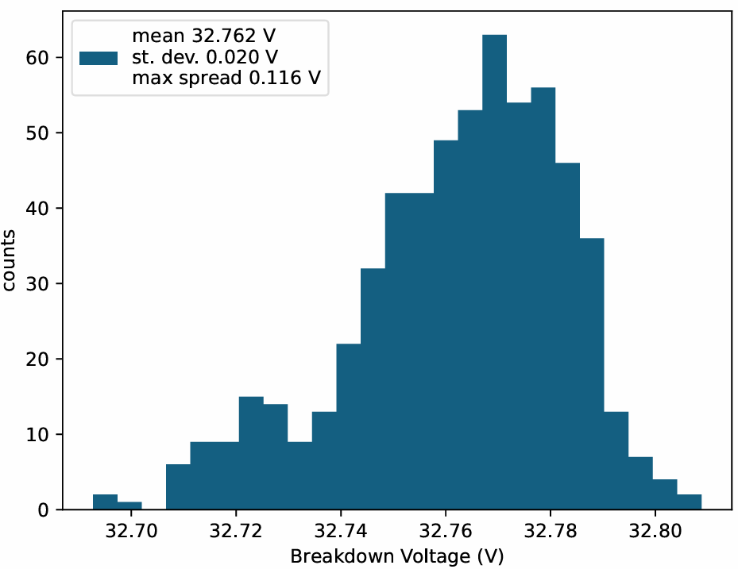
Results – V_{BD} distribution
IV curve type
Packaging IV
Parametric IV
Method
NFD
SLD

Slide 8
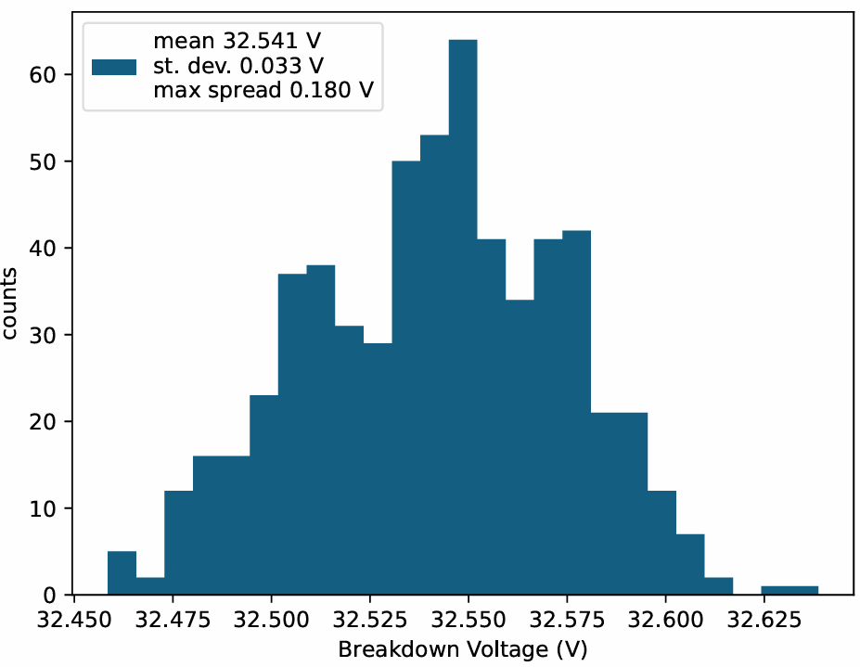
Results – V_{BD} distribution
IV curve type
Packaging IV
Parametric IV
Method
NFD
SLD

Slide 9
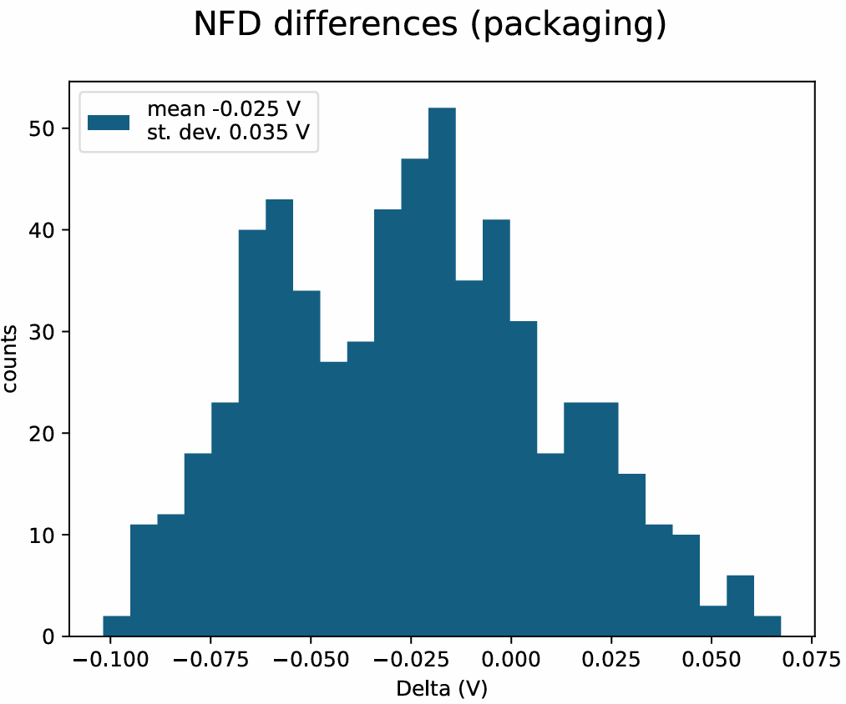
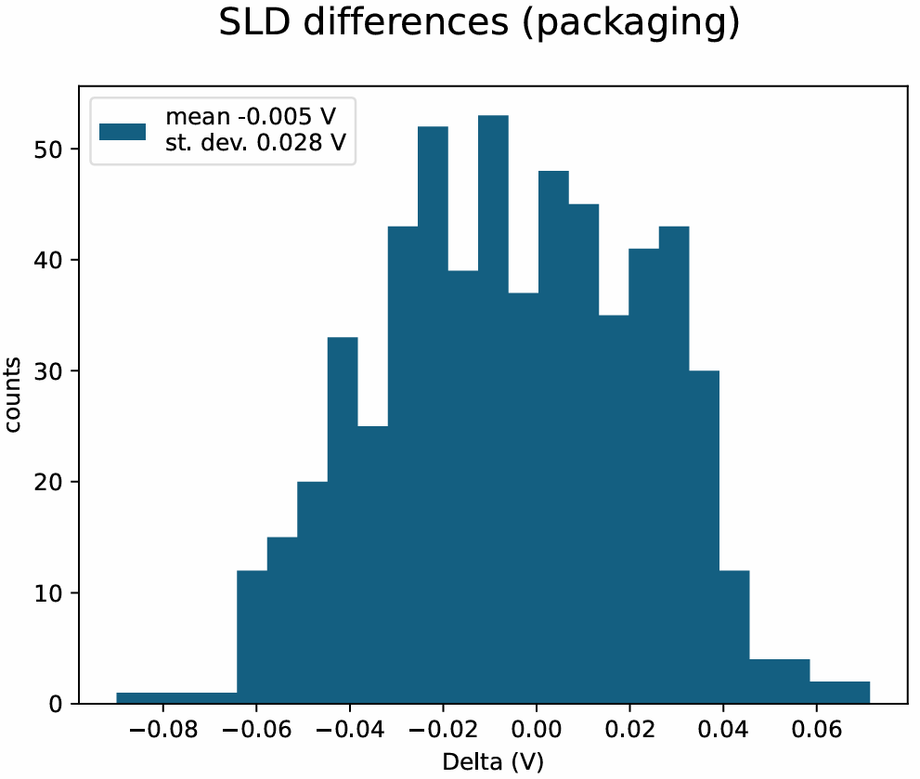
Results – V_{BD} distribution – packaging - differences

Slide 10
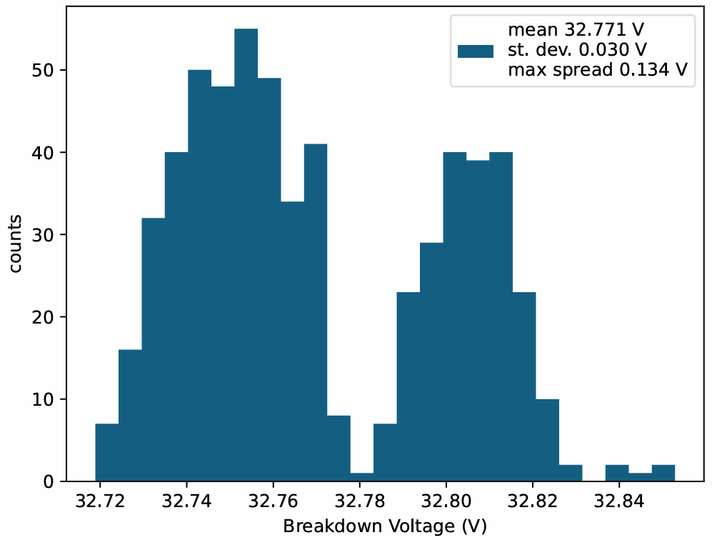
Results – V_{BD} distribution
IV curve type
Packaging IV
Parametric IV
Method
NFD
SLD

Slide 11
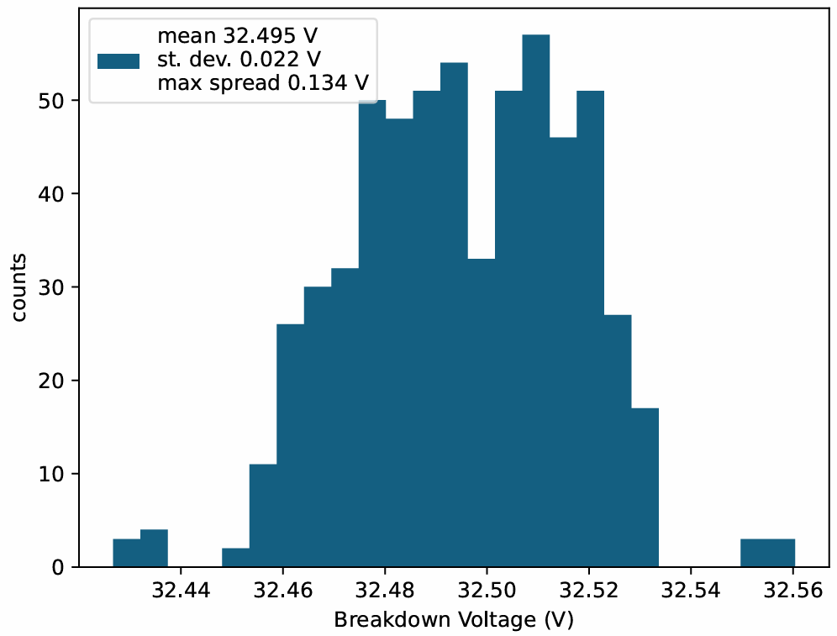
Results – V_{BD} distribution
IV curve type
Packaging IV
Parametric IV
Method
NFD
SLD

Slide 12
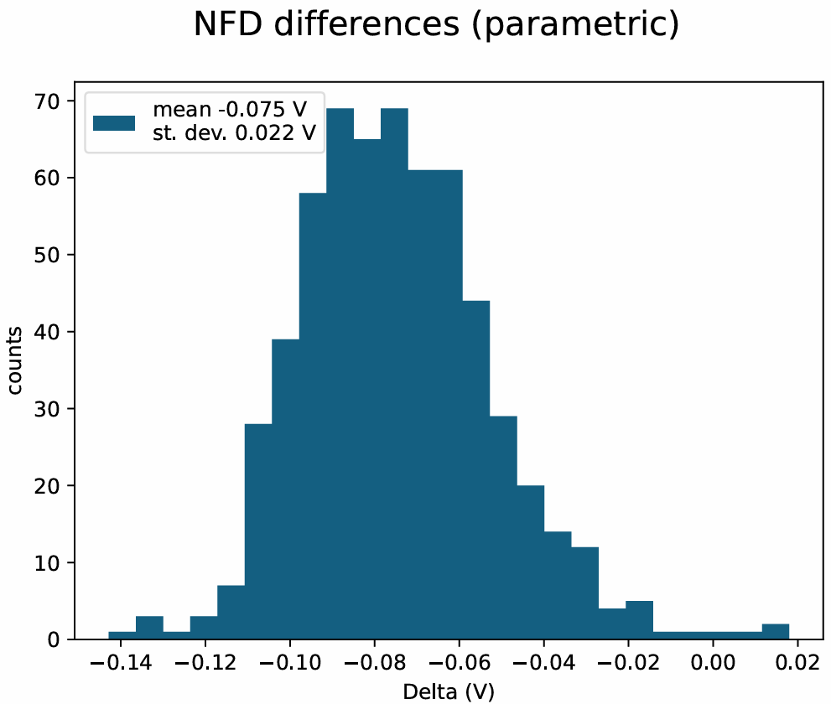
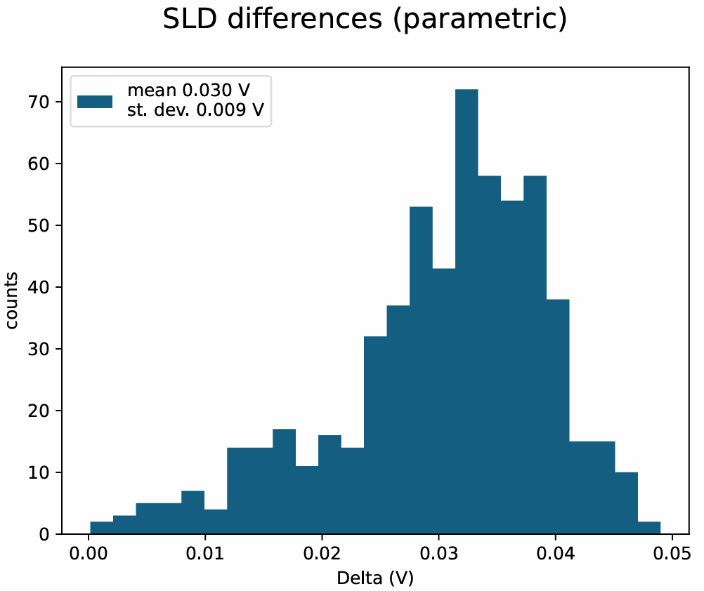
Results – V_{BD} distribution – parametric - differences

Slide 13
Conclusions
Comparison of CACTUS/FBK analyses on the same data set
  Parametric (wafer level) IV (100 mV step)
  Packaging IV (50 mV step)
Need a finer resolution for grouping SiPMs
  waiting for data with higher resolution* from FBK
  *50 mV step and 10 mV step

Slide 14
BACKUP

Slide 15
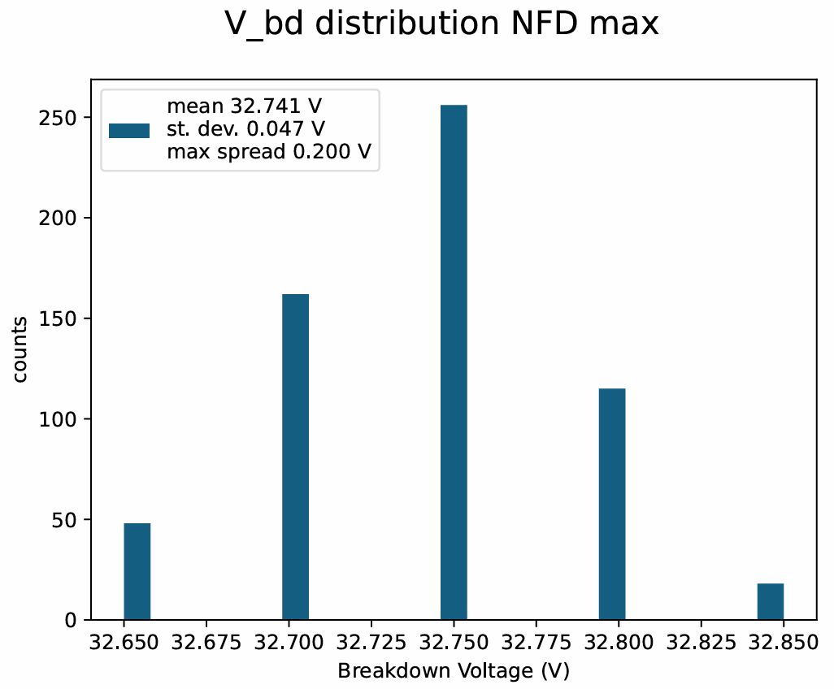
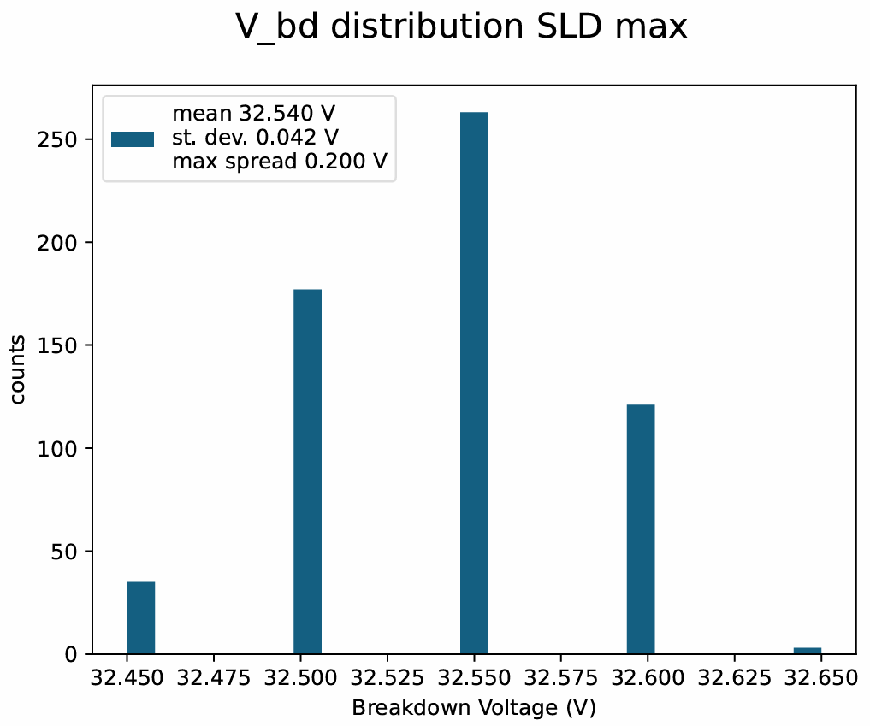
Results – V_{BD} distribution - packaging – max

Slide 16
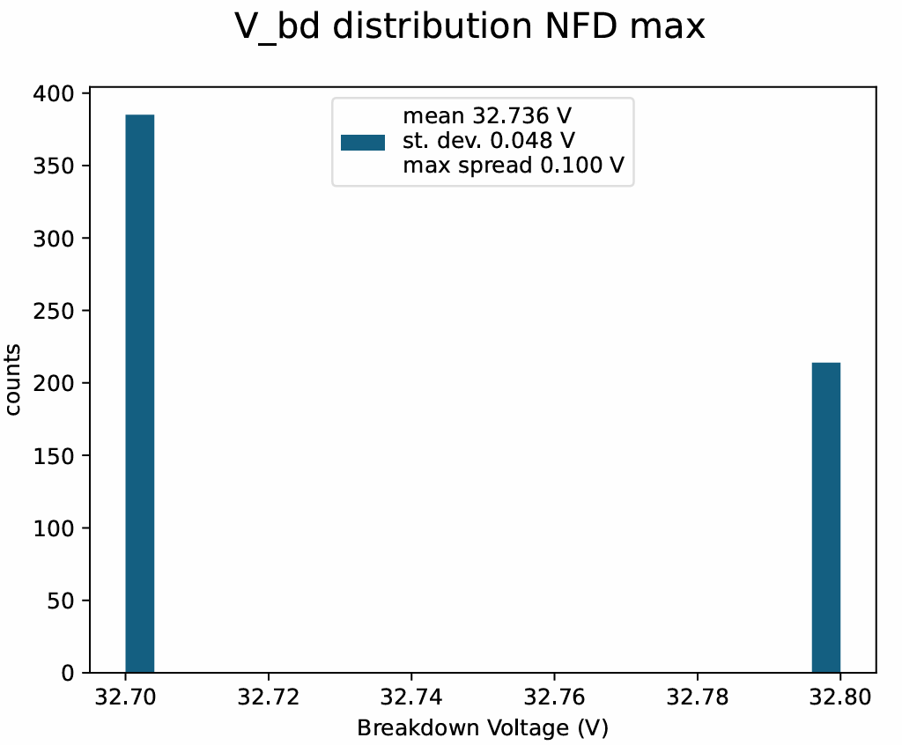
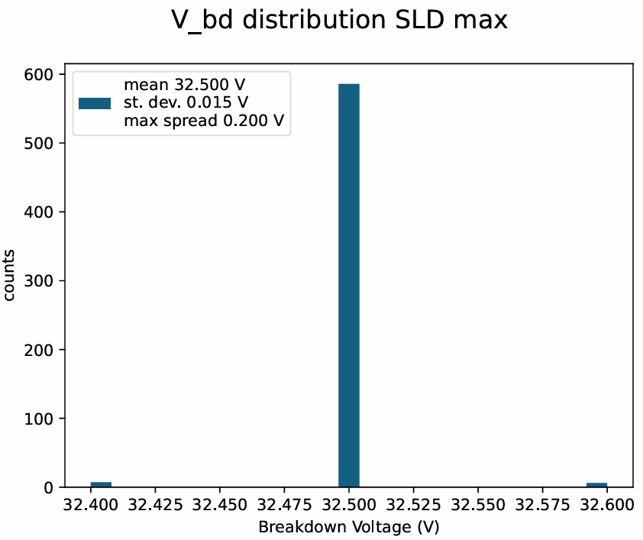
Results – V_{BD} distribution - parametric – max

Slide 17
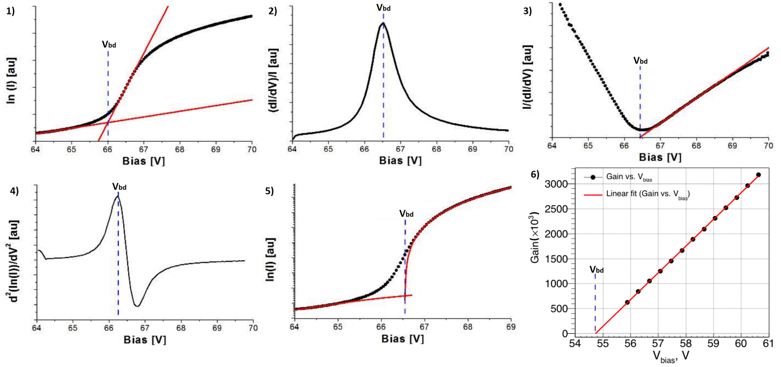
Reverse IV analysis methods
CACTUS
FBK

Slide 18
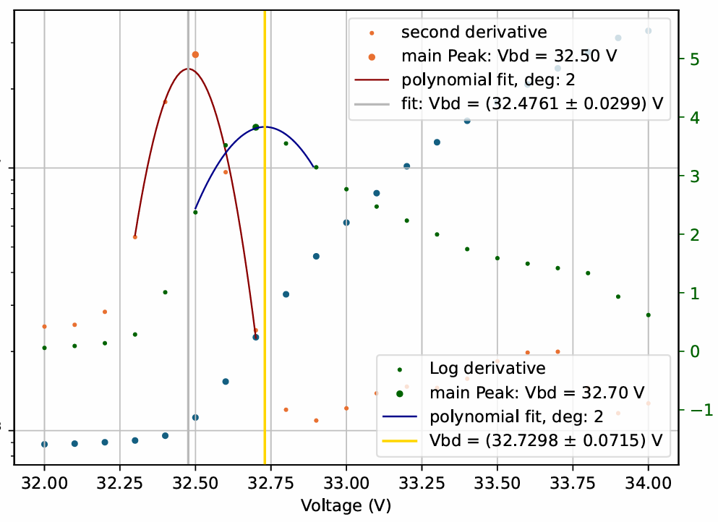
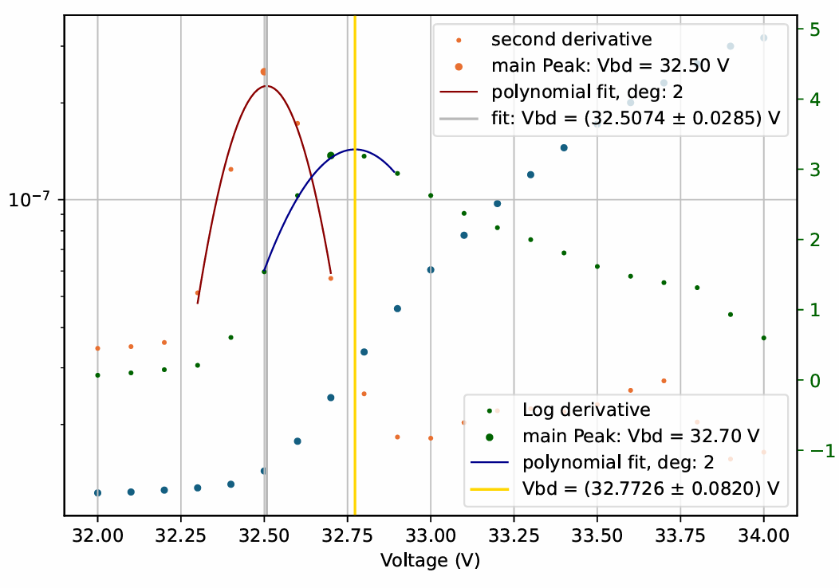
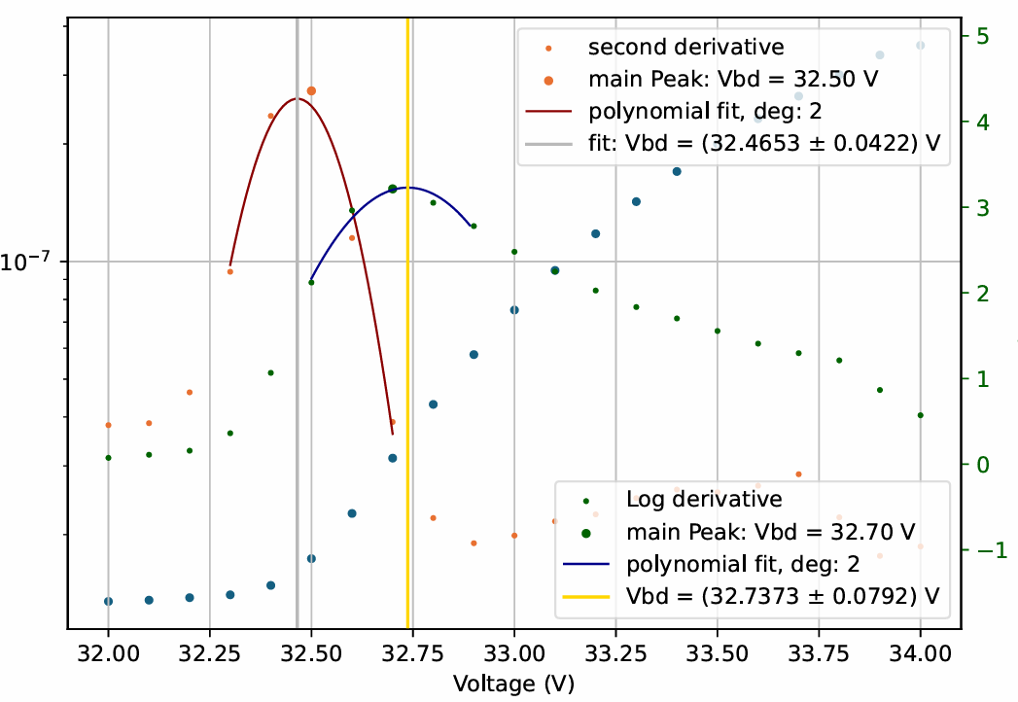
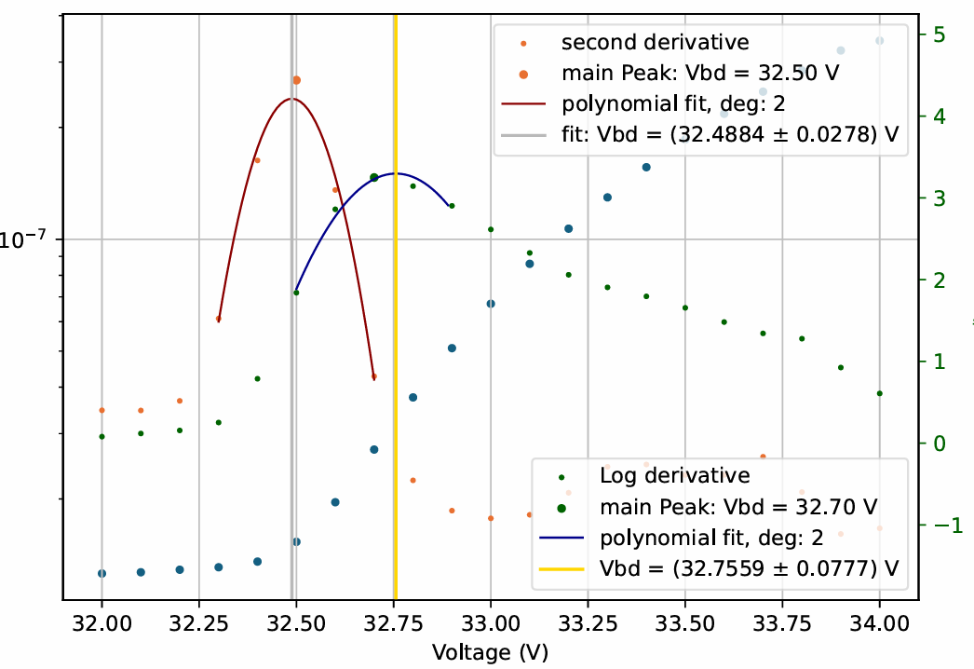
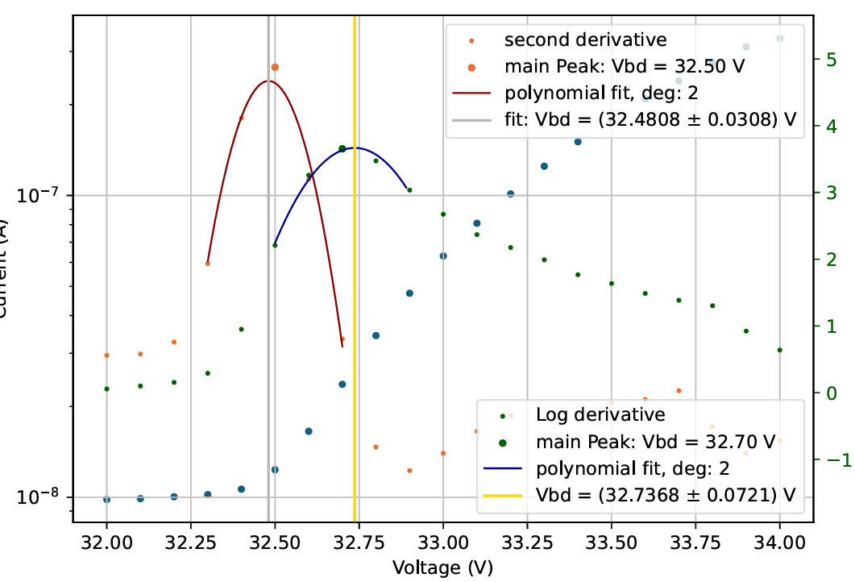
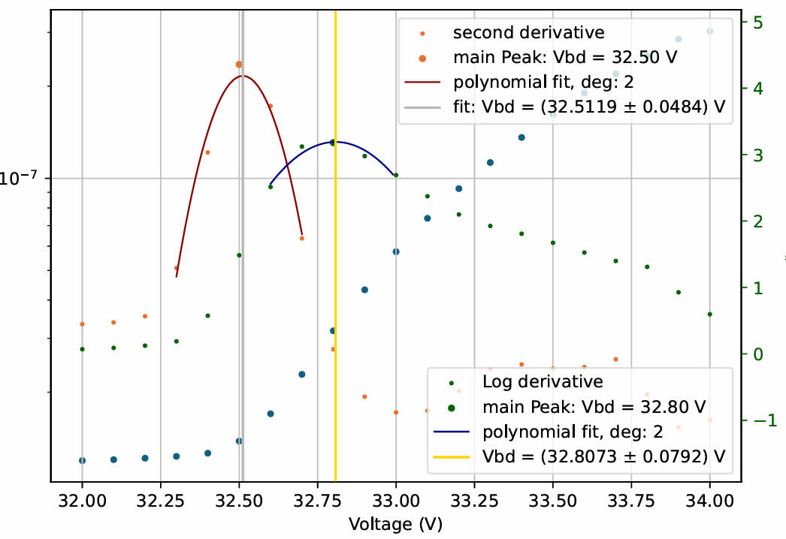
100 mV step, SLD maximum

