Slide 1
Technology Development MAP Friday Meeting
Harold Kirk
Brookhaven National Laboratory
April 12, 2013

Slide 2
Outline
Summary of TD Activities
L2 Summary reports
Topical Report
Recent All Season Cavity Results at the MTA, Yagmur Torun, IIT

Slide 3
Technology Development Activities
RF Studies
Modular 805MHz Cavity (SLAC, LBNL)
200MHz cavity development (LBNL,FNAL)
HPRF (Muons, Inc., FNAL)
SRF cavities (Cornell)
HTS Studies
BISCO 2212 cable development (FNAL)
YBCO based high-field solenoids (BNL)
Magnet Design (Next Slide)
Prototyping rapid pulsing (400 Hz) dipoles for rapid cycling synchrotrons
Conceptual design of a 4-MW target system

Slide 4
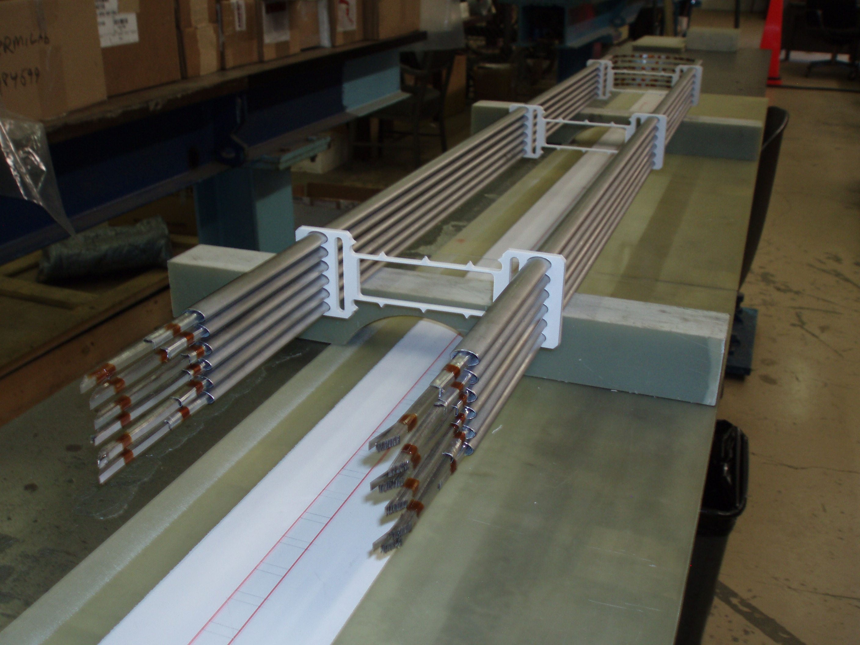
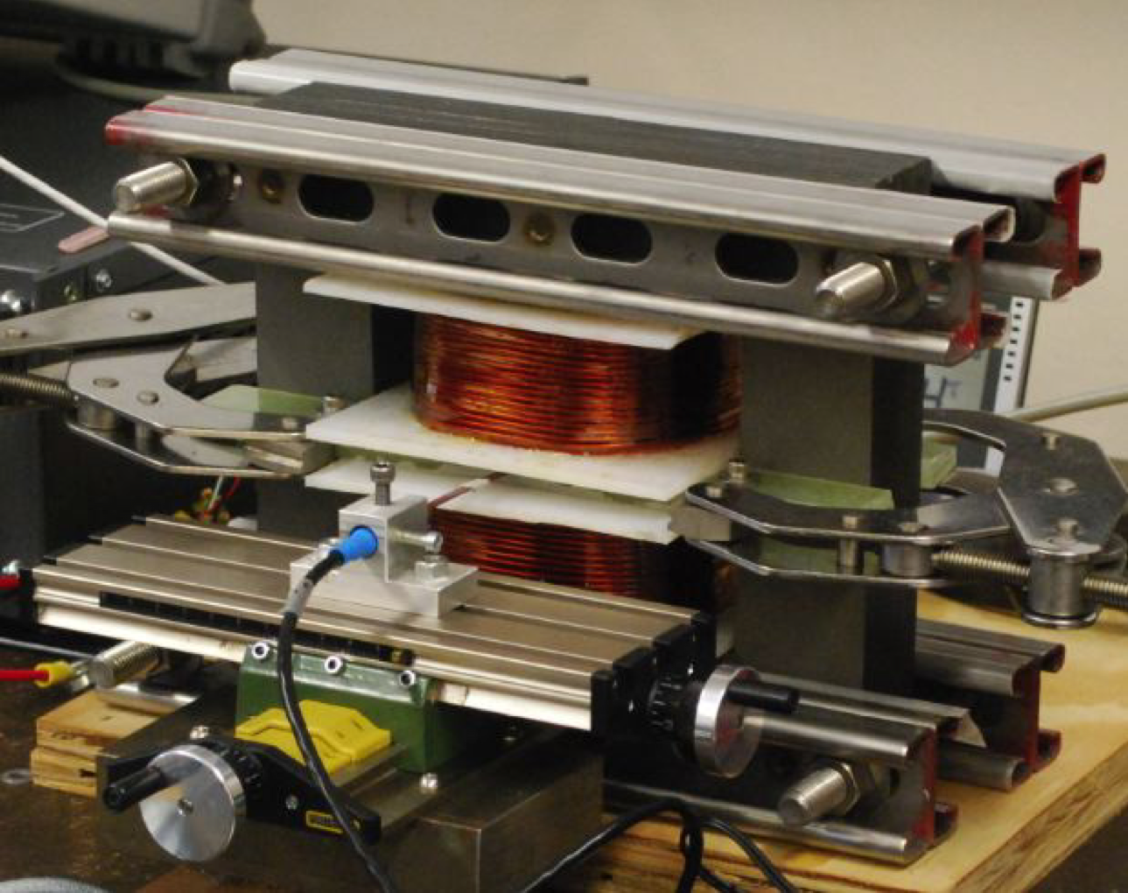
Magnet Design
±1.8-T, 400Hz RCS magnets (BNL, Mississippi)
HTS rapid cycling magnets (FNAL)
Collider ring magnets (FNAL, PBL)
IR Quadrupoles (FNAL)
HCC design and prototyping (FNAL, Muons, Inc.)
Mississippi-
Test reached 1.8T Design & prototype work in progress
FNAL- HTS rapid cycling coils

Slide 5
12 April, 2013
03 01: Normal Conducting RF
Derun Li
Modular cavity (collaboration with SLAC)
Cavity fabrication started
Already have parts made
Halted due to budget at SLAC and should resume soon
201 MHz cavity
Preparation for testing at MTA using the single cavity vessel and accessory components:
RF coupler MP simulations with MICE B field map,
Tuners and actuators (in progress, but delayed)
MP simulation studies (collaboration with SLAC)
MICE magnets: SS and CC
Available resources at SLAC for the modular cavity fabrication
EP of the remaining MICE cavities at LBNL
Development of the modular cavity fabrication plans and schedule
Sign off of the interface document between LBNL and FNAL
Fabrication of the modular cavity
Fabrication of actuators at LBNL
Modular cavity
Fabrication drawings complete
Interface document between SLAC and LBNL signed
Fabrication started and parts are made
Ready for PO of the Be plates
Bi-weekly meetings at SLAC to monitor/oversee fabrication progress
Fabrication drawings of the RF coupler for 201 MHz MICE cavity delivered to Fermilab and sent out for quotes
Revisit RF coupler design, update and MP simulation studies
Cryostat fabrication for MICE CC magnet started
Some parts are made
Continue the modular cavity fabrication
EP of the remaining MICE cavities at LBNL
Development of the modular cavity testing plan
Data analysis of previous 805 MHz testing results
MP simulation studies of the MICE cavity and coupler with external magnetic fields and explore other possible solutions
Fabrication of two 201 MHz RF couplers for the first MICE cavity in preparation for the testing at MTA
Complete the fabrication of actuators at LBNL
Support MTA RF testing programs
Sign-off of the interface document between LBNL and Fermilab
Fabrication of the modular cavity
Further development of the cavity test plan
Support of the 201 MHz installation at MTA, Fermilab
MP studies of 201-MHz cavities with B field
Support the RF coupler fabrication at Fermilab
Continue the fabrication of actuators at LBNL

Slide 6
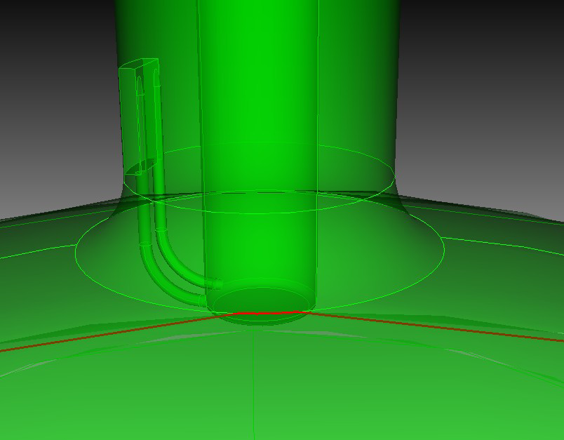
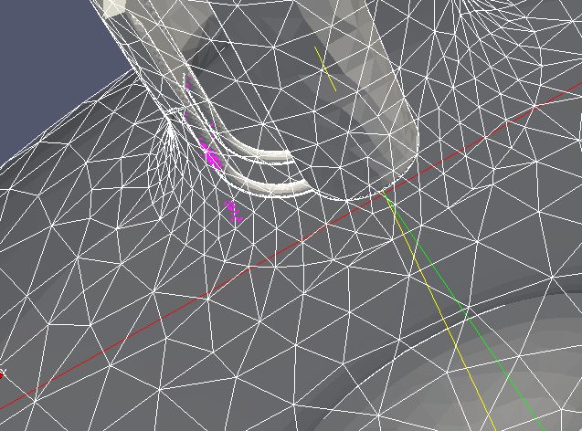
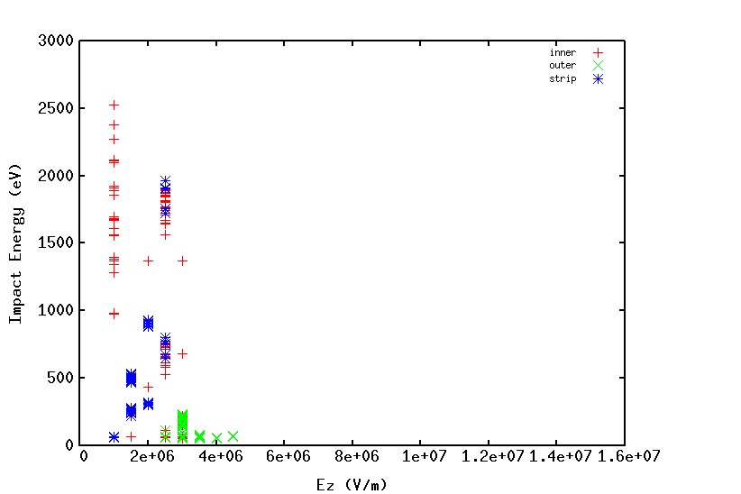
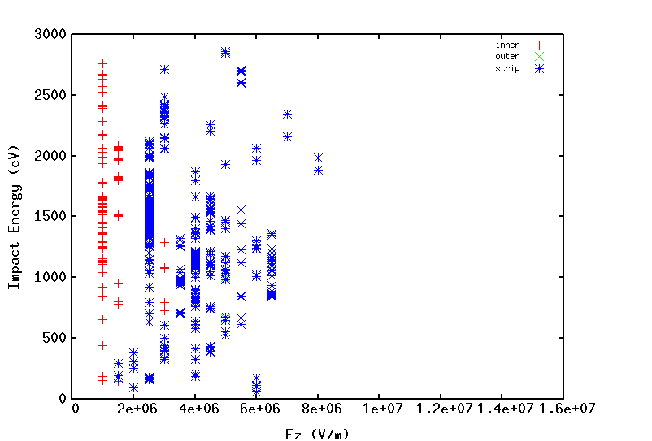
201 MHz RF Coupler Update

Slide 7
12 April, 2013
3.2 – Superconducting RF
Don Hartill
.
Completed plan for e-beam welding of cavity with reduced thickness of Nb on one end
Research Instruments has started adding beam tubes to two 500 MHz cavities
Research Instruments shipment of 500 MHz cavities expected in ~6 weeks
Testing of 500 MHz explosion-bonded cavities expected in late spring and early summer. Testing to be completed by mid-summer
Preparation of 3GHz electroformed cavity by summer
500MHz cavity preparations by Research Instruments
First e-beam weld by Research Instruments of the adapter ring on the 500MHz prototype (key weld to finish the cavities)

Slide 8
MAP Magnets [03-03]
HTS Magnets / ReBCO – Ramesh Gupta
100 mm ReBCO solenoid containing 24 pancakes was removed from test stand. Outer fiberglass epoxy support was removed. No physical damage or abnormality was found on the outer surface of pancakes.
Next month: The structure will be completely dissembled and all 12 double-pancakes will be individually inspected. Detailed testing of individual double pancake at 77K is expected to start.
HTS Magnets /2212 – Tengming Shen
Wound and reacted a Bi-2212 coil (Six layer, 244.5 turns, ID=2a₁=33.40 mm, OD=2a₂=48.1 mm; Length=2b=57.80 mm; insulation: alumina-silicate)
Next month: The coil will be instrumented with voltage taps, film heaters, thermometers, strain gauges, and acoustic emission sensors and then epoxy impregnated with CTD-101k. It will be tested 4.2 K, 14 T together with its quench characteristics.
Helical Solenoid (HCC) – Mauricio Lopes w/ Muons, Inc.
Planning and conceptual design activities for development of Nb3Sn coils for next stage of HCC; design & engineering effort in early stages
Next month: continue with design and engineering work
Rapid Cycling Magnets / HTS – Henyrk Piekarz
Welding of 12 sub-cable cryogenic pipes to all magnet cable flanges is complete; fabrication of support fixture to splice 6 x 20 HTS strands to and connect to power lead;
Engineering design of magnet & leads cryostats is complete; procurement & fabrication of components for all cryogenic transfer lines and cryo-boxes is complete
Next month: Assemble splicing setup for HTS to power leads; test splicing setup and develop procedure; Procure for magnet & lead cryostats and submit for fabrication at VMS
Rapid Cycling Magnets / Conv – Don Summers
Dipole has been operated at 1.8T and 1410Hz
Next month: work is underway to transpose strands in the coils to reduce eddy current losses.
General Magnet Design – Sasha Zlobin
No new magnet design studies this month
Next month: depends on disc/needs of Mokhov & group; e.g., changes in ring design => magnet requirements, parameters
Note: all tasks spent time developing/revising plans for FY13/FY14/FY15

Slide 9
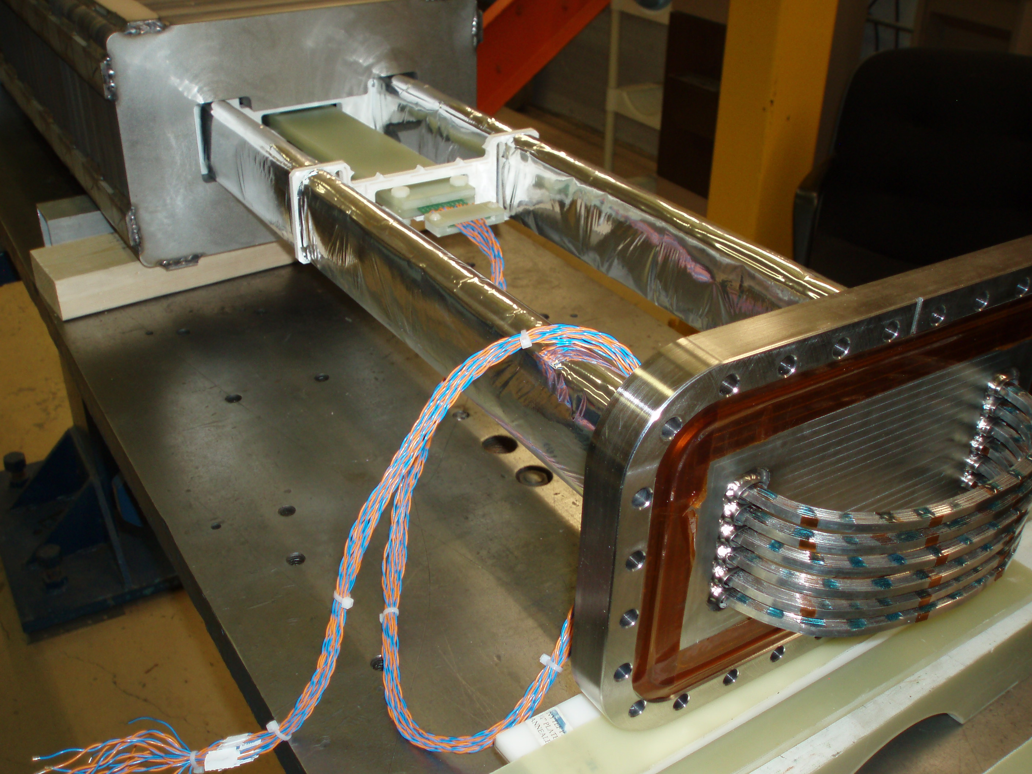
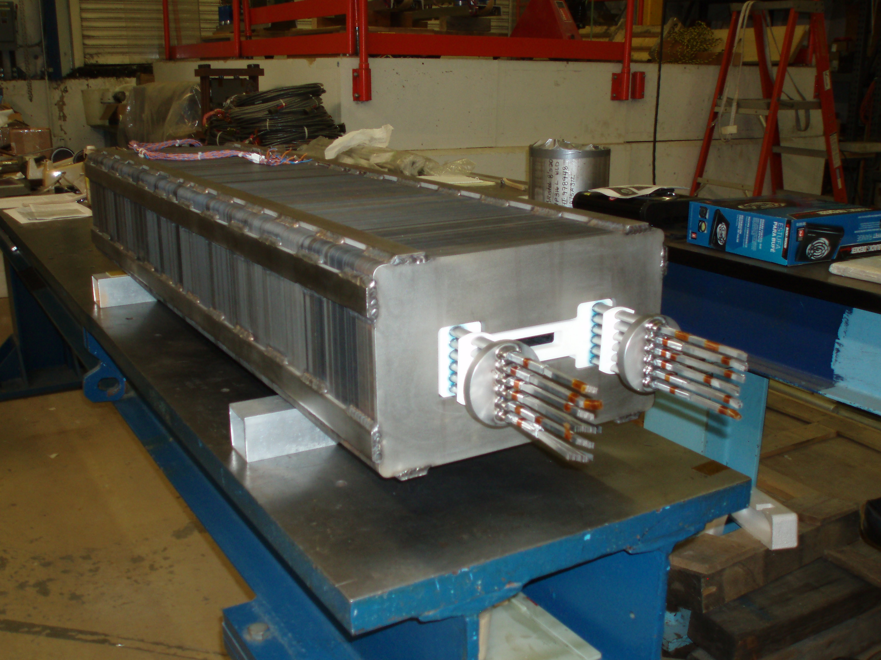
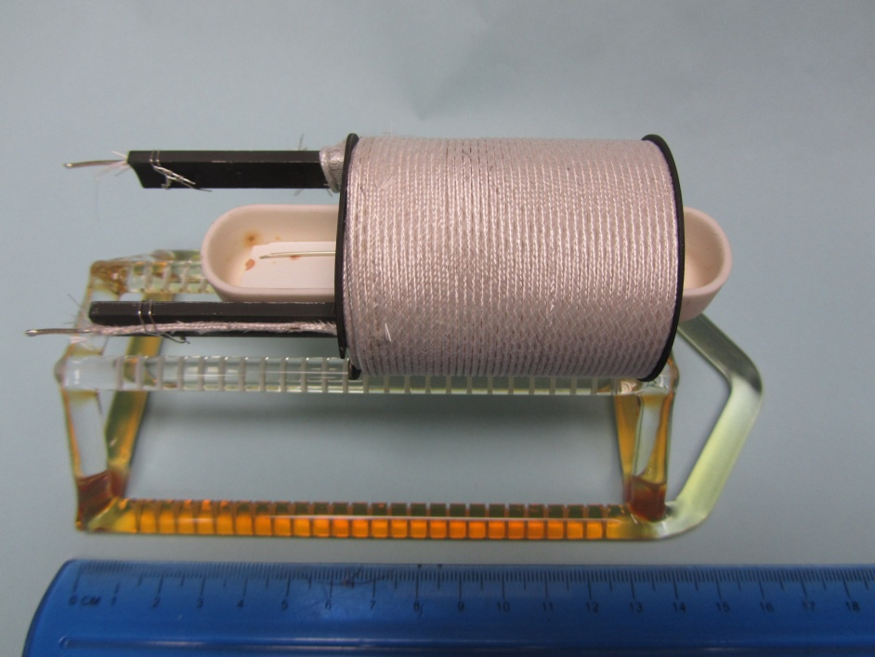
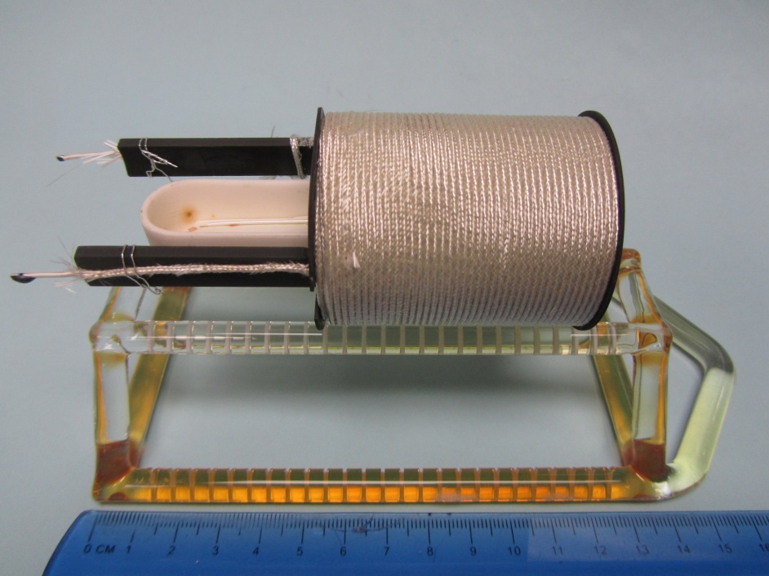
Rapid Cycling SC Magnet Assembly Work H. Piekarz
Inserting coil into the magnet gap. The 8-cell,
520 mm long flat coil probe is in the center.
12 stacks of 20 HTS strands at magnet
end to be connected with power leads.
Bi-2212 conductor and coil development
T. Shen
(a) Before reaction
(b) After reaction
Wind and react a Bi-2212 coil (Six layer, 244.5 turns, ID=2a₁=33.40 mm, OD=2a₂=48.1 mm; Length=2b=57.80 mm; insulation: alumina-silicate

Slide 10
12 April, 2013
Kirk McDonald
03.04 Targets and Absorbers
Ding, Souchlas: Preparations for running multiple MARS1512 jobs on clusters.
Sayed: ICOOL simulation of relation between proton beam time and rapidity of magnet taper
Zhan: Thesis proposal defense at SUNY Stony Brook.
Weggel: First look at magnet design for the chicane; high heat loads in magnets may favor use of HTS conductor. Magnet design for “taper” that ends at z = 7 m.
Snopok: Use of MARS capability to import geometry from ROOT (G4beamline) for first look at energy deposition in the chicane.
McDonald: Participation in IDS-NF Plenary Meeting 10 to prepare for writing of the RDR.
The basic target system concept is well-defined.
Clarify whether we can drop the capture solenoid field from 20 T to 15 T.
Optimize target & decay magnetic configuration for best performance of beam delivered to accelerator (a step towards a global optimization of the entire MC/NF).
Extend target system conceptual design up to start of buncher (including chicane in decay/drift region).
Begin technical design of mercury handling system, and of magnet cryostats and shielding modules from target to buncher.
Continuation of all projects of previous month

Slide 11
12 April 2013
3.5 – MuCool Test Area
Yağmur Torun
805-MHz vacuum RF: all-season cavity run at B=0-3T done
201-MHz vacuum RF: Single-Cavity Module transport stand built; tuner test fixture redesigned (R. Schultz, J. Gaynier, A. DeMello); vacuum vessel surveyed (J. Volk)
Infrastructure – on track: beamline upgrade, RF switch re-commissioning, station-2 vacuum system
Data analysis: HPRF beam test PRL draft ready (B. Freemire, K. Yonehara, A. Tollestrup, M. Chung); beam spot analysis RSI submitted (M. Jana)
Mechanical help for single-cavity module assy
Access to machine shop
Help for beamline upgrade commissioning
Single-Cavity Module assembly
Pillbox with grid windows
Operations: LabView control/conditioning program for 805-MHz system updated (D. Peterson) enabling 24/7 running
RF source: modulator up(?)graded (A. Moretti)
Solenoid: quench training instrumentation installed (J. Volk)
Dielectric loaded HPRF: parts test fit (K. Yonehara, A. Moretti)
Surface inspection: button microscopy fixture built (R. Schultz, J. Sobolewski); pillbox window analysis in progress (M. Jana)
Data analysis/publication
magnetic insulation
Be-Cu buttons
HPRF beam test
Current program
All-season cavity in magnetic field
Inspection
B > 3T
Next on the list
Grid windows on pillbox cavity
201-MHz Single-Cavity Module
Dielectric-loaded HPRF
New 805-MHz modular cavity
Other
Beamline commissioning
805-MHz all-season cavity operation in B>3T
Complete button microscopy, analysis
Build 201-MHz RF control system upgrade
Build parts for 201-MHz Single-Cavity Module
Solenoid training
201-MHz tuner test stand (L. Somaschini, P. Hanlet)
Finalize beamline documentation (J. Volk)

