Slide 1
Beam Measurement using Drone – drone beam calibration
Jixia Li
2024/11/11

Slide 2
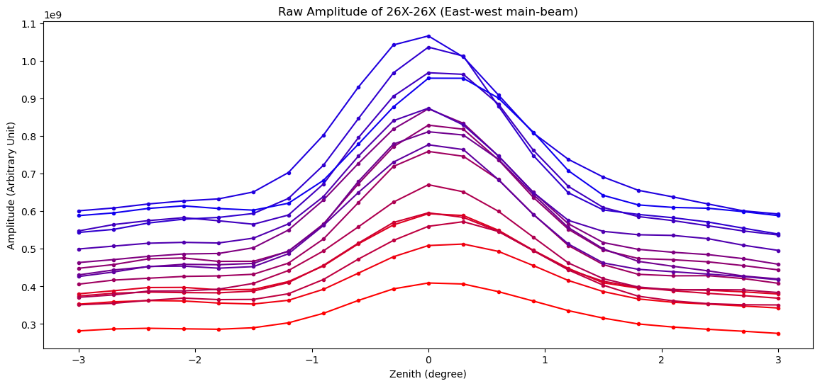
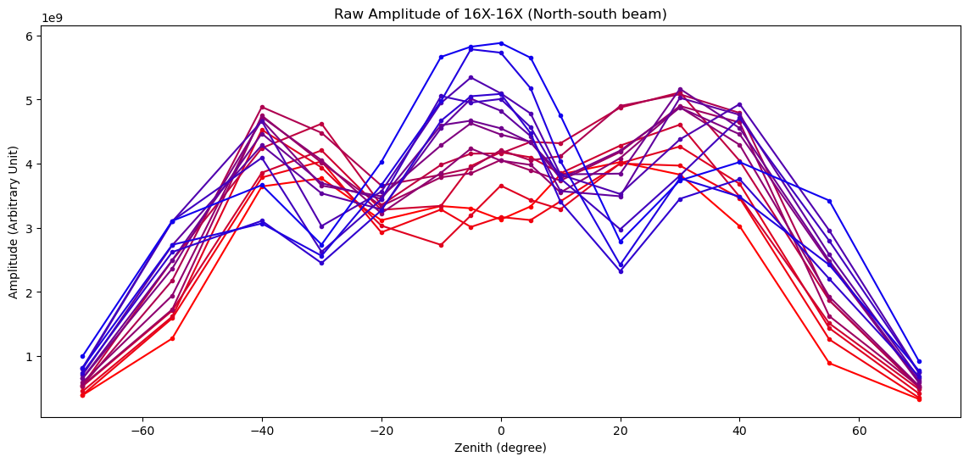
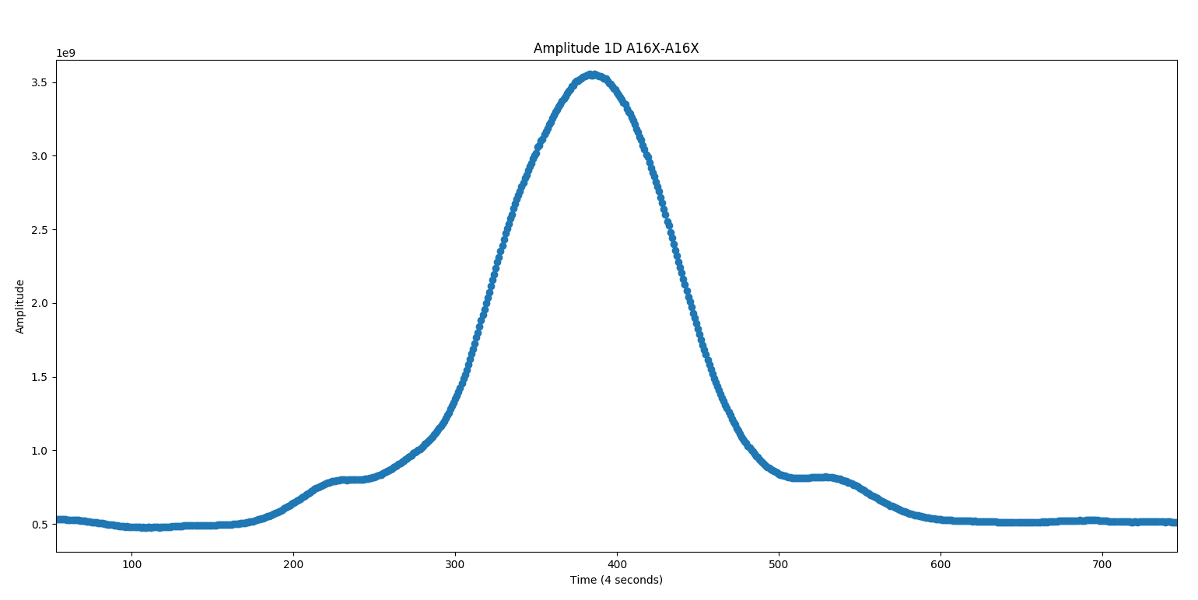
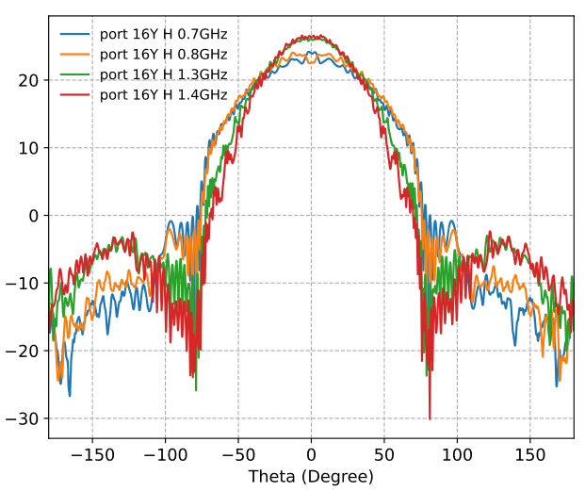
Comparison of drone, Sun & Simulation
Sun et. al. 2022
Drone (Top) vs Sun (bottom left, EW beam) vs Simulation (bottom right, NS beam)

Slide 3
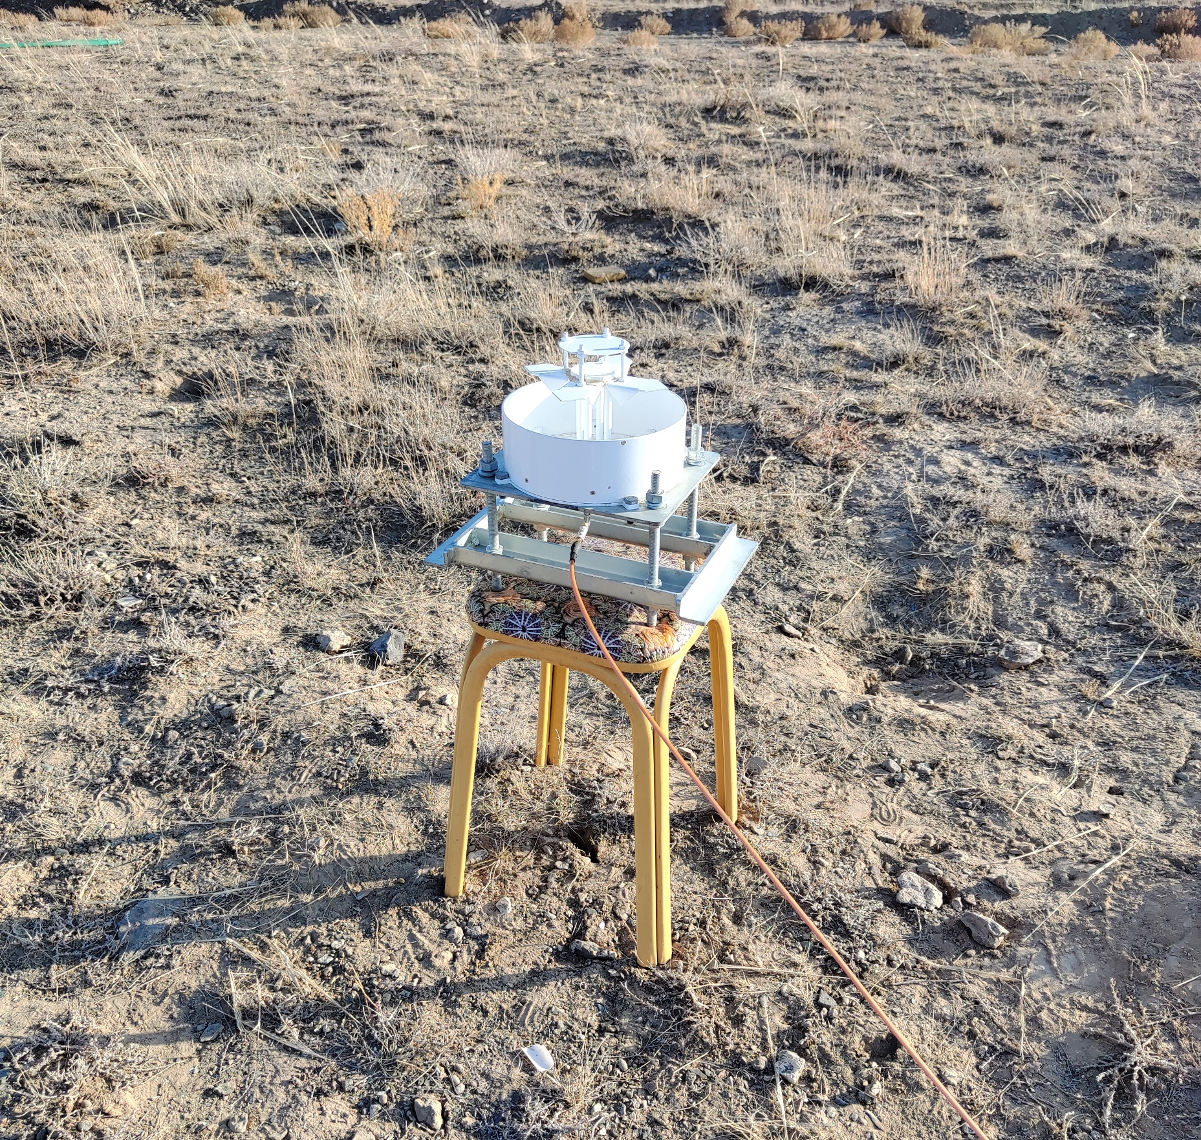
2 types of antenna
Dipole Antenna
3 meter above ground
Drone over 100 meter high
Feed Antenna
0.5 meter above ground
Drone over 100 meter high

Slide 4
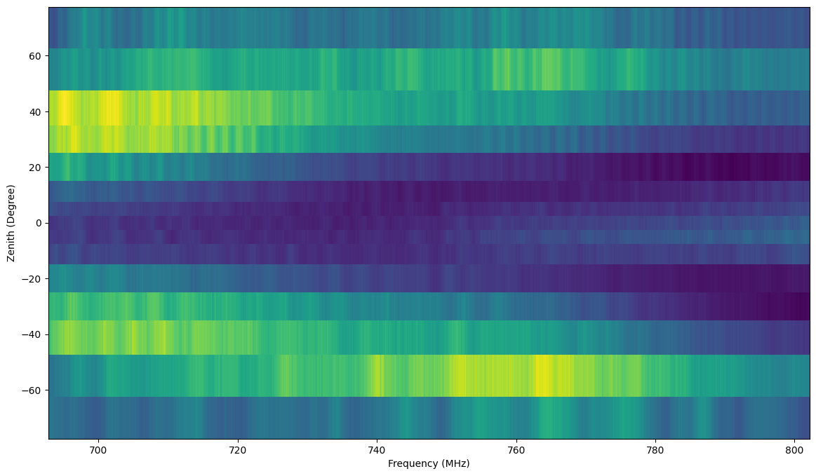
Drone Beam Measured by Dipole vs Feed
Dipole Antenna
3 meter above ground
Drone over 100 meter high
Feed Antenna
0.5 meter above ground
Drone over 100 meter high

Slide 5
Corrected Cylinder Beam (dipole)

Slide 6
Corrected Cylinder Beam (feed)

Slide 7
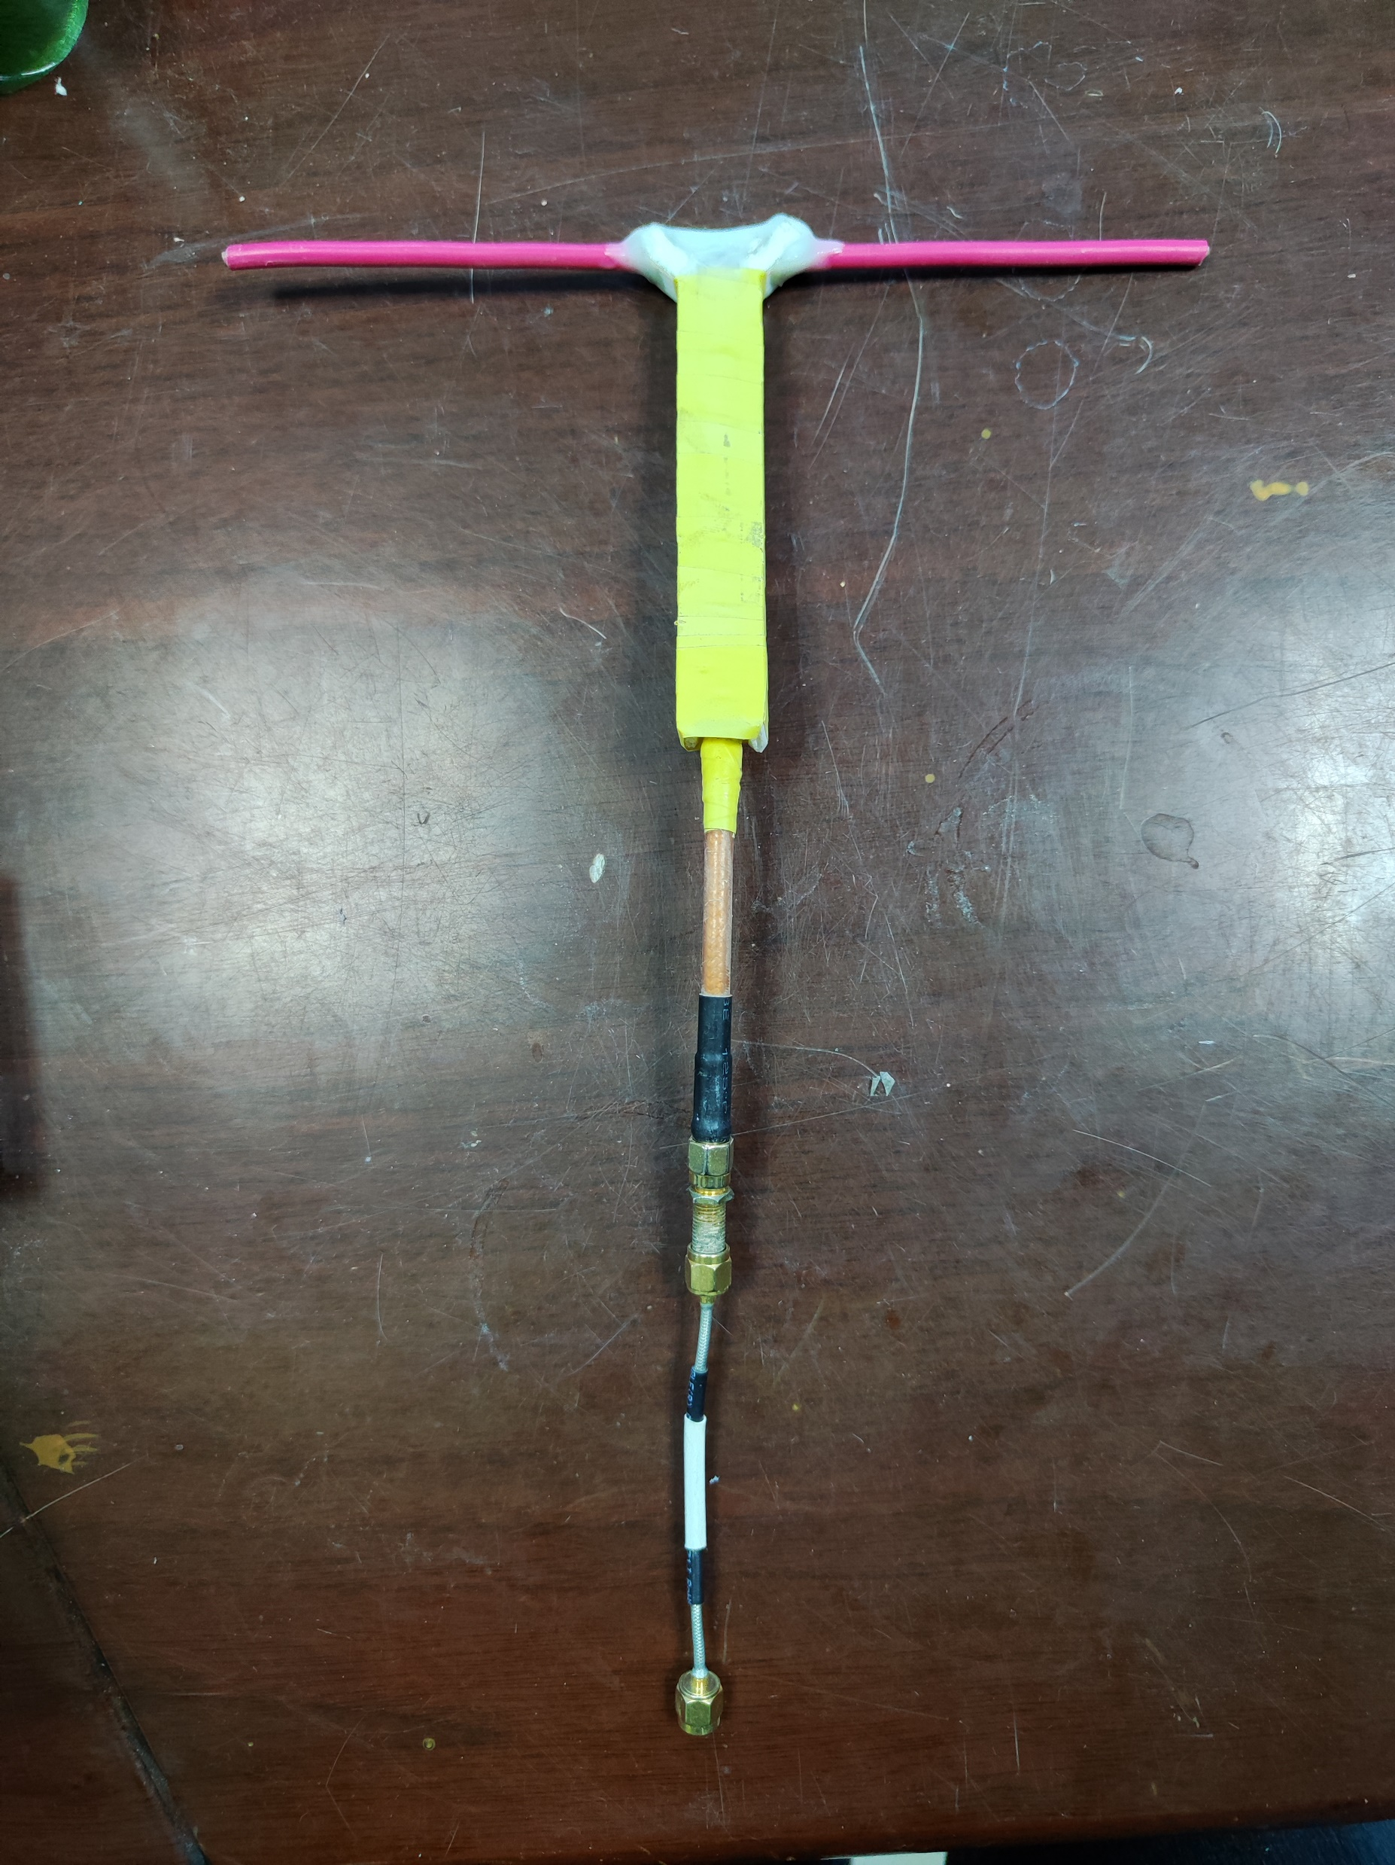
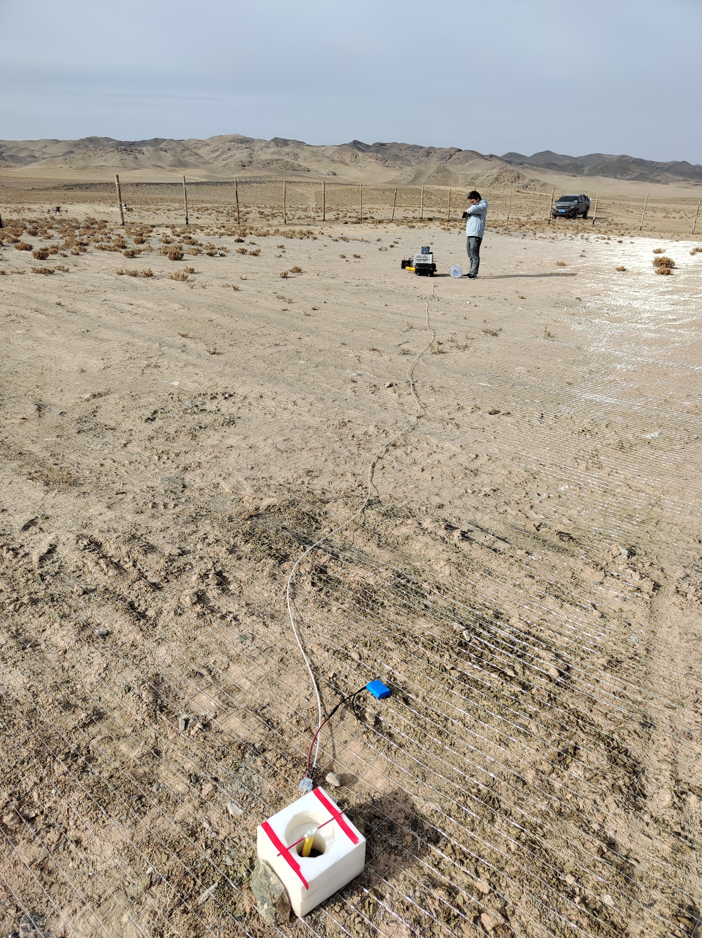
Dipole2 and circular
New dipole made by Suonanben
(have balun part)
Circular polarization antenna
Experiment done inside/outside GS2 site.
(i.e. with/without ground metal net.

Slide 8
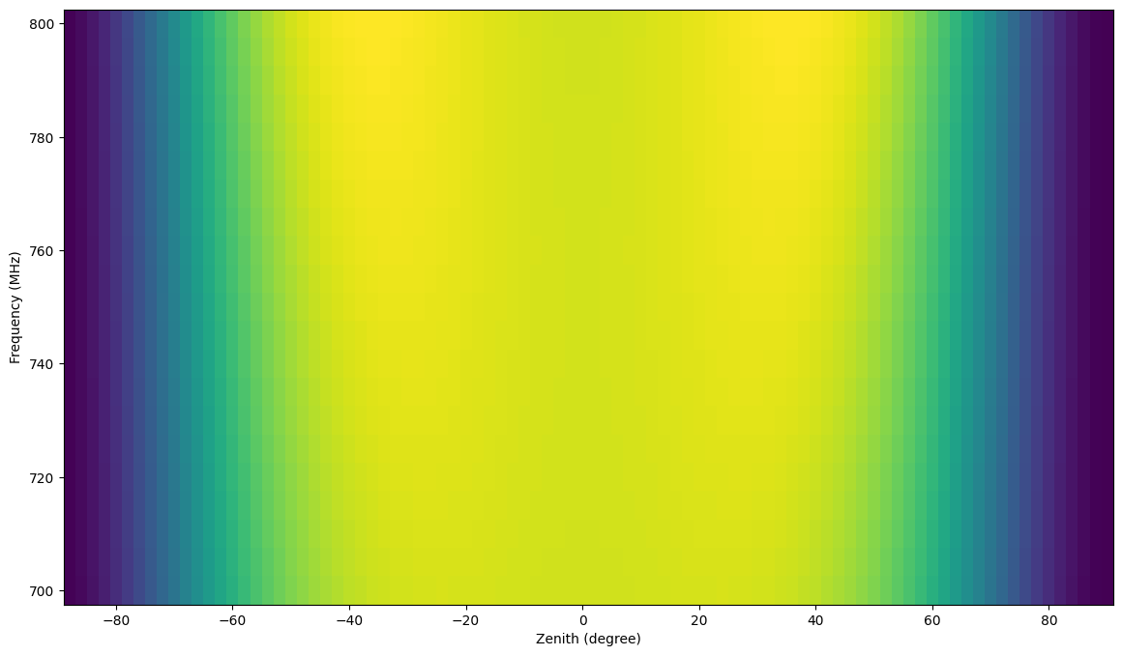
Simulation of dipole2 (wo/wi metal ground)
Outside GS2 site
(i.e. without ground metal net.)
Inside GS2 site
(i.e. with ground metal net.)

Slide 9
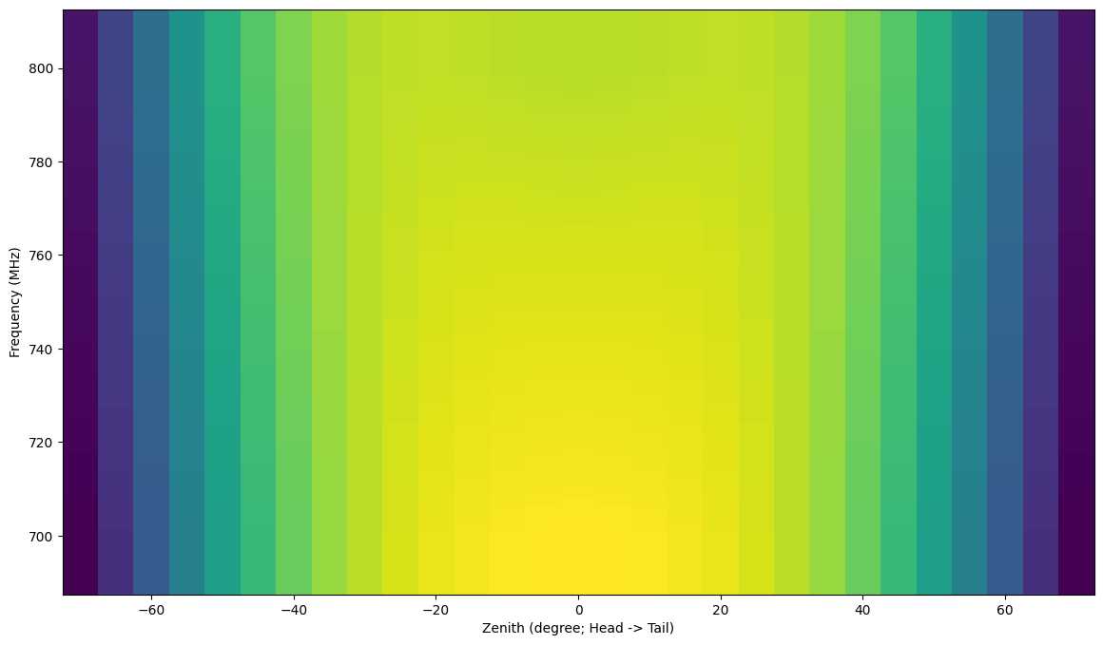
2d-Interpolated Simulated Beam – dipole2
Outside GS2 site
(i.e. without ground metal net.)
Inside GS2 site
(i.e. with ground metal net.)

Slide 10
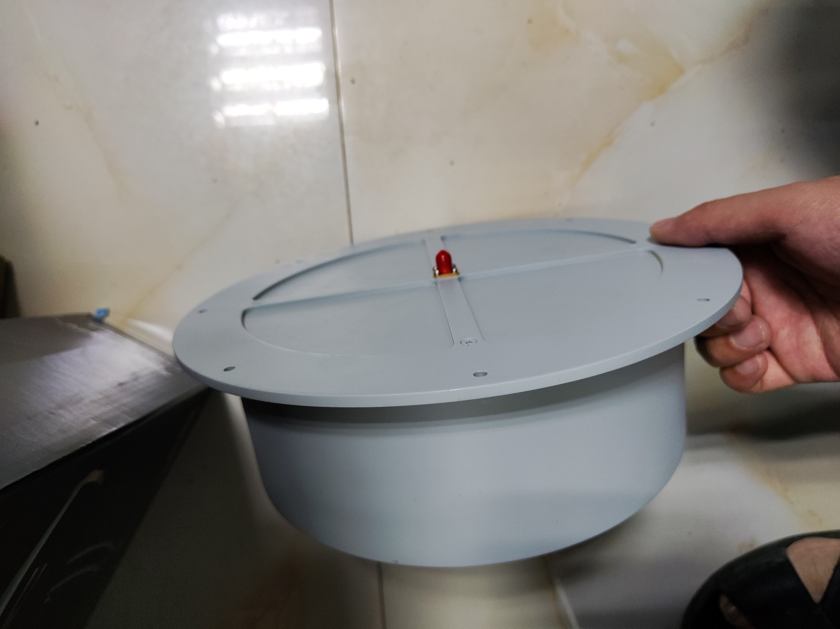
Simulation of circular (wo metal ground)
Simulation from datasheet
of the manufacture
Only 700 MHz is within our range.

Slide 11
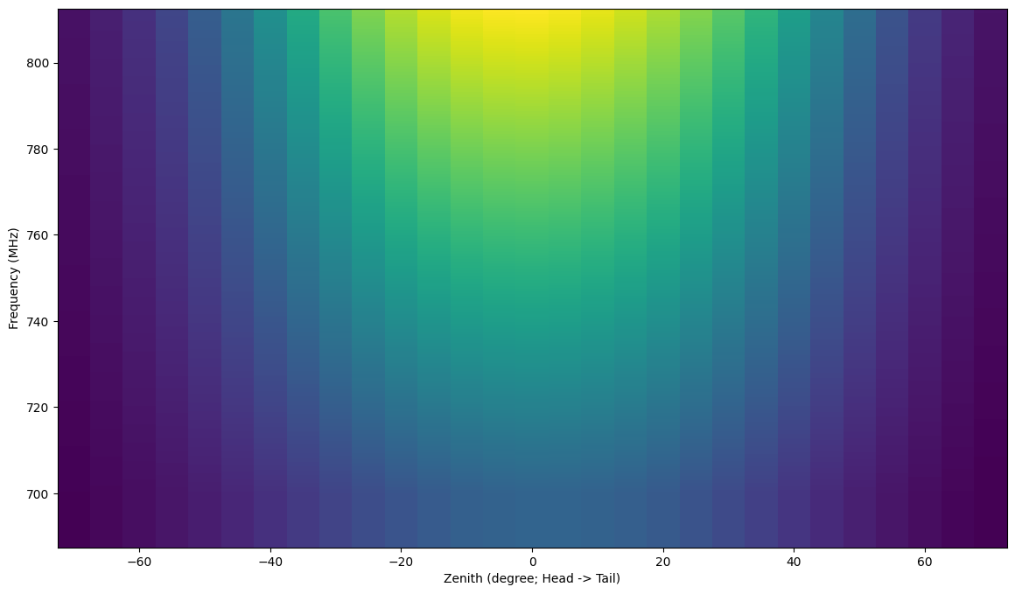
2d-Interpolated Simulated Beam – circular
Dipole 2 outside GS2
Circular outside GS2

Slide 12
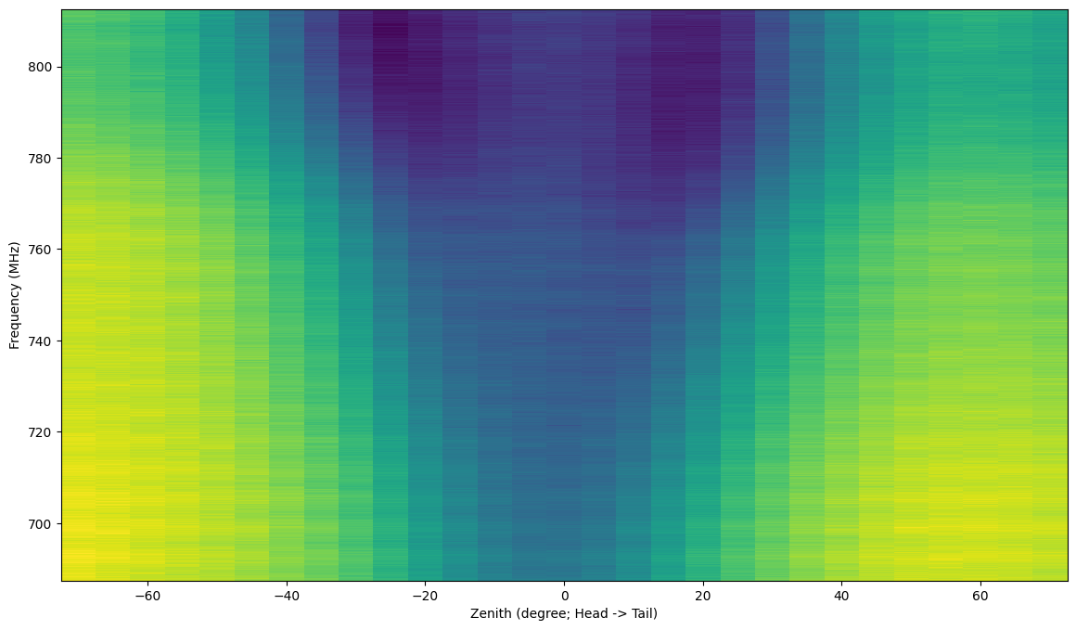
Drone Beam – dipole2 outside GS2
Without calibration
With calibration
Dipole2 is 10 cm above ground.

Slide 13
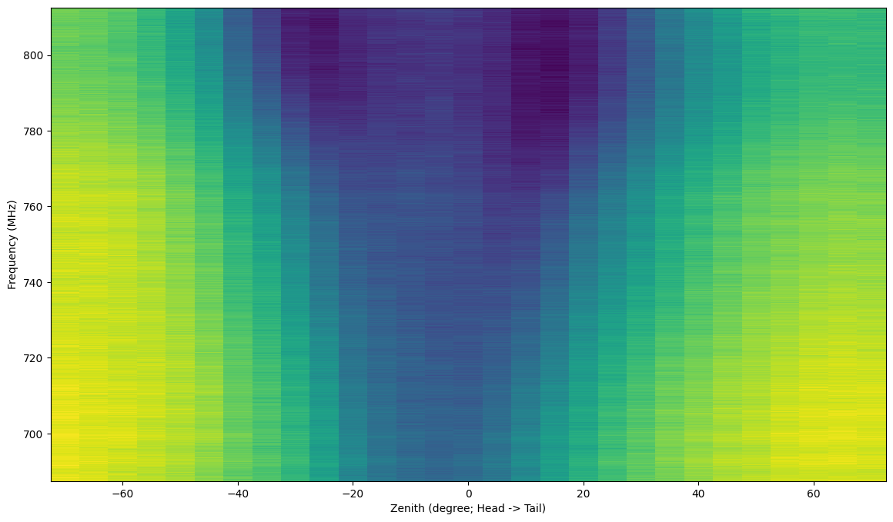
Drone Beam – dipole2 inside GS2
Without calibration
With calibration
Dipole2 is 10 cm above ground.

Slide 14
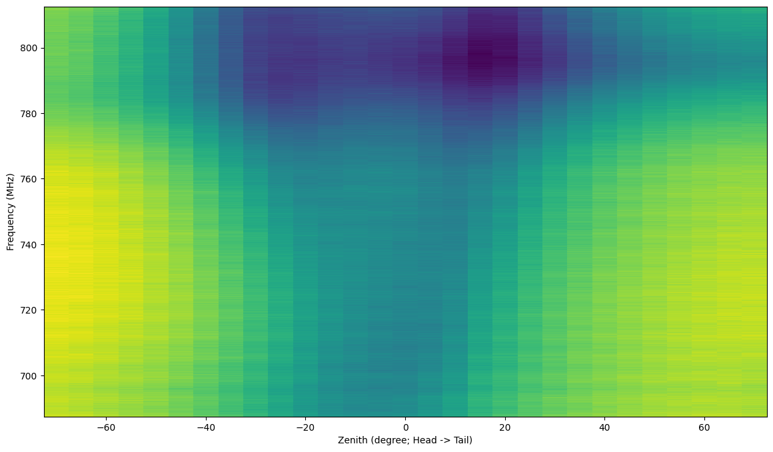
Drone Beam – circular outside GS2
Without calibration
With calibration
Circular feed is on the ground.

Slide 15
Linear plot

Slide 16
dB plot
dB

