Slide 1
TMS Steel Structure Design Update
Preliminary
S. Newbry 15 November 2024

Slide 2
Outline
Steel structure overview
Requirements summary
Preliminary FEA Results

Slide 3
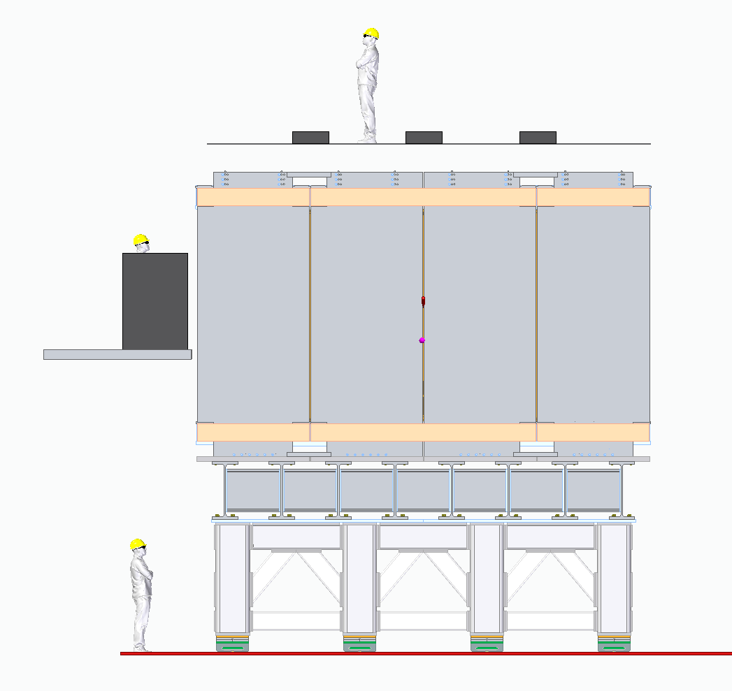
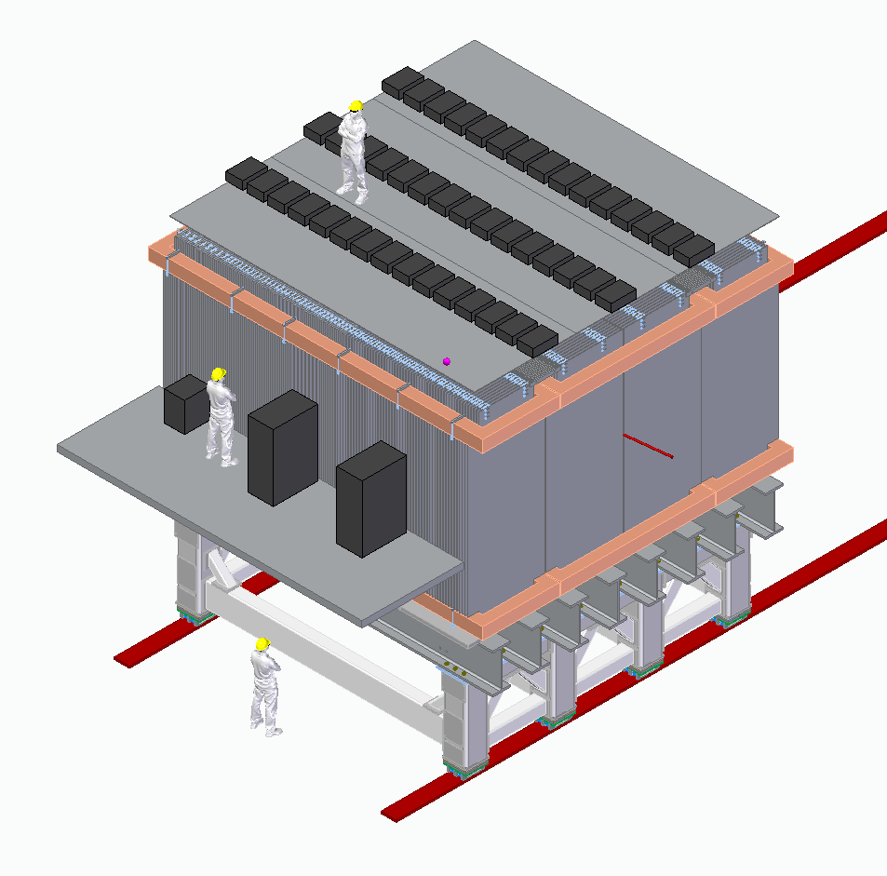
Overview – Context

Slide 4
Mass Breakdown
From CAD model
Steel plates: 711T
Coils: 77T
Steel structure: 65T
Cassettes: 50T
Brackets (fasten steel plates and coils): 38T
Aluminum baseplates: 11T
Estimate for mezzanine and cabling: 13T
Total: 965T
900T supported on steel structure

Slide 5
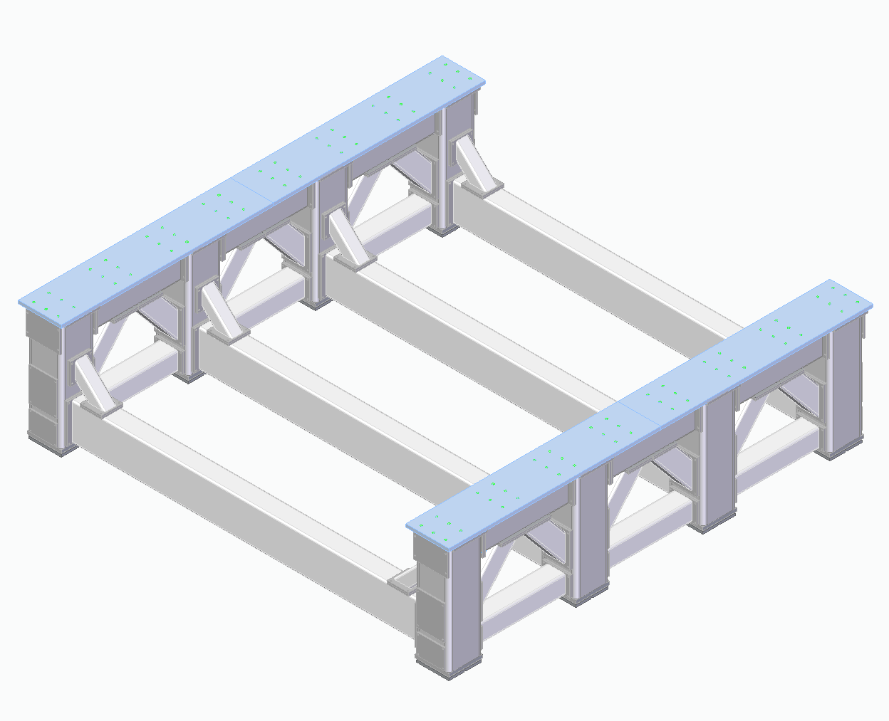
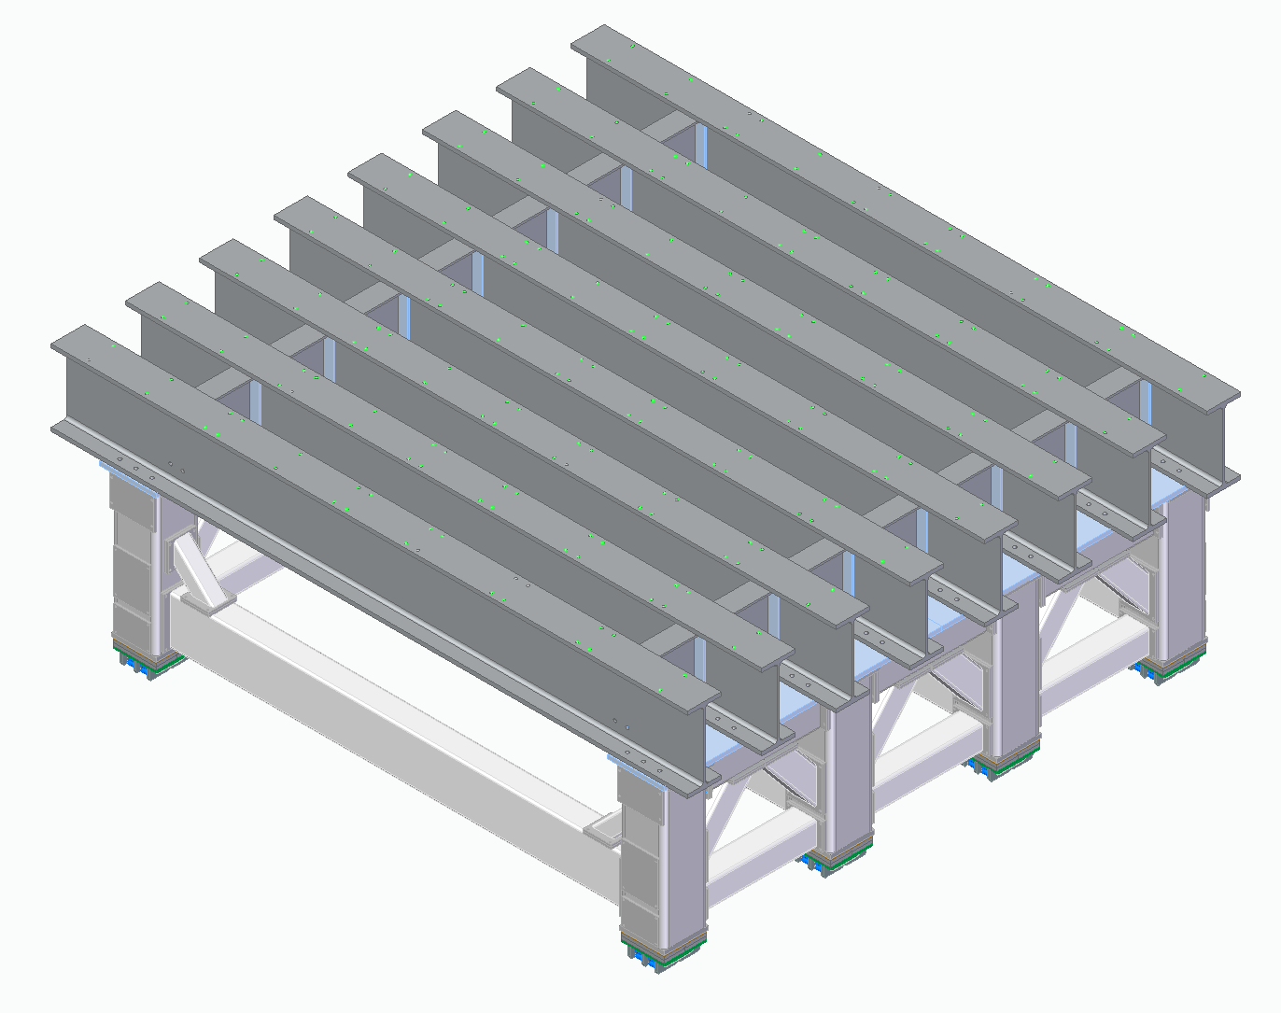
Steel Structure Overview
Standard size tubing
https://www.saginawpipe.com/ jumbo-tubing/
Uprights: 22” square, .875” wall
Long Crossbars: 24” x 12”, .5” wall
Short upper crossbars: 16” x 12”, .5” wall
Short lower crossbars: 12” x 12”, .5” wall
Large diagonals: 12” x 12”, .5” wall
Small diagonals: 8” x 8”, .5” wall
Standard size W-beams
36” x 330 lb/ft

Slide 6
Requirements Summary
“TMS Frame Requirements” draft document
900T mass to be supported
Steel: A992 (W-beams), A36 (Tubes)
Design code: AISC Steel Construction
Minimum factor of safety of 2 vs yielding
Load cases for FEA:
1 gravity (normal operation)
1 gravity + 160T lateral load (roller lateral sliding)

Slide 7
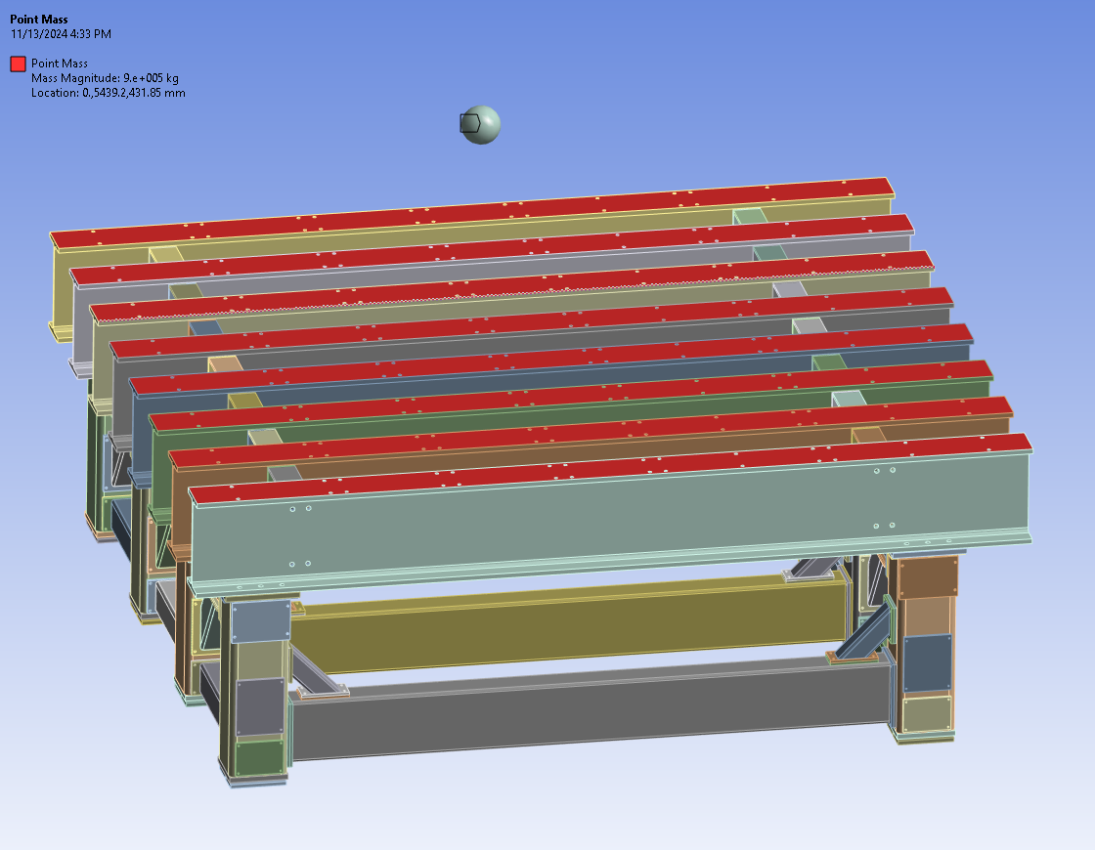
FEA Setup – Remote Mass
900T mass of steel plates, coils, and detectors

Slide 8
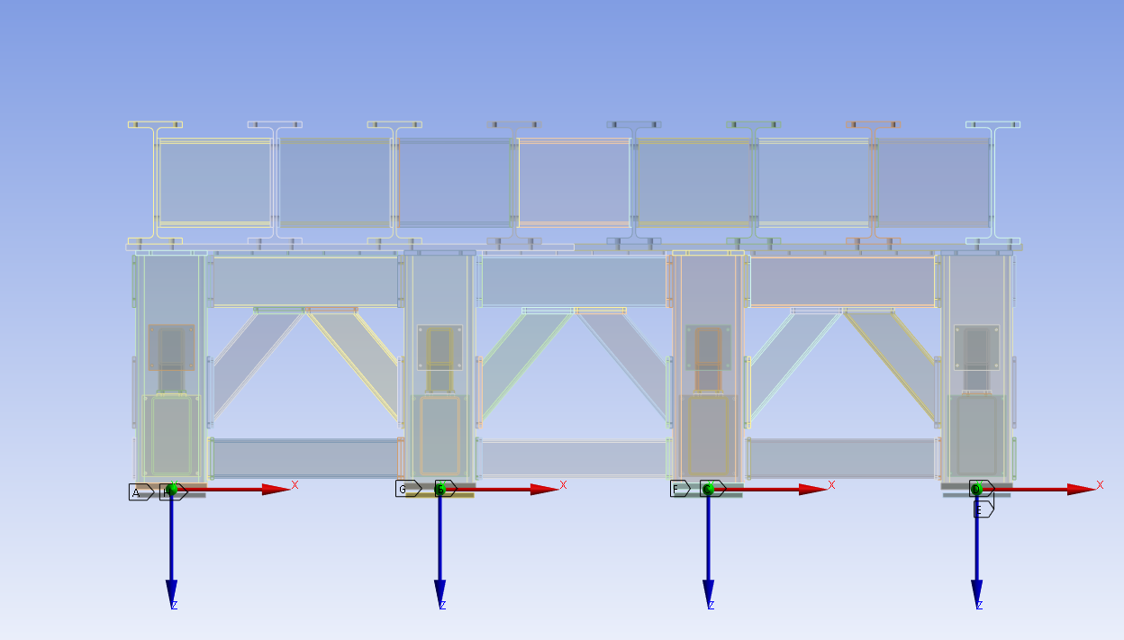
FEA Setup – Elastomer Pads
8 places, 20T/mm spring constant

Slide 9
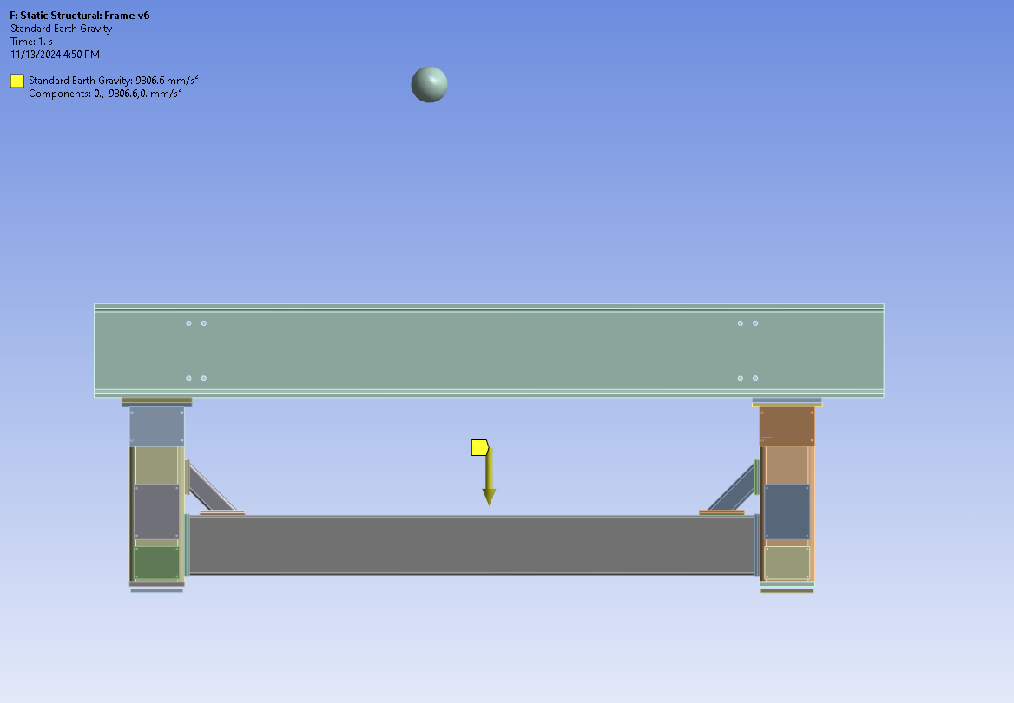
Load Case – 1G Vertical

Slide 10
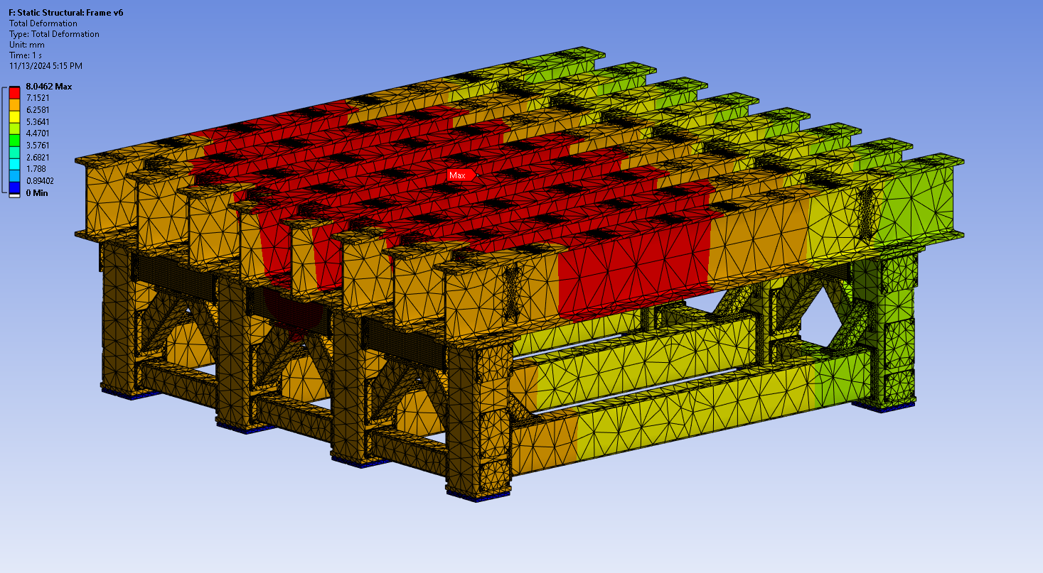
Deflection – 1G Vertical
~5mm compression of elastomer pads
~3mm bending of W-beams

Slide 11
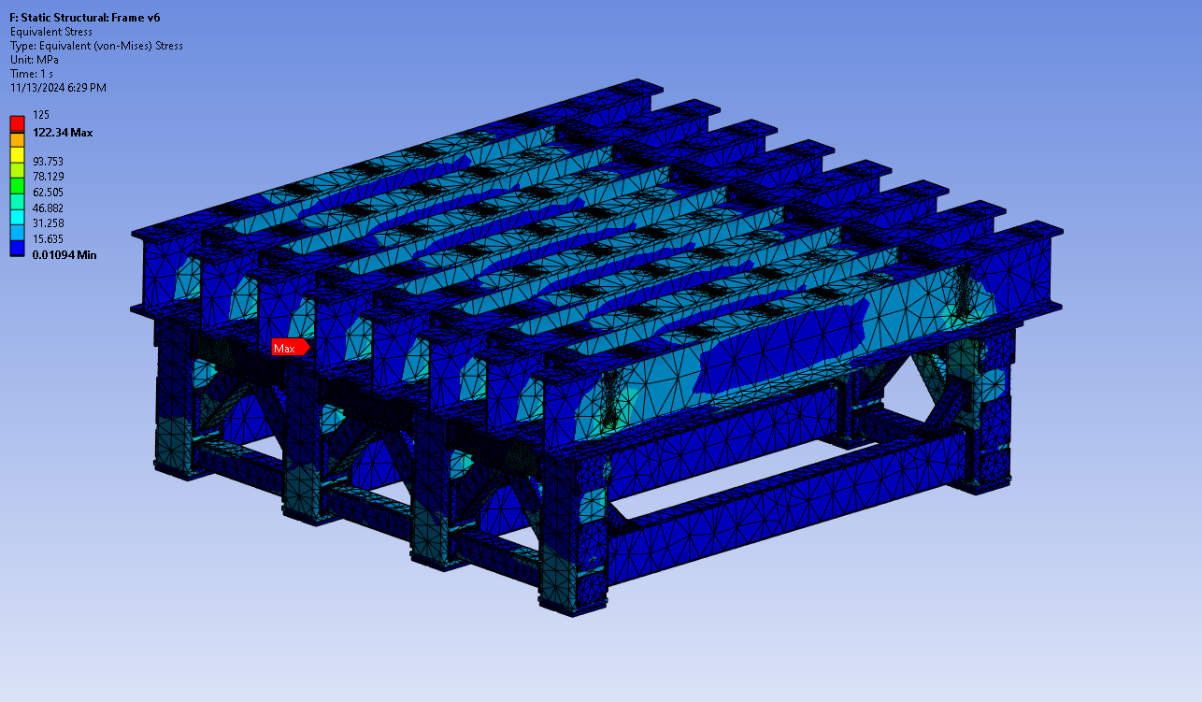
Stress – 1G Vertical
Maximum stress is below 125MPa limit for A36 steel

Slide 12
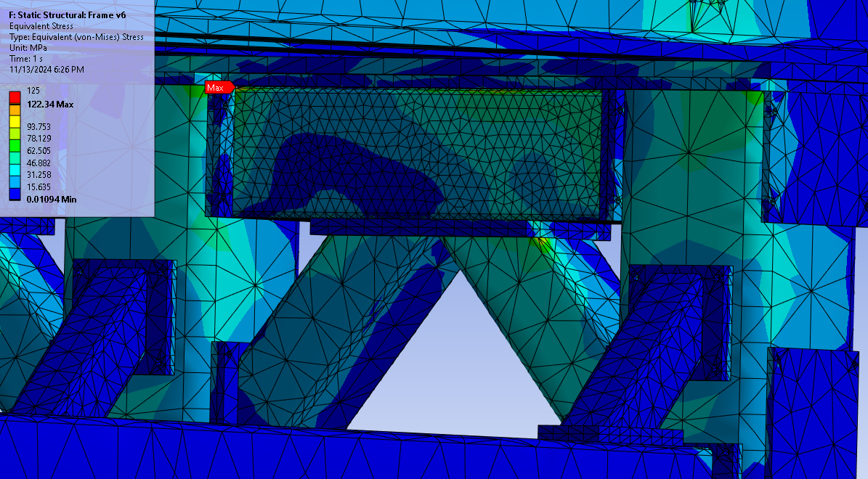
Stress – 1G Vertical
Maximum stress appears to be a stress singularity

Slide 13
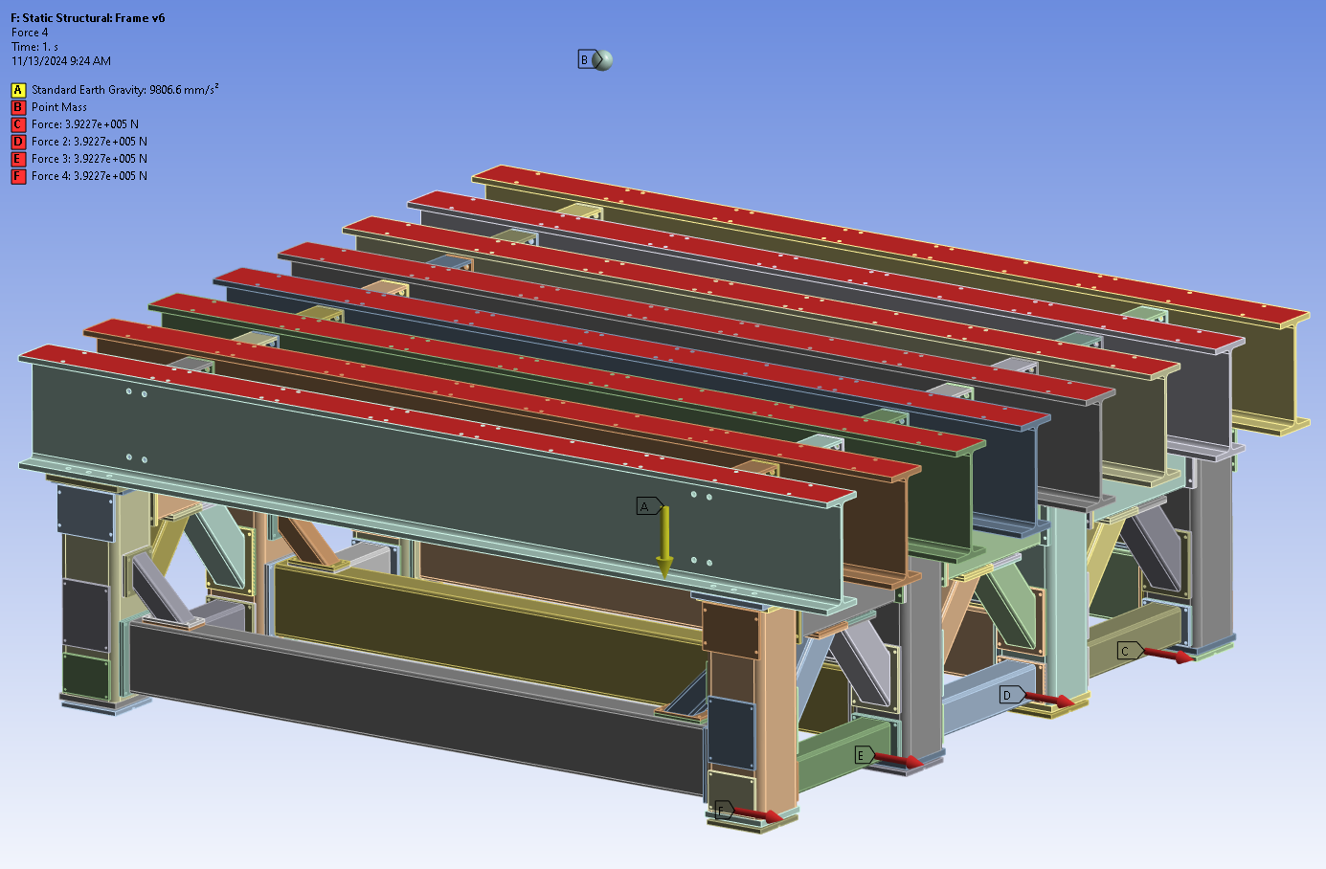
Load Case – 1G + 160T lateral load
Lateral load applied to 4 feet

Slide 14
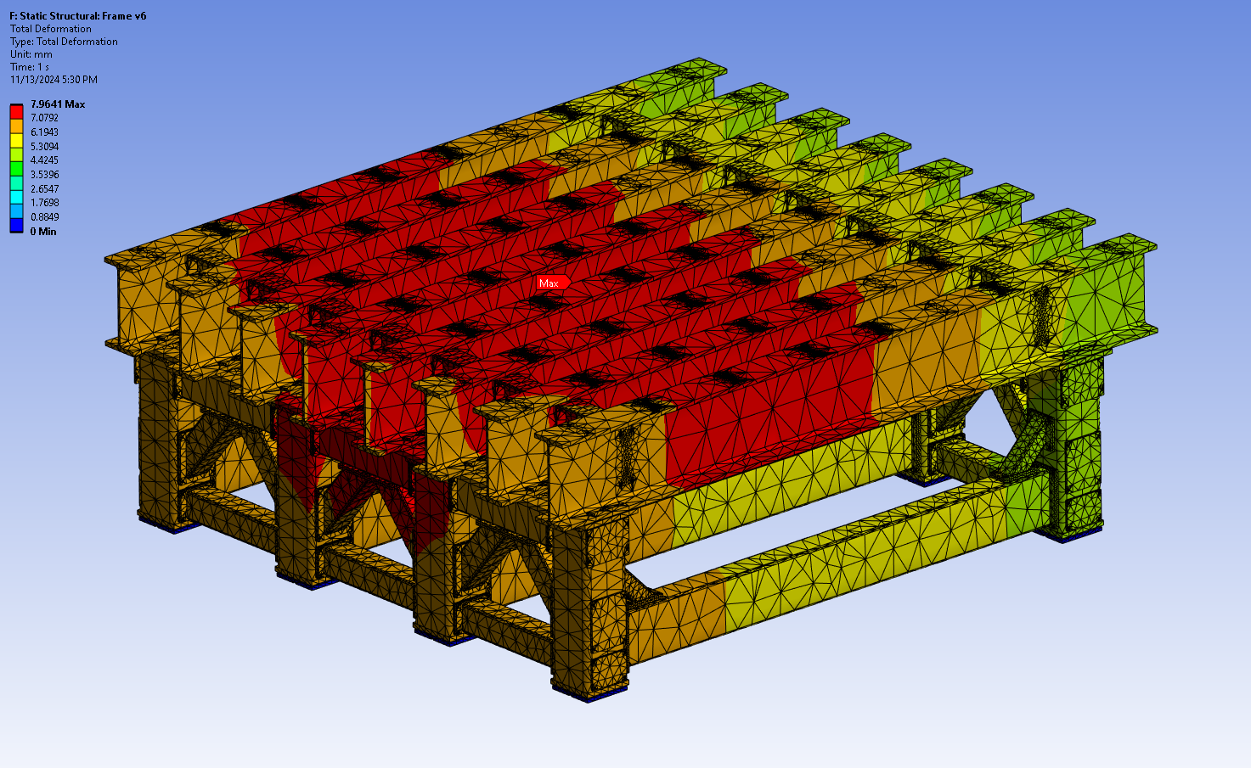
Deflection – 1G + 160T lateral load

Slide 15
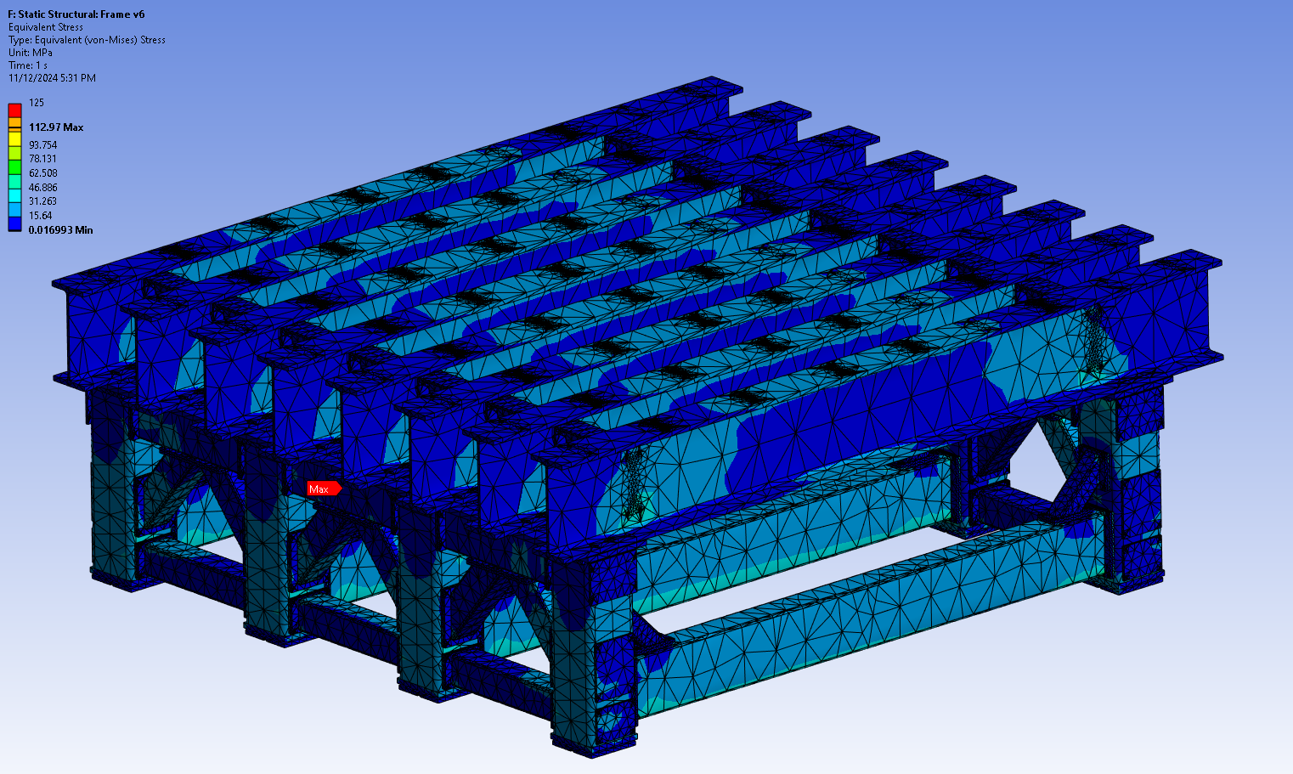
Stress – 1G + 160T lateral load

Slide 16
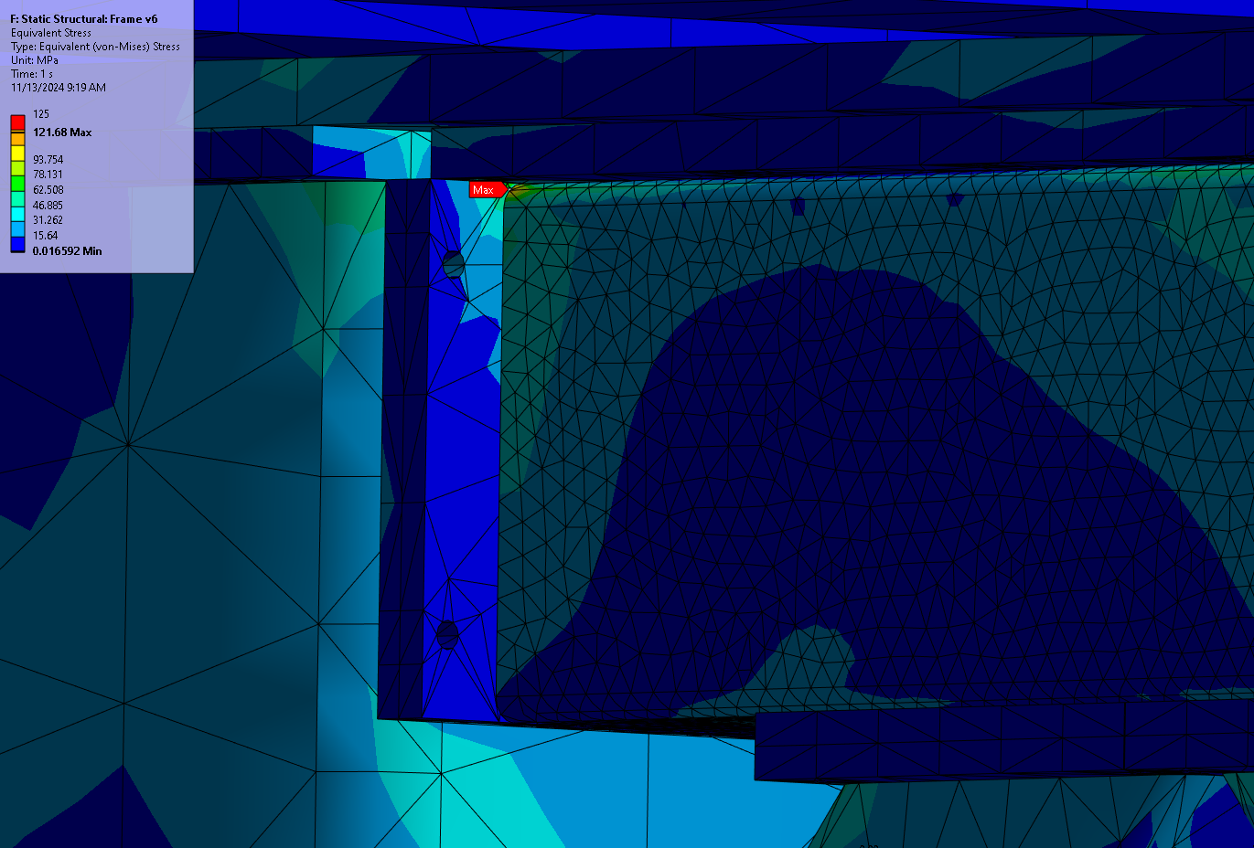
Stress – 1G + 160T lateral load
Rerun with smaller mesh in high stress area
Maximum stress is below 125MPa limit for A36 steel
Maximum stress appears to be a stress singularity

Slide 17
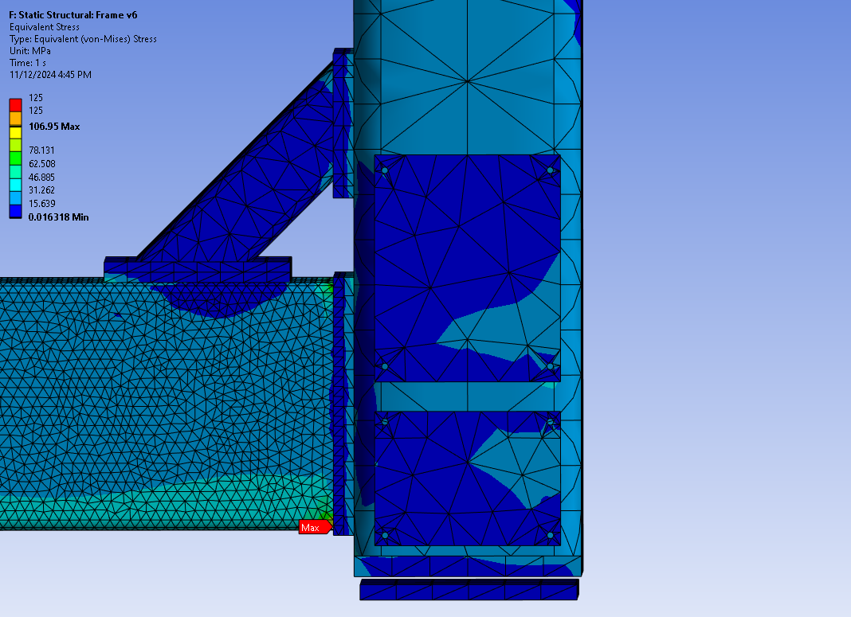
Stress – 1G + 160T lateral load
Rerun with smaller mesh in high stress area
Maximum stress is below 125MPa limit for A36 steel
Maximum stress appears to be a stress singularity

Slide 18
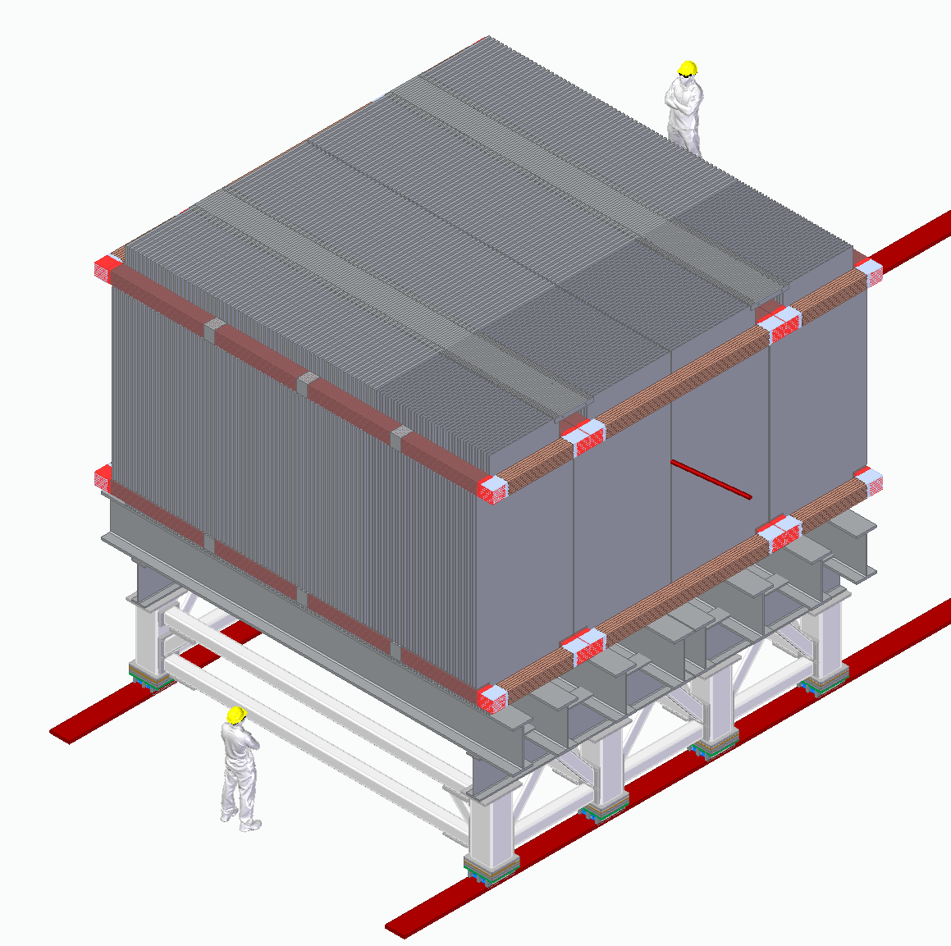
End
June 2024
November 2024

