Slide 1
Mu2e report
Greg Rakness (FNAL)
Friday 9am AD meeting
15-Nov-2024
https://indico.fnal.gov/event/67061/

Slide 2
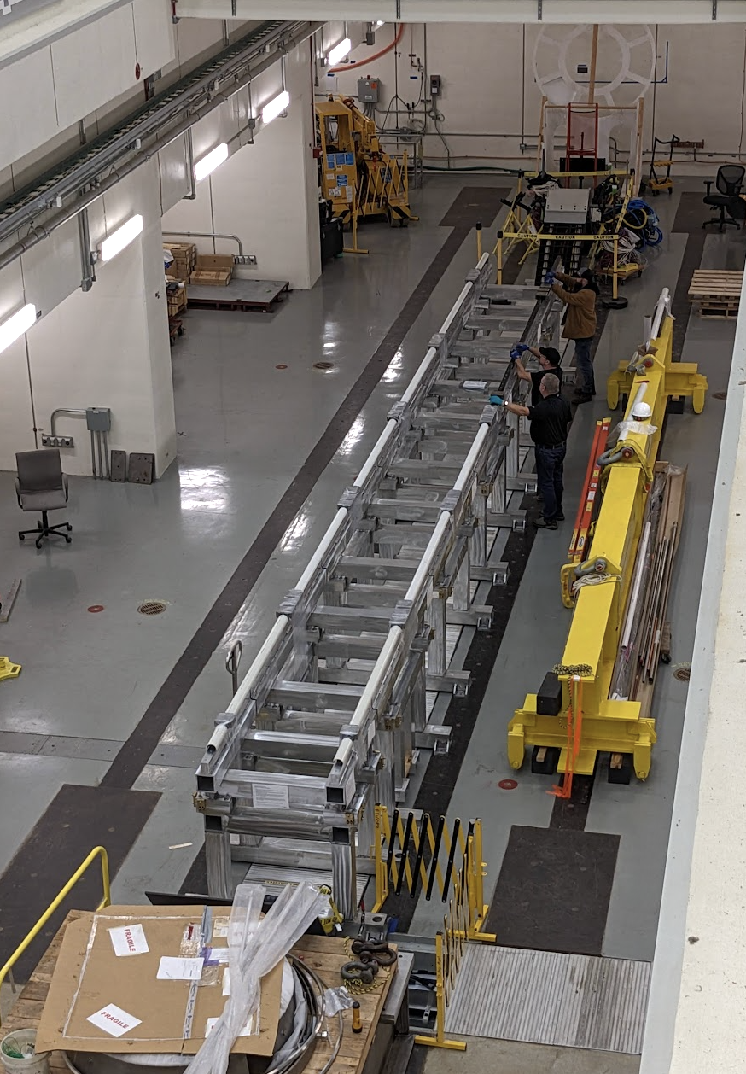
Progress on Detector Train
External stands have been installed at Mu2e and are being aligned
Recall: External stands support detector train
After alignment, installing toe clamps to keep external stands in place
Vacuum Pump Spool Piece (VPSP)
Stopping Target + proton absorbers
Detector Solenoid
Tracker
Instrument Feedthrough Bulkhead (IFB)
Calorimeter
External Stands
Muon Beam Stop

Slide 3
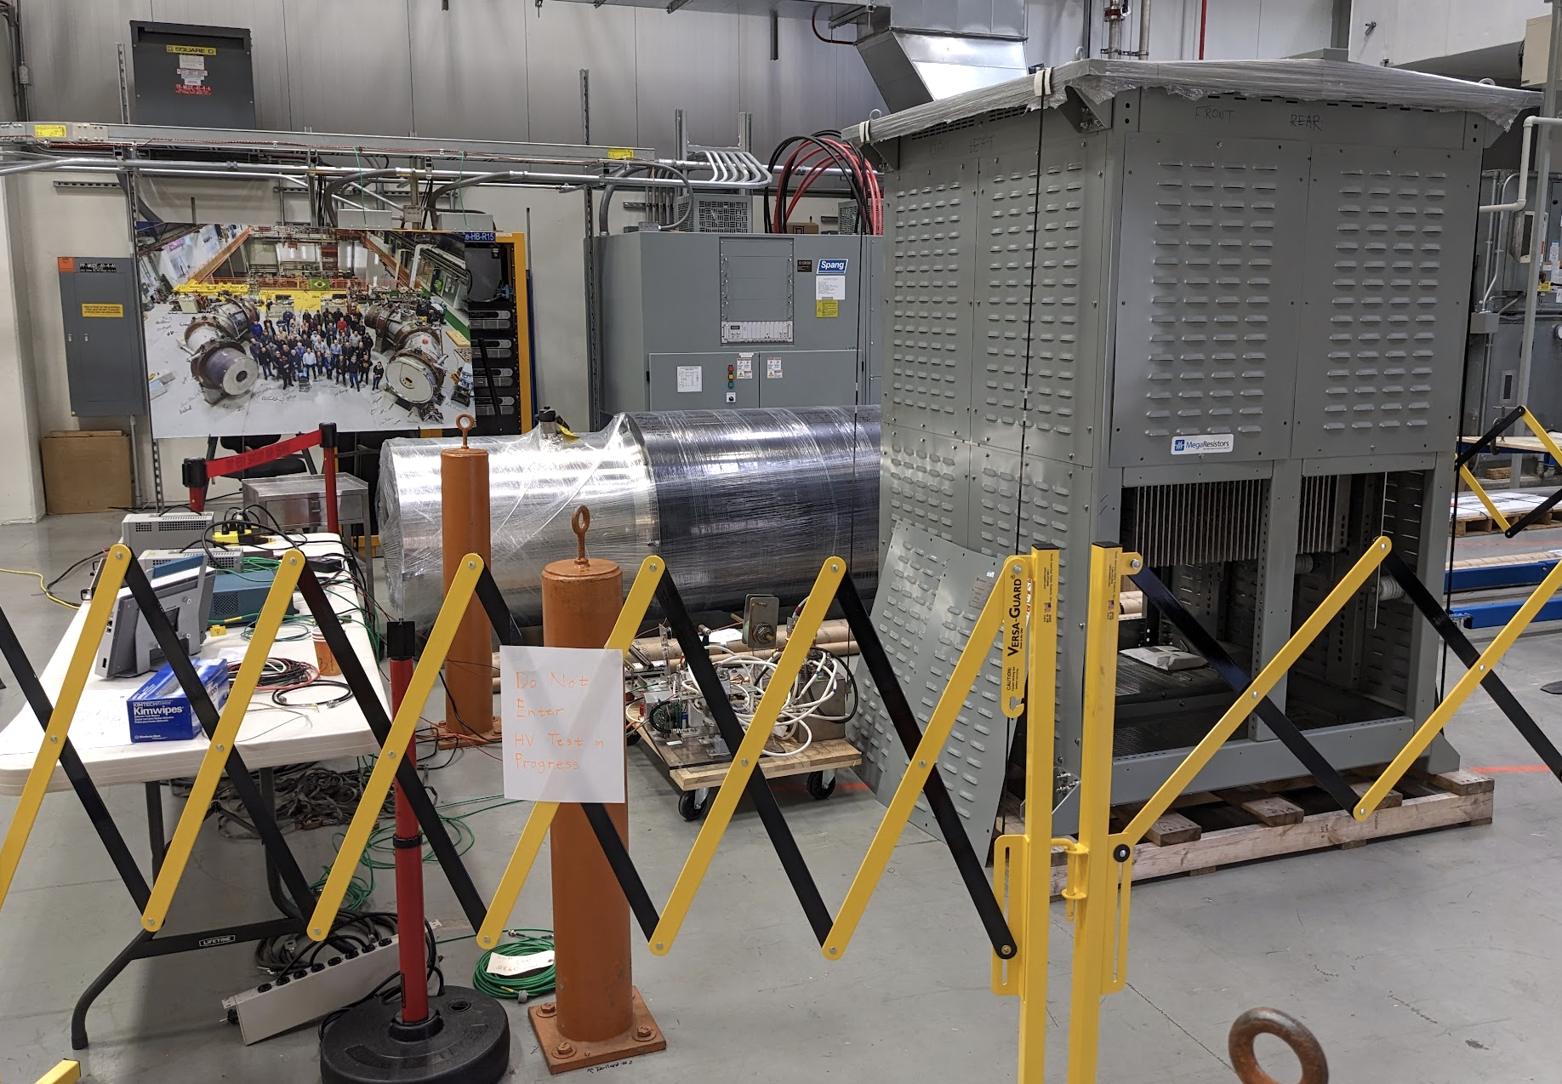
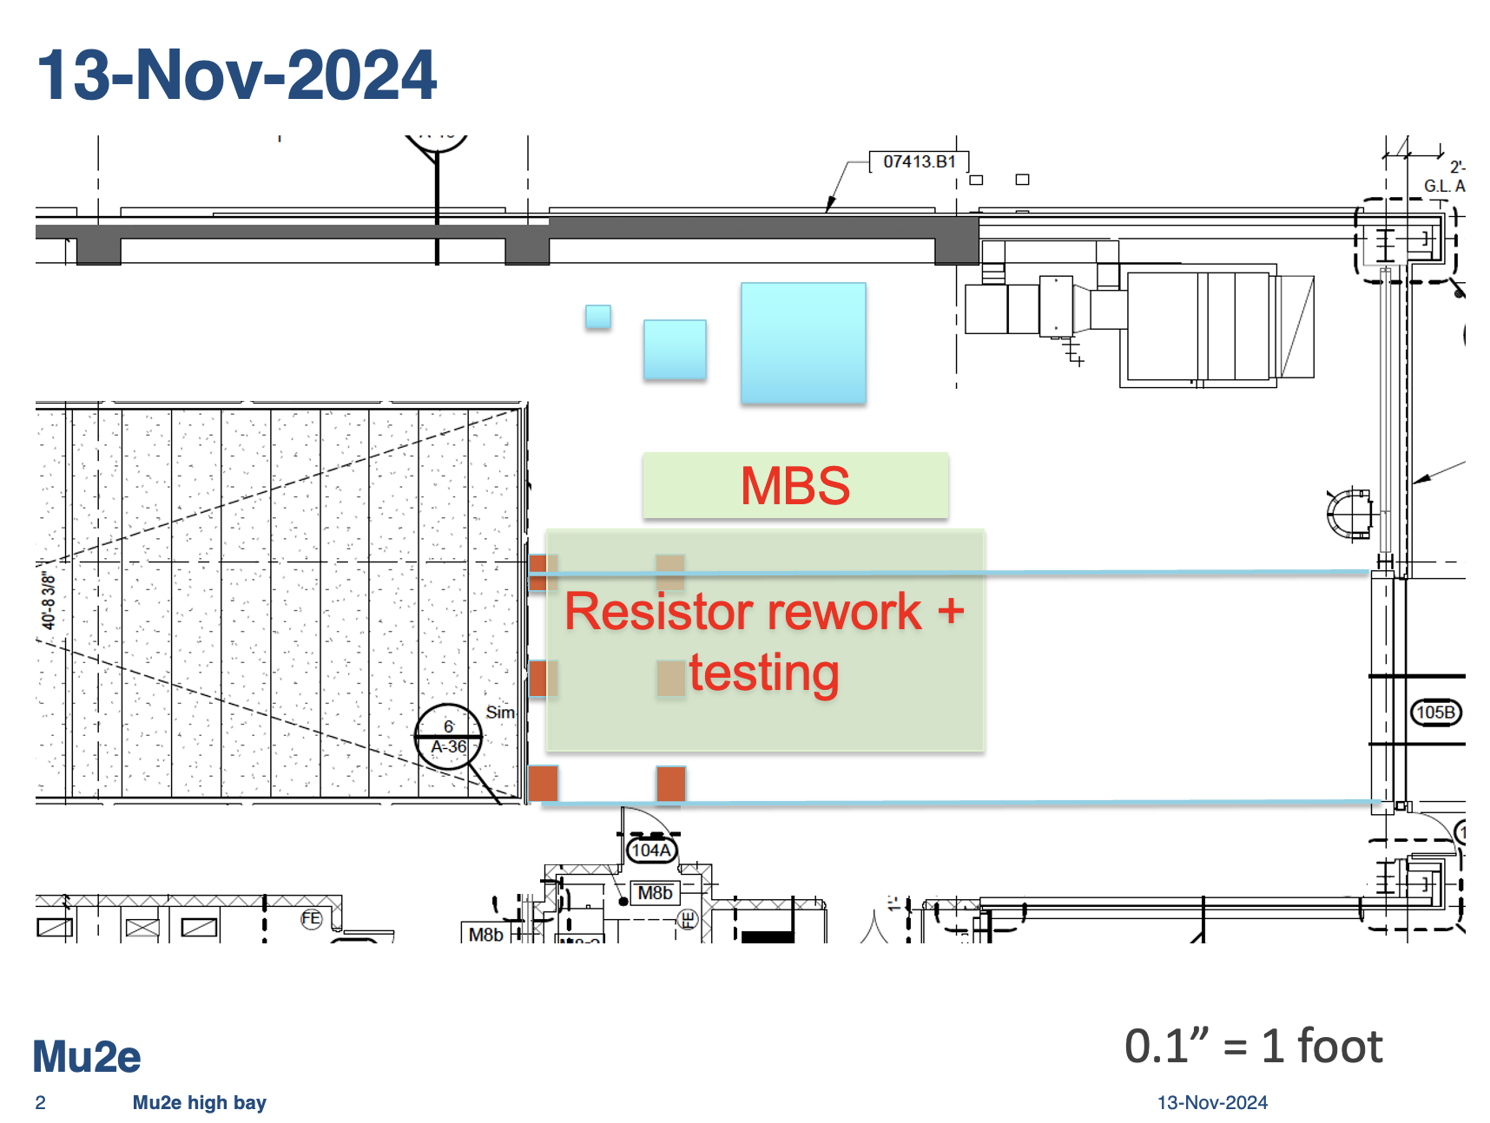
Receiving dock high bay is “full”
Presently in high bay: muon beam stop, and rework + testing of 1st of 5 dump resistors
Thanks to PPD EED/DDOD for rework
Thanks to AD PESD for testing
Expecting to receive IFB and VPSP ~Thanksgiving, so we can assemble the Detector Train and then get the Tracker and Calorimeter into the building…
… but… there is not enough room in the high bay
John Nazjdion has offered to use DAB for resistor rework and testing
Advantages: rework + testing can continue unfettered, and we can use the high bay to receive equipment efficiently
Disadvantage: the setup needs to move from Mu2e to DAB
We are planning go to move the dump resistor rework + testing to DAB
Sorry Ramfis.

