Slide 1
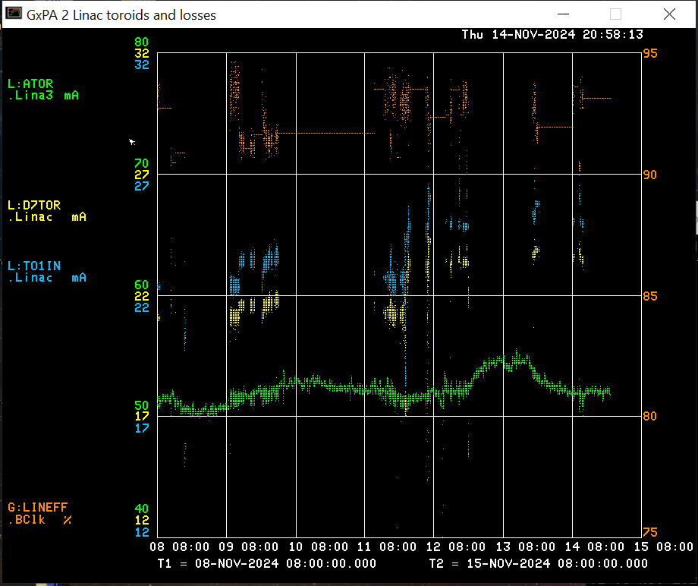
LINAC Operations Report
Beam output: Source: 52.2 mA
TO1IN: 25.5 mA
D7TOR: 23.5 mA
Efficiency: 92 %
Issues this week:
LRF3 Marx cell 24 failure Sunday night
Replaced Monday morning
Sunday night MW3 ‘Out’ switch failed
Accessed Linac to replace switch Tuesday morning with Booster experts
55 LCW system Chiller #4 pump failed Tuesday evening
ISD able to get pump running Wednesday afternoon
BPM problems started Wed night
Linac, Instrumentation, and Controls experts working on it
Beam to Booster last Friday evening
Tuning Saturday morning
Linac studies Monday afternoon
MW scans Monday evening
Linac high-intensity studies and Debuncher phase scan studies Tuesday evening
Beam studies resumed Wednesday evening after 55 LCW system recovery

