Slide 1
Project Activities for MSD
Mayling Wong-Squires
AD Operations Friday 9am Meeting
15 November 2024

Slide 2
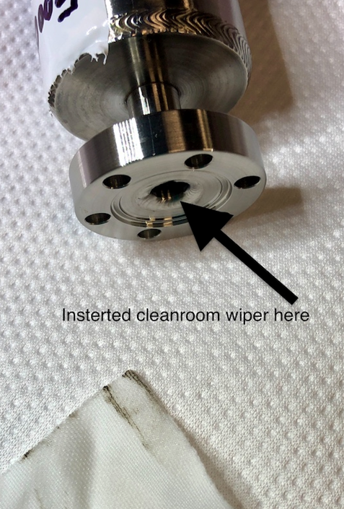
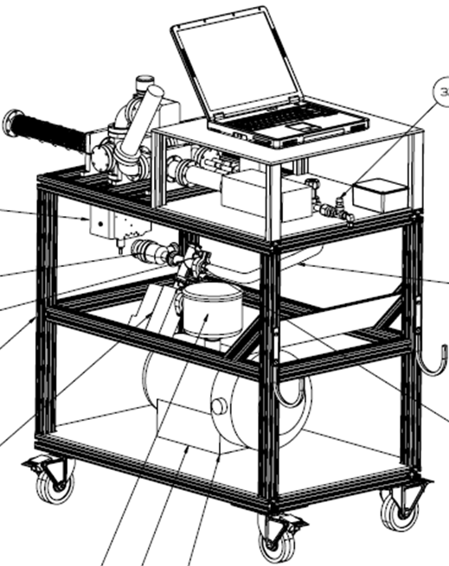
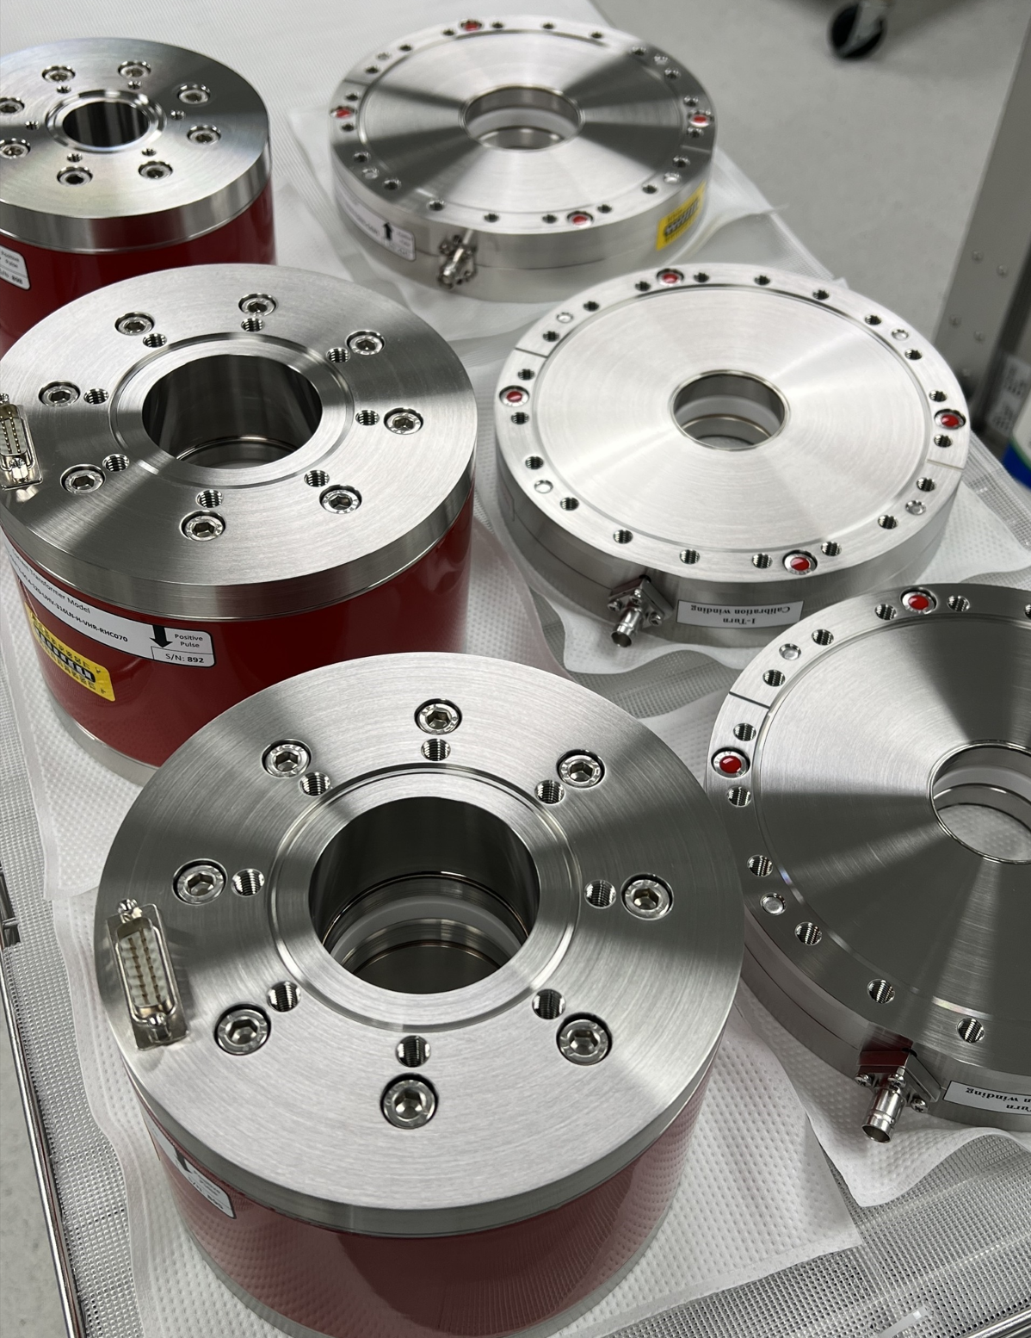
PIP-II Vacuum Systems Lucy Nobrega (L3, CAM), Kathrine Laureto (Deputy L3), Alex Chen (Lead Vacuum Engineer), Rich Andrews (Chamber design), Eric Pirtle (Design)
Working on
Vacuum QC of first ACCTs, DCCTs, WCMs using Beam Instrumentation traveler (complete)
QC and assembly of mass flow carts in progress. QC discovered contamination on standard leaks, prompting further checking and possibly replacement or of standard leaks on all CMTF MFC’s.
Writing travelers and finalizing hand-off documentation
Finalizing design for
Warm Front End, Superconducting Linac, and Linac and Beam Transfer/Beam Absorber lines
Dipole transition first article fabrication. Tube shaping in progress.
laserwire UHV chamber, commissioning cart, wide aperture BPM’s (D Krokosz)
laserwire optics and adjustment stages (T Price)
Department resources needed
Engineering: instrumentation design (D Krokosz, continuing)
Vacuum technician for acceptance testing and vacuum cart assembly (Marino Alvarado, Elias Lopez, Ron Kellett)
Design/Drafting: SCL and BTL design & integration (E Pirtle, continuing), BTL chambers and transitions (D Hurd)
Contamination discovered on mass flow cart standard leak
Assembly of 3 mass flow carts for slow pumping and venting of the UHV/particle-free PIP-II beamline has begun. This cart is a copyrighted Fermilab design.
Vacuum QC of first ACCT’s, DCCT’s, WCM’s

Slide 3
LBNF LCW Systems Dave Hixson, Scott Oplt, Will Derylo, Noah Vollmer, Jay Hayman
Design engineering and drafting continue in all areas
Typical LCW piping and bus supports fabrication drawings nearly complete
LBNF-05 Power Supply Room​, Pump Room: piping models and construction drawing generation continues
Primary Beam Enclosure (PBE) LCW secondary headers design continues, dependent on below
Magnet power and water connection design continues
Inter-dipole power and LCW connections modeling in progress, adapting MI style connections
Collaboration between PESD and MSD in the areas with minimal space: power turn-arounds, quad bypasses, bus connections to dipoles
Bus shielding design restarted - with Jay Hayman (APS-TD)
Coming Up
Finish engineering notes for Intermediate Water systems
Redesign/Routing of LCW, Opticool, and Bus from MI-10 to PBE: bus type to be determined
Check drawings for the Target and Absorber Halls Intermediate Water Systems
Department resources needed
Fluids engineer for continued LCW piping, magnet electrical and LCW connections, Nitrogen and Compressed air systems

