Slide 1
0900 AD Shutdown Scheduling Meeting
Marty Murphy
15 Nov. 2024

Slide 2
Current Status
Power outage at MI-30 today until 15:30.
MI-8 Collimators
Gradient magnets and spool pieces were installed and aligned last week.
Subsequent vacuum leak took a few days to sort out, but vacuum is stable now.
Remaining steel has been moved outside the enclosure.
SME inspection of MI-8 beam line was completed and no issues were found.
MI LCW
So far temperatures around the ring are around 90F and the MI30 HX has been used sparingly if at all. This is good.
MI Power
AD continues to work with ISD to determine the best configuration for powering beam lines and to adjust LOTO procedures as needed.
Maintenance outages at MI20 and MI40 were completed Wednesday & Thursday, respectively.
PESD successfully test the new PS for Q847

Slide 3
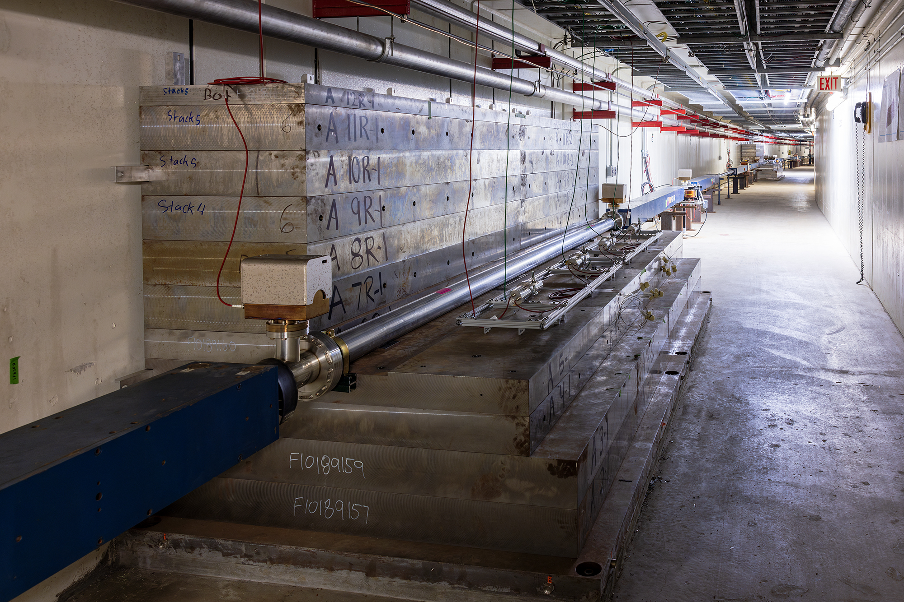
From 825 looking down stream

Slide 4
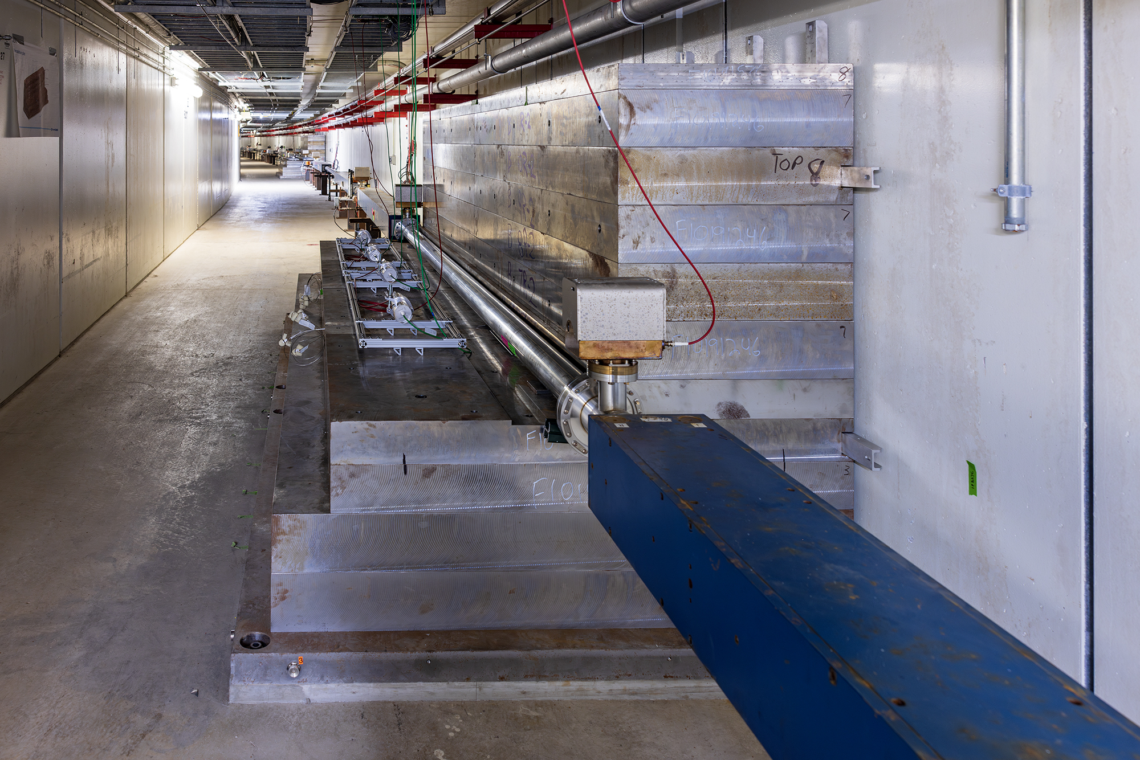
From 827 looking up-stream

Slide 5
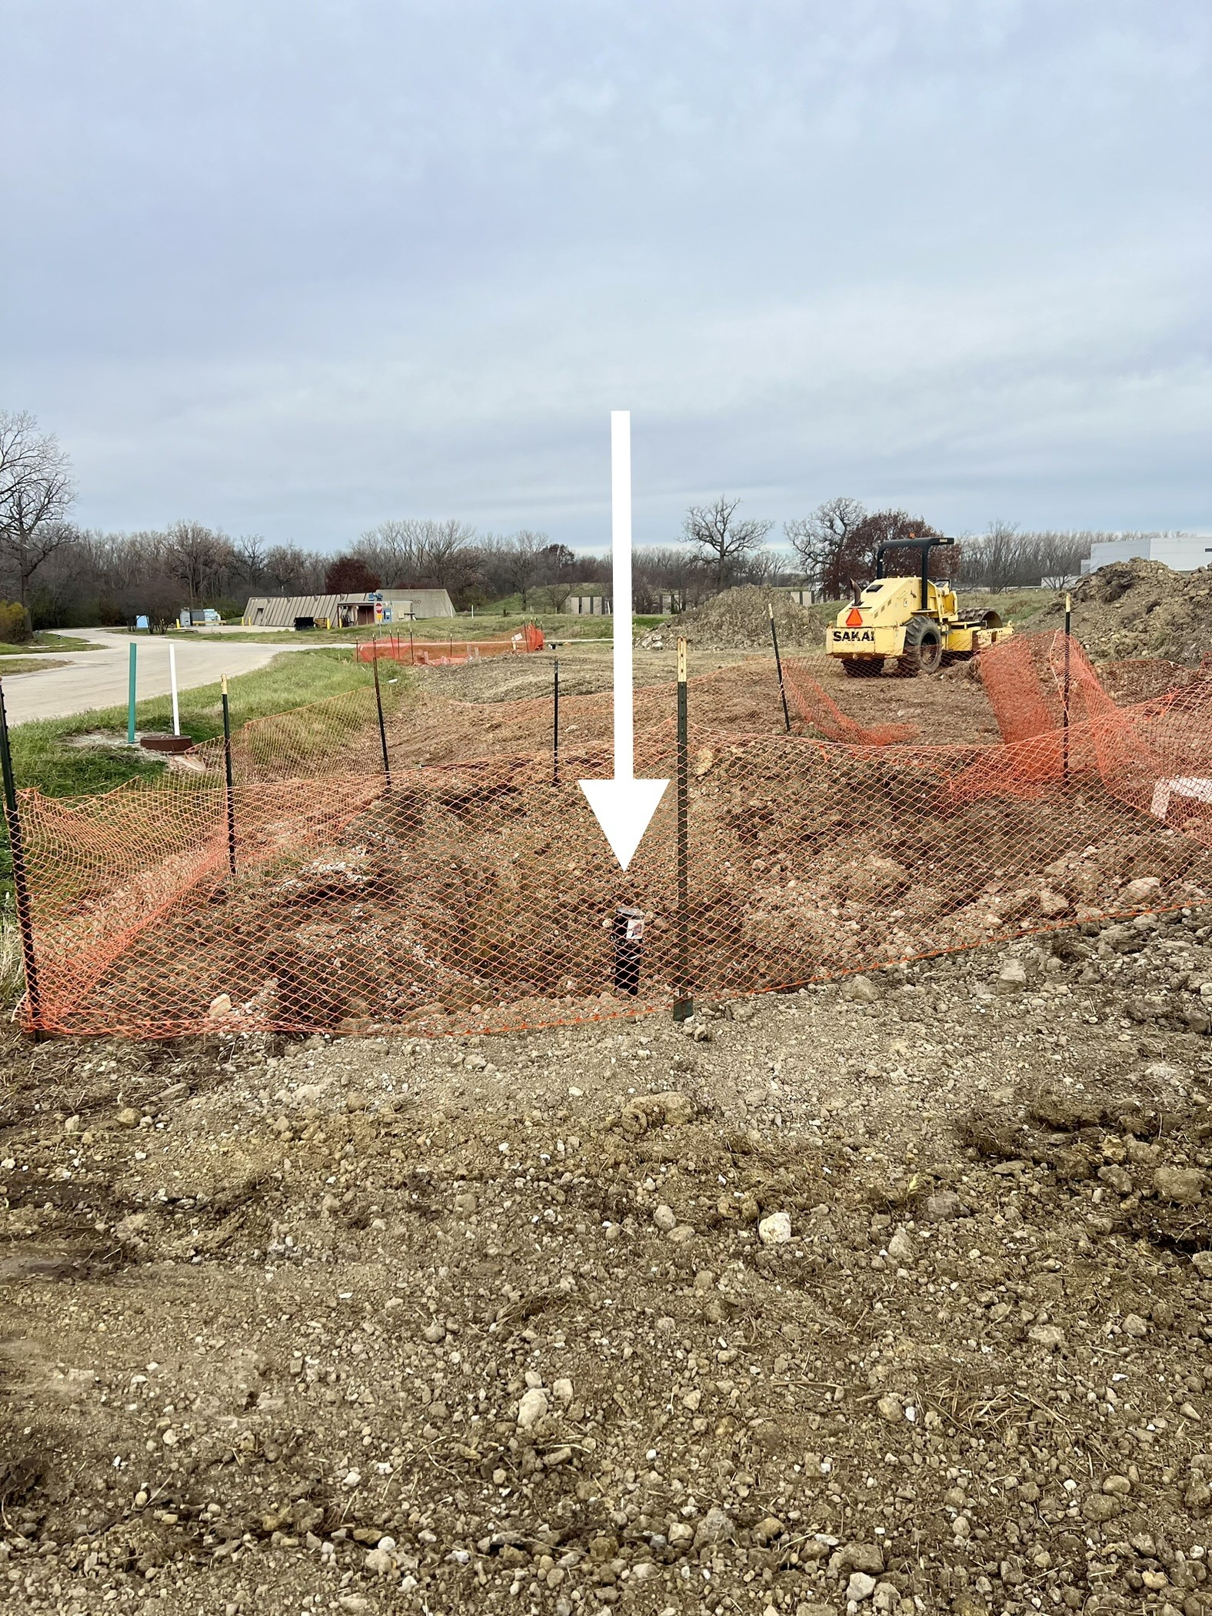
Domestic water pipe work along the Muon Transport berm resulted in a new valve stem emerging very close to the MI-8 berm.
The photographer here was standing on the center of MI-8 berm looking 90-degrees to beam-right.
We have begun the USI process to assess its impact.

Slide 6
Plan:
MI-8 Collimators
Final clean-up activities in MI-8. Job is basically done until Summer ‘25. Thanks to Bob, Ryan, Bryan & Max for their thoughtful and consistent work on this installation.
MI-8 Berm USI in progress for ISD water excavation.
MI beam sign-offs.
Complete Power Outages TBD
Houses remaining are MI 52 & 62.

