Slide 1
Muon Campus Shutdown Report
Jim Morgan
Friday 09:00 Ops Meeting
November 15, 2024

Slide 2
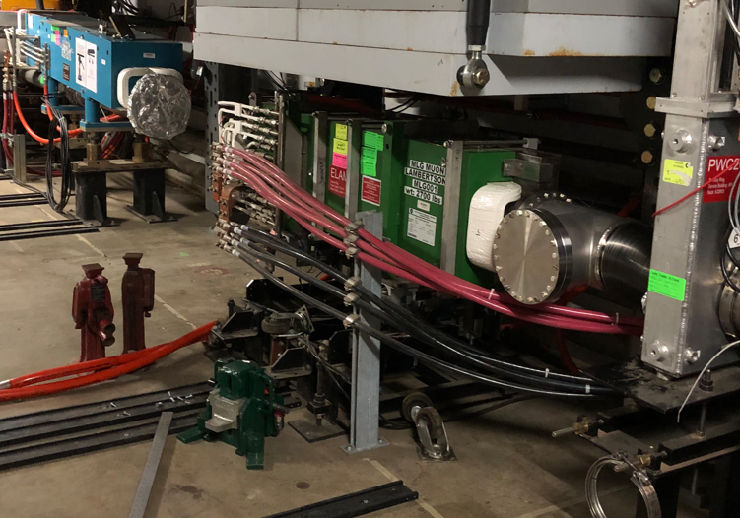
Muon Campus status
Electrostatic Septum ESS2 installation and new stand check-out for both septa
ESS1 and ESS2 aligned to Delivery Ring centerline
Vacuum connections made on ESS2 and pump-down initiated
High voltage connections made on ESS2
Motion-control check-out began on ESS1 & ESS2
Q205 rad hard quadrupole and modified vacuum pipe installation
Special pipe was installed in magnet early in the week, final welding Thursday
Profilometer Tee has been installed upstream of ELAM
Domestic water line repair north of AP-0 and over MI-8 Line
Berm integrity needs to be checked after repairs
Miscellaneous LCW leaks repaired
Muon LCW resistivity continues to be poor
AP-0 A/C work paused, reasons unclear
Study – M1-M3 Optics
Study – Alternative M5 optics

Slide 3
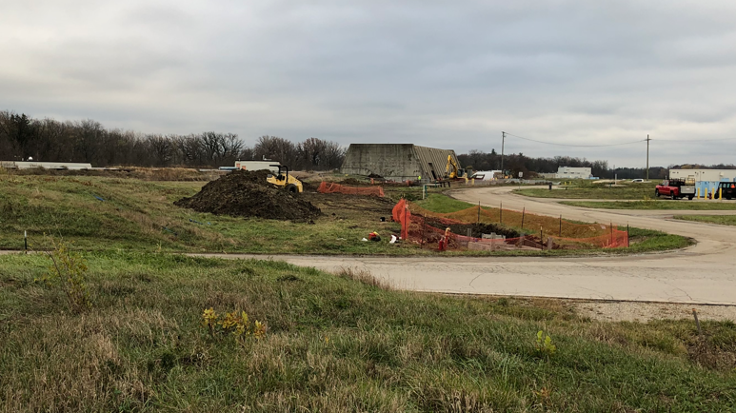
Domestic water line replacement north of AP-0

Slide 4
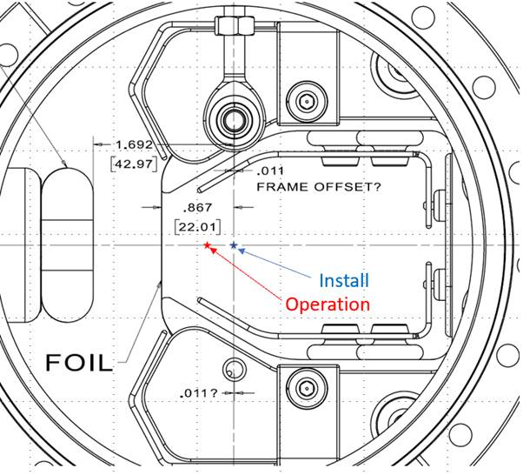
Electrostatic septum

Slide 5
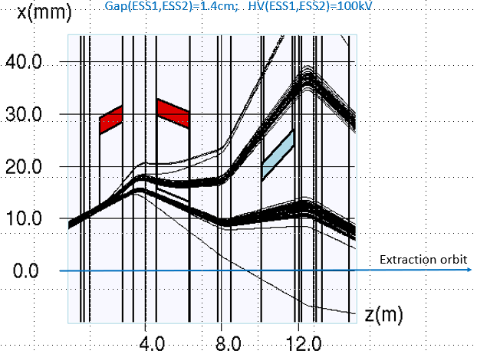
Simulation of resonantly extracted beam trajectory
Cathode
Cathode
Extracted Beam
Circulating Beam
ESS1
ESS2
ELAM

Slide 6
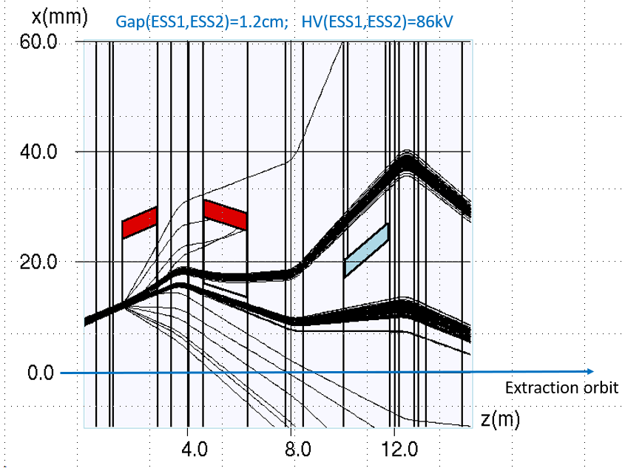
Simulation of resonantly extracted beam trajectory

Slide 7
Upcoming work
D30 installation work
ESS area vacuum pump-down continues, ion pumps have been turned on
ESS vacuum needs to improve before high voltage conditioning can begin
Q205 installation, vacuum connections and vacuum pump-down
Domestic water line repairs south of AP-0 may have compromised shielding
Close to Transport berm, need to survey to understand if berm was disturbed
Excavation for new water line crossed over MI-8 tunnel
Other upcoming work
Install additional steel shielding above ECMAG
Several survey & alignment tasks including Q205 & M4 WCM
Continue ESS1 & ESS2 motion-control check-out and limit switch adjustments
Repair Kirk Key hardware on disconnects, requires more modifications to disconnect
Replace several power supply circuit breakers and some primary wiring
Prepare to install Mu2e Extinction Monitor Collimator in Absorber area
M4 Final Focus vacuum installation, A/C dipole installation
Hope to begin preparing for beam operation later this month
Re-core Rings, Extraction and M4 Enclosures to operational cores next week
Safety system testing afterwards

