Slide 1


Analysis of coil 254 Non-Conformity
MQXFA team, with special contributions by:
Jesse Schmalzle, BNL
Mike Naus, LBNL
Lance Cooley and Liora Louis, FSU
MQXFA20 Coil Acceptance Review; Dec 12, 2024

Slide 2
Analysis Plan
At BNL a replica was made of the scratches on coil 254
  The depth at each scratch location on the replica sample was measured at FSU
Similar damages/scratches were done on an MQXFA cable in several points
  This cable was sent to LBNL for RRR measurements around the scratches
  After RRR measurements, the samples were sent to FSU for measuring the depth at each scratch location using replica samples (as for the coil)

Slide 3
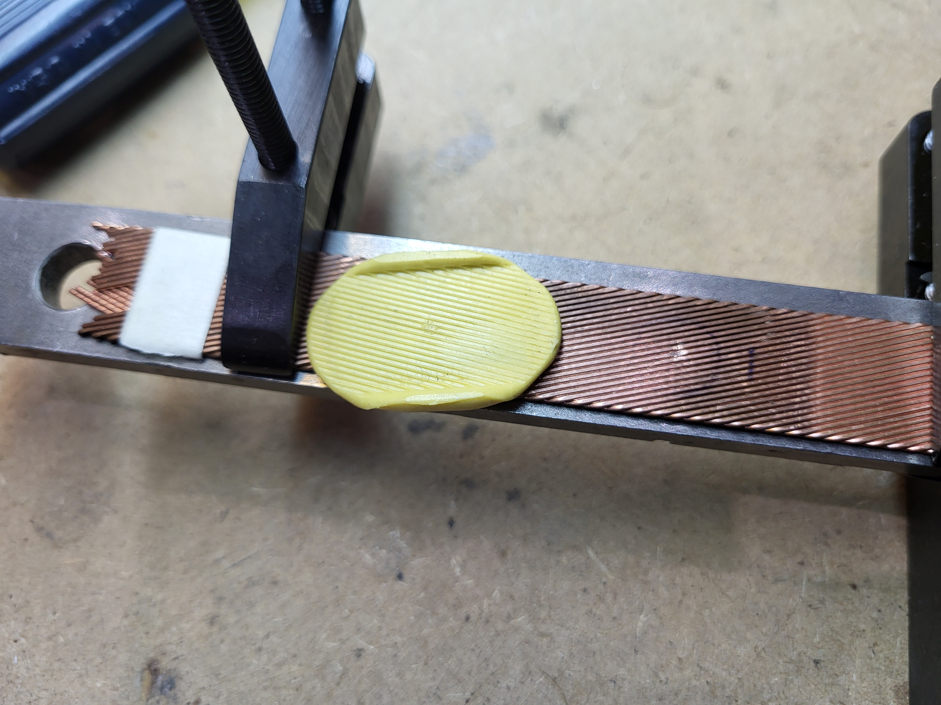
Example of Replica Sample

Slide 4
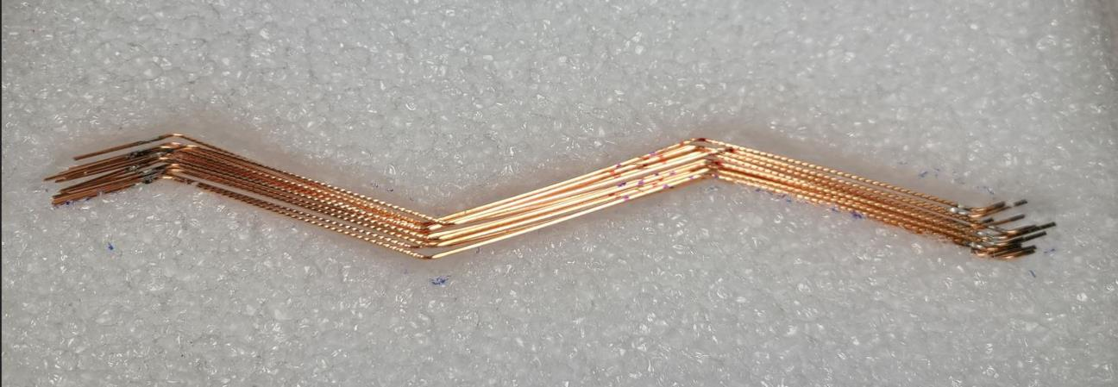
Samples Extracted from Scratched Cable
I have marked in red the most "suspect" scratches of each strand. These scratches appeared to show non-Cu colored discoloration after heat treatment (e.g., Nb and/or Sn), but it sometimes wasn't exactly clear under magnification. Other scratches, which were not showing discoloration, were marked in blue.
(Mike Naus)

Slide 5
Coil 254 Scratches
Extracted Strand RRR
Mike Naus

Slide 6
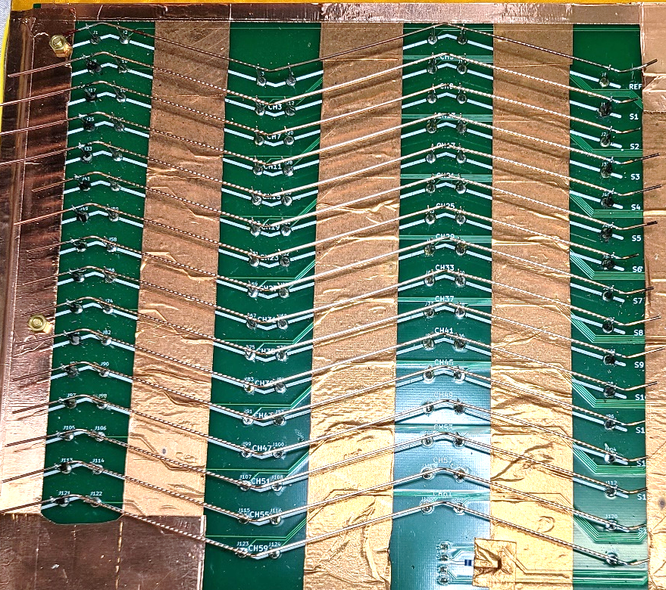
Scratch Locations on Extracted Strands
Scratch with Discoloration
Scratch without Discoloration
No Scratch

Slide 7
RRR Data
Sample # | Top Straight | Minor Edge | Bottom Straight | Major Edge | Overall RRR
1 | 299 | 241 | 294 | 228 | 283
2 | 308 | 231 | 326 | 246 | 300
3 | 314 | 245 | 323 | 238 | 303
4 | 317 | 244 | 329 | 248 | 306
5 | 280 | 224 | 286 | 232 | 272
6 | 308 | 236 | 316 | 268 | 299
7 | 310 | 233 | 303 | 248 | 293
8 | 301 | 228 | 311 | 220 | 288
9 | 308 | 240 | 313 | 220 | 293
10 | 326 | 255 | 312 | 262 | 307
11 | 292 | 213 | 298 | 261 | 283
12 | 249 | 208 | 255 | 203 | 243
13 | 290 | 242 | 301 | 229 | 283
14 | 310 | 238 | 298 | 243 | 291
15 | 295 | 234 | 285 | 204 | 274
Scratch with Discoloration
Scratch without Discoloration
No Scratch
No notable differences within a strand section (i.e., within a column)
No notable differences between edges nor between straight sections
Average: 235.5
Min: 203
Max: 268

Slide 8
Summary of FSU Investigation

Slide 11
Deepest scratches are in the “Red Strands”

Slide 14
Conclusions
The deepest scratch measured on the coil 254 replica sample is 82 μm deep
The deepest scratch measured on replica samples of the scratched cable is 79 μm deep
➔ the RRR measurements on the strands extracted from the scratched cable are relevant for assessing the RRR around the damaged areas of coil 254, although slightly optimistic for the deepest scratch.
The RRR measurements on the strands extracted from the scratched cable showed no RRR degradation.
➔ No significant degradation of the local RRR is expected in coil 254 because of these scratches.

