Slide 1
QXFA254 Cable Scratches
Jesse Schmalzle
January 8, 2024

Slide 2
254 Cable Scratches
Fiberglass cable insulation damage and cable scratches noted during prep for reaction.
Damage caused by razor blade when trimming fiberglass interlayer insulation after coil curing.
2 locations, each area ~ 2.5” long:
Inner layer coil midplane, transition side, 39” from NL end.
Outer layer coil midplane, transition side, 90” from NL end.
Inspection and photos before and after reaction.
Inner layer – scratches in copper.
Outer layer – scratches in copper, 4 small black spots observed under magnification after reaction.

Slide 3
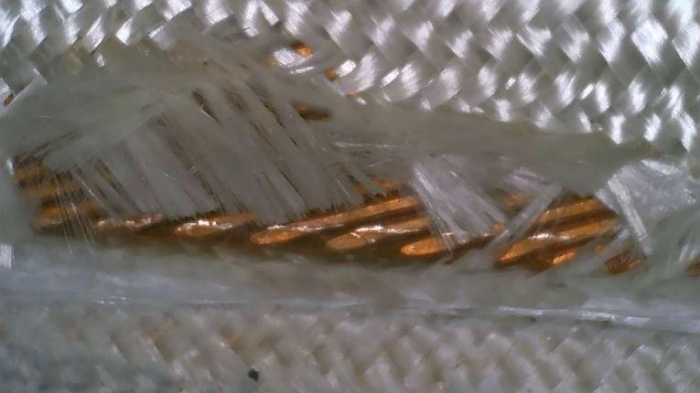
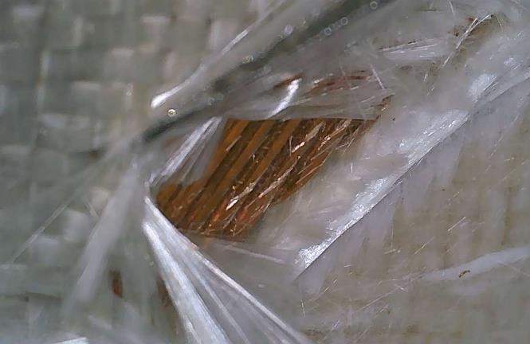
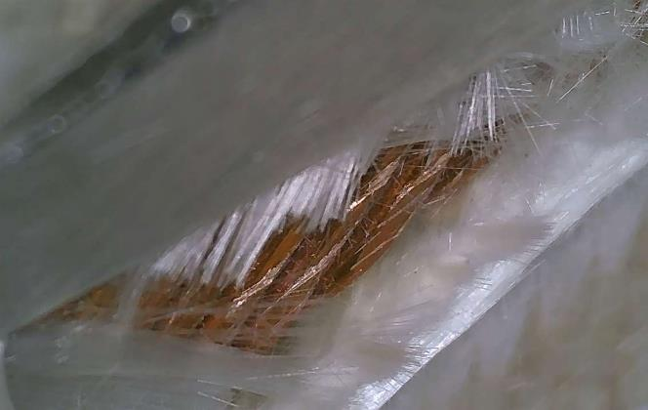
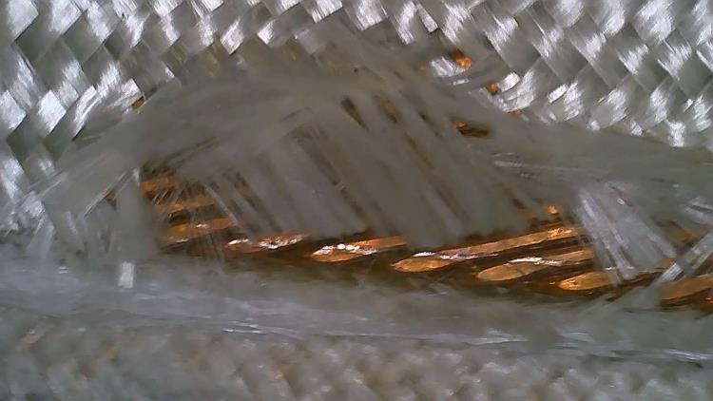
254 Cable Scratches
Before Reaction - Inner layer coil midplane, transition side, 39” from NL end:

Slide 4
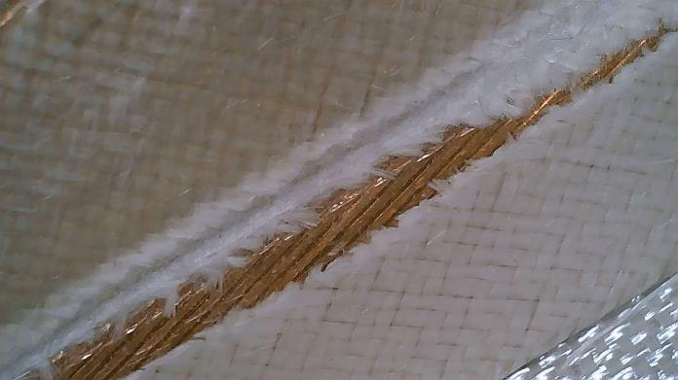
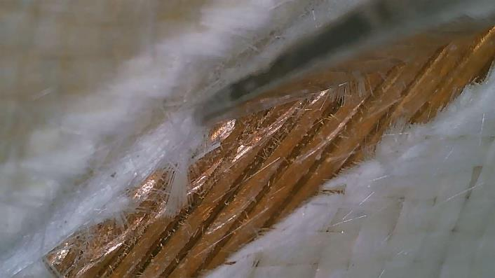
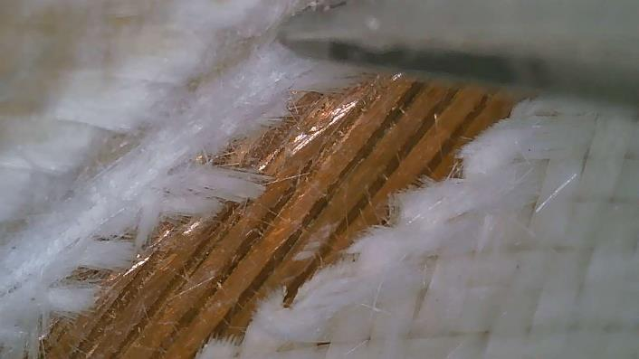
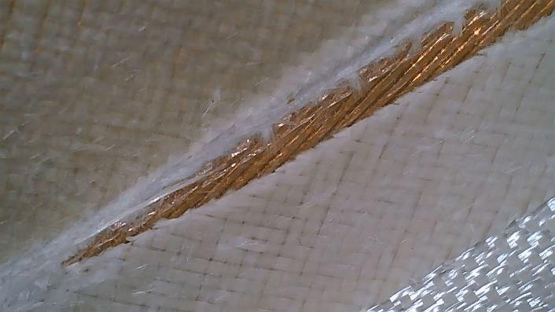
254 Cable Scratches
Before Reaction - Outer layer coil midplane, transition side, 90” from NL end:

Slide 5
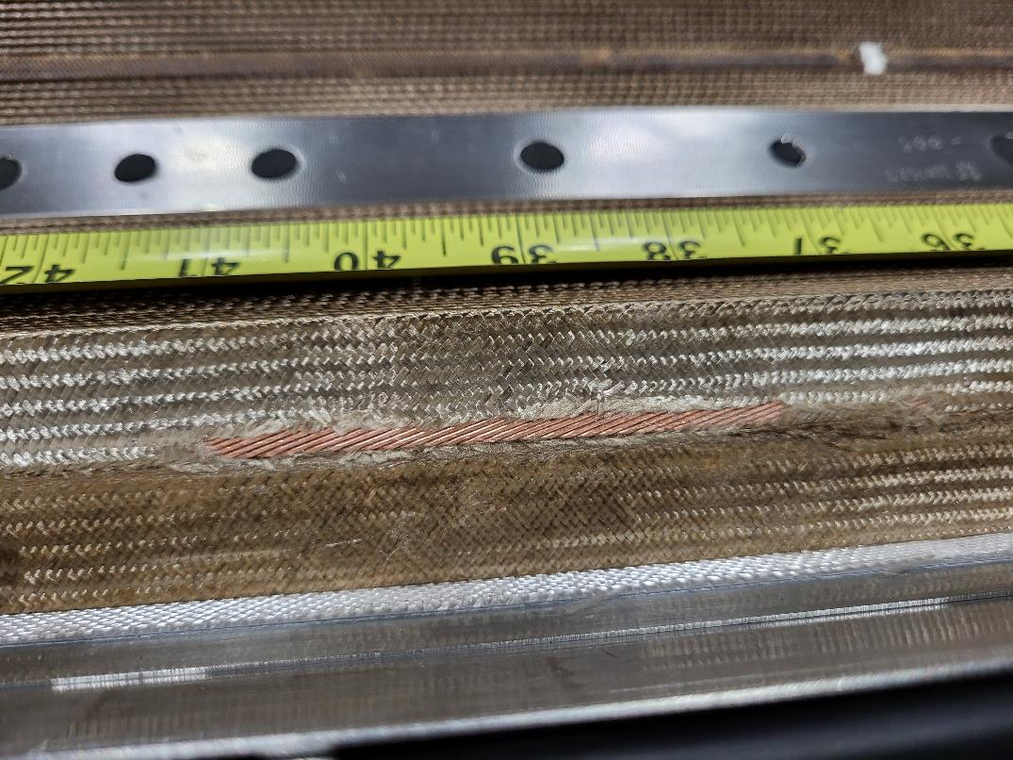
254 Cable Scratches
After Reaction - Inner layer coil midplane, transition side, 39” from NL end:

Slide 6
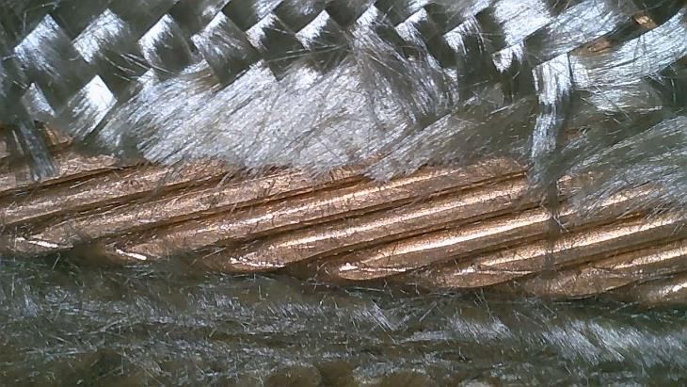
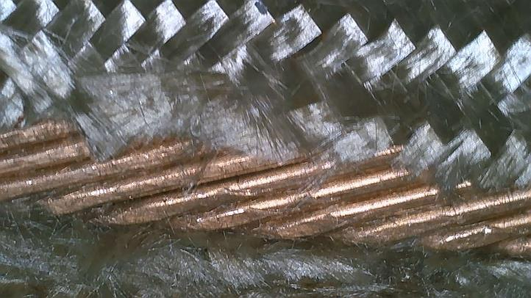
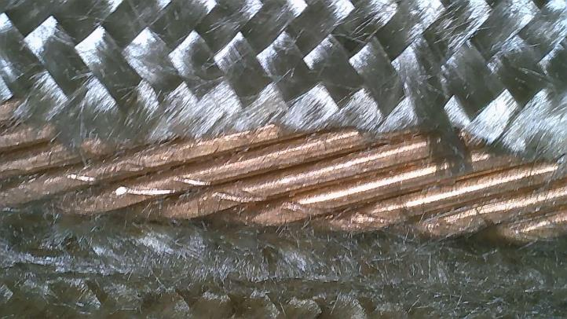
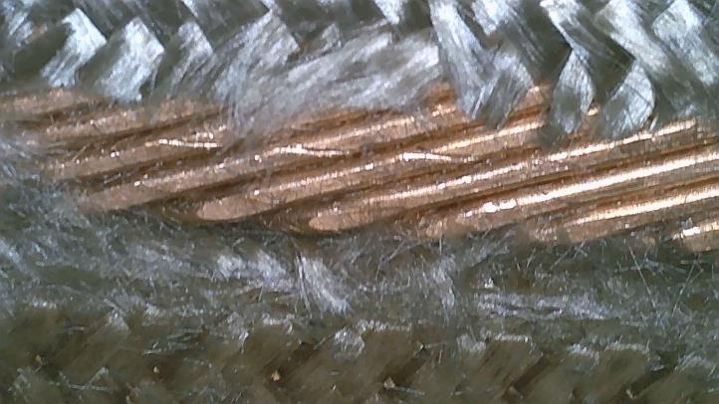
254 Cable Scratches
After Reaction - Inner layer coil midplane, transition side, 39” from NL end:

Slide 7
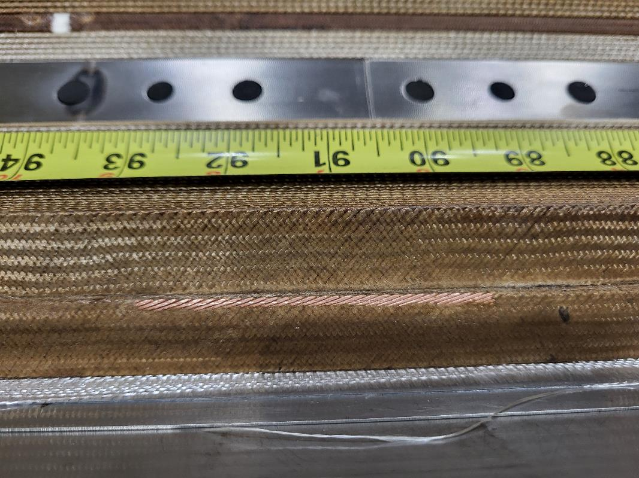
254 Cable Scratches
After Reaction - Outer layer coil midplane, transition side, 90” from NL end:

Slide 8
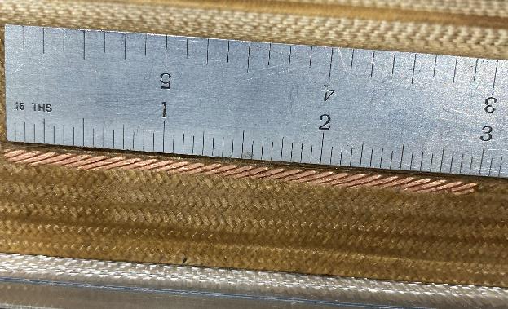
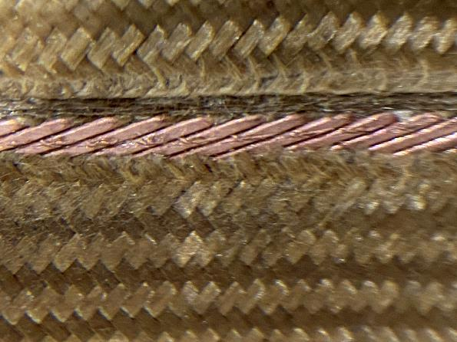
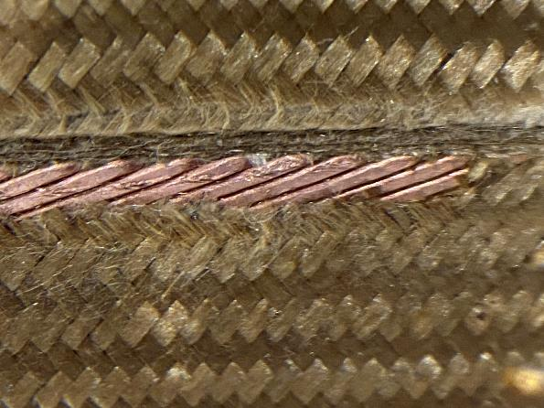
254 Cable Scratches
After Reaction - Outer layer coil midplane, transition side, 90” from NL end:

Slide 9
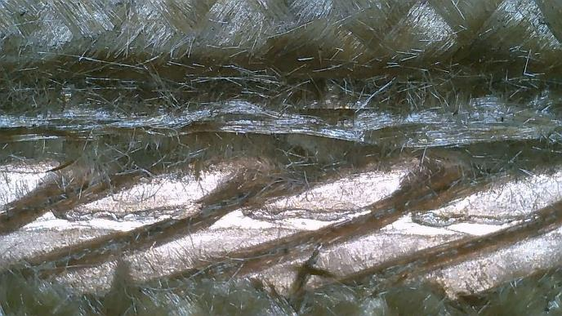
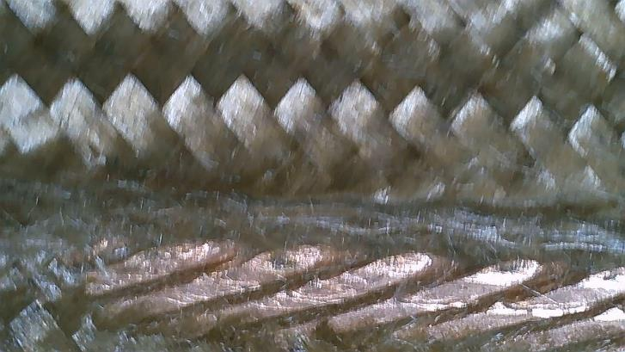
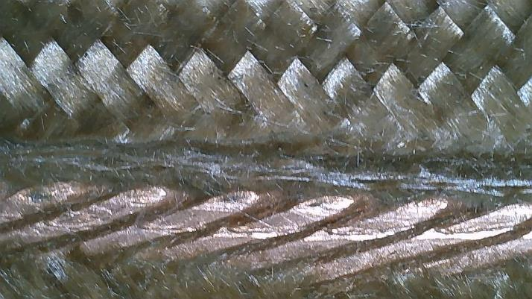
254 Cable Scratches
After Reaction - Outer layer coil midplane, transition side, 90” from NL end:
4 small black spots observed along the scratch:

Slide 10
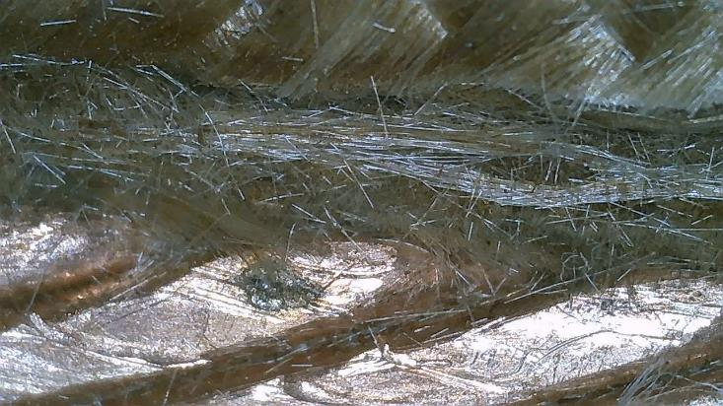
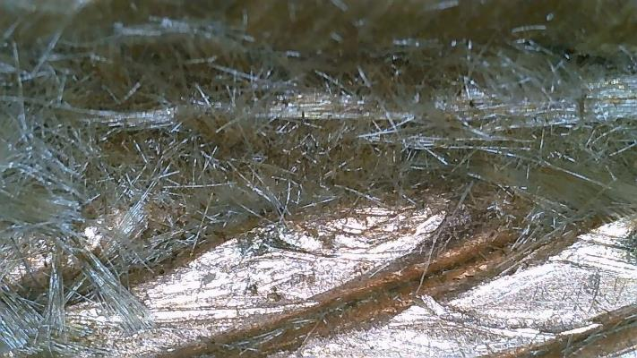
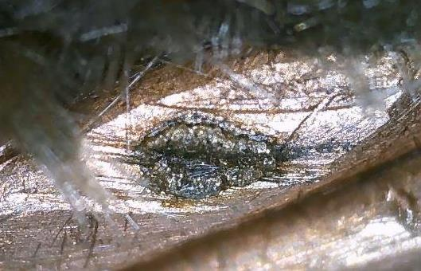
254 Cable Scratches
After Reaction - Outer layer coil midplane, transition side, 90” from NL end:
The 2 largest spots:

