Slide 1


QXFA254 Coil Review
Jesse Schmalzle
December 12, 2024

Slide 2
Outline
Coil Fab DRs
Additional Info
  Coil length, Pole gaps
  Reaction plots
  Electrical Data
Notes:
  Series coil.
  After to change for B6 adjustment.

Slide 3
QXFA254 - DRs
DRs posted to interface traveler.
Critical = Affecting Form, Fit or Function
(as found)

Slide 4
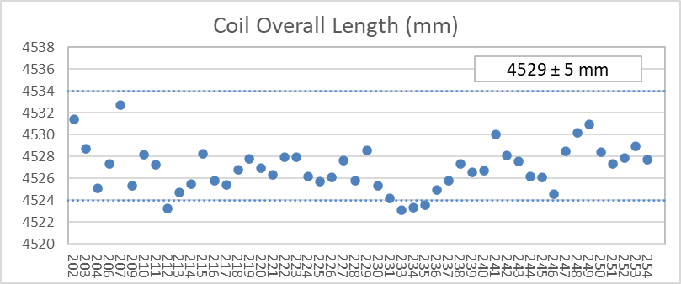
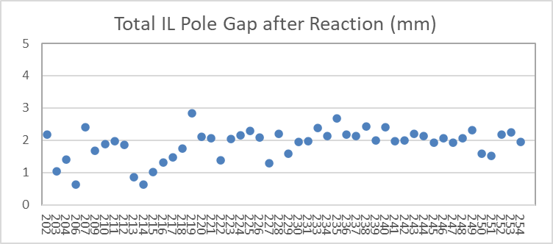
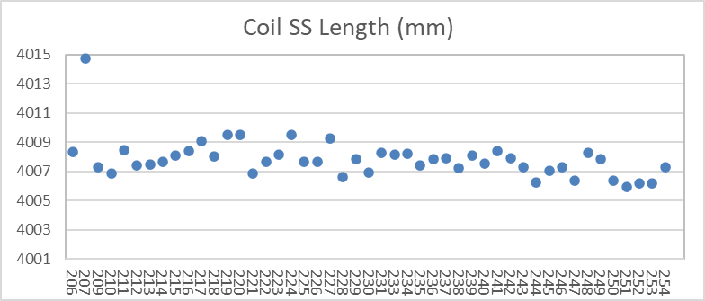
QXFA254 – Length, Gaps
Coil length within spec.
(207 error in initial pole gap setting)

Slide 5
QXFA254 - Reaction
Temperatures and dwell times all within spec.

Slide 6
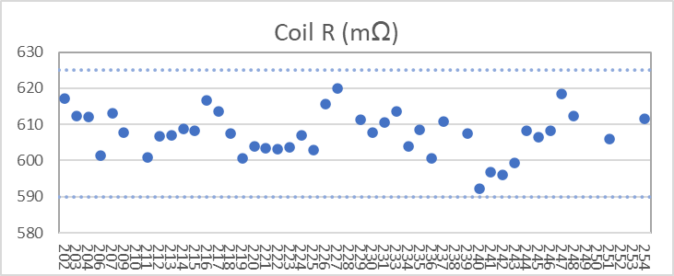
QXFA254 - Electrical
Final electrical checks – all passed

Slide 7
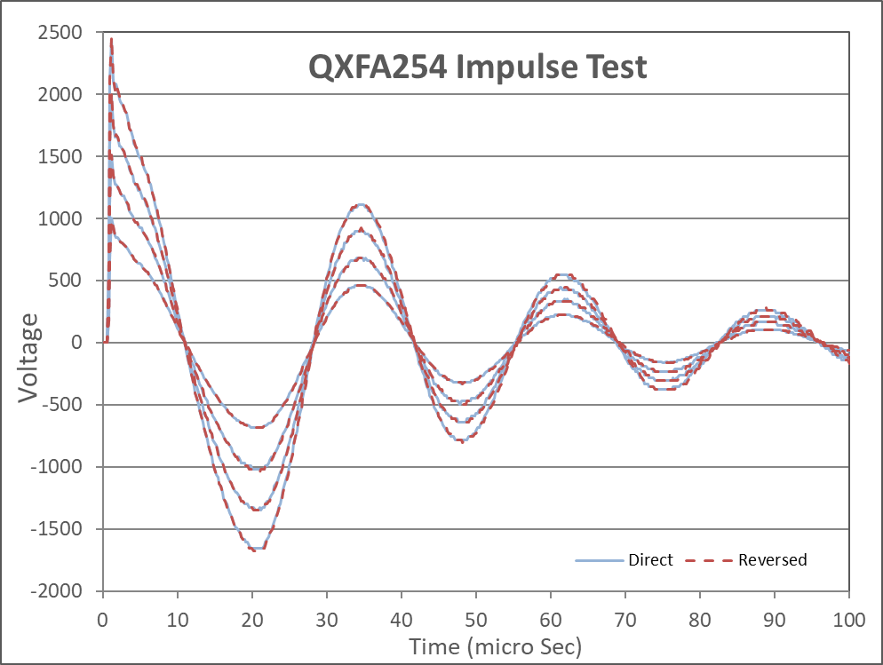
QXFA254 - Electrical

Slide 8
QXFA254 - DRs
Cable scratch details & photos on following slides

Slide 9
254 Cable Scratches
Fiberglass cable insulation damage and cable scratches noted during prep for reaction.
  Damage caused by razor blade when trimming fiberglass interlayer insulation after coil curing.
  2 locations, each area ~ 2.5” long:
    Inner layer coil midplane, transition side, 39” from NL end.
    Outer layer coil midplane, transition side, 90” from NL end.
  Inspection and photos before and after reaction.
    Inner layer – scratches in copper.
    Outer layer – scratches in copper, 4 small black spots observed under magnification after reaction.

Slide 10
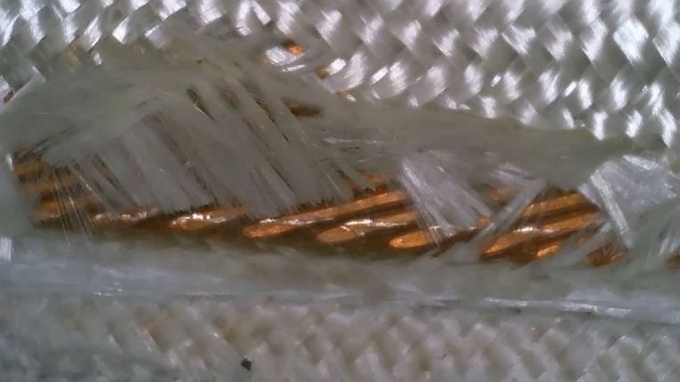
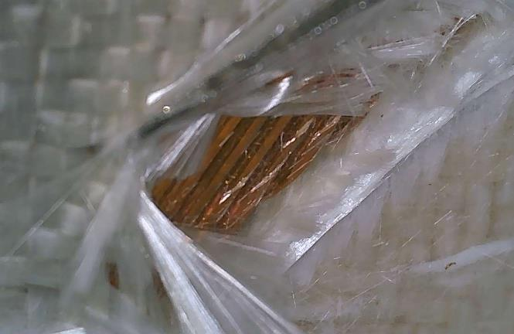
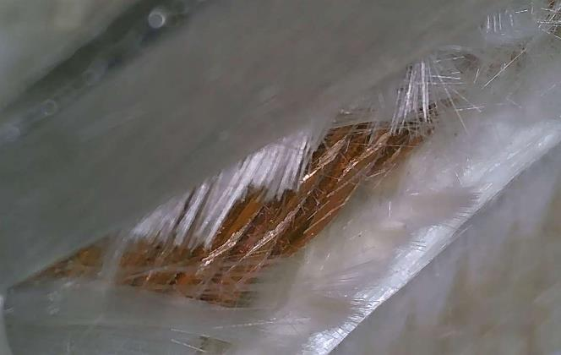
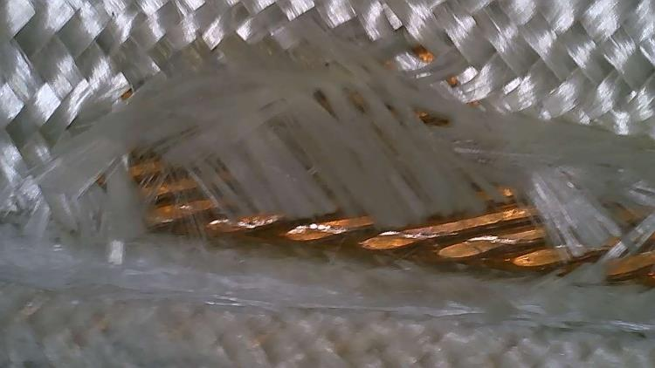
254 Cable Scratches
  Before Reaction - Inner layer coil midplane, transition side, 39” from NL end:

Slide 11
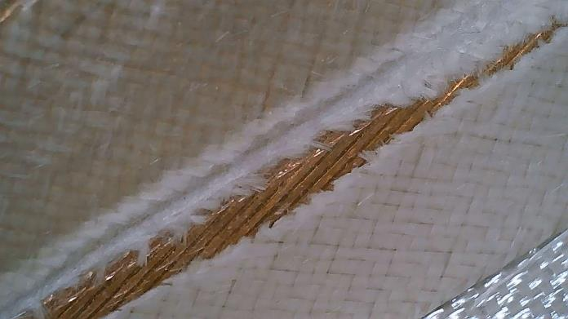
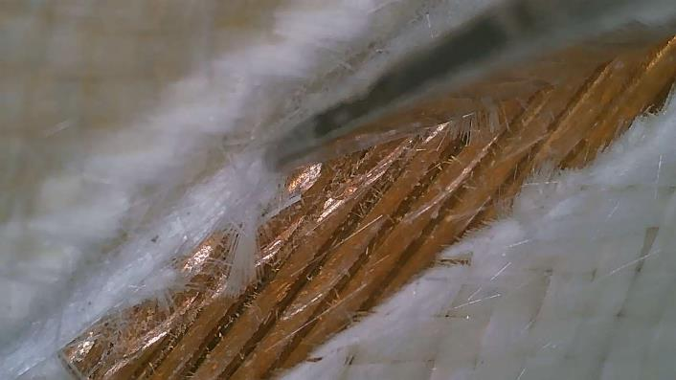
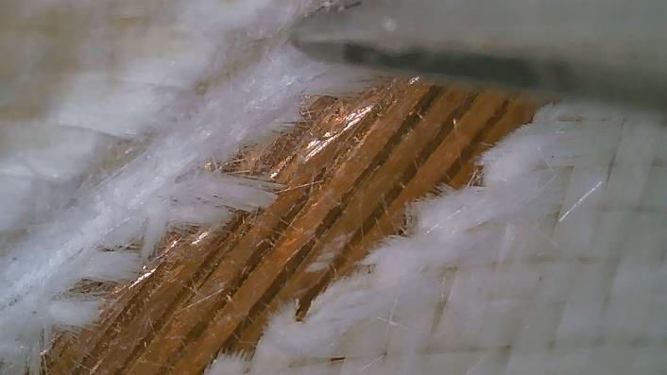
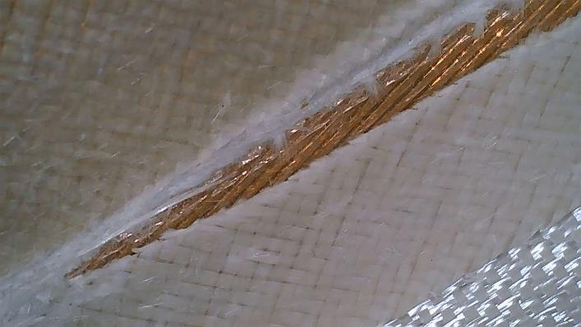
254 Cable Scratches
  Before Reaction - Outer layer coil midplane, transition side, 90” from NL end:

Slide 12
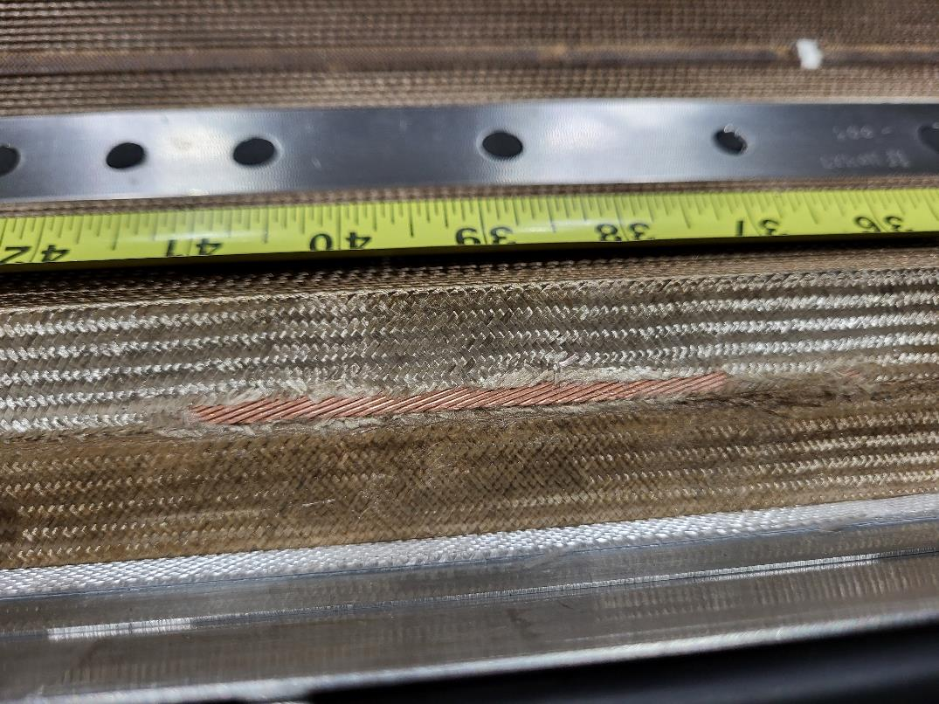
254 Cable Scratches
  After Reaction - Inner layer coil midplane, transition side, 39” from NL end:

Slide 13
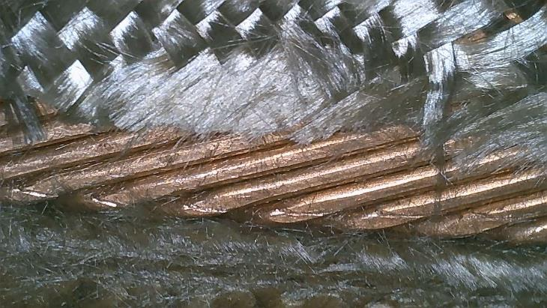
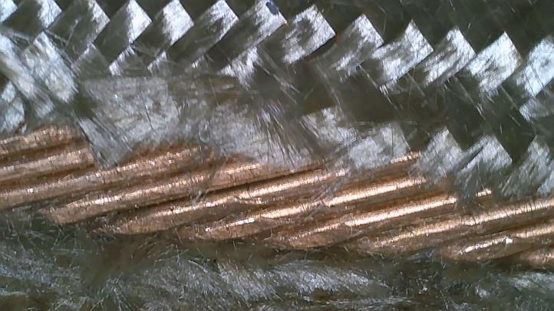
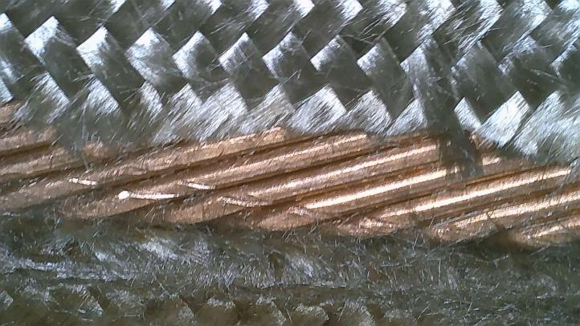
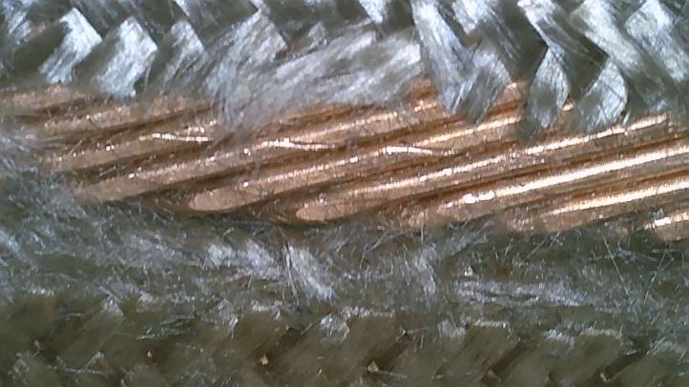
254 Cable Scratches
  After Reaction - Inner layer coil midplane, transition side, 39” from NL end:

Slide 14
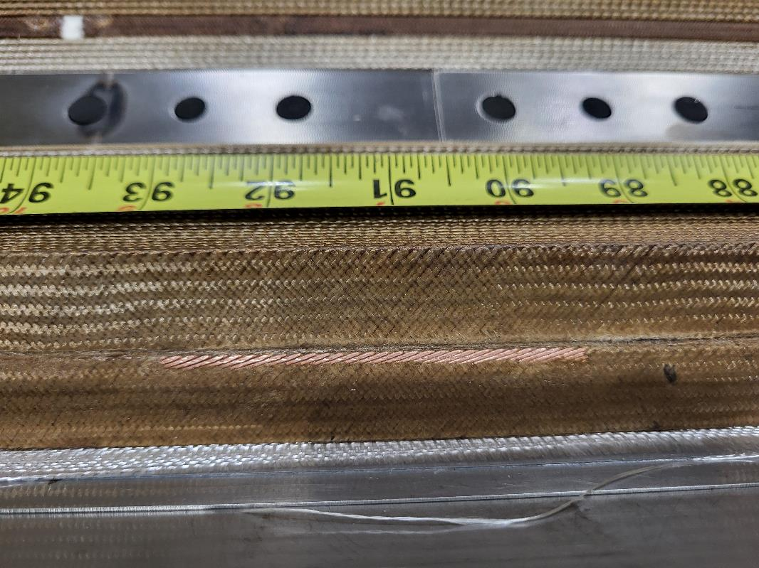
254 Cable Scratches
  After Reaction - Outer layer coil midplane, transition side, 90” from NL end:

Slide 15
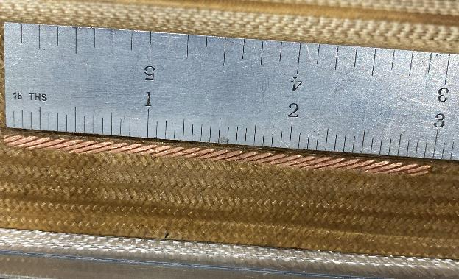
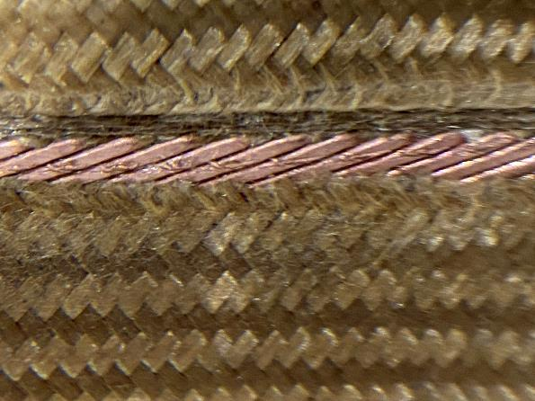
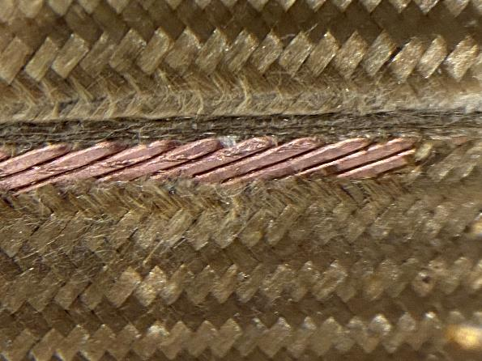
254 Cable Scratches
  After Reaction - Outer layer coil midplane, transition side, 90” from NL end:

Slide 16
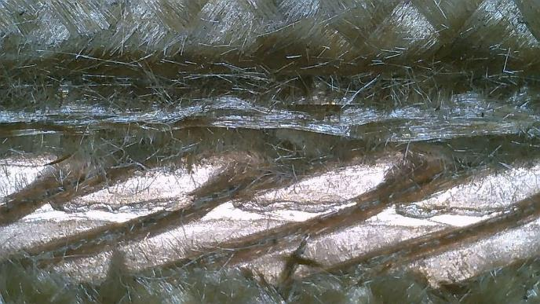
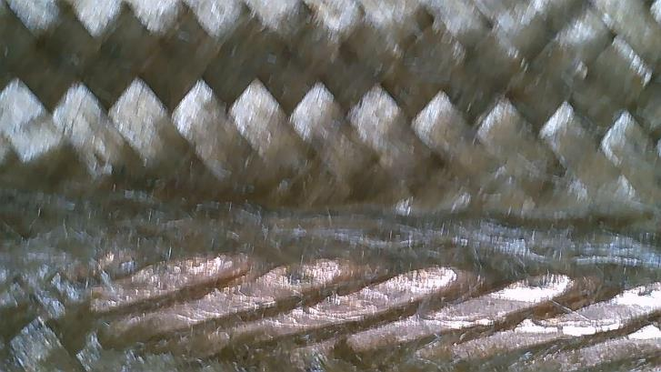
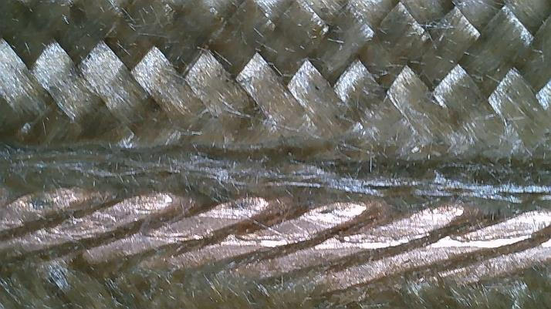
254 Cable Scratches
  After Reaction - Outer layer coil midplane, transition side, 90” from NL end:
    4 small black spots observed along the scratch:

Slide 17
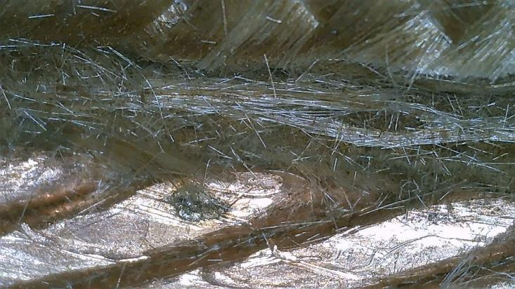
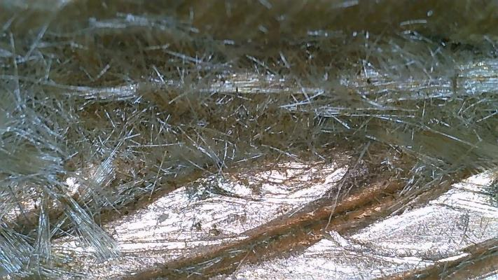
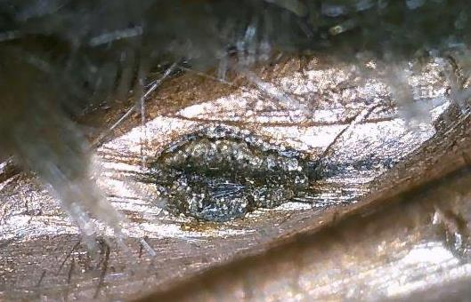
254 Cable Scratches
  After Reaction - Outer layer coil midplane, transition side, 90” from NL end:
    The 2 largest spots:

Slide 18
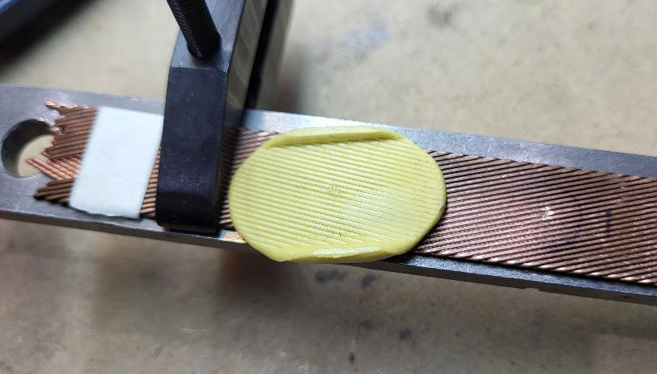
254 Cable Scratches
  Impression of the sample cable for measurement with confocal microscope.
Alumilite silicone mold putty:
Amazing Mold Putty (alumilite.com)

Slide 19
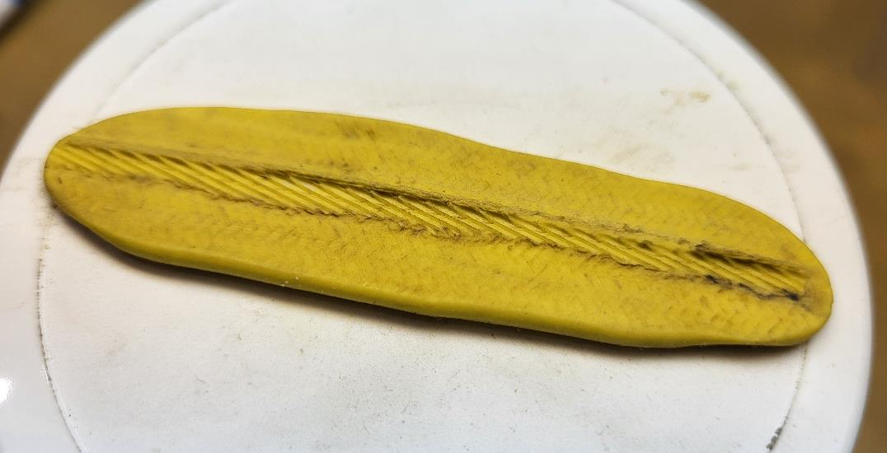
254 Cable Scratches
  Impression of the scratched area on coil 254 for measurement with confocal microscope.

