Slide 1
QXFA142 Quench Heater-Coil Short Repair and Glass Bead Removal
Fred Nobrega, CAM/L3
MQXFAP20 Coil Acceptance Review
December 12, 2024

Slide 2
Introduction
QXFA142 developed heater #3 to coil hipot failure at magnet assembly. The coil was returned to FNAL for analysis and possible repair.
The repair process hopes to find evidence of the cause of failure, S2 glass bead or other foreign object.
There are 2 failure modes with glass beads that create electrical creep paths.
Glass bead between the coil and QH that damages the Kapton under load.
Glass bead above the QH. Load applied to the area drives the bead through the heater and Kapton.

Slide 3
Beads Below and Above Trace
QXFA155
QXFA142
Glass beads below trace.
Glass beads above trace

Slide 4
QXFA142
Pit ~ 0.7mm wide, burn area is larger.
No clear evidence the object was above or below the QH trace.

Slide 5
Repair Plan
Remove damaged section of glass above the trace about 2 inches wide. Inspect glass and trace. Bag and save the glass.
Follow repair procedure used on coils 127 and 137 with the following exception.
Beginning about an inch away from the hole on both sides to separate the trace from the coil and slowly move towards the damaged area from both directions.
The objective is to retrieve any possible debris to characterize the size, and to inspect the damaged area below the trace. (Note, nothing was found)
Add Kapton below the trace and cover the repair area with fiberglass.
Assemble into the impregnation tooling and VPI.
Perform complete electrical measurements & tests
CMM the repair area.

Slide 6
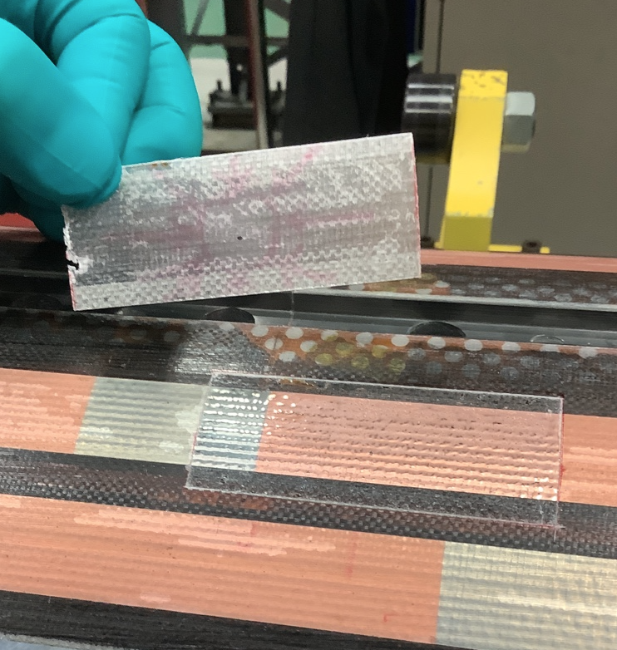
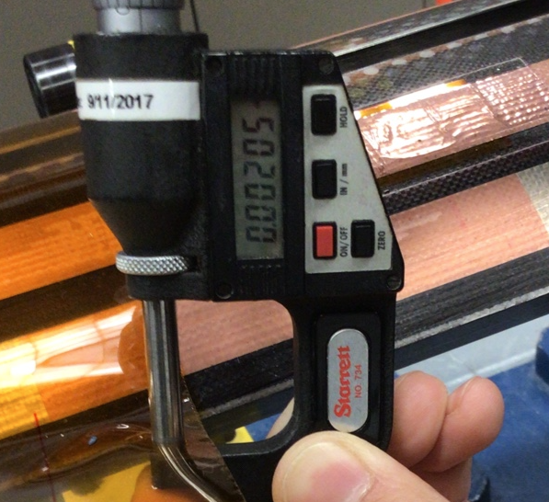
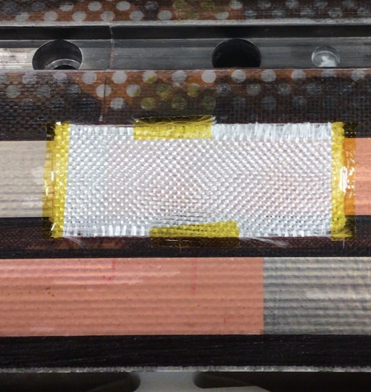
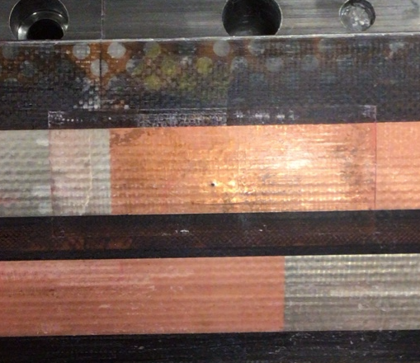
QXFA142 VPI Repaired Area
Trace separated from coil for Kapton.
Glass removed.
New glass for VPI.
Post impregnation.

Slide 7
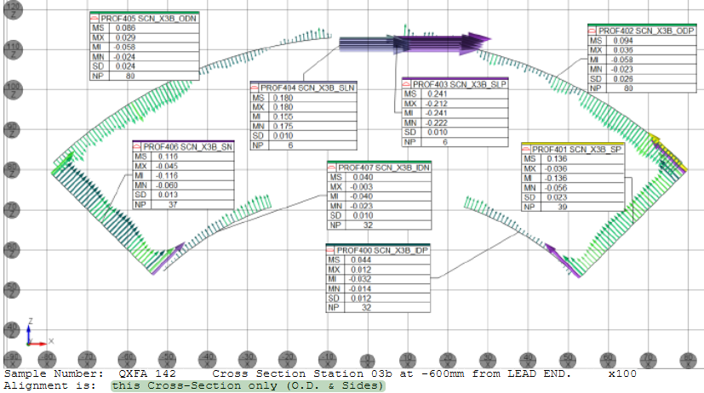
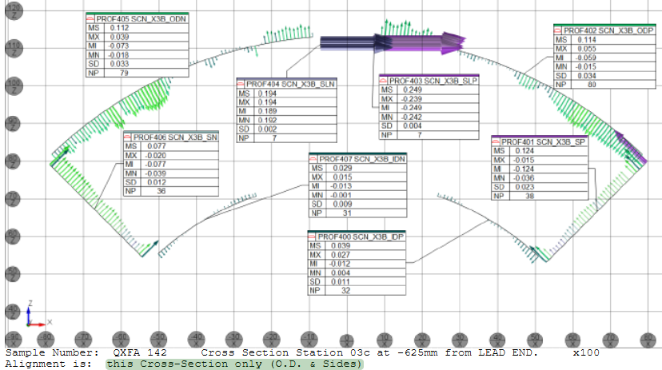
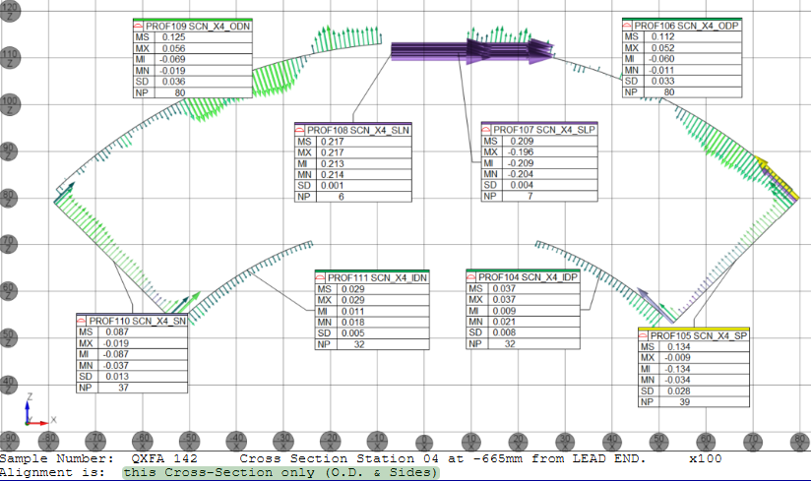
QXFA142 CMM of Repair
The repaired area extended from ~ 600 mm to 670 mm from the LE.
Three cross sections measured at 600 mm, 625 mm, and 665 mm.
Grid scale = 100 μm

Slide 8
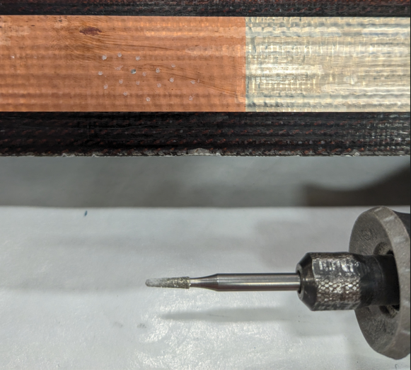
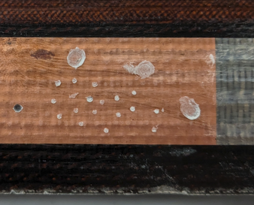
Removal Technique for Bead Above Trace
For glass beads above trace.
Dremel Tool used to grind the bead and create a recess, small or large. Low RPM, easy to control. S2 glass is 310 µm thick.
Practice coil examples shown in photos.
Very small.
Large.
Small.

Slide 9
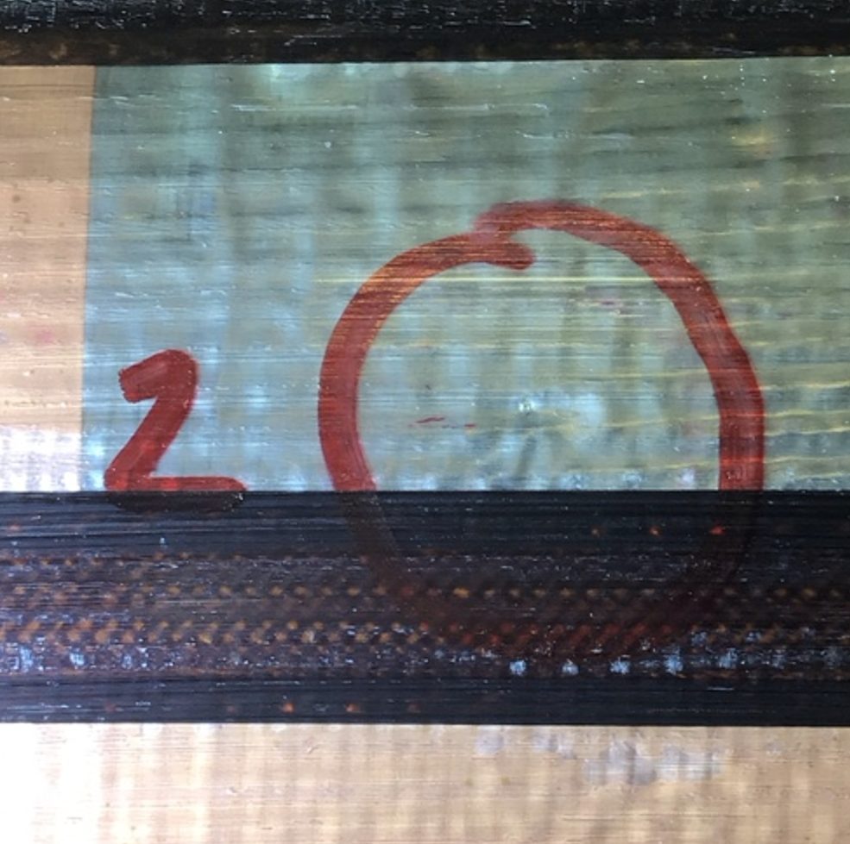
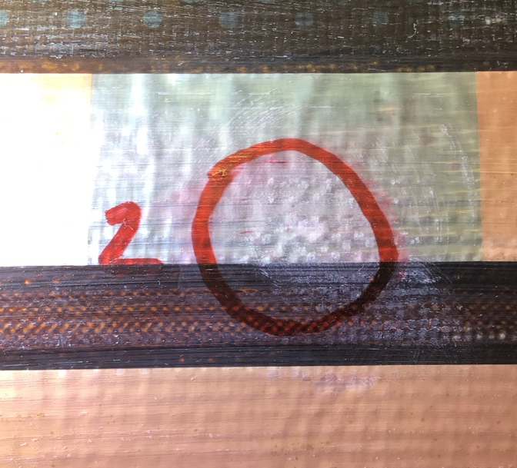
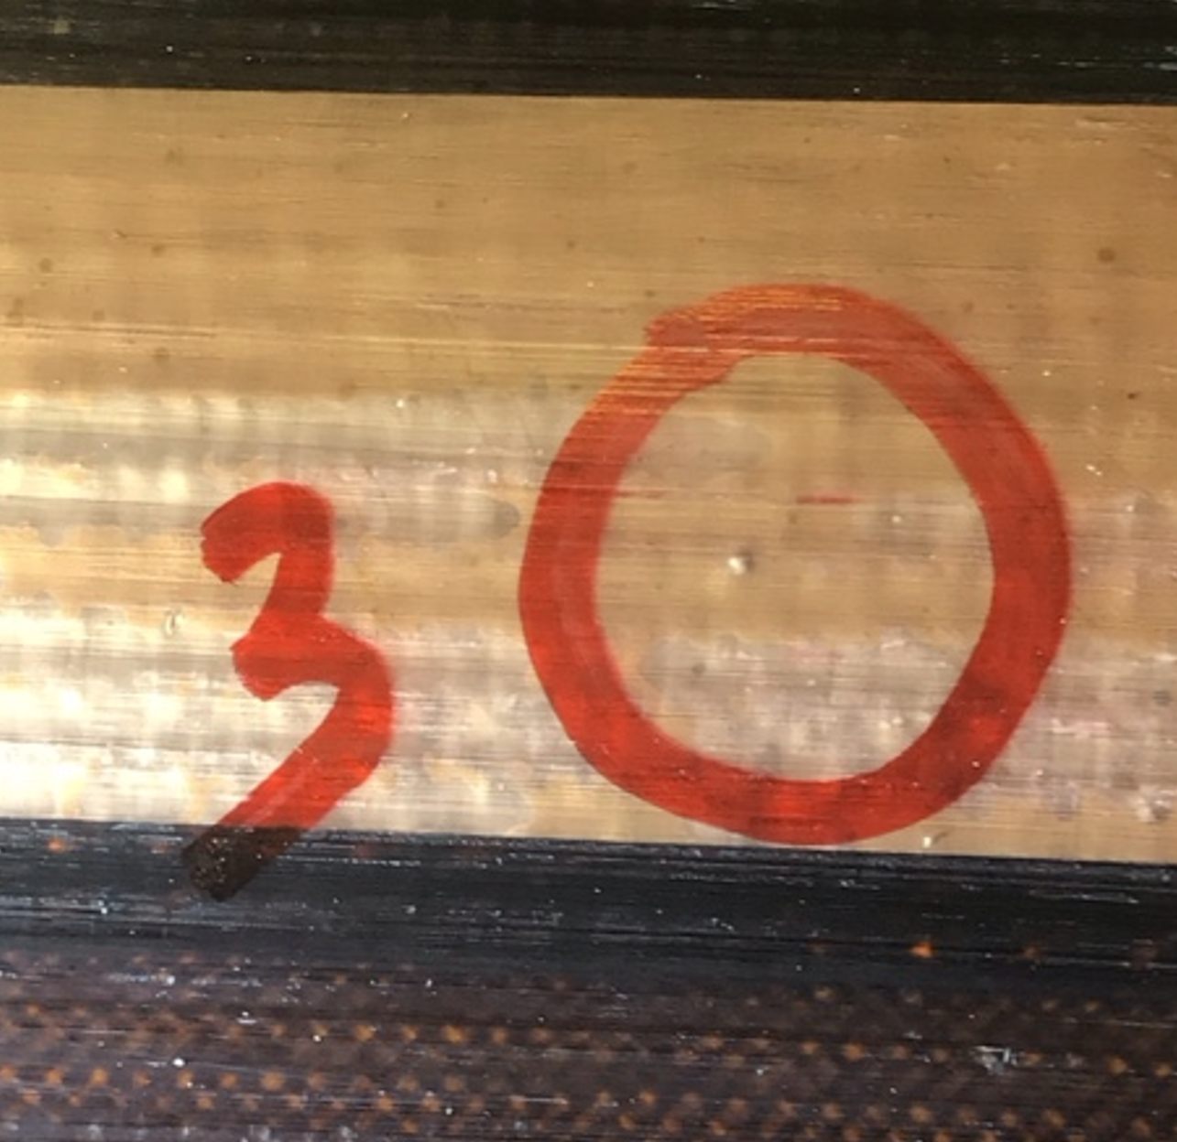
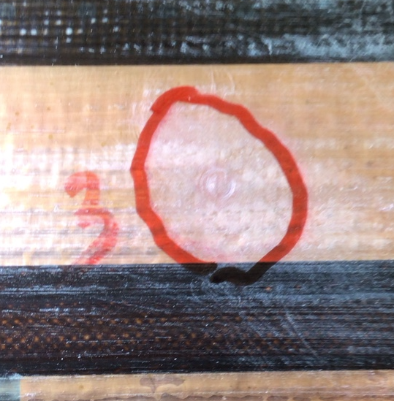
Glass Beads Identified and Removed
Three repairs, 1st was described earlier, 2nd and 3rd shown in photos using Dremel tool.
Beads identified.
Beads removed.

Slide 10
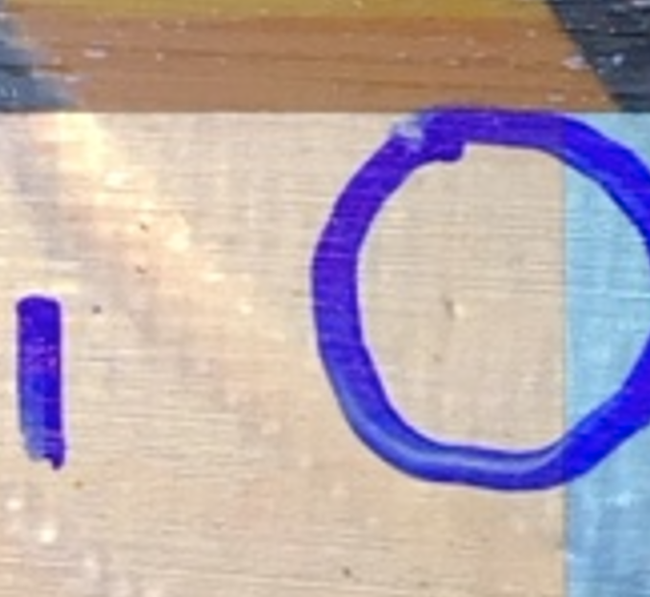
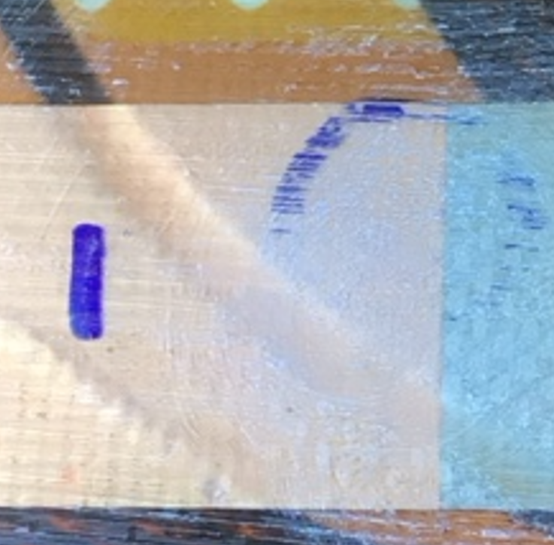
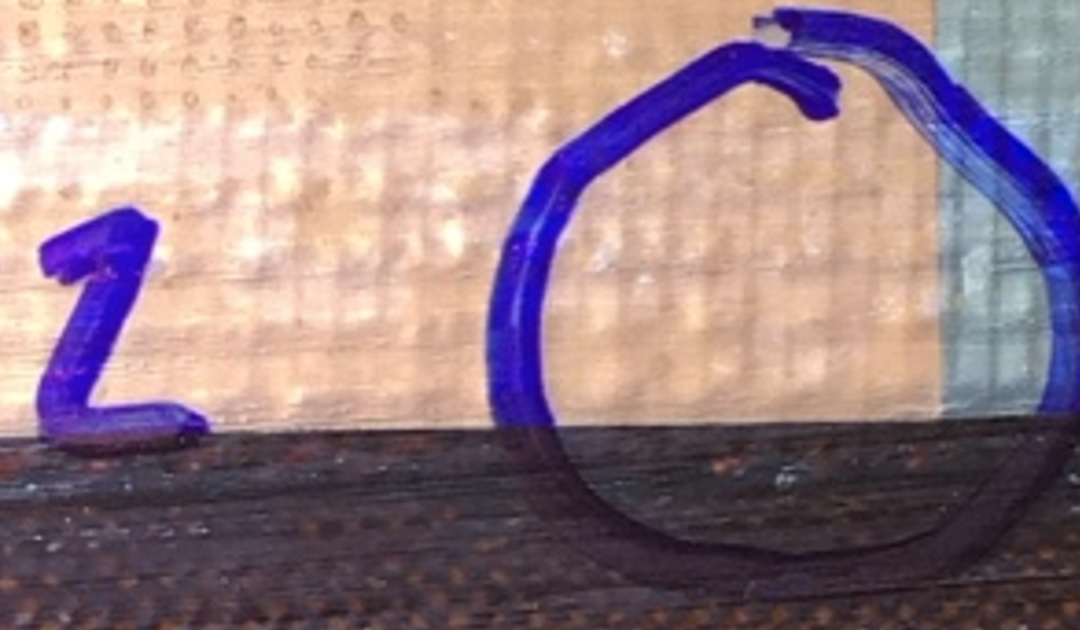
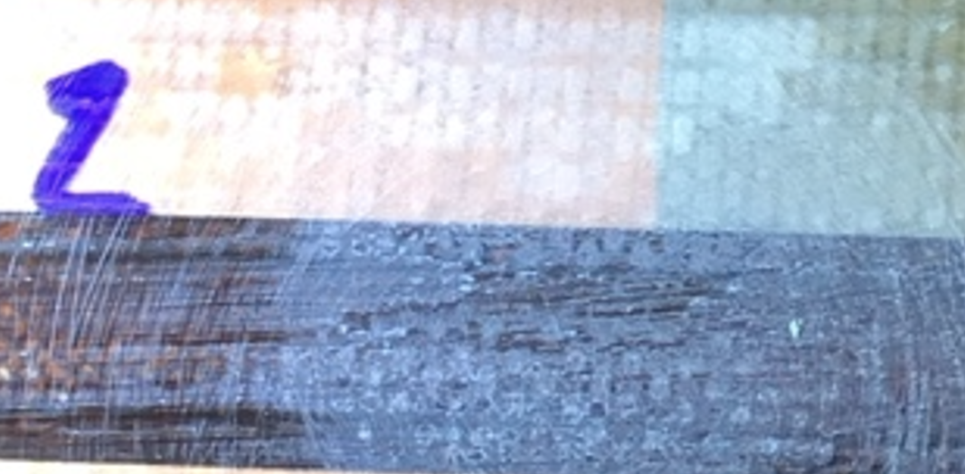
Suspected Glass Bead
All suspected glass beads were visually inspected.
None were considered a risk to the coil.
All were sanded as an extra precaution. Radom examples shown.

Slide 11
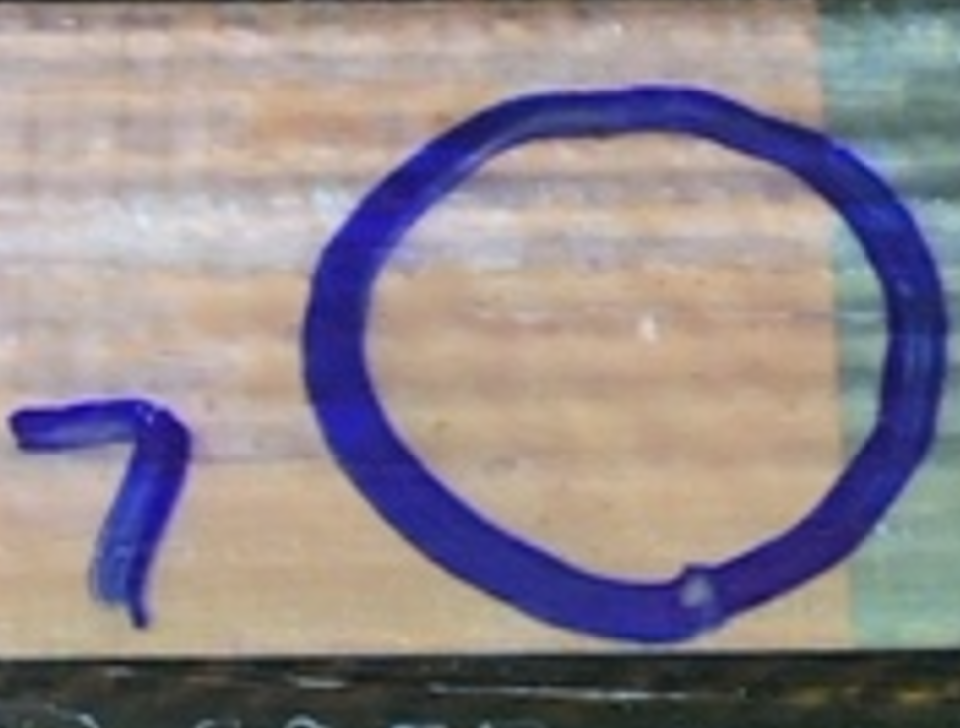
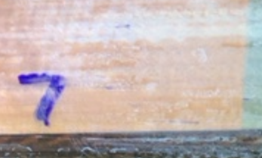
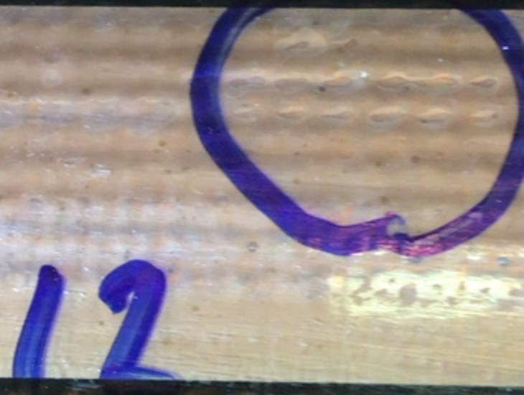
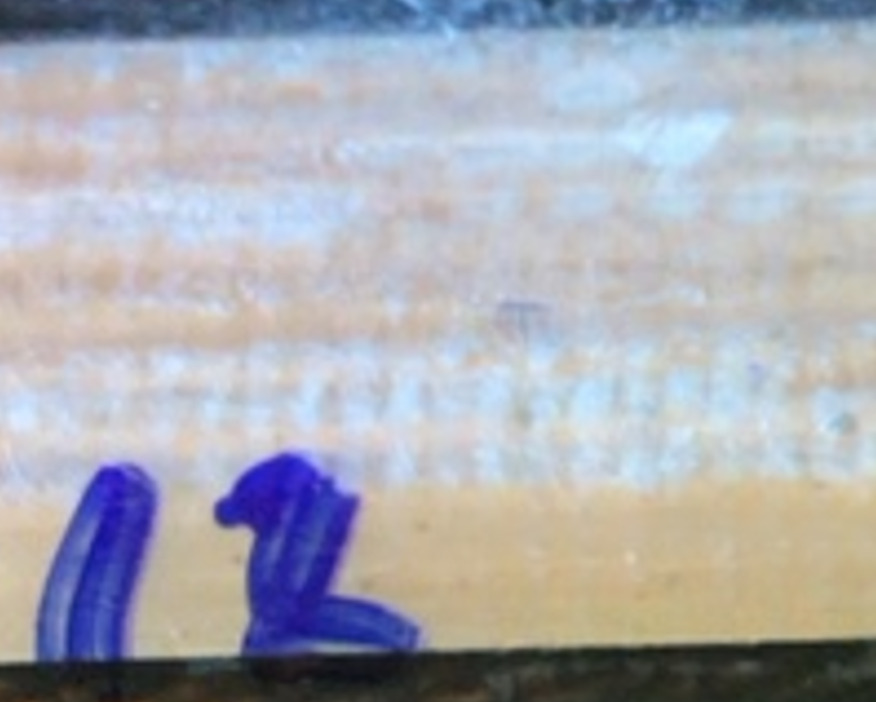
Suspected Glass Bead
All suspected glass beads were visually inspected.
None were considered a risk to the coil.
All were sanded as an extra precaution. Radom examples shown.

