Slide 1
MQXFA20 Coils Acceptance Review QXFA121, QXFA125, QXFA142, and QXFA146
Fred Nobrega, L3/CAM, Coil Fabrication at FNAL
Miao Yu, Deputy L3
Vittorio Marinozzi, Electrical Measurements & Testing
MQXFA20 Coils Acceptance Review
December 12, 2024

Slide 2
Overview
The MQXFA coil working group team selected the best coils on hold for use in MQXFA20. Coils on hold have critical DR’s.
DR’s written against specific step in traveler which conforms to the following documents:
QXFA Series Coil Production Specification, US-HiLumi-doc-2986
MQXFA Final Design Report, US-HiLumi-doc-948
QXFA Series Coil Fabrication Electrical QC Plan, US-HiLumi-doc-521
Appendix
Coil data for the magnet fabrication report

Slide 3
DR Summary
Legend
Noncritical DR
Critical DR
Critical DR – affects form/fit/function and needs L2 review
Coil # | W&C Prep | React | Impreg | CMM Interface | Electrical | Total DR’s | Critical DR’s
QXFA121 |  | 1 | 1 |  |  | 2 | 1
QXFA125 | 3 |  | 4+1 |  | 5 | 13 | 1
QXFA142 MQXFA14 | 1 | 2 | 1 | 0 | 8* 1 | 12 | 1
QXFA146 | 4 | 1 |  | 1 | 1 | 7 | 1
* 8 electrical DR’s for temp/humidity out of spec. Majority were caused by elevated shop floor temperature.
Links to all DR’s: (VPN or FNAL services account required)
Discrepancy Reports – QXFA121, QXFA125, QXFA142, QXFA146

Slide 4
QXFA121 DR’s
Legend
Minor DR
Critical DR
Critical DR – affects form/fit/function and needs L2 review
DR Number | Description | Disposition | Impact/Corrective Action
11960 Reaction | While inspecting the coil ID before reaction, 2 gaps between cable turns were observed. | Resume coil fabrication. | Impact: none. Corrective action: none.
111968 Impreg | During the removal process of the LE mandrel block, the reacted lead was bumped by the technician's wrist. | Continue with lead soldering per the traveler and subsequent steps. The coil will be epoxy impregnated and quarantined. Additional analysis and cable tests are planned in order to determine if the coil will be taken out of quarantine and shipped to LBNL. | Corrective action: Added tapped holes in LE mandrel blocks to use jack screws during removal. Machined LE mandrel block tabs by 10 mils on each side. Developed procedure and updated traveler for LE mandrel block removal. Impact: coil on hold.

Slide 5
QXFA125 DR’s
Legend
Minor DR
Critical DR
Critical DR – affects form/fit/function and needs L2 review
DR Number | Description | Disposition | Impact/Corrective Action
12023 Winding | Cable reel mislabeled by insulation vendor. | The cable ID is 1132 and continue the cable preparation. | Impact: none. Corrective action: none.
112026 Coil Interface | Stains were noticed on the insulation during cable respooling. | Use another cable for coil 125 and do analysis of stain impact on cable performance. | Analysis of the impact of these stains on cable performance (Ic and RRR) showed no significant impact. Therefore, cable 1132 may be used for another coil. Impact: none. Corrective action: none.
12059 Winding | Stain on cable insulation | Repair insulation. | Unknow source, perhaps at insulation vendor. Impact & corrective action: none
12119 Impreg | Voltage tap shifted on lead after insulation. | Desolder and reposition. | Corrective action: Verify orientation of voltage tap after insulating and before installing splice block. Impact: none
12122 Electrical | Coil to Structure short 54 ohms. | Continue with fabrication | Coil to structure short vanished after VPI. Corrective action: none Impact: none

Slide 6
QXFA125 DR’s
Legend
Minor DR
Critical DR
Critical DR – affects form/fit/function and needs L2 review
DR Number | Description | Disposition | Impact/Corrective Action
12125 Impreg | Unable to position SS pins to a depth of 5.5 mm. Teflon spacer was wrong size. | Use off normal work plan to remove all Teflon spacers and SS pins. Reassemble per traveler. | Corrective action: Update traveler. On the holes with pins, verify thickness of 0.055" flat Teflon plug and install. Use 1mil Kapton tape to hold the plug in place. Impact: none,
111968 Impreg
12133 Electrical | Q is 1.36, min is 1.40 | The Q range spec was updated and revised to 1.30-1.50 | Impact: none. Corrective action: none.
12134 Electrical | Coil to structure short at 700 kohms. Excess binder suspected. | Proceed with coil fabrication following the traveler. | Reduce binder used in coil fabrication 10% by weight.
12133 Electrical | Low LS and Q. | The Q range spec was updated and revised to 1.30-1.50, LS spec updated. | Impact: none. Corrective action: none.
12156 Impreg | The epoxy tank would not pump down below 3.5 Torr. | Leak checked and found faulty feed valve. | Corrective action: Clean epoxy tank and replace feed valve. Impact: none

Slide 7
QXFA125 DR’s
Legend
Minor DR
Critical DR
Critical DR – affects form/fit/function and needs L2 review
DR Number | Description | Disposition | Impact/Corrective Action
12165 Electrical | The LS and Q are low. The LS is 6.52 and the min is 6.60. The Q is 1.24 and the minimum is 1.30 | Limits updated to be 6.50 mH to 7.00 for the Ls at 20 Hz. For the Q at 20 Hz, the range is between 1.20 and 1.40. | Impact: none. Corrective action: none.
12166 Impreg | While the coil was being filed, it appears that the technician went too far into the midplane and exposed cable. | Fill exposed cable near midplane with Stycast and sand flush to midplane and OD. | Corrective action: Implement review of process and training for each 2-person team performing this task. Impact: coil on hold.
112174 Impreg | During Impregnation on the inner LE, the glass with a VT pocket shifted so now only one of the voltage taps are visible. | Carefully cut through the epoxy and glass to expose the 2nd voltage tap. | Corrective action: update traveler. Before installing the mandrel block over the VT pocket, make sure the solder tap window is still open. Impact: none

Slide 8
QXFA142 NCR
Legend
Minor DR
Critical DR
Critical DR – affects form/fit/function and needs L2 review
NCR Number | Description | Disposition | Impact/Corrective Action
MQXFA-NCR-0515 | unidentified glass bead at 630 mm from LE resulted in burn spot in PH3 post post-loading EQC (hipot test) | Send coil back to FNAL for rework. | Impact: Cost & schedule for disassembly, shipping, and repair. Corrective action: None, unable to determine material that burned thru the trace and glass.
Note: DR’s for QXFA142 were reviewed during the MQXFA14 Coil Acceptance Review and can be found in the backup slides.

Slide 9
QXFA146 DR’s
Legend
Minor DR
Critical DR
Critical DR – affects form/fit/function and needs L2 review
DR Number | Description | Disposition | Impact/Corrective Action
12816 Winding | While getting ready to measure the cable length we noticed that there are blue and green lines on the cable instead of red and blue. | The cable 1260 was handled multipole times, so now the blue/green end is on top of the cable. Respool the cable onto the regular spool first, and then follow the traveler step 4.6 | Impact: none. Corrective action: none.
112822 Winding | High popped strand count during cable length measuring. | Respool onto vendor’s spool and put on hold. | Impact: none. Corrective action: none.
12825 Winding | The vendor did not label the cable reel. | Remove 12” of cable insulation and photograph the blue and red colored strands. Determine the serial number based on the position of the color strands on the cable using the provided table. | Impact: none. Corrective action: Cable team to meet with the vendor to address the issue.

Slide 10
QXFA146 DR’s
Legend
Minor DR
Critical DR
Critical DR – affects form/fit/function and needs L2 review
DR Number | Description | Disposition | Impact/Corrective Action
12897 Reaction | Temperature oscillations in the 395C and 665C soaks. The average soak temperatures are 396.0C and 665.3C. Probable cause is thermocouple contact with heater during reaction. | Use as is. | Impact: none. Corrective action: Move TC feed through from near floor to near ceiling and bundle TC's after each use with wire and have chew chief verify sign off in traveler. The next coil, 147 did not have these oscillations.
112923 Impreg | Coil to structure short reading 1.8 ohms. The voltage tap is contacting the midplane shim. | Repair the VT following the QXFA 146 Off Normal Work Plan and then process the coil by following the traveler. | Impact: none. Corrective action: none.
12924 Impreg | Delamination of midplane in several areas. Most likely cause is mold release cross contamination. SS mold released midplane shims were used to trim the G11 midplane shims. | Complete fabrication. | Corrective action: Add step in Pre-Impregnation traveler to trim G-11 midplane shim after mechanical scrubbing of the SS midplane impregnation shim and before the addition of the step 3 mold release.
12956 Impreg | Coil CMM midplane out of tolerance at multiple locations by at most 0.34 mm. | Complete fabrication and put coil on hold. | Use dedicated SS midplane shims for trimming G11.

Slide 11
Appendix
Backup slides
Coil data for magnet fabrication report
Reaction temperature plots
Electrical measurements & tests
Coil lengths
Cable parameters
Wedge lengths & gaps
Pole gaps

Slide 12
Backup Slides
See separate slide decks for each coil’s evaluation and repair.

Slide 13
Reviewed for MQXFA14 QXFA142 DR’s
Legend
Minor DR
Critical DR
Critical DR – affects form/fit/function and needs L2 review
DR Number | Description | Disposition | Impact/Corrective Action
12597 Winding & Curing Prep | During cable respooling, insulation snags and black marks observed. The last ~100 m had blue ink on the insulation. | NEWT is using an alcohol drip on the entire run to help remove excess lube from the braided surface. The alcohol is causing the blue and green marking done by Berkley to run throughout the cable on a reel. Disposition: Mark the location and during coil winding, carefully remove the contaminated fiber strand. | Inform LBNL cable team to inform NEWT and find the cause and solution to improve the quality of the braiding.
12620 Electrical Testing | The resistance is high. The range is 517.00 to 547.00. Our resistance is 551.98 mega ohms. | The coil was recently removed from the curing press on the morning of this measurement resulting in the coil’s increased resistance. Continue to move forward with coil fabrication as planned. | Follow the electrical traveler when taking resistive measurements.

Slide 14
Reviewed for MQXFA14 QXFA142 DR’s
Legend
Minor DR
Critical DR
Critical DR – affects form/fit/function and needs L2 review
DR Number | Description | Disposition | Impact/Corrective Action
12622 Reaction | While visually inspecting the coil ID, we noticed that the Lead End L1 Saddle(B2-IC4) had a chip on the corner. | Insulate the saddle with extra glass strip added between the last turn and the saddle to cover the bare metal at both corners. | Minor/None
12638 Reaction | During the 665C soak, T/C #9 had 136 measurements (0.55%) above the upper spec limit. Most were 0.1C above, but they went as high as 0.6C above. | Possible degraded thermocouple. A neighboring TC also running high failed and was replaced before this reaction cycle. After reaction, the replaced TC measurements were near the average at all temperature soaks. Disposition: Continue coil fab following the traveler. | Impact: minor as there are 9 thermocouples used to monitor the coil Corrective action: Replace all thermocouples with duplex TC’s (dual element).
12676 Electrical Testing | Coil resistance and humidity out of spec. | The building was warm, and the coil was warm after curing. Move forward with fabrication and review the coil resistance in the next electrical step of the traveler. | Wait 24-48hrs (if possible) before measuring the coil resistance after curing.

Slide 15
Reviewed for MQXFA14 QXFA142 DR’s
Legend
Minor DR
Critical DR
Critical DR – affects form/fit/function and needs L2 review
DR Number | Description | Disposition | Impact/Corrective Action
12678 Splice / Epoxy Impreg | Small S2 glass beads created by the laser cutter. Beads likely dislodged during insulation assembly and landed above the cloth on the coil OD. | Lightly buff with fine sandpaper until smooth. | Minor/None
12706 Electrical Testing | Temp out of spec. | Continue to move forward with fabrication. | Monitor room temp at each step.
12708 Electrical Testing | Temp was high on shop floor. | Proceed with production, since all electrical parameters are in range. | None
12711 Electrical Testing | Winter weather caused for warmer temps on the floor. | All relevant electrical parameters are in range, proceed with production. | None
12712 Electrical Testing | Winter weather caused for warmer temps on the floor. | All electrical measurements are in range, proceed with production. | None

Slide 16
Reviewed for MQXFA14 QXFA142 DR’s
Legend
Minor DR
Critical DR
Critical DR – affects form/fit/function and needs L2 review
DR Number | Description | Disposition | Impact/Corrective Action
12713 Electrical Testing | Winter weather caused for warmer temp in work area. | Continue to move forward with coil fabrication. | None
12714 Electrical Testing | Voltage tap readings are out of spec. | Continue with coil fabrication. Observe the voltage tap measurements of the subsequent step. | None, VT within spec.

Slide 17
Coil Data for Magnet Fabrication Report

Slide 18
QXFA121 Average Temperature & Dwell Time

Slide 19
QXFA121 210° C Plateau

Slide 20
QXFA121 395° C Plateau

Slide 21
QXFA121 665° C Plateau

Slide 22
QXFA125 Average Temperature & Dwell Time

Slide 23
QXFA125 210° C Plateau

Slide 24
QXFA125 395° C Plateau
T/C #4

Slide 25
QXFA125 665° C Plateau

Slide 26
QXFA142 Average Temperature & Dwell Time

Slide 27
QXFA142 210° C Plateau

Slide 28
QXFA142 395° C Plateau

Slide 29
QXFA142 665° C Plateau

Slide 30
QXFA146 Average Temperature & Dwell Time

Slide 31
QXFA146 210° C Plateau

Slide 32
QXFA146 395° C Plateau
T/C #4

Slide 33
QXFA146 665° C Plateau

Slide 34
QXFA121 Hi-pot & Electrical Checks
Hipot: | Final Test Voltage [V] | Max Leakage (µA) | Final Leakage (µA)
Pole to Coil | 100 | 0.2 | 0.0
PHB01 to Coil | 3680 | 0.5 | 0.0
PHB02 to Coil | 3680 | 0.8 | 0.0
PHB03 to Coil | 3680 | 0.8 | 0.0
PHB04 to Coil | 3680 | 0.7 | 0.0
LE IL Endshoe to Coil | 1000 | 0.0 | 0.0
LE OL Endshoe to Coil | 1000 | 0.0 | 0.0
RE IL Endshoe to Coil | 1000 | 0.0 | 0.0
RE OL Endshoe to Coil | 1000 | 0.0 | 0.0
LE OL Endshoe to PHB01 | 2500 | 0.0 | 0.0
LE OL Endshoe to PHB02 | 2500 | 0.1 | 0.0
LE OL Endshoe to PHB03 | 2500 | 0.1 | 0.0
LE OL Endshoe to PHB04 | 2500 | 0.0 | 0.0
RE OL Endshoe to PHB01 | 2500 | 0.0 | 0.0
RE OL Endshoe to PHB02 | 2500 | 0.0 | 0.0
RE OL Endshoe to PHB03 | 2500 | 0.0 | 0.0
RE OL Endshoe to PHB04 | 2500 | 0.0 | 0.0
LE IL Endshoe to LE OL Endshoe | 1000 | 0.0 | 0.0
RE IL Endshoe to RE OL Endshoe | 1000 | 0.0 | 0.0
Measurement | QXFA 121 | Average | STD | STD/AVG | Min | MAX
Coil R @1 A (mΩ) | 608.13 | 605.90 | 4.55 | 0.01 | 595.73 | 614.75
Ls @ 20 Hz (mH) | 5.1 | 4.86 | 0.31 | 0.06 | 4.56 | 6.29
Q | 0.834 | 0.79 | 0.10 | 0.13 | 0.73 | 1.28
Ls @ 100 Hz (mH) | 3.6 | 3.43 | 0.61 | 0.18 | 3.17 | 6.24
Q | 1.68 | 1.76 | 0.78 | 0.44 | 1.55 | 5.44
Ls @ 1 kHz (mH) | 1.94 | 2.06 | 0.79 | 0.38 | 1.85 | 5.75
Q | 1.92 | 2.32 | 1.30 | 0.56 | 1.95 | 8.41
VTA1 (mΩ) | 0.3 | 0.32 | 0.28 | 0.87 | 0.02 | 0.98
VTA2 | 0.6 | 0.38 | 0.29 | 0.76 | 0.04 | 1.00
VTB2 | 608.76 | 604.94 | 4.96 | 0.01 | 593.70 | 614.70
VTB1 | 608.8 | 605.54 | 4.33 | 0.01 | 595.61 | 614.80
VTA01 – VTA02 | 0.3 | 0.19 | 0.31 | 1.64 | 0.00 | 0.80
VTB02 – VTB01 | 0.04 | 0.09 | 0.05 | 0.51 | 0.02 | 0.15
VTB01-VTA01 | 608.5 | 607.76 | 1.86 | 0.00 | 605.52 | 610.22
QHB1 | 1.79 | 1.96 | 0.15 | 0.08 | 1.61 | 2.20
QHB2 | 1.82 | 1.98 | 0.14 | 0.07 | 1.65 | 2.21
QHB3 | 1.79 | 1.98 | 0.13 | 0.07 | 1.62 | 2.22
QHB4 | 1.78 | 1.97 | 0.14 | 0.07 | 1.61 | 2.23
Test Time | 11/20/24 11 am
Room Temperature [F] : | 68.40
Relative Humidity [%]: | 31.1

Slide 35
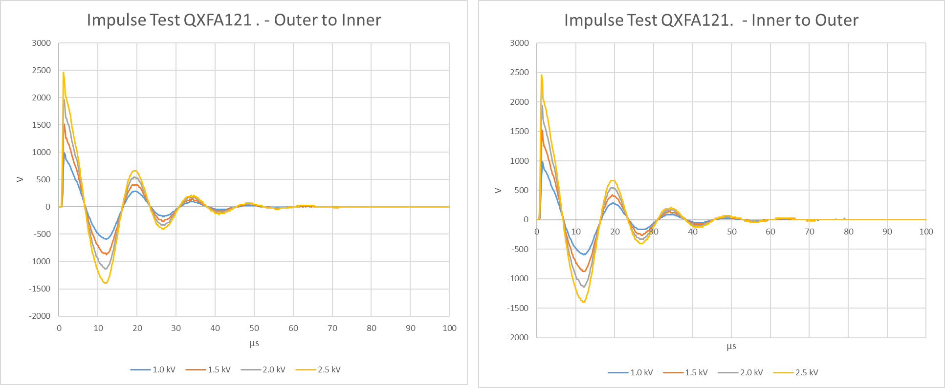
QXFA121 Impulse Test

Slide 36
QXFA125 Hi-pot & Electrical Checks
Hipot: | Final Test Voltage [V] | Max Leakage (µA) | Final Leakage (µA)
Pole to Coil | 100 | 0.1 | 0.0
PHB01 to Coil | 3680 | 0.8 | 0.0
PHB02 to Coil | 3680 | 0.6 | 0.0
PHB03 to Coil | 3680 | 0.7 | 0.0
PHB04 to Coil | 3680 | 0.7 | 0.0
LE IL Endshoe to Coil | 1000 | 0.1 | 0.0
LE OL Endshoe to Coil | 1000 | 0.1 | 0.0
RE IL Endshoe to Coil | 1000 | 0.0 | 0.0
RE OL Endshoe to Coil | 1000 | 0.0 | 0.0
LE OL Endshoe to PHB01 | 2500 | 0.0 | 0.0
LE OL Endshoe to PHB02 | 2500 | 0.0 | 0.0
LE OL Endshoe to PHB03 | 2500 | 0.1 | 0.0
LE OL Endshoe to PHB04 | 2500 | 0.0 | 0.0
RE OL Endshoe to PHB01 | 2500 | 0.1 | 0.0
RE OL Endshoe to PHB02 | 2500 | 0.0 | 0.0
RE OL Endshoe to PHB03 | 2500 | 0.0 | 0.0
RE OL Endshoe to PHB04 | 2500 | 0.0 | 0.0
LE IL Endshoe to LE OL Endshoe | 1000 | 0.0 | 0.0
RE IL Endshoe to RE OL Endshoe | 1000 | 0.0 | 0.0
Measurement | QXFA 125 | Average | STD | STD/AVG | Min | MAX
Coil R @1 A (mΩ) | 604.27 | 605.90 | 4.55 | 0.01 | 595.73 | 614.75
Ls @ 20 Hz (mH) | 4.8 | 4.86 | 0.31 | 0.06 | 4.56 | 6.29
Q | 0.77 | 0.79 | 0.10 | 0.13 | 0.73 | 1.28
Ls @ 100 Hz (mH) | 3.28 | 3.43 | 0.61 | 0.18 | 3.17 | 6.24
Q | 1.62 | 1.76 | 0.78 | 0.44 | 1.55 | 5.44
Ls @ 1 kHz (mH) | 1.95 | 2.06 | 0.79 | 0.38 | 1.85 | 5.75
Q | 2.1 | 2.32 | 1.30 | 0.56 | 1.95 | 8.41
VTA1 (mΩ) | 0.3 | 0.32 | 0.28 | 0.87 | 0.02 | 0.98
VTA2 | 0.32 | 0.38 | 0.29 | 0.76 | 0.04 | 1.00
VTB2 | 604.18 | 604.94 | 4.96 | 0.01 | 593.70 | 614.70
VTB1 | 604.2 | 605.54 | 4.33 | 0.01 | 595.61 | 614.80
VTA01 – VTA02 | 0.02 | 0.19 | 0.31 | 1.64 | 0.00 | 0.80
VTB02 – VTB01 | 0.02 | 0.09 | 0.05 | 0.51 | 0.02 | 0.15
VTB01-VTA01 | 603.9 | 607.76 | 1.86 | 0.00 | 605.52 | 610.22
QHB1 | 2.12 | 1.96 | 0.15 | 0.08 | 1.61 | 2.20
QHB2 | 2.12 | 1.98 | 0.14 | 0.07 | 1.65 | 2.21
QHB3 | 2.08 | 1.98 | 0.13 | 0.07 | 1.62 | 2.22
QHB4 | 2.07 | 1.97 | 0.14 | 0.07 | 1.61 | 2.23
Test Time | 11/18/24 10 am
Room Temperature [F] : | 68.49
Relative Humidity [%]: | 48.1

Slide 37
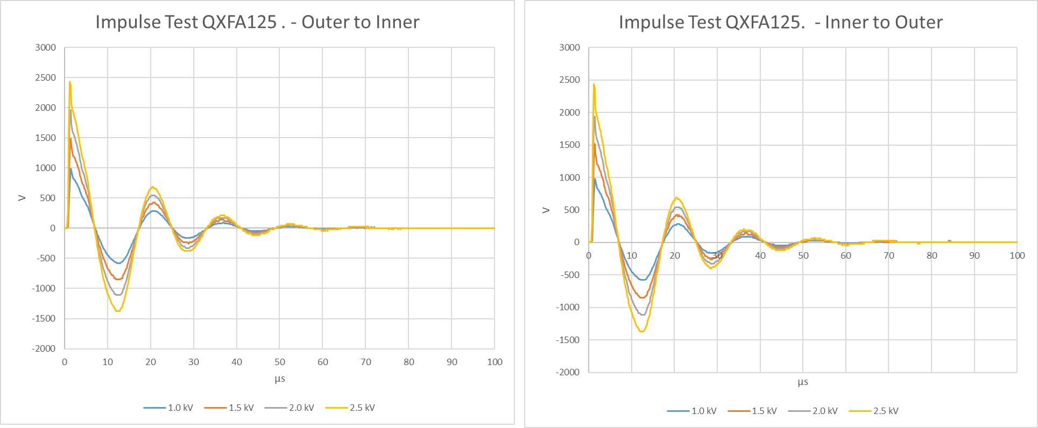
QXFA165 Impulse Test

Slide 38
QXFA142 Hi-pot & Electrical Checks
Hipot: | Final Test Voltage [V] | Max Leakage (µA) | Final Leakage (µA)
Pole to Coil | 100 | 0.5 | 0.0
PHB01 to Coil | 3680 | 0.6 | 0.0
PHB02 to Coil | 3680 | 0.7 | 0.0
PHB03 to Coil | 3680 | 0.5 | 0.0
PHB04 to Coil | 3680 | 0.6 | 0.0
LE IL Endshoe to Coil | 1000 | 0.0 | 0.0
LE OL Endshoe to Coil | 1000 | 0.0 | 0.0
RE IL Endshoe to Coil | 1000 | 0.0 | 0.0
RE OL Endshoe to Coil | 1000 | 0.0 | 0.0
LE OL Endshoe to PHB01 | 2500 | 0.0 | 0.0
LE OL Endshoe to PHB02 | 2500 | 0.0 | 0.0
LE OL Endshoe to PHB03 | 2500 | 0.0 | 0.0
LE OL Endshoe to PHB04 | 2500 | 0.0 | 0.0
RE OL Endshoe to PHB01 | 2500 | 0.0 | 0.0
RE OL Endshoe to PHB02 | 2500 | 0.1 | 0.0
RE OL Endshoe to PHB03 | 2500 | 0.0 | 0.0
RE OL Endshoe to PHB04 | 2500 | 0.0 | 0.0
LE IL Endshoe to LE OL Endshoe | 1000 | 0.0 | 0.0
RE IL Endshoe to RE OL Endshoe | 1000 | 0.0 | 0.0
Measurement | QXFA 142 | Average | STD | STD/AVG | Min | MAX
Coil R @1 A (mΩ) | 601.78 | 605.90 | 4.55 | 0.01 | 595.73 | 614.75
Ls @ 20 Hz (mH) | 4.8 | 4.86 | 0.31 | 0.06 | 4.56 | 6.29
Q | 0.78 | 0.79 | 0.10 | 0.13 | 0.73 | 1.28
Ls @ 100 Hz (mH) | 3.32 | 3.43 | 0.61 | 0.18 | 3.17 | 6.24
Q | 1.62 | 1.76 | 0.78 | 0.44 | 1.55 | 5.44
Ls @ 1 kHz (mH) | 1.92 | 2.06 | 0.79 | 0.38 | 1.85 | 5.75
Q | 2.08 | 2.32 | 1.30 | 0.56 | 1.95 | 8.41
VTA1 (mΩ) | 0.05 | 0.32 | 0.28 | 0.87 | 0.02 | 0.98
VTA2 | 0.09 | 0.38 | 0.29 | 0.76 | 0.04 | 1.00
VTB2 | 601.24 | 604.94 | 4.96 | 0.01 | 593.70 | 614.70
VTB1 | 601.31 | 605.54 | 4.33 | 0.01 | 595.61 | 614.80
VTA01 – VTA02 | 0.04 | 0.19 | 0.31 | 1.64 | 0.00 | 0.80
VTB02 – VTB01 | 0.07 | 0.09 | 0.05 | 0.51 | 0.02 | 0.15
VTB01-VTA01 | 601.26 | 607.76 | 1.86 | 0.00 | 605.52 | 610.22
QHB1 | 1.82 | 1.96 | 0.15 | 0.08 | 1.61 | 2.20
QHB2 | 1.92 | 1.98 | 0.14 | 0.07 | 1.65 | 2.21
QHB3 | 1.86 | 1.98 | 0.13 | 0.07 | 1.62 | 2.22
QHB4 | 1.89 | 1.97 | 0.14 | 0.07 | 1.61 | 2.23
Test Time | 11/22/24 10 am
Room Temperature [F] : | 69.4
Relative Humidity [%]: | 32.8

Slide 39
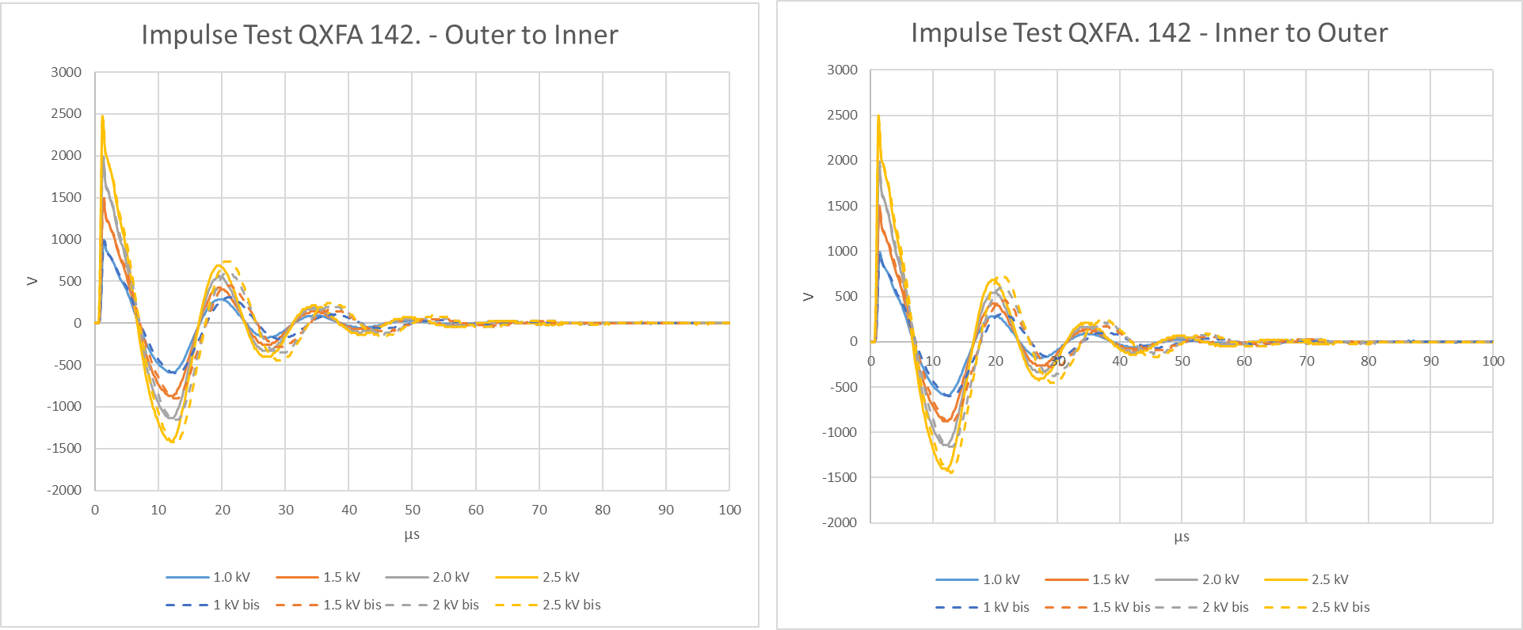
QXFA142 Impulse Test

Slide 40
QXFA146 Hi-pot & Electrical Checks
Hipot: | Final Test Voltage [V] | Max Leakage (µA) | Final Leakage (µA)
Pole to Coil | 100 | 0.3 | 0.0
PHB01 to Coil | 3680 | 0.5 | 0.0
PHB02 to Coil | 3680 | 0.8 | 0.0
PHB03 to Coil | 3680 | 0.5 | 0.0
PHB04 to Coil | 3680 | 0.6 | 0.0
LE IL Endshoe to Coil | 1000 | 0.0 | 0.0
LE OL Endshoe to Coil | 1000 | 0.0 | 0.0
RE IL Endshoe to Coil | 1000 | 0.0 | 0.0
RE OL Endshoe to Coil | 1000 | 0.0 | 0.0
LE OL Endshoe to PHB01 | 2500 | 0.1 | 0.0
LE OL Endshoe to PHB02 | 2500 | 0.1 | 0.0
LE OL Endshoe to PHB03 | 2500 | 0.1 | 0.0
LE OL Endshoe to PHB04 | 2500 | 0.1 | 0.0
RE OL Endshoe to PHB01 | 2500 | 0.0 | 0.0
RE OL Endshoe to PHB02 | 2500 | 0.0 | 0.0
RE OL Endshoe to PHB03 | 2500 | 0.0 | 0.0
RE OL Endshoe to PHB04 | 2500 | 0.0 | 0.0
LE IL Endshoe to LE OL Endshoe | 1000 | 0.0 | 0.0
RE IL Endshoe to RE OL Endshoe | 1000 | 0.0 | 0.0
Measurement | QXFA 146 | Average | STD | STD/AVG | Min | MAX
Coil R @1 A (mΩ) | 600.61 | 605.90 | 4.55 | 0.01 | 595.73 | 614.75
Ls @ 20 Hz (mH) | 5.0 | 4.86 | 0.31 | 0.06 | 4.56 | 6.29
Q | 0.825 | 0.79 | 0.10 | 0.13 | 0.73 | 1.28
Ls @ 100 Hz (mH) | 3.5 | 3.43 | 0.61 | 0.18 | 3.17 | 6.24
Q | 1.65 | 1.76 | 0.78 | 0.44 | 1.55 | 5.44
Ls @ 1 kHz (mH) | 1.91 | 2.06 | 0.79 | 0.38 | 1.85 | 5.75
Q | 1.96 | 2.32 | 1.30 | 0.56 | 1.95 | 8.41
VTA1 (mΩ) | 0.75 | 0.32 | 0.28 | 0.87 | 0.02 | 0.98
VTA2 | 0.78 | 0.38 | 0.29 | 0.76 | 0.04 | 1.00
VTB2 | 599.02 | 604.94 | 4.96 | 0.01 | 593.70 | 614.70
VTB1 | 599.1 | 605.54 | 4.33 | 0.01 | 595.61 | 614.80
VTA01 – VTA02 | 0.03 | 0.19 | 0.31 | 1.64 | 0.00 | 0.80
VTB02 – VTB01 | 0.08 | 0.09 | 0.05 | 0.51 | 0.02 | 0.15
VTB01-VTA01 | 598.35 | 607.76 | 1.86 | 0.00 | 605.52 | 610.22
QHB1 | 1.94 | 1.96 | 0.15 | 0.08 | 1.61 | 2.20
QHB2 | 1.92 | 1.98 | 0.14 | 0.07 | 1.65 | 2.21
QHB3 | 1.94 | 1.98 | 0.13 | 0.07 | 1.62 | 2.22
QHB4 | 1.91 | 1.97 | 0.14 | 0.07 | 1.61 | 2.23
Test Time | 08/23/24 9 am
Room Temperature [F] : | 70.12
Relative Humidity [%]: | 52.9

Slide 41
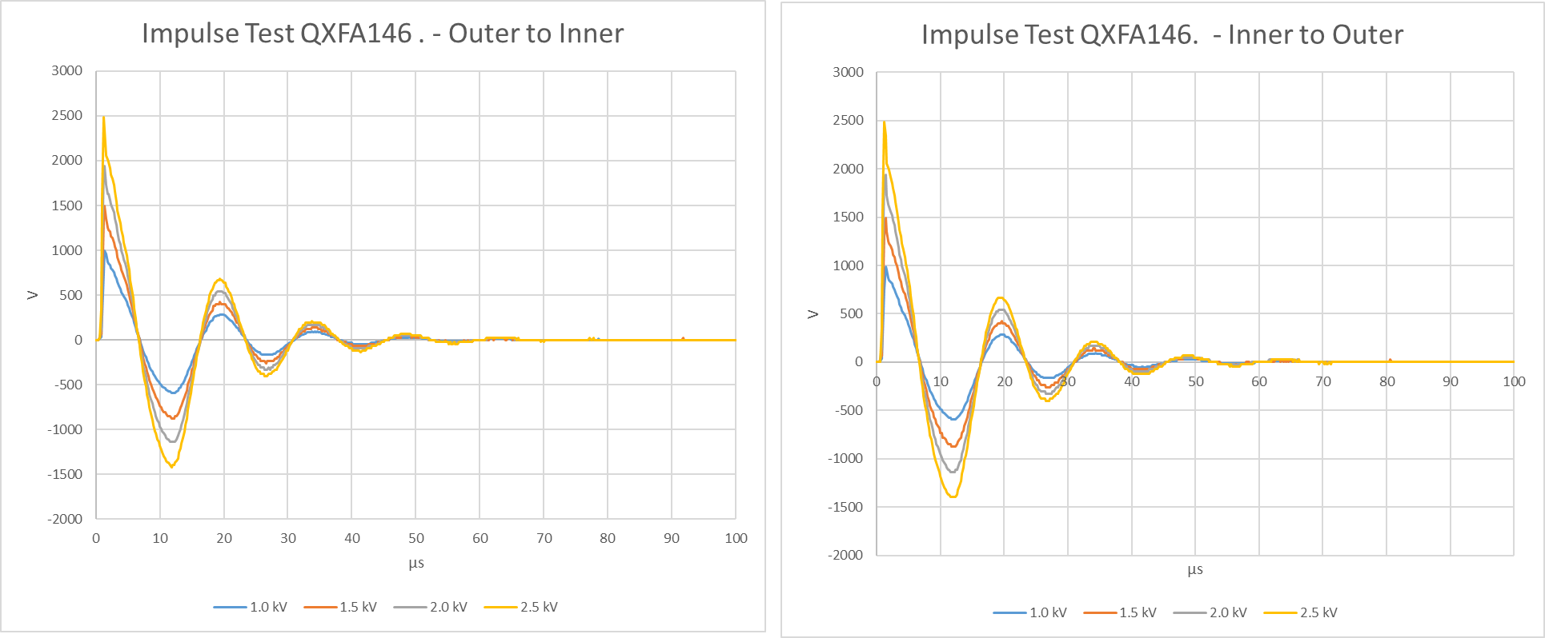
QXFA146 Impulse Test

Slide 42
Coil Length
 | Overall Coil Length (mm)
Pre-Series Requirement | 4532 ± 5.0
Series Requirement | 4529 ± 5.0
QXFA 121 | 4532
QXFA 125 | 4531.2
QXFA 142 | 4534.1
QXFA146 | 4532.2

Slide 43
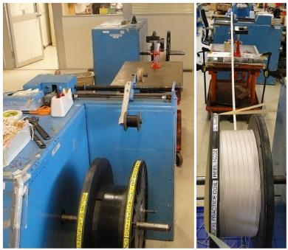
Cable Preparation
Re-spool the insulated cable to verify the total length (min. 441 m including the winding lead).
Split into two reels for L1 coil (min. 195 m) and L2 coil (min. 246 m).
Cable respooling
Cable respooling | Cable ID | Total (m) | L1 (m) | L2 (m)
QXFA 121 | P43OL1125 | 448.3 | 199 | 249.3
QXFA 125 | P43OL1121 | 451.3 | 205.3 | 246
QXFA 142 | P43OL1172 | 452 | 206 | 246
QXFA 146 | P43OL1180 | 448.9 | 202.9 | 246
Cable length in coil
Cable length in coil | Cable ID | Total (m) | L1 (m) | L2 (m)
Average (QXFA 104-164) |  | 427.1 | 188 | 239.1
QXFA 121 | P43OL1125 | 424.9* | 186.3* | 238.6
QXFA 125 | P43OL1121 | 427 | 187.8 | 239.2
QXFA 142 | P43OL1172 | 427.2 | 187.7 | 239.5
QXFA 146 | P43OL1180 | 427.1 | 188.3 | 238.8
* For QXFA 121, based on L1 drop-off cable length measurement, L1 cable usage is calculated 186.3 m, about 1.7 m less than the average. It is believed the L1 drop-off cable length was measured with errors.

Slide 44
Wedge Length and Gap
QXFA 121, 125, 142, and 146
Wedge gap: 2 mm 3.75 mm 3.75 mm 3.75 mm 3.75 mm 3.75 mm 2 mm

Slide 45
Pole Gap

