Slide 1
Coil 146 mid-plane delamination
Michael Solis, Paolo Ferracin
on behalf of the MQXF collaboration
December 12, 2024
LBNL, Berkeley, CA, USA

Slide 2
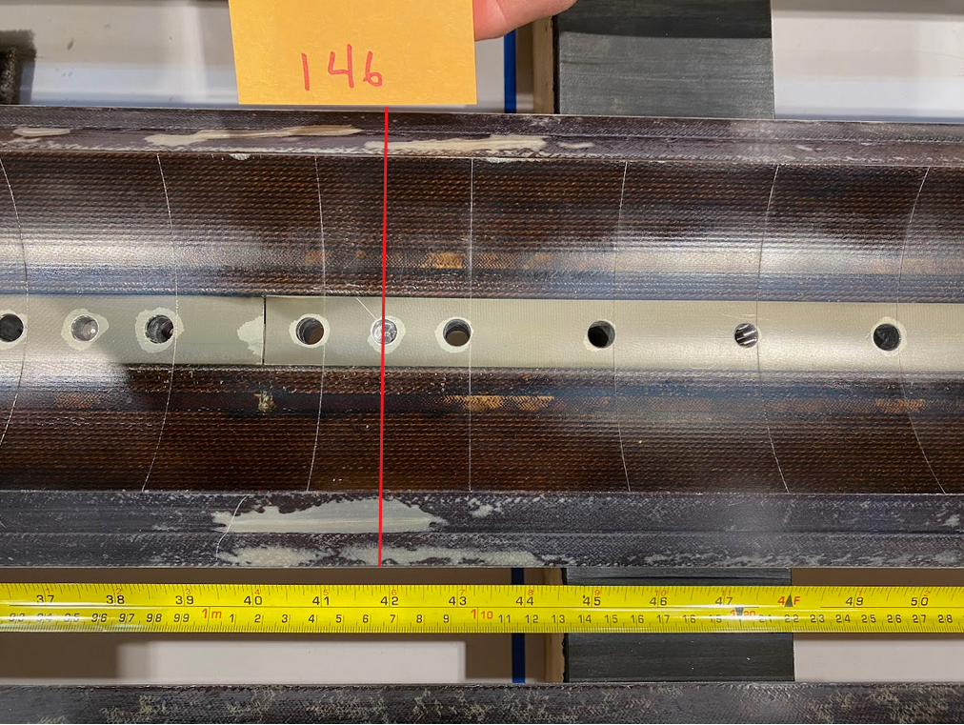
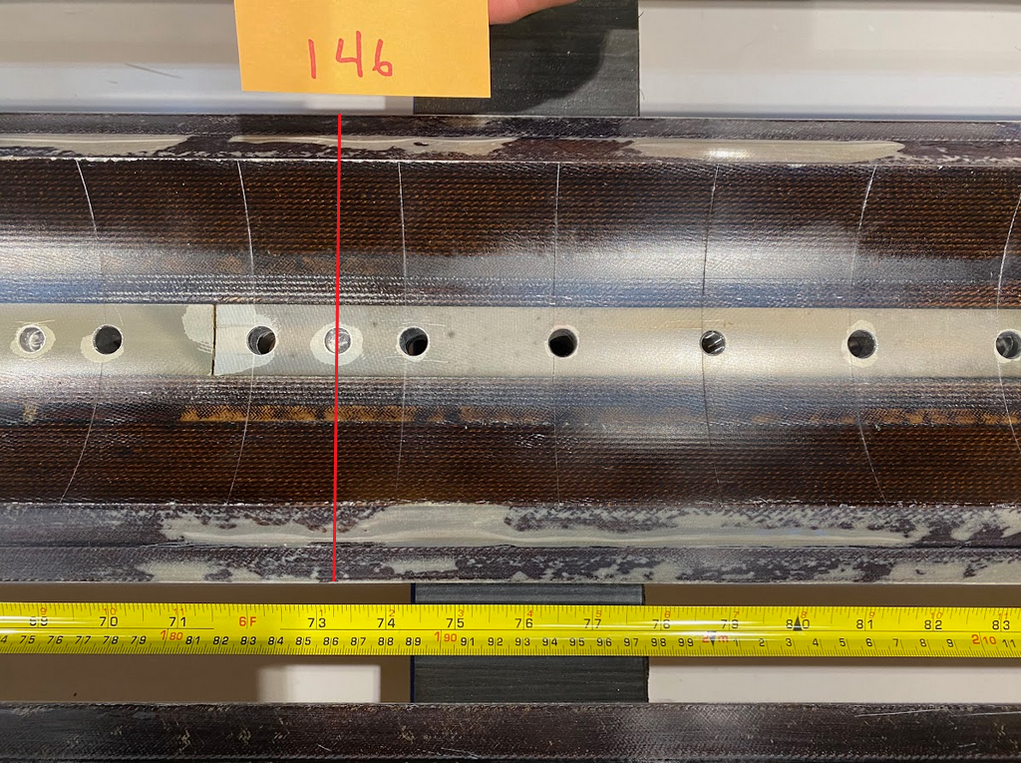
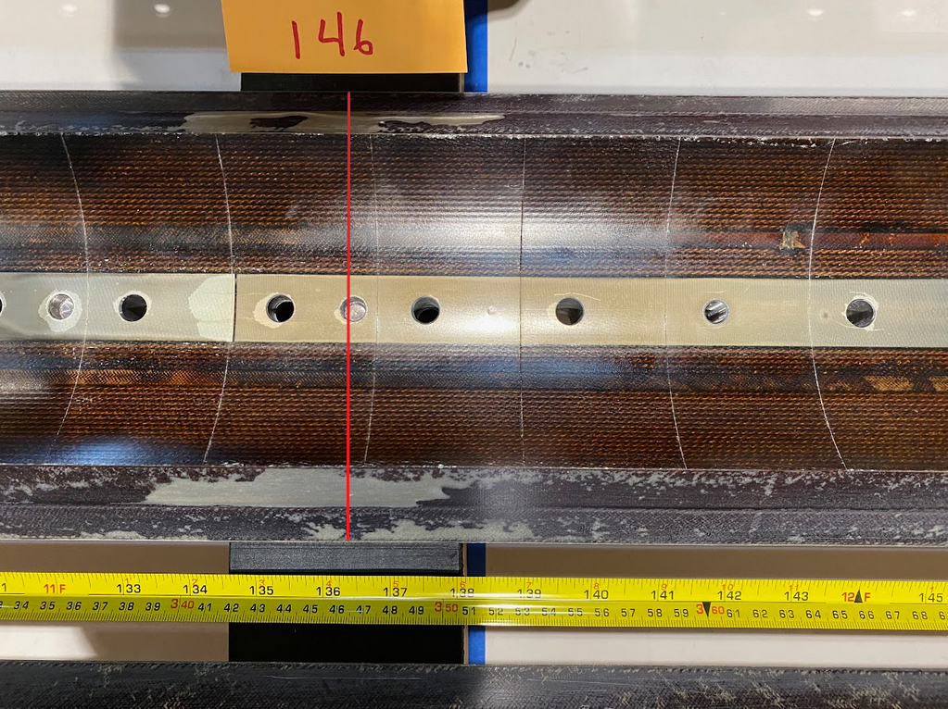
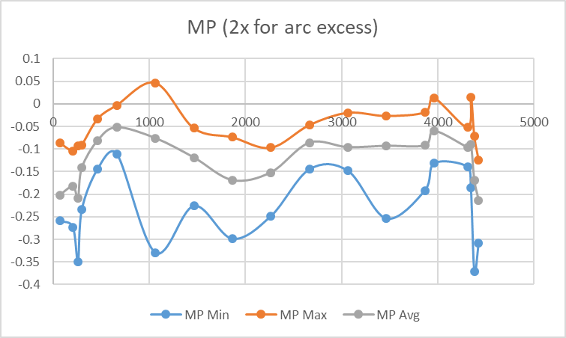
Observations
Upon incoming inspection coil 146 was found to have significant delamination along the mid-plane.
Areas highlighted also had a large measurement spread
Xsec1065
Xsec1865
Xsec3465

Slide 3
Coil 146 MP measurements
 | MP Min | MP Max | MP Avg | max-min ∆
70 | -0.259 | -0.086 | -0.202 | 0.173
207 | -0.273 | -0.105 | -0.183 | 0.168
260 | -0.349 | -0.093 | -0.208 | 0.256
300 | -0.234 | -0.091 | -0.141 | 0.143
465 | -0.144 | -0.033 | -0.081 | 0.111
665 | -0.111 | -0.003 | -0.052 | 0.108
1065 | -0.330 | 0.046 | -0.076 | 0.376
1465 | -0.226 | -0.054 | -0.119 | 0.172
1865 | -0.299 | -0.074 | -0.169 | 0.225
2265 | -0.249 | -0.097 | -0.152 | 0.152
2665 | -0.145 | -0.047 | -0.086 | 0.098
3065 | -0.148 | -0.020 | -0.096 | 0.128
3465 | -0.254 | -0.027 | -0.093 | 0.227
3865 | -0.192 | -0.019 | -0.092 | 0.173
3965 | -0.131 | 0.012 | -0.060 | 0.143
4310 | -0.139 | -0.052 | -0.096 | 0.087
4345 | -0.186 | 0.015 | -0.089 | 0.201
4380 | -0.371 | -0.072 | -0.169 | 0.299
4426 | -0.308 | -0.125 | -0.214 | 0.183
 |  |  | (MP Avg) Avg | (max-min ∆) Avg
 |  |  | -0.125 | 0.180
 |  |  | (MP Avg) Max | (max-min ∆) Max
 |  |  | -0.052 | 0.376
 |  |  | (MP Avg) Min | (max-min ∆) Min
 |  |  | -0.214 | 0.087

Slide 4
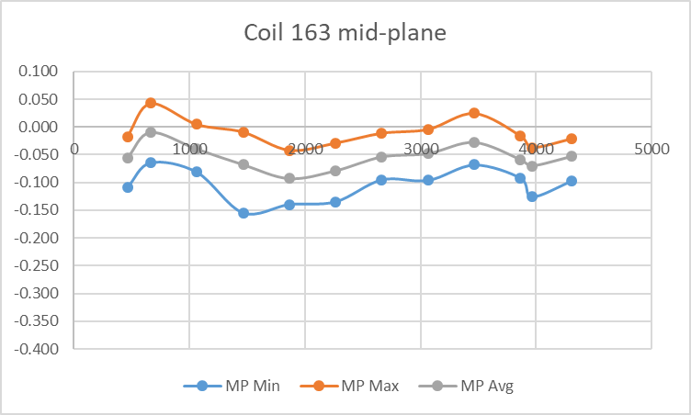
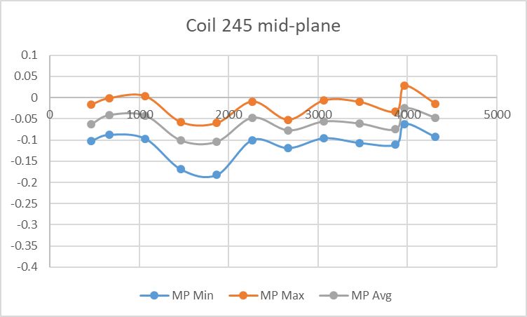
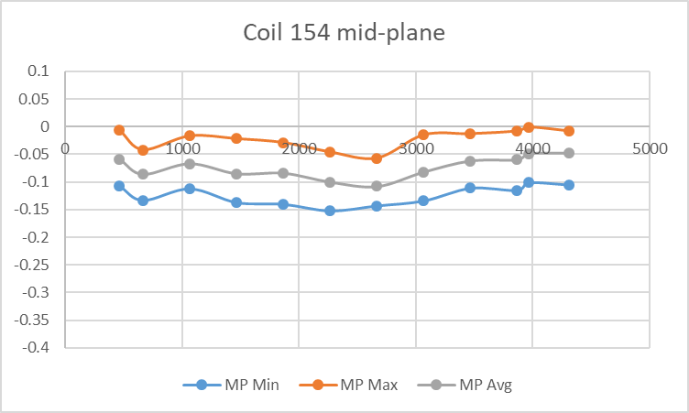
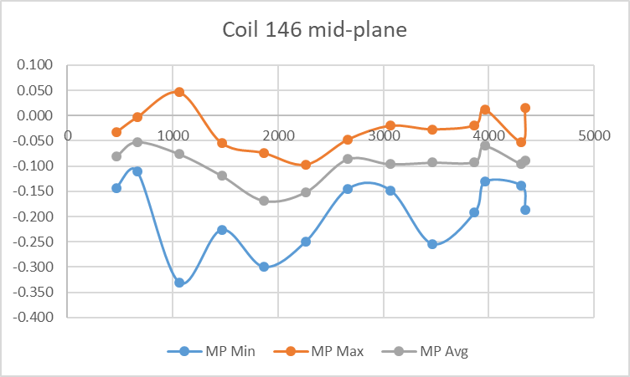
Coil MP Sample Comparison
(MP Avg)Avg | (max-min ∆) Avg
-0.055 | 0.095
(MP Avg)Max | (max-min ∆)Max
-0.010 | 0.146
(MP Avg)Min | (max-min ∆))Min
-0.093 | 0.076
(MP Avg)Avg | (max-min ∆) Avg
-0.062 | 0.092
(MP Avg)Max | (max-min ∆)Max
-0.025 | 0.122
(MP Avg)Min | (max-min ∆))Min
-0.104 | 0.067
(MP Avg)Avg | (max-min ∆) Avg
-0.074 | 0.102
(MP Avg)Max | (max-min ∆)Max
-0.048 | 0.119
(MP Avg)Min | (max-min ∆))Min
-0.108 | 0.086
(MP Avg)Avg | (max-min ∆) Avg
-0.098 | 0.167
(MP Avg)Max | (max-min ∆)Max
-0.052 | 0.376
(MP Avg)Min | (max-min ∆))Min
-0.169 | 0.087

Slide 5
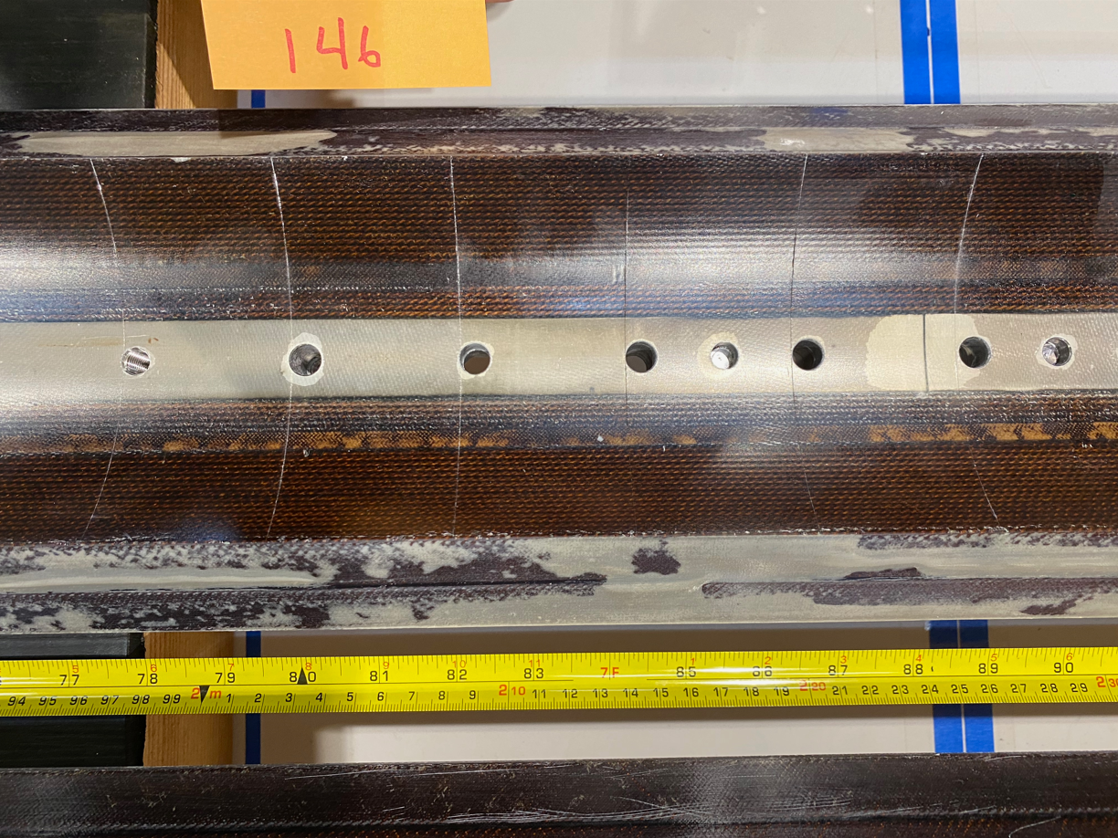
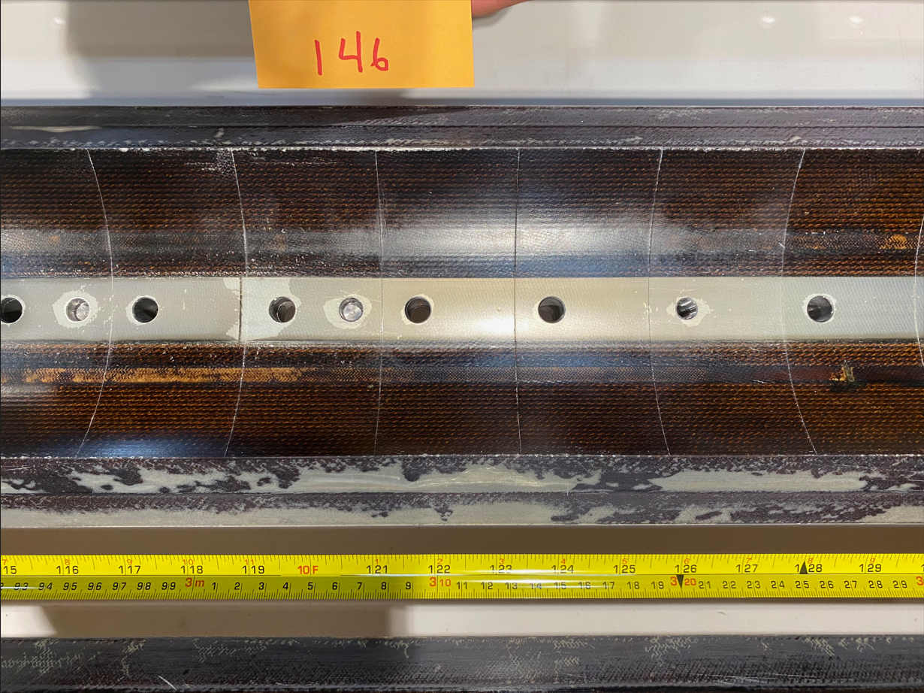
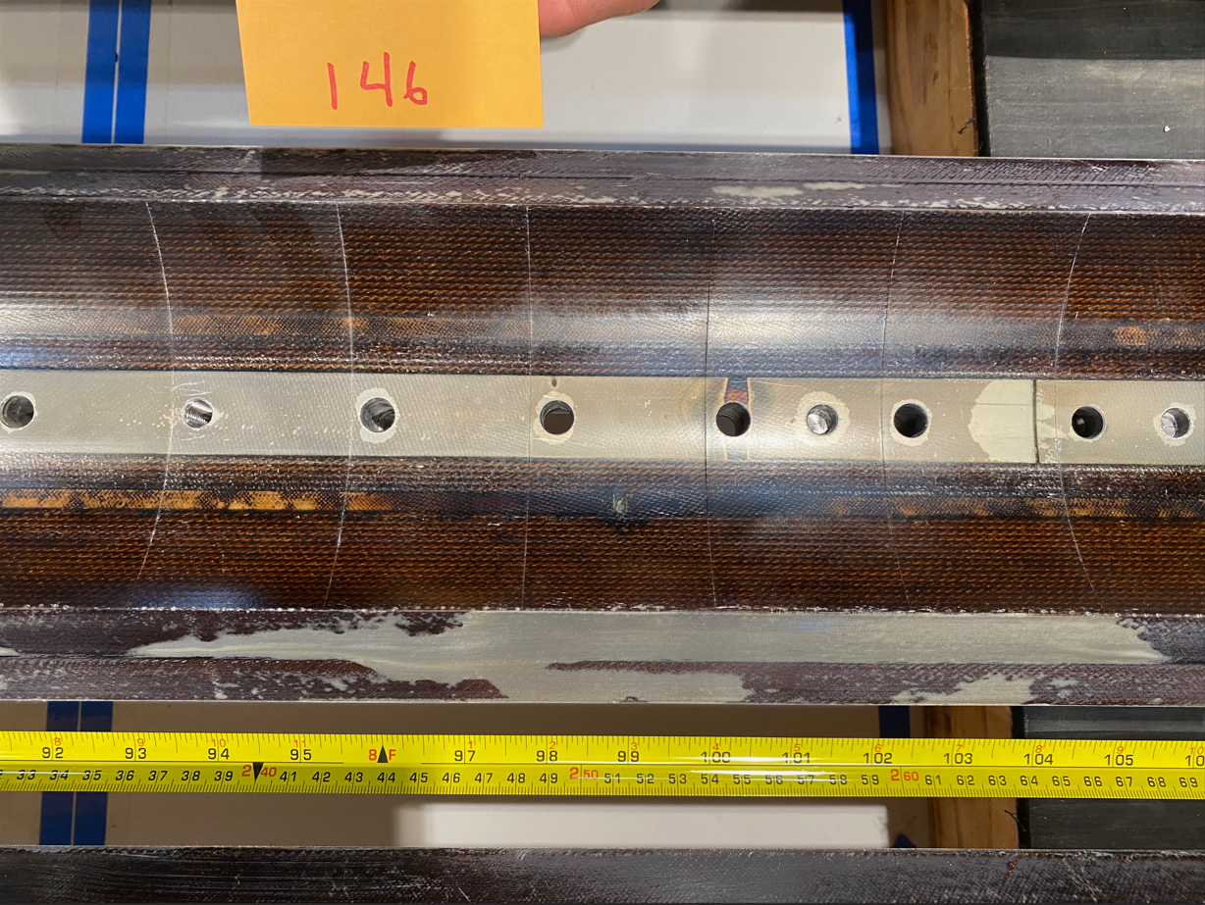
Observations
Xsec1065
Xsec1865
Xsec3465
Images of the worst delamination in areas not necessarily captured by the standard coil measurement plan

Slide 6
Conclusion
The viewed midplane delamination of coil 146 if having an effect on the coil midplane measurements.
  The average midplane for 146 is 34µm larger than a random sampling of coils without delamination
  The average difference between the max and min points is 71µm greater than a random sampling of coils without delamination
  The maximum difference between the max and min points is 247µm greater than a random sampling of coils without delamination
Though the CMM captured some of the effects of the delamination there are areas of delamination that appear to be worse than what was measured.

Slide 7
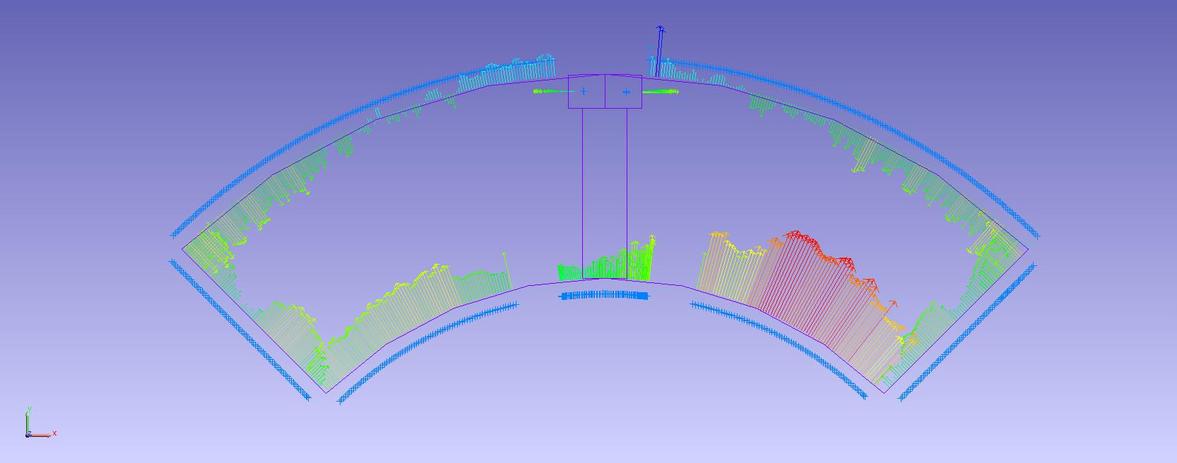
Arc length excess

Slide 8
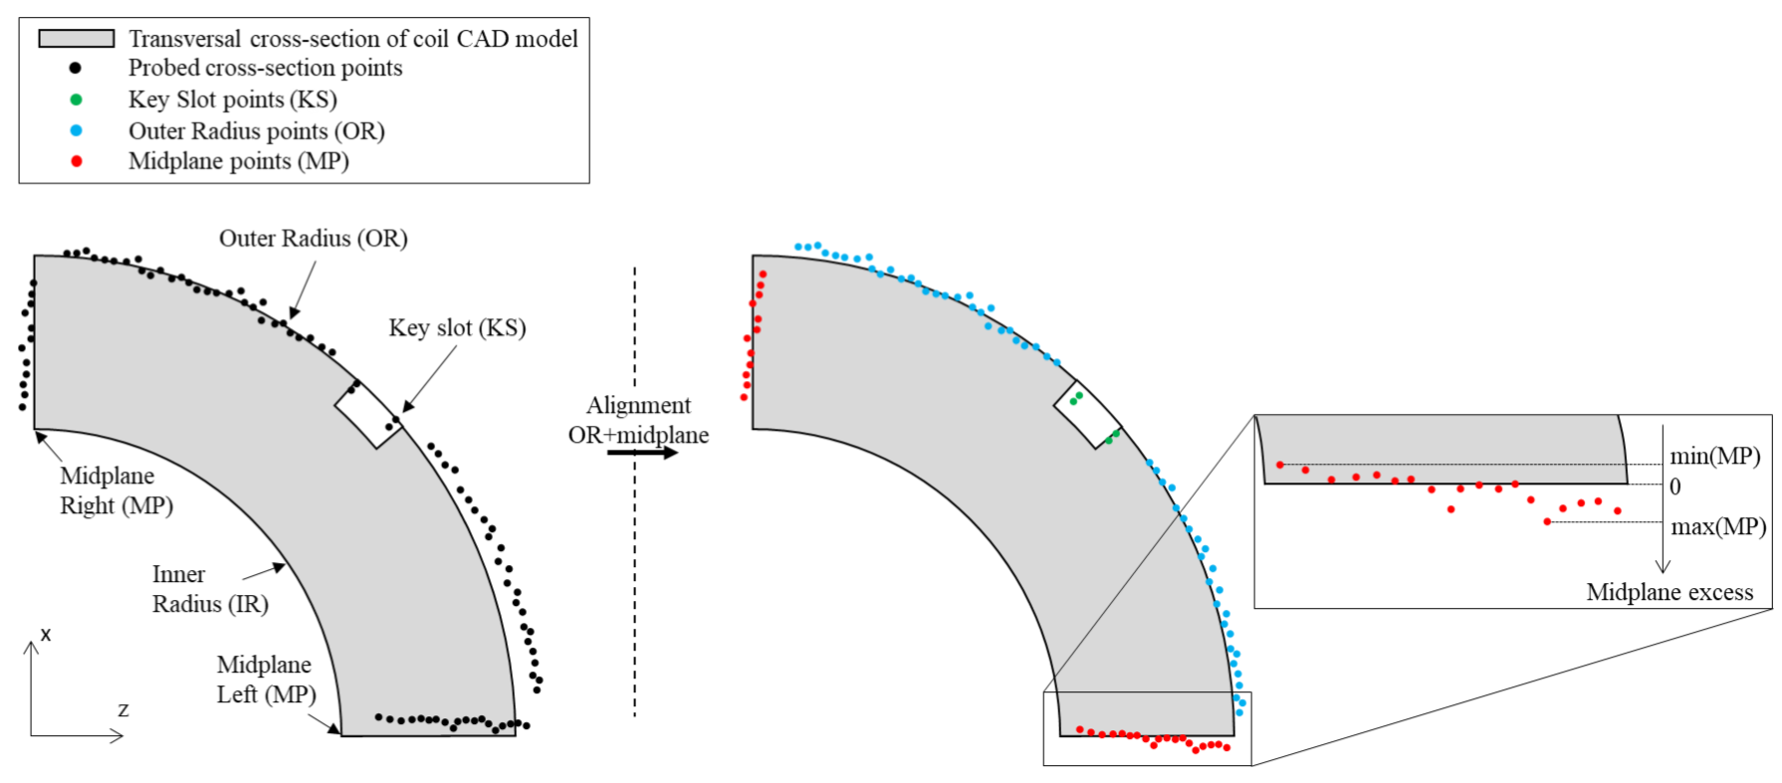
Impregnated coil dimensional tolerances
Arc length excess (straight section)
The impregnated coil is accepted for use in MQXFA if its arc length excesses along the straight section are within the following tolerances: +0.150/-0.250 mm
The arc length excess, which is difference between the measured coil arc length and the nominal one, is determined by fitting outer radius and mid-planes points with the nominal profile, with equal weighting and imposing as symmetrical the two mid-planes offsets. The sum of the two measured mid-plane offsets provides the arc length excess

Slide 9

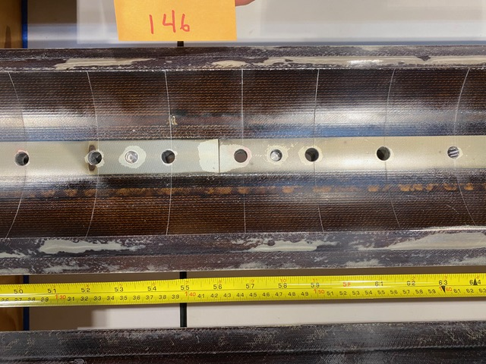
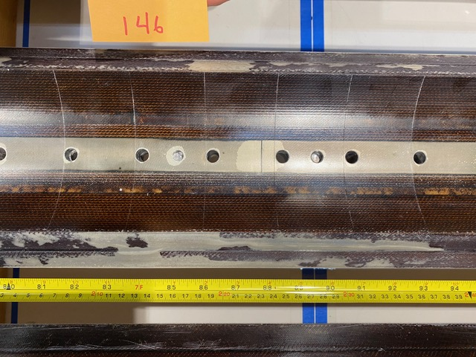
Observations
Upon incoming inspection coil 146 was found to have significant delamination along the mid-plane.
Xsec1065
Xsec1865
Xsec3065
Xsec1465
Xsec3465
Xsec2265

Slide 10
Observations
Upon incoming inspection coil 146 was found to have significant delamination along the mid-plane
Three sections appear to have a large spread in measurement data (1065, 1865, 3465)
Three additional sections are where delamination was present, visually (1465, 2265, 3065)

Slide 11
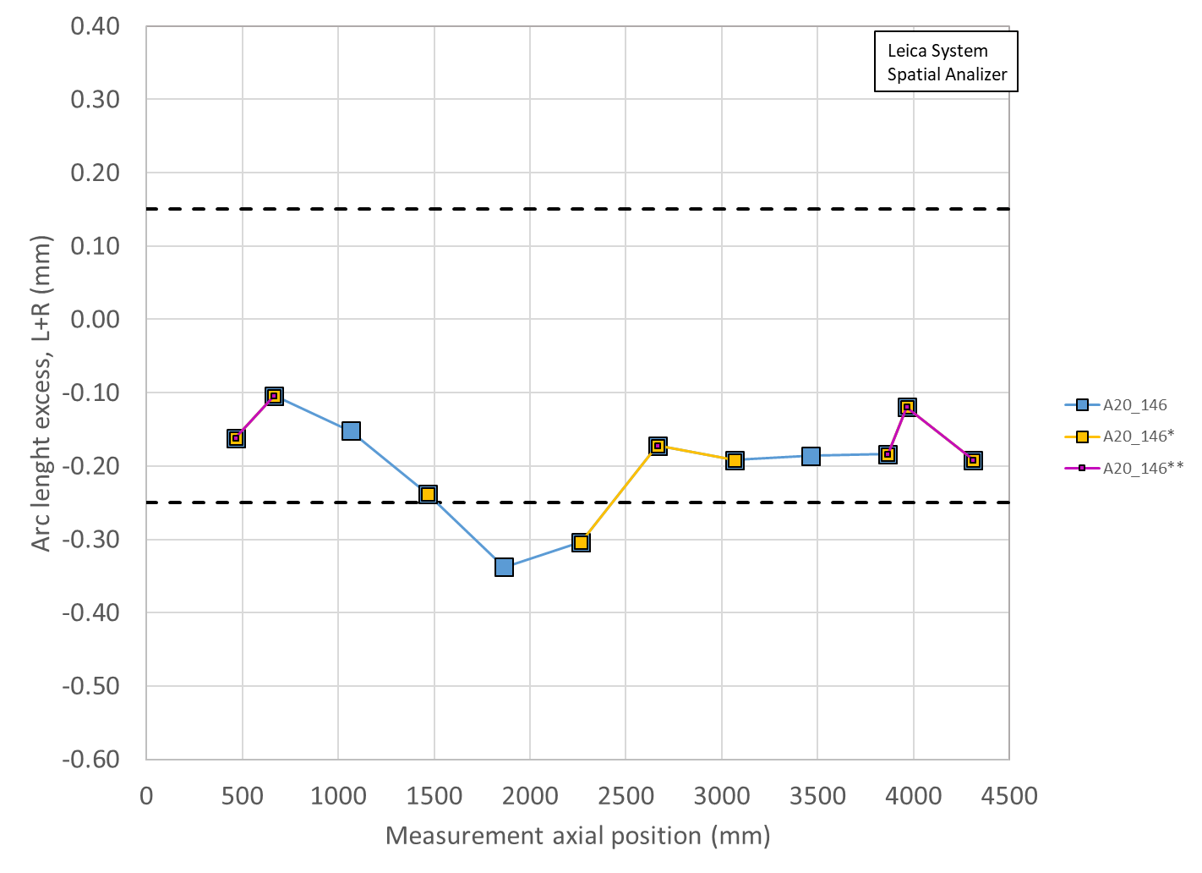
Arc length excess straight section

Slide 12
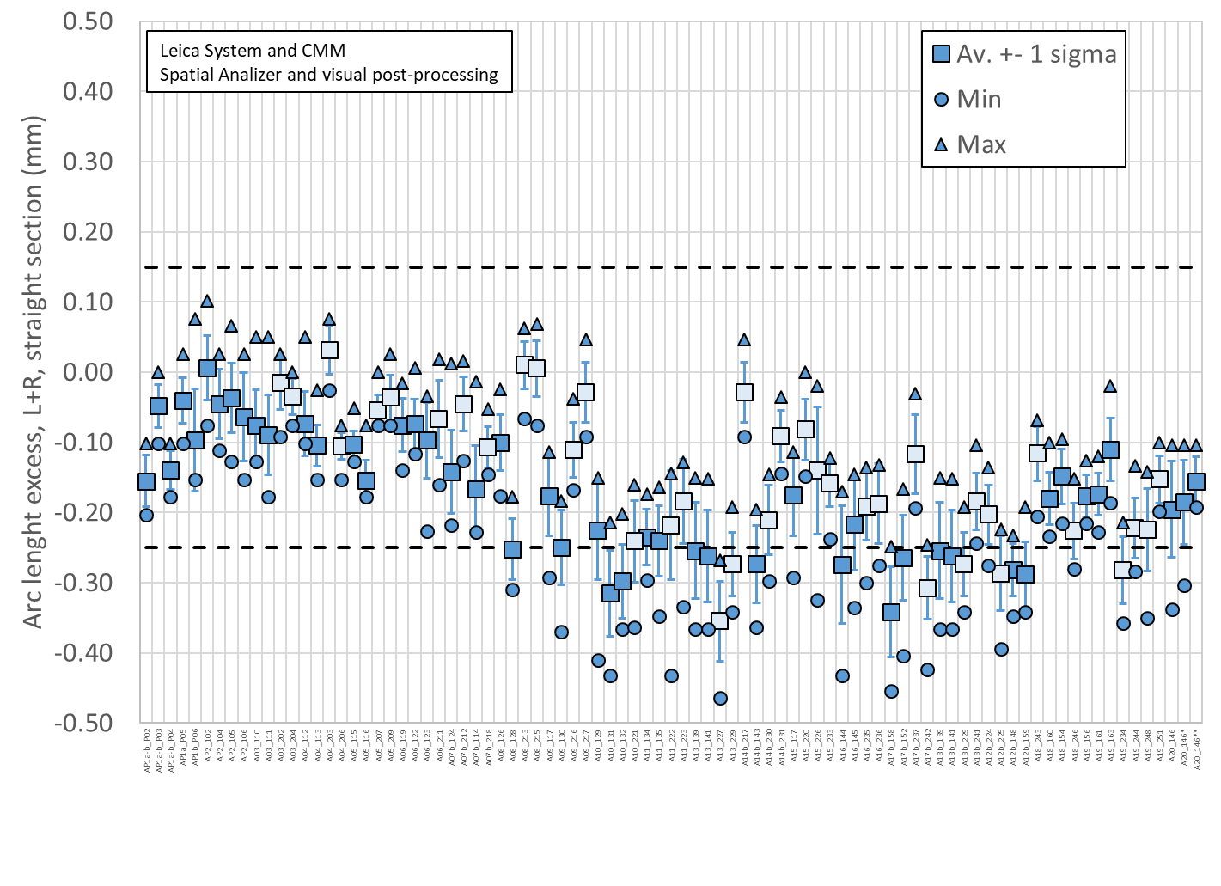
Arc length excess straight section

Slide 13
Arc length excess straight section
Conclusions
  The difference in arc length in the straight section between coil 146, coil 146* (where 3 data have been removed) and coil 146** (where 6 data have been removed) is
    From -0.195 mm (146) to -0.185 mm (146*) to -0.156 mm (146**)
      5 um per mid-plane (from 146 to 146*)
      15 um per mid-plane (from 146 to 146*)
  So the maximum difference between the 3 mid-plane shim (per side) would be 20 um
Action items
  The coils will be shimmed on the mid-plane to compensate

