Slide 1
MQXFA20 coil dimensions
P. Ferracin, Dan Cheng, Jennifer Doyle, Katherine Ray, Michael Solis
on behalf of the MQXF collaboration
MQXFA20 Coils Acceptance Review
December 12th, 2024
LBNL, Berkeley, CA, USA

Slide 2
About 146 we remove 6 points, so, 146**
We plot both the pre-loading and post loading 142, checking if the straight section is different

Slide 3
Outline
Data taking and processing
Impregnated coil dimensional tolerances
Results (straight section)
Arc length excess
Outer radius profile deviation
Inner radial deviations (coil blocks)
Inner radial deviations (pole)
Key slot deviations
Best-fit outer radius
Appendix

Slide 4
Outline
Data taking and processing
Impregnated coil dimensional tolerances
Results (straight section)
Arc length excess
Outer radius profile deviation
Inner radial deviations (coil blocks)
Inner radial deviations (pole)
Key slot deviations
Best-fit outer radius
Appendix

Slide 5
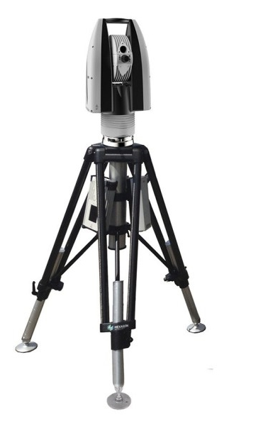
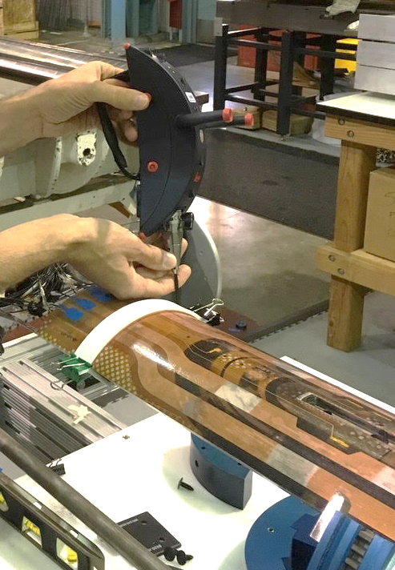
Data taking and processing
Leica System
AT960 with T-Probe
Data processed using
Spatial Analyzer

Slide 6
Post processing
Each cross section is treated separately.
Coils cross-sections are measured in 15 different locations along the coil length, from 70 mm close to the lead end to 4426 mm close to the return end.
The 12 so-called straight section locations, where the pole key slot is present, are from 465 mm close to the lead end to 4310 mm close to the return end.
The strain gauge is at location 3965 mm.

Slide 7
Outline
Data taking and processing
Impregnated coil dimensional tolerances
Results (straight section)
Arc length excess
Outer radius profile deviation
Inner radial deviations (coil blocks)
Inner radial deviations (pole)
Key slot deviations
Best-fit outer radius
Appendix

Slide 8
Impregnated coil dimensional tolerances (for series coils)

Slide 9
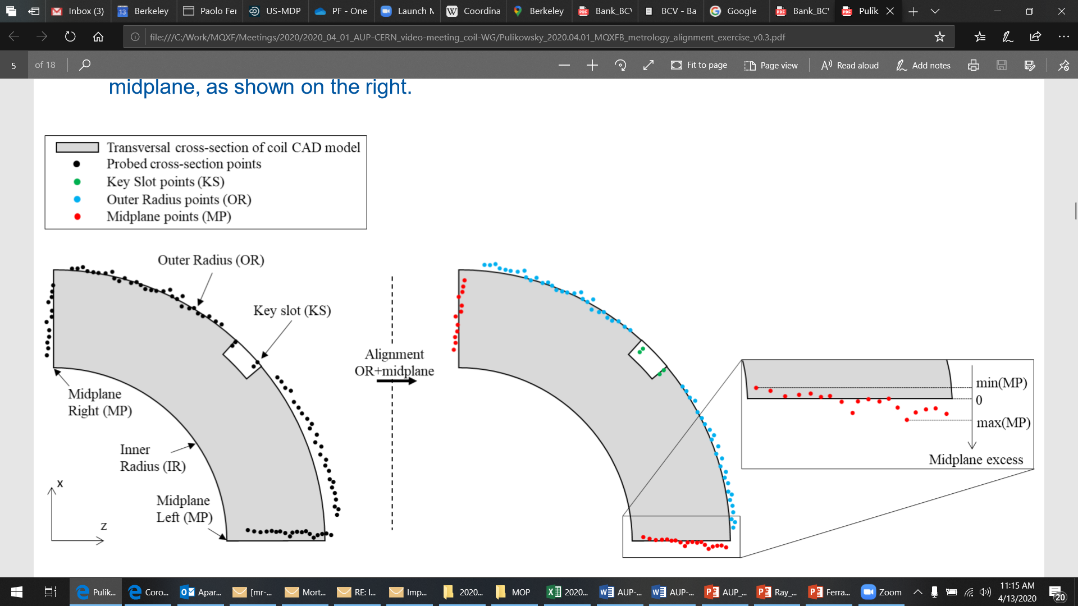
Impregnated coil dimensional tolerances Arc length excess (straight section)
The impregnated coil is accepted for use in MQXFA if its arc length excesses along the straight section are within the following tolerances: +0.150/-0.250 mm
The arc length excess, which is difference between the measured coil arc length and the nominal one, is determined by fitting outer radius and mid-planes points with the nominal profile, with equal weighting and imposing as symmetrical the two mid-planes offsets. The sum of the two measured mid-plane offsets provides the arc length excess

Slide 10
Impregnated coil dimensional tolerances Arc length excess (ends)
At 260 and 300 mm (for the lead end) and at 4340 and 4380 mm (for the return end) the absolute value of the coil delta arc-length must not exceed 210 mm.
The coil delta arc-length is the difference between the coil arc length at each location in the ends and the average coil arc-length in the straight section.

Slide 11
Impregnated coil dimensional tolerances Outer radius profile deviation
The impregnated coil is accepted for use in MQXFA if its outer radius profile deviations along the straight section are within the following tolerances: +0.200/-0.250 mm
The outer radius profile deviation, which is given by the variation of each point on the outer radius with respect to the nominal outer radius, is determined by fitting outer radius and mid-planes points with the nominal profile, with equal weighting and imposing as symmetrical the two mid-planes offsets. Positive deviation indicates more material than nominal, negative indicates less material than nominal.

Slide 12
Impregnated coil dimensional tolerances “Coil blocks” inner radius profile deviation
The impregnated coil is accepted for use in MQXFA if its “coil blocks” inner radius profile deviations (E-F in next slide) along the straight section are within the following tolerances: +0.150/-0.250 mm
The “coil blocks” inner radius profile deviations, which is given by the variation of each point on the inner radius with respect to the nominal radius, is determined by fitting outer radius and mid-planes points with the nominal profile, with equal weighting and imposing as symmetrical the two mid-planes offsets. Positive deviation indicates more material than nominal, negative indicates less material than nominal.

Slide 13
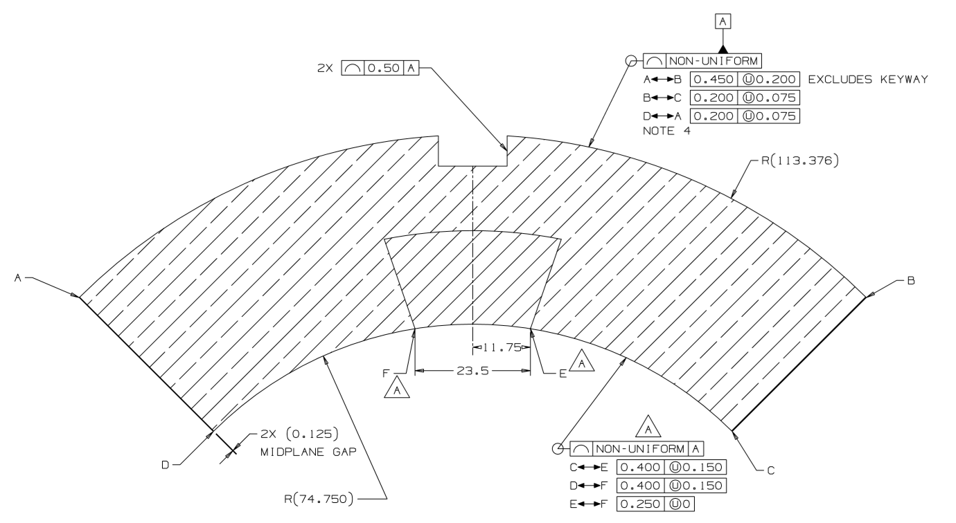
Impregnated coil dimensional tolerances

Slide 14
Impregnated coil dimensional tolerances “Pole” inner radius profile deviation
The impregnated coil is accepted for use in MQXFA if its “pole” inner radius profile deviations (C-E and D-F in next slide) along the straight section are within the following tolerances: +0.000/-0.250 mm*
The “pole” inner radius profile deviations, which is given by the variation of each point on the inner radius with respect to the nominal radius, is determined by fitting outer radius and mid-planes points with the nominal profile, with equal weighting and imposing as symmetrical the two mid-planes offsets. Positive deviation indicates more material than nominal, negative indicates less material than nominal.

Slide 15
Impregnated coil dimensional tolerances
* Cross-section measurements shall be taken close to all possible bumper locations. In addition, data shall be taken on the surface surrounding the pole holes where bumpers are inserted and projected on the closest measured cross-section.

Slide 16
Impregnated coil dimensional tolerances Pole key slot mis-alignment
The impregnated coil is accepted for use in MQXFA if its pole key slot mis-alignment along the straight section are within the following tolerances: +0.250/-0.250 mm
The pole key slot mis-alignment, which is the misalignment of the center of the pole key slot with respect to the nominal position, is determined by fitting outer radius and mid-planes points with the nominal profile, with equal weighting and imposing as symmetrical the two mid-planes offsets.
View from LE, positive shift towards left

Slide 17
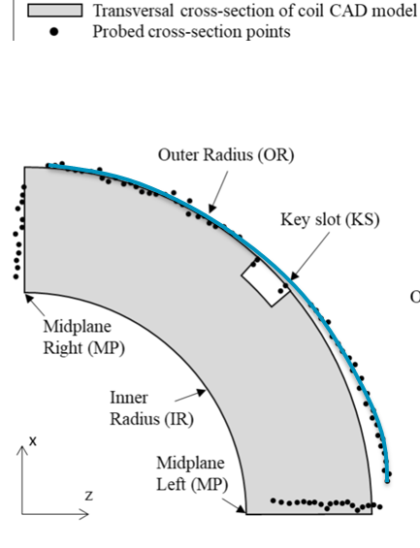
Best-fit outer radius
The best-fit outer radius is determined by best-fitting only the outer radius points.
No tolerance is specified
Used to monitor coil-to-collar contact surfaces (“LQ effect”)

Slide 18
Outline
Data taking and processing
Impregnated coil dimensional tolerances
Results (straight section)
Arc length excess
Delta arc length excess straight section - ends
Outer radius profile deviation
Inner radial deviations (coil blocks)
Inner radial deviations (pole)
Key slot deviations
Best-fit outer radius
Appendix

Slide 19
Arc length excess

Slide 20
Impregnated coil dimensional tolerances Arc length excess (straight section)
The impregnated coil is accepted for use in MQXFA if its arc length excesses along the straight section are within the following tolerances: +0.150/-0.250 mm
The arc length excess, which is difference between the measured coil arc length and the nominal one, is determined by fitting outer radius and mid-planes points with the nominal profile, with equal weighting and imposing as symmetrical the two mid-planes offsets. The sum of the two measured mid-plane offsets provides the arc length excess

Slide 21
Delamination in coil 146

Slide 22
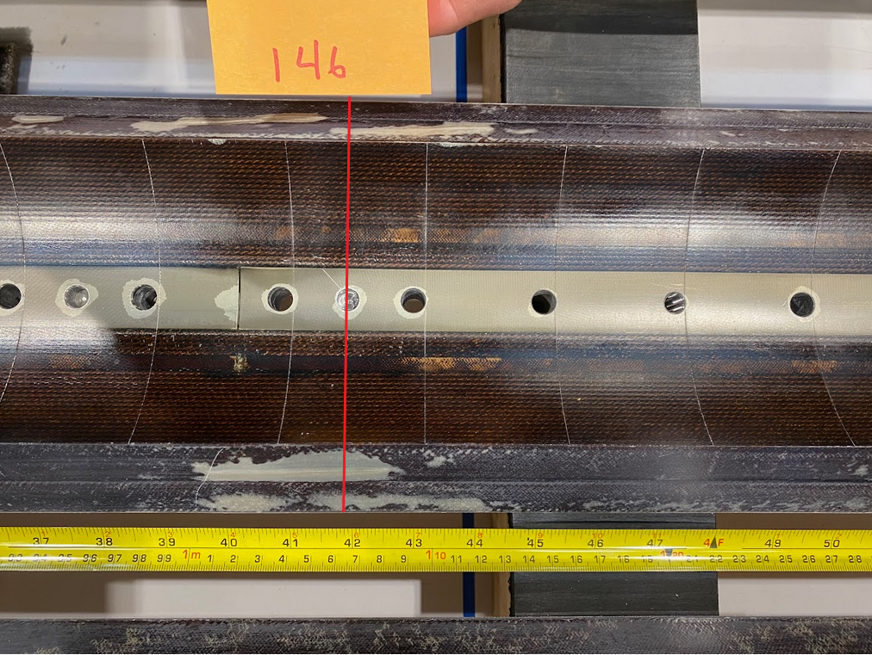
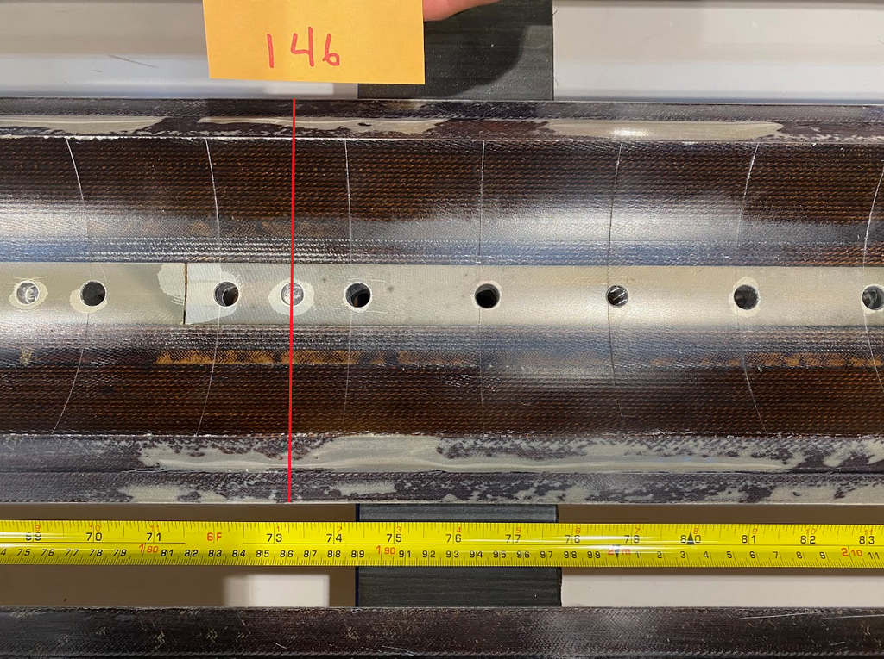
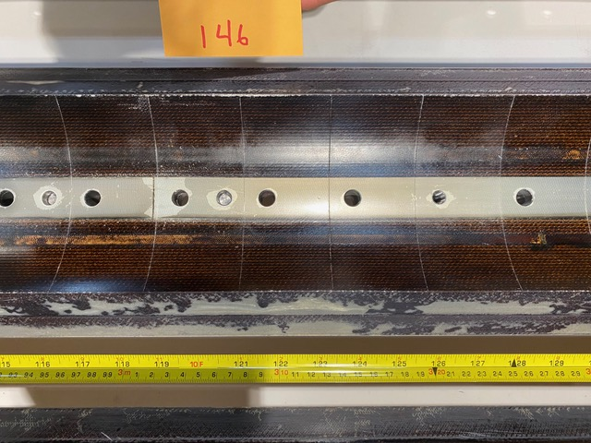
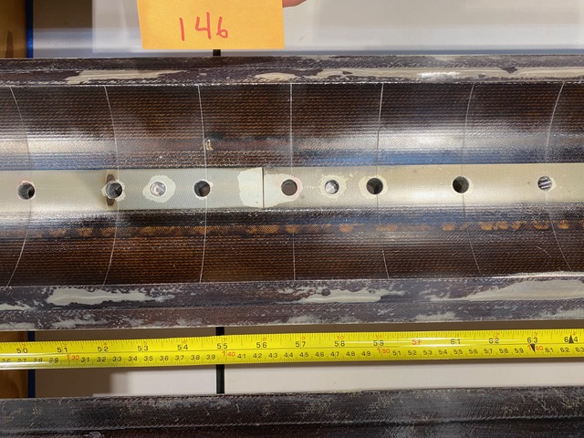
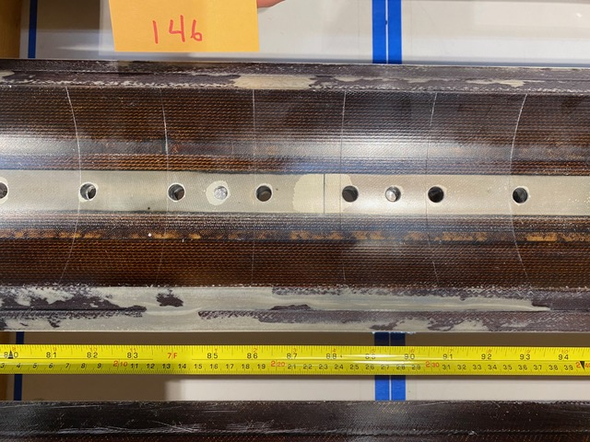
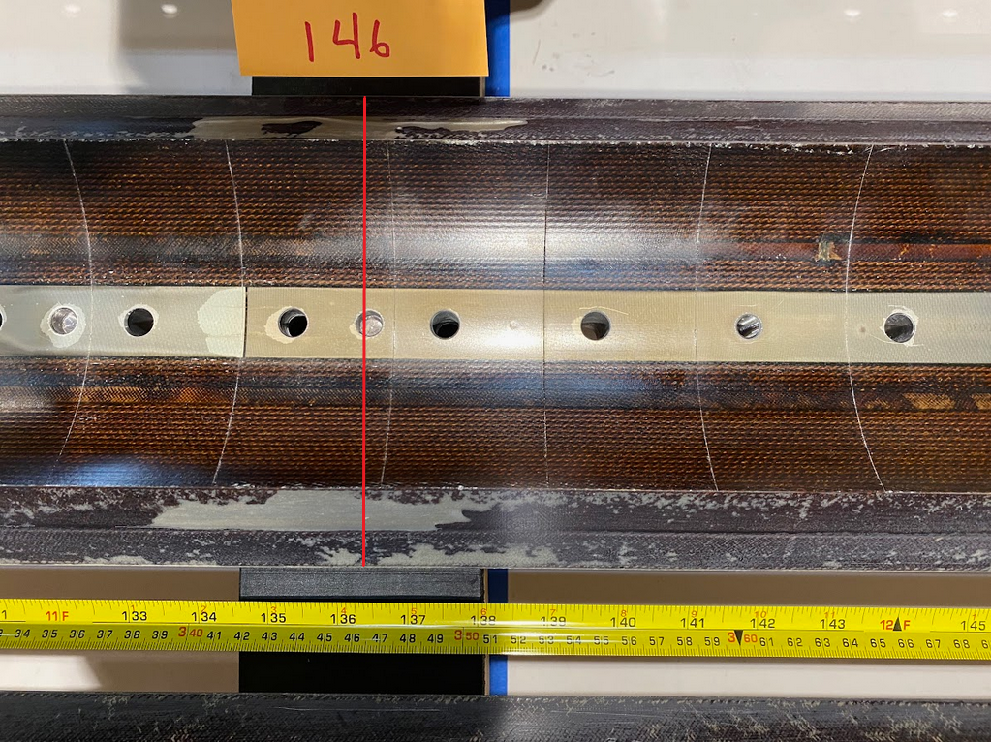
Observations
Upon incoming inspection coil 146 was found to have significant delamination along the mid-plane.
Xsec1065
Xsec1865
Xsec3065
Xsec1465
Xsec3465
Xsec2265

Slide 23
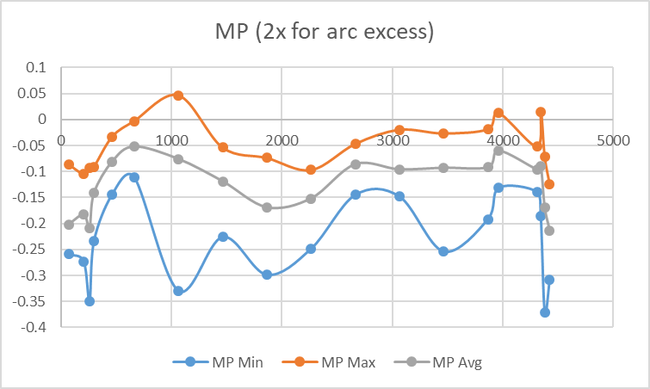
Observations
Upon incoming inspection coil 146 was found to have significant delamination along the mid-plane.

Slide 24
Arc length excess straight section

Slide 25
Arc length excess straight section

Slide 26
Arc length excess straight section
Conclusions
The difference in arc length in the straight section between coil 146, coil 146* (where 3 data have been removed) and coil 146** (where 6 data have been removed) is
From -0.195 mm (146) to -0.185 mm (146*) to -0.156 mm (146**)
5 um per mid-plane (from 146 to 146*)
15 um per mid-plane (from 146 to 146**)
So the maxim difference between the 3 mid-plane shim (per side) would be 20 um
Action items
The coils will be shimmed on the mid-plane to compensate

Slide 27
All coils

Slide 28
Arc length excess straight section

Slide 29
Arc length excess straight section

Slide 30
Arc length excess straight section
Conclusions
Coils 125, 254 with several points out of spec
Action items
The coils will be shimmed on the mid-plane to compensate

Slide 31
Outline
Data taking and processing
Impregnated coil dimensional tolerances
Results (straight section)
Arc length excess
Delta arc length excess straight section - ends
Outer radius profile deviation
Inner radial deviations (coil blocks)
Inner radial deviations (pole)
Key slot deviations
Best-fit outer radius
Appendix

Slide 32
Impregnated coil dimensional tolerances Arc length excess (ends)
At 260 and 300 mm (for the lead end) and at 4340 and 4380 mm (for the return end) the absolute value of the coil delta arc-length must not exceed 210 mm.
The coil delta arc-length is the difference between the coil arc length at each location in the ends and the average coil arc-length in the straight section.

Slide 33
Arc length excess full length

Slide 34
Arc length excess LE

Slide 35
Arc length excess RE

Slide 36
Delta between arc length excess straight section and spacer-wedge transition
Red & dark blue markers: measured at 207 mm and 4426 mm
Orange & light blue markers: measured at 260-300 mm and 4340-4380 mm

Slide 37
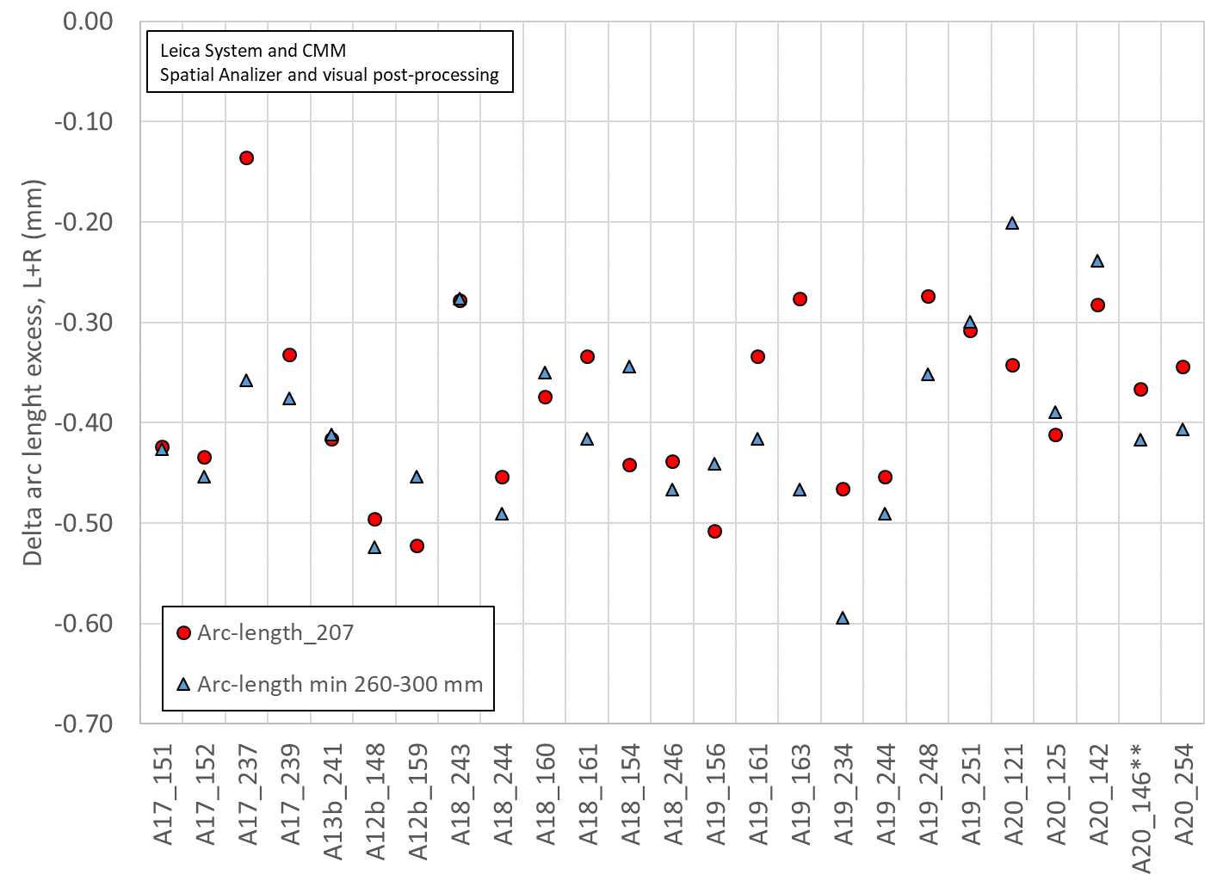
Delta between arc length excess straight section and spacer-wedge transition
The “min 260-300 mm is in average 0.035 mm smaller than the 207 mm value

Slide 38
Delta arc length excess straight section - ends
Conclusions
Coils 125, 146, 254 are out of spec
Action items
“If Delta arc-length is slightly above 210 um, disposition may be to set minimum magnet preload > 80+ MPa”
TLS will be used in the LE

Slide 39
Outline
Data taking and processing
Impregnated coil dimensional tolerances
Results (straight section)
Arc length excess
Delta arc length excess straight section - ends
Outer radius profile deviation
Inner radial deviations (coil blocks)
Inner radial deviations (pole)
Key slot deviations
Best-fit outer radius
Appendix

Slide 40
Outer radius profile deviation

Slide 41
Impregnated coil dimensional tolerances Outer radius profile deviation
The impregnated coil is accepted for use in MQXFA if its outer radius profile deviations along the straight section are within the following tolerances: +0.200/-0.250 mm
The outer radius profile deviation, which is given by the variation of each point on the outer radius with respect to the nominal outer radius, is determined by fitting outer radius and mid-planes points with the nominal profile, with equal weighting and imposing as symmetrical the two mid-planes offsets. Positive deviation indicates more material than nominal, negative indicates less material than nominal.

Slide 42
Outer radius profile deviations straight section (min-max)

Slide 43
Outer radius profile deviations straight section

Slide 44
Outer radius profile deviations straight section
Conclusions
All coils within spec
Action items
No action items

Slide 45
Outline
Data taking and processing
Impregnated coil dimensional tolerances
Results (straight section)
Arc length excess
Delta arc length excess straight section - ends
Outer radius profile deviation
Inner radial deviations (coil blocks)
Inner radial deviations (pole)
Key slot deviations
Best-fit outer radius
Appendix

Slide 46
Inner radial deviations (coil blocks)

Slide 47
Impregnated coil dimensional tolerances “Coil blocks” inner radius profile deviation
The impregnated coil is accepted for use in MQXFA if its “coil blocks” inner radius profile deviations (E-F in next slide) along the straight section are within the following tolerances: +0.150/-0.250 mm
The “coil blocks” inner radius profile deviations, which is given by the variation of each point on the inner radius with respect to the nominal radius, is determined by fitting outer radius and mid-planes points with the nominal profile, with equal weighting and imposing as symmetrical the two mid-planes offsets. Positive deviation indicates more material than nominal, negative indicates less material than nominal.

Slide 48
Coil blocks inner radial deviations straight section (min-max)

Slide 49
Coil blocks inner radial deviations straight section

Slide 50
Coil blocks inner radial deviations straight section
Conclusions
All coils in spec
Action items
No action items

Slide 51
Outline
Data taking and processing
Impregnated coil dimensional tolerances
Results (straight section)
Arc length excess
Delta arc length excess straight section - ends
Outer radius profile deviation
Inner radial deviations (coil blocks)
Inner radial deviations (pole)
Key slot deviations
Best-fit outer radius
Appendix

Slide 52
Inner radial deviations (pole)

Slide 53
Impregnated coil dimensional tolerances “Pole” inner radius profile deviation
The impregnated coil is accepted for use in MQXFA if its “pole” inner radius profile deviations (C-E and D-F in next slide) along the straight section are within the following tolerances: +0.000/-0.250 mm*
The “pole” inner radius profile deviations, which is given by the variation of each point on the inner radius with respect to the nominal radius, is determined by fitting outer radius and mid-planes points with the nominal profile, with equal weighting and imposing as symmetrical the two mid-planes offsets. Positive deviation indicates more material than nominal, negative indicates less material than nominal.

Slide 54
Pole inner radial deviations straight section (min-max)

Slide 55
Pole inner radial deviations straight section

Slide 56
Pole inner radial deviations straight section
Conclusions
Several out of spec positions, in all coils,
Coil bumper thickness to be corrected to compensate
Action items
Coil bumper thickness to be corrected to compensate

Slide 57
Outline
Data taking and processing
Impregnated coil dimensional tolerances
Results (straight section)
Arc length excess
Delta arc length excess straight section - ends
Outer radius profile deviation
Inner radial deviations (coil blocks)
Inner radial deviations (pole)
Key slot deviations
Best-fit outer radius
Appendix

Slide 58
Key slot deviations*
*View from LE, positive shift towards left

Slide 59
Impregnated coil dimensional tolerances Pole key slot mis-alignment
The impregnated coil is accepted for use in MQXFA if its pole key slot mis-alignment along the straight section are within the following tolerances: +0.250/-0.250 mm
The pole key slot mis-alignment, which is the misalignment of the center of the pole key slot with respect to the nominal position, is determined by fitting outer radius and mid-planes points with the nominal profile, with equal weighting and imposing as symmetrical the two mid-planes offsets.
View from LE, positive shift towards left

Slide 60
Key slot deviations

Slide 61
Key slot deviations

Slide 62
Key slot deviations
Conclusions
No coils out of spec
*See LBNL note and Record of Decision in Docdb-2844

Slide 63
Outline
Data taking and processing
Impregnated coil dimensional tolerances
Results (straight section)
Arc length excess
Delta arc length excess straight section - ends
Outer radius profile deviation
Inner radial deviations (coil blocks)
Inner radial deviations (pole)
Key slot deviations
Best-fit outer radius
Appendix

Slide 64
Best-fit outer radius
The best-fit outer radius is determined by best-fitting only the outer radius points.
No tolerance is specified
Used to monitor coil-to-collar contact surfaces (“LQ effect”)

Slide 65
Best-fit outer radius deviations

Slide 66
Best-fit outer radius deviations

Slide 67
Best-fit outer radius deviations
Conclusions
Data consistent with previous magnets

Slide 68
Out of specs
Arc length excess
Coils 125, 254 with several points out of spec
The coils will be shimmed on the mid-plane to compensate
Delta arc length excess straight section – ends
Coils 125, 146, 254 are out of spec
“If Delta arc-length is slightly above 210 um, disposition may be to set minimum magnet preload > 80+ MPa”
TLS will be used in the LE
Outer radius profile deviation
All coils within spec
Inner radial deviations (coil blocks)
All coils within spec
Inner radial deviations (pole)
Several out of spec positions, in all coils,
Coil bumper thickness to be corrected to compensate
Key slot deviations
All coils within spec
Best-fit outer radius deviations
Data consistent with previous magnets

Slide 69
Outline
Data taking and processing
Impregnated coil dimensional tolerances
Results (straight section)
Arc length excess
Delta arc length excess straight section - ends
Outer radius profile deviation
Inner radial deviations (coil blocks)
Inner radial deviations (pole)
Key slot deviations
Best-fit outer radius
Appendix

Slide 70
Appendix

Slide 71
142 pre and post loading

Slide 72
142 pre and post loading

Slide 73
142 pre and post loading
Conclusions
The difference in arc length in the straight section between coil 142_pre-loading and coil 142_post- loading is
From -0.238 (142_pre-loading) to -0.094 (142_post-loading)

Slide 74
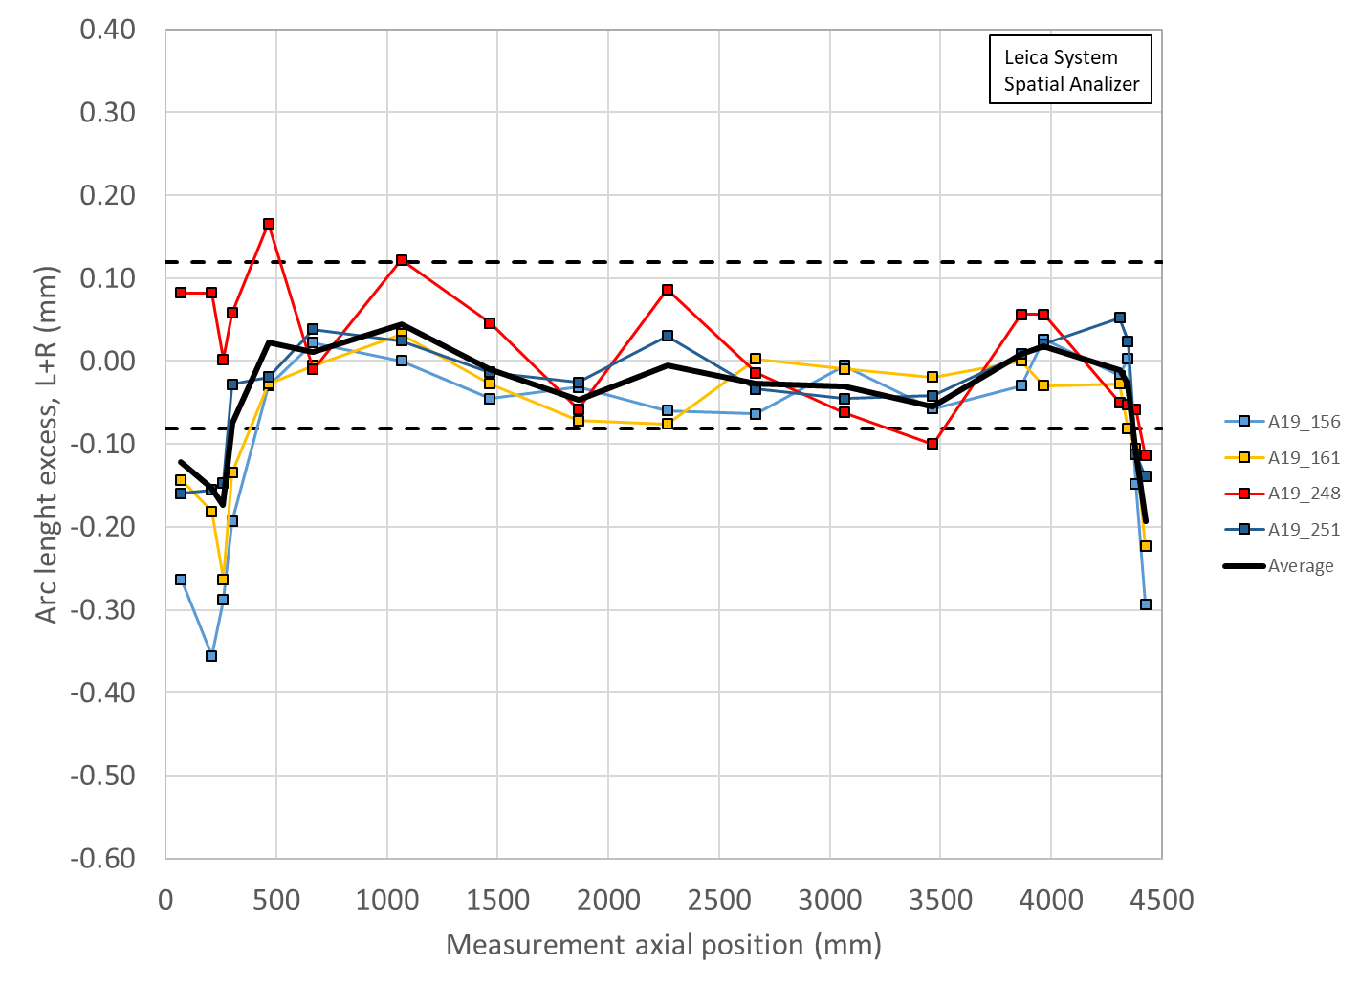
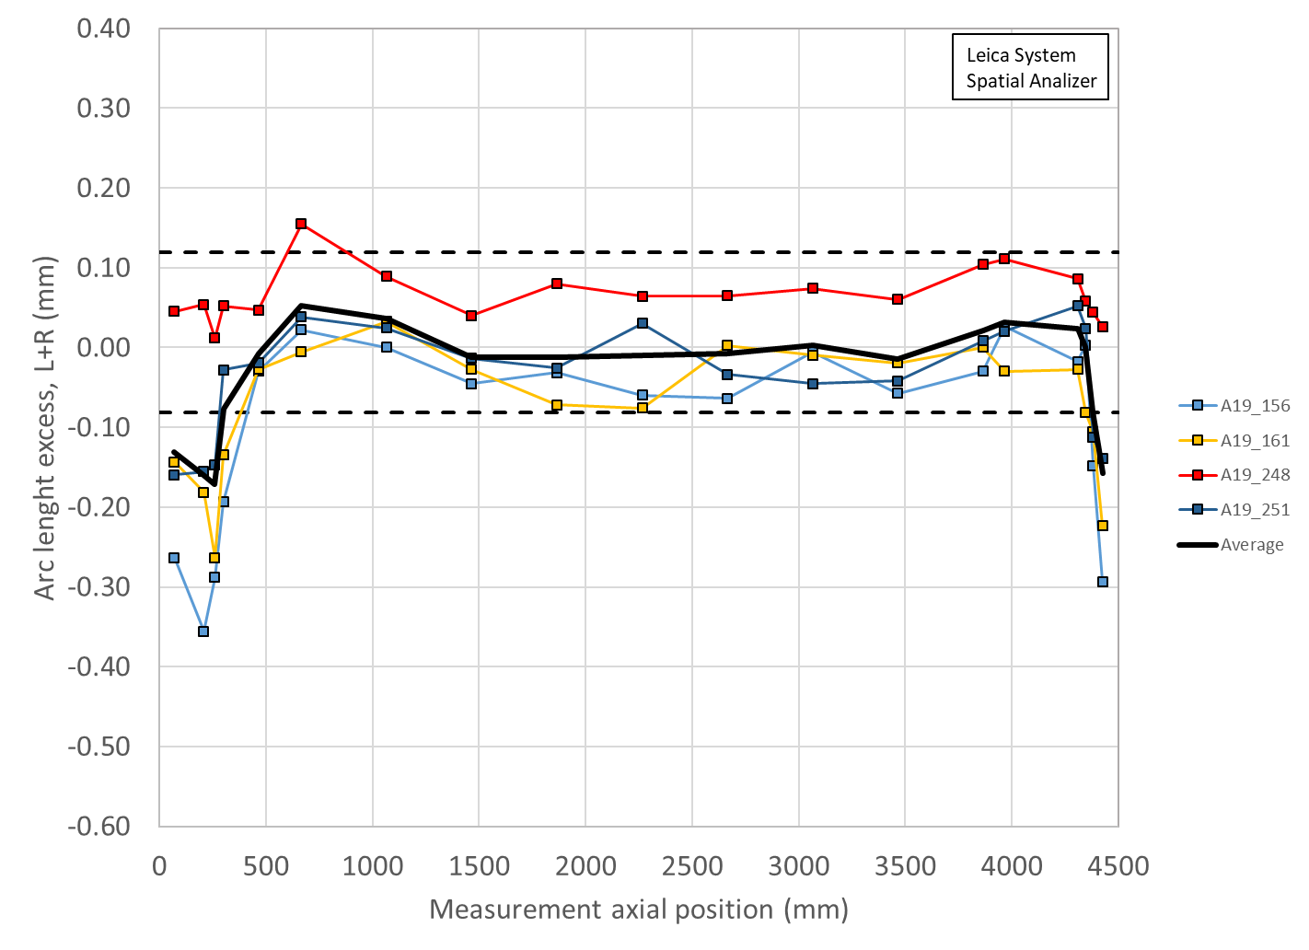
248 Operator I vs II (old tip)
Ave ss: -0.007 mm
Delta LE: -0.168 mm
Ave ss: +0.009 mm
Delta LE: -0.180 mm

Slide 75
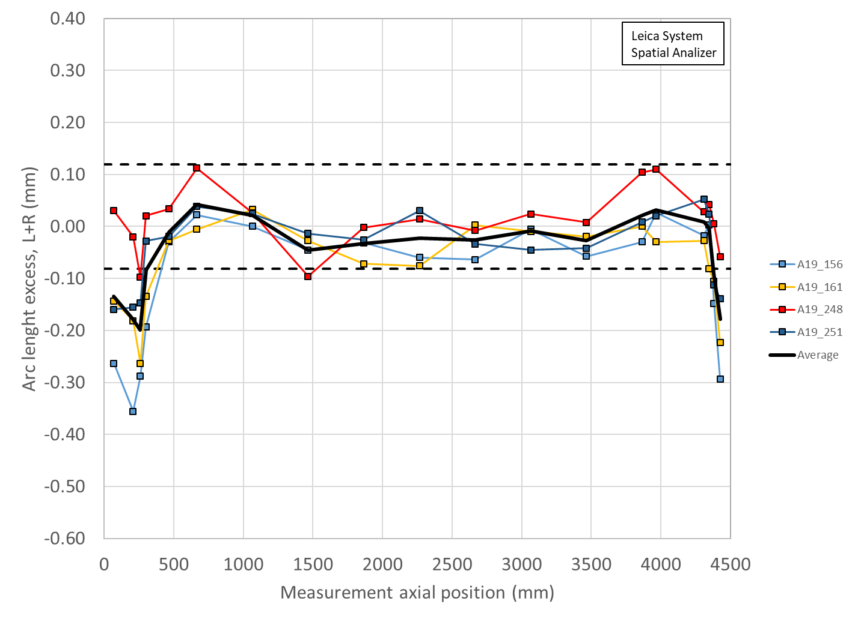
248 Operator I vs II (new tip)
Ave ss: -0.007 mm
Delta LE: -0.168 mm
Ave ss: -0.004 mm
Delta LE: -0.195 mm

Slide 76
244 vs 248 I vs 248 II (old) vs 248 II (new)
Average ss after mid-plane shimming:
-0004 vs -0.007 vs +0.009 vs -0.007 um
Average delta LE-ss after mid-plane shimming: -0.230 vs -0.168 vs -0.180 vs -0.195 um

Slide 77
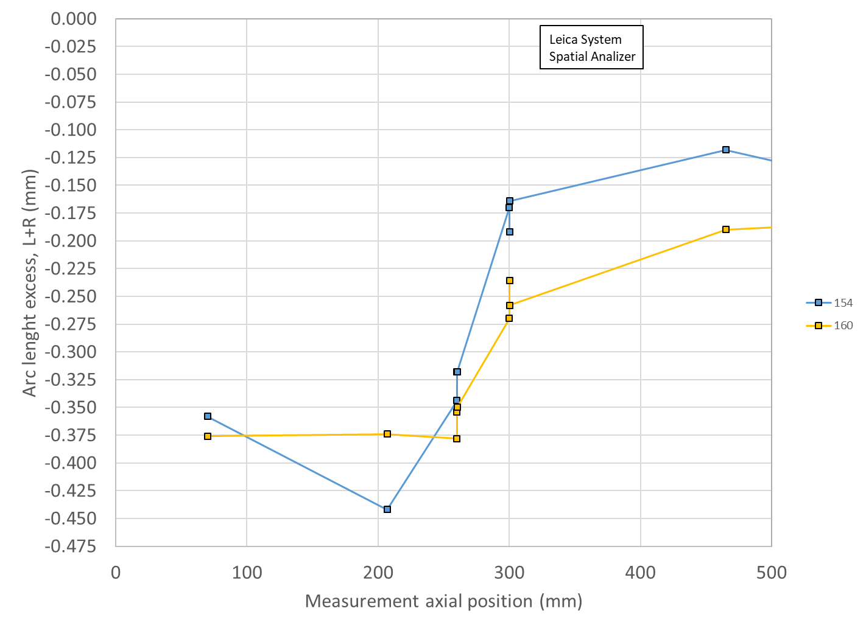
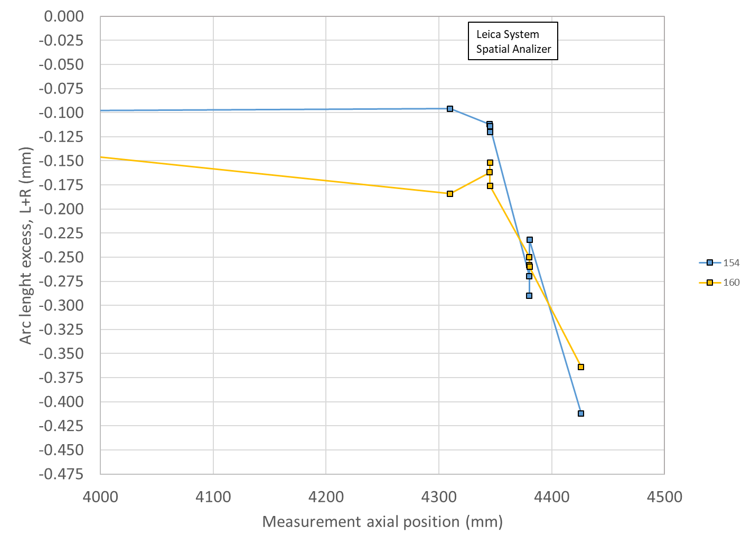
Measurements repeated 3 times

Slide 78
Comparison FNAL-LBNL

Slide 79
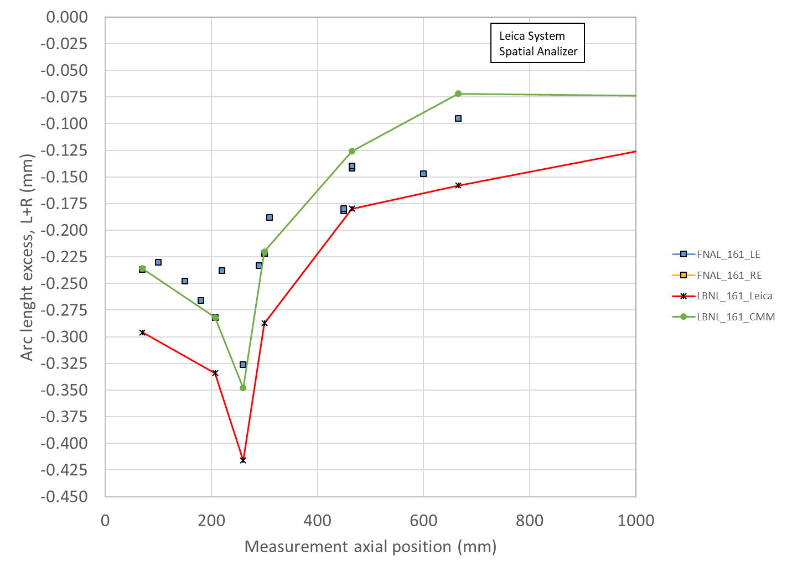
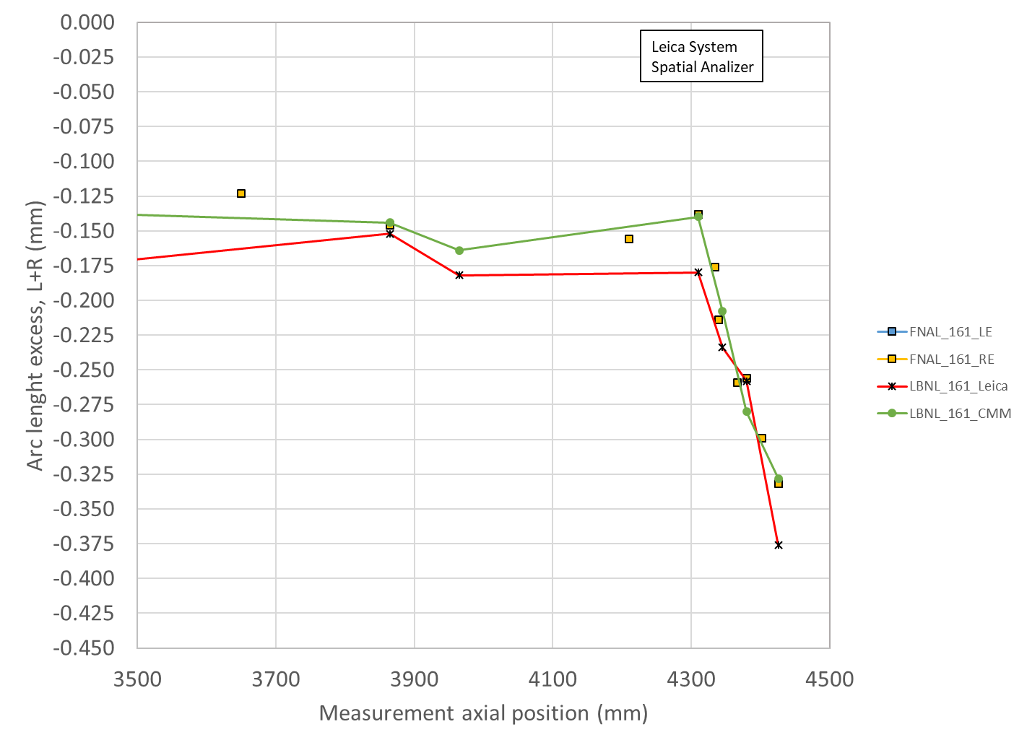
Comparison FNAL-LBNL

