Slide 1


Coil ordering in MQXFA20 based on conductor properties
Maria Baldini, Vittorio Marinozzi

Slide 2
MQXFA20 cables: RRR estimations
Maximum coil to ground voltage at quench with ordering: 353 V (EDMS 1963398, Us-HiLumi Docdb 879)
COIL | CABLE
121 | P43OL1125
125 | P43OL1125
142 | P43OL1172
146 | P43OL1180
254 | P43OL1219
Rolled and minor edge extracted samples used to estimate RRR of the coil
Each cable: 40 strands in parallels coming from several spools
Spools come from different billets.
There is one rolled sample value per billet.
If the Cu/NCu value of the spool used for the cable is not present, the Cu/NCu of a particular spool is estimated averaging data from spools belonging to the same billet.
A weighted mean (weight= # of strands) is used to estimate cable RRR rolled samples and Cu/NCu values.
Minor and Major edge extracted samples are collected only from the most represented billets. Values are averaged
Witness sample RRR are also collected on representative billets. Data are not measured anymore starting from cable 1134

Slide 3
MQXFA20 coils
COIL | RRR rolled | RRR minor edge | RRR major edge
121 | 247.05 | 305.2 | 336.6
125 | 294.9 | 315.2 | 358.4
142 | 198.2 | 241.4 | 313.6
146 | 186.15 | 251.2 | 232.4
254 | 190.35 | 226.6 | 260.8
COIL | Cu/nCu
121 | 1.147
125 | 1.161
142 | 1.166
146 | 1.183
254 | 1.211

Slide 4
RRR estimate values

Slide 5
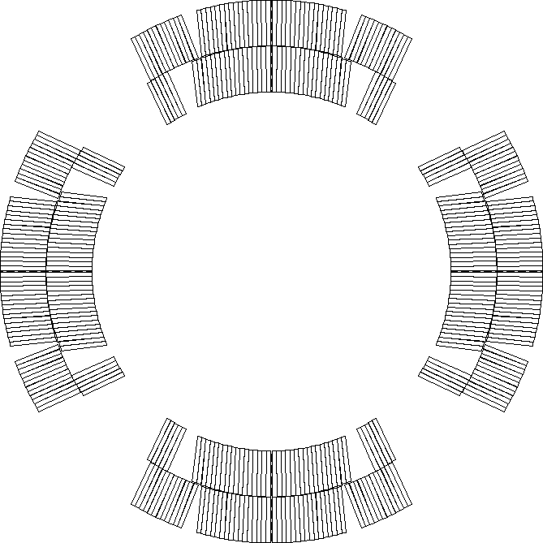
Peak voltages assumptions
Current: 16470
  Old nominal, since electrical design criteria are based on old nominal current
Nominal protection (CLIQ 600 V - 40 mF, OL QH 300 V – 7.05 mF)
Coils are reported in mechanical ordering
Peak voltages have been computed using rolled and minor edge RRR values. All coil orderings resulting in peak voltage to ground less than 353 V with both assumptions and for all failure cases have been identified
Peak voltages computed using STEAM-LEDET app provided by CERN
  All combinations of coils are considered
    (121 125 142 146 254)
  For each combination, nominal scenario plus 3 failure scenarios are considered
P2
P1
P3
P4
Notes:
Need to be u

Slide 6
Acceptable coil ordering
Coils are reported in mechanical order
There are 35 acceptable coil orderings with voltage < 353 V that are common for both rolled and minor edge RRR values (values reported for rolled RRR)
P1 | P2 | P3 | P4 | Volt
146 | 142 | 254 | 125 | 328
146 | 142 | 254 | 121 | 330
146 | 142 | 121 | 254 | 330
142 | 146 | 254 | 125 | 330
142 | 146 | 254 | 121 | 332
142 | 146 | 121 | 254 | 332
254 | 146 | 121 | 142 | 333
254 | 142 | 121 | 146 | 333
146 | 142 | 121 | 125 | 335
146 | 121 | 254 | 125 | 335
142 | 121 | 254 | 125 | 335
254 | 146 | 125 | 121 | 336
142 | 146 | 121 | 125 | 336
254 | 142 | 125 | 121 | 337
121 | 146 | 254 | 125 | 338
121 | 146 | 125 | 254 | 338
121 | 142 | 254 | 125 | 338
121 | 142 | 125 | 254 | 338
P1 | P2 | P3 | P4 | Volt
121 | 146 | 254 | 142 | 340
121 | 146 | 125 | 142 | 340
121 | 142 | 254 | 146 | 340
121 | 142 | 125 | 146 | 340
254 | 142 | 125 | 146 | 341
254 | 146 | 125 | 142 | 342
146 | 254 | 121 | 125 | 342
142 | 254 | 121 | 125 | 343
254 | 146 | 121 | 125 | 344
254 | 142 | 121 | 125 | 344
142 | 121 | 146 | 254 | 346
254 | 121 | 146 | 142 | 347
142 | 254 | 146 | 121 | 348
254 | 142 | 146 | 121 | 349
121 | 254 | 146 | 142 | 349
121 | 142 | 146 | 254 | 349
142 | 121 | 254 | 146 | 353

Slide 7
Backup slides

Slide 8
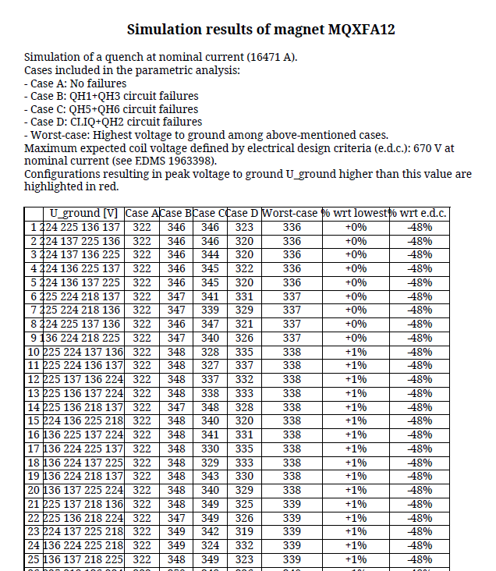
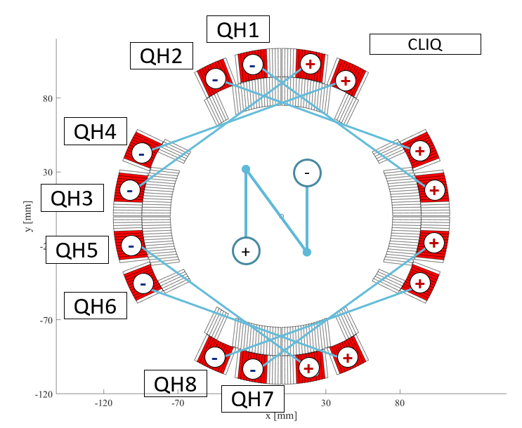
Peak voltages report
Old value, since design criteria are based on old nominal current

