Slide 1


MQXFA20
AUP 302.2.02 and 302.2.03 –
• Strand Procurement & Testing
• Cable Fabrication & Testing
Lance Cooley – NHMFL/ASC (302.2.02 L3)
Vito Lombardo – FNAL (302.2.02 CAM)
Ian Pong – LBNL (302.2.03 L3 & CAM)
Mike Naus – LBNL (302.2.03 L3 Deputy & CAM Deputy)
Elizabeth Lee – LBNL, Manufacturing Engineer (now at LBNL ALS)
Jonathan Lee – LBNL Intern Student (now Grad Student at NHMFL)

Slide 2
Cable & Coil Overview
Coil # | Cable #
121 | P43OL1125
125 | P43OL1121
142 | P43OL1172
146 | P43OL1180
254 | P43OL1219
Previously approved (MQXFA14)
Not reviewed here
All cables are 2nd generation QXF cables produced under AUP

Slide 3
Cable QC Summary
All cables passed the required quality control testing per US-HiLumi-Doc 74
There were No Critical DRs

Slide 4

Cable 1125 (Coil 121)
DR Detail: 0 DRs

Slide 5
Cable 1121 (Coil 125)
DR Detail: 0 DRs

Slide 6
Cable 1180 (Coil 146)
DR Detail: 5 DRs

Slide 7
QXFA-146 / P43OL1180: I_{c} Measurement
DR #12612 (1 of 5)
Issue: One of three strands was unable to be measured for I_{c}, requiring measurement of back-up strand
Cause: Believed to be sample handling damage, per FNAL
Acceptance Justification:
  Backup sample successfully measured with passing results

Slide 8
QXFA-146 / P43OL1180: RRR Heat Treat
DR #12605 (2 of 5)
Issue:
Temperature range along sample length during 200°C HT plateau > 2°C.
210°C Plateau: Range = 2.2 °C
400°C Plateau: Range = 0.8 °C ← ok
665°C Plateau: Range = 1.7 °C ← ok
Cause: Possible measurement error due to TC calibration temperatures
  220°C too far outside the calibrated range (400C & 665C)
Acceptance Justification:
Quartz-encapsulated witness wire RRR within normal range
Average temperatures were on target: 209.5°C
210°C plateau is the least impactful to RRR

Slide 9
QXFA-146 / P43OL1180: Insulation Stains
DR #12621 (3 of 5)
Issue: Oil staining at 47th and 79th meter from blue/red (tail) end
Cause: Believed to be caused by braiding vendor
Disposition: Accept. Notified coiling for repair, if warranted.

Slide 10
QXFA-146 / P43OL1180: Excess 4BR Lubricant
DR #12564 (4 of 5)
Issue: Excess residual cable fabrication lubricant (4BR) in cable after cabling. Potential handling issue.
Cause: Lubricant intentionally increased in an effort to mitigate facet divergence issue.
Excess lubricant dripping from underside of wound spool of cable
Acceptance Justification:
  4BR is considered a “vanishing lubricant” with high volatility
  Not known to cause any mechanical instability

Slide 11
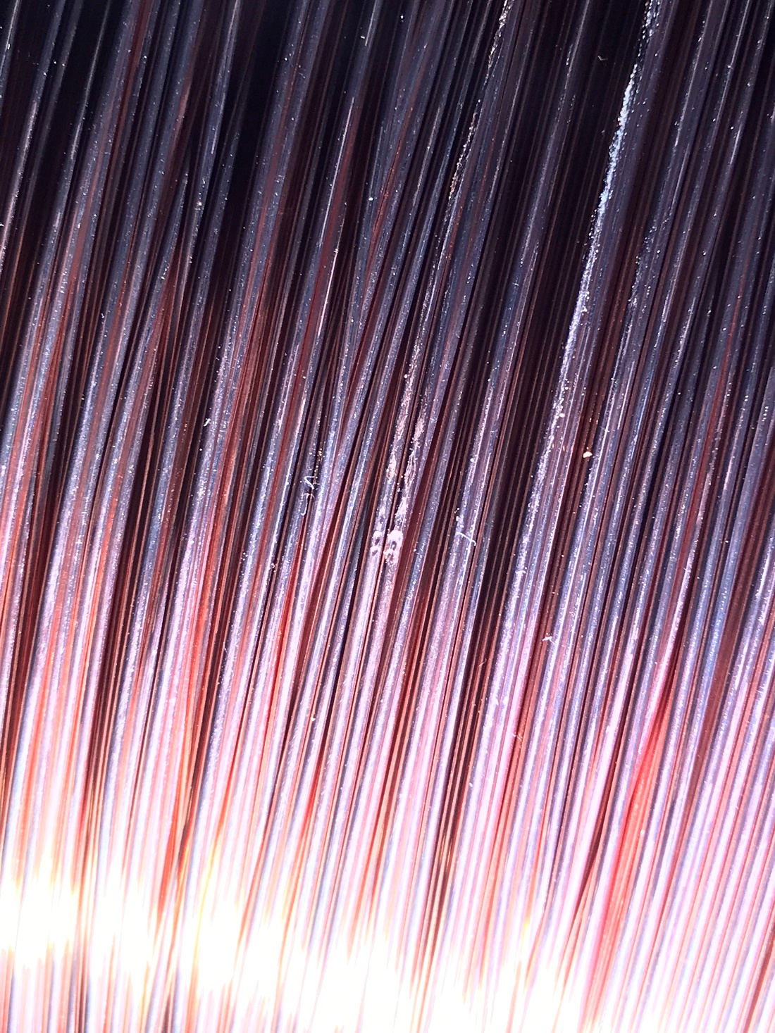
QXFA-146 / P43OL1180: Wire Damage
DR #12648 (5 of 5)
Issue: Round wire on spool damaged prior to cable winding
Cause: Spool bumped by wheeled steel frame moving through the area
Acceptance Justification:
  Spool unwound until damaged section could be removed & scrapped
  Remainder of wire used for cabling
  Corrective Action: Spools kept covered with cushioning wrap (e.g., bubble wrap)

Slide 12
Cable 1219 (Coil 254)
DR Detail: 2 DRs

Slide 13
QXFA-254 / P43OL1219: Wire Diameter OOS
DR #13179 (1 of 2)
Issue: For the 3 spools from Billet #00716:
>25% of wire diameters OOS high (Threshold #1)
>1% of wire diameters OOS high by > 1 µm (Threshold #2)
Spec: 0.847 mm ≤ d ≤ 0.853 mm
Cause: Unknown.
    Vendor data looked acceptable.
    LBNL micrometer passed gauge checks.
Disposition: Use as-is. Based on L3 & technical staff discussion
Cable passed all subsequent mechanical & electrical checks

Slide 14
QXFA-254 / P43OL1219: Wire Diameter OOS
DR #13180 (2 of 2)
Issue: For the 2 spools from Billet #00726:
>25% of wire diameters OOS high (Threshold #1)
>1% of wire diameters OOS high by > 1 µm (Threshold #2)
Spec: 0.847 mm ≤ d ≤ 0.853 mm
Cause: Unknown.
    Vendor data looked acceptable.
    LBNL micrometer passed gauge checks.
Disposition: Use as-is. Based on L3 & technical staff discussion
Cable passed all subsequent mechanical & electrical checks

Slide 15
END
[Back-Up Slides Below]

Slide 16
Cable 1172 (Coil 142)
DR Detail: 7 DRs

Slide 17
QXFA-142 / P43OL1172: I_{c} Measurement
DR #12513 (1 of 7)
Issue: One of three strands was unable to be measured for I_{c}, requiring measurement of back-up strand
Cause: Believed to be sample handling damage, per FNAL
Acceptance Justification:
  Backup sample successfully measured with passing results

Slide 18
QXFA-142 / P43OL1147: RRR Heat Treat
DR #12512 (2 of 7)
Issue: Temperature range along sample length during HT plateaus >2°C
210°C Plateau: Range = 3.4 °C
400°C Plateau: Range = 1.1 °C ← ok
665°C Plateau: Range = 2.9 °C
Cause: Non-optimal furnace temperature setpoints
Acceptance Justification:
Quartz-encapsulated witness wire RRR within normal range
    Temperatures were within historical norms
    Average temperatures were on target
  210C Plateau: Average = 210.7 °C
  400C Plateau: Average = 399.6 °C
  665C Plateau: Average = 664.9 °C

Slide 19
QXFA-142 / P43OL1172: Insulation Verification OOS
DR #12502 (3 of 7)
Issue: Insulation thickness on LBNL verification above USL by 4 µm
0.154 mm (LBNL) versus 0.148 mm (NEWT)
0.140 mm ≤ t ≤ 0.150 mm
Cause: Vendor measurement error due to measurement drift
  NEWT equipment sent to annual calibration after this run
  This issue was seen in all cables in this shipment
Decision: Accept as-is.
  OOS by small amount on high/conservative side
  Cable was slightly thinner than target (1.524 mm), which partially compensates
  Subsequent measurement on ‘cable drop’ section was in-spec

Slide 20
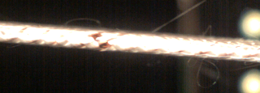
QXFA-142 / P43OL1172: Insulation
DR #12503 (4 of 7)
Issue: Bare spot at cable edge at 369th meter
Cause: Braiding operator error during bobbin changeover
Decision Justification: Accept. Notified coiling for repair, if warranted.

Slide 21
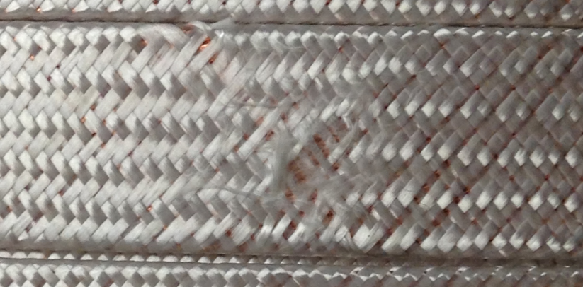
QXFA-142 / P43OL1172: Insulation
DR #12504 (5 of 7)
Issue: Braid surface is frayed at 70th meter from blue-green end
Cause: Bobbin failure on braiding machine
Acceptance Justification: Accept. Notified coiling for repair, if warranted.

Slide 22
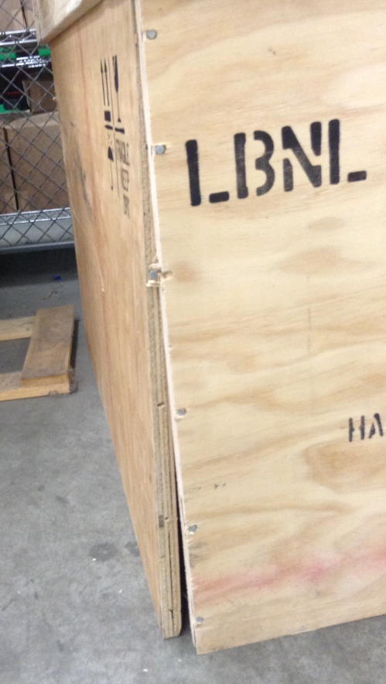
QXFA-142 / P43OL1172: Insulation
DR #12501 (6 of 7)
Issue: Shipping crate damaged upon arrival at braiding vendor
Cause: Suspected inappropriate handling by shipping vendor
Acceptance Justification:
No damage to cables inside

Slide 23
QXFA-142 / P43OL1172: Cable Archive Length
DR #12477 (7 of 7)
Issue: Cable shorter than nominal. Required ‘cable drops’ from coiling to meet 3 m minimum length for archive.
Cause: Extra length needed at cable start-up to dial-in the process
Acceptance Justification: Accept. No quality issues with cable itself.

Slide 24
Strand Summary
All strands ordered per the “HiLumi” specification under the AUP program, per the following POs:
  FNAL 646116 Shipment A and B
  FNAL 655175 Shipment C and D
  FNAL 667037 Shipment A and B1
  FNAL 683525 Shipment B
Conductor Description:
  Ø0.85 mm, 108/127 stack, Ti-doped, Reduced-Sn core

Slide 25
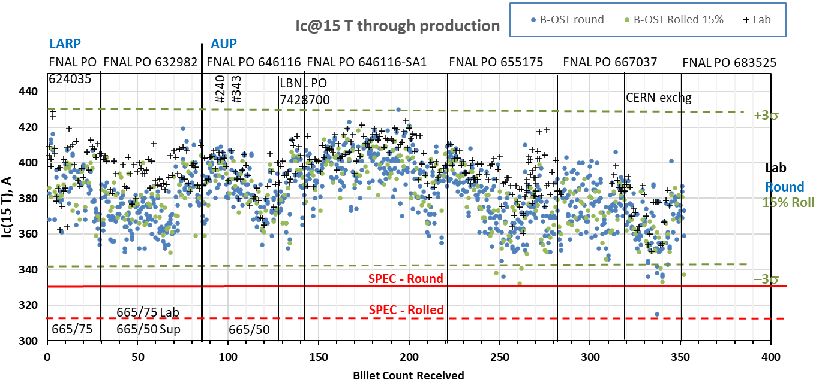
Strand Production Data – I_{c, 15T}
Yellow bands indicate strand data for these cables
Both 665°C/75h
S: 665°C/50h
V: 665°/75h
Both 665°C/50h

Slide 26
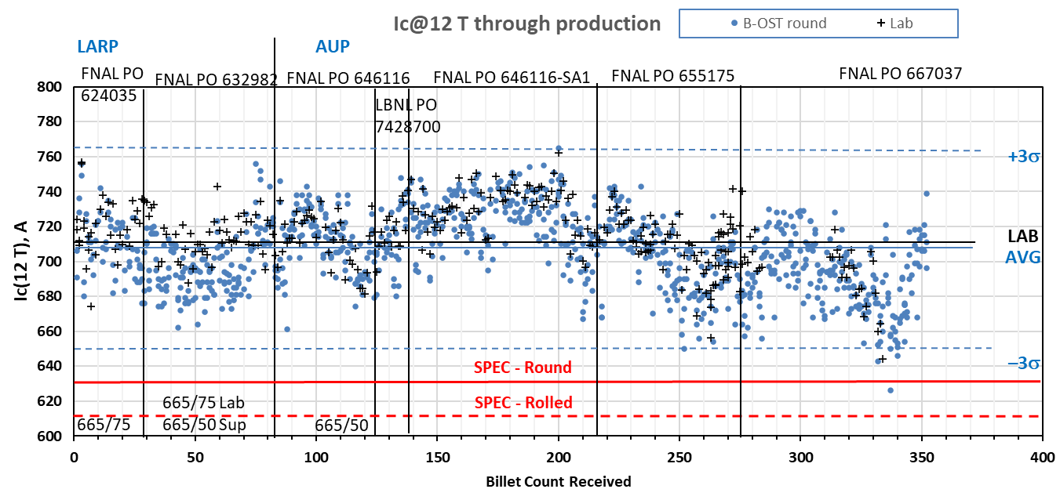
Strand Production Data – I_{c, 12T}
Yellow bands indicate strand data for these cables
Both 665°C/50h
Both 665°C/75h
S: 665°C/50h
V: 665°/75h

Slide 27
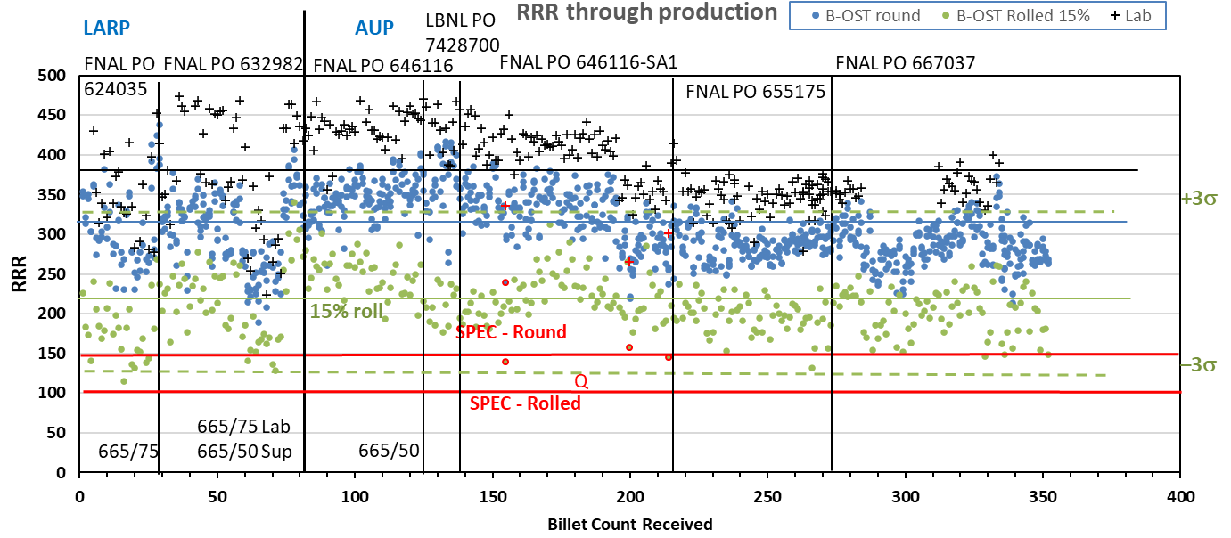
Strand Production Data - RRR
Data for 15% rolled strand predicts the RRR at cable sharp bend
Lab: IEC method, Supplier: 20K method
Inter-lab comparisons have validated approaches (see QP)
Yellow bands indicate strand data for these cables

