Slide 1


MQXFA20
AUP 302.2.02 and 302.2.03 –
• Strand Procurement & Testing
• Cable Fabrication & Testing
Lance Cooley – NHMFL/ASC (302.2.02 L3)
Vito Lombardo – FNAL (302.2.02 CAM)
Ian Pong – LBNL (302.2.03 L3 & CAM)
Mike Naus – LBNL (302.2.03 L3 Deputy & CAM Deputy)
Elizabeth Lee – LBNL, Manufacturing Engineer (now at LBNL ALS)
Jonathan Lee – LBNL Intern Student (now Grad Student at NHMFL)

Slide 2
Cable & Coil Overview
Coil # | Cable #
121 | P43OL1125
125 | P43OL1121
142 | P43OL1172
146 | P43OL1180
254 | P43OL1219
Previously approved (MQXFA14)
Not reviewed here
All cables are 2nd generation QXF cables produced under AUP

Slide 3
Cable QC Summary
All cables passed the required quality control testing per US-HiLumi-Doc 74
There were No Critical DRs

Slide 4

Cable 1125 (Coil 121)
DR Detail: 0 DRs

Slide 5
Cable 1121 (Coil 125)
DR Detail: 0 DRs

Slide 6
Cable 1180 (Coil 146)
DR Detail: 5 DRs

Slide 7
QXFA-146 / P43OL1180: I_{c} Measurement
DR #12612 (1 of 5)
Issue: One of three strands was unable to be measured for I_{c}, requiring measurement of back-up strand
Cause: Believed to be sample handling damage, per FNAL
Acceptance Justification:
  Backup sample successfully measured with passing results

Slide 8
QXFA-146 / P43OL1180: RRR Heat Treat
DR #12605 (2 of 5)
Issue:
Temperature range along sample length during 200°C HT plateau > 2°C.
210°C Plateau: Range = 2.2 °C
400°C Plateau: Range = 0.8 °C ← ok
665°C Plateau: Range = 1.7 °C ← ok
Cause: Possible measurement error due to TC calibration temperatures
  220°C too far outside the calibrated range (400C & 665C)
Acceptance Justification:
Quartz-encapsulated witness wire RRR within normal range
Average temperatures were on target: 209.5°C
210°C plateau is the least impactful to RRR

Slide 9
QXFA-146 / P43OL1180: Insulation Stains
DR #12621 (3 of 5)
Issue: Oil staining at 47th and 79th meter from blue/red (tail) end
Cause: Believed to be caused by braiding vendor
Disposition: Accept. Notified coiling for repair, if warranted.

Slide 10
QXFA-146 / P43OL1180: Excess 4BR Lubricant
DR #12564 (4 of 5)
Issue: Excess residual cable fabrication lubricant (4BR) in cable after cabling. Potential handling issue.
Cause: Lubricant intentionally increased in an effort to mitigate facet divergence issue.
Excess lubricant dripping from underside of wound spool of cable
Acceptance Justification:
  4BR is considered a “vanishing lubricant” with high volatility
  Not known to cause any mechanical instability

Slide 11
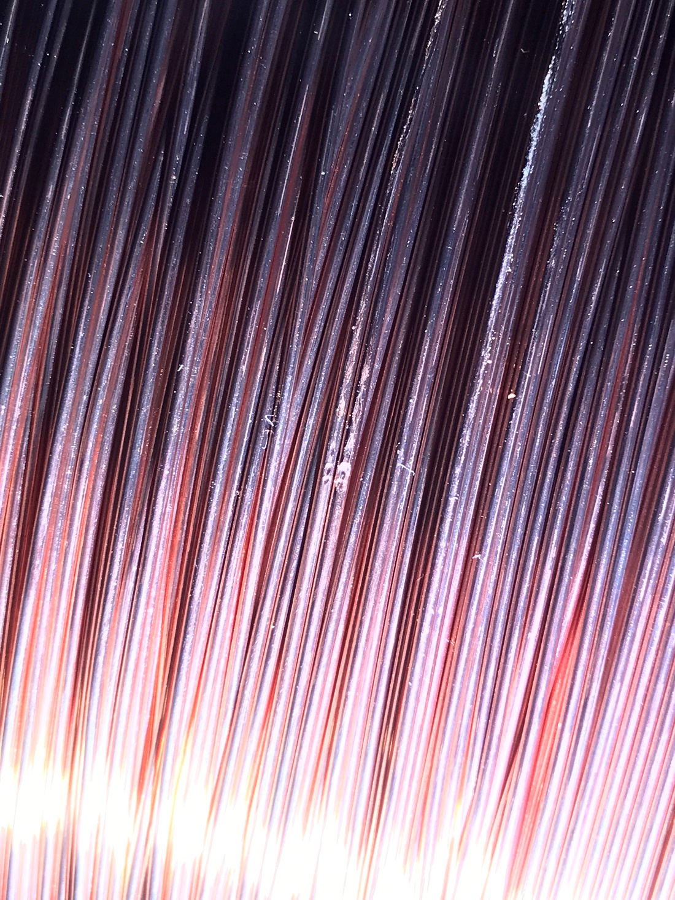
QXFA-146 / P43OL1180: Wire Damage
DR #12648 (5 of 5)
Issue: Round wire on spool damaged prior to cable winding
Cause: Spool bumped by wheeled steel frame moving through the area
Acceptance Justification:
  Spool unwound until damaged section could be removed & scrapped
  Remainder of wire used for cabling
  Corrective Action: Spools kept covered with cushioning wrap (e.g., bubble wrap)

Slide 12
Cable 1219 (Coil 254)
DR Detail: 2 DRs

Slide 13
QXFA-254 / P43OL1219: Wire Diameter OOS
DR #13179 (1 of 2)
Issue: For the 3 spools from Billet #00716:
>25% of wire diameters OOS high (Threshold #1)
>1% of wire diameters OOS high by > 1 µm (Threshold #2)
Spec: 0.847 mm ≤ d ≤ 0.853 mm
Cause: Unknown.
    Vendor data looked acceptable.
    LBNL micrometer passed gauge checks.
Disposition: Use as-is. Based on L3 & technical staff discussion
Cable passed all subsequent mechanical & electrical checks

Slide 14
QXFA-254 / P43OL1219: Wire Diameter OOS
DR #13180 (2 of 2)
Issue: For the 2 spools from Billet #00726:
>25% of wire diameters OOS high (Threshold #1)
>1% of wire diameters OOS high by > 1 µm (Threshold #2)
Spec: 0.847 mm ≤ d ≤ 0.853 mm
Cause: Unknown.
    Vendor data looked acceptable.
    LBNL micrometer passed gauge checks.
Disposition: Use as-is. Based on L3 & technical staff discussion
Cable passed all subsequent mechanical & electrical checks

Slide 15
END
[Back-Up Slides Below]

Slide 16
Cable 1172 (Coil 142)
DR Detail: 7 DRs

Slide 17
QXFA-142 / P43OL1172: I_{c} Measurement
DR #12513 (1 of 7)
Issue: One of three strands was unable to be measured for I_{c}, requiring measurement of back-up strand
Cause: Believed to be sample handling damage, per FNAL
Acceptance Justification:
  Backup sample successfully measured with passing results

Slide 18
QXFA-142 / P43OL1147: RRR Heat Treat
DR #12512 (2 of 7)
Issue: Temperature range along sample length during HT plateaus >2°C
210°C Plateau: Range = 3.4 °C
400°C Plateau: Range = 1.1 °C ← ok
665°C Plateau: Range = 2.9 °C
Cause: Non-optimal furnace temperature setpoints
Acceptance Justification:
Quartz-encapsulated witness wire RRR within normal range
    Temperatures were within historical norms
    Average temperatures were on target
  210C Plateau: Average = 210.7 °C
  400C Plateau: Average = 399.6 °C
  665C Plateau: Average = 664.9 °C

Slide 19
QXFA-142 / P43OL1172: Insulation Verification OOS
DR #12502 (3 of 7)
Issue: Insulation thickness on LBNL verification above USL by 4 µm
0.154 mm (LBNL) versus 0.148 mm (NEWT)
0.140 mm ≤ t ≤ 0.150 mm
Cause: Vendor measurement error due to measurement drift
  NEWT equipment sent to annual calibration after this run
  This issue was seen in all cables in this shipment
Decision: Accept as-is.
  OOS by small amount on high/conservative side
  Cable was slightly thinner than target (1.524 mm), which partially compensates
  Subsequent measurement on ‘cable drop’ section was in-spec

Slide 20
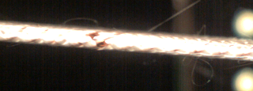
QXFA-142 / P43OL1172: Insulation
DR #12503 (4 of 7)
Issue: Bare spot at cable edge at 369th meter
Cause: Braiding operator error during bobbin changeover
Decision Justification: Accept. Notified coiling for repair, if warranted.

Slide 21
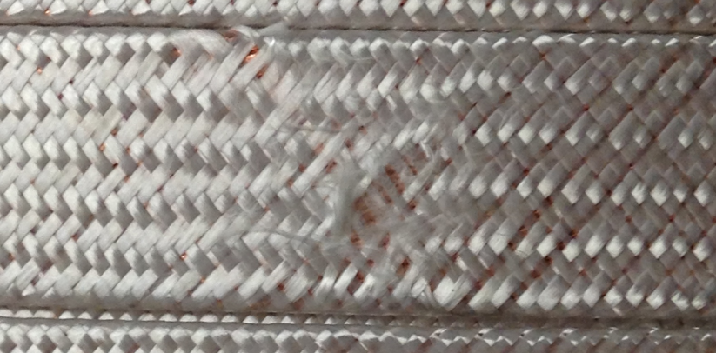
QXFA-142 / P43OL1172: Insulation
DR #12504 (5 of 7)
Issue: Braid surface is frayed at 70th meter from blue-green end
Cause: Bobbin failure on braiding machine
Acceptance Justification: Accept. Notified coiling for repair, if warranted.

Slide 22
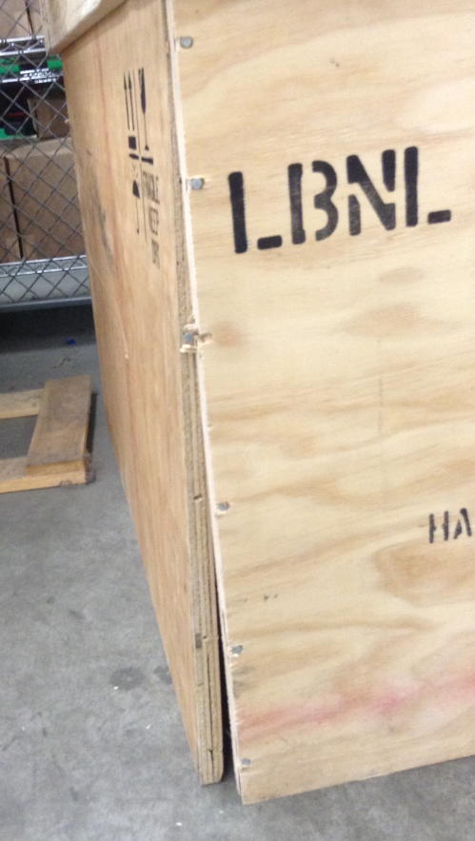
QXFA-142 / P43OL1172: Insulation
DR #12501 (6 of 7)
Issue: Shipping crate damaged upon arrival at braiding vendor
Cause: Suspected inappropriate handling by shipping vendor
Acceptance Justification:
No damage to cables inside

Slide 23
QXFA-142 / P43OL1172: Cable Archive Length
DR #12477 (7 of 7)
Issue: Cable shorter than nominal. Required ‘cable drops’ from coiling to meet 3 m minimum length for archive.
Cause: Extra length needed at cable start-up to dial-in the process
Acceptance Justification: Accept. No quality issues with cable itself.

Slide 24
Strand Summary
All strands ordered per the “HiLumi” specification under the AUP program, per the following POs:
  FNAL 646116 Shipment A and B
  FNAL 655175 Shipment C and D
  FNAL 667037 Shipment A and B1
  FNAL 683525 Shipment B
Conductor Description:
  Ø0.85 mm, 108/127 stack, Ti-doped, Reduced-Sn core

Slide 25
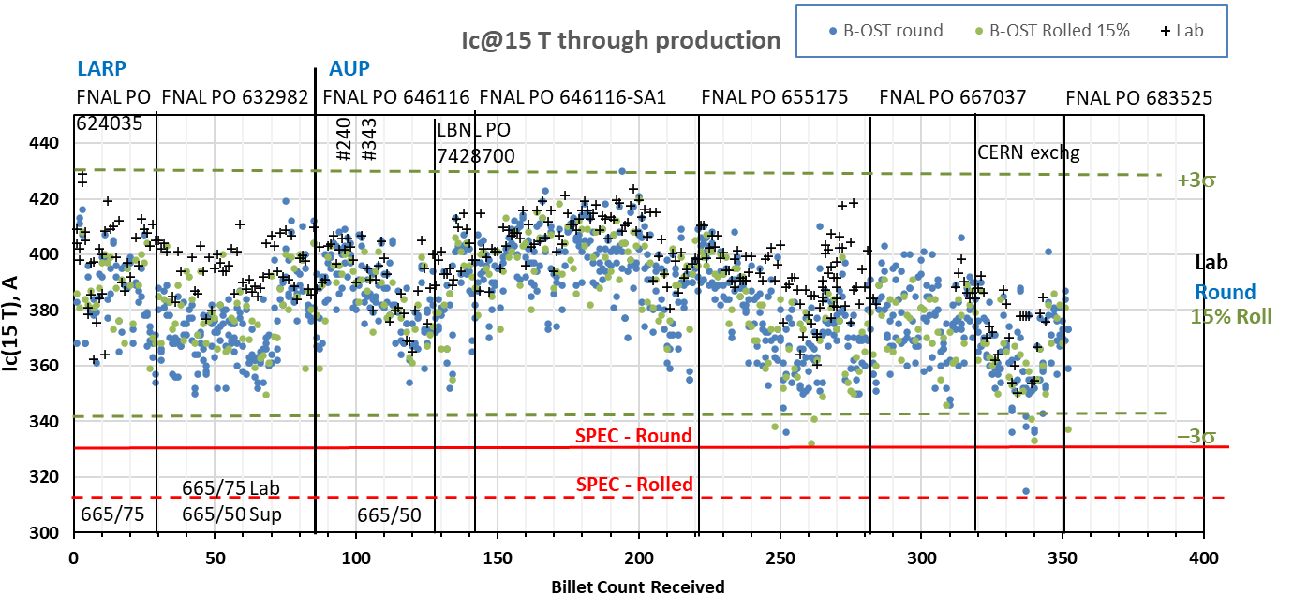
Strand Production Data – I_{c, 15T}
Yellow bands indicate strand data for these cables
Both 665°C/75h
S: 665°C/50h
V: 665°/75h
Both 665°C/50h

Slide 26
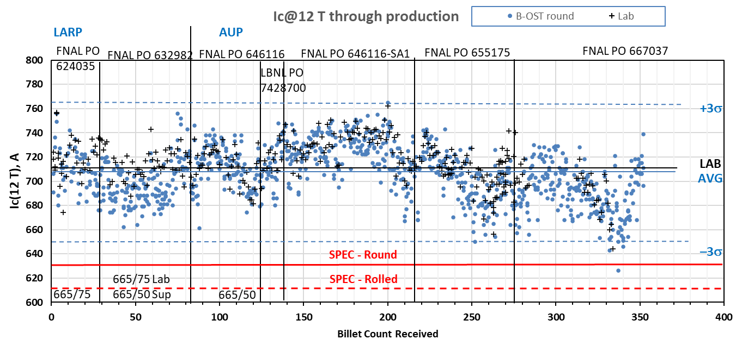
Strand Production Data – I_{c, 12T}
Yellow bands indicate strand data for these cables
Both 665°C/50h
Both 665°C/75h
S: 665°C/50h
V: 665°/75h

Slide 27
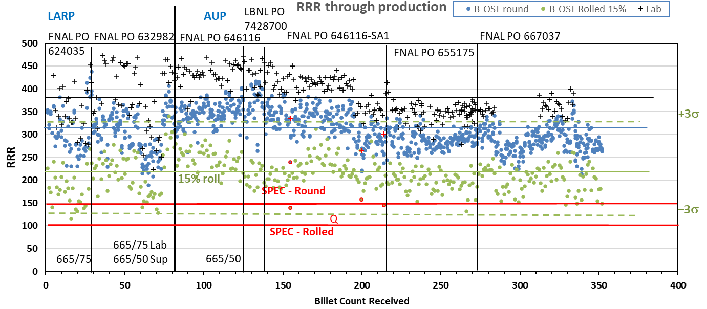
Strand Production Data - RRR
Data for 15% rolled strand predicts the RRR at cable sharp bend
Lab: IEC method, Supplier: 20K method
Inter-lab comparisons have validated approaches (see QP)
Yellow bands indicate strand data for these cables

Slide 28
QXFA-121 / P43OL1125

Slide 29
P43OL1125 – Cable Date, Lengths
Cable Manufacture Date
  02 Apr 2019 (Production run)
Cable Length:
  466 m (LBNL, fabricated, including LBNL samples)

Slide 30
P43OL1125 – Strand and SS Core ID
Spool:
  PO08S00365A01U x 2 ULs
  PO08S00374A03U x 5 ULs
  PO08S00368A03U x 1 ULs
  PO08S00361A01U x 8 ULs
  PO08S00367A02U x 5 ULs
  PO08S00368A04U x 1 ULs
  PO08S00369A02U x 10 ULs
  PO08S00368A05U x 8 ULs
Core:
  120L26A7322313
    Heat: 844979. Lot: 16-597
    Material: 316L
    Chemical Properties CoT/CoC #172660-1: 0.14 wt% Co
    Core width: 12.0 mm
From 6 billets

Slide 31
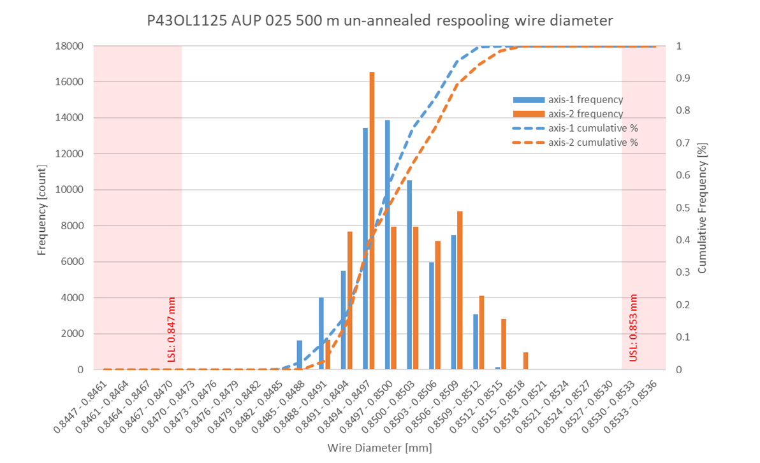
P43OL1125 Respooling Wire Diameter
Below LSL: 0.000%
Above USL: 0.000%

Slide 32
P43OL1125 – Cable QC Data Summary
CME:
Residual Twist: 130°
10-stack:
  Qualification: 1.522 mm
  Production tail end: 1.525 mm
 | Pressure (MPa) | Angle (°) | Width (mm) | Thickness (mm)
Maximum | 17.1 | 0.423 | 18.172 | 1.528
Average | 17.0 | 0.405 | 18.148 | 1.522
Minimum | 17.0 | 0.381 | 18.143 | 1.517
Sigma | 0.01 | 0.006 | 0.003 | 0.002

Slide 33
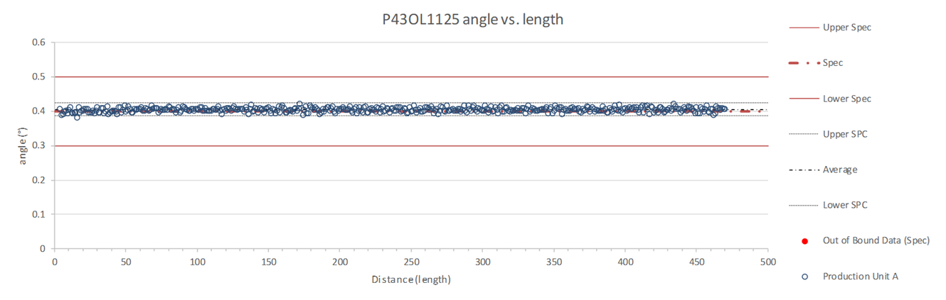
Rollers: P-91 (2017-12-08) and P-92 (2017-12-08)

Slide 34
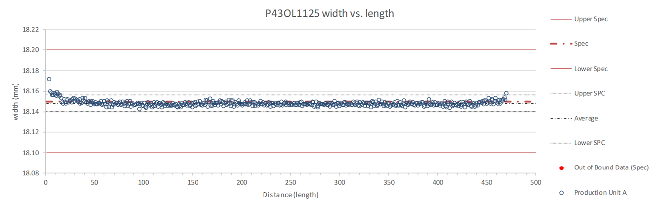
Rollers: P-91 (2017-12-08) and P-92 (2017-12-08)

Slide 35
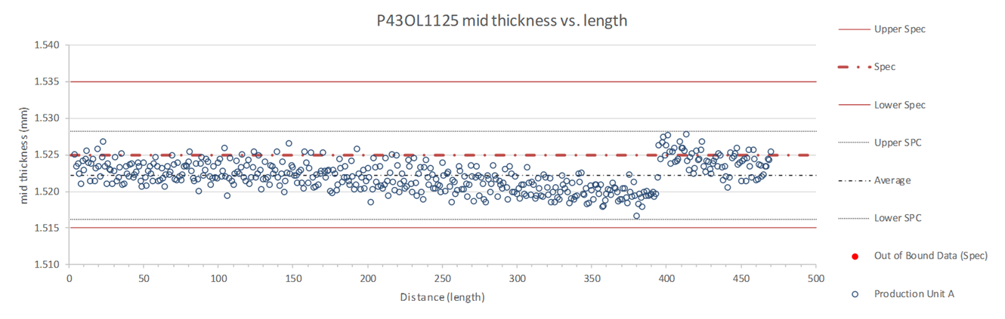
Rollers: P-91 (2017-12-08) and P-92 (2017-12-08)

Slide 36
P43OL1125 – Braiding
Fiberglass Lot: #100858
P/I: 18.0
Spool tension: 10 lbs. @ payoff. 20 lbs. @ takeup (12 lbs min)
Bobbin payoff tension: 0.125 lbs. ≤ T ≤ 0.250 lbs.
Insulation Thickness (at 5 MPa)
Site | Cycle #1 (mm) | Cycle #2 (mm) | Cycle #3 (mm) | Average (mm)
NEWT | 0.150 | 0.148 | 0.146 | 0.148
LBNL Verification | 0.151 | 0.150 | 0.148 | 0.150

Slide 37
P43OL1125 – Wire Parameters
Properties | Inspected Average
Wire Diameter | 0.850 ± 0.001 mm (LBNL)¹
Cu ratio ª | 53.5% (OST)
Strand twist pitch ª | 19.0 mm (OST)
RRR (RW) ª | 342 (OST)
RRR (15% rolled) ª | 247 (OST)
I_{C} (4.2 K, 15 T) ª | 396A (OST)
I_{C} (4.2 K, 14 T) ª | 492 A (OST)
I_{C} (4.2 K, 13 T) ª | 600 A (OST)
I_{C} (4.2 K, 12 T) ª | 724 A (OST)
ª First billet averaged, then weighted average according
to the spool distribution in the cable
¹ As-received. LBNL respooling data. Mean ± 1 sigma

Slide 38
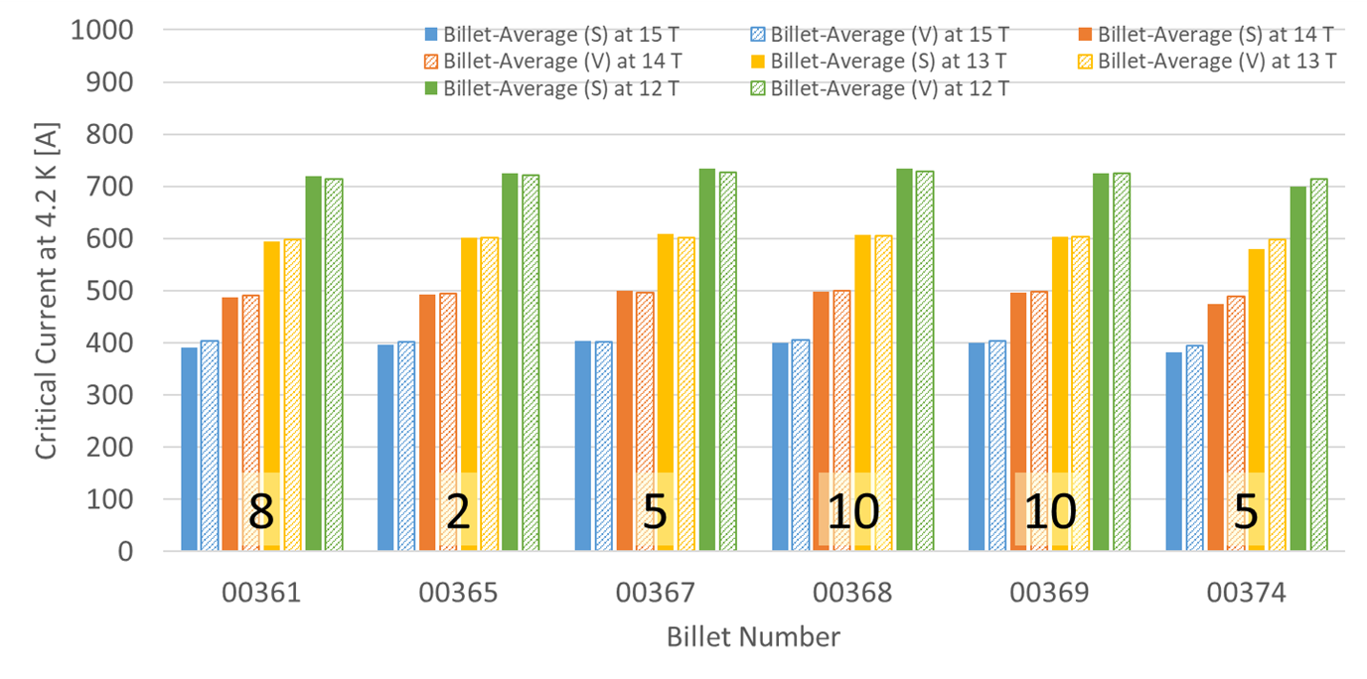
P43OL125 – Wire Parameters
Supplier (S) and Verification (V) I_{C} Data
Number of spools from that billet used in the cable

Slide 39
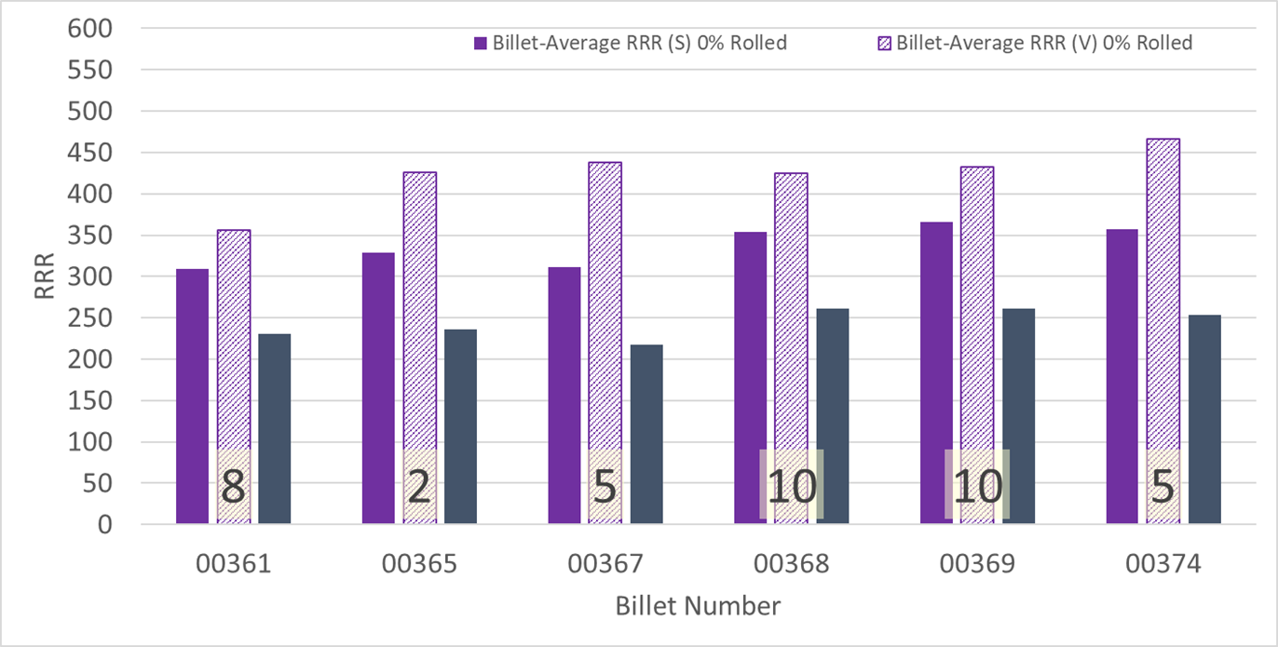
P43OL1125 – Wire Parameters
Supplier (S) and Verification (V) RRR Data
Number of spools from that billet used in the cable

Slide 40
P43OL1125 – Extracted Strand RRR
Cable ID | No. of Units from Billet (spool) | Heat Treat/ Sample ID | Major Edge RRR | Minor Edge RRR | Straight 1 RRR | Straight 2 RRR
P43OL1125AE49E PO08S00368A05U | 10 (8) | LRLK190404ALC2 | 317 | 266 | 394 | 369
P43OL1125AE05E PO08S00374A03U | 5 (5) | LRLK190404ALC2 | 367 | 316 | 453 | 454
P43OL1125AE25E PO08S00367A02U | 5 (5) | LRLK190404ALC2 | 348 | 323 | 390 | 410
P43OL1125AE13E PO08S00361A01U | 8 (8) | LRLK190404ALC2 | 342 | 314 | 389 | 410
P43OL1125AE35E PO08S00369A02U | 10 (10) | LRLK190404ALC1 | 307 | 309 | 391 | 384

Slide 41
P43OL1125 – I_{c}*
Wire/ Cable Strand | I_{c}(A) at Field (T)
 | 12 T | 13 T | 14 T | 15 T
PO08S00369A02U P43OL1125AE35E | 732 | 612 | 502 | 405
PO08S00369A02U P43OL1125AE37E | 741 | 620 | 510 | 413
*These I_{c} data are from before BCR 070, when strands were extracted, HT’d and measured at FNAL. The # of required I_{c} samples was less. This is an attempt to pull FNAL extracted strand data and analyze it with current (Dec 2024) LBNL methods.

Slide 42
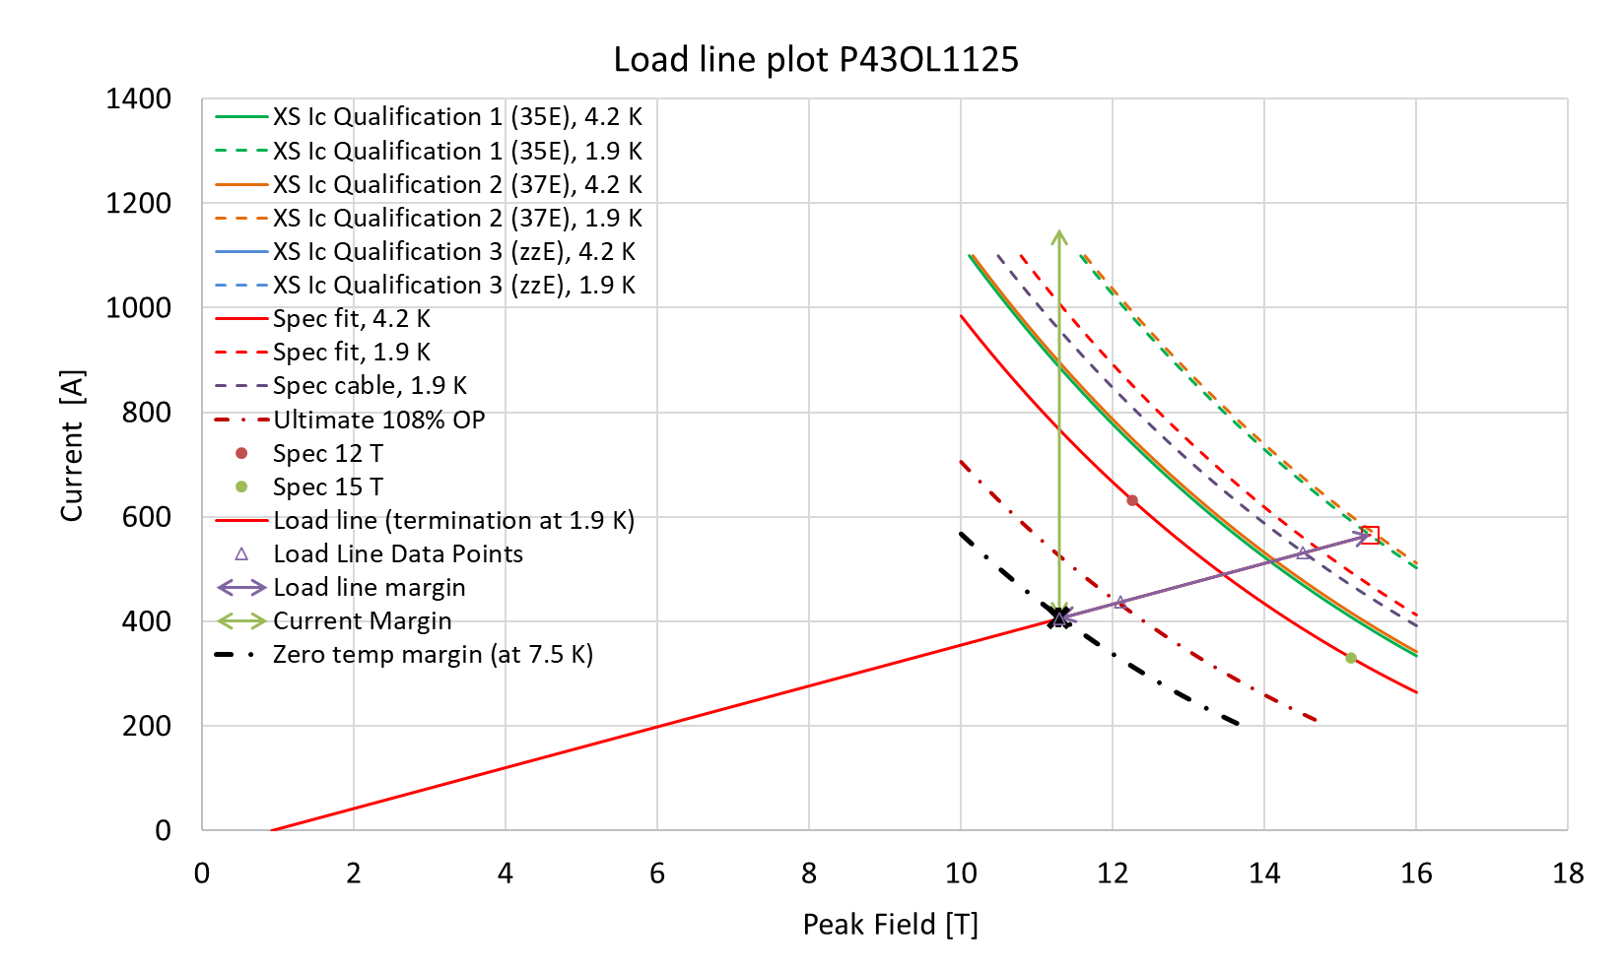
P43OL1125 – SSL Plot*
*These I_{c} data are from before BCR 070, when strands were extracted, HT’d and measured at FNAL. The # of required I_{c} samples was less. This is an attempt to pull FNAL extracted strand data and analyze it with current (Dec 2024) LBNL methods.

Slide 43
P43OL1125 – SSL Margins*
Strand from which Margin is Calculated: | Strand # 35E @ 1.9 K
Margins | Margin | Operating Point (X)
Load Line Margin (Purple Arrow) | 28.3% | 71.7%
Current Margin (Green Arrow) | 64.8% | 35.2%
Temperature Margin (K) | 5.6 | 7.5
Limits | Strand | Strand x 40
Selected Strand’s Current (A) at Margin-Calculation Field | 1151 | 46060
Selected Strand’s Current (A) at 100% SSL | 566 | 22626
Selected Strand’s Field (T) at 100% SSL | 15.4
*These I_{c} data are from before BCR 070, when strands were extracted, HT’d and measured at FNAL. The # of required I_{c} samples was less. This is an attempt to pull FNAL extracted strand data and analyze it with current (Dec 2024) LBNL methods.

Slide 44
QXFA-125 / P43OL1121

Slide 45
P43OL1121 – Cable Date, Lengths
Cable Manufacture Date
  08 Feb 2019 (Production run)
Cable Length:
  471 m (LBNL, fabricated, including LBNL samples)

Slide 46
P43OL1121 – Strand and SS Core ID
Spool:
  PO08S00349A03U x 6 ULs
  PO08S00349A04U x 7 ULs
  PO08S00352A01U x 17 ULs
  PO08S00353A02U x 1 ULs
  PO08S00353A03U x 5 ULs
  PO08S00356A01U x 4 ULs
Core:
  120L30A7322313
    Heat: 844979. Lot: 16-597
    Material: 316L
    Chemical Properties CoT/CoC #172660-1: 0.14 wt% Co
    Core width: 12.0 mm
From 4 billets

Slide 47
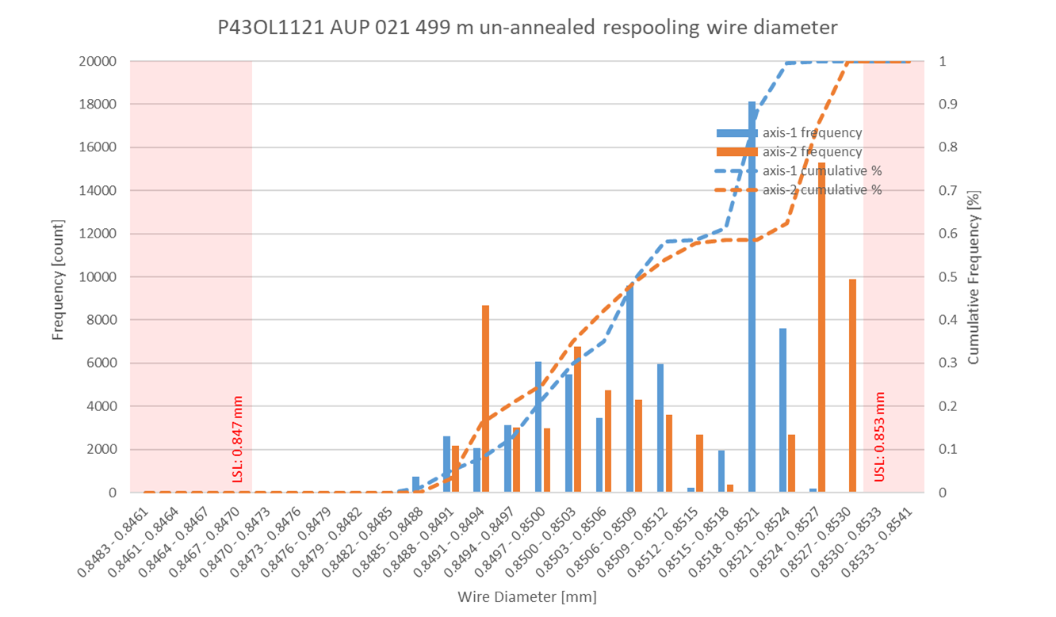
P43OL1121 Respooling Wire Diameter
Below LSL: 0.00%
Above USL: 0.74%

Slide 48
P43OL1121 – Cable QC Data Summary
CME:
Residual Twist: 100°
10-stack:
  Qualification: 1.532 mm
  Production tail end: 1.527 mm
 | Pressure (MPa) | Angle (°) | Width (mm) | Thickness (mm)
Maximum | 17.1 | 0.420 | 18.177 | 1.531
Average | 17.1 | 0.404 | 18.152 | 1.524
Minimum | 17.0 | 0.382 | 18.147 | 1.521
Sigma | 0.01 | 0.007 | 0.003 | 0.002

Slide 49
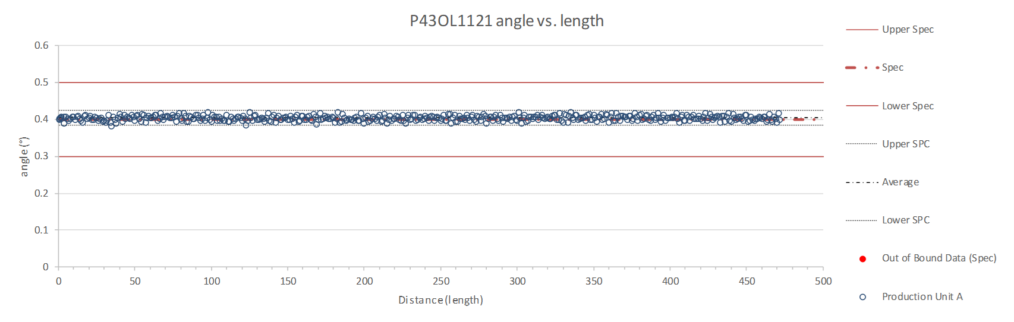
Rollers: P-91 (2017-12-08) and P-92 (2017-12-08)

Slide 50
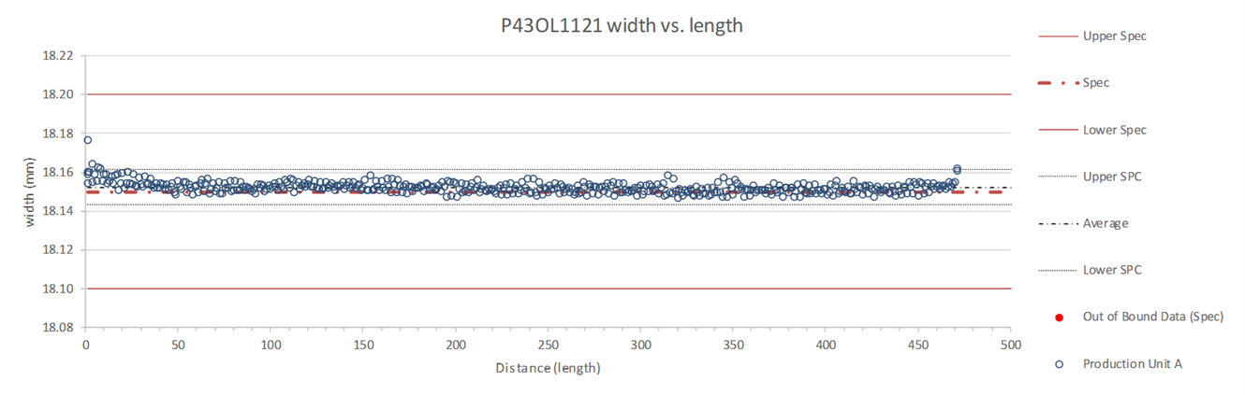
Rollers: P-91 (2017-12-08) and P-92 (2017-12-08)

Slide 51
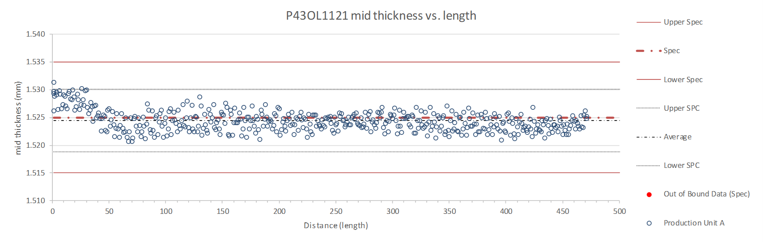
Rollers: P-91 (2017-12-08) and P-92 (2017-12-08)

Slide 52
P43OL1121 – Braiding
Fiberglass Lot: #100858
P/I: 18.0
Spool tension: 10 lbs. @ payoff. 20 lbs. @ takeup (12 lbs min)
Bobbin payoff tension: 0.125 lbs. ≤ T ≤ 0.250 lbs.
Insulation Thickness (at 5 MPa)
Site | Cycle #1 (mm) | Cycle #2 (mm) | Cycle #3 (mm) | Average (mm)
NEWT | 0.146 | 0.144 | 0.143 | 0.144
LBNL Verification | 0.152 | 0.149 | 0.148 | 0.150

Slide 53
P43OL1121 – Wire Parameters
Properties | Inspected Average
Wire Diameter | 0.851 ± 0.001 mm (LBNL)¹
Cu ratio ª | 53.8% (OST)
Strand twist pitch ª | 18.9 mm (OST)
RRR (RW) ª | 348 (OST)
RRR (15% rolled) ª | 295 (OST)
I_{C} (4.2 K, 15 T) ª | 394 A (OST)
I_{C} (4.2 K, 14 T) ª | 489 A (OST)
I_{C} (4.2 K, 13 T) ª | 597 A (OST)
I_{C} (4.2 K, 12 T) ª | 720 A (OST)
ª First billet averaged, then weighted average according
to the spool distribution in the cable
¹ As-received. LBNL respooling data. Mean ± 1 sigma

Slide 54
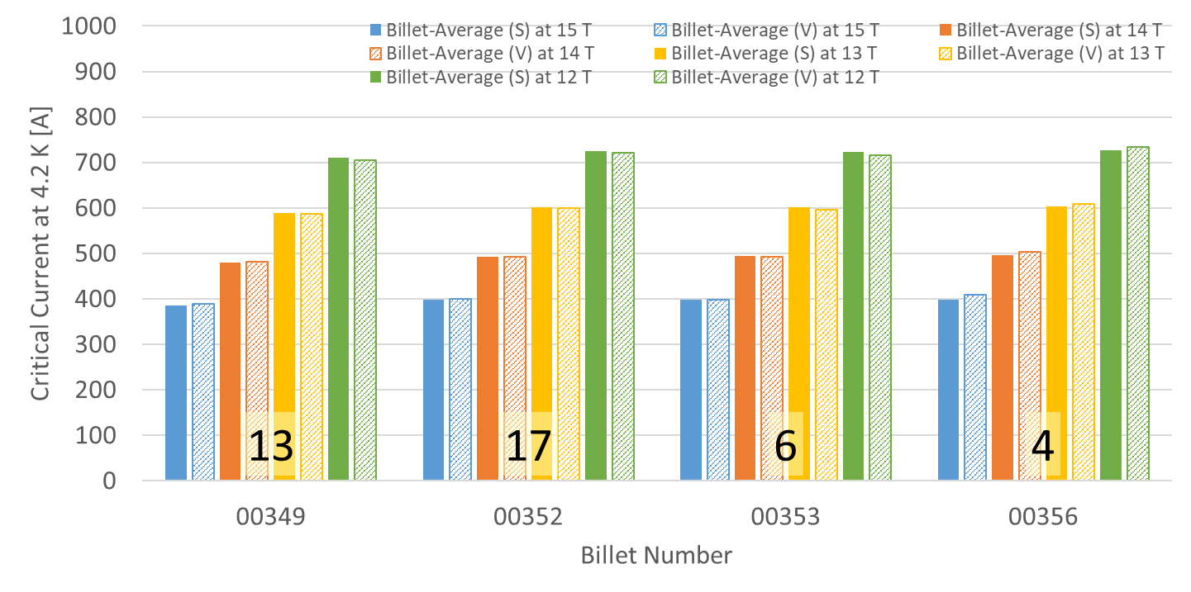
P43OL1121 – Wire Parameters
Supplier (S) and Verification (V) I_{C} Data
Number of spools from that billet used in the cable

Slide 55
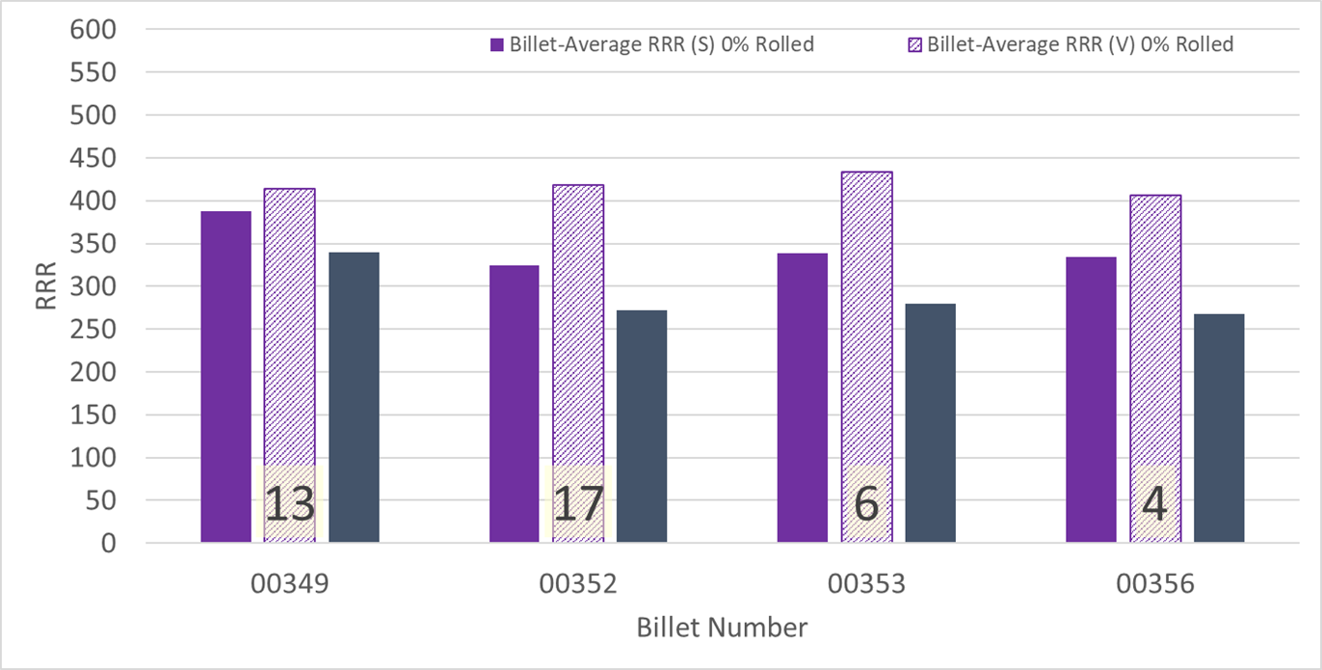
P43OL1121 – Wire Parameters
Supplier (S) and Verification (V) RRR Data
Number of spools from that billet used in the cable

Slide 56
P43OL1121 – Extracted Strand RRR
Cable ID | No. of Units from Billet (spool) | Heat Treat/ Sample ID | Major Edge RRR | Minor Edge RRR | Straight 1 RRR | Straight 2 RRR
P43OL1121AE37E PO08S00352A01U | 17 (17) | LRLK190404ALC1 | 352 | 313 | 394 | 402
P43OL1121AE36E PO08S00352A01U | 17 (17) | LRLK190404ALC6 | 304 | 270 | 367 | 396
P43OL1121AE07E PO08S00353A03U | 6 (5) | LRLK190404ALC1 | 383 | 371 | 410 | 422
P43OL1121AE05E PO08S00356A01U | 4 (4) | LRLK190404ALC1 | 334 | 301 | 367 | 393
P43OL1121AE25E PO08S00349A04U | 13 (7) | LRLK190404ALC1 | 419 | 321 | 410 | 383

Slide 57
P43OL1121 – I_{c}*
Wire/ Cable Strand | I_{c}(A) at Field (T)
 | 12 T | 13 T | 14 T | 15 T
PO08S00352A01U P43OL1121AE39E | 716 | 595 | 488 | 393
PO08S00349A04U P43OL1121AE25E | 712 | 590 | 482 | 387
*These I_{c} data are from before BCR 070, when strands were extracted, HT’d and measured at FNAL. The # of required I_{c} samples was less. This is an attempt to pull FNAL extracted strand data and analyze it with current (Dec 2024) LBNL methods.

Slide 58
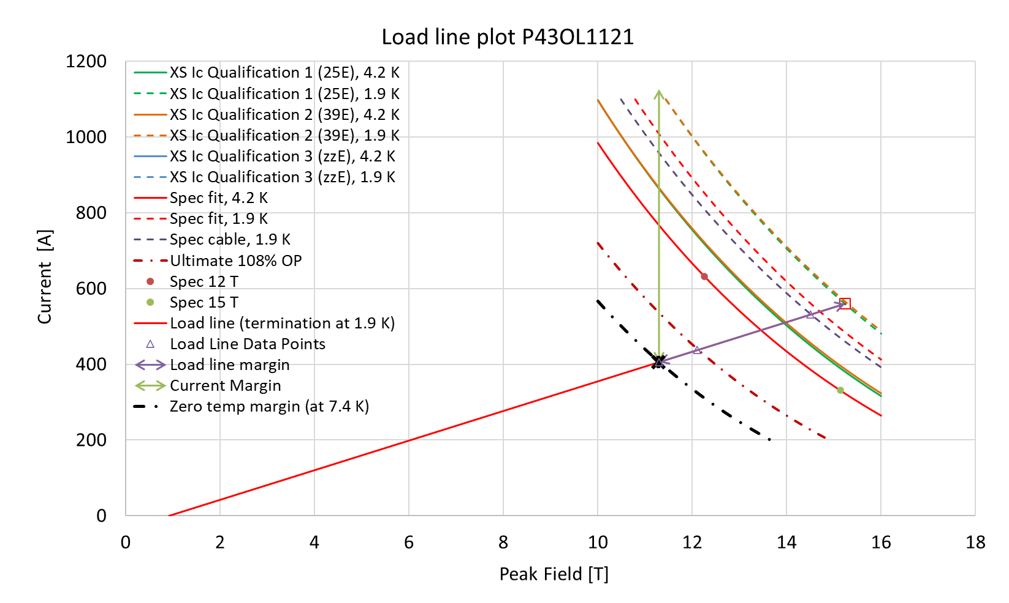
P43OL1121 – SSL Plot*
*These I_{c} data are from before BCR 070, when strands were extracted, HT’d and measured at FNAL. The # of required I_{c} samples was less. This is an attempt to pull FNAL extracted strand data and analyze it with current (Dec 2024) LBNL methods.

Slide 59
P43OL1121 – SSL Margins*
Strand from which Margin is Calculated: | Strand # 25E @ 1.9 K
Margins | Margin | Operating Point (X)
Load Line Margin (Purple Arrow) | 27.5% | 72.5%
Current Margin (Green Arrow) | 64.0% | 36.0%
Temperature Margin (K) | 5.5 | 7.4
Limits | Strand | Strand x 40
Selected Strand’s Current (A) at Margin-Calculation Field | 1126 | 45054
Selected Strand’s Current (A) at 100% SSL | 560 | 22392
Selected Strand’s Field (T) at 100% SSL | 15.2
*These I_{c} data are from before BCR 070, when strands were extracted, HT’d and measured at FNAL. The # of required I_{c} samples was less. This is an attempt to pull FNAL extracted strand data and analyze it with current (Dec 2024) LBNL methods.

Slide 60
QXFA-142 / P43OL1172

Slide 61
P43OL1172 – Cable Date, Lengths
Cable Manufacture Date
  22 June 2021(Production run)
Cable Length:
  461 m (LBNL, fabricated, including LBNL samples)

Slide 62
P43OL1172 – Strand and SS Core ID
Spool:
  PO08S00552A02U x 5 ULs
  PO08S00557A01U x 17 ULs
  PO08S00558A02U x 3 ULs
  PO08S00575A03U x 3 ULs
  PO08S00575A04U x 2 ULs
  PO08S00575A05U x 10 ULs
Core:
  120L23A7400804
    Heat: 850858. Lot: 17-521
    Material: 316L
    Chemical Properties CoT/CoC #187781-1: 0.16 wt% Co
    Core width: 12.0 mm
From 4 billets

Slide 63
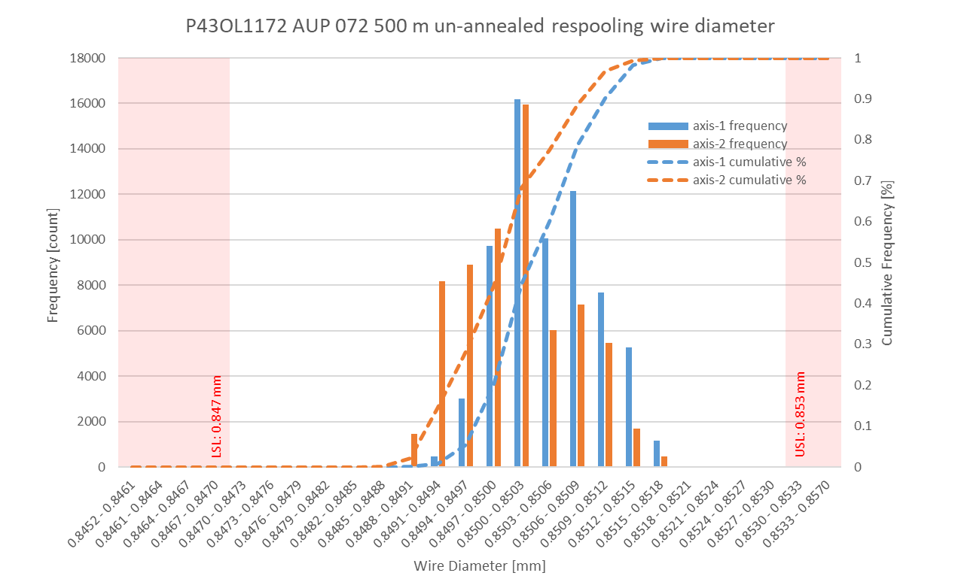
P43OL1172 Respooling Wire Diameter
Below LSL: 0.002%
Above USL: 0.005%

Slide 64
P43OL1172 – Cable QC Data Summary
CME:
Residual Twist: 145°
10-stack:
  Qualification: 1.528 mm
  Production tail end: 1.527 mm
 | Pressure (MPa) | Angle (°) | Width (mm) | Thickness (mm)
Maximum | 17.1 | 0.445 | 18.164 | 1.531
Average | 17.0 | 0.427 | 18.136 | 1.524
Minimum | 17.0 | 0.376 | 18.130 | 1.519
Sigma | 0.01 | 0.011 | 0.004 | 0.001

Slide 65
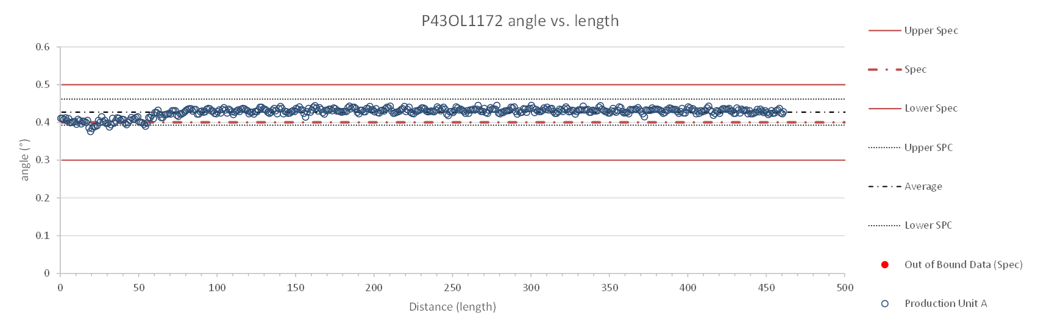
Rollers: P-95 (2019 12 02) & P-96 (2019 12 02)

Slide 66
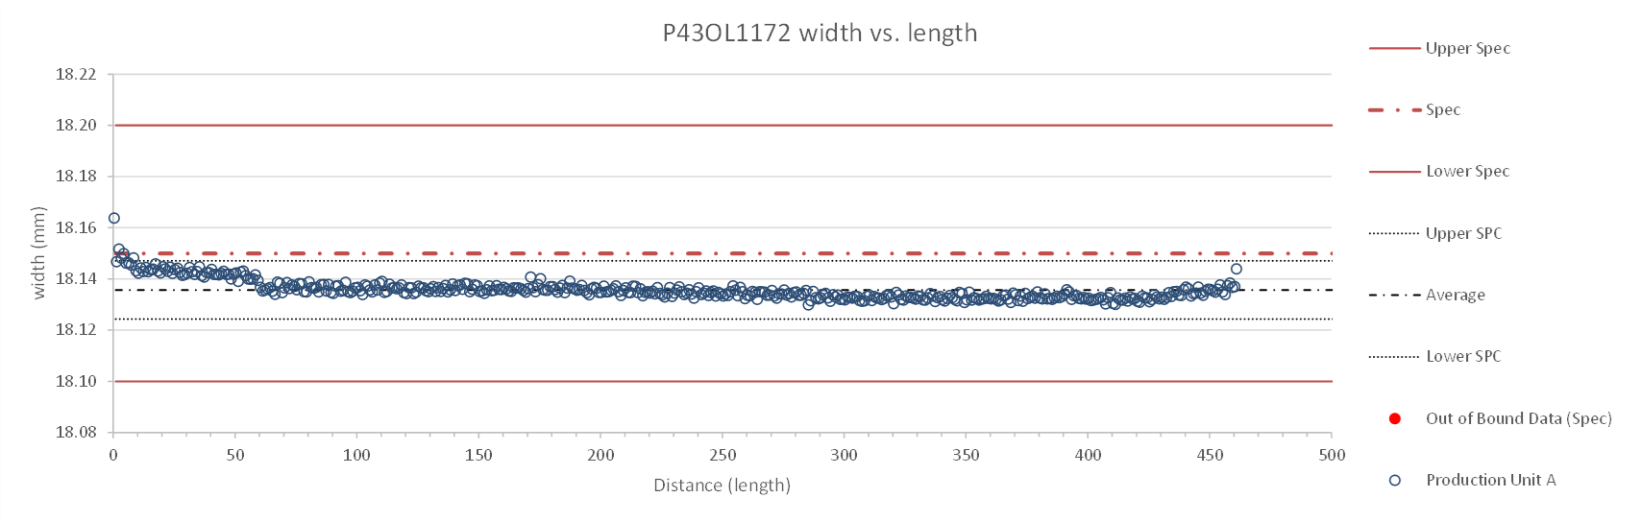
Rollers: P-95 (2019 12 02) & P-96 (2019 12 02)

Slide 67
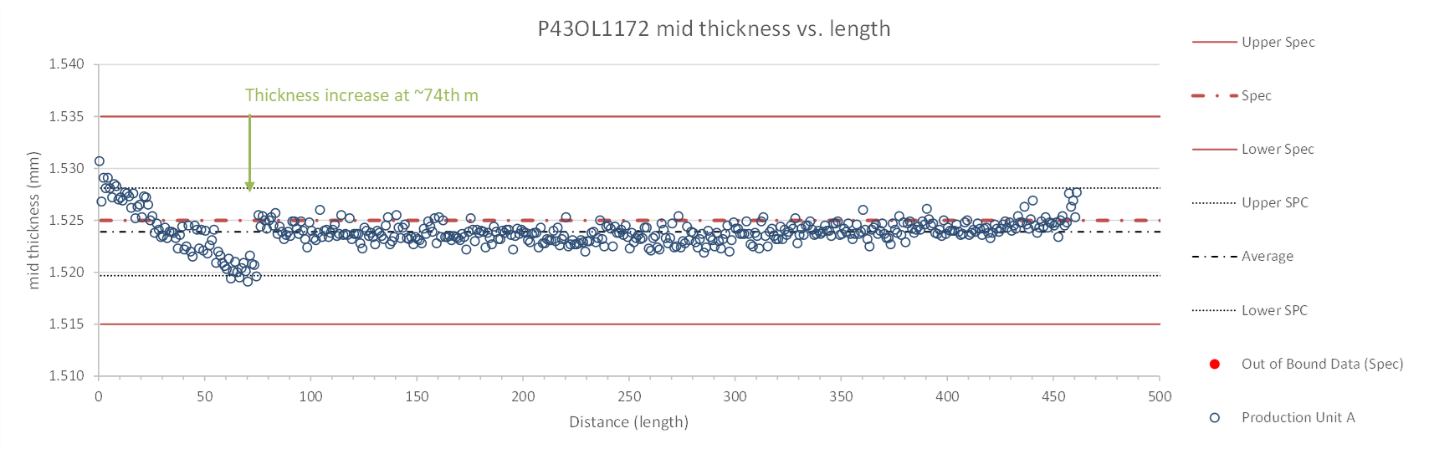
Rollers: P-95 (2019 12 02) & P-96 (2019 12 02)

Slide 68
P43OL1172 – Braiding
Fiberglass Lot: #111154
P/I: 18.9
Spool tension: 10 lbs. @ payoff. 20 lbs. @ takeup (12 lbs min)
Bobbin payoff tension: 0.125 lbs. ≤ T ≤ 0.250 lbs.
Insulation Thickness (at 5 MPa)
Site | Cycle #1 (mm) | Cycle #2 (mm) | Cycle #3 (mm) | Average (mm)
NEWT | 0.150 | 0.148 | 0.146 | 0.148
LBNL Verification | 0.156 | 0.153 | 0.151 | 0.154

Slide 69
P43OL1172 – Wire Parameters
Properties | Inspected Average
Wire Diameter | 0.8503 ± 0.0005 mm (LBNL)¹
Cu ratio ª | 53.97% (BOST)
Strand twist pitch ª | 18.5mm (BOST)
RRR (RW) ª | 310 (BOST)
RRR (15% rolled) ª | 198 (BOST)
I_{C} (4.2 K, 15 T) ª | 392 A (BOST)
I_{C} (4.2 K, 14 T) ª | 487 A (BOST)
I_{C} (4.2 K, 13 T) ª | 596 A (BOST)
I_{C} (4.2 K, 12 T) ª | 718 A (BOST)
ª First billet averaged, then weighted average according
to the spool distribution in the cable
¹ As-received. LBNL respooling data. Mean ± 1 sigma

Slide 70
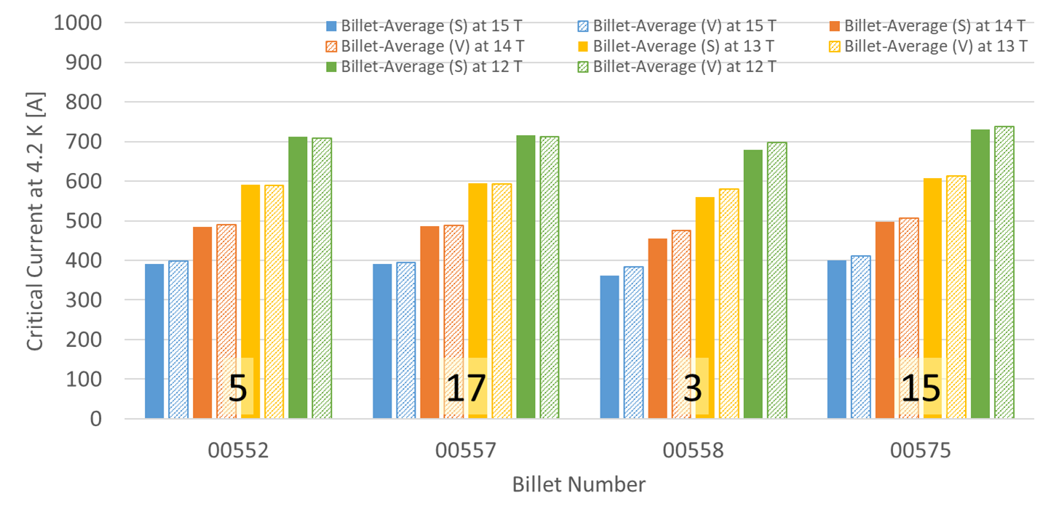
P43OL1172 – Wire Parameters
Supplier (S) and Verification (V) I_{C} Data
Number of spools from that billet used in the cable

Slide 71
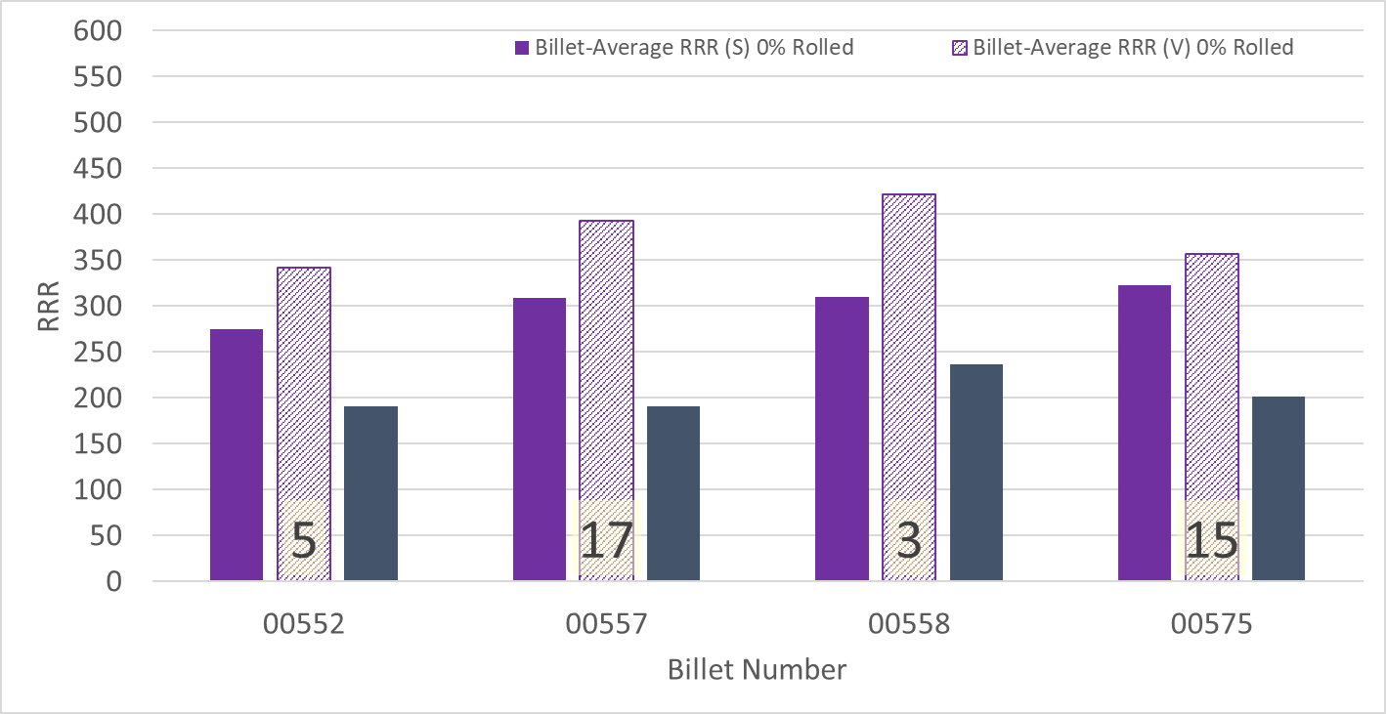
P43OL1172 – Wire Parameters
Supplier (S) and Verification (V) RRR Data
Number of spools from that billet used in the cable

Slide 72
P43OL1172 – Extracted Strand RRR
Cable ID | No. of Units from Billet (spool) | Heat Treat/ Sample ID | Major Edge RRR | Minor Edge RRR | Straight 1 RRR | Straight 2 RRR
PO08S00552A02U P43OL1172AE03E | 5 (5) | LRLK210709ALC1 | 301 | 241 | 334 | 352
PO08S00557A01U P43OL1172AE09E | 17 (17) | LRLK210709ALC1 | 318 | 231 | 343 | 332
PO08S00557A01U P43OL1172AE11E | 17 (17) | LRLK210709ALC2 | 296 | 233 | 367 | 351
PO08S00558A02U P43OL1172AE35E | 3 (3) | LRLK210709ALC2 | 366 | 276 | 403 | 390
PO08S00575A05U P43OL1172AE47E | 15 (10) | LRLK210709ALC1 | 287 | 226 | 335 | 332

Slide 73
P43OL1172 – I_{c}, Cable Qual Samples
Wire/ Cable Strand | I_{c}(A) at Field (T)
 | 12 T | 13 T | 14 T | 15 T
PO08S00575A05U P43OL1172AE47E | 657 | 543 | 444 | 355
PO08S00552A02U P43OL1172AE01E | 620 | 509 | 418 | 337
PO08S00557A01U P43OL1172AE11E | 625 | 516 | 420 | 334

Slide 74
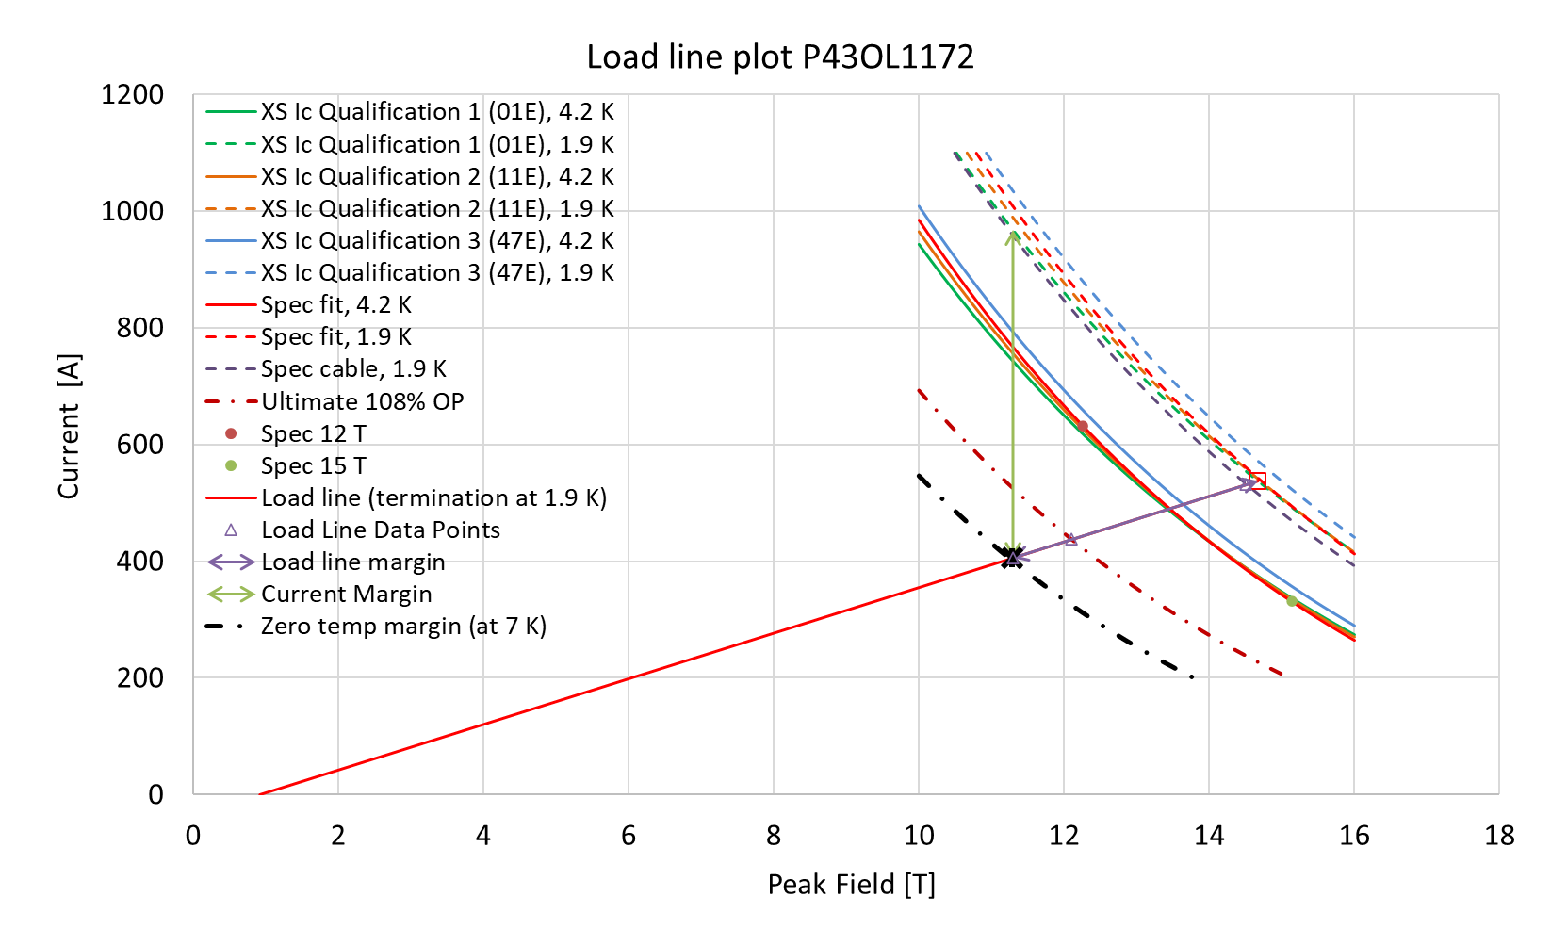
P43OL1172 – SSL Plot, Cable Qual Samples

Slide 75
P43OL1172 – SSL Margins, Qual Samples
Strand from which Margin is Calculated: | Strand # 01E @ 1.9 K
Margins | Margin | Operating Point (X)
Load Line Margin (Purple Arrow) | 24.5% | 75.5%
Current Margin (Green Arrow) | 58.1% | 41.9%
Temperature Margin (K) | 5.1 | 7.0
Limits | Strand | Strand x 40
Selected Strand’s Current (A) at Margin-Calculation Field | 968 | 38715
Selected Strand’s Current (A) at 100% SSL | 538 | 21503
Selected Strand’s Field (T) at 100% SSL | 14.7

Slide 76
QXFA-146 / P43OL1180

Slide 77
P43OL1180 – Cable Date, Lengths
Cable Manufacture Date
  09 Sept 2021 (Production run)
Cable Length:
  465 m (LBNL, fabricated, including LBNL samples)

Slide 78
P43OL1180 – Strand and SS Core ID
Spool:
  PO08S00645A03U
  PO08S00648A01U
  PO08S00648A02U
  PO08S00648A03U
  PO08S00642A01U
Core:
  120L31A7400804
    Heat: 850858. Lot: 17-521
    Material: 316L
    Chemical Properties CoT/CoC # 187781-1: 0.16 wt% Co
    Core width: 12.0 mm
From 3 billets

Slide 79
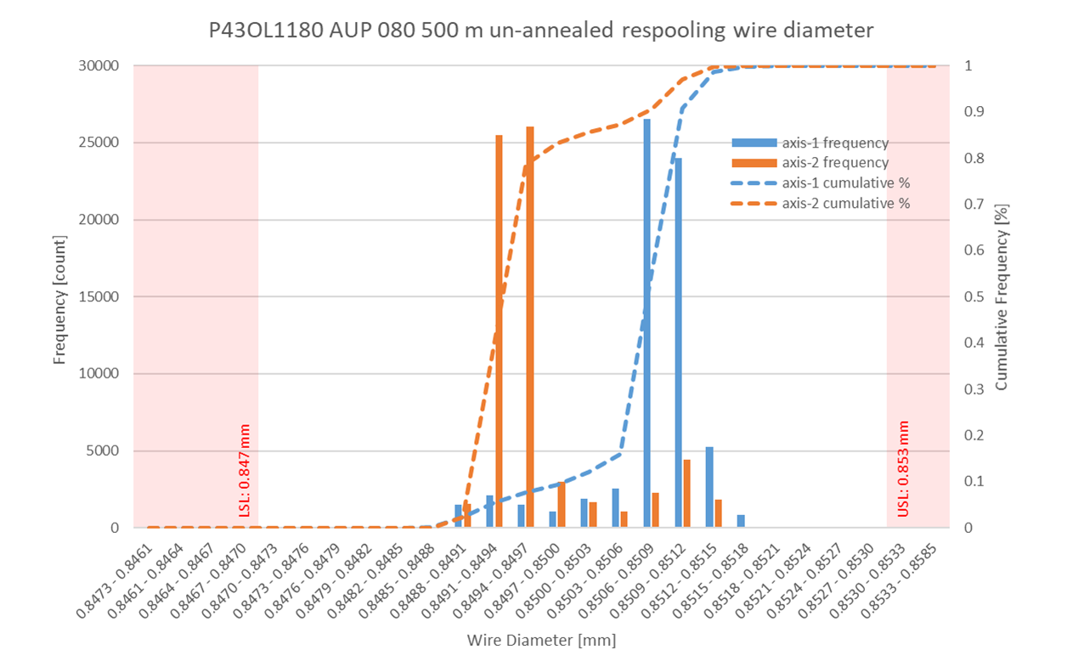
P43OL1180 Respooling Wire Diameter
Below LSL: 0.000%
Above USL: 0.007%

Slide 80
P43OL1180 – Cable QC Data Summary
CME:
Residual Twist: 140°
10-stack:
  Qualification: 1.535 mm
  Production tail end: 1.530 mm
 | Pressure (MPa) | Angle (°) | Width (mm) | Thickness (mm)
Maximum | 17.0 | 0.395 | 18.168 | 1.531
Average | 17.0 | 0.361 | 18.137 | 1.521
Minimum | 17.0 | 0.342 | 18.133 | 1.518
Sigma | 0.01 | 0.007 | 0.003 | 0.002

Slide 81
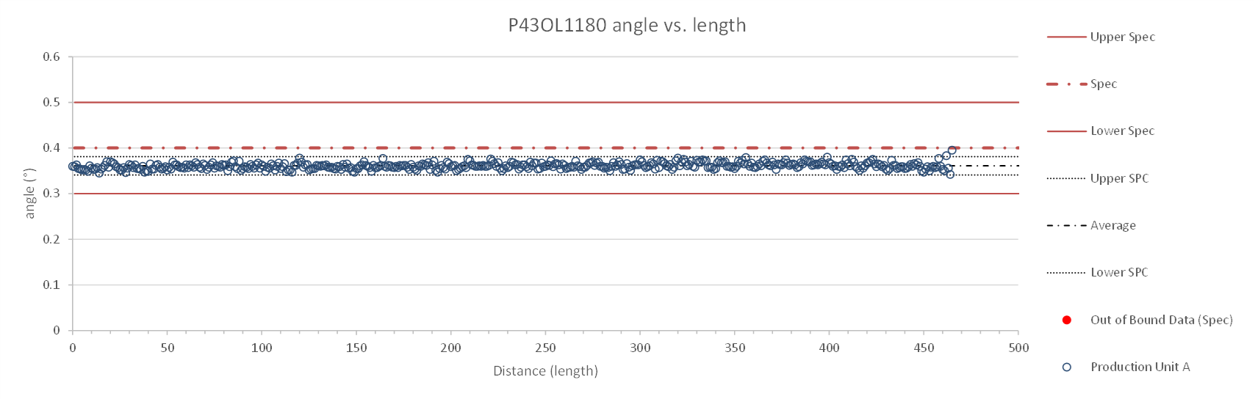
Rollers: P-93 (2021-08-09) & P-94 (2021-08-09)

Slide 82
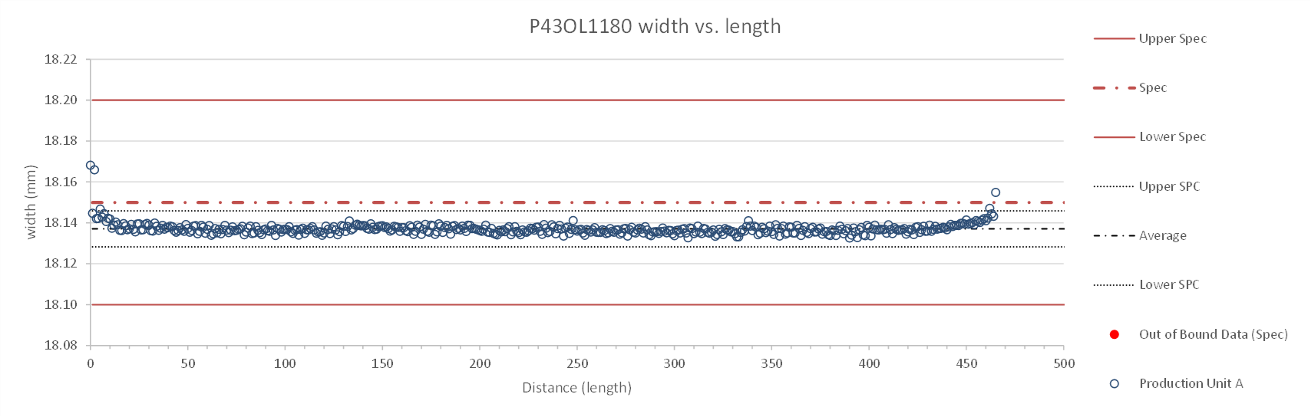
Rollers: P-93 (2021-08-09) & P-94 (2021-08-09)

Slide 83
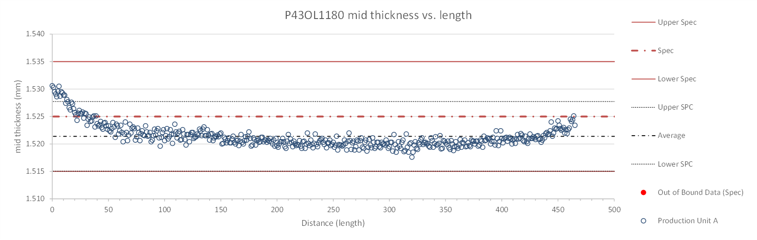
Rollers: P-93 (2021-08-09) & P-94 (2021-08-09)

Slide 84
P43OL1180 – Braiding
Fiberglass Lot: #111154
P/I: 18.9
Spool tension: 10 lbs. @ payoff. 20 lbs. @ takeup (12 lbs min)
Bobbin payoff tension: 0.125 lbs. ≤ T ≤ 0.250 lbs.
Insulation Thickness (at 5 MPa)
Site | Cycle #1 (mm) | Cycle #2 (mm) | Cycle #3 (mm) | Average (mm)
NEWT | 0.149 | 0.147 | 0.145 | 0.147
LBNL Verification | 0.143 | 0.141 | 0.140 | 0.141

Slide 85
P43OL1180 – Wire Parameters
Properties | Inspected Average
Wire Diameter | 0.8502 ± 0.007 mm (LBNL)¹
Cu ratio ª | 54.30% (BOST)
Strand twist pitch ª | 19.7 mm (BOST)
RRR (RW) ª | 384 (BOST)
RRR (15% rolled) ª | 186 (BOST)
I_{C} (4.2 K, 15 T) ª | 368 A (BOST)
I_{C} (4.2 K, 14 T) ª | 463 A (BOST)
I_{C} (4.2 K, 13 T) ª | 568 A (BOST)
I_{C} (4.2 K, 12 T) ª | 689 A (BOST)
ª First billet averaged, then weighted average according
to the spool distribution in the cable
¹ As-received. LBNL respooling data. Mean ± 1 sigma

Slide 86
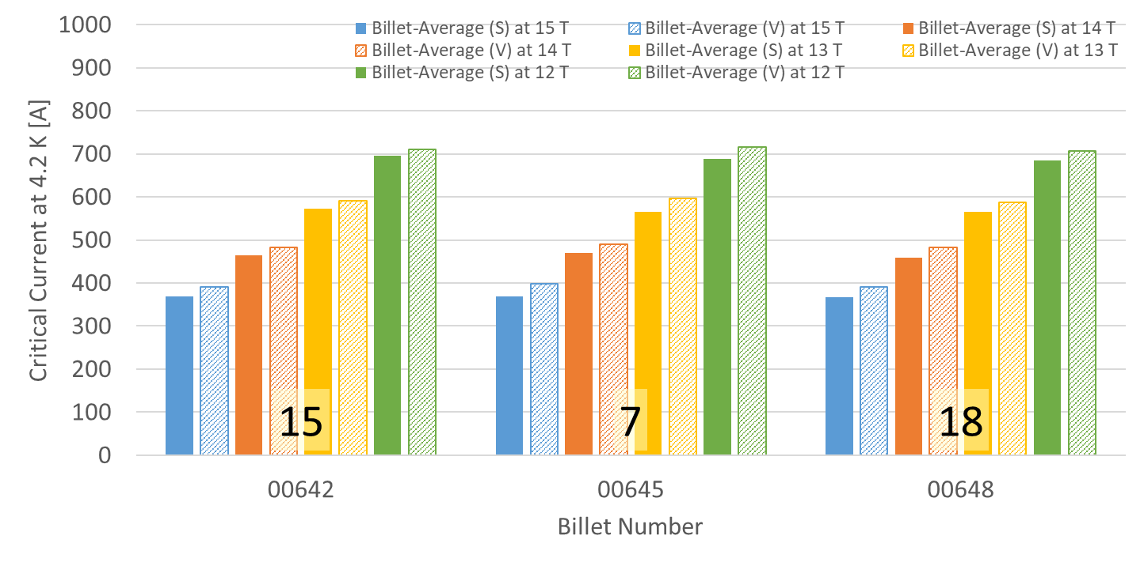
P43OL1180 – Wire Parameters
Supplier (S) and Verification (V) I_{C} Data
Cable Readiness/ S and V. Will need MDB
Number of spools from that billet used in the cable

Slide 87
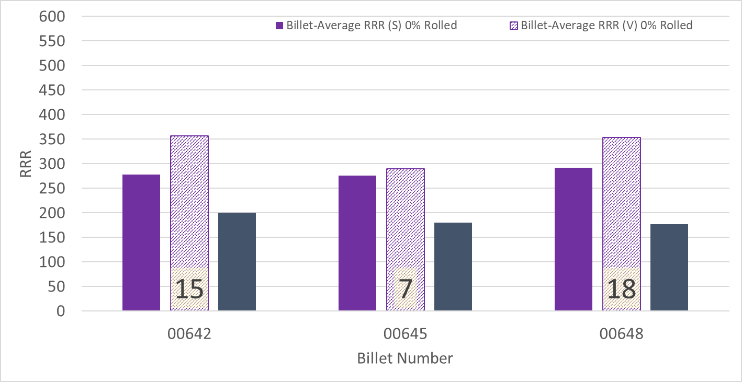
P43OL1180 – Wire Parameters
Supplier (S) and Verification (V) RRR Data
Number of spools from that billet used in the cable

Slide 88
P43OL1180 – Extracted Strand RRR
Cable ID | No. of Units from Billet (spool) | Heat Treat/ Sample ID | Major Edge RRR | Minor Edge RRR | Straight 1 RRR | Straight 2 RRR
PO08S00645A03U P43OL1180AE03E | 7 (7) | LRLK211012ALC1 | 208 | 239 | 276 | 291
PO08S00648A01U P43OL1180AE12E | 18 (5) | LRLK211012ALC1 | 239 | 265 | 320 | 329
PO08S00648A03U P43OL1180AE23E | 18 (11) | LRLK211012ALC2 | 221 | 231 | 304 | 322
PO08S00642A01U P43OL1180AE39E | 15 (15) | LRLK211012ALC1 | 241 | 251 | 304 | 324
PO08S00642A01U P43OL1180AE41E | 15 (15) | LRLK211012ALC1 | 253 | 270 | 323 | 326

Slide 89
P43OL1180 – I_{c}, Cable Qual Samples
Wire/ Cable Strand | I_{c}(A) at Field (T)
 | 12 T | 13 T | 14 T | 15 T
PO08S00642A01U P43OL1180AE39E | 689 | 571 | 466 | 374
PO08S00645A03U P43OL1180AE01E | 701 | 577 | 473 | 382
PO08S00642A01U P43OL1180AE41E | 681 | 563 | 460 | 368

Slide 90
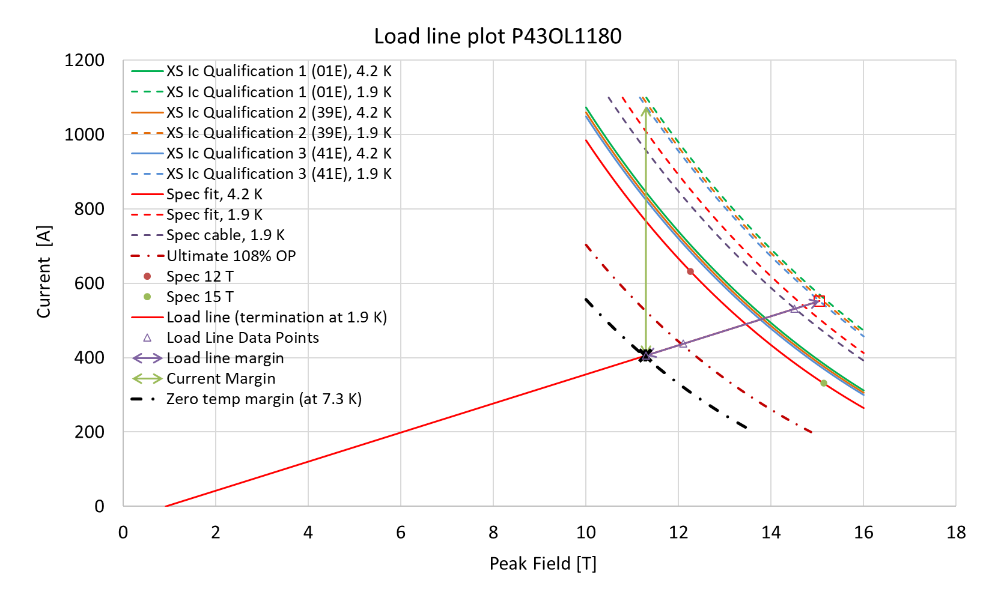
P43OL1180 – SSL Plot, Cable Qual Samples

Slide 91
P43OL1180 – SSL Margins, Qual Samples
Strand from which Margin is Calculated: | Strand # 41E @ 1.9 K
Margins | Margin | Operating Point (X)
Load Line Margin (Purple Arrow) | 26.5% | 73.4%
Current Margin (Green Arrow) | 62.3% | 37.7%
Temperature Margin (K) | 5.4 | 7.3
Limits | Strand | Strand x 40
Selected Strand’s Current (A) at Margin-Calculation Field | 1076 | 43036
Selected Strand’s Current (A) at 100% SSL | 552 | 22099
Selected Strand’s Field (T) at 100% SSL | 15.0

Slide 92
QXFA-254 / P43OL1219

Slide 93
P43OL1219 – Cable Date, Lengths
Cable Manufacture Date
  10 Apr 2023 (Production run)
Cable Length:
  468 m (LBNL, fabricated, including LBNL samples)

Slide 94
P43OL1219 – Strand and SS Core ID
Spool:
  PO08S00716A03U x 1 ULs
  PO08S00716A04U x 1 ULs
  PO08S00716A05U x 2 ULs
  PO08S00726A01U x 12 ULs
  PO08S00726A02U x 6 ULs
  PO08S00722A01U x 1 ULs
  PO08S00722A02U x 17 ULs
Core:
  120L01A7670955
    Heat: 861087. Lot: 20-547
    Material: 316L
    Chemical Properties (CoT/CoC #??): 0.17 wt% Co
    Core width: 12.0 mm
From 3 billets

Slide 95
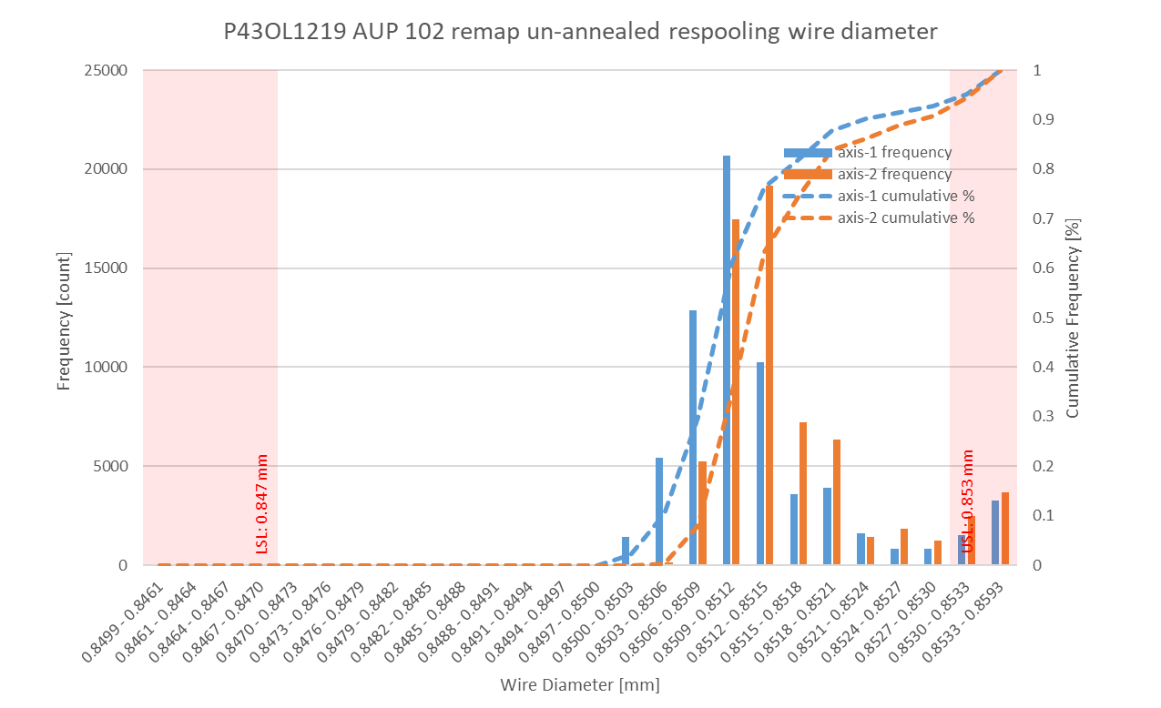
P43OL1219 Respooling Wire Diameter
Below LSL: 0.000%
Above USL: 5.247%

Slide 96
P43OL1219 – Cable QC Data Summary
CME:
Residual Twist: 140°
10-stack:
  Qualification: 1.535 mm
  Production tail end: 1.530 mm
 | Pressure (MPa) | Angle (°) | Width (mm) | Thickness (mm)
Maximum | 17.0 | 0.419 | 18.156 | 1.530
Average | 16.9 | 0.389 | 18.128 | 1.524
Minimum | 16.8 | 0.366 | 18.122 | 1.518
Sigma | 0.02 | 0.007 | 0.003 | 0.002

Slide 97
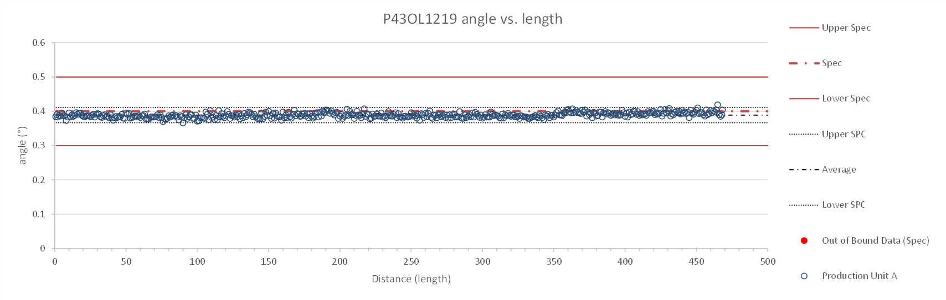
Rollers: P-93 (2021-08-09) & P-94 (2021-08-09)

Slide 98
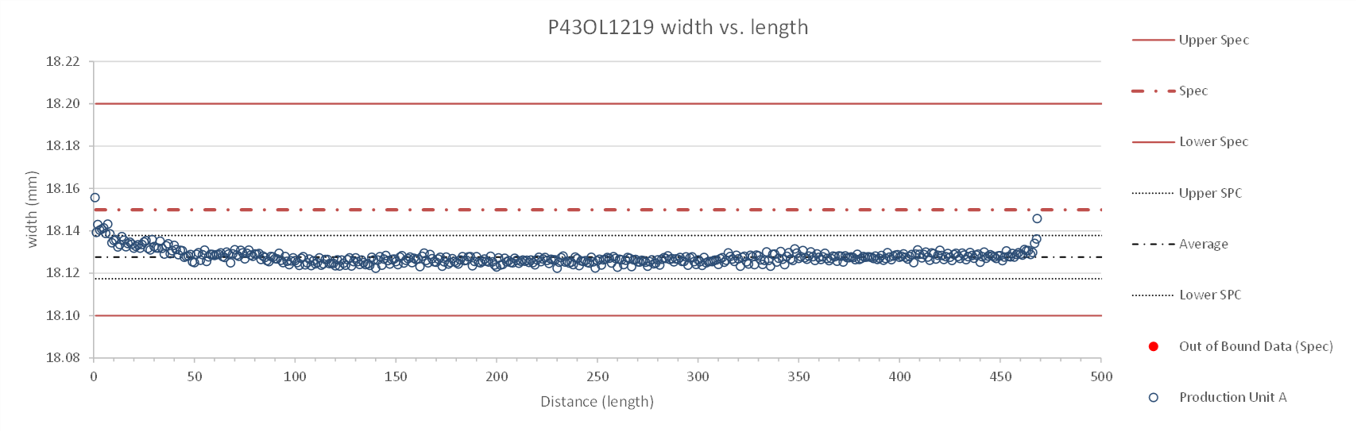
Rollers: P-93 (2021-08-09) & P-94 (2021-08-09)

Slide 99
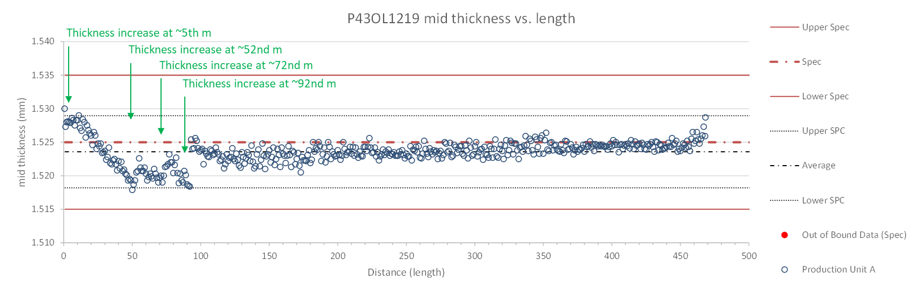
Rollers: P-93 (2021-08-09) & P-94 (2021-08-09)

Slide 100
P43OL1219 – Braiding
Fiberglass Lot: #RCV00011562
P/I: 18.9
Spool tension: 10 lbs. @ payoff. 20 lbs. @ takeup (12 lbs min)
Bobbin payoff tension: 0.125 lbs. ≤ T ≤ 0.250 lbs.
Insulation Thickness (at 5 MPa)
Site | Cycle #1 (mm) | Cycle #2 (mm) | Cycle #3 (mm) | Average (mm)
NEWT | 0.144 | 0.142 | 0.141 | 0.142
LBNL Verification | 0.150 | 0.147 | 0.146 | 0.148

Slide 101
P43OL1219 – Wire Parameters
Properties | Inspected Average
Wire Diameter | 0.8514 ± 0.0008 mm (LBNL)¹
Cu ratio ª | 53.71% (BOST)
Strand twist pitch ª | 18.6mm (BOST)
RRR (RW) ª | 263 (BOST)
RRR (15% rolled) ª | 190 (BOST)
I_{C} (4.2 K, 15 T) ª | 353 A (BOST)
I_{C} (4.2 K, 14 T) ª | 445 A (BOST)
I_{C} (4.2 K, 13 T) ª | 548 A (BOST)
I_{C} (4.2 K, 12 T) ª | 666 A (BOST)
ª First billet averaged, then weighted average according
to the spool distribution in the cable
¹ As-received. LBNL respooling data. Mean ± 1 sigma

Slide 102
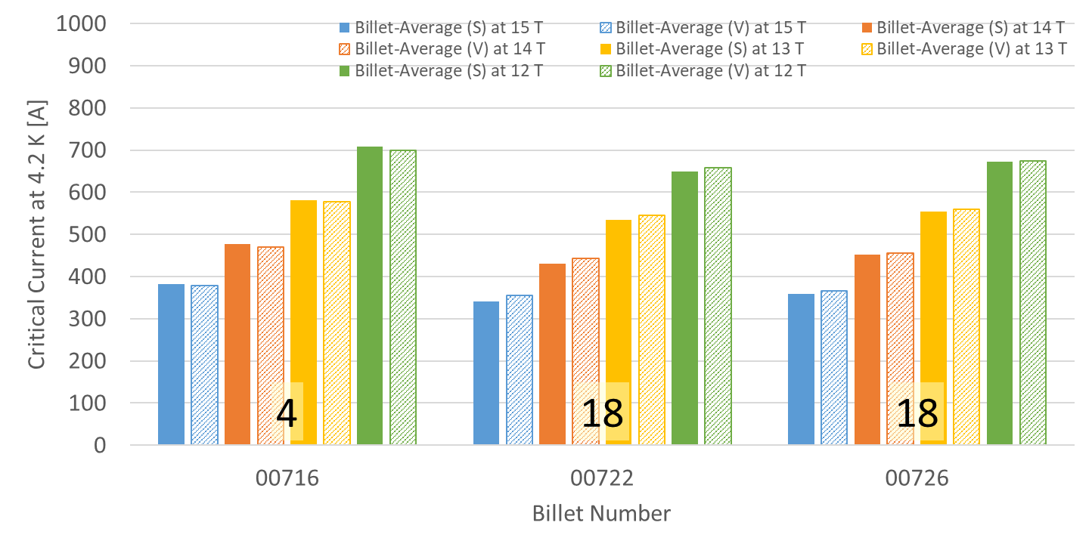
P43OL1219 – Wire Parameters
Supplier (S) and Verification (V) I_{C} Data
Number of spools from that billet used in the cable

Slide 103
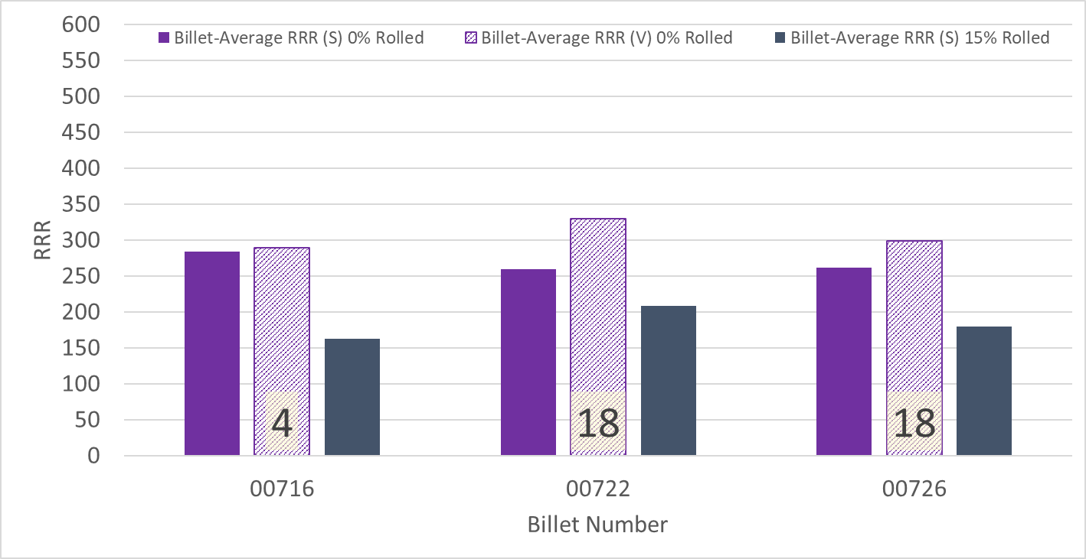
P43OL1219 – Wire Parameters
Supplier (S) and Verification (V) RRR Data
Number of spools from that billet used in the cable

Slide 104
P43OL1219 – Extracted Strand RRR
Cable ID | No. of Units from Billet (spool) | Heat Treat/ Sample ID | Major Edge RRR | Minor Edge RRR | Straight 1 RRR | Straight 2 RRR
PO08S00726A02U P43OL1219AE03E | 18 (6) | LRLK230411ALC1 | 257 | 204 | 315 | 321
PO08S00726A01U P43OL1219AE11E | 18 (12) | LRLK230411ALC1 | 272 | 225 | 301 | 297
PO08S00726A01U P43OL1219AE12E | 18 (12) | LRLK230411ALC1 | 273 | 260 | 329 | 347
PO08S00722A02U P43OL1219AE30E | 18 (17) | LRLK230411ALC1 | 253 | 228 | 283 | 308
PO08S00722A02U P43OL1219AE31E | 18 (17) | LRLK230411ALC1 | 249 | 216 | 281 | 289

Slide 105
P43OL1219 – I_{c}, Cable Qual Samples
Wire/ Cable Strand | I_{c}(A) at Field (T)
 | 12 T | 13 T | 14 T | 15 T
PO08S00722A02U P43OL1219AE30E | 623 | 517 | 415 | 329
PO08S00726A01U P43OL1219AE11E | 627 | 518 | 417 | 332
PO08S00726A02U P43OL1219AE01E | 626 | 516 | 420 | 336

Slide 106
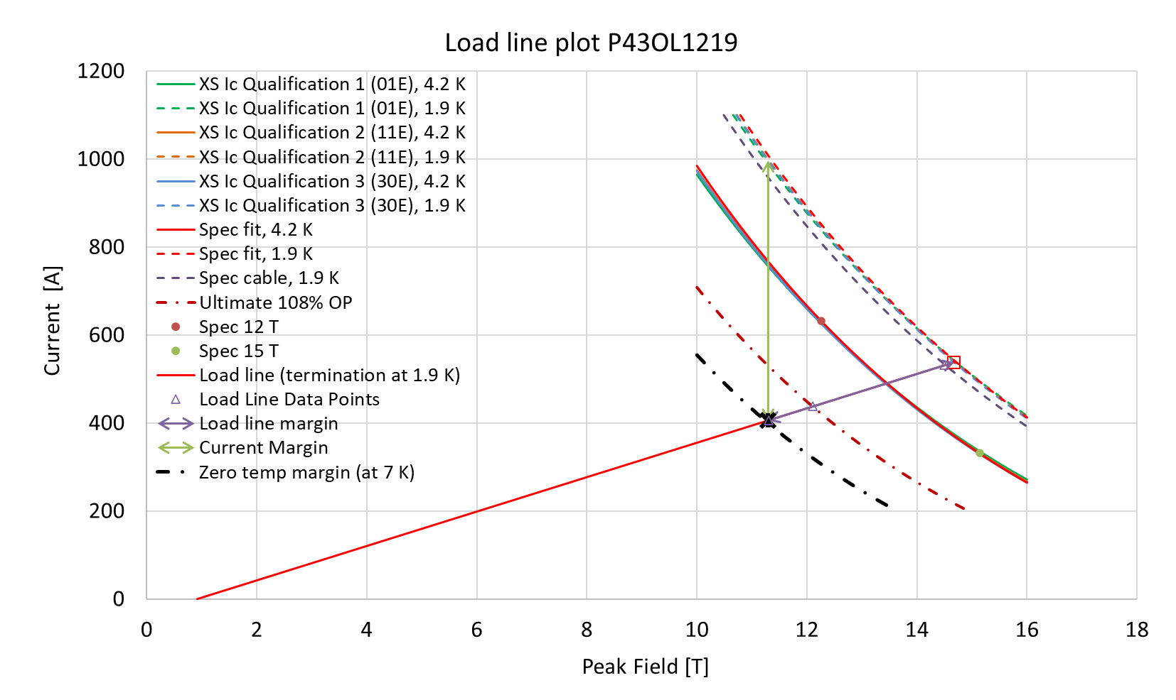
P43OL1219 – SSL Plot, Cable Qual Samples

Slide 107
P43OL1219 – SSL Margins, Qual Samples
Strand from which Margin is Calculated: | Strand # 30E @ 1.9 K
Margins | Margin | Operating Point (X)
Load Line Margin (Purple Arrow) | 24.6% | 75.4%
Current Margin (Green Arrow) | 59.3% | 40.7%
Temperature Margin (K) | 5.1 | 7.0
Limits | Strand | Strand x 40
Selected Strand’s Current (A) at Margin-Calculation Field | 996 | 39854
Selected Strand’s Current (A) at 100% SSL | 538 | 21520
Selected Strand’s Field (T) at 100% SSL | 14.7

