Slide 1
Booster Gradient Magnet
Partial Discharge Measurement Efforts
Jeff Larson & Kent Triplett
With lots of good help from:
Howie Pfeffer, Matt Davidson, Matt Kufer, Chris Jensen, Ryan Crawford, Todd Johnson, KeAndre Worthy
& a host of others!
2023 & 2024

Slide 2
A Little History…
Testing the gradient magnets for partial discharge was suggested to us by Technical Division Folks in 2023 – Thanks Dave!
Worked with PESD to borrow their Partial Discharge Detector, began learning how to use it.
Testing began in late 2023. Problems with the Biddle display required replacement of the CRT HVPS. Onsite repairs completed and Biddle ready for use by end of January 2024.
Primary instrument used to measure partial discharge is a Biddle 27000 Series Partial Discharge Detector (belongs to PESD).
By March 2024 we had just learned how to use Biddle Evaluation Unit to associate displayed numbers with the Biddle O-scope displays.
Attached an A/D unit that records the partial discharge and test voltage. Record rate ~ 350 Hz per channel. Gave us the ability to produce images of the testing results. Also, testing results are recorded and can be played back anytime!
April 2024 added 500:1 divider and buffered RMS circuit for accurate measurement of the applied test high voltage.
Began using an Elgar when some sine wave distortion was noticed on our test voltage which cleaned up the applied waveform nicely.
HV Transformer upgraded a couple of times during the process for better test voltage. Now using a Penning Gauge Cold Cat transformer. At 1KV max current 5mA (2KV max 18mA)
Out board scope added for better viewing of partial discharge
Efforts supported by Impact Work Package # 37042 Booster Girder Partial Discharge Testing

Slide 3
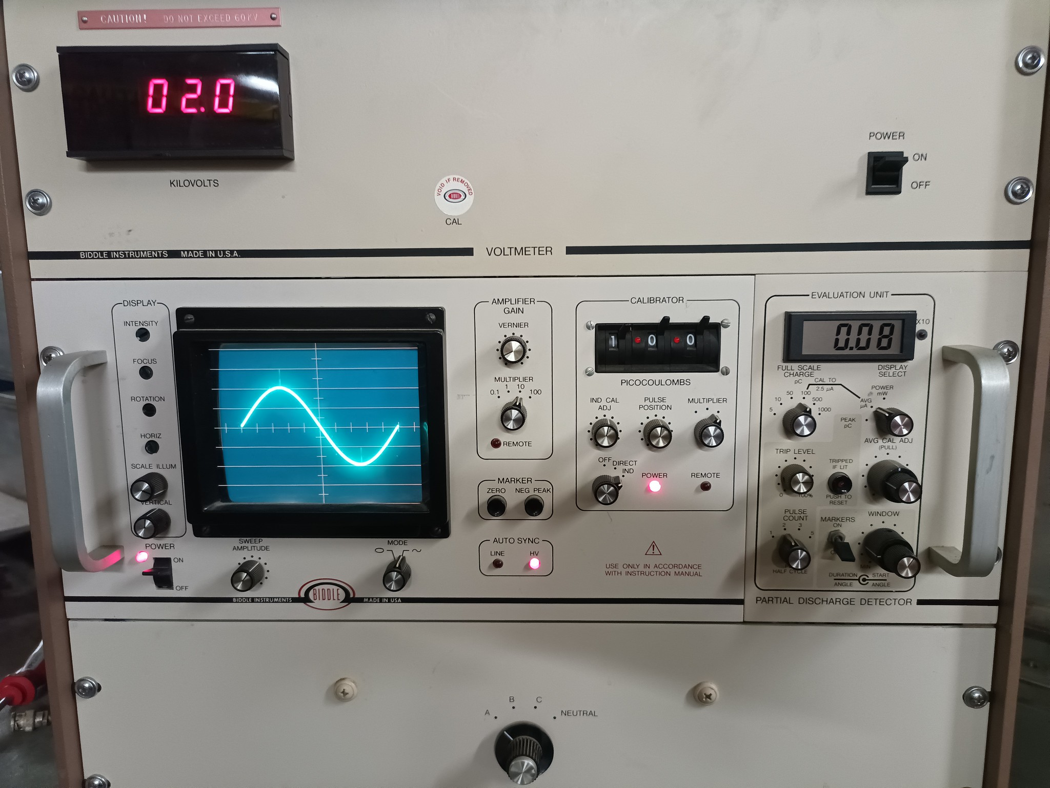
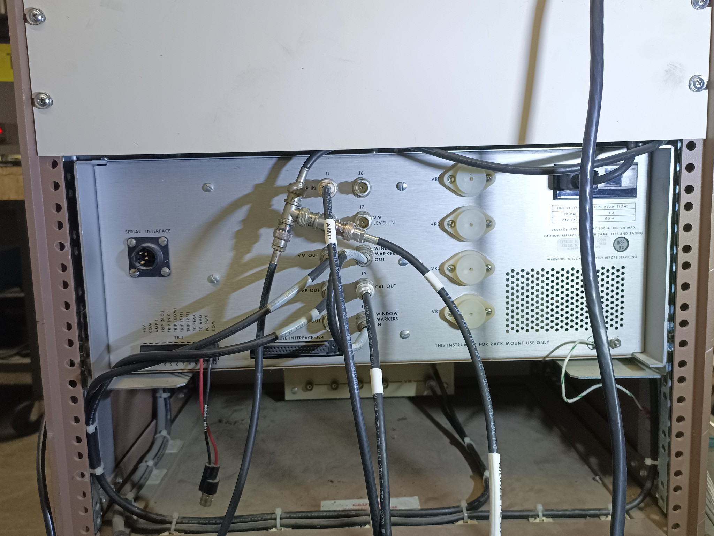
Biddle 27000 Series Partial Discharge Detector
Circa 1992
Offers kilovolt meter reading at top
CRT Display with controls for calibrating observed signals
On board Calibration Source Unit
On board Evaluation Unit counts and provides a trip level!
Rear Panel connections to the load and offers measurements opportunity for:
Peak partial discharge (pico Coulombs)
Average partial discharge (micro Amperes)
Apparent Power Dissipation (milli Watts)

Slide 4
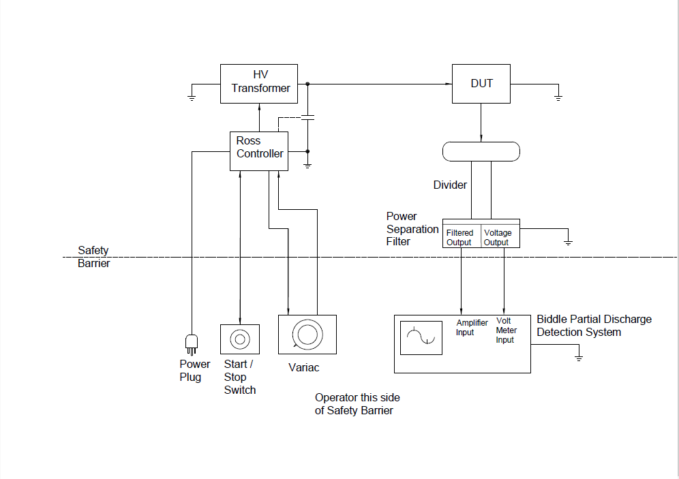
Biddle book diagram of System Configuration
Our diagram of how it is implemented.

Slide 5
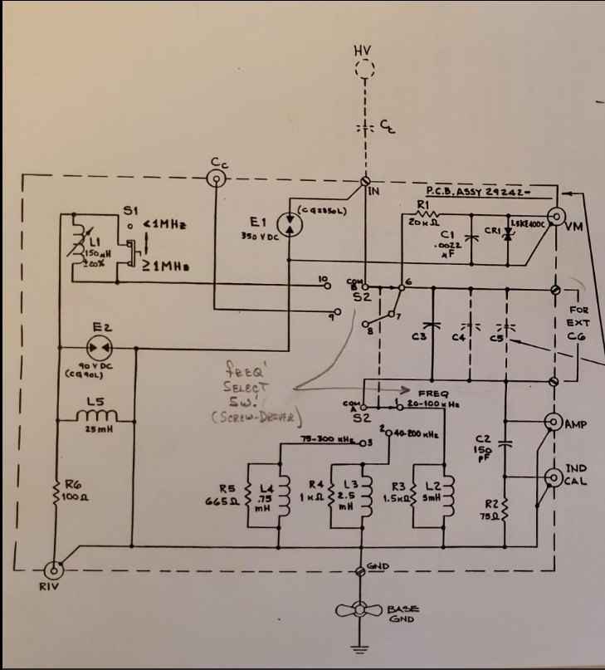
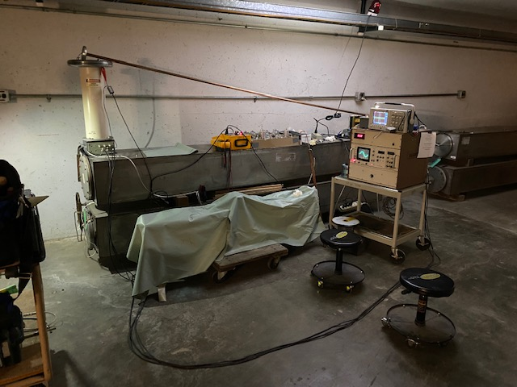
Power Separation Filter
Capacitive Divider that allows connection to PD Detection Electronics
Early testing of one of the Booster Spare Magnets inside the gate. Calibration in progress.

Slide 6
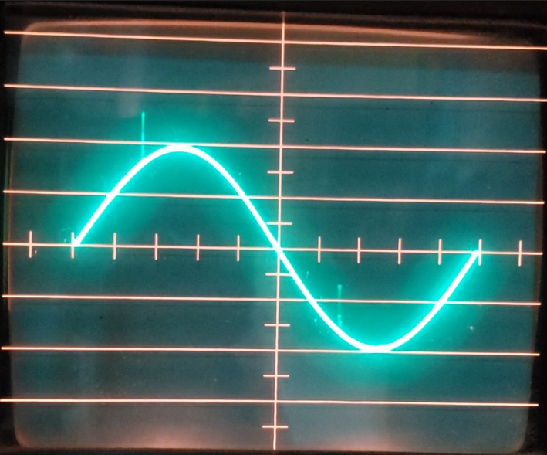
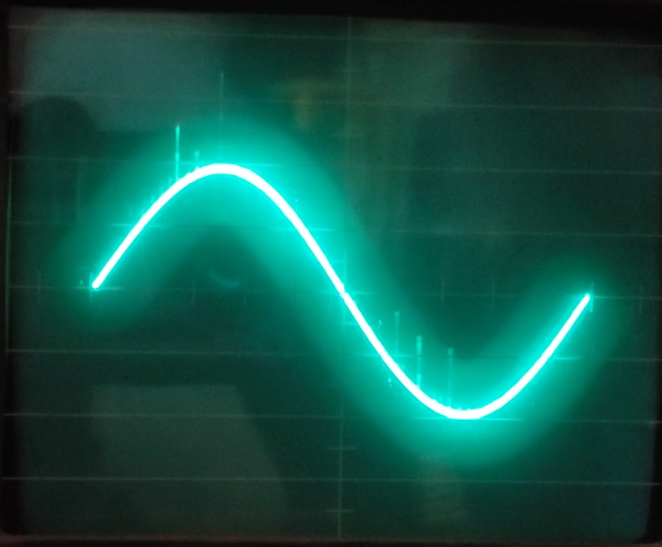
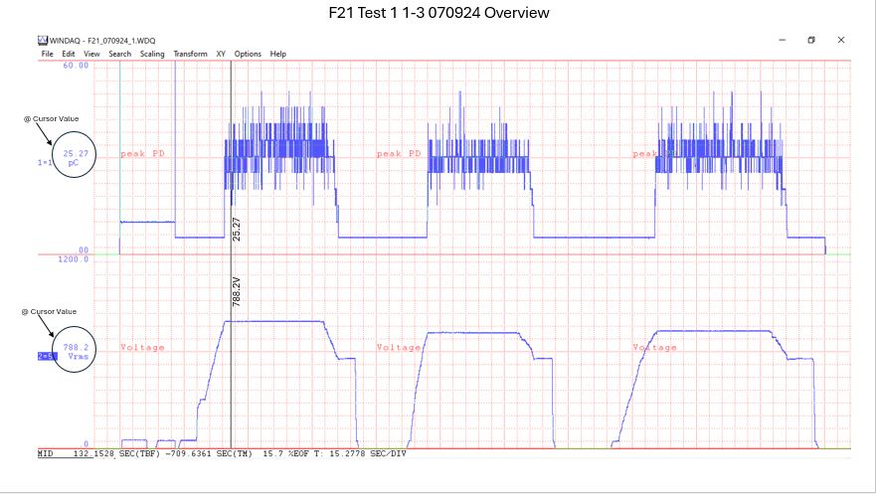
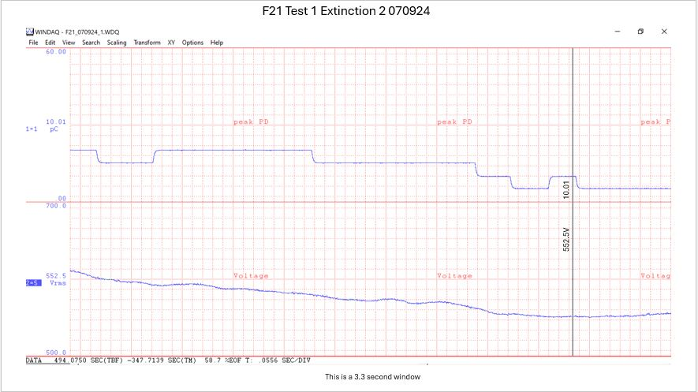
Biddle Oscilloscope Display
Left image showing calibration is set, no HV applied, preparing to test
The two ‘markers’ are calibration pulses used to help quantify scope signal displacement.
Right image showing HV applied with display of ~ 100pC of discharge.
Detecting
Partial
Discharge
D/A Output
Left image is a wide view, window is ~15 minutes wide
Right image is a close view, ~ 3 seconds wide.
Note the Y-axis mid-scale values shown are the cursor location values.
These values come from the Biddle Evaluation Unit
The numbers from EU are ~ 1/3 the value of some peaks observed on the Scope
Top trace is the resultant partial discharge in picoCoulombs
Bottom trace is the Applied Voltage in RMS
Cursor

Slide 7
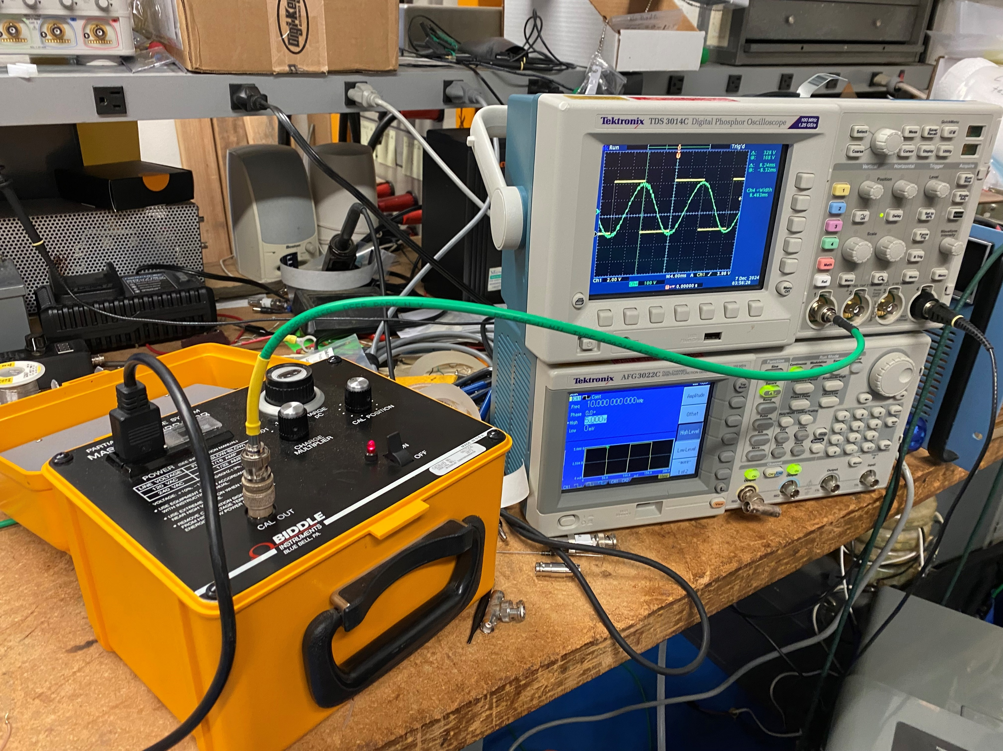
The Biddle Master Calibrator
Provides a calibration source variable 0 – 1000pC
Output is a square wave with 8.3mS pulse width
Pulse height of 13.33V equivalent to 1000pC output
Synchronized to power line
Master Calibrator agrees well with On Board Calibrator
Our Calibration Procedure
Every testing effort begins with a calibration check and set, as well as a noise floor observation/minimization.
If noise floor is above 5pC, make efforts to reduce the noise floor. This could include efforts to move cables, move components, and turn off electrical noise sources.
Assure magnet & testing setup are configured as desired and are ready for the test.
Assure HV is off.
Attach Master Calibrator to testing setup
Turn on Master Calibrator and set 490pC of output.
Adjust Biddle Amplifier Gains and Scope so display is ~5 divisions and the Evaluation Unit is reading ~490pC. Verify the D/A also sees the expected voltage and response.
Adjust Master Calibrator for 100pC output.
Verify Scope, Evaluation Unit, D/A all indicate about 100 pC of partial discharge.
Turn off Master Calibrator and disconnect from Setup before applying test voltage.
We also check the test setup by itself without a test load attached. Can run the testing setup to full 2.1KV and watch for any signs of partial discharge.
Master Calibrator output is a square wave w 8.3 mS pulse width
Yellow square wave displayed is the Master Calibrator output
Green AC wave is sampled in our room and shows how ratty our line is!

Slide 8
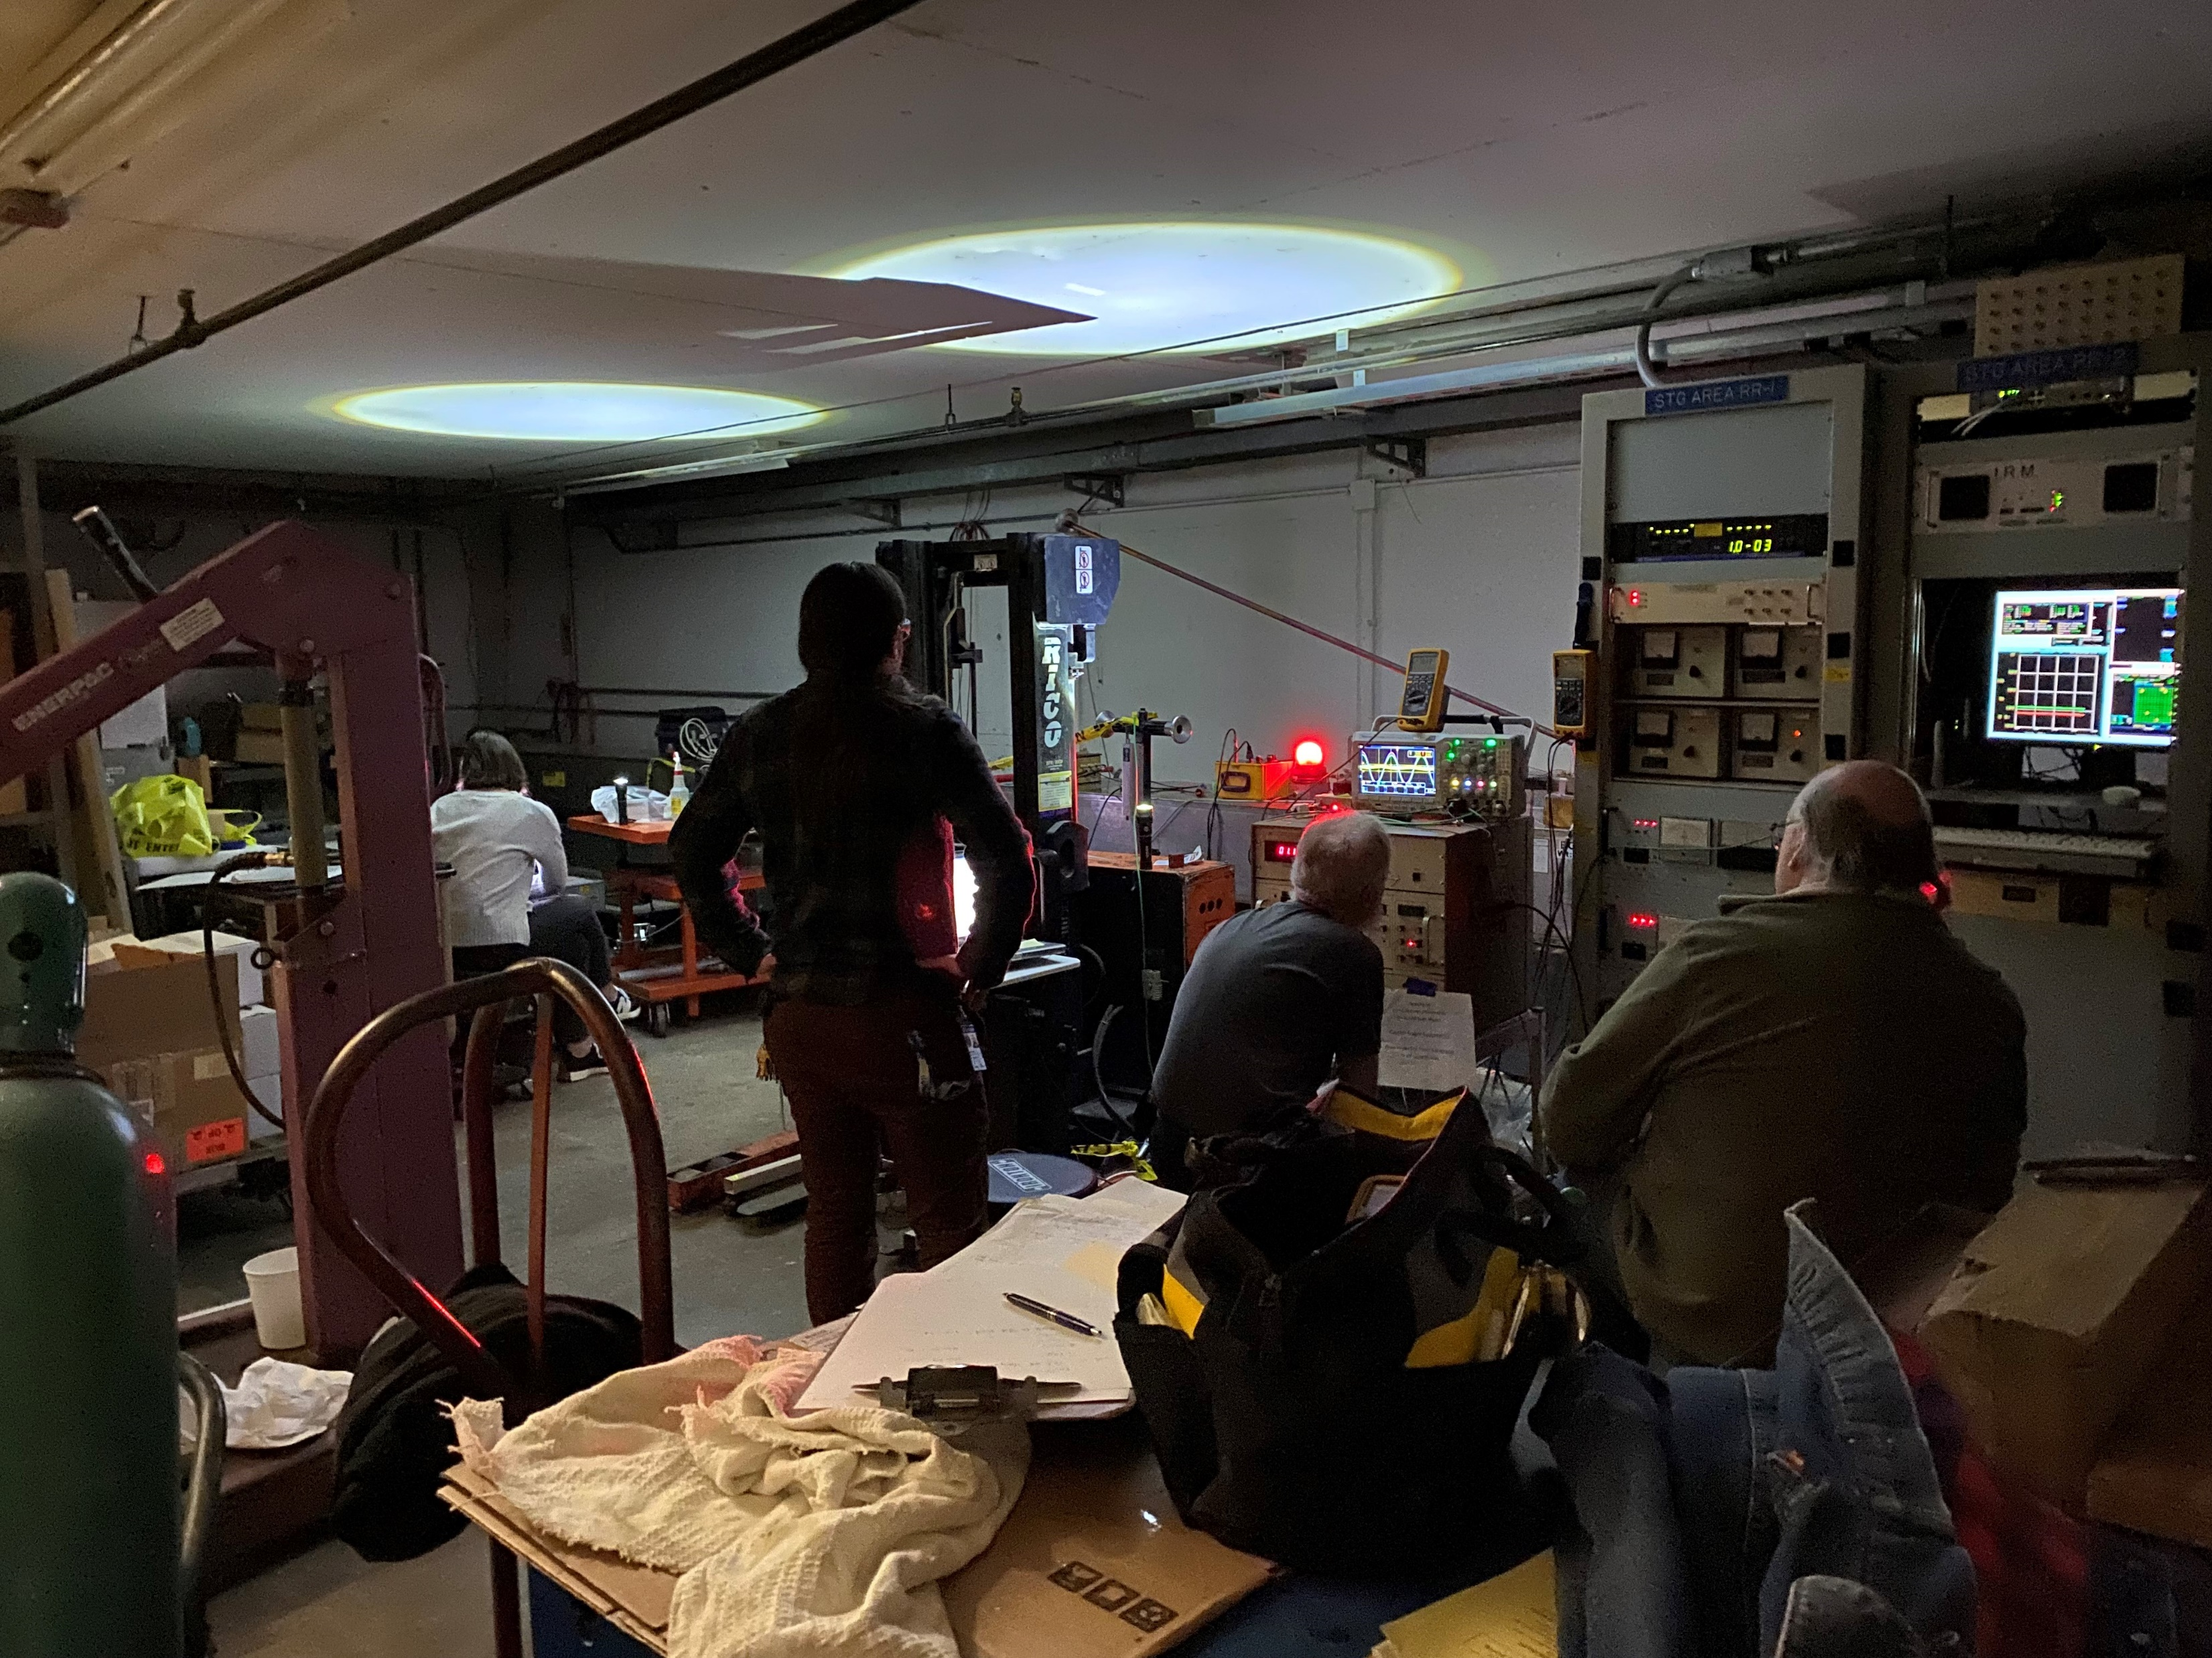
The following pages show some results of corona testing on the F21 magnet in the Staging Area on May 7 and on May 9, 2024.
F21 magnet is under vacuum with B:IPS1 at ~4.2 E-7 torr for these tests.
RGA is connected. Thanks MSD folks!
No vacuum activity was observed due to testing.
Note during 02/22/24 F21 test, the ion pump tripped off during testing. Sorry no D/A images to show, After that event, we did not encounter another vacuum rise during testing.
Listened carefully for external corona on the magnet and in the setup.
Used two different detectors.
The Ultra Probe “Sound Gun” ultrasonic detector by UE Systems Inc needs ~250pC of discharge before it can detect corona.
The Radar Engineers model 247 Hot Stick Line Sniffer can detect below 100 pC. It is very directional but can detect down to ~50 pC of discharge or better. Ultrasonic mode works best.
No external corona was detected on the magnets and testing apparatus.
Tested various external corona sources and evaluated how effective our detectors are at hearing corona.
Partial Discharge Testing in the Staging Area with RGA attached
Kathryn Laureto operating the RGA – thanks Mechanical Support folks!
Matt Davidson & Todd Johnson helping us with the testing process
We turned off Staging Area lights because PSF vulnerable to electrical (ballast) noise

Slide 9
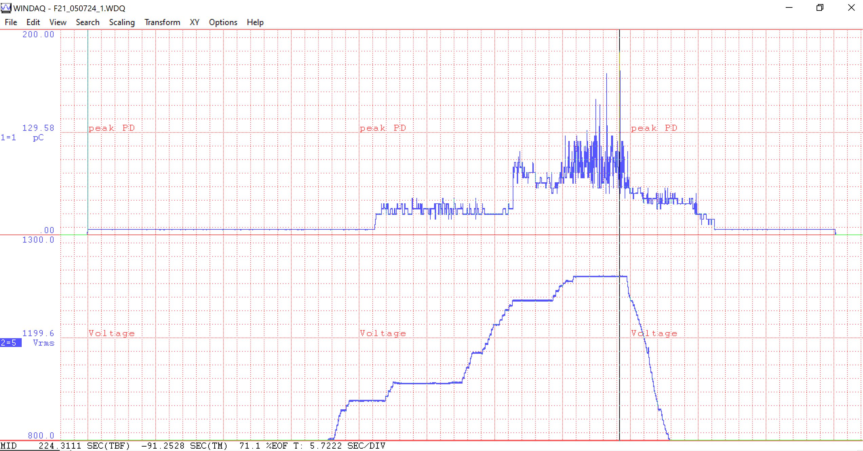
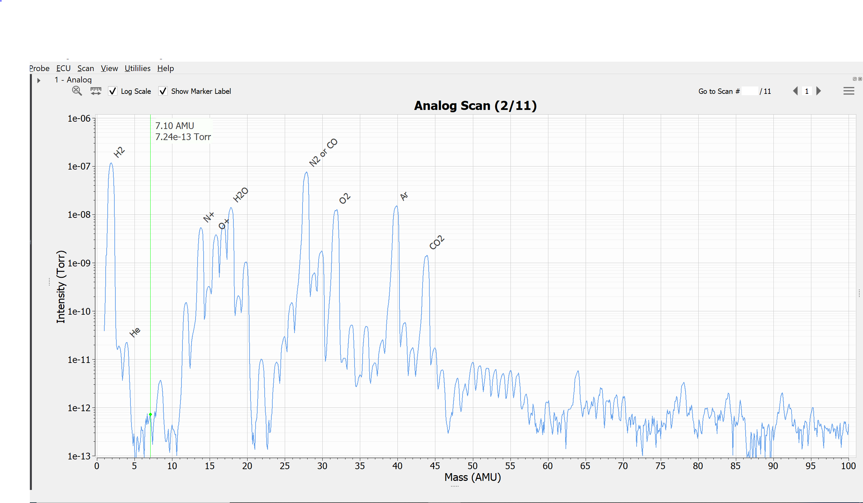
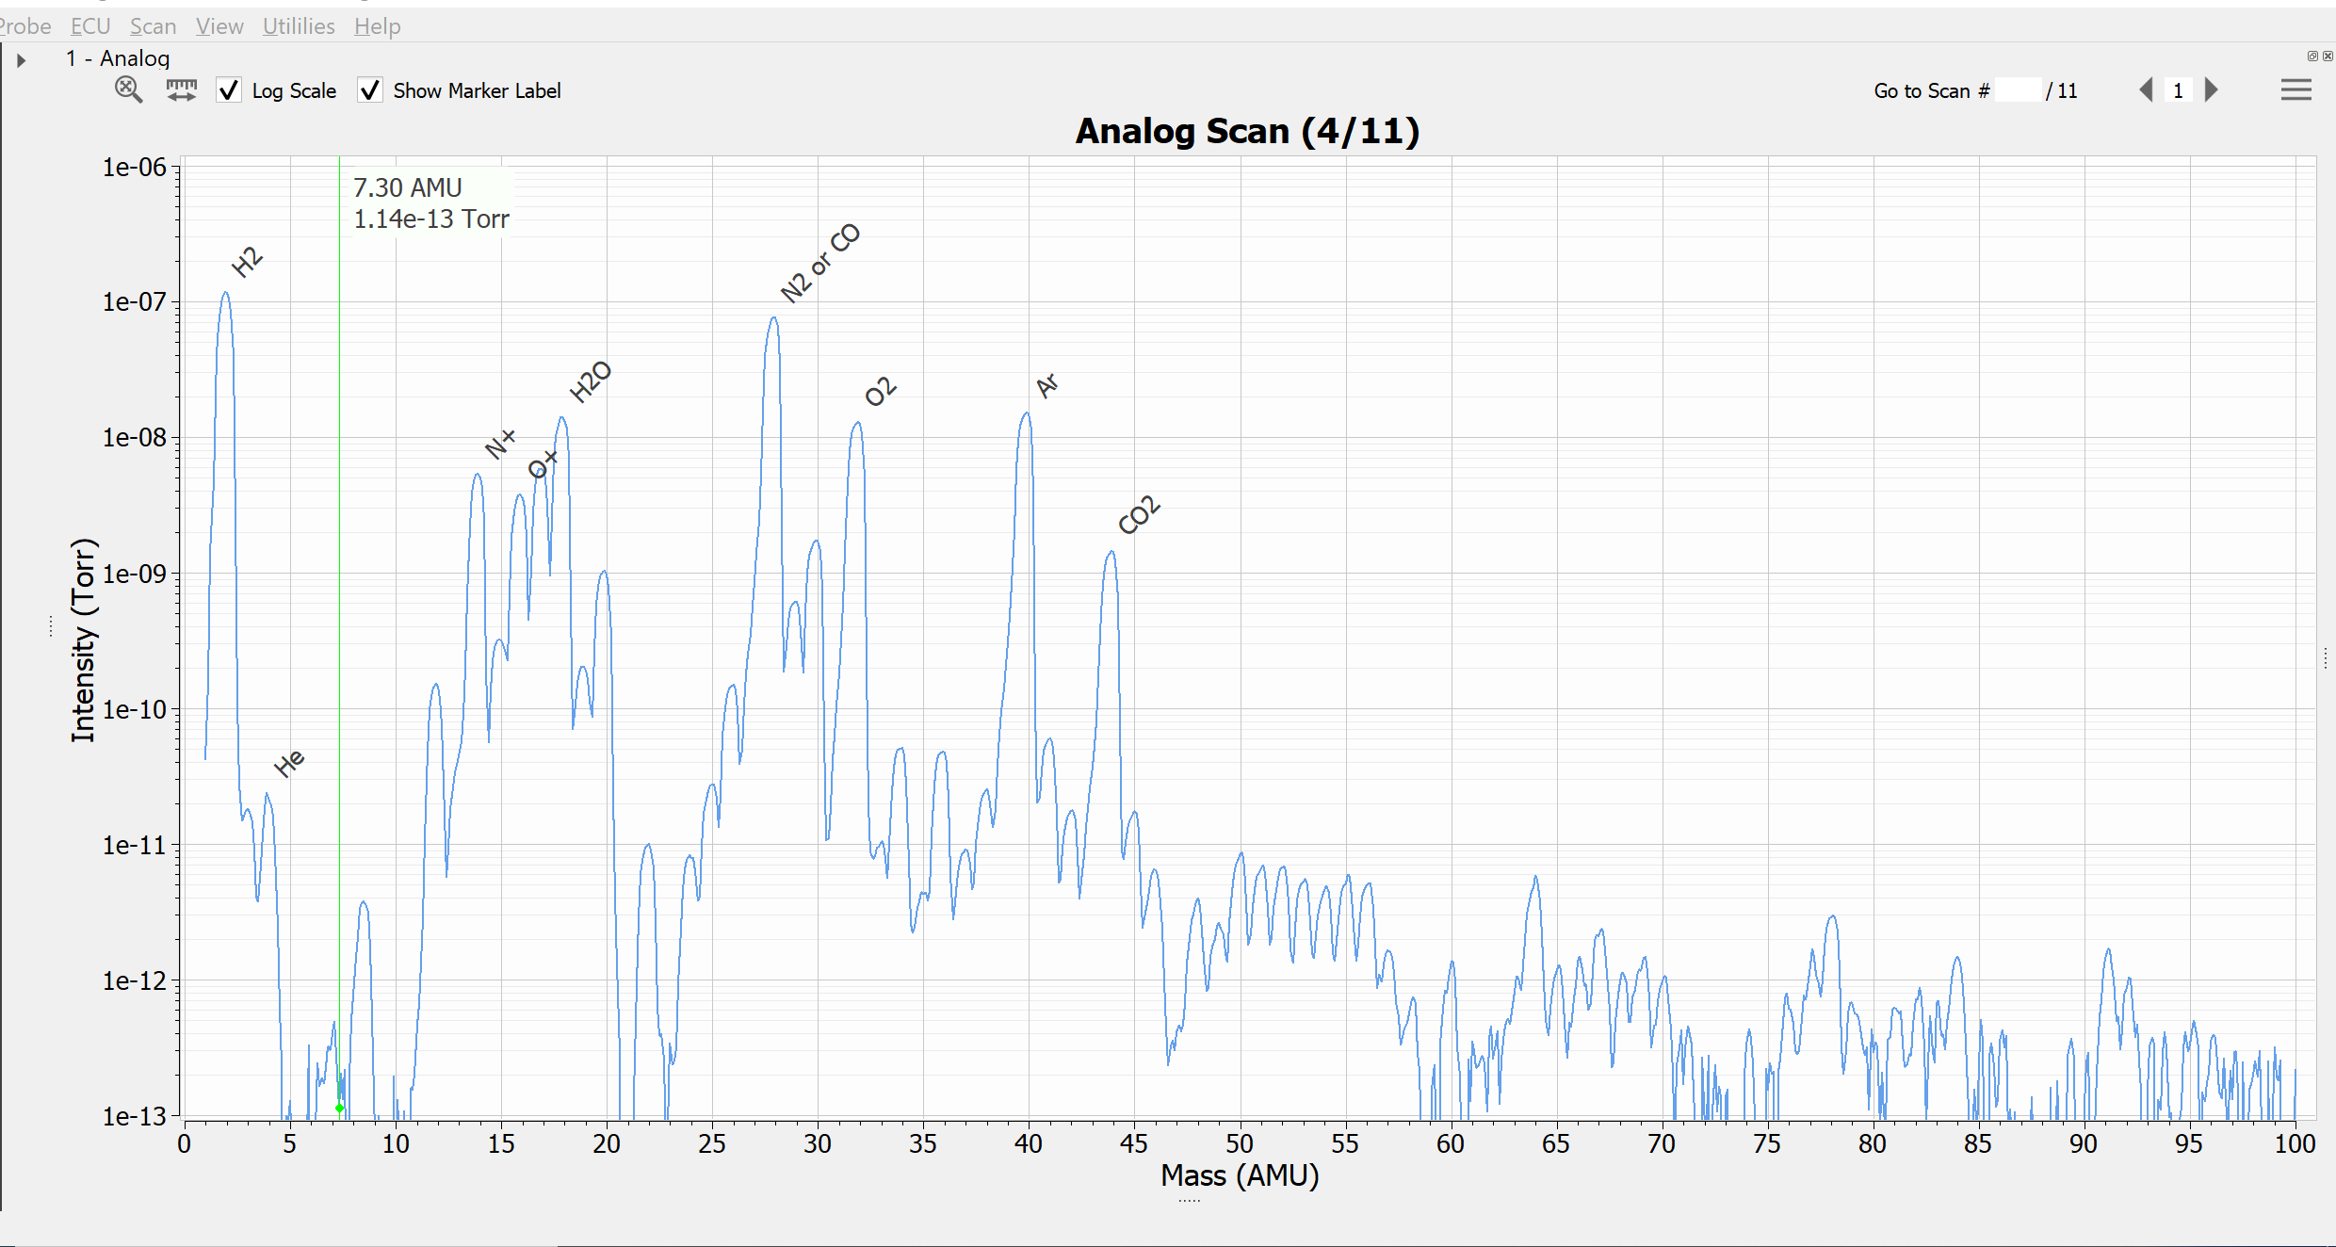
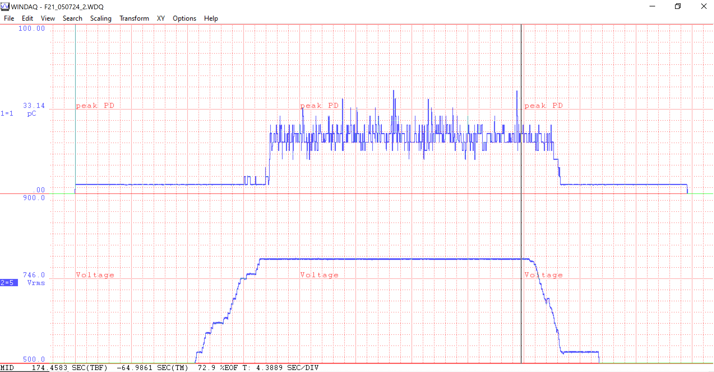
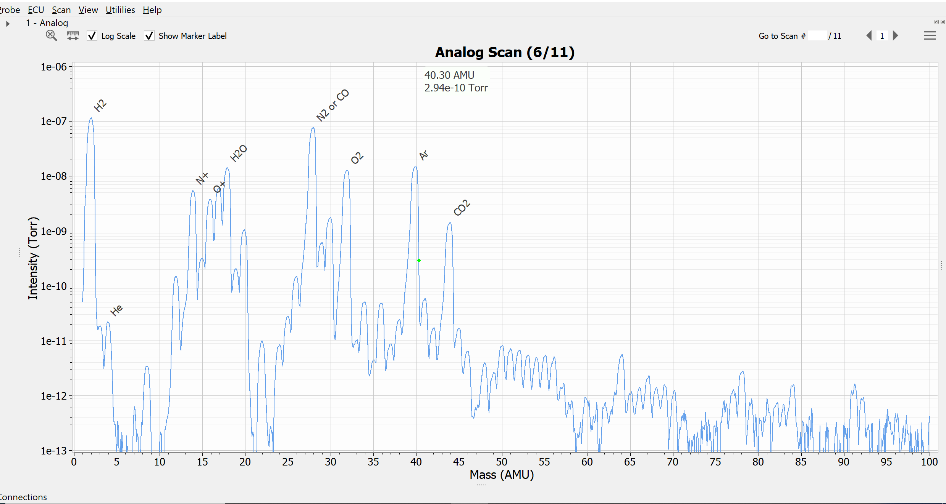
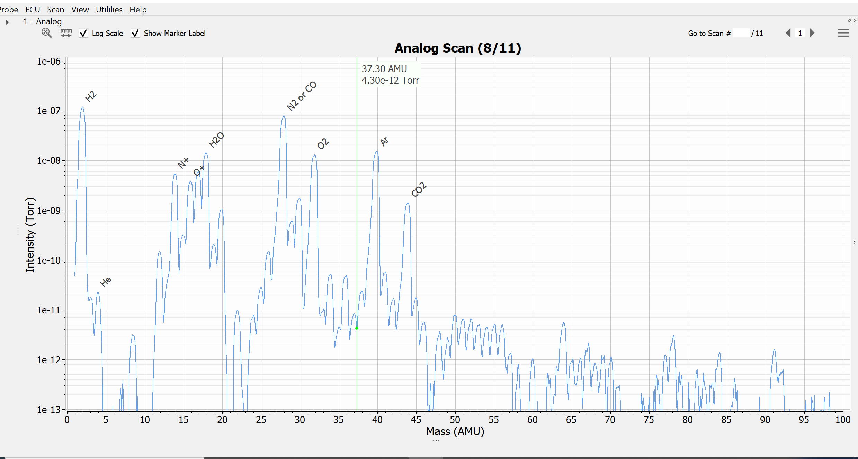
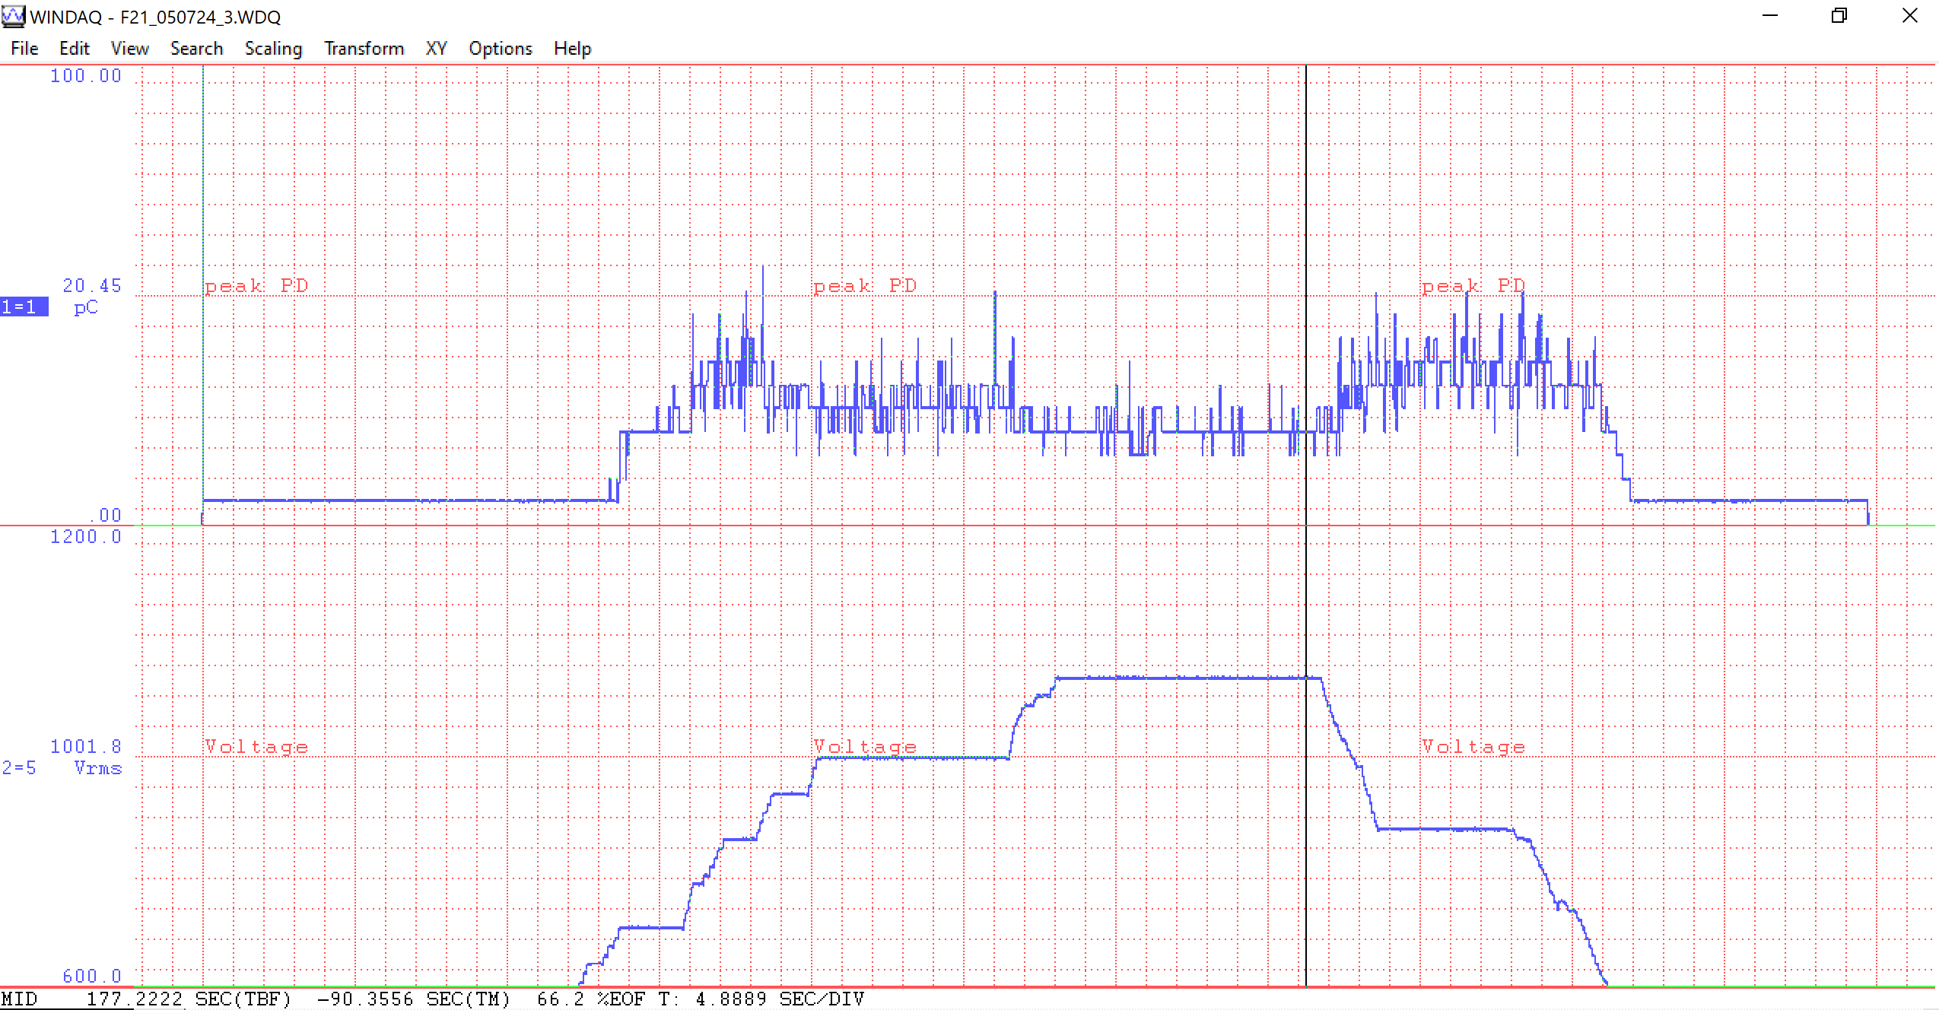
Test 1
F21 Tests 1-3 050724 Overview
Scan before tests begin
Scan during testing
Test 2
Scan during testing
Scan during testing
Test 3
F21 magnet is under vacuum with B:IPS1 at ~4.2 E-7 torr for these tests. RGA connected.
We did not observe any vacuum activity associated with this testing.

Slide 10
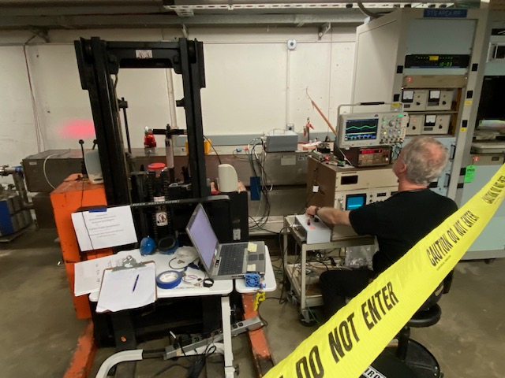
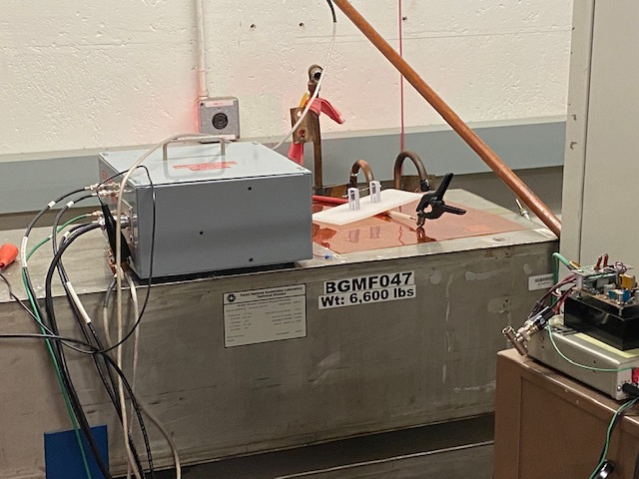
Our Testing Setup has evolved & improved!
Modified Kufer Corona Test Box now takes place of the
Biddle PSF capacitive divider!
Much more compact, transportable, less susceptible to noise!
Accurate Vrms via RMS circuitry
DataQ A/D unit makes recording applied V and resulting partial discharge possible. Interface via laptop.

Slide 11
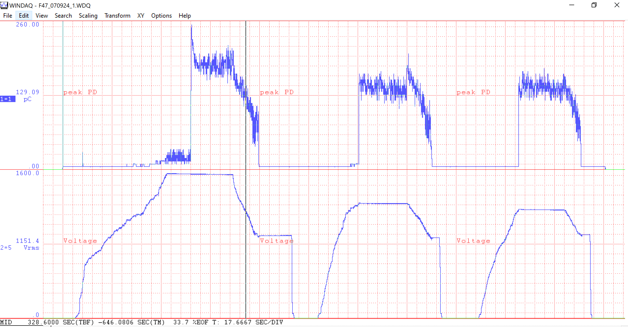
F47 Test 1 1-3 070924 Overview
Here F47 magnet is at atmosphere

Slide 12
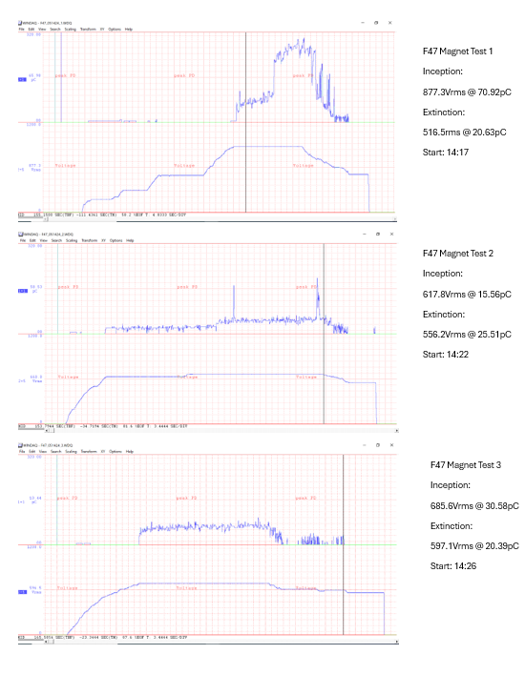
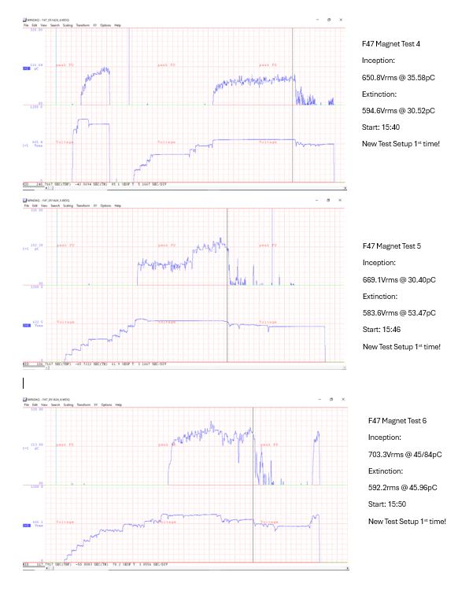
F47 Tests 1-6 051424 Overview
Comparing the PSF to Kufer Box Response
‘Original’ setup
New setup used 1st time

Slide 13
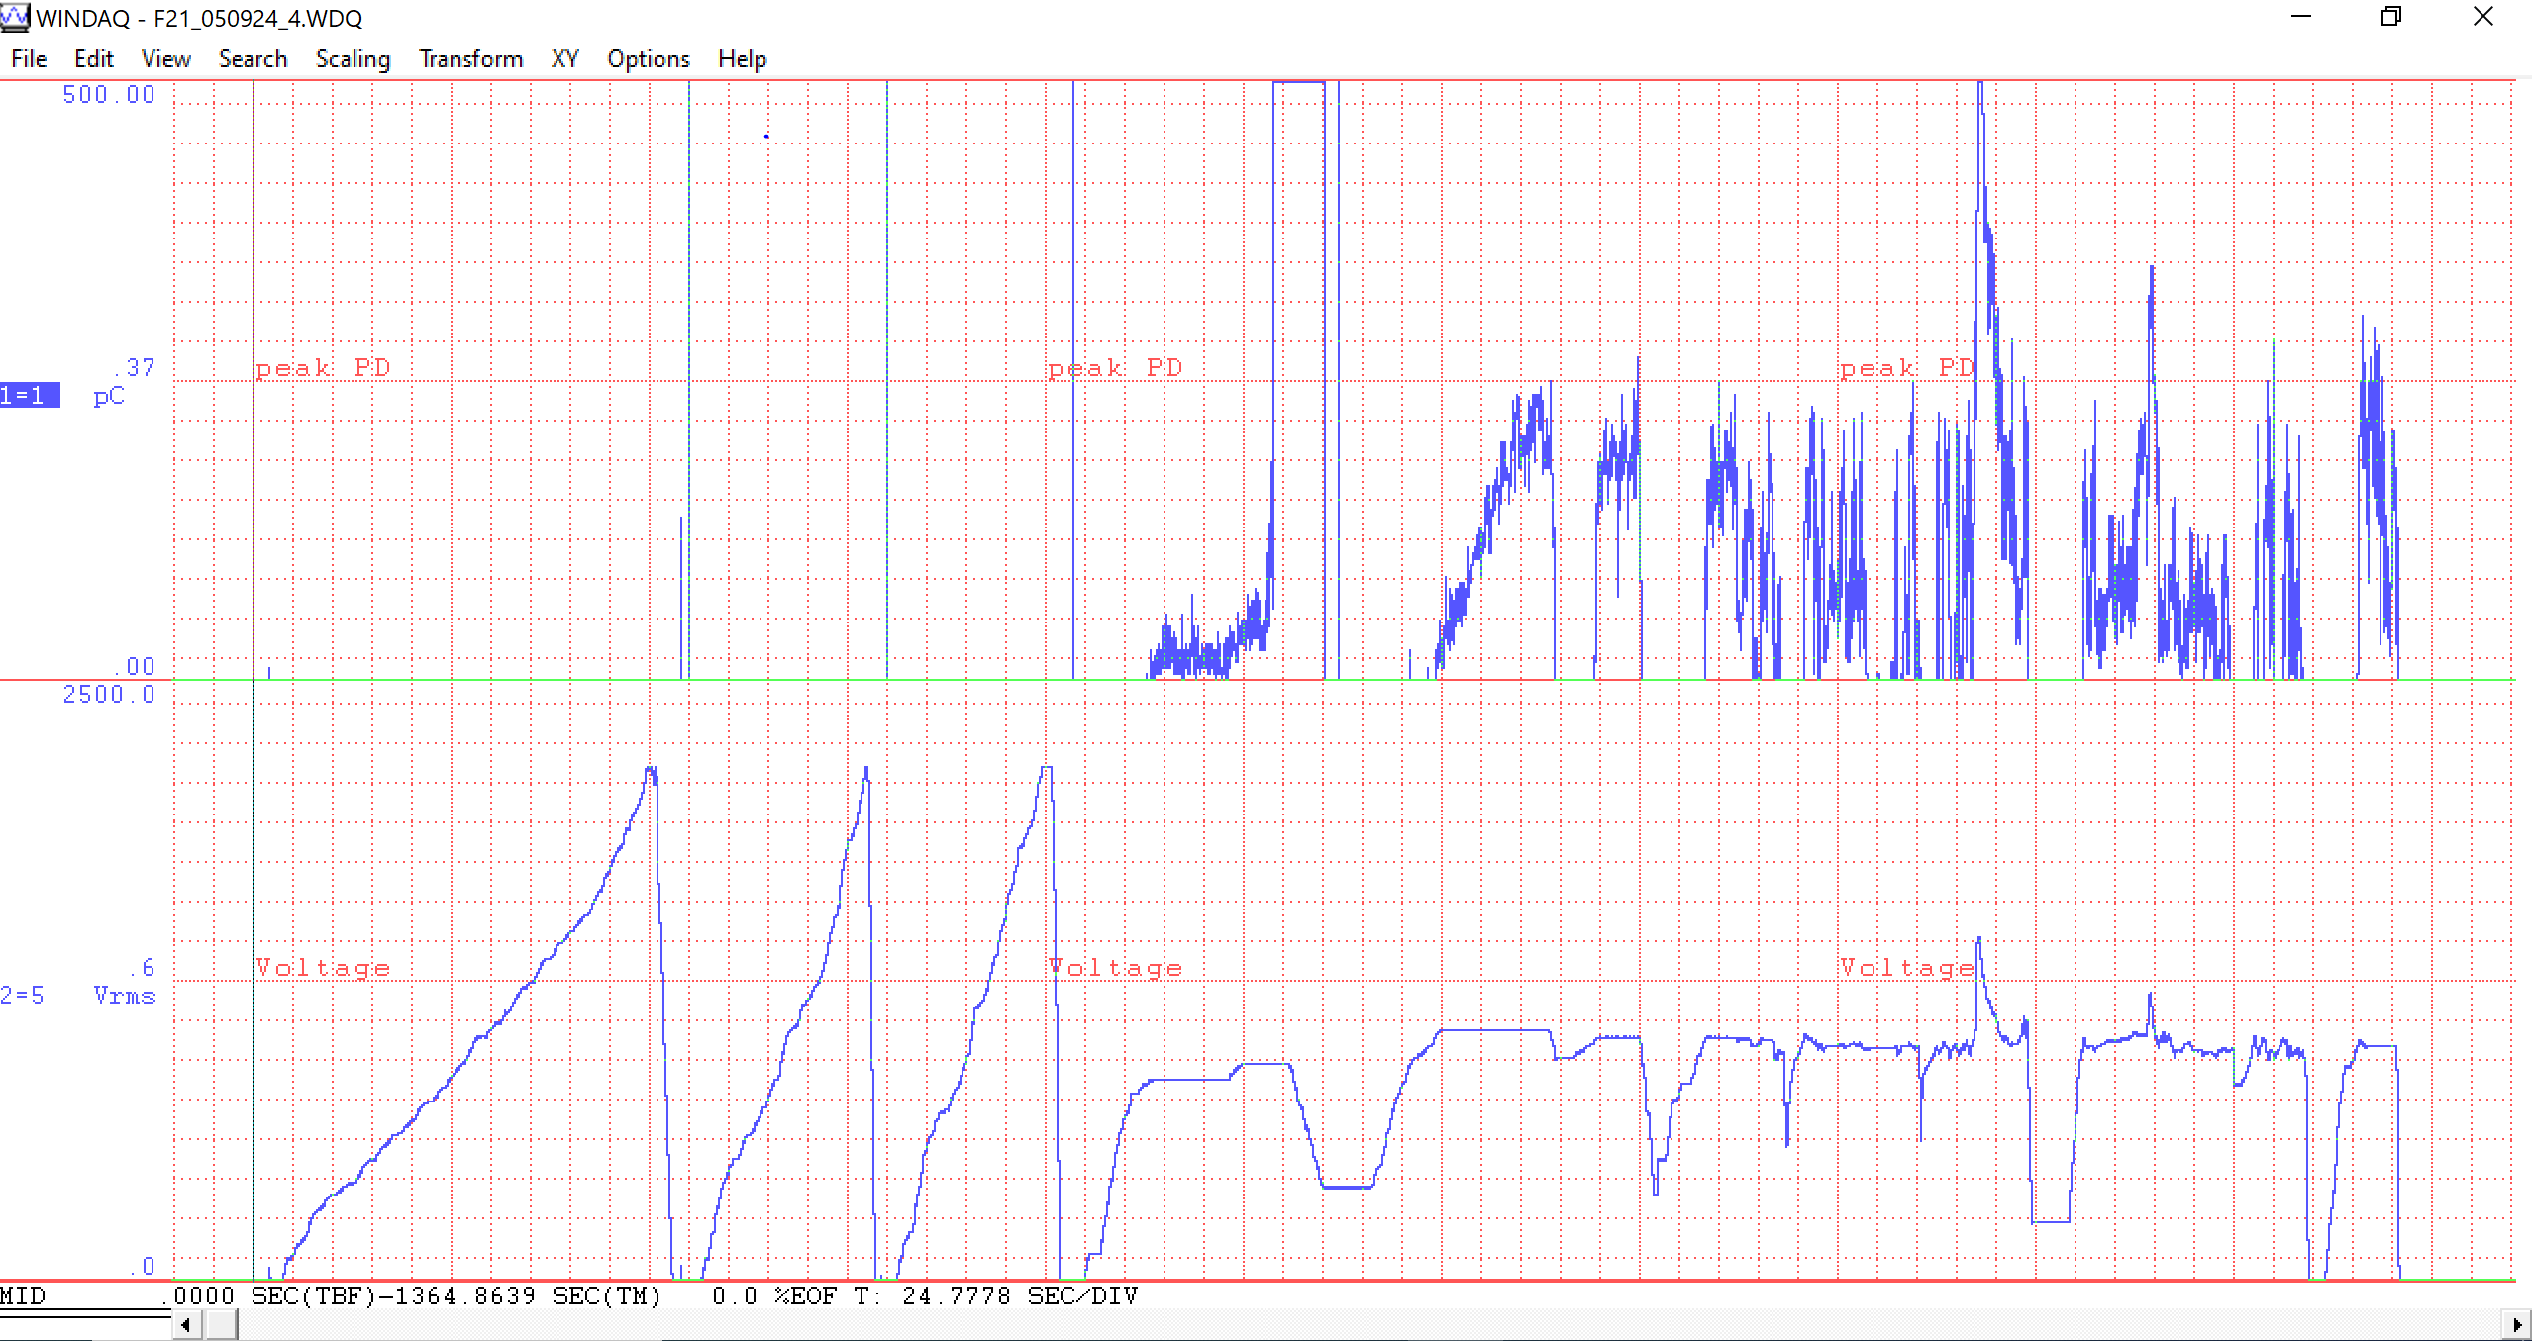
External Corona Tests 050924
Spark Gap < 1/16” & No Kapton
Spark Gap 3/16” & Kapton
Spark Gap 3/16” No Kapton
HV Lead to corona ball laying on Kapton Sheet on F21 skin
Here we are trying to make external corona and test the ultrasound detection. As you can see, it was not easy to make corona with the test spark gaps at our testing voltages!

Slide 14
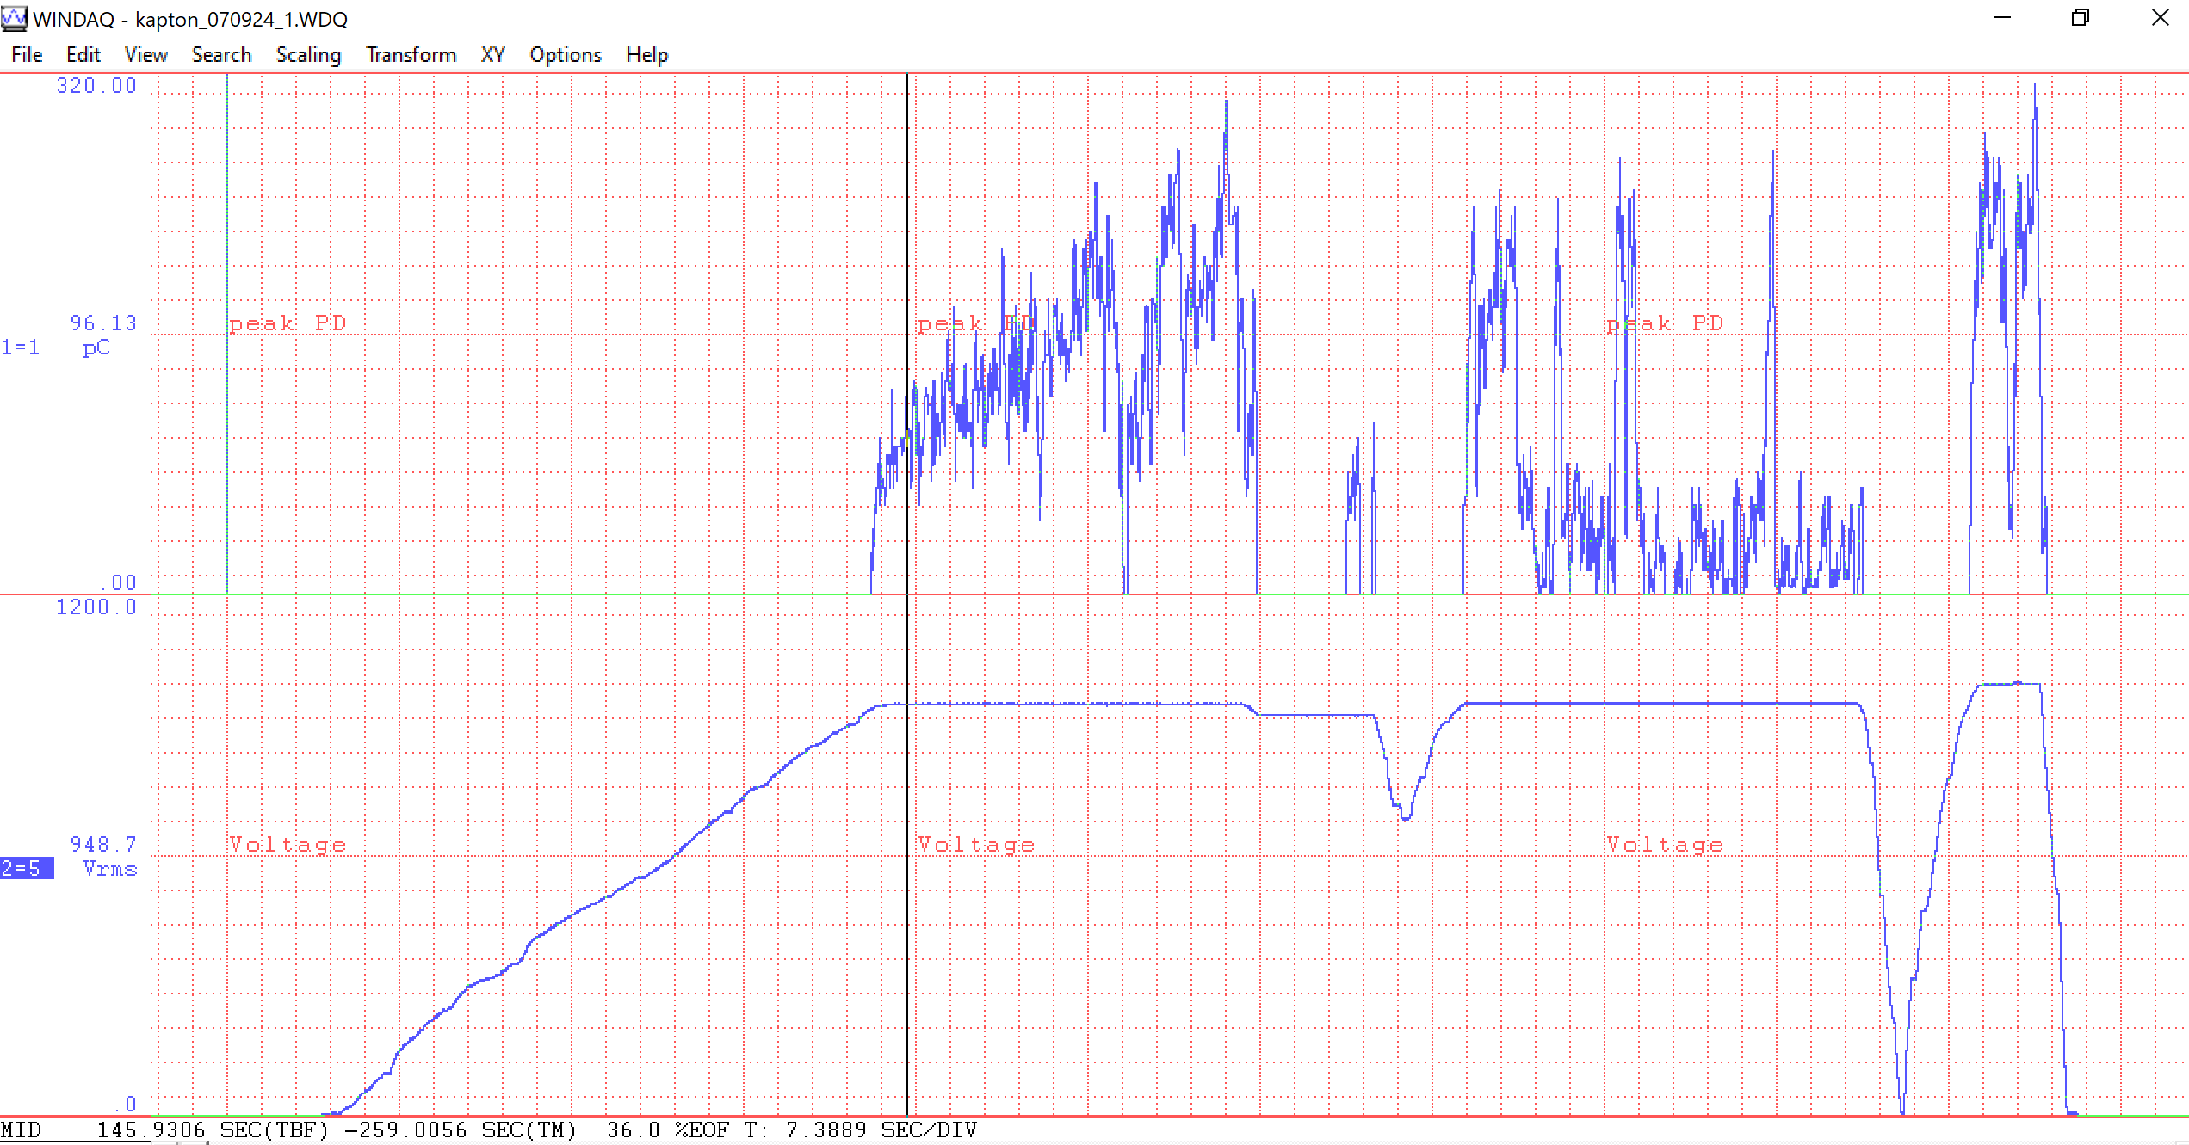
Kapton Test 1 1-3 070924 Overview

Slide 15
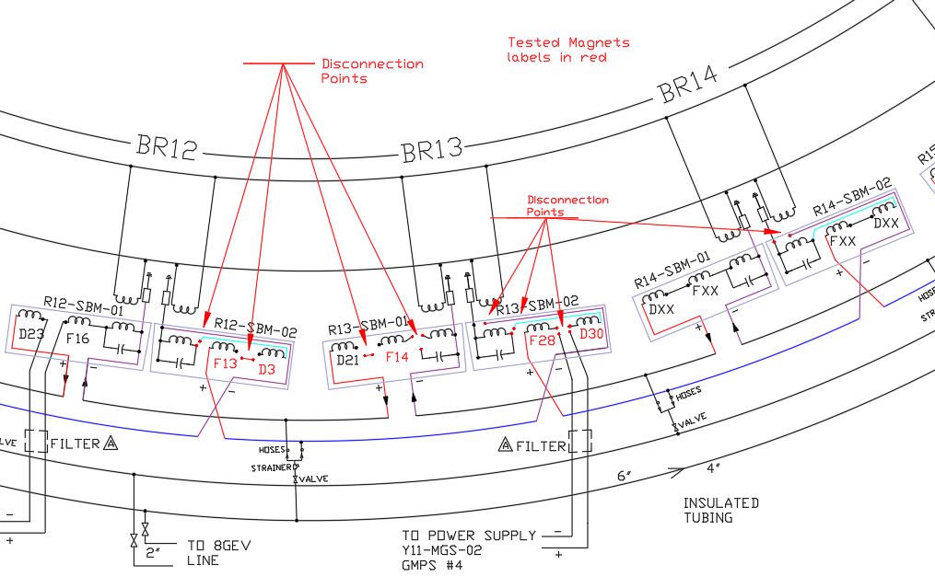
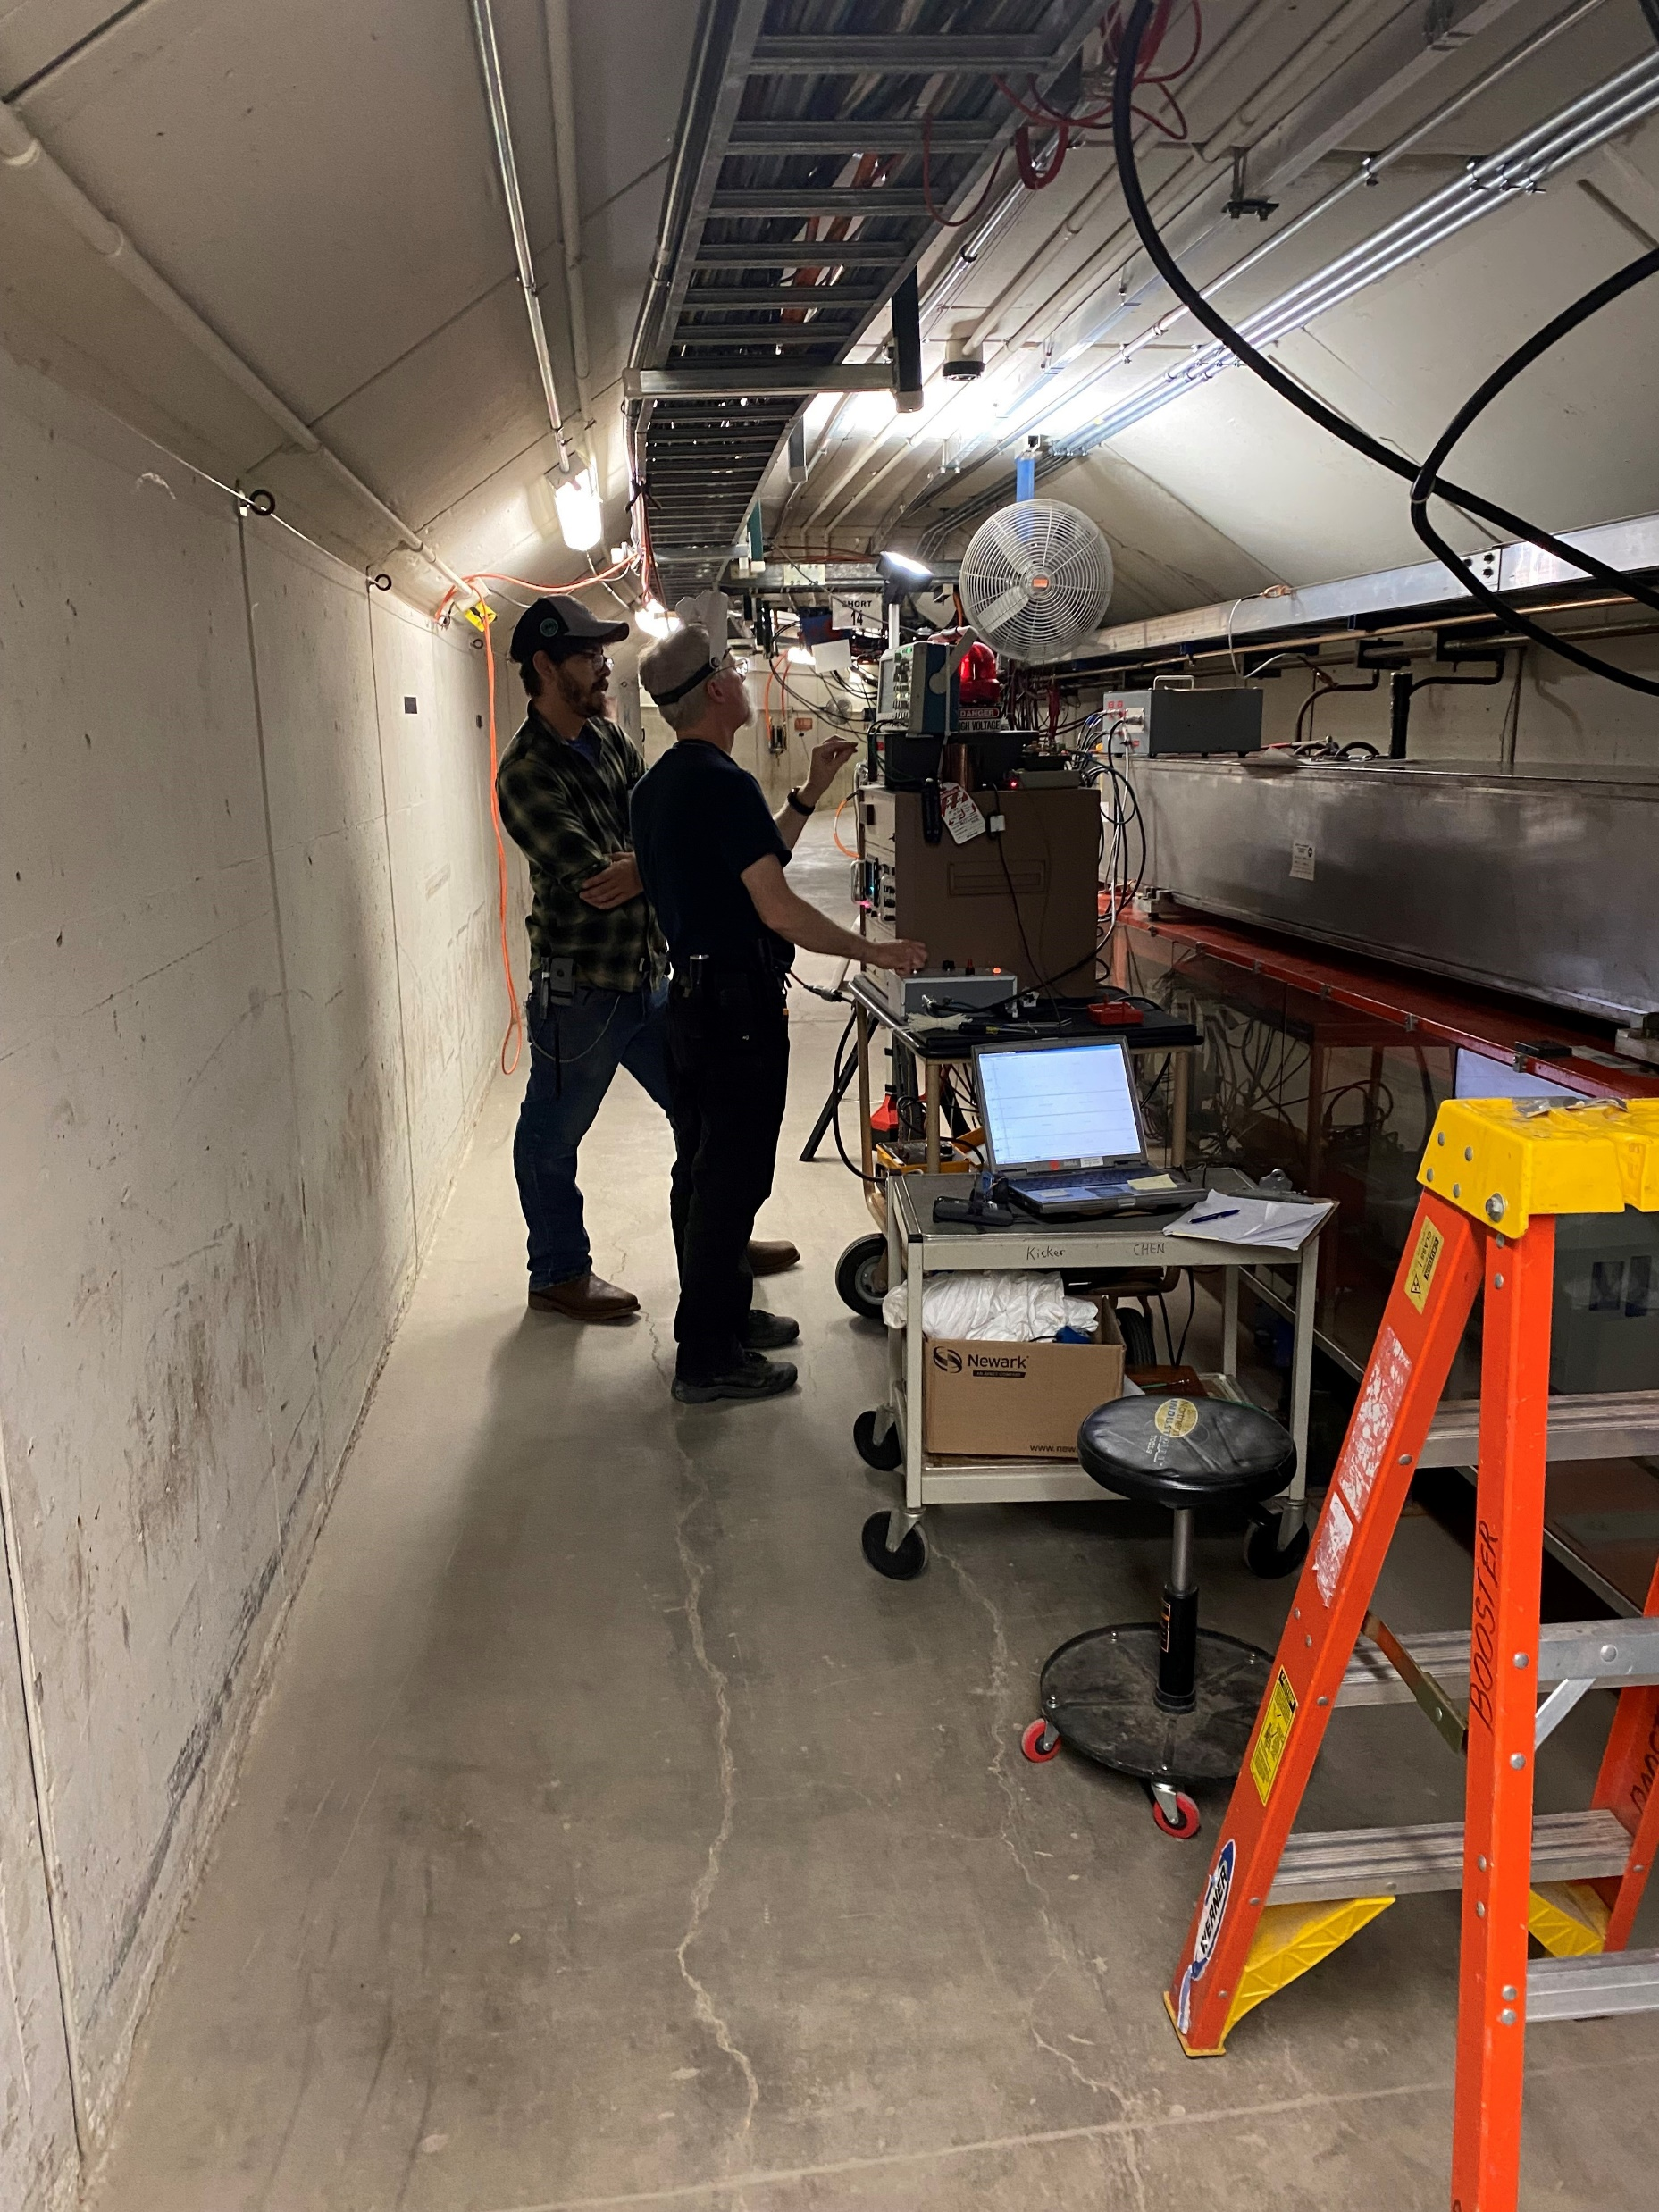
Partial Discharge Testing in the Booster Tunnel
We were able to test 8 magnets in the tunnel during Shutdown 2024.
No operational magnet was totally isolated during testing. We did not want to cut the bus.
At best, the magnet and the girder manifold would have been tested.
At worst, the magnet, girder manifold, and bus work to next series girder was included.
All bus work into and out of a test area was verified to be grounded.
Bus Connections for
Girder Choke
Girder Capacitors
V-G Divider
COTO Relay
Magnet or PS
were removed for the testing.
LCW was flowing at some level during testing.
The Booster Bus offered locations to isolate portions of the magnet string

Slide 16
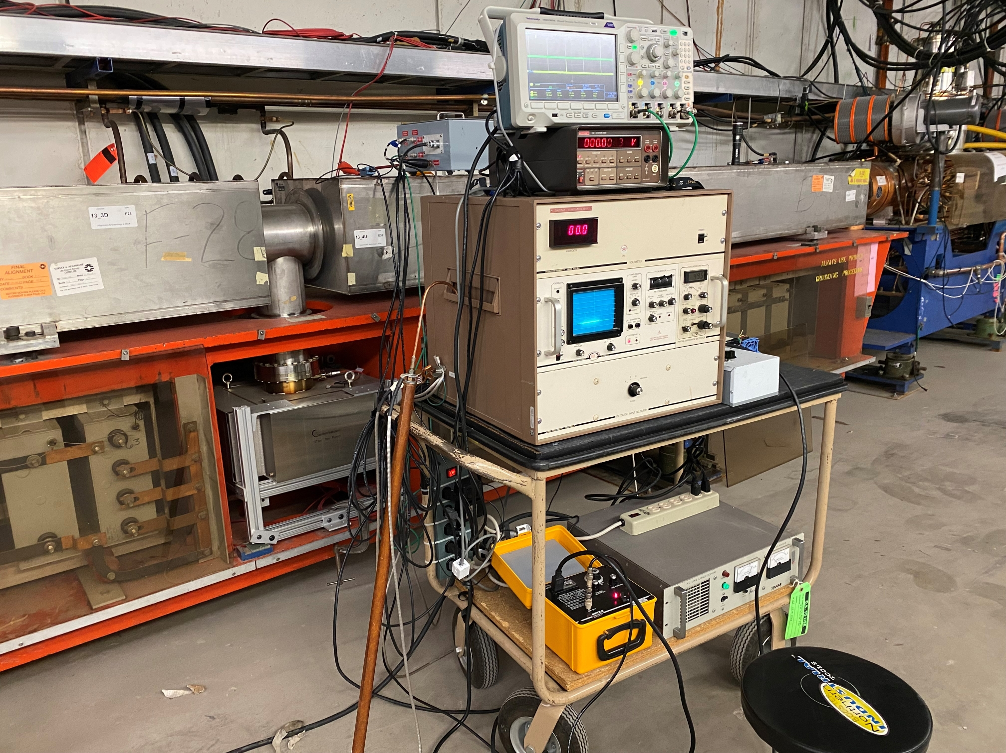
The following pages show some results of corona testing during the Summer Shutdown 2024.
Tests include:
F14 magnet on the 13-1 girder, at atmosphere 09/04/24
D30 magnet on the 13-1 girder, under vacuum 09/04/24
F14 magnet on the 13-1 girder, under vacuum 09/24/24
D30 magnet on the 13-1 girder, under vacuum 09/24/24
F28 magnet + on the 13-2 girder, under vacuum 09/26/24
F28 magnet + on the 13-2 girder, under vacuum 09/27/24
F13 magnet + on the 12-2 girder, under vacuum 09/27/24
D3 magnet on the 12-2 girder, under vacuum 09/27/24
Equipment staged at L13 for testing Magnets

Slide 17
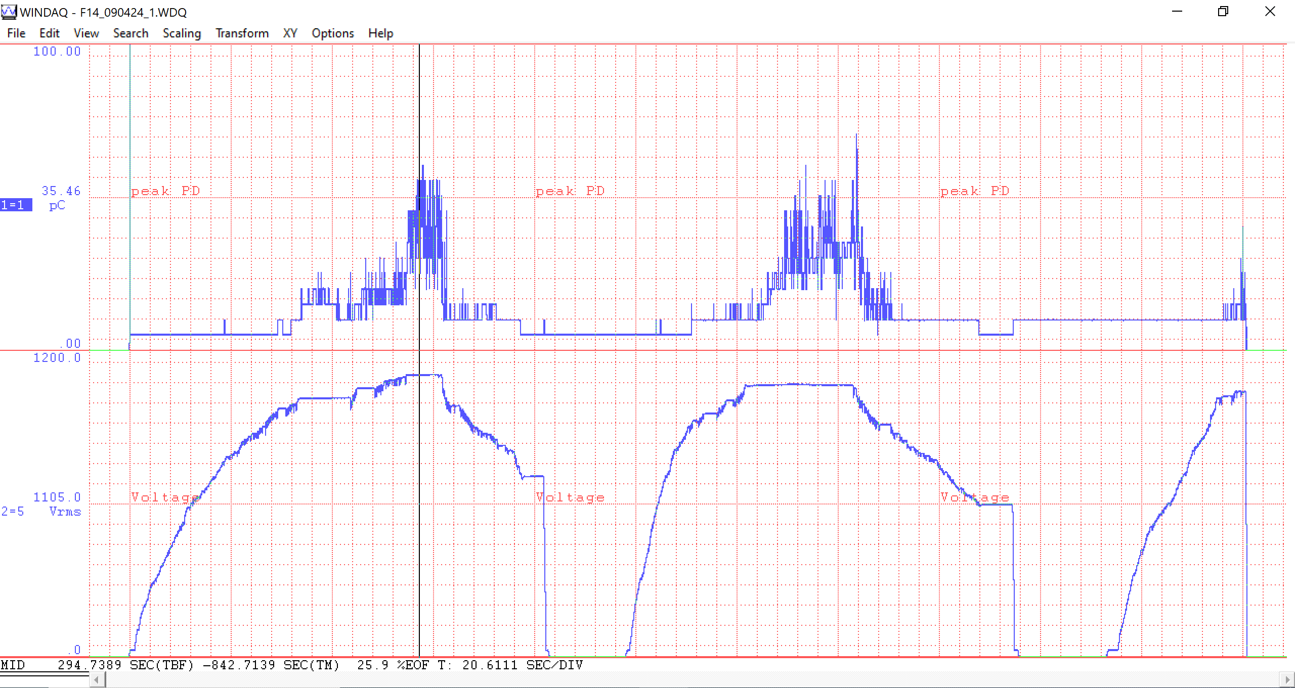
F14 @ Girder 13-1 Test 1 1-3 090424 Overview
@ Cursor Value
1105.0V 35.46
@ Cursor Value
This is a 20.6 minute window

Slide 18
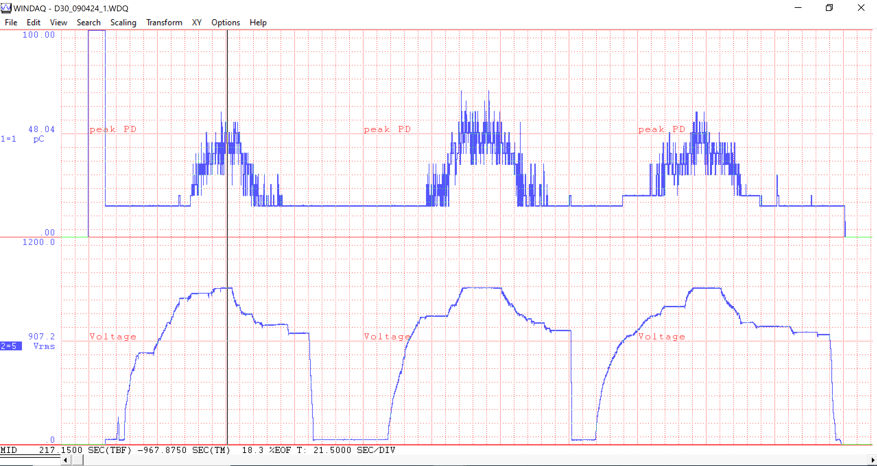
D30 @ Girder 13-2 Test 1 1-3 090424 Overview
907.2V 48.04
Calibration Check + Turbos
This is a 21.5 minute window

Slide 19
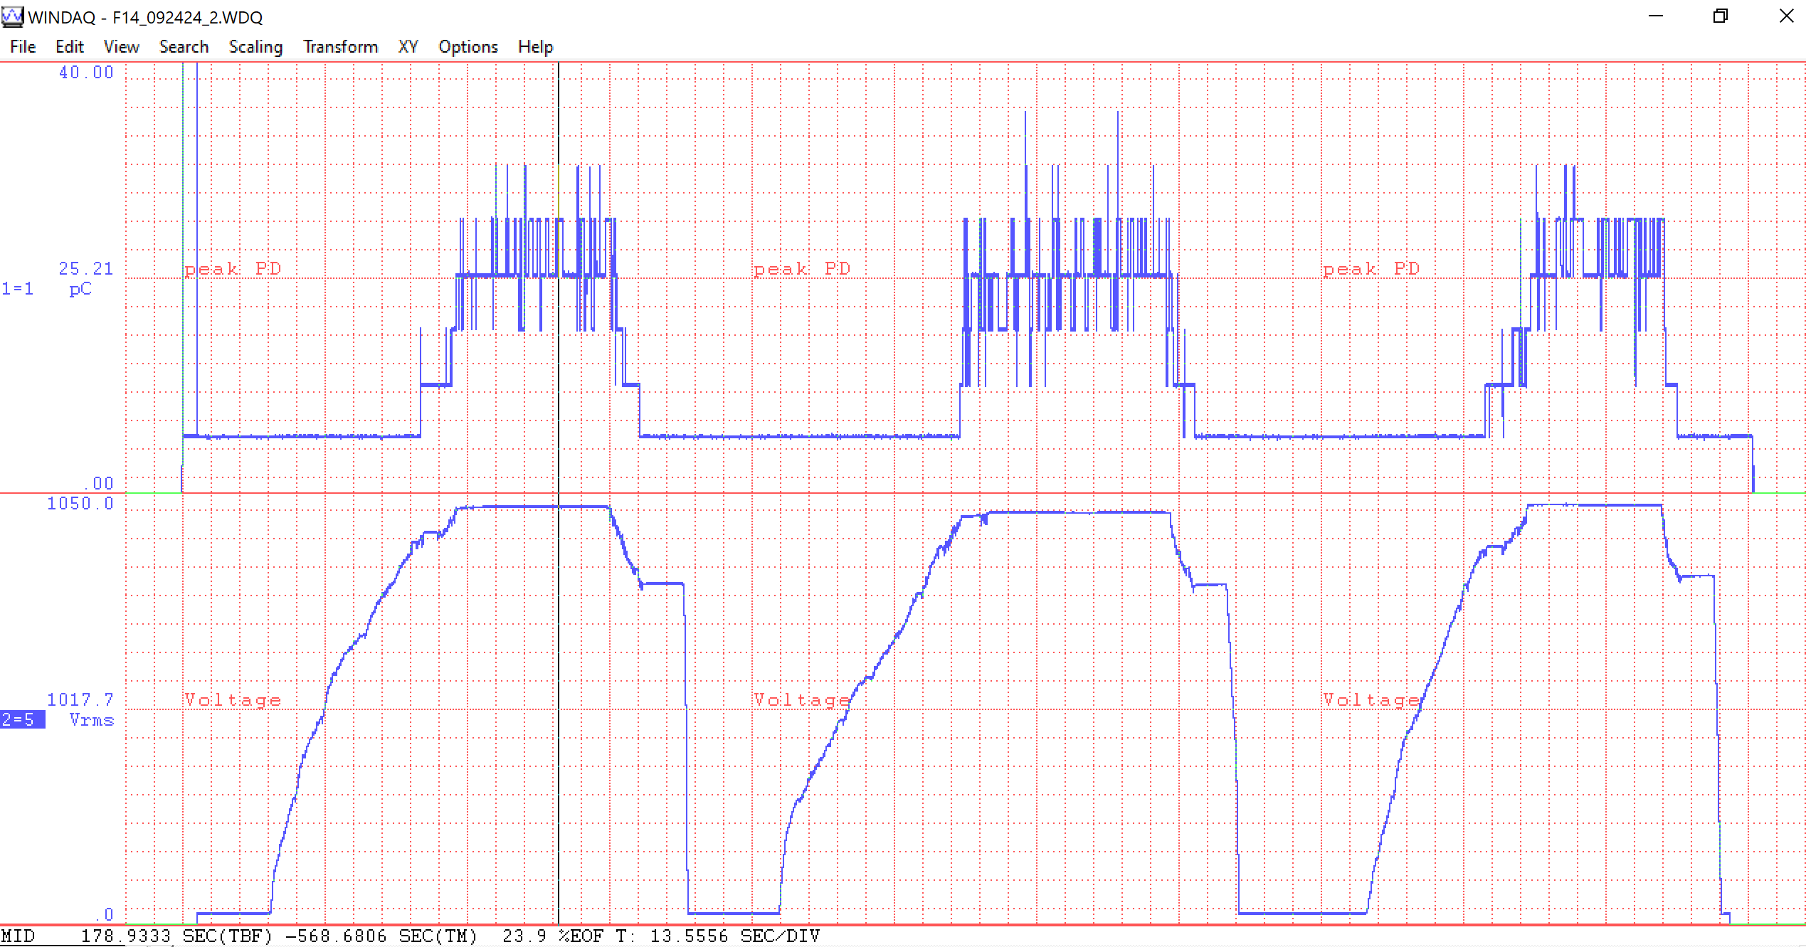
F14 @ Girder 13-1 Test 2 1-3 092424 Overview
1017.7V 25.21
This is a 13.5 minute window

Slide 20
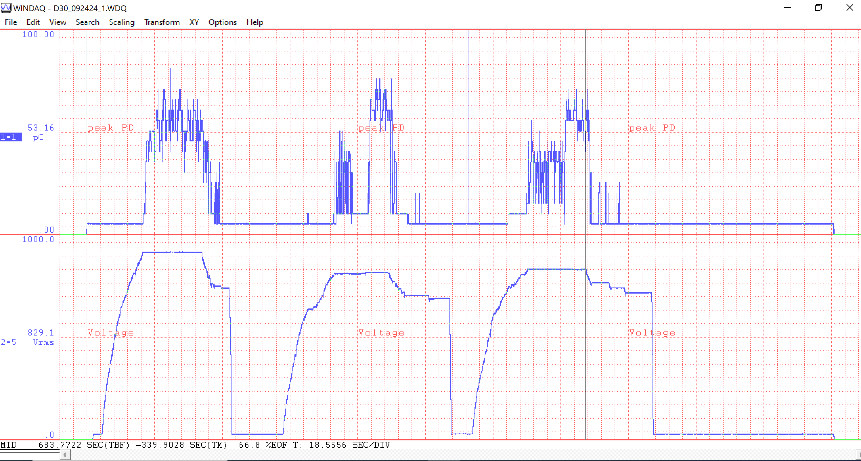
D30 @ Girder 13-2 Test 1 1-3 092424 Overview
907.2V 48.04
This is an 18.5 minute window

Slide 21
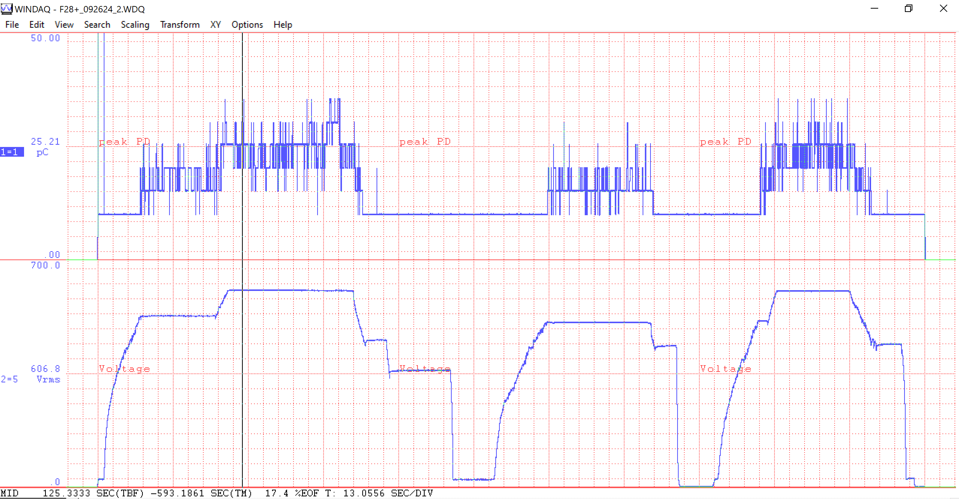
F28+ @ Girder 13-2 Test 2 092624 Overview
606.8V 25.21
This is a 13.0 minute window

Slide 22
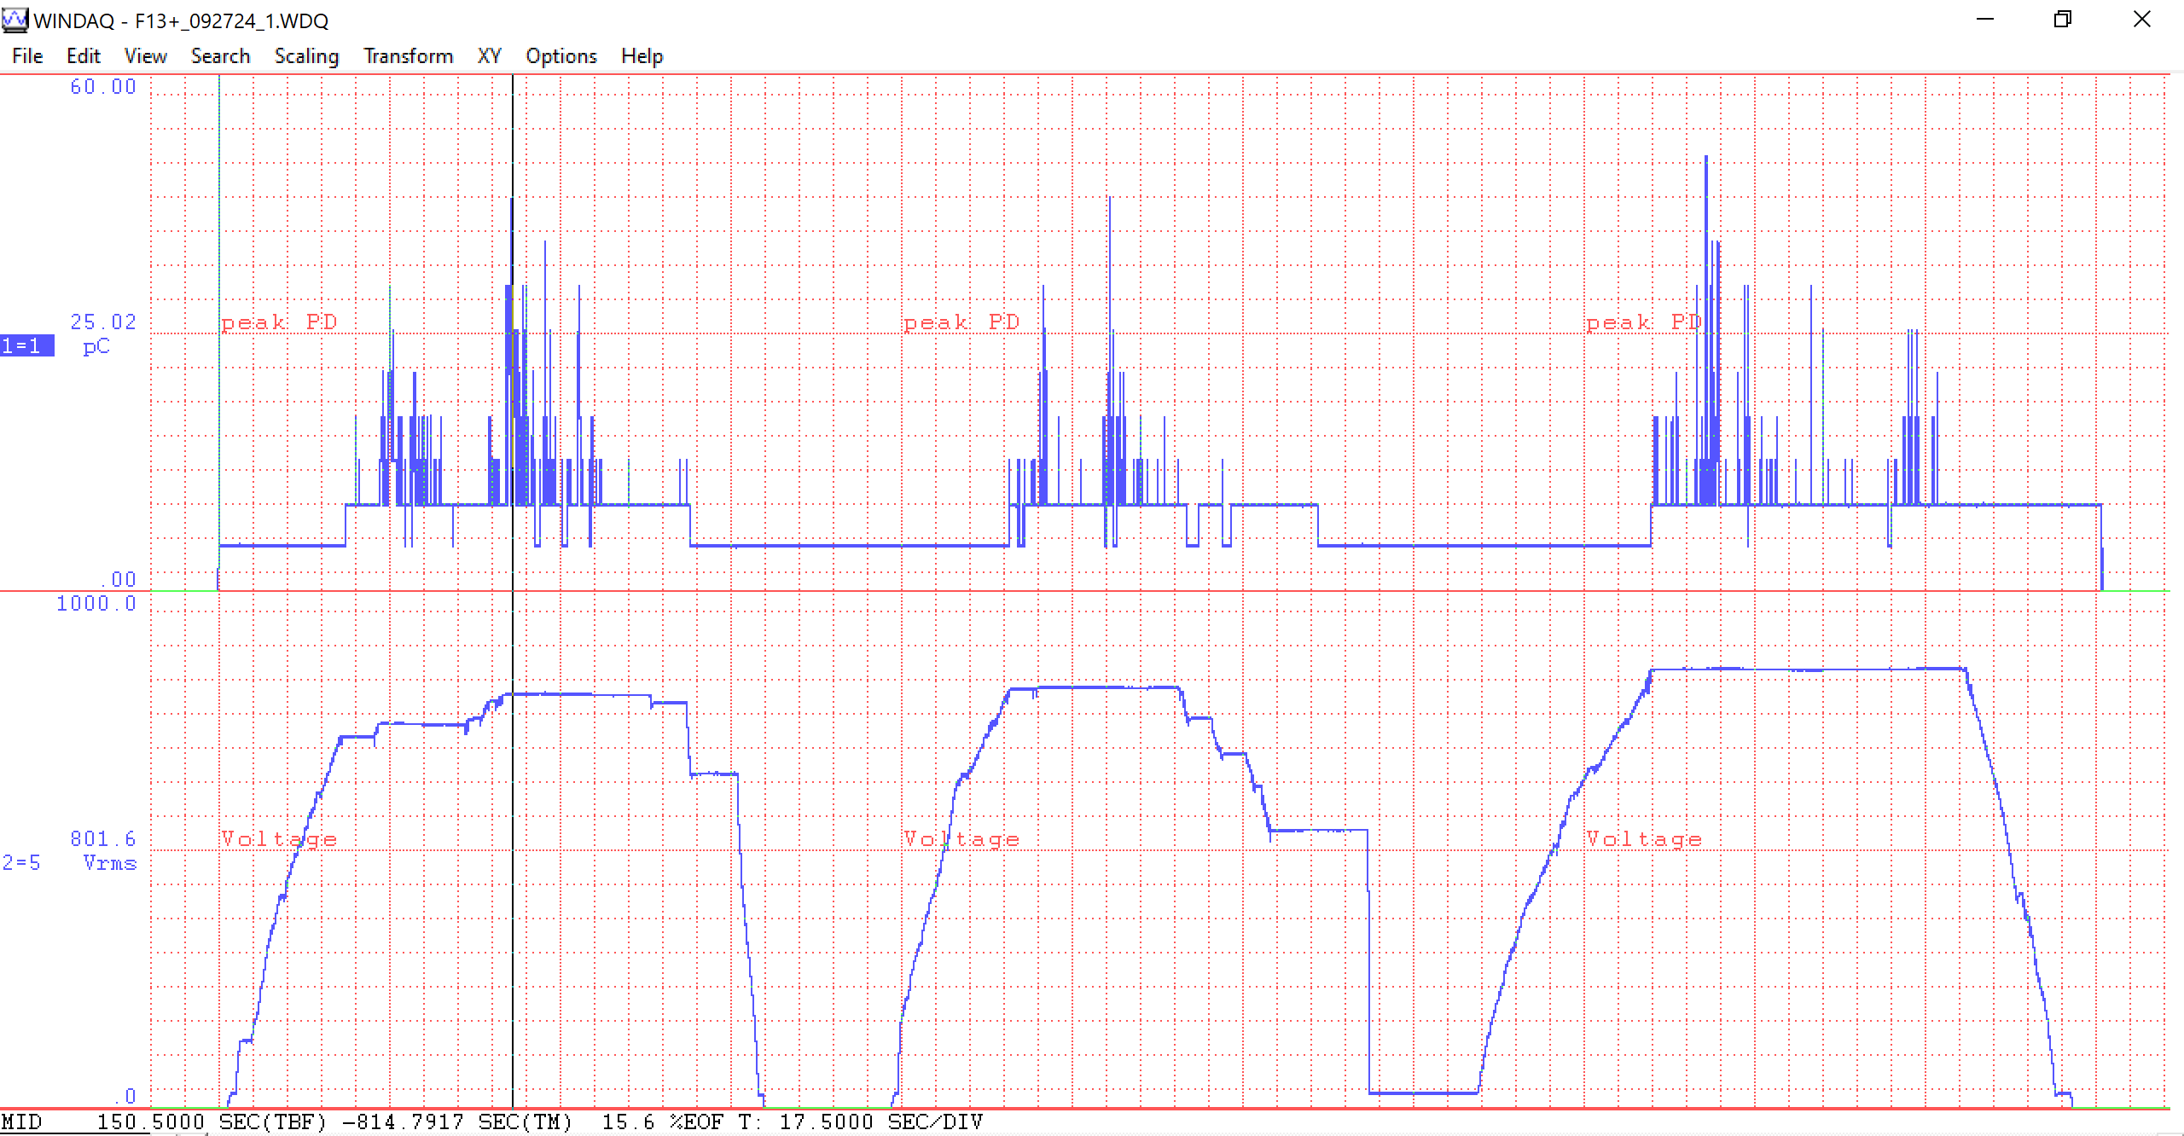
F13+ @ Girder 12-2 Test 1 1-3 092724 Overview
801.6V 25.02
This is a 17.5 minute window

Slide 23
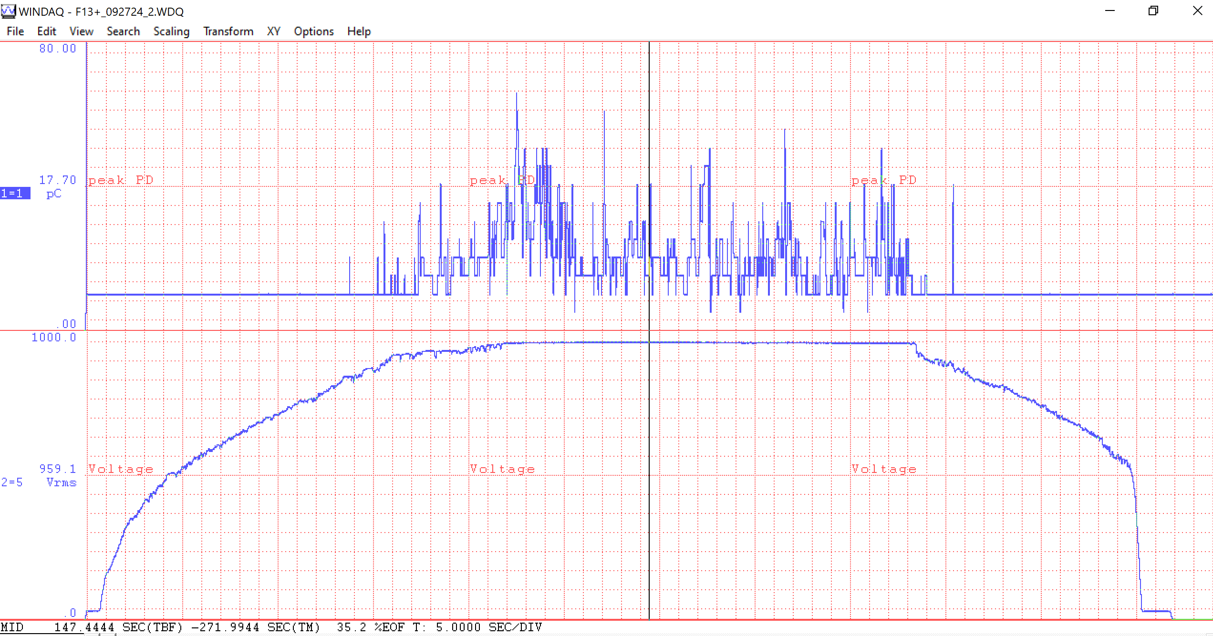
F13+ @ Girder 12-2 Test 2 1-3 092724 Overview
907.2V 48.04
This is a 5 minute window

Slide 24
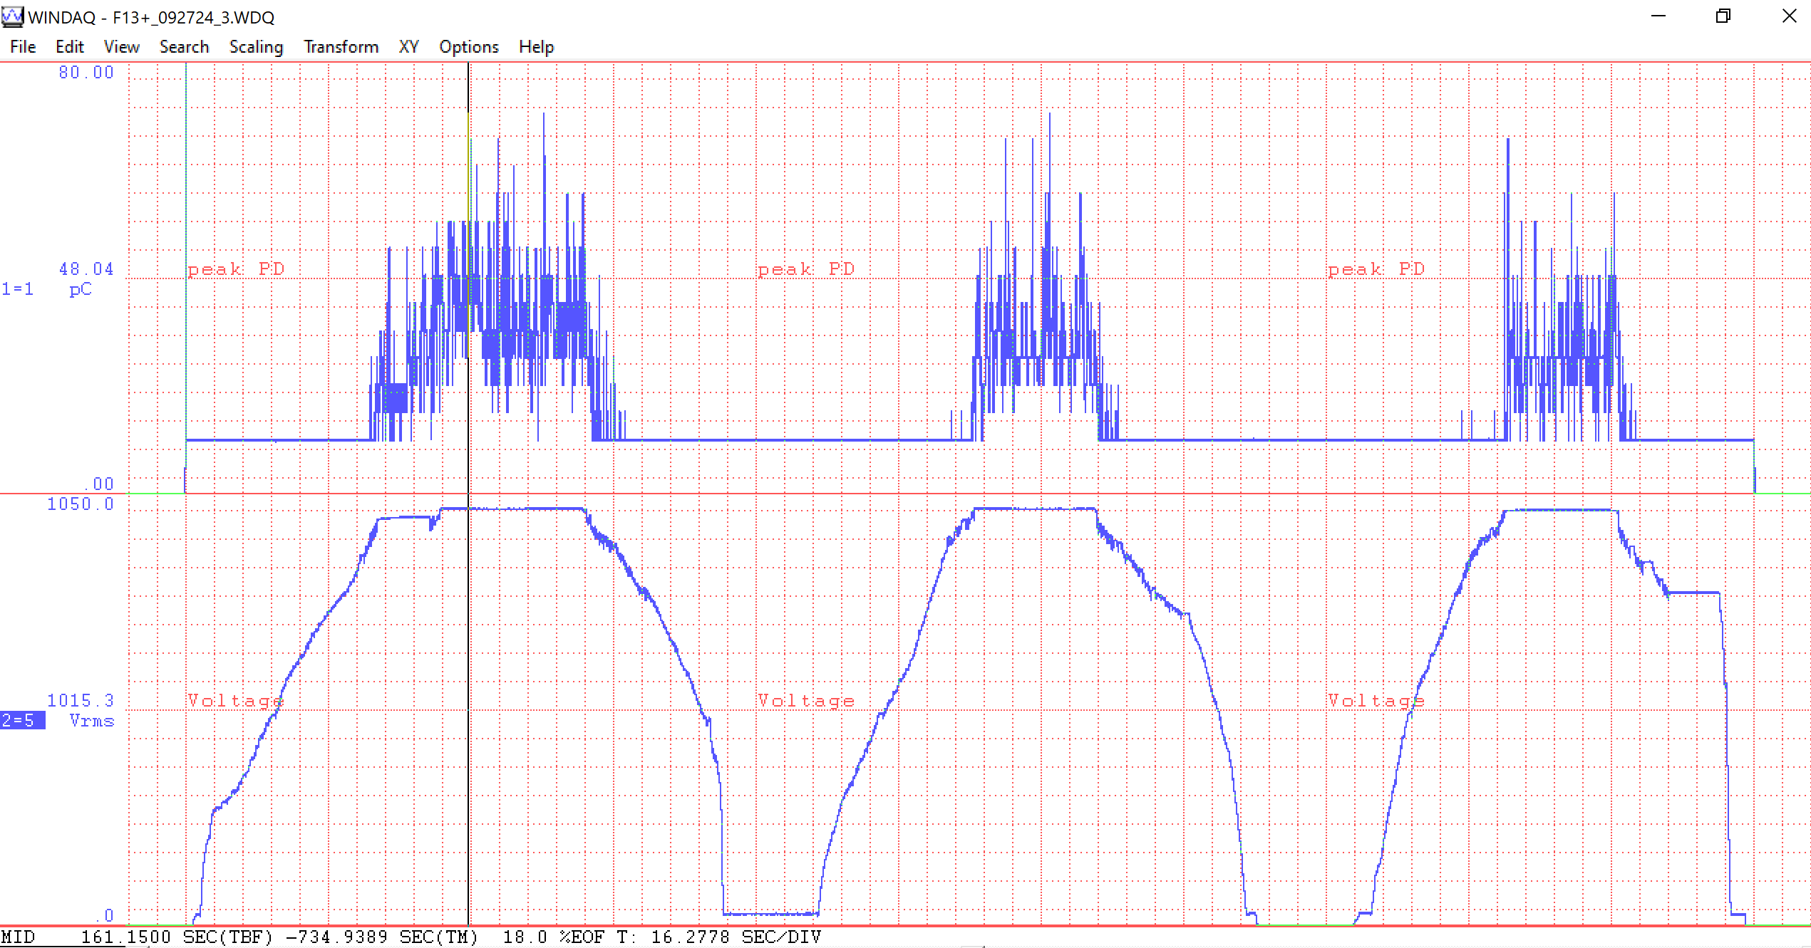
F13+ @ Girder 12-2 Test 3 1-3 092724 Overview
1015.3V 48.04
This is a 16.2 minute window

Slide 25
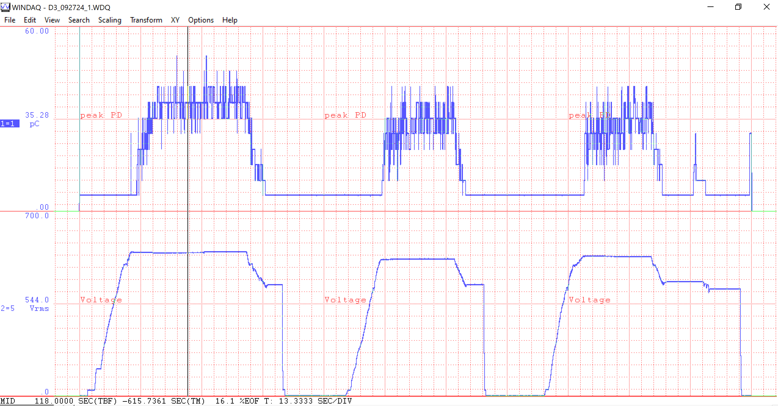
D3 @ Girder 12-2 Test 1 1-3 092724 Overview
544.0V 35.28
This is a 13.3 minute window

Slide 26
Averaged Inception & Extinction Voltages
Tested Spare Magnets
Tested Operational Magnets
Magnet | Locale | ~ V Inception (RMS) | ~ V Extinction (RMS) | ~ V Extinction (Peak) | Vacuum
F41 | Booster Spares | 750V | 620V | 877V | ATM
F44 | Booster Spares | 1800V | 850V | 1200V | ATM
F45 | Booster Spares | 1450V | 800V | 1130V | ATM
F133 | Booster Spares | 800 V | 500V | 707V | ATM
D48 | Booster Spares | 1400KV | 1000V | 1410V | ATM
D10 | Staging Area | 1400V | 1200V | 1700V | IPS2 ~6.5E-8
D134 | Staging Area | 1330V | 1100V | 1560V | IPS2 ~6.5E-8
F47 | Staging Area | 720 V 1177V | 726V 868V | 792V 1220V | IPS1 ~1.2E-7 ATM
F21 | Staging Area | 795V 726V | 545V 558V | 771V 789V | IPS1 ~1.1E-7 ATM
F46 | E4R | 1200V | 960V | 1360V | ATM
D51 | E4R | 890V | 740V | 1050V | ATM
Magnet | Locale | ~ V Inception (RMS) | ~ V Extinction (RMS) | ~ V Extinction (Peak) | V simulation 15Hz Peak | Vacuum
F13+ | 12-2 | 887.2V | 820V | 1160V | 587V | ~ 2E-8
D3 | 12-2 | 531.1V | 424V | 600V | 740V | ~ 2E-8
F14 | 13-1 | 1033.2V 939.8V | 872V 818V | 1230V 1160V | 715V | ATM ~ 2E-8
F28+ | 13-2 | 641.8 V | 545V | 770V | 731V | ~ 2E-8
D30 | 13-2 | 803.4V 822.3V | 711V 731V | 1010V 1030V | 797V | ATM ~ 2E-8
D34 | 14-1 | 1076.5V | 903V | 1276V | 580V | ~ 2E-8
F36 | 14-1 | 603.2V | 482V | 681V | 660V | ~ 2E-8
D37 | 14-2 | 646.9V | 537V | 760V | 664V | ~ 2E-8
Data Updated & From BCM 100124 pptx
We have tested 8 Booster ring magnets in the tunnel.
D3 looks like it may be partial discharging as we run now at 15Hz.
F28 extinction voltage is near the 15Hz simulation voltage.
F36 extinction voltage is near the 15Hz simulation voltage.
V simulation 15Hz Peak values came from M Mubarak’s presentation
Averaged values came from multiple tests
We have tested all 11 of our spare magnets.
F41, F133, F47, F21 tested a bit on the low end.

Slide 27
Summary of DAR Test Results taken 10/10/2024
Magnet | Girder | Megger Vdc | I µA | R to Gnd MΩ | DAR | Cap nF
F13 | 12-2 | ? | 15.6 | 65.2 | 1.03 | 76
D3 | 12-2 | ? | 24.8 | 40.8 | 1.00 | 66
F14 | 13-1 | 1011 | 28.7 | 35.2 | 1.01 | 51
F28 | 13-2 | 997 | 332 | 2.91 | 0.65 | 89
D30 | 13-2 | 1019 | 13.9 | 73.1 | 1.03 | 74
D34 | 14-1 | ? | 130 | 7.63 | 1.00 | 70
F36 | 14-1 | ? | 64.1 | 15.63 | 1.00 | 66
F35 | 14-2 | 991 | 130 | 7.65 | 1.00 | 52
D37 | 14-2 | 990 | 656 | 1.396 | 0.93 | 74
Measurements taken with a Megger MIT-1025
DAR = Dielectric Absorption Ratio = (V at 30 seconds) / (V at 60 seconds)
? Indicates VDC at end of test was not noted, but can infer approximate value from I and R and other results
Cap is the measured capacitance

Slide 28
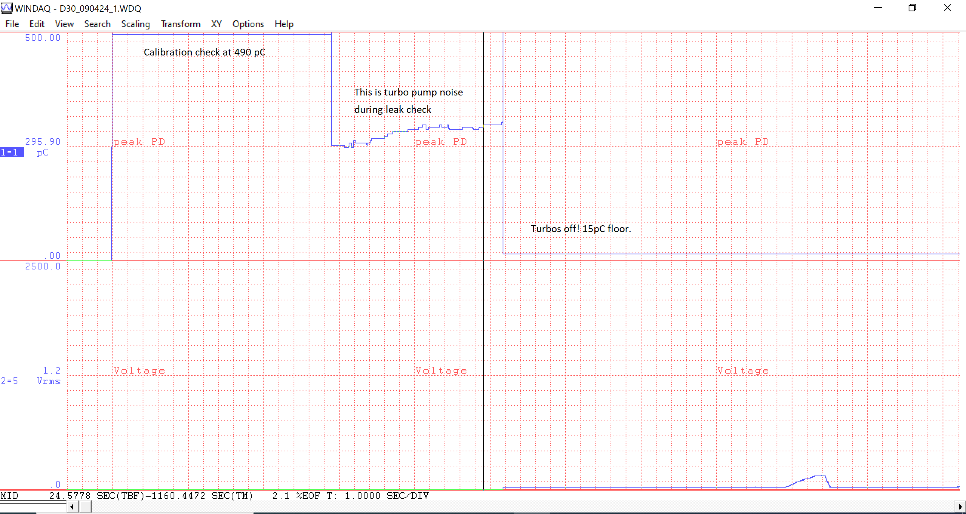
D30 @ Girder 13-2 Test 1 090424 – Startup Observations.
This is a 1 minute window

Slide 29
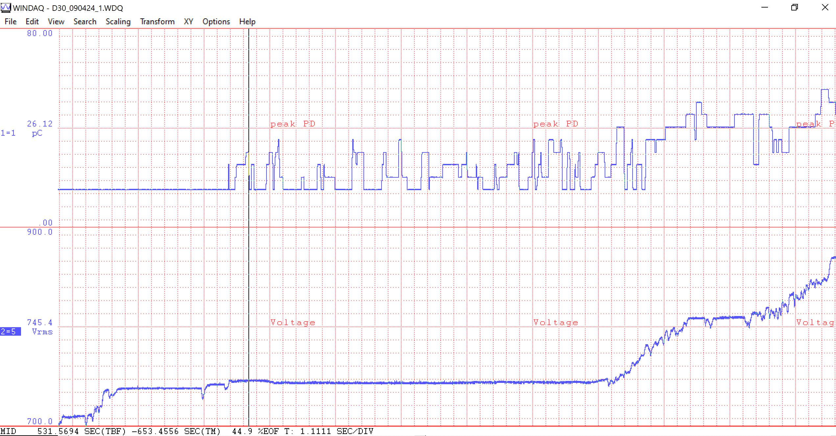
D30 @ Girder 13-2 Test 1 Inception 2 090424
1232.0V 116.21
This is a 1.1 minute window

Slide 30
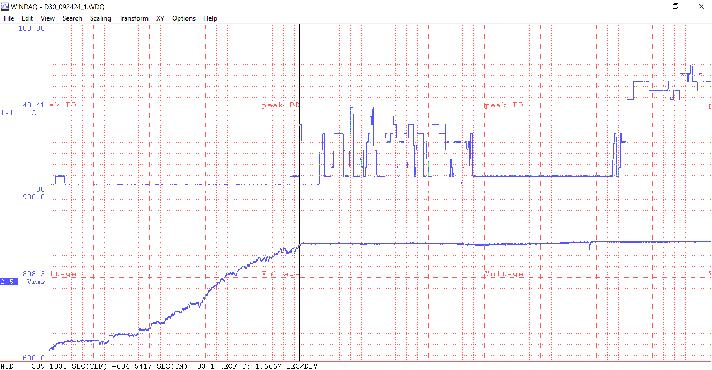
D30 @ Girder 13-2 Test 1 Inception 2 092424
808.3V 140.41
This is a 1.6 minute window

Slide 31
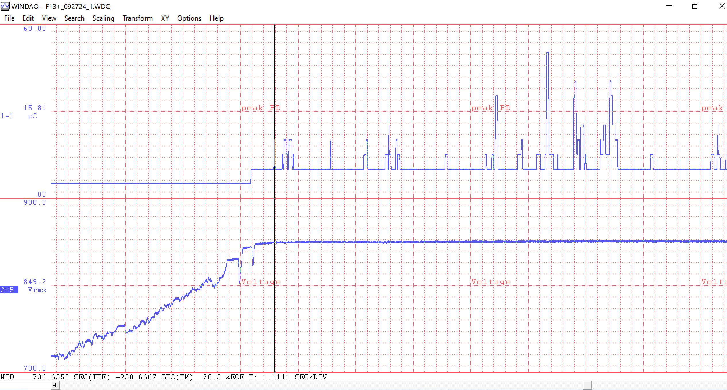
F13+ @ Girder 12-2 Test 1 Inception 3 092724
849.2V 15.81
This is a 1.1 minute window

Slide 32
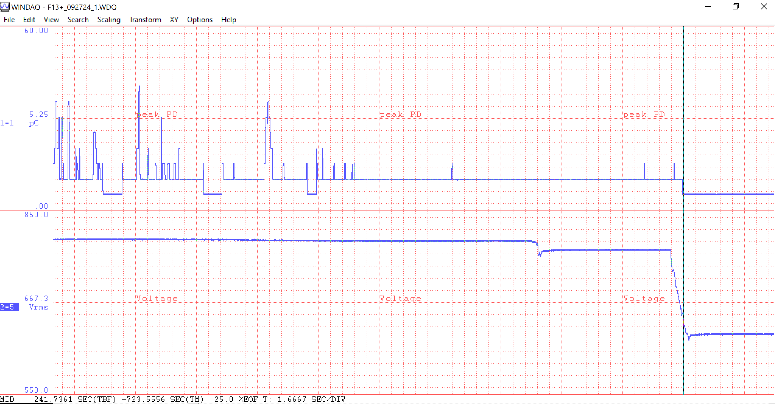
F13+ @ Girder 12-2 Test 1 Extinction 1 092724
667.3V 5.25
This is a 1.6 minute window

Slide 33
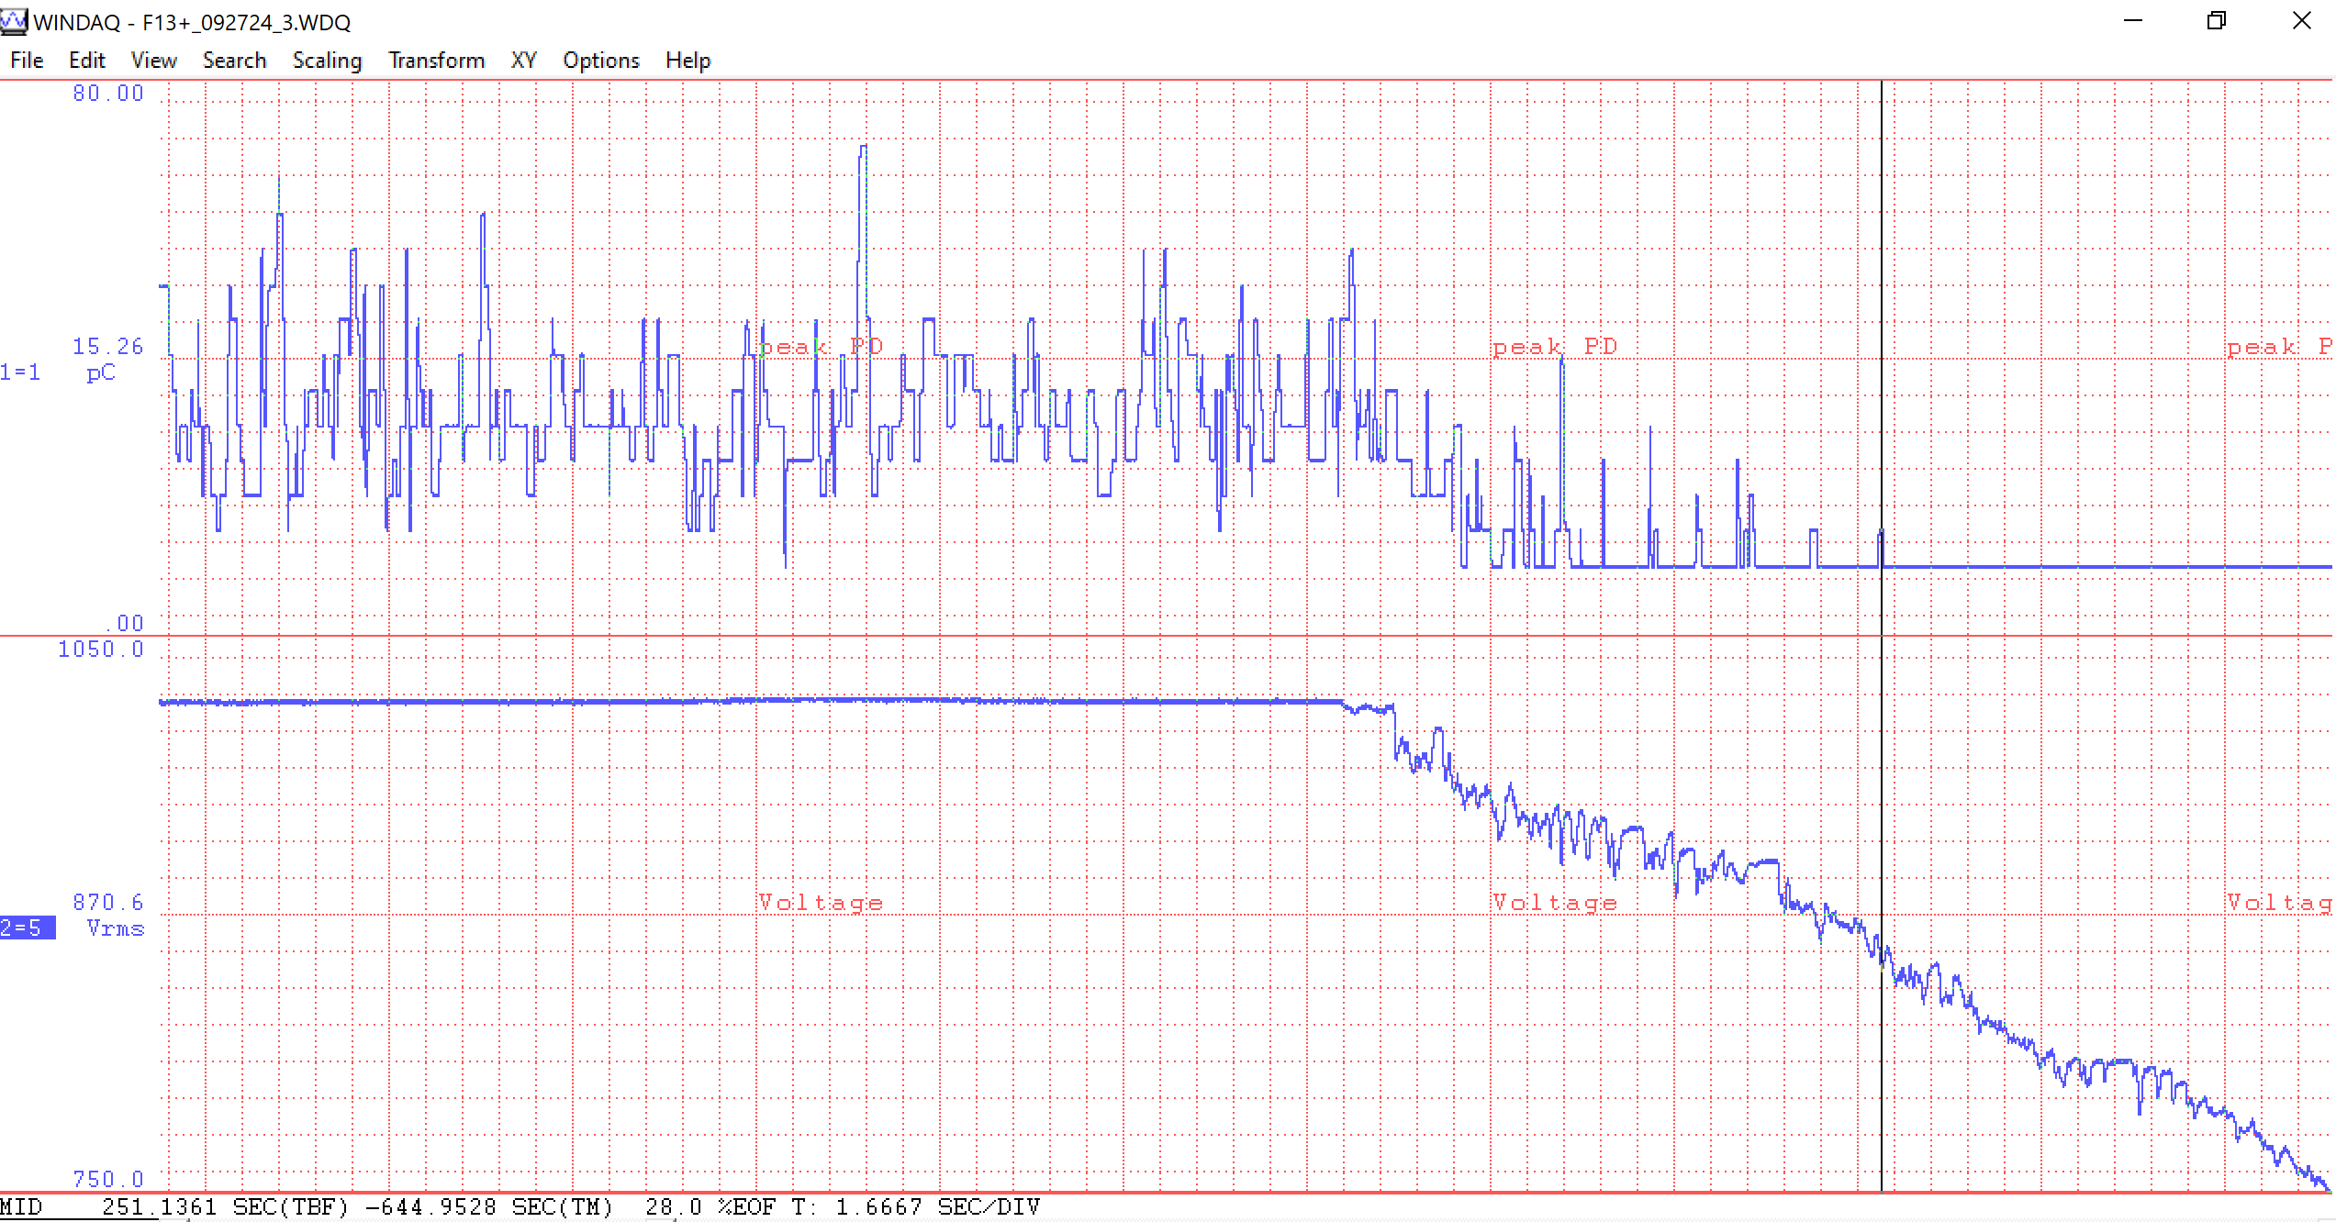
F13+ @ Girder 12-2 Test 3 Extinction 1 092724
870.6V 15.26
This is a 1.6 minute window

Slide 35
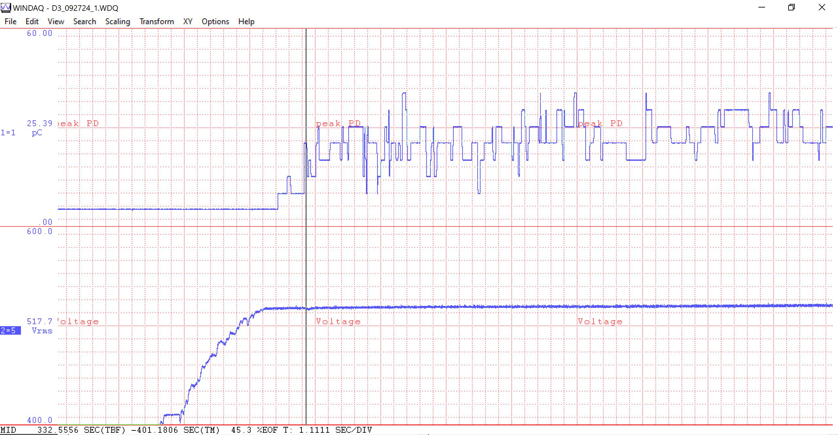
D3 @ Girder 12-2 Test 1 Inception 2 092724
517.7V 25.39
This is a 1.1 minute window

Slide 36
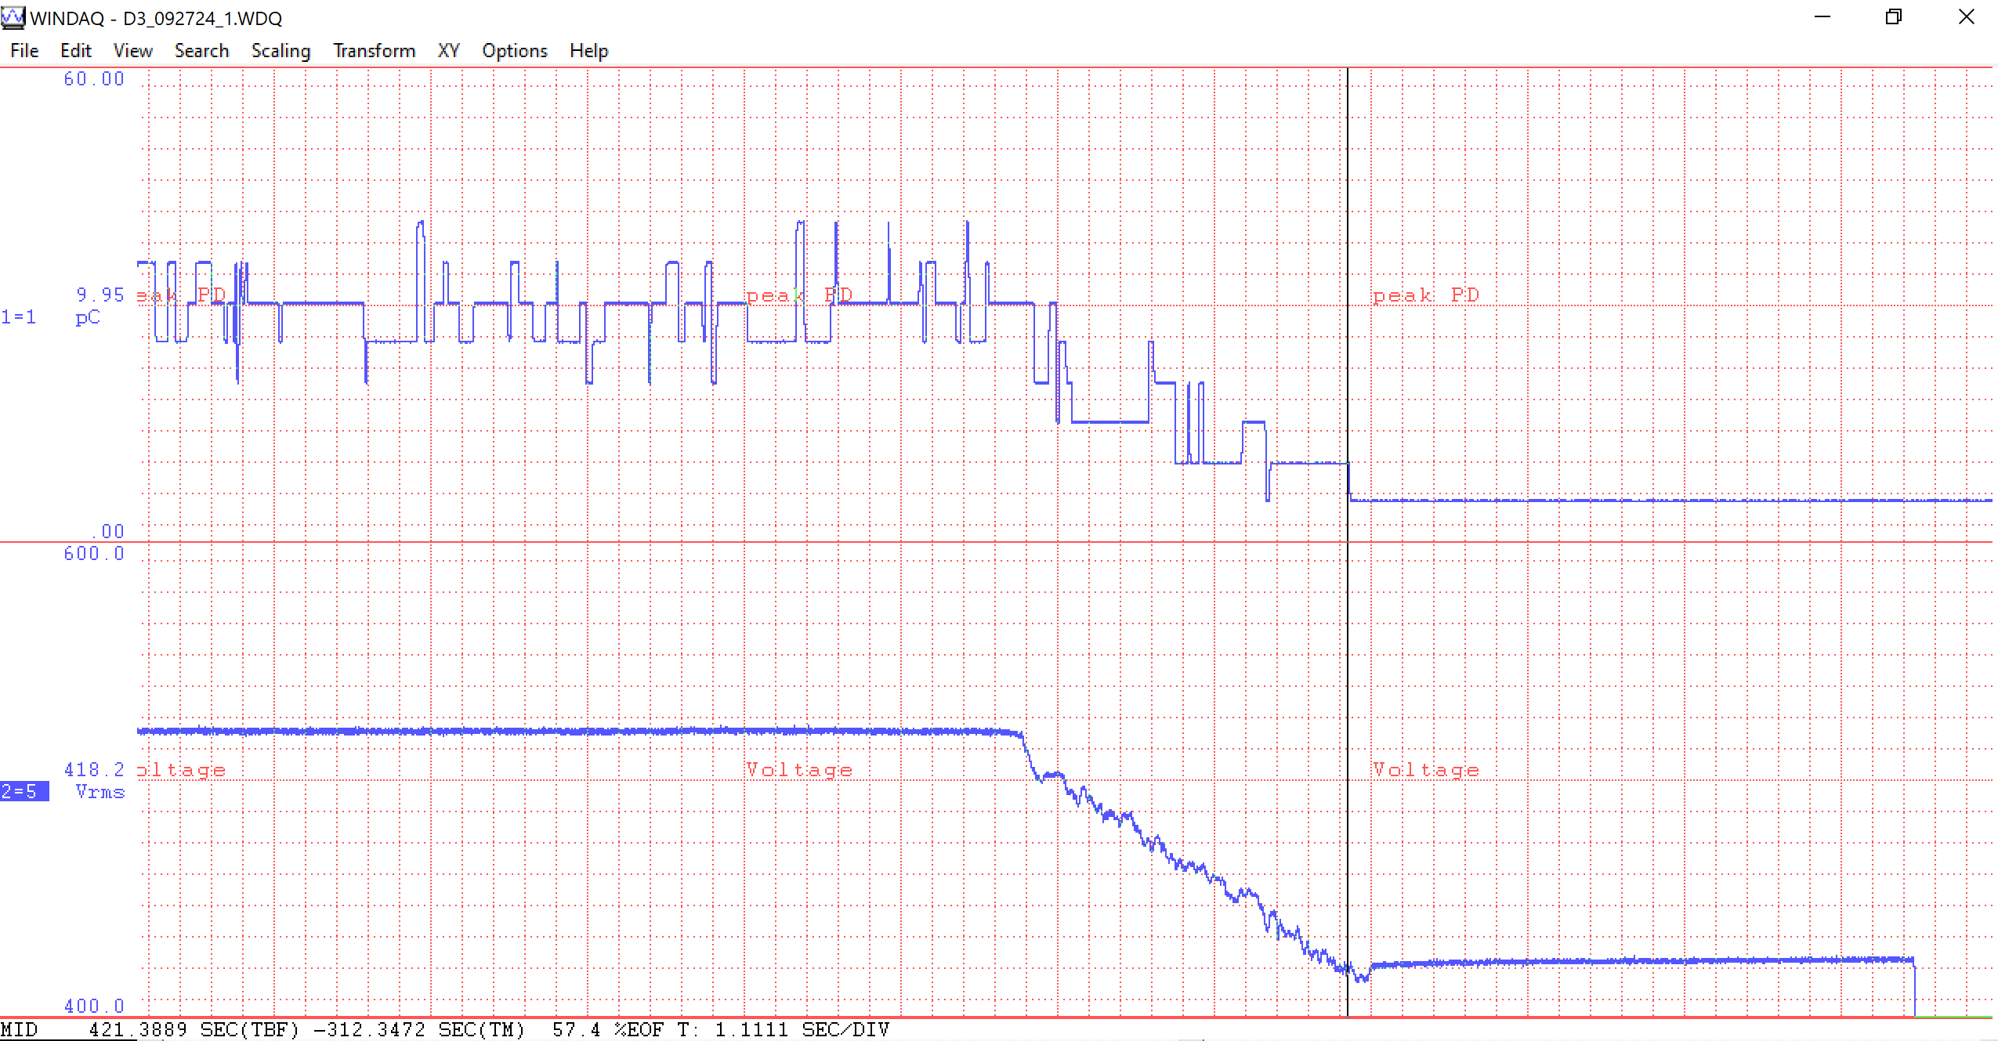
D3 @ Girder 12-2 Test 1 Extinction 2 092724
418.2V 9.95
This is a 1.1 minute window

Slide 37
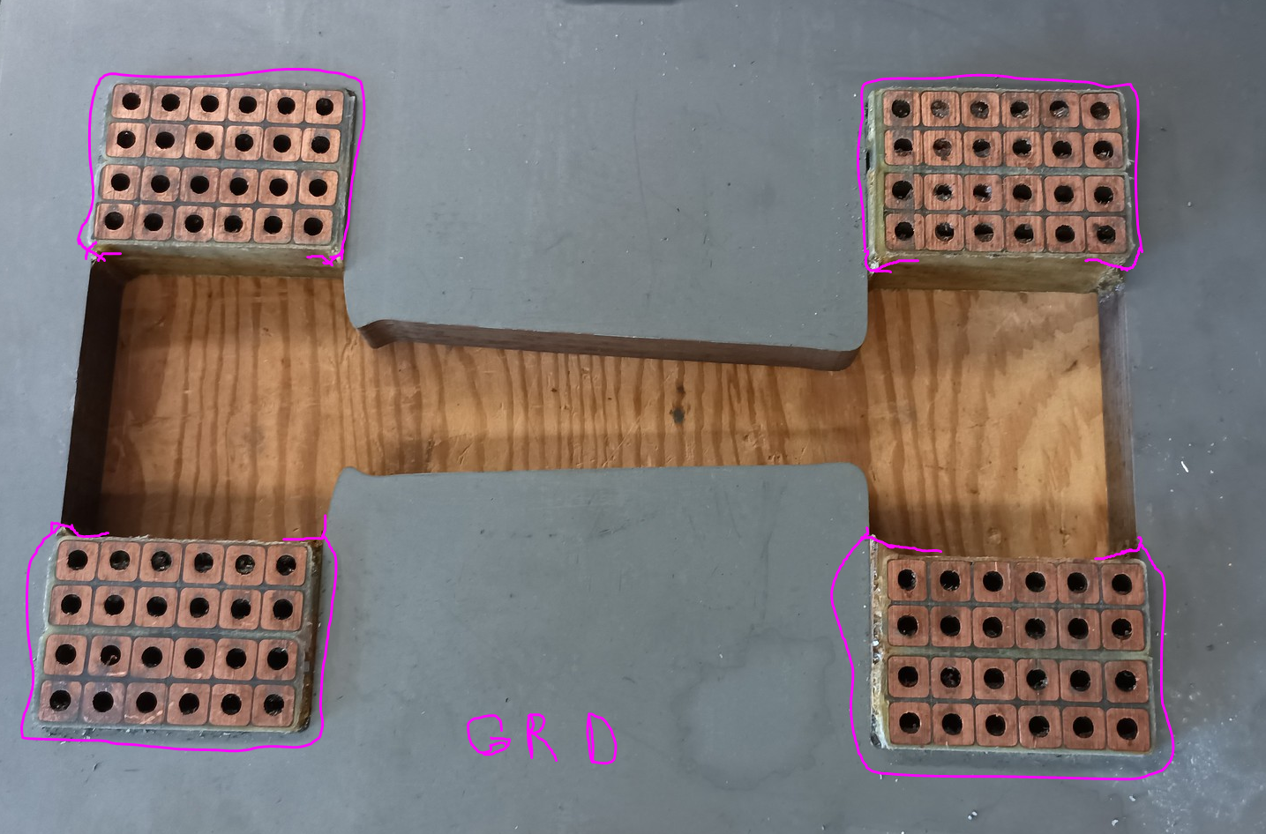
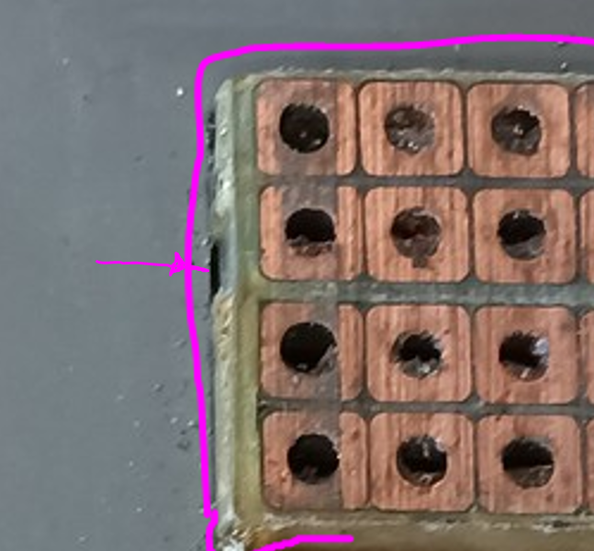
The presence of multiple dielectrics is most likely the answer to how we are getting corona at such low voltages.

Slide 38
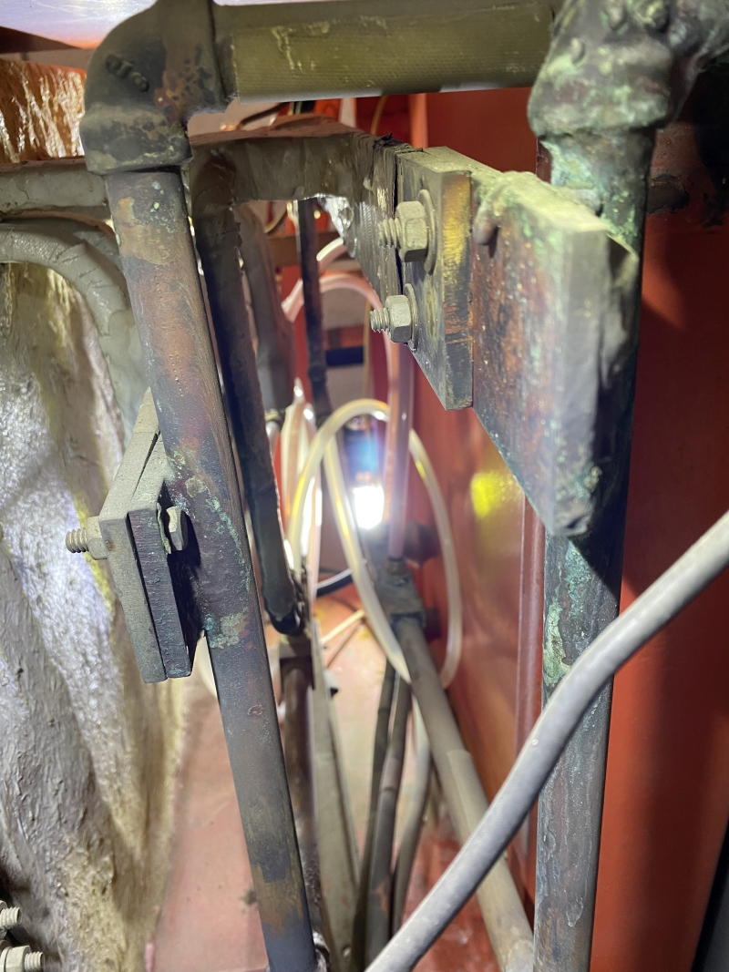
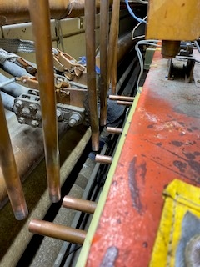
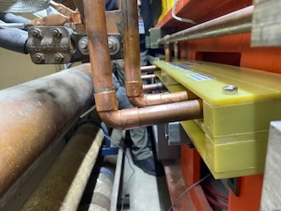
2-1 manifold connections
11-1 Choke connections at back to girder bus

