Slide 1
Impact of Partial Discharge (PD) in Magnets
David Harding
Booster Gradient Magnets Corona Testing Micro-Workshop
10 December 2024

Slide 2
Why insulate?
We don’t want electric current to leak from the conductor to ground (including the core and vacuum chamber of the magnet) or from one conductor to another.
Safety
Magnet performance
What starts as a small leak can grow into a bigger leak and a bigger problem.

Slide 3
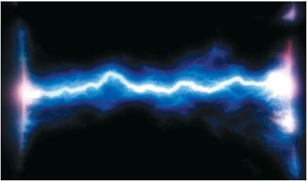
Why insulate?
When you apply a voltage between two surfaces, electrons gather on one surface and are pushed away from the other.
If two conductors (including ground as a conductor) are touching, the electrons can flow.
If a third conductor, like a screwdriver, tap water, or a trail of carbon, makes a jumper between two conductors, you get leakage.
If there is only air or vacuum between two conductors, at a high enough voltage and small enough distance, the electric field (V/L) can get big enough to rip electrons off the surface – Field Emission.
Under some conditions of electric field and gas density, the electrons can multiply, discharge the stored electrons, and make a very destructive arc.

Slide 4
How does insulation work?
Fill the gap completely with dielectric material.
When voltage is applied, electrons in the material shift a little but are still bound in the atoms.
You wind up with an excess of electrons at one material-conductor boundary and a deficit at the other boundary, canceling out the electron deficit or surplus on the surface of the conductors.
With little net charge, there is little electric field to rip electrons from a surface.
At a high enough voltage the dielectric breaks down.
Hi-pot (High Potential) testing DC checks for dielectric integrity and external connections between conductors.

Slide 5
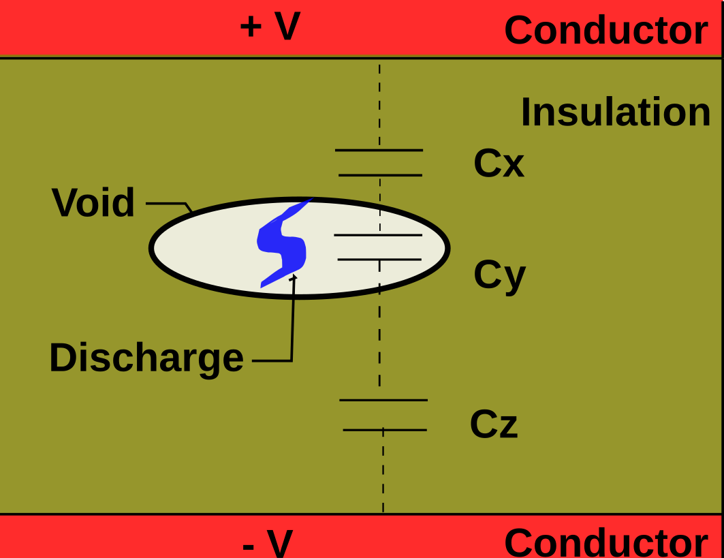
Partial Discharge
If there is a little bubble in the insulation, electric charge will accumulate on either side of the bubble, making an electric field between the two sides.
If that field gets big enough, then electrons can be torn from the surface and accelerated to smash into the other side.
This drains the surface charge and reduces the field so the discharge stops.
The voltage across void is a fraction of total voltage.
Inception voltage is where the discharge starts.
Extinction voltage is where the discharge stops.

Slide 6
PD Resulting from AC Excitation
V_{inc}- Voltage at which PD occurs (during rise or fall of the voltage) is called PD inception voltage.
After the discharge is extinguished, the charge is momentarily redistributed within the cavity, “de-stressing” the void
V_{ext}- Voltage at which PD no longer occurs (during rise or fall of the voltage) is called PD extinction voltage.
After the discharge occurs, the voltage again builds across in the void, as the applied AC voltage continues along its normal cycle
Total Voltage
Across Insulation
V_{inc}
Voltage Across
Void
V_{ext}
V_{ext}
V_{inc}
Voltage Across Void with AC Voltage Subtracted
Example of a Single PD Event Occurring Within a Half Cycle
of AC Voltage

Slide 7
PD Resulting from AC Excitation
With higher AC Voltage applied, the critical breakdown stress may again be reached multiple times within the void before the AC voltage reaches its peak value
The time interval between ignition and extinction of the actual discharge pulse is < 100 ns, and results in an electromagnetic transient in the order of 100 ns
Depending on the dielectric type frequency of PD may vary from tens to hundreds of kHz
Total Voltage
Across Insulation
V_{inc}
Voltage Across
Void
V_{ext}
V_{ext}
V_{inc}
Voltage Across Void with AC Voltage Subtracted
Example of a Multiple PD Event Occurring Within a Half Cycle
of AC Voltage

Slide 8
Why Is Partial Discharge Bad?
Every partial discharge event is a tiny spark that releases heat and carbonizes a little insulation.
This eats away at the insulation and eventually we can get a short circuit through the insulation and a magnet failure.

Slide 9
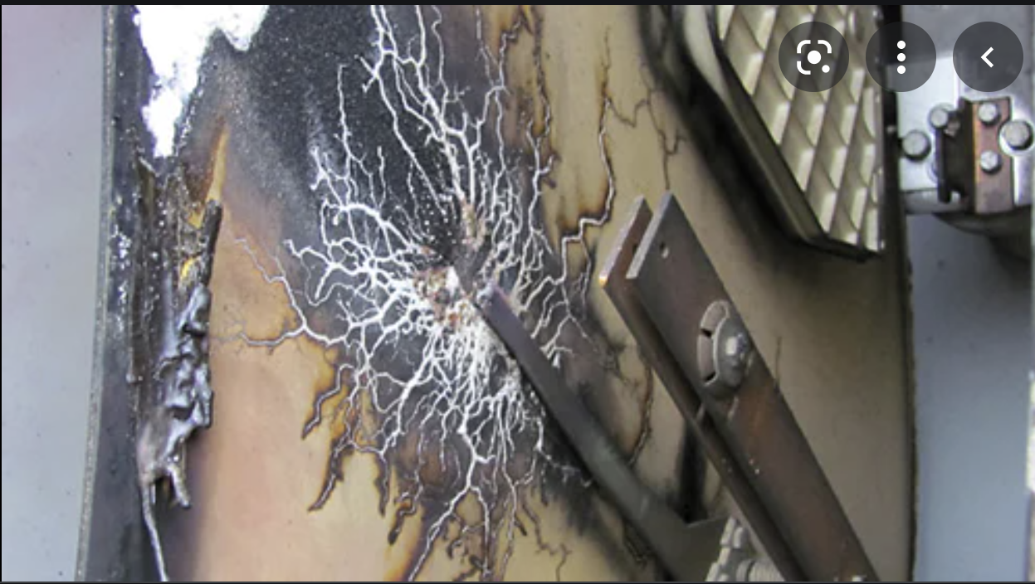
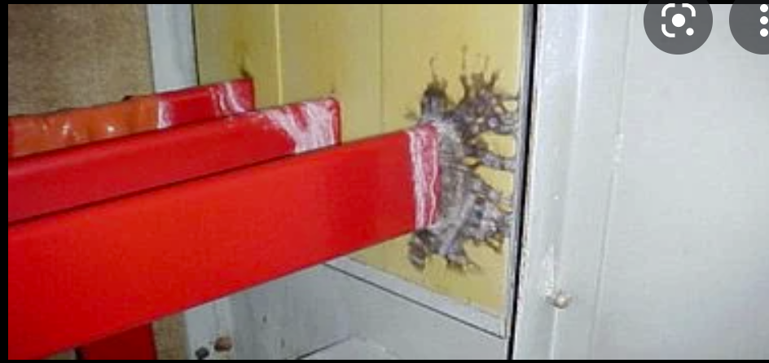
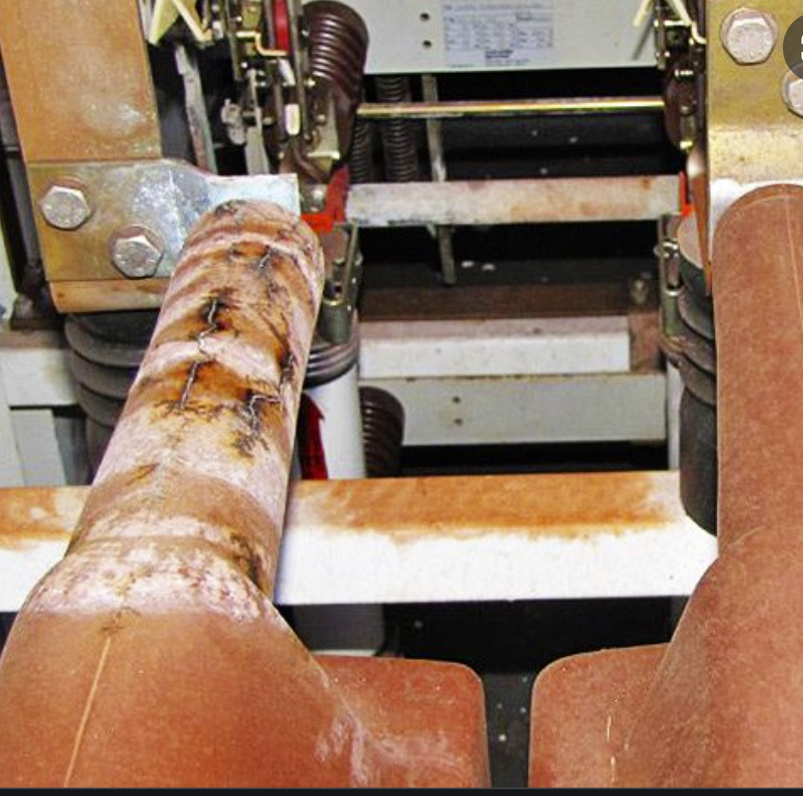
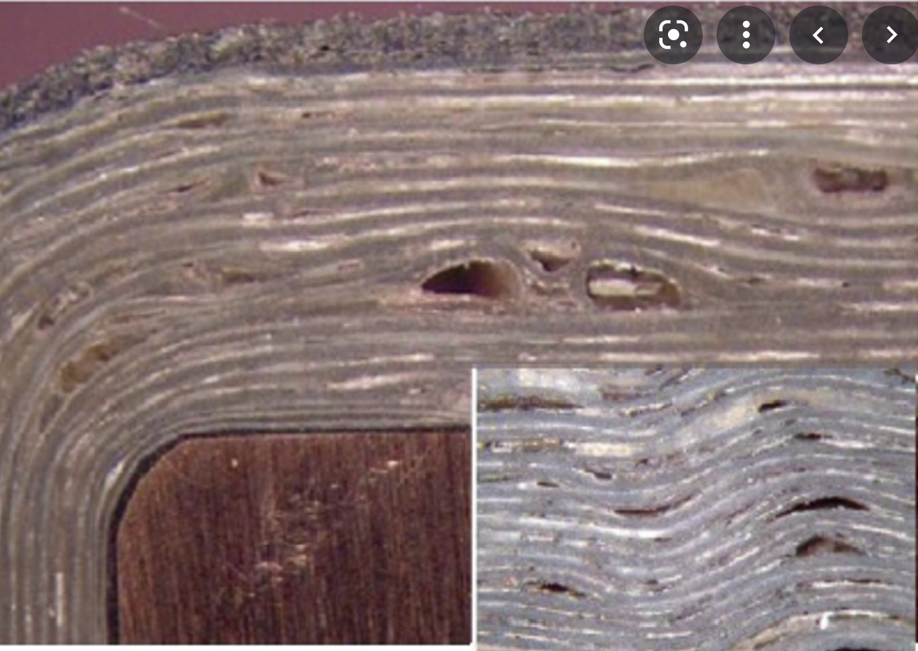
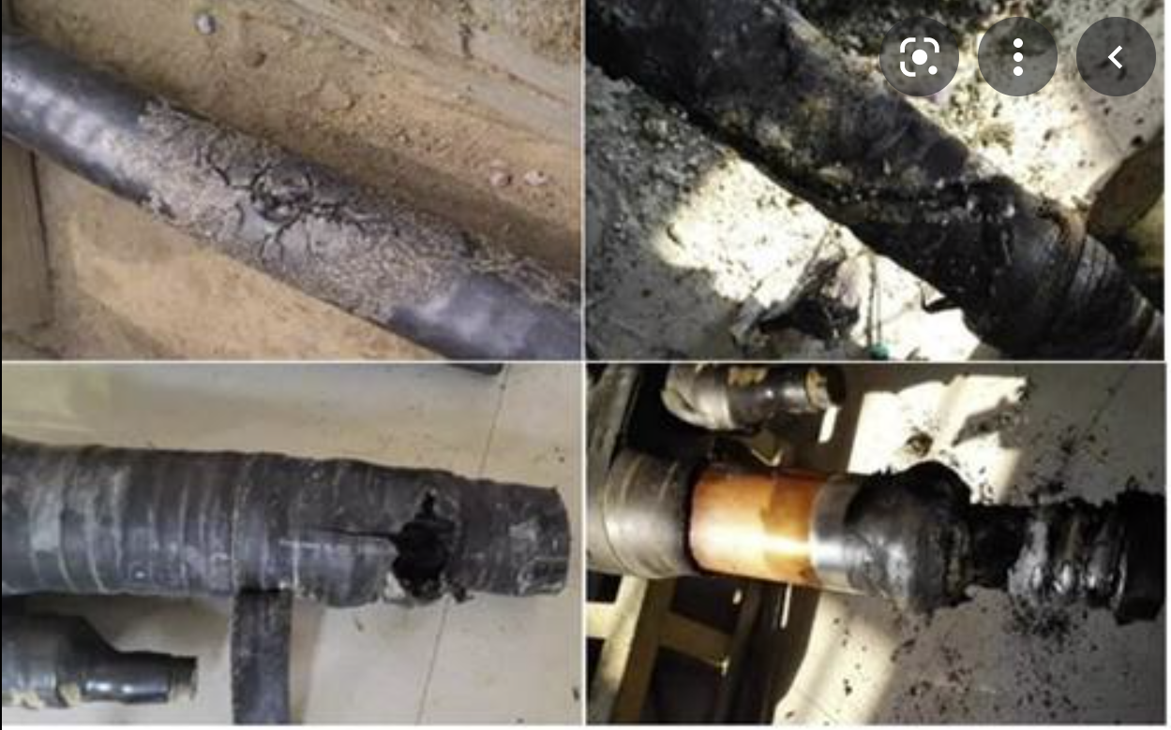
PD – Precursor of Insulation Failure
Age
Electrical stress wears out insulation
Overvoltage
Operating above nominal voltage increases chances for electrical breakdown
Overtemperature
Overheating degrades dielectric properties of electrical insulation
Radiation exposure
Releases initial electrons
Surface contamination
Lack of cleaning
Material defects
Manufacturing defects
Mechanical damage
During installation or in service

Slide 10
Why Are We Worried Now?
Going to 20 Hz operation in the Booster from 15 Hz means higher voltages.
If the higher voltages push us beyond the inception voltage for partial discharges on some magnets, then the stable operating conditions of the last 54 years will be exceeded and partial discharge will start, eventually leading to magnet failures.
The integrated vacuum impregnation of the Booster Combined Function Magnets makes visual inspection for voids impossible.
Note: Similar concerns apply to the Main Injector in the ACE regime.

