Slide 1
302.4.04 – Cryo-assemblies Horizontal Test Weekly status report
G. Chlachidze, S. Stoynev
Nov. 18th, 2024

Slide 2
Next Steps
LQXFA/B02 Test Traveler is closed
LQXFA/B02 Test Report – in progress, will be ready for the internal review this week
LQXFA/B03 test preparations:
Run plan drafted
Test checklist drafted
Checkout forms – work in progress

Slide 3
Next Steps
Short term steps to improve/expedite the controlled cooldown and warmup at Stand 4
Complete insulation of the helium lines & relief valves upstream to the HX
Indoor work in progress
Waiting equipment for the outdoor work
Update/Improve the controlled cooldown and warmup procedures for cryo-operators – Planned for next week
Replace faulty GHe flow-meter – Work starts this week

Slide 4
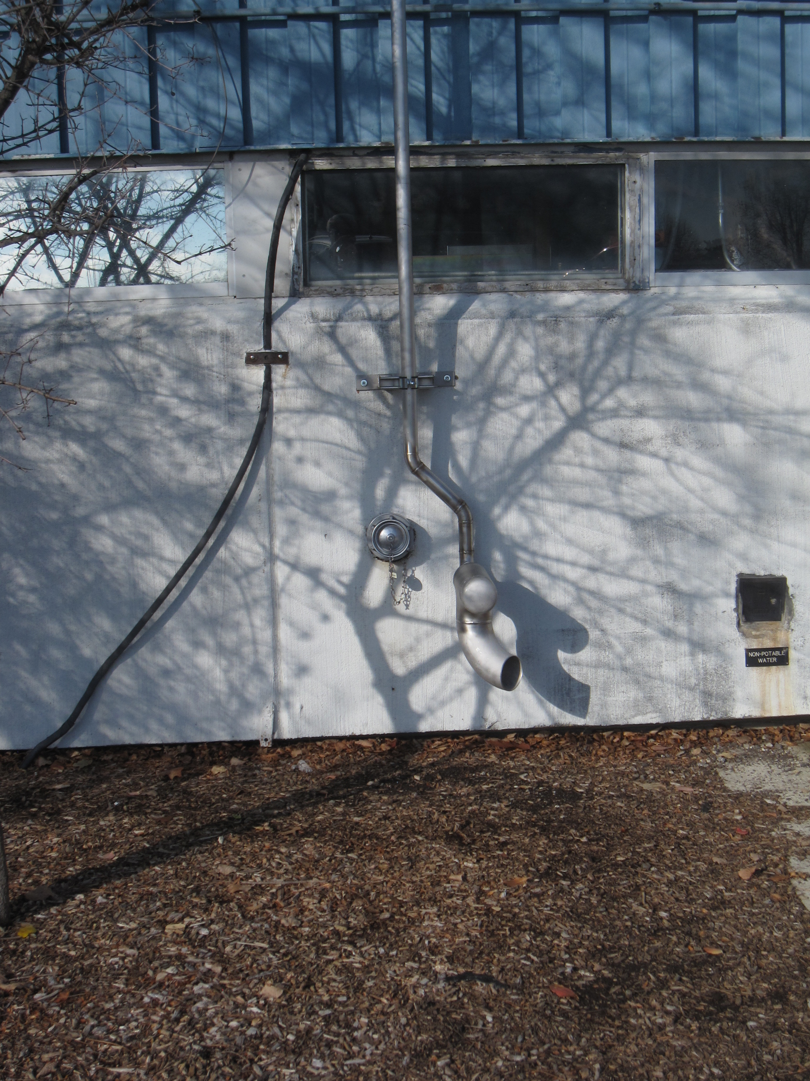
Next Steps
Nitrogen vent

Slide 5
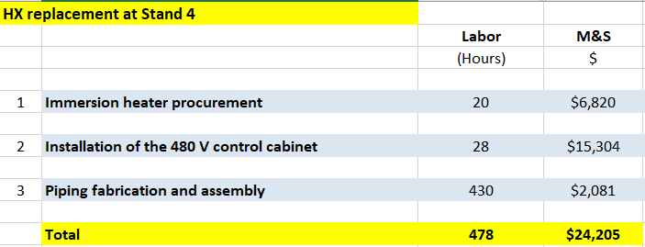
Next Steps
Long term improvements may include replacement of the heat exchanger at Stand 4
Two main goals for the HX replacement: increased reliability of the cold operation and faster cooldown and warmup
Cost estimate based on the installation experience at CMTF in 2023

Slide 6
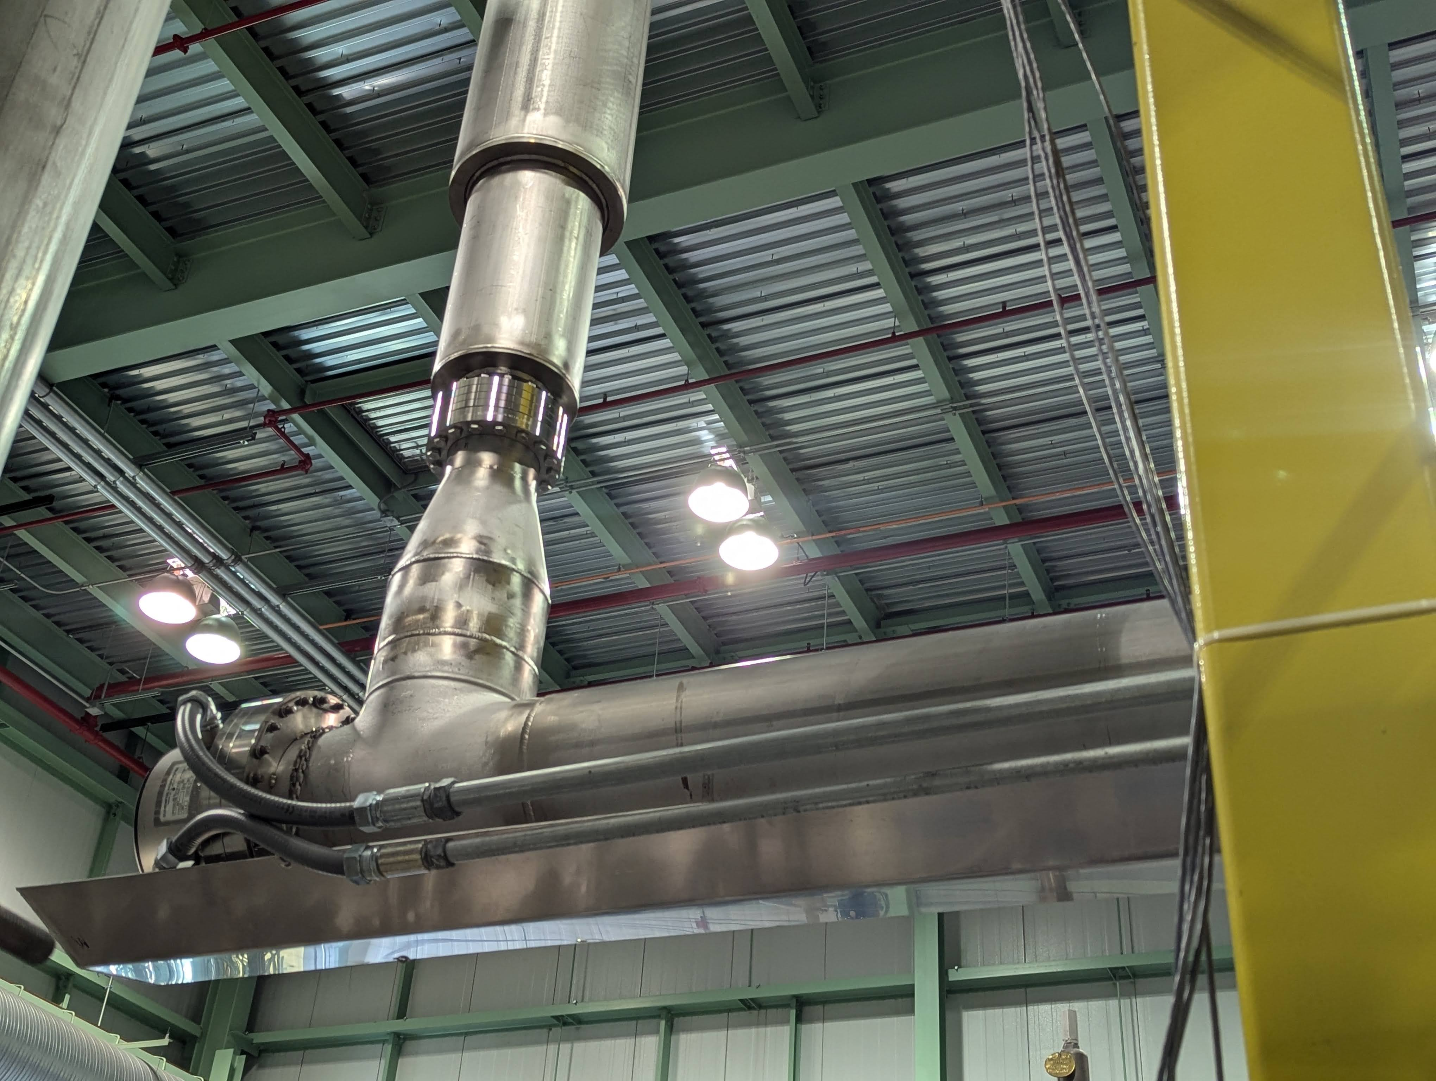
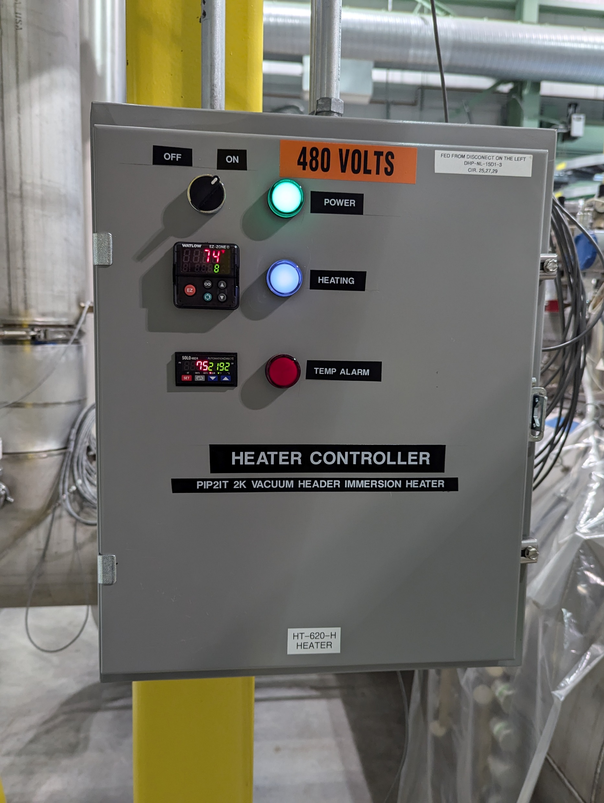
HX Replacement
Powerful immersion heaters already in use at various test facilities, including in IB1
Design for 16.5 kW heater is available, rough cost estimate 50-60 k$
With this improvement we could safely run with Ghe flow up to 18 g/s
Need to replace the sub-cooler if we want to exceed 20 g/s
Helium flow
Immersion Heater with Conflat Flange

