Slide 1
302.4.01 Magnets Vertical Test at BNL Weekly Status
Febin Kurian
18-Nov-2024

Slide 2
MQXFA12b-Incoming Inspections
Magnet is under electrical checks in wiring stand
Expected to move to the dewar today
Expected start of cool down on 20th Nov (Wednesday)

Slide 3
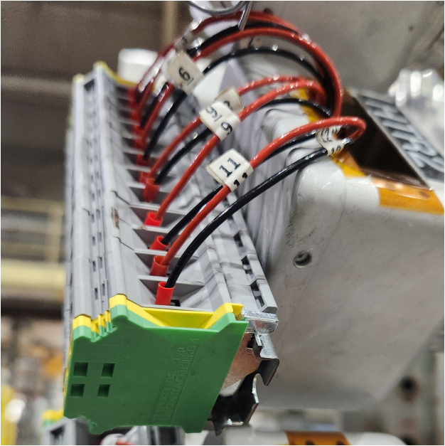
Second Top Hat Repair
Heaters: All Passed Hi Pot
V-taps: Undergoing pin-by-pin hipot
Passed: VT1, VT2, VT3, VT6
Failed: VT4
Still to be checked: VT5

Slide 4
CRYOGENIC STATUS
CTI 4000 system status
Running
Linde 1610 system status
Running

Slide 5
MQXFA 18
Waiting for outgoing tests

