Slide 1
HL-LHC Accelerator Upgrade Project PMG #65
Giorgio Apollinari/Gianluca Sabbi/Vito Lombardo
Project & Deputy Project Managers
PMG – Nov 19th, 2024

Slide 2
Plans for Today
AUP Status – Apollinari/Sabbi/Lombardo
Funding
CERN Cost & Schedule 2024 Review
Next PMG:
Planned for Tue. Dec. 17th or Tue. Jan. 21st

Slide 3
Project Manager Summary Assessment and Funding
AUP is fully funded at the rebaseline TPC level ($266M)
FY24-FY26 are “Carry-forward years”, with FNAL funds supporting activities at BNL and LBNL, if necessary
No transfer to BNL expected.
Completed a $2M transfer of funds from FNAL to LBNL.
Further BCRs and Manual EAC adjustment might require additional corrections.
Followed on monthly basis, might be impacted by future BCRs
 | Funding Received to Date | ACWP+OC to date | Remaining Funds at CD-4 (Based on BAC) | Remaining Funds at CD-4 (Based on EAC)
BNL | 45,541 | 38,334 | 602 | 604
LBNL | 46,634 | 44,153 | -910 | -926
Updated Oct 2024

Slide 4
CERN Cost & Schedule Review 2024
Appreciation of Threshold vs. Objective KPPs and IPR Management Recommendation to start addressing Scope Contingency
CERN is giving upmost priority to Q1/Q3 cryomodules
(All) Crab Cavities delays at center-stage during C&S, with discussions of delayed installation

Slide 5
DOE IPR Review – July 2024
Successful completion of July ’24 IPR Review (thanks to HiLumi PO for the participation)
1 “Management” Recommendation:
Review and document the criteria by which the decision will be made to exercise scope contingency. Update all project planning as needed based on this review. Complete by the end of October 2024.
STRATEGY
Maintain control of expenditures and introduce, wherever possible, cost-reduction measures to insure AUP “Objective Goals” are likely to be achieved.
First pass at Scope Contingency Criteria shared with IPT(DOE) on 9/16, and with CERN on 10/4. Further progress at HiLumi CM and on 10/29 & 11/27

Slide 6
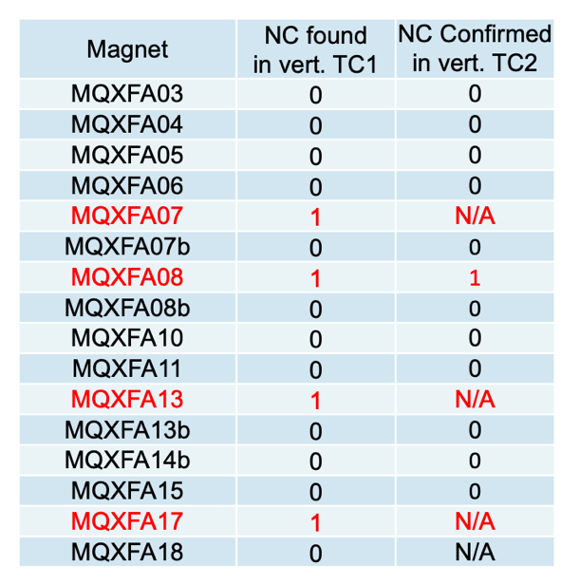
Cost Reduction Measure Magnet Vertical Test Decision
Decision: Test all remaining MQXFA Magnets vertically through only TC1 and reduce number of magnetic measurements at BNL.
BCR implemented in Nov. ’24 schedule, with an AUP cost savings of ~1M$
Pros:
Reduce considerably risks for LQXFA/B, eliminating the necessity to carry forward a cryomodule re-assembly in the baseline schedule
Reduces costs and anticipates schedule
Cons:
Training memory establishment delayed from Vertical Test to LQXFAB Horizontal Test

Slide 7
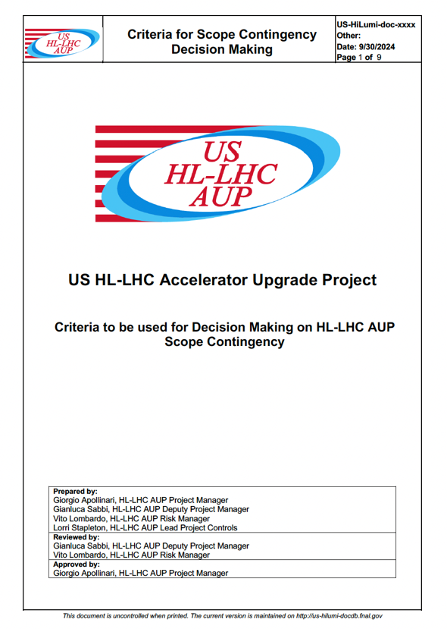
Objective vs. Threshold KPPs Criteria for Decision Making
Criteria to trigger discussion with CERN on scope Reduction:
Based on decreasing contingency performance
Criteria to execute scope Reduction:
Based on preserving success for overall HL-LHC endeavor

Slide 8
Scope Contingency - Trigger Criteria
AUP strives to have sufficient Contingency to maintain C.L. for Risk Coverage at the 90% level.
C.L. fell at ~80% level at IPR time (June ‘24), ~70% by Sep. ‘24
Criteria #1: Discussions with CERN on Scope Reduction to recover Scope Contingency will be triggered by 3 consecutive reporting periods with a Confidence Level to cover extant Risks at - or below - 75%.
Criteria #2: Any Scope Reduction must ensure that capabilities and resources exist at other participating Labs (most notably CERN) to complete HL-LHC per approved design.
Criteria #3 (almost a Corollary to Criteria #2): Any Scope Reduction will prioritize execution in the US of Hard Scope* over Soft Scope*.
Discussions with CERN on help to AUP for activities that can be performed on European soil (ex: test of Cryomodules).

Slide 9
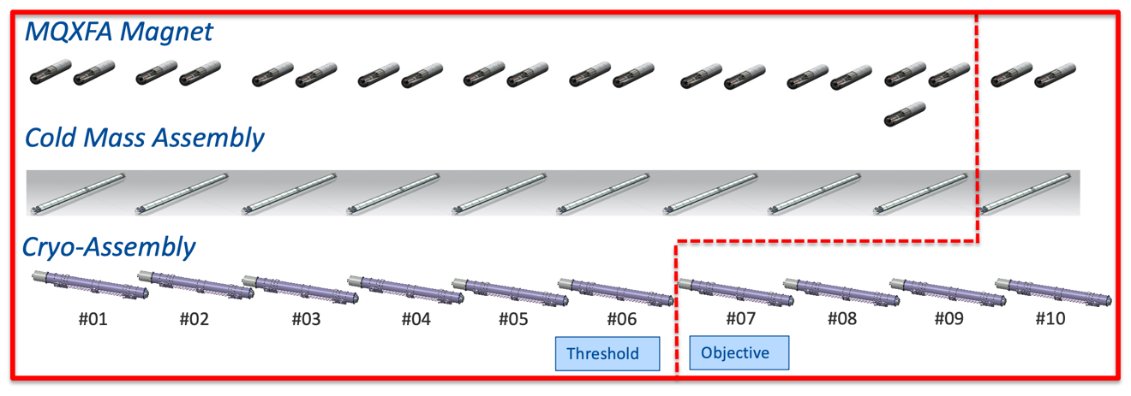
Examples of Potential Solutions for Scope Contingency
Hard Scope: Magnet Assembly
AUP commitment to produce last 2 magnets
Soft Scope: CryoM. Test
Potential help for some cryomodule tests at CERN partially funded by AUP at nominal ~75k$/test

Slide 10
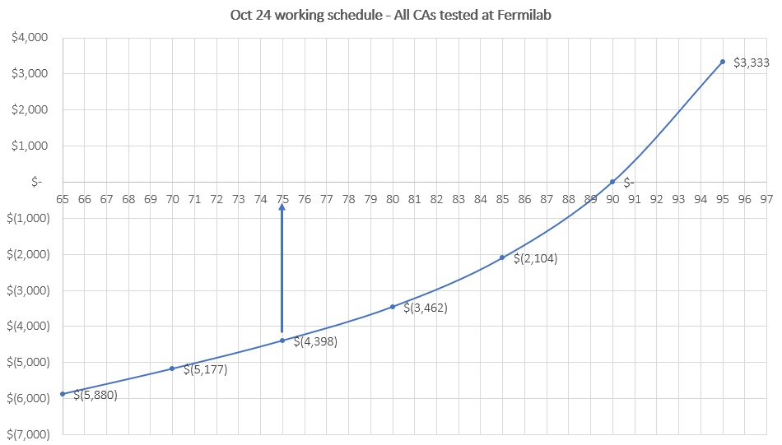
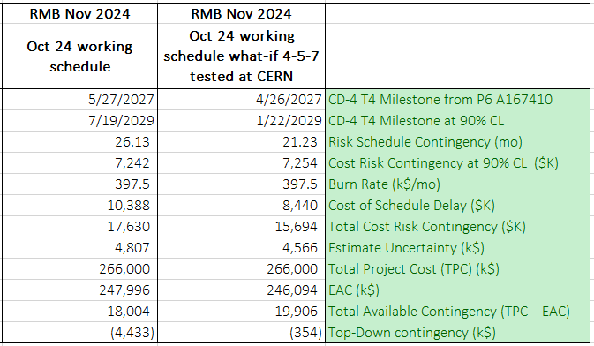
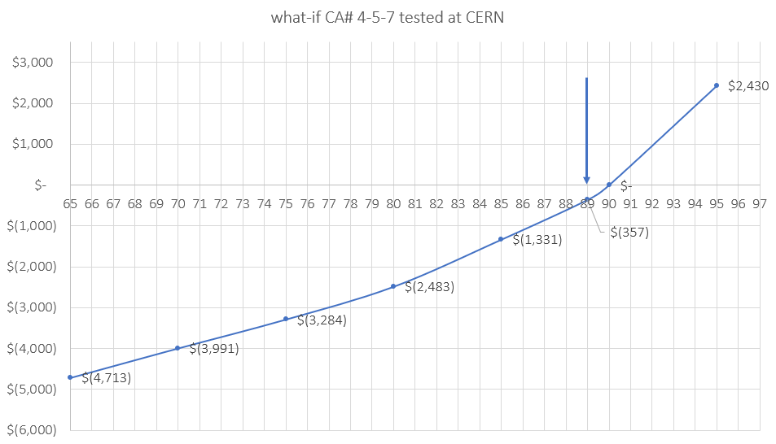
(Preliminary) Results of Oct. ‘24 Working Schedule (1TC) and What-If (CERN tests of 4-5-7)
CAs 4-5-7 tested
at CERN
CL 75%
1TC BCR
All remaining CAs tested at FNAL
CL 75%
CL 89%
CL 89%

Slide 11
Additional Coils
CERN insisted to mention, in the AUP C&S presentation, that CERN could help AUP with “Imminent agreement on production of 5 MQXFA coils that can potentially be used as “Parts Exchange” items”
On the other hand, they were surprised when told that the value of an AUP coil would be ~560k$.
 | Unit Cost | Coil #1 | Coil #2 | Coil #3 | Coil #4 | Coil #5
Conductor | 220 | 220 | 220 | 220 | 220 | 220
Cable | 80 | 80 | 80 | 80 | 80 | 80
Coil Parts | 60 | 60 | 60 | 60 | 60 | 60
Manufact. | 200 | 200 | 200 | 200 | 200 | 200
Total New Cost | 560 | 200 | 200 | 280 | 340 | 340
Red:
In AUP budget
& “available”
Green:
Income from sale
Black:
Invest. from AUP
Contingency for
Production
Additional Cost: 1,360 k$
Income: 1,120 k$ (560k$ x 2)
Drain on Contingency: 1,360k$ +(1,200k$-1,120k$) (Parts Exchange)
1,440k$
Draw on Contingency. AUP needs this
number to be as small as possible

Slide 12
Conclusions on Q1/Q3 CryoAssemblies
Steering Group Meeting on 11/27 (Wednesday before Thanksgiving)
Expect agreement on 3 CryoAssemblies tests at CERN
Hope for convergence on plan to produce 5 more MQXFA coils.
Report at next PMG (Dec. or Jan.)

Slide 13
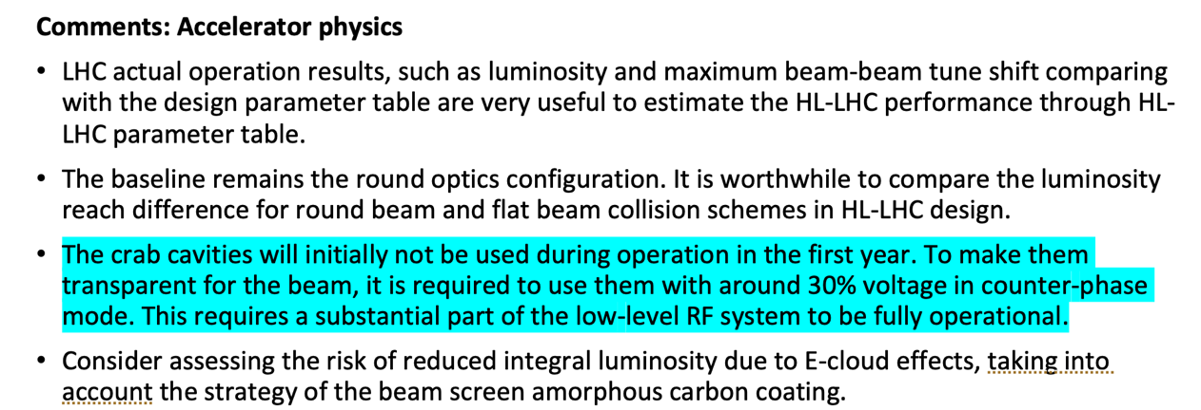
RFD Crab Cavities
Crab Cavities are late (both RFD and DQW)
Cavities are not envisioned to be available from the first year of HiLumi Operation

Slide 15
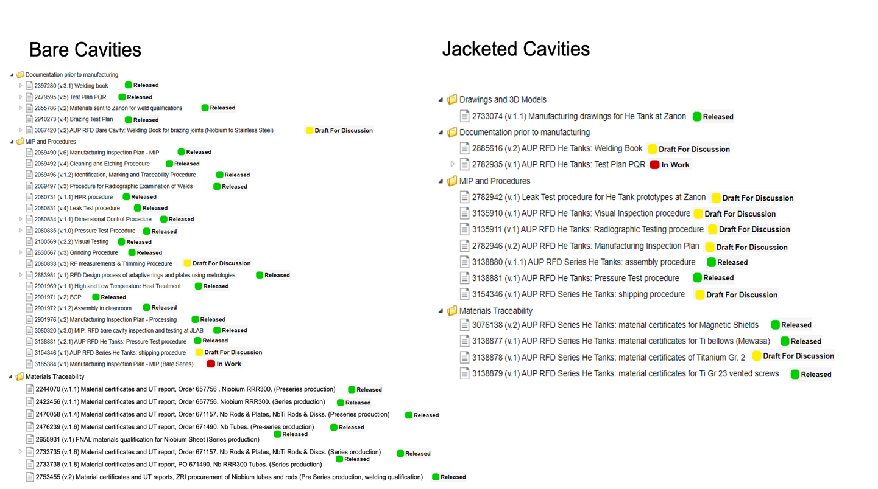
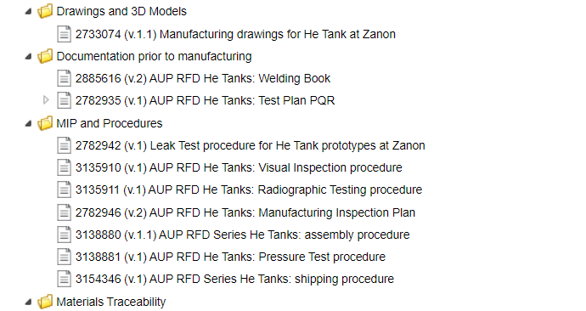
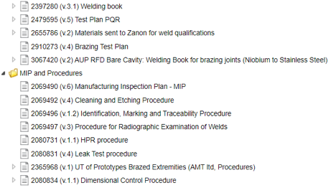
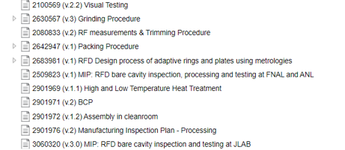
RFD Documentation
Bare Cavities
Jacketed Cavities
7th Nov. ’24 following first WP4,
AUP/L2 and QA Offices meeting
10th Oct. ‘24

Slide 16
Documentation to Start Production
In addition to WP4-AUP/L2 interactions, CERN and AUP QA Offices continuous involvement is expected to be necessary and essential.
Jamie Blowers (US-QA) and Hector Gavela (CERN-QA)
It is a widespread feeling among US SRF technical experts that CERN is requiring construction performance beyond the “state of the art” at existing industrial partners

Slide 17
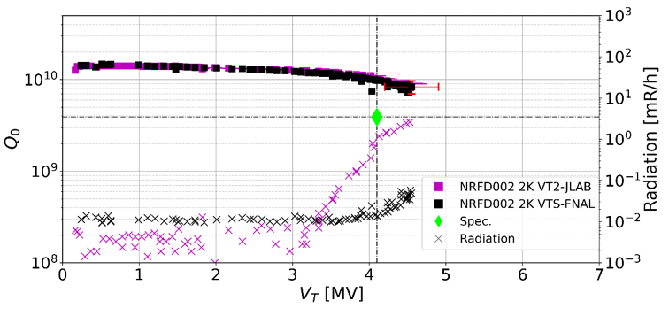
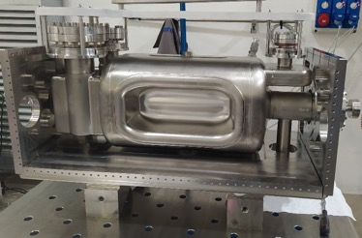
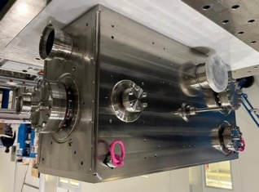
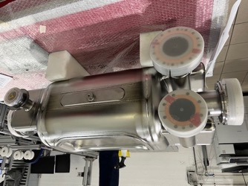
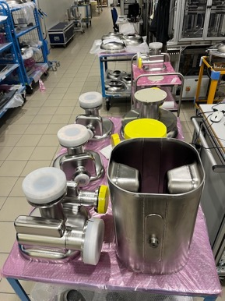
RFD Crab Cavities Technical Progress
Pre-Series #2 Performance
Welding of Prototype Cavity Helium Tank (not a deliverable) completed without surprises and with ~zero frequency shift.
Cavity is at JLAB waiting for test, to be delivered to TRIUMF for String Assembly check-out (TCM0)
Plot by A. Castilla
Admin. Limit
Pre-Series #1 requires more BCP
Invaluable help from CERN with ceramic feedthroughs for HOMs
Series #3 Completed
at ZANON
Parts for cavities
#4-to-#6 at ZANON
Start of Assembly
Completed Assembly
Issue on missing QC step (C-SCAN)
for brazed flanges on Series #3-to-#6

Slide 18
Technical Production Areas of Attention (cont.)
Bare cavities production completely paused at this time on AUP decision pending clarification of NCRs.
NCR needed to address a QC step (C-SCAN on brazed flanges) included in the Engineering Specs and “slipped through the cracks” during production of the first 4 units.
NCRs to address continuation of assembly (or removal from production line) for Series Cavities #3-to-#6 (draft EDMS 3181073)
CERN help appears to be available for quick turn-around C-SCAN of brazed flanges for cavities #7-to-#12
Metrology NCR
Jacketed cavities documentation completion and sign-off on a timely basis a categorical condition before production start.

Slide 19
RFD Related NCRs
Pre-series NCRs (Cavities #1-#2)
EDMS 3190827 “NCR-NRFD01/02 Brazed Joints Nb/SS qualifications”:
CERN to approve the NCR for the Brazing Joints made at ANL and qualified at CERN (bureaucracy)
EDMS 3172667 “NCR: RF measurements at cold – HCAACFCA002-UP000001 & 2”
Accepted with warnings by CERN. Additional information should be provided to close the loop (such as 3D metrology for multipoles simulation and beam aperture…)
EDMS 3189970 “CERN analysis of metrology reports for bare cavities RFD1 and RFD2”
NCR to be generated by AUP after internal discussion to reply to CERN metrology analysis. All the minor NCR related to the subcomponents will be closed if this NCR will be approved by CERN.
Finding difficulties to get ZANON agreement on additional measurement to satisfy resolution of NCR
Series Cavities NCRs (Cavities #3 - #12):
EDMS 3181073 “NCR for lack of UT “C” scan reports for brazed joints”
Comments have been provided on EDMS but not the official outcome.
Jacketed Cavities
(Expected) NCR on Ti-SS brazing

Slide 20
Other approaches (to be) considered:
Allow ZANON to complete Bare Cavities by existing contract
Test Cavities in the US
Once performance is established, work on metrology to fulfill CERN needs and requirements.

Slide 21
Conclusions on RFD Crab Cavities
Documentation approval of upmost importance
Convergence on NCRs will be critical for success of this part of the Project.
Expect step-wise modifications in plans as we move forward

