Slide 1
FD1/FD2 Installation Engineering Update
Nicholas Joniak
11/19/2024

Slide 2
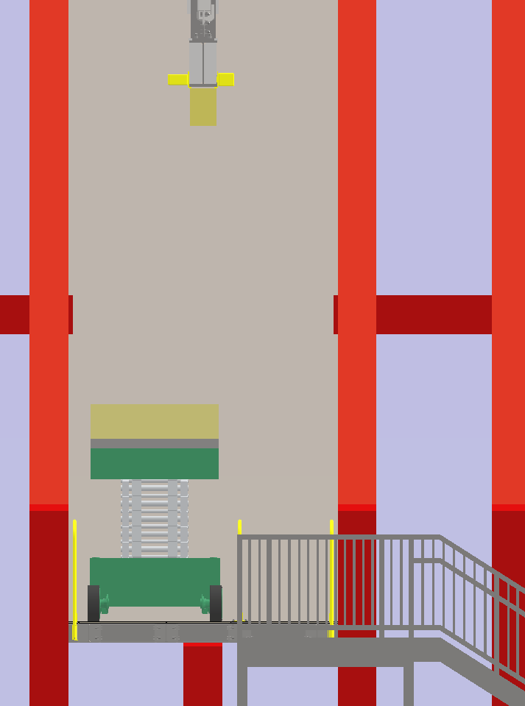
Engineering Updates
Procurement Status:
  Upcoming:
    No update – engineering work in progress.
  Existing:
    Lift table - delivery of base Genie machine to Manlift delayed to mid-December.
FD2 TCO:
  Finalized TCO Platform analysis plan being sent out later today.
    Integrated COTS safety rail components into platform design.
      Revised attachment locations to allows lift table fitment.

Slide 3
Engineering Updates (Cont.)
185 Test:
  BNL CRP-SST drawings for procurement.
    CRP-SST (small) drawings from design team sent out to consortia for review.
    CRP-SST (large) drawings (with revised tolerancing) to be completed this week and sent out for review.
  Assembly model:
    Request was made for STEP file of completed test assembly (previously all work done in Navisworks).
    New model created and posted to EDMS: https://edms.cern.ch/document/299662
      Created using latest v.8 vertical drift models.
      Very large file due to increased model complexity.
        Concern going forward for upcoming interface drawing exercises.

