Slide 1
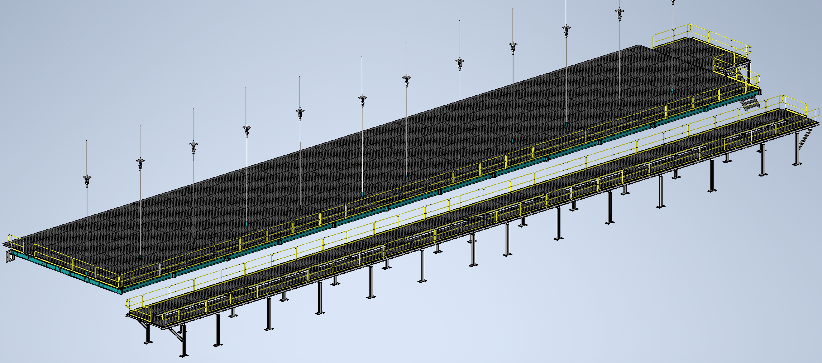
Mezzanine Flooring and Railing
Status
Design note first draft complete
Eng. Analysis of mounting bases in process
Walking surface and railings for mezzanines
Install Activity:
Install flooring and railing onto detector, cryo, and ledge mezzanines
16-Sept-26
Tech Spec. | N/A | Starting this week
3D Model | N/A | Complete | 11/1/24
Design Note | N/A | First Draft Complete | 11/8/24
Eng. Analysis | N/A | In Process | 11/20/24
CO Report | N/A | Empty
2D Drawings | N/A | Empty
Schedule Contact | N/A | Empty
Install Procedure | N/A | In Process
Store/Move 120d - 4mo
Fabrication
30d – 1mo
Procurement plan
Decking and railings are COTS
Two types of custom railing mounts will be required
Self install
Procurement
90d – 3mo
Latest “Submit to Procurement”
16-Jan-26
Fabrication/delivery
PRR Target: Dec. 2024

Slide 2
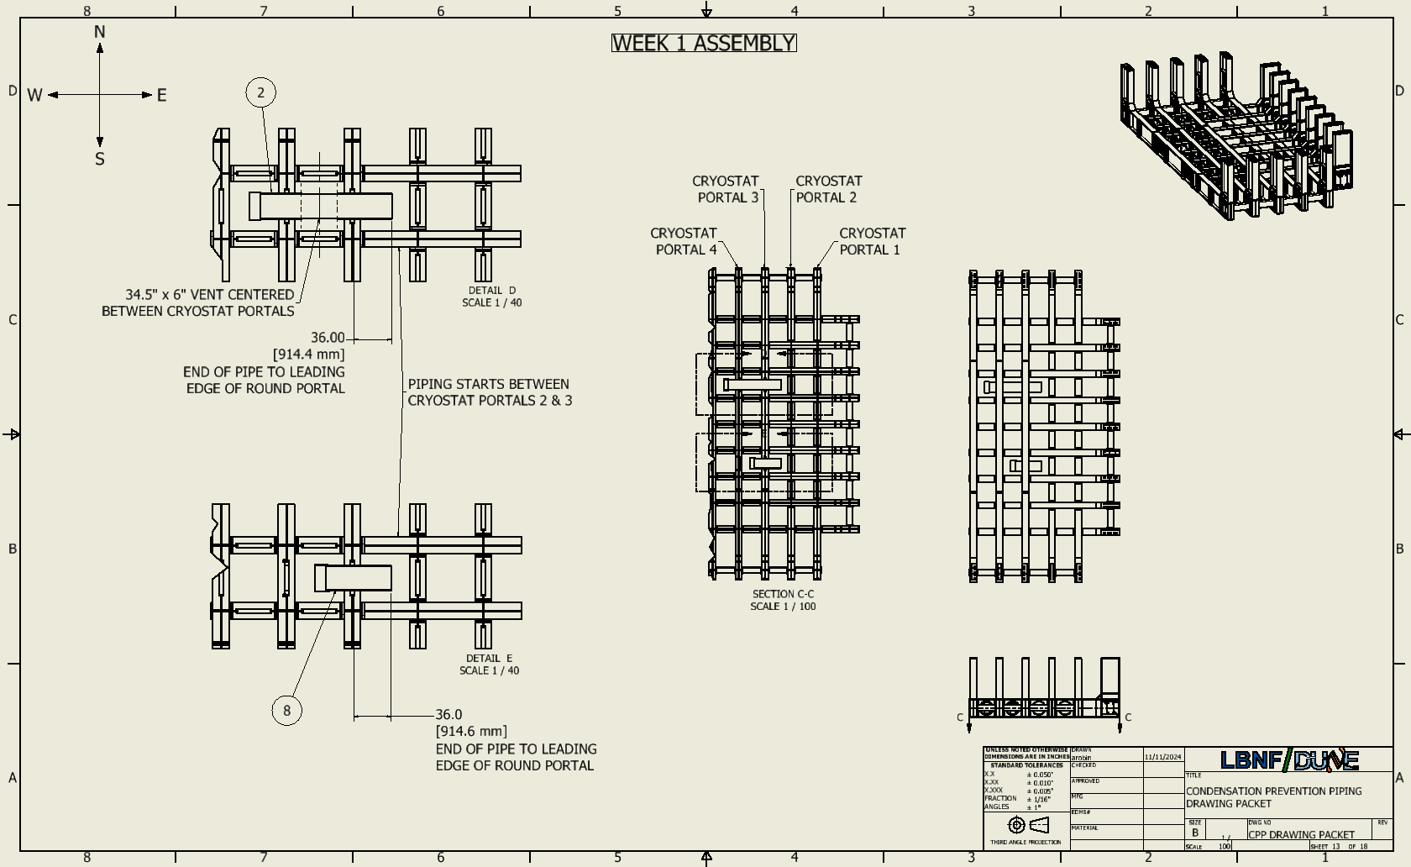
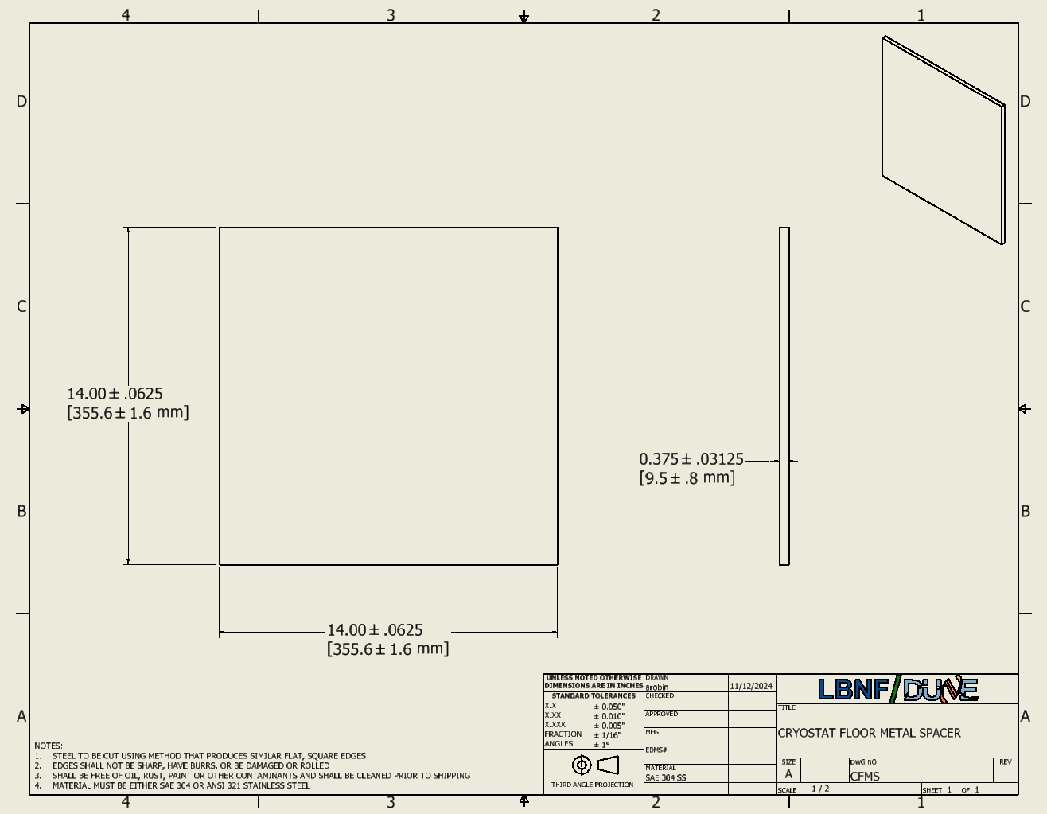
Last Week
Mezzanine Flooring and Railing
Working on analysis of custom rail bases
Adding in annex to design note covering the floor supports in the cavern wall
Condensation Prevention Piping
Finished drawing packet for procurement/installation
Cryostat Shims
Made 2D drawings for procurement

