Slide 1
9 O’Clock Meeting
Nathan Ruffatti
MCR Crew Chief
Wednesday, Nov 20th, 2024

Slide 2
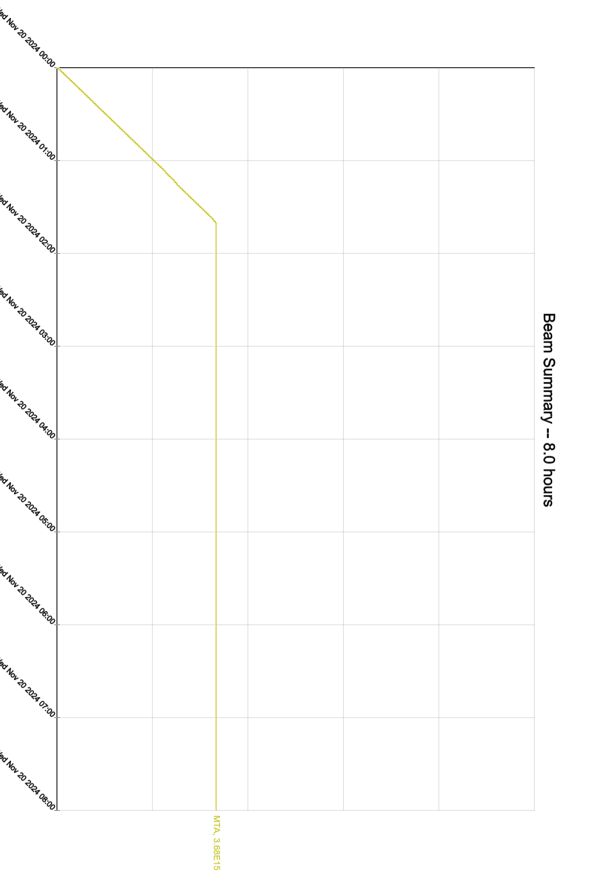
Since Monday…
  Monday:
  Beam to MTA
  Leak suspected in MI magnet system
    No leaks found in ring tour
  BRF B ENI amplifier blown fuse and broken fuse holder. A and B ENI amplifiers were both replaced
  Tuesday:
  Booster East power outage
  MI52 and MI62 power outages
  BNB CDC testing and beamline checkouts
    LCW high temps. MI30 LCW temp setpoint lowered, still haven’t reached equilibrium
  Contactors for problem sumps in Booster replaced
  Laser Notcher is on
  Wednesday:
  MTA finished up ~0200, is now in controlled access
  E and F Sector power outage today
  MI12A/B is in CA
  MI-8 is in SA

